Slide 1
Outcome of the workshop on Security for EUCISE 2020
Technical Advisory Group
18th November 2015

Slide 2
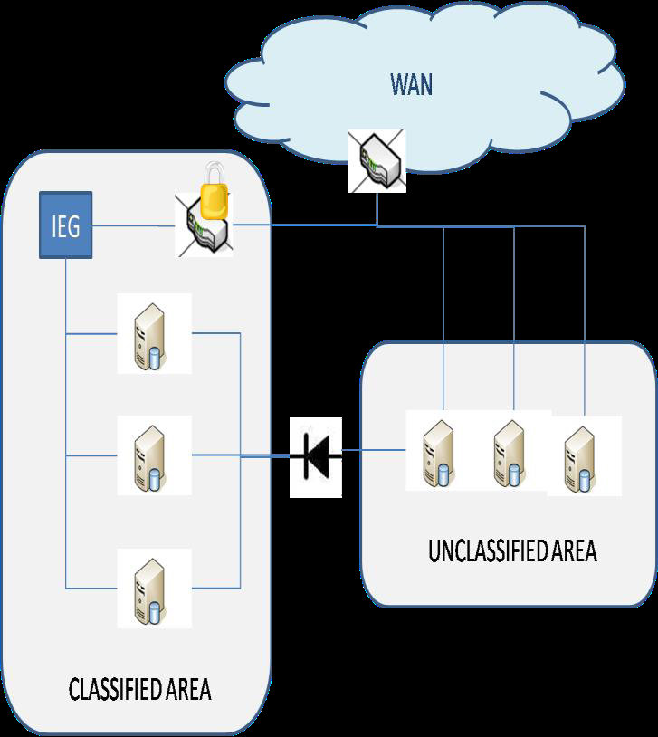
Security Challenges in EUCISE2020
Protect the exchange of real information
Not fully tested in pilot projects
Sensitive data, personal data
Dual use architecture
to support the cooperation between military and civilian partners
Exchange of classified and unclassified information
classified information up to EU-RESTRICTED level

Slide 3
Information Security in EUCISE2020
WP4 Deliverables
User needs
Technical specifications
Security requirements
Deliverables
4.3 Technical specifications → Security requirements for unclassified info
4.5 Security requirements → for the exchange of classified info
Security board
Review WP4 deliverables
Advise EUCISE2020 about security and the national security procedures

Slide 4
EUCISE2020 Workshop on Information Security
EUCISE2020 WP4 organised a workshop on Information Security on October 6-7 2015
Held in the JRC premises (Ispra)
Participants:
15 MS participants, including 2 from NSA
Commission: 3 from DIGIT, 5 from JRC

Slide 5
EUCISE2020 Workshop on Information Security
Objectives:
Agree on the information security requirements for the exchange of classified data
For deliverable 4.5
Review the requirements for the exchange of unclassified data
For deliverable 4.3
Better understand the security accreditation cycle
Define the requirements of the accreditation for the IT systems
Identify potential delays at national level
Analyse the potential benefits of using the s-TESTA network

Slide 6
Security for Classified Information
Main requirements for the validation phase:
At least 2 partners with existing restricted systems
An agreement to exchange real classified data for the validation period
Status:
Not yet identified, the EUCISE2020 Project Coordinator is working on binding agreements

Slide 7
Security for Classified Information
Building the exchange of EU-RESTRICTED information
Set up a EU-RESTRICTED accredited network
Independent and segregated channel
Enhance/Document the CISE components
Accreditation of the full solution (network + software)
Validation of the solution

Slide 8
Architecture options
The exchange of EU restricted information will require a change in the implementation of the CISE architecture
The creation of a separate network between existing accredited systems
The definition of information flows between networks
LS 1
CISE restricted
network
LS 2
GW1
GW2
Authority 2
LS 4
CISE unclassified
network
LS 3
GW4
GW3
Authority 1
Authority 3

Slide 9
Architecture options
The implementation of the EU-RESTRICTED network will be driven by the EU Information Assurance Security Policies and Guidelines
LS 1
CISE restricted
network
LS 2
GW1
GW2
Authority 2
Authority 1

Slide 10
Solutions for the Classified Network
Create a new network set up by the industry
Process already used in the past to connect classified systems in the MSs
Independent network + crypto device
Internet + crypto device (only for EU-RESTRICTED information)
Existing solutions by the industry
Reuse existing networks
s-TESTA: Secure network at EU level among MSs
Other national networks used for bilateral exchange

Slide 11
S-TESTA
Introduction of the main features by the EC representatives
Open questions from the participants:
Accreditation level for classified information
Possibility of creating a specific subnetwork for the project
Availability of the network in the Member States
Connection procedure to the network
Contact points?
Availability for military partners
Notes:
To say a remark on the benefits for EUCISE vs the benefits for CISE.

Slide 12
Information Flows
From the unclassified network to the classified one (uni-directional)
Where to implement them:
LS 1.1
CISE restricted
network
LS 2
GW1.1
GW2
Authority 2
LS 1.2
CISE non-restricted
network
LS 3
GW1.2
GW3
Authority 1
Authority 3

Slide 13
Information Flows
For EUCISE2020, legacy systems should implement the information flow between networks
Full control of the information partners can provide in each network
No impact on the design of the common infrastructure
LS 1.1
CISE restricted
network
LS 2
GW1.1
GW2
Authority 2
LS 1.2
CISE non-restricted
network
LS 3
GW1.2
GW3
Authority 1
Authority 3

Slide 14
Accreditation of the Solution
At the end of the EUCISE2020 Phase 2
Once the EUCISE2020 components are developed and tested
Before connecting the real legacy systems
Each member state participating in the restricted validation should launch their national accreditation process
Managed by their National Security Agency
The duration depends on the MSs involved (no less than 2 months)
For the accreditation, the contractors or the partners will need to provide the SSRS (System specific security requirement statement)
To be added as a requirement in the call for tenders

Slide 15
Review of the Security Requirements
Requirements that apply to the exchange of both unclassified and classified information
Main topics discussed:
Identification of participants
Authentication participants
Authorisation/Access Rights to the information
Logging
Accounting
The results will be included in the WP4 deliverable D4.3

Slide 16
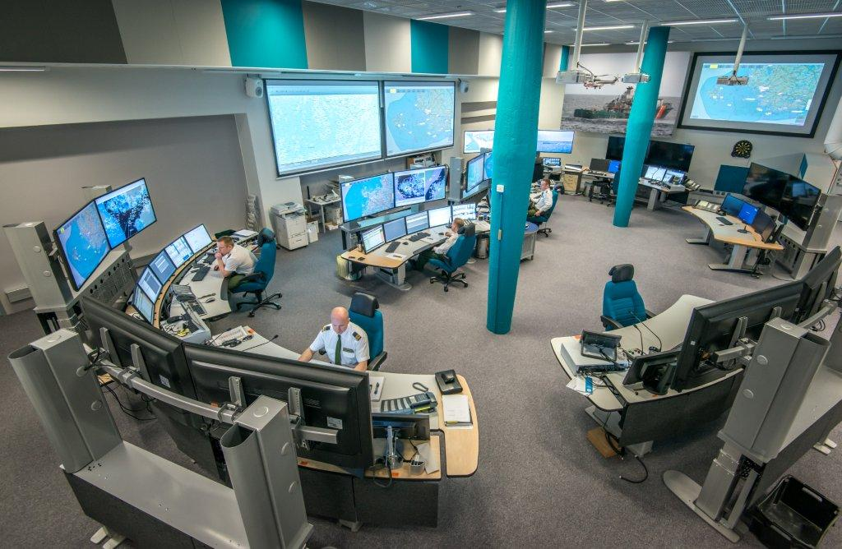
Thank You
https://webgate.ec.europa.eu/maritimeforum/en/cise

