Slide 1



Marine Spatial Planning and
The Crown Estate’s
Marine Resource System (MaRS)
Pete Edmonds – Marine Data Manager
12th October 2011

Slide 2
Structure
  The Crown Estate
  Marine spatial planning in the UK
  Marine asset planning
  Marine Resource System (MaRS)
  Challenges

Slide 3



Actively managed £7bn (€8bn!) portfolio
Urban
Rural
Residential
Retail
Offices
Industrial
Land/Forestry
Farms
Quarries
Residential
Windsor
Marine
Seabed
Foreshore
Fish farms
Wind farms
Windsor Great Park
Savill Gardens
Racecourse
Notes:
We are very diverse. Our property ranges from offices and shops in the heart of London, to commercial premises and housing, to farmland and parkland, right through to the foreshore and seabed.
Being so diverse gives us obvious advantages. It helps us to withstand the economic ups and downs because our commercial activities range across different sectors of the market. We are also able to take advantage of the synergy between our businesses.
Our portfolio is divided into four estates: urban, rural, marine and Windsor. We are not passive custodians of our assets. Our customers, the people and businesses who occupy and use our land and property, are really important to us. We seek to work with them to help them add value to their businesses, because we believe that what’s good for their business is also good for ours.

Slide 4

Marine
c. £50m revenue in 2010/11
Seabed to 12 nautical mile territorial limit
55% of the UK’s foreshore
Renewable energy within REZ (200nm)
Mineral extraction (excluding hydrocarbons)
Notes:
Many people are surprised to learn that the seabed around the UK is owned by The Crown Estate. In fact, The Crown Estate owns virtually the entire seabed out to the 12 nautical mile territorial limit, giving it the rights to explore and utilise the natural resources of the UK continental shelf, excluding oil, gas and coal. It generates a sizeable income from dredging, fish farms, marinas, piers and jetties, pipelines, cables and aggregates.
The Crown Estate also hold the rights to license the generation of renewable energy on the continental shelf, playing a pivotal role in helping to deliver the government’s targets of 30% of energy from renewable sources by 2020. Consents are already in place for the generation of 8 gigawatts of renewable energy – enough to power more than 6 million homes.
We are developing wave and tidal power projects to commercial scale and establishing a framework for the storage of CO_{2,} all of which will have a significant impact on the UK’s security of energy supply and CO₂ mitigation capability – another example of how doing what’s goods for business is also doing good in the wider sense.

Slide 5
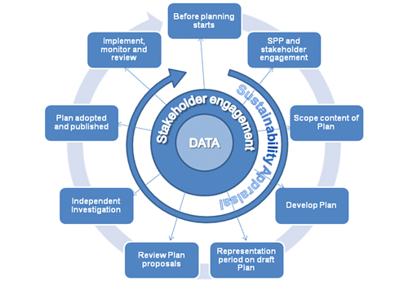
Marine Spatial Planning
Sustainability
Management
Balancing
Activities
Resources
Assets
Notes:
Achieving sustainability through managing and balancing the activities, resources and assets in the marine environment.

Slide 6
Marine Spatial Planning in the UK
Statutory Authorities:
Marine Management Organisation
Marine Scotland
Welsh Government
Department of the Environment Northern Ireland

Slide 7
The Crown Estate’s involvement
Stakeholder – major land owner
Asset planner – our ‘view’
Advisor – spatial planning

Slide 8
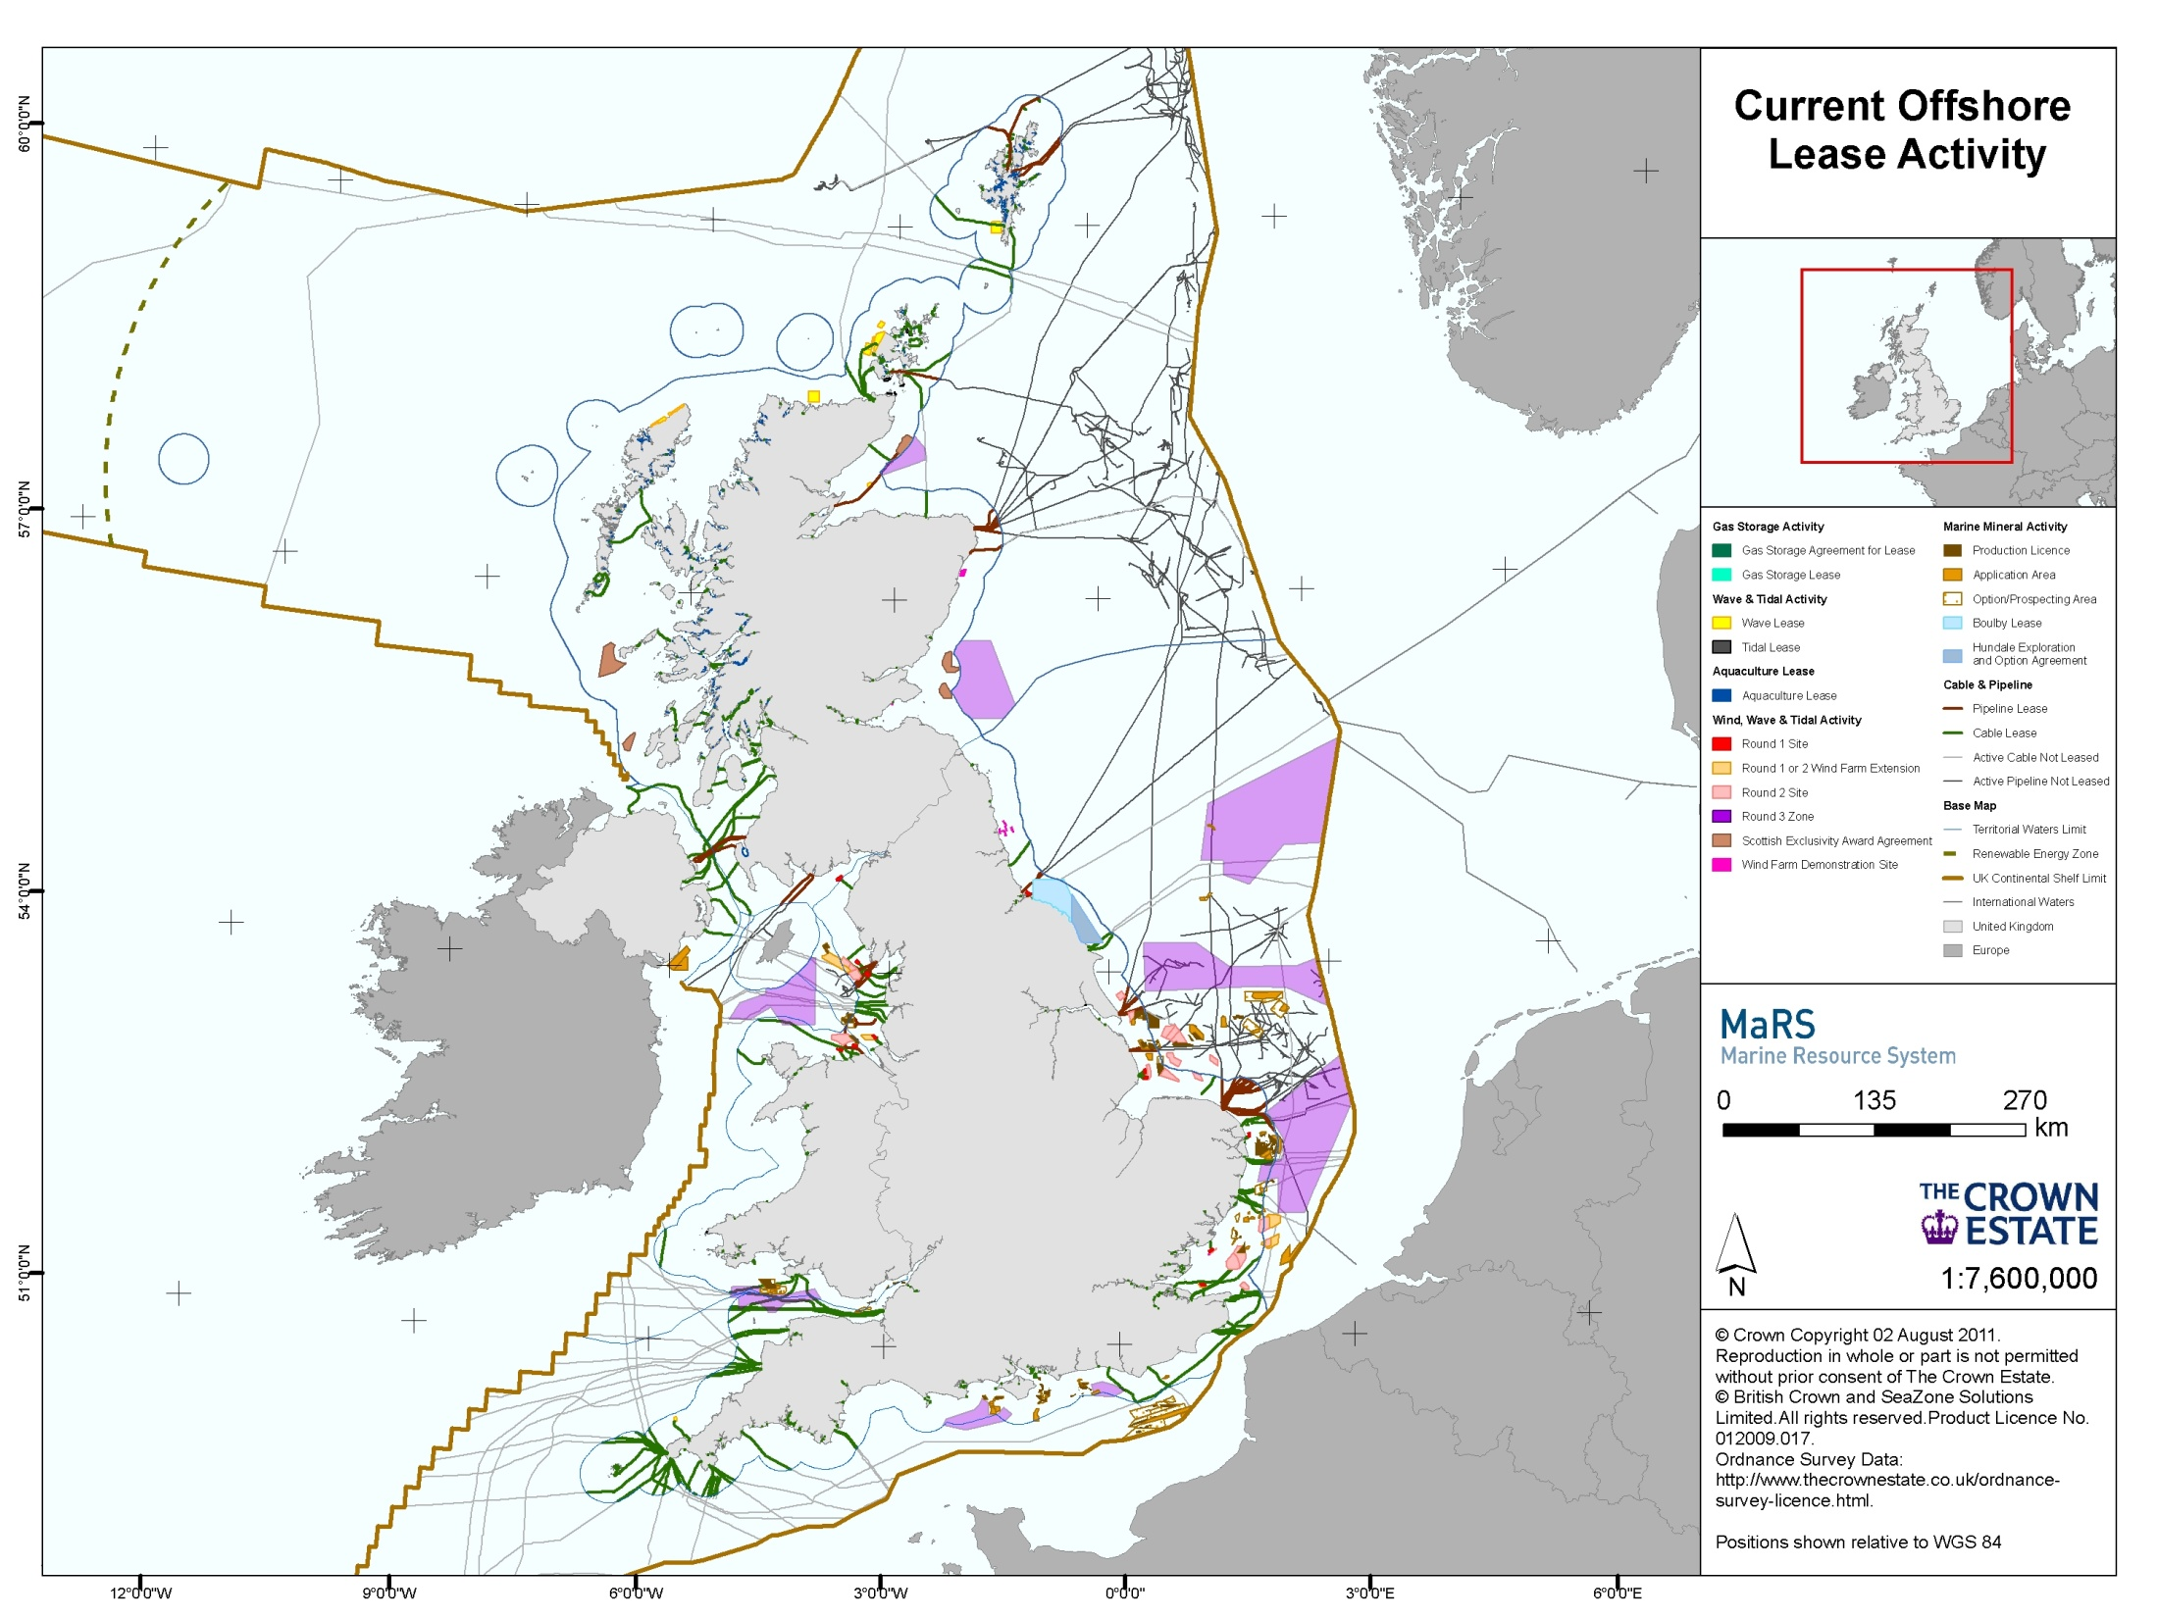
Marine Asset Planning
Sustainability
Management
Balancing
Activities
Resources
Assets

Slide 9
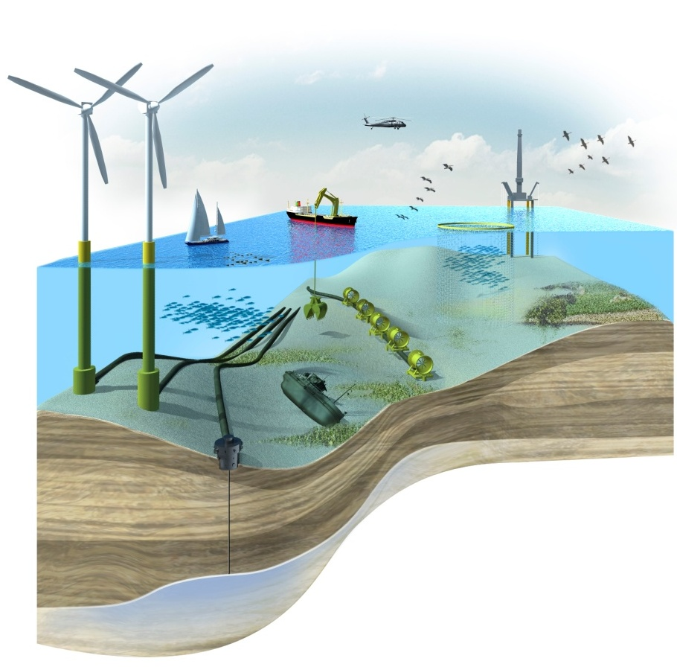
Marine Resource System (MaRS)
  Advanced asset planning GIS-based tool
  Three years development
  Robust
  Flexible
  Auditable
  Three parts:
  Desktop tool (GIS-based)
  Members website portal
  Desktop administration tool
  Use:
  Decision Support for identifying areas of opportunity within the marine estate
  Promote long-term sustainable decision making
  Adds value to existing estate

Slide 10
Marine Resource System (MaRS)
Suitability Mapping
Restrictions
Exclusions
Data
Policy, Weights, Scores
Notes:
MaRS uses multi-criteria analysis to help identify areas of opportunity or constraint for a given activity.
This allows us to represent stakeholders who have an interest in the marine estate.
Multi criteria analysis provides a transparent, robust and repeatable methodology for assessing priorities.
Now that i’ve explained about policy, I’m going to show how we build up a MaRS model using Multi Criteria Analysis

Slide 11






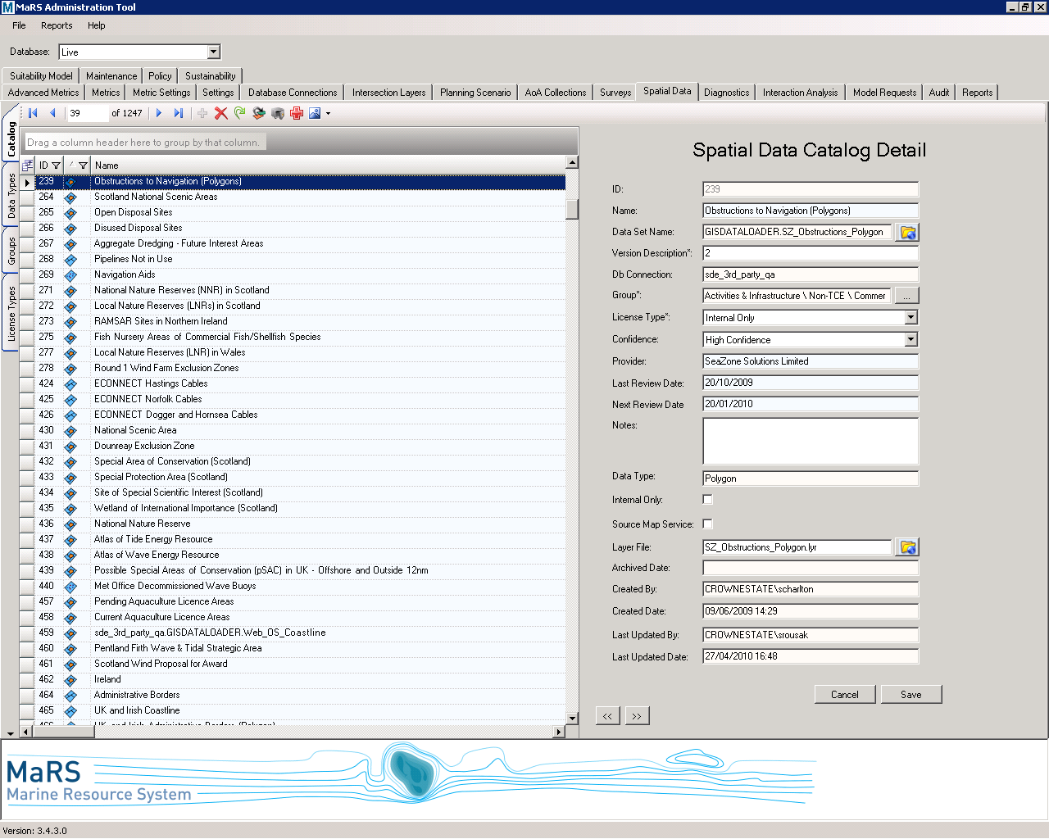
Multi-Criteria Analysis
Data
  Multiple datasets from a wide range of providers
  Integrated data management – full metadata, confidence assessed and quality assured
  400+ layers
  42 data providers
Policy, Weights, Scores
Exclusions
Restrictions
Suitability mapping

Slide 12
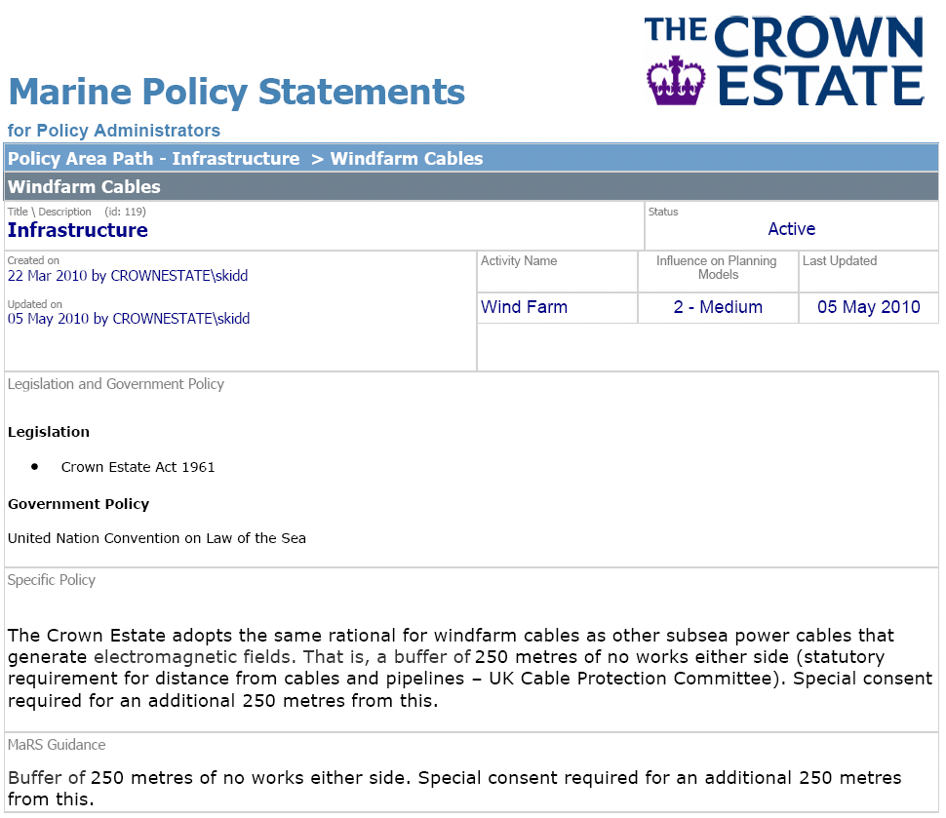
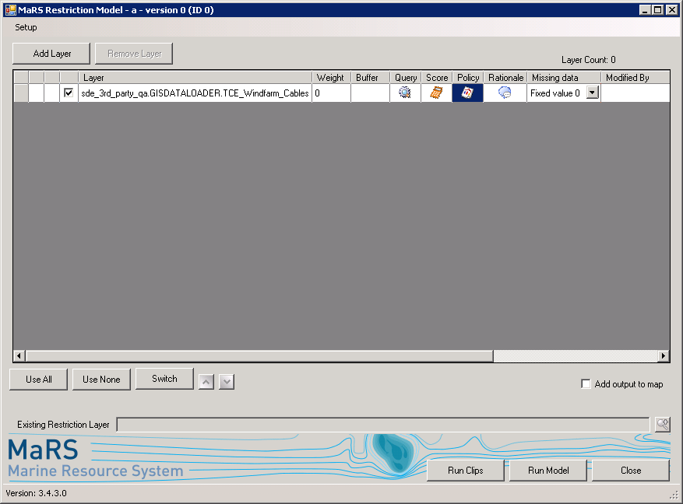
Multi-Criteria Analysis
Data
Policy, Weights, Scores
Exclusions
Restrictions
Suitability mapping

Slide 13
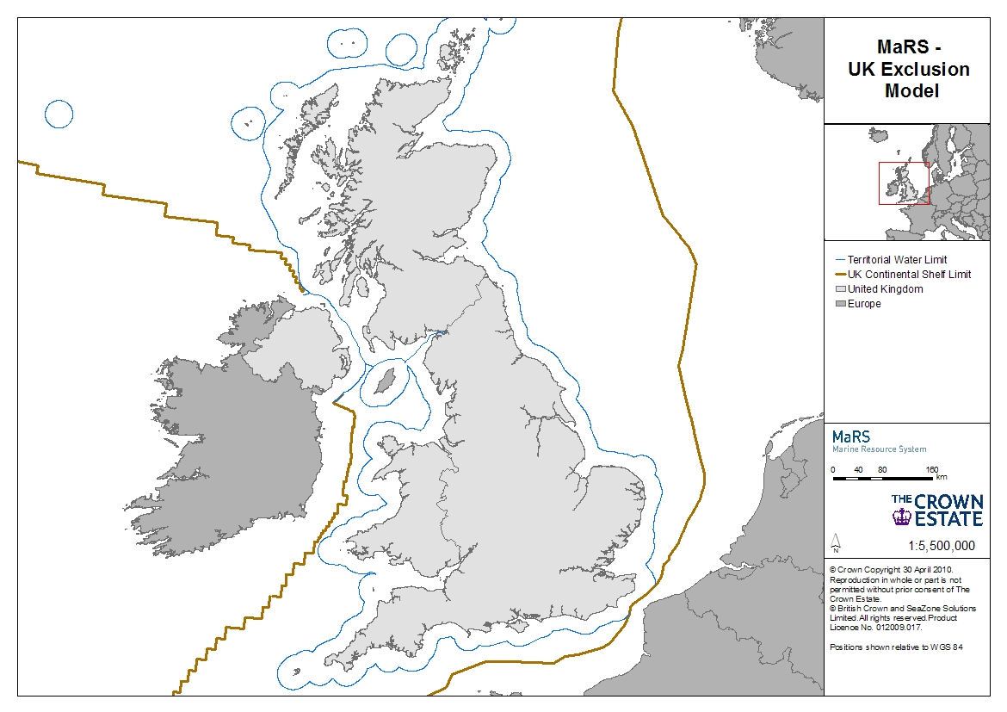
Multi-Criteria Analysis
Data
Policy, Weights, Scores
Exclusions
Restrictions
Suitability mapping

Slide 14
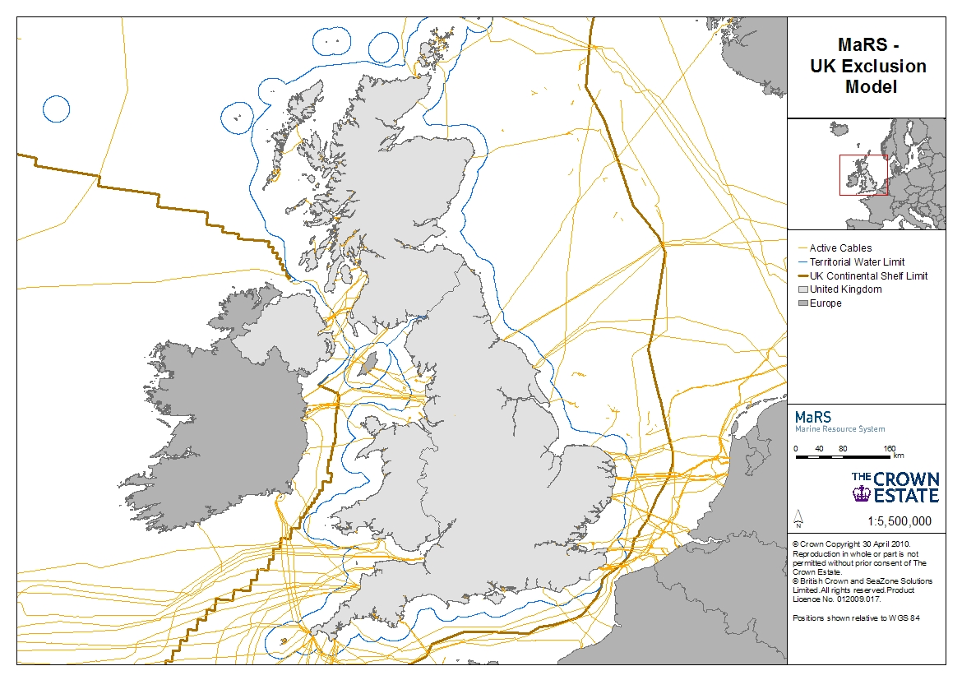
Multi-Criteria Analysis
Data
Policy, Weights, Scores
Exclusions
Restrictions
Suitability mapping

Slide 15
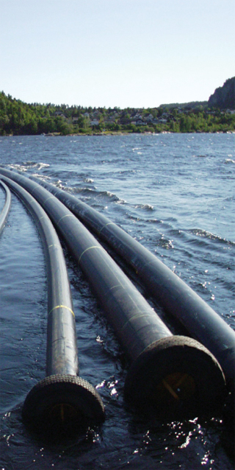
Multi-Criteria Analysis
Data
Policy, Weights, Scores
Exclusions
Restrictions
Suitability mapping

Slide 16
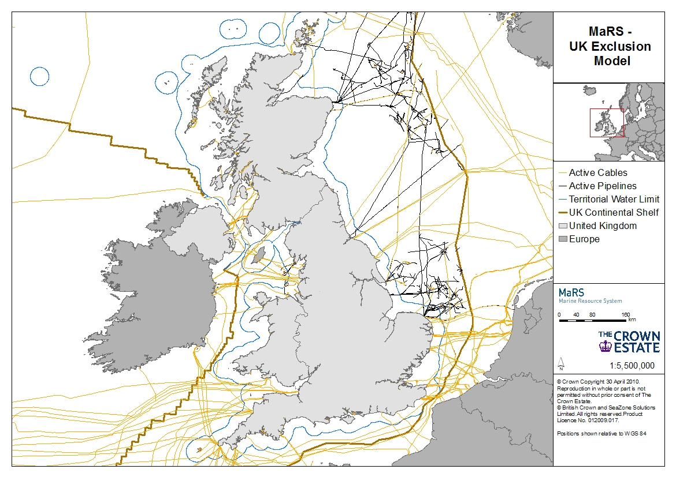
Multi-Criteria Analysis
Data
Policy, Weights, Scores
Exclusions
Restrictions
Suitability mapping

Slide 17
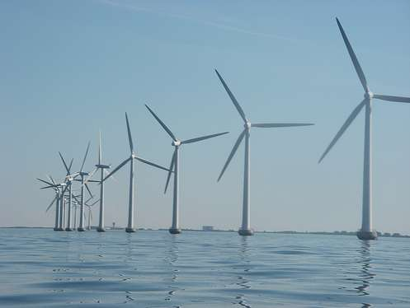
Multi-Criteria Analysis
Data
Policy, Weights, Scores
Exclusions
Restrictions
Suitability mapping

Slide 18
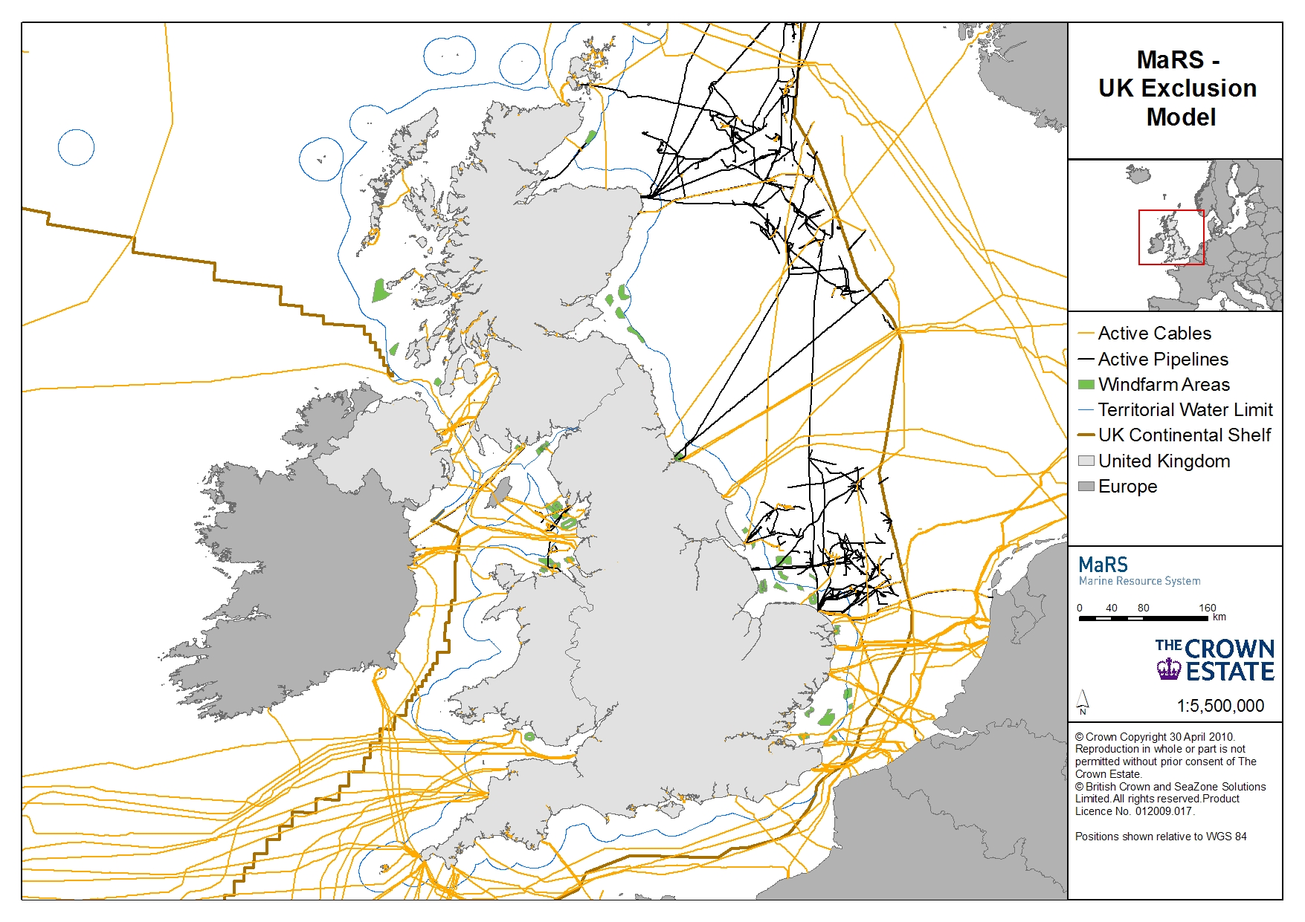
Multi-Criteria Analysis
Data
Policy, Weights, Scores
Exclusions
Restrictions
Suitability mapping

Slide 19
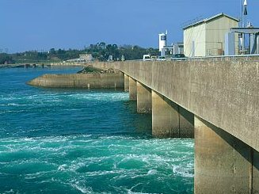
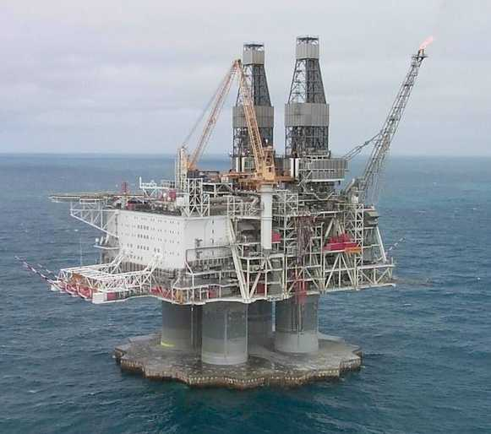
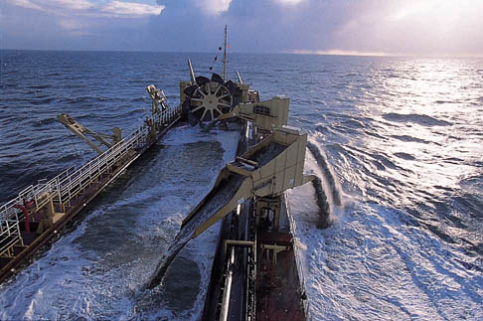
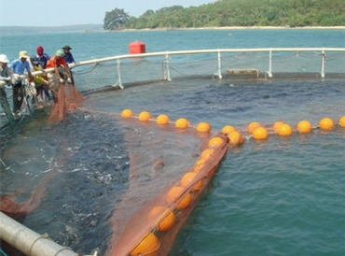
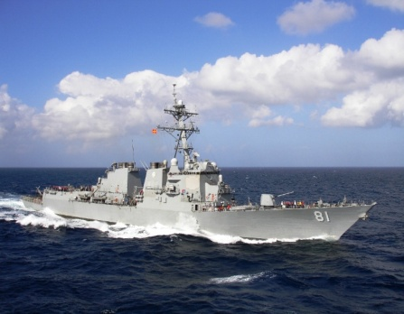
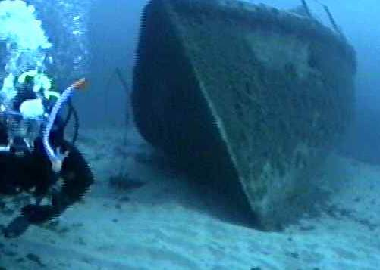

Multi-Criteria Analysis
Data
Policy, Weights, Scores
Exclusions
Restrictions
Suitability mapping

Slide 20
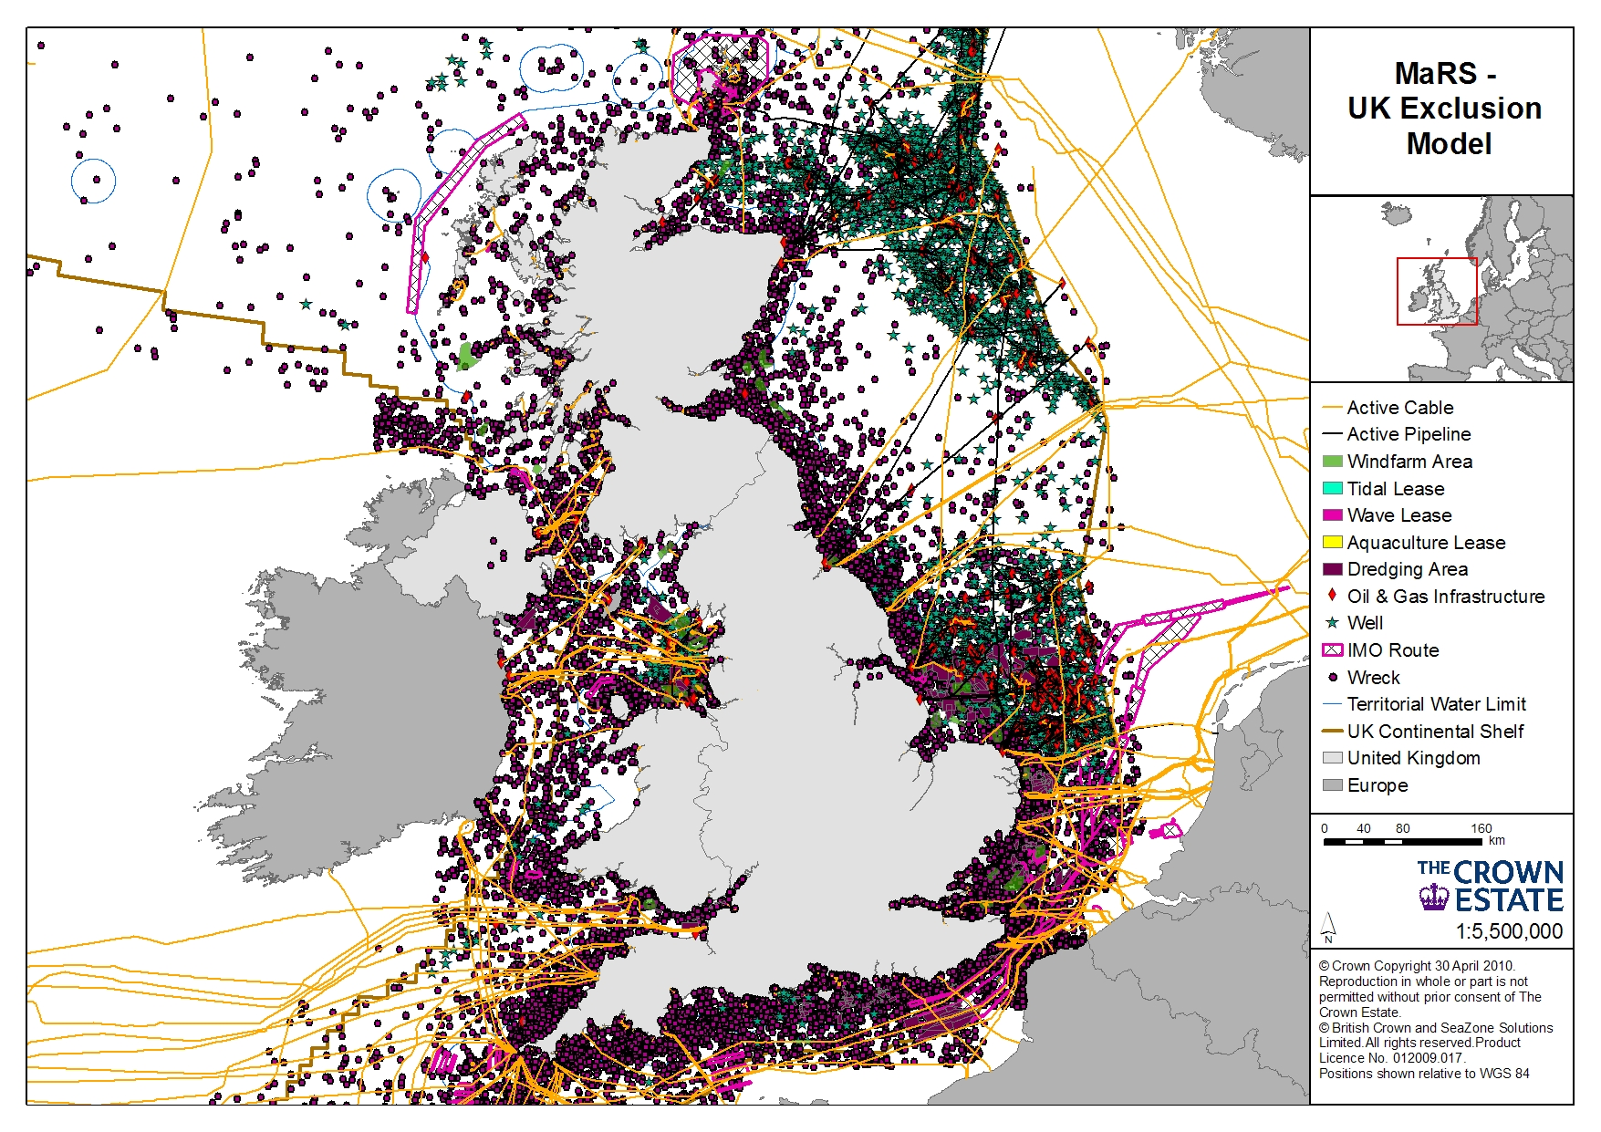
Multi-Criteria Analysis
Data
Policy, Weights, Scores
Exclusions
Restrictions
Suitability mapping

Slide 21
Multi-Criteria Analysis
Data
Policy, Weights, Scores
Exclusions
Restrictions
Suitability mapping

Slide 22
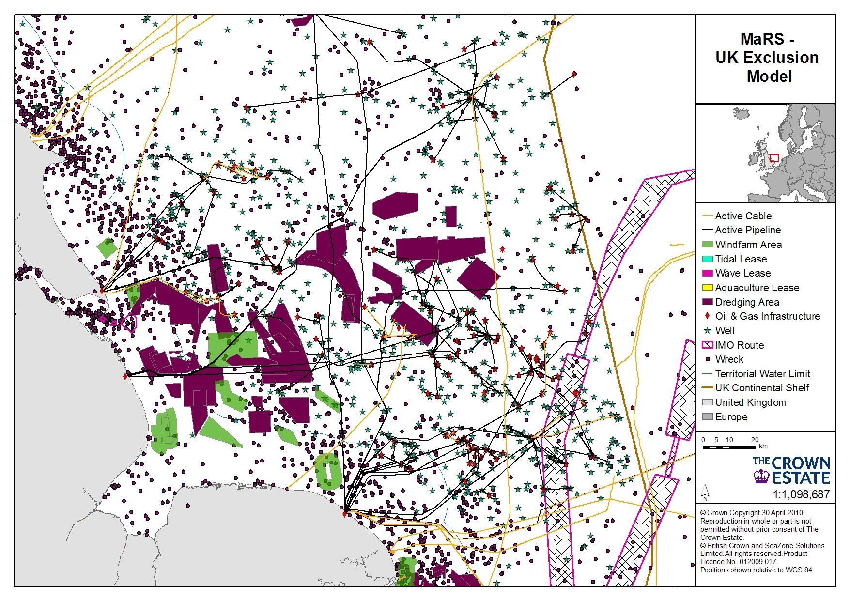
Multi-Criteria Analysis
Data
Policy, Weights, Scores
Exclusions
Restrictions
Suitability mapping

Slide 23
Multi-Criteria Analysis
Data
Policy, Weights, Scores
Exclusions
Restrictions
Suitability mapping

Slide 24
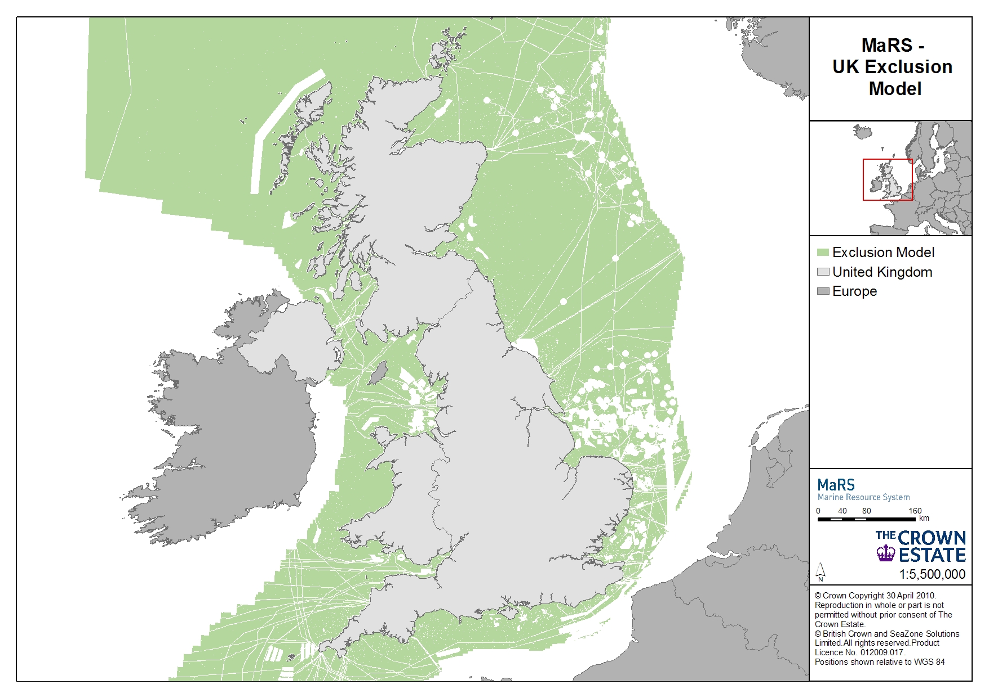
Multi-Criteria Analysis
Data
Policy, Weights, Scores
Exclusions
Restrictions
Suitability mapping

Slide 25
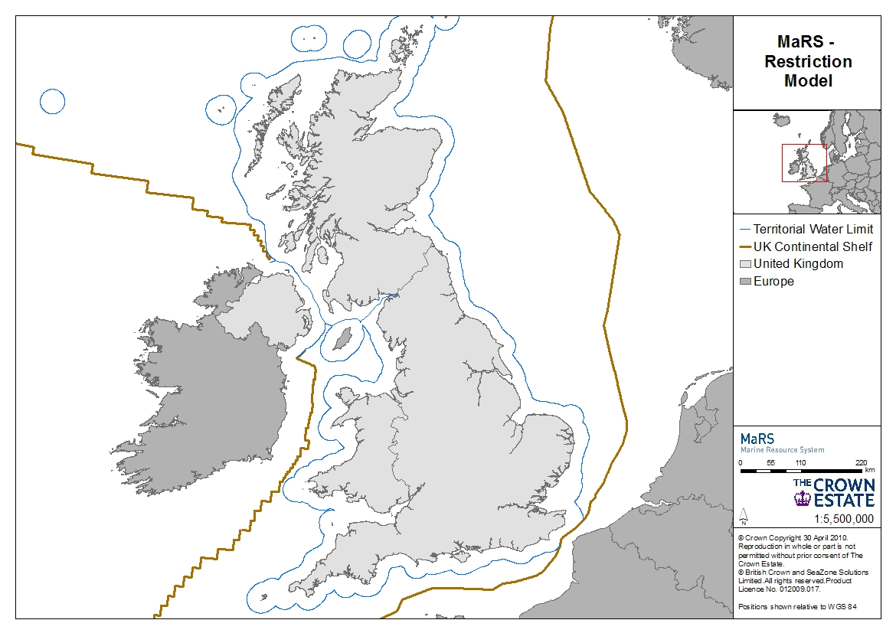
Multi-Criteria Analysis
Data
Policy, Weights, Scores
Exclusions
Restrictions
Suitability mapping

Slide 26
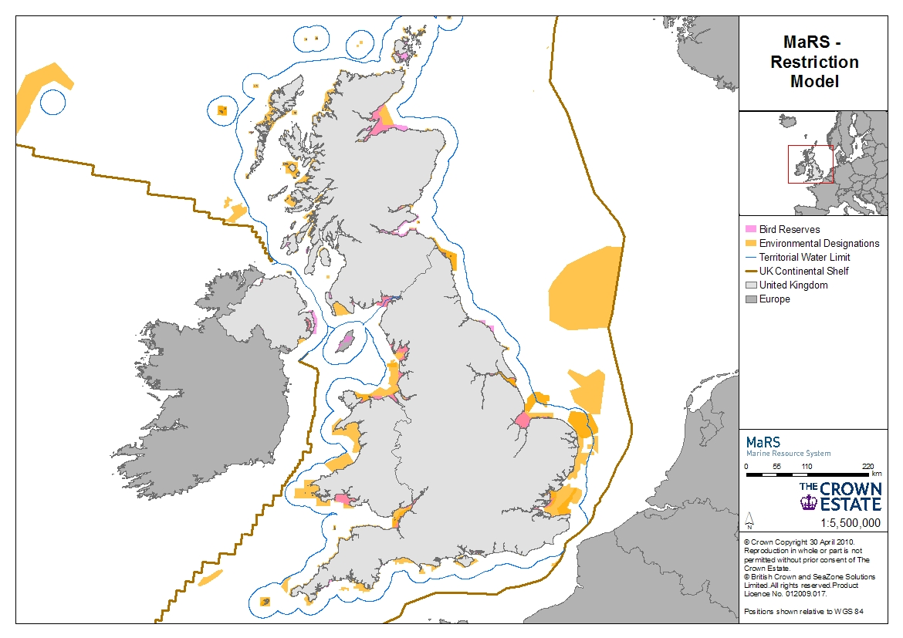
Multi-Criteria Analysis
Data
Policy, Weights, Scores
Exclusions
Environmental
Restrictions
Restrictions
Suitability mapping

Slide 27
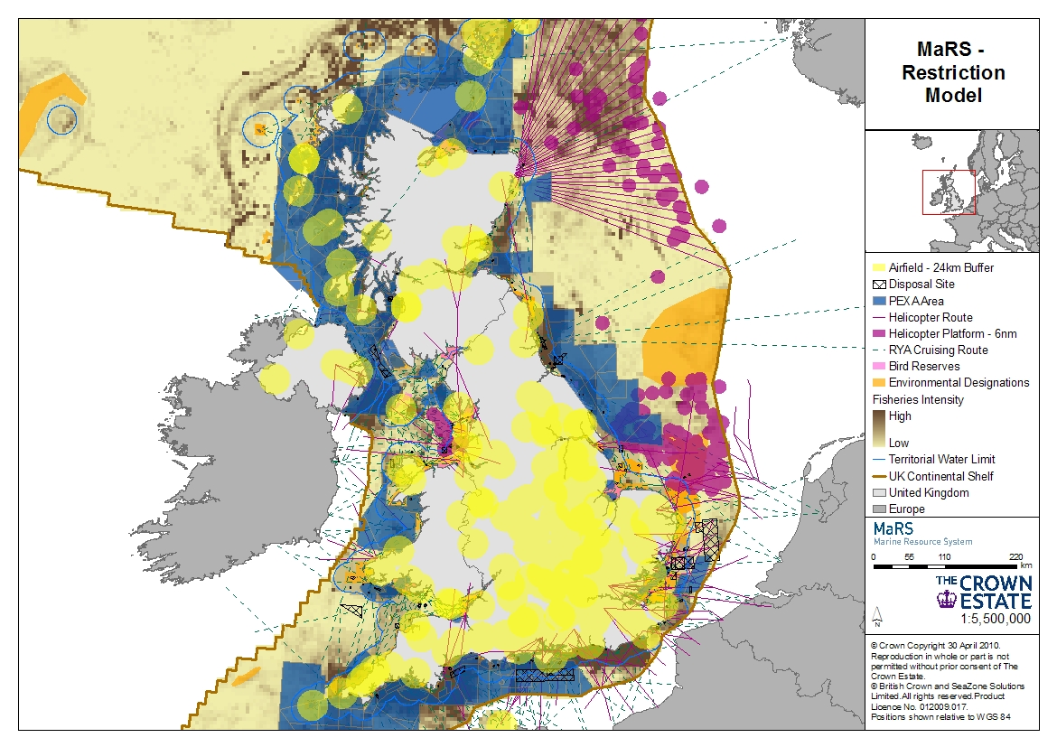
Multi-Criteria Analysis
Data
Policy, Weights, Scores
Exclusions
Other Sea User Restrictions
Restriction
Suitability mapping

Slide 28
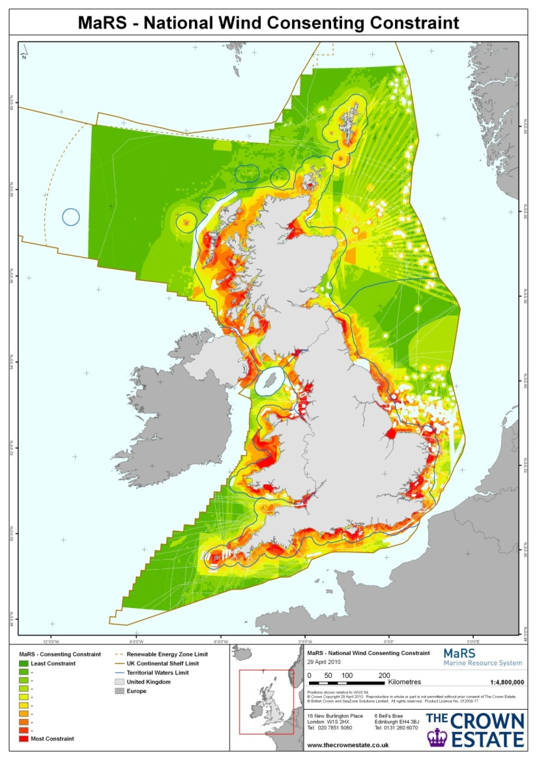
Multi-Criteria Analysis
Data
Policy, Weights, Scores
Exclusions
Restrictions
Suitability mapping

Slide 29
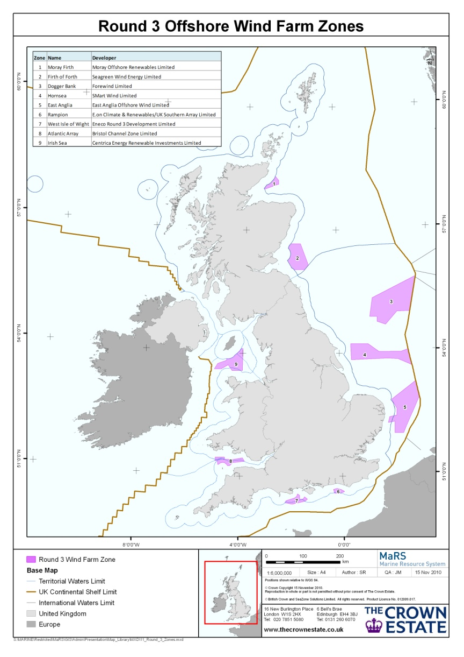
Marine Resource System (MaRS)
Examples of Use: Determining Round 3 Offshore Wind Farm Zones
  Combined technical and non-technical MaRS models to assess site suitability
  Zones of least constraint were determined from model outputs in order to align with UK Government targets of achieving 25GW of renewable energy by 2020 (¼ of the UK’s generation needs)
  Zones further refined through external consultation, e.g. Ministry of Defence
  Round 3 Development Partners – MaRS Portal access for Project identification

Slide 30
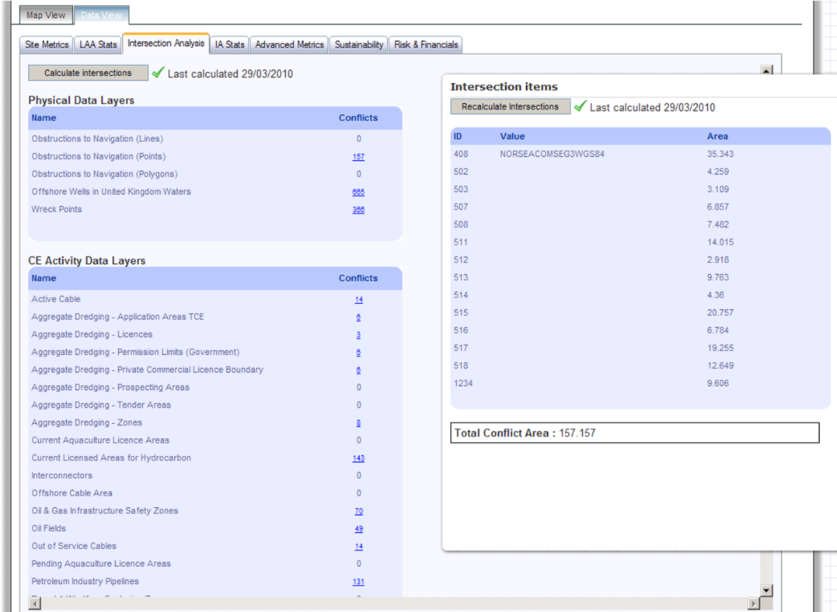
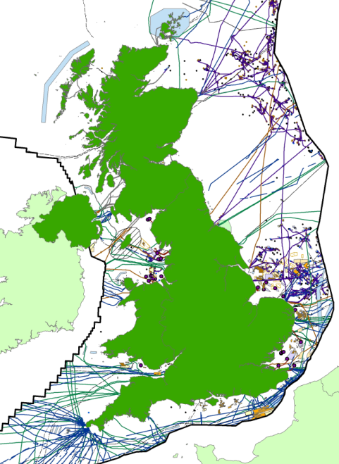
Marine Resource System (MaRS)
Examples of Use: Conflict Checking
  Checks against:
    CE and non-CE activities
    Cultural conflicts
    Physical obstructions
    Ecological and environmental
  Calculated in MaRS portal
  Detailed analysis on conflicts
  Detailed conflict report
  Safeguarding assets

Slide 31
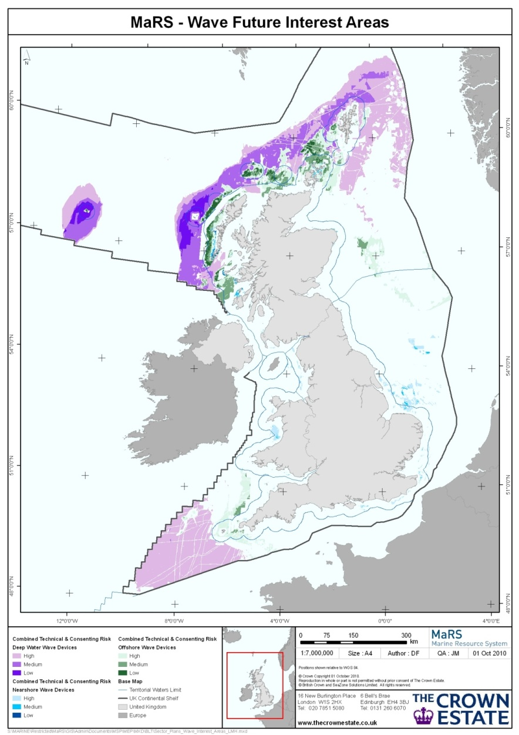
Marine Resource System (MaRS)
Examples of Use: Internal Asset Planning
  First series of individual sector reviews
    Reviewed existing assets & financial information
    MaRS used to shape areas of potential future interest for each sector within the marine estate
  Fed into a Marine Estate Review (MER) which draws together all future interest to identify potential future conflicts
  Proactive approach to planning of marine assets
  Identifies potentially conflicting activities to be resolved

Slide 32
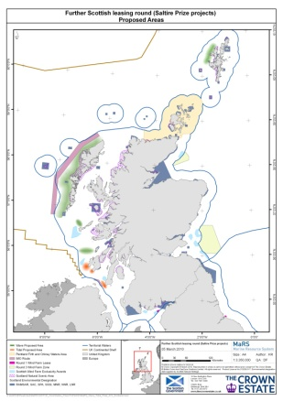
Marine Resource System (MaRS)
Examples of Use: Providing expert advice to external organisations
  Providing asset planning advice and integrating the use of MaRS within the external marine planning process, e.g.:
    MMO – Joint project to map marine resources
    Marine Scotland – Identifying areas for Saltire Prize (wave & tidal)
  Integrating MaRS model outputs into other external organisations, e.g.:
    National Grid - Offshore Transmission Network Feasibility Study
    CCW – Marine mammal sensitivity mapping
  MaRS is a transparent, evidence based tool that can be used as a means to engage with external bodies

Slide 33
Benefits of MaRS
  Robust and evidence based site selection process incorporating the interests of multiple stakeholders.
  Fast, clear, transparent and repeatable analysis that informs internal planning decisions.
  Facilitates proactive asset planning and the identification of potential conflicts that require resolution.
  MaRS ENABLES INFORMED DECISIONS TO BE MADE.

Slide 34
Future of MaRS
  Future interest areas to identify regions of commercial opportunity.
  Continual improvements to both the desktop tool and web portal to improve usability.
  Facilitate integration into planning authority organisations, such as the Marine Management Organisation (MMO), as a key marine spatial planning tool.
  Continue to drive towards an integrated database of marine information for the UK and surrounding waters.
  Engagement with organisations who would benefit from utilising MaRS.

Slide 35
Challenges
Challenges / Limitations | Actions
Complexity of the marine environment, competition for space | Strong evidence base – Improve policy, further identify constraints and opportunities, e.g. Coexisting activities
Dataset content, coverage, context and availability | Improving evidence base – Datasets, e.g. resolution. Identify gaps and target improvements, e.g. bird surveys Data products geared towards planning, e.g. sensitivity data
Evolving technologies and policies | Work with regulators & developers
Engagement with relevant stakeholders | Partnership – participatory planning – Further build relationships with external organisations
Notes:
Data: useful to have data products as well as underlying raw data otherwise you need a whole load of experts!
better criteria, better baselines, improved tools, greater coverage and new data to fill key gaps in knowledge.

Slide 36
Thank you
Pete Edmonds
Marine Data Manager peter.edmonds@thecrownestate.co.uk
+44 (0)207 851 5349

