Slide 1
9 September 2015 – DG MARE lunch seminar
Presentation by Dr. Hans Bruyninckx, Executive Director, EEA

Slide 2
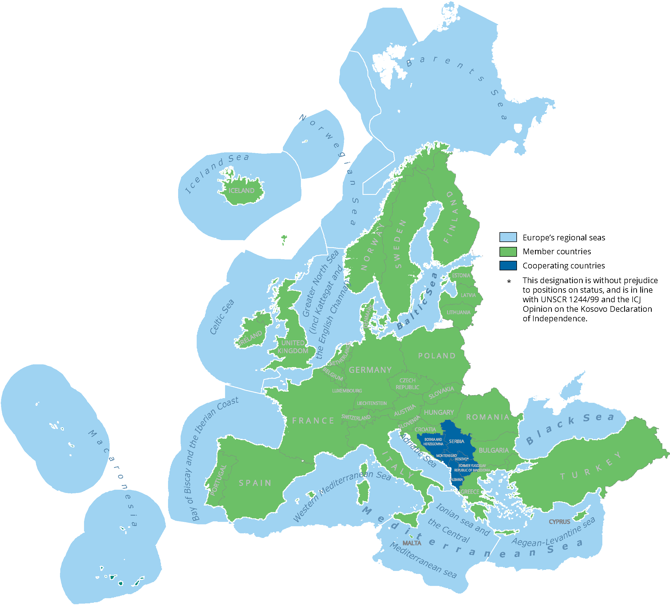
The European Environment Agency
The EEA is an EU agency that operates at the interface of science and policy.
With a network of more than 300 institutions in 39 European countries, the EEA provides timely, reliable and relevant information to support sustainable development.
EEA work is targeted at EU institutions, EEA member countries, civil society and the general public.

Slide 3
The European environment – state and outlook 2015 (SOER 2015)
A comprehensive assessment of past trends and future outlooks.
SOER 2015 informs policy implementation and reflects on opportunities to recalibrate policies, knowledge, investments and innovations in line with the 2050 vision of the 7th EAP.
SOER 2015 Synthesis report
SOER 2015 Assessment of global megatrends
Global
megatrends
European
briefings
Cross-country
comparisons
Countries and regions
11 briefings
25 briefings
9 briefings
39+3 briefings

Slide 4
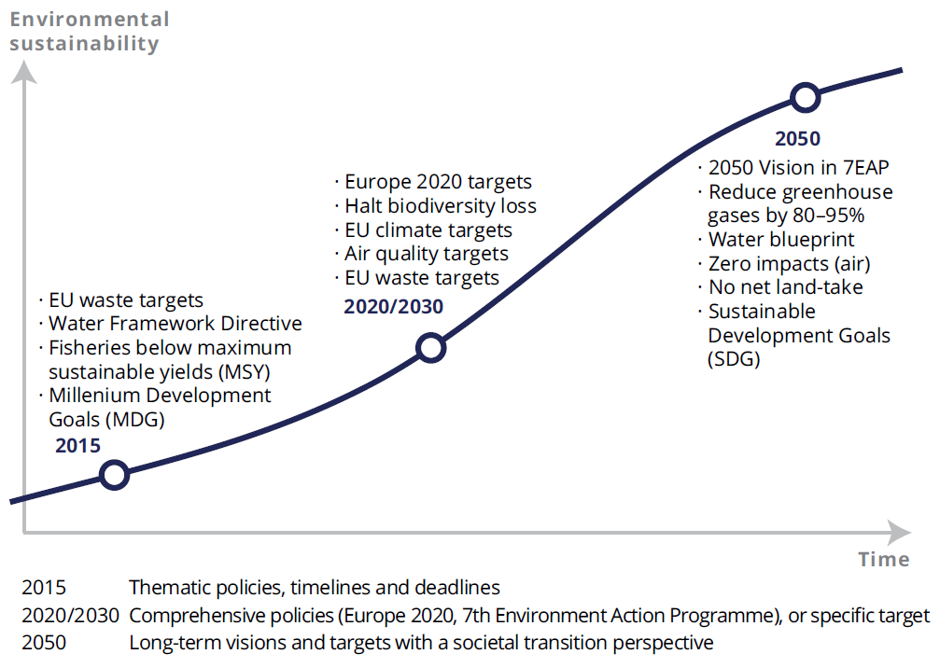
The policy context
Good Environmental Status (GES) in Europe’s seas
EU waste targets
Water Framework Directive
Fisheries at maximum sustainable yields (MSY)
Millennium Development
Source: EEA Multiannual Work Programme 2014–2018

Slide 5
Vision of the 7th Environment Action Programme
‘In 2050, we live well, within the planet's ecological limits.
Our prosperity and healthy environment stem from an innovative, circular economy where nothing is wasted and where natural resources are managed sustainably, and biodiversity is protected, valued and restored in ways that enhance our society's resilience. Our low-carbon growth has long been decoupled from resource use, setting the pace for a global safe and sustainable society.’
Source: 7th EU Environment Action Programme

Slide 6
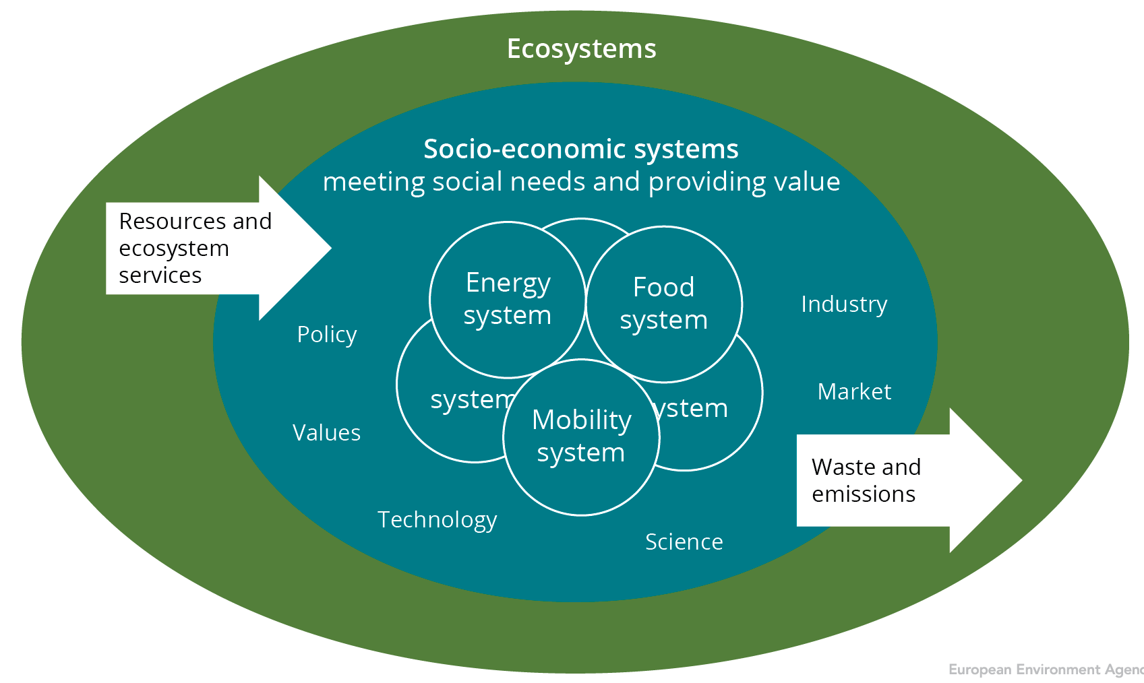
Living well within environmental limits requires a transition to a resource-efficient, circular, low-carbon economy

Slide 8
Key messages from SOER 2015
Policies have delivered substantial benefits for the environment, economy and people’s well-being; major challenges remain
Europe faces persistent and emerging challenges linked to production and consumption systems, and the rapidly changing global context
Achieving the 2050 vision requires system transitions, driven by more ambitious actions on policy, knowledge, investments and innovation
Doing so presents major opportunities to boost Europe’s economy and employment and put Europe at the frontier of science and innovation
© Daniel Danko, Environment & Me /EEA

Slide 9
Assessing past trends and future outlooks
The Synthesis report addresses the three thematic priority objectives of the 7th EAP:
Protecting, conserving and enhancing natural capital
Resource efficiency and the low-carbon economy
Safeguarding from environmental risks to health
Two overall patterns emerge:
Resource efficiency improvements have been notable but have not translated into increased ecosystem and social resilience
The long-term outlook is often less positive than recent trends
© Ana Skobe, Environment & Me /EEA

Slide 10
Thematic priority objective 1: Protecting, conserving and enhancing natural capital
 | Past (5–10 year) trends |  | Progress to policy targets
Terrestrial and freshwater biodiversity |  |  | ◻
Land use and soil functions |  |  | No target
Ecological status of freshwater bodies |  |  | ☒
Water quality and nutrient loading |  |  | ◻
Air pollution and its ecosystem impacts |  |  | ◻
Marine and coastal biodiversity |  |  | ☒
Climate change impacts on ecosystems |  |  | No target
20+ years outlook
Improving trends dominate
Largely on track
☑
Trends show mixed picture
Partially on track
◻
Deteriorating trends dominate
Largely not on track
☒
Source: EEA. SOER 2015 Synthesis report.

Slide 11
Thematic priority objective 2: Resource efficiency and the low-carbon economy
 | Past (5–10 year) trends |  | Progress to policy targets
Material resource efficiency and material use |  |  | No target
Waste management |  |  | ◻
Greenhouse gas emissions and climate change mitigation |  |  | ☑ / ☒
Energy consumption and fossil fuel use |  |  | ☑
Transport demand and related environmental impacts |  |  | ◻
Industrial pollution to air, soil and water |  |  | ◻
Water use and water quantity stress |  |  | ☒
20+ years outlook
Improving trends dominate
Largely on track
☑
Trends show mixed picture
Partially on track
◻
☒
Source: EEA. SOER 2015 Synthesis report.
Deteriorating trends dominate
Largely not on track

Slide 12
Thematic priority objective 3: Safeguarding from environmental risks to health
 | Past (5–10 year) trends |  | Progress to policy targets
Water pollution and related environmental health risks |  |  | ☑ / ◻
Air pollution and related environmental health risks |  |  | ◻
Noise pollution (especially in urban areas) |  |  | ◻
Urban systems and grey infrastructure |  |  | No target
Climate change and related environmental health risks |  |  | No target
Chemicals and related environmental health risks |  |  | ◻ / ☒
20+ years outlook
/
Improving trends dominate
Largely on track
☑
Trends show mixed picture
Partially on track
◻
Deteriorating trends dominate
Largely not on track
☒
Source: EEA. SOER 2015 Synthesis report.

Slide 13
The overall picture: Efficiency improvements have not secured long-term resilience
 |  | Protecting, conserving and enhancing natural capital |  |  |  |  |  |  |  | Resource efficiency and the low-carbon economy |  |  |  |  |  |  |  | Safeguarding from environmental risks to health
Past (5–10) year trends
20+ years outlook |  |  |  |  |  |  |  |  |  |  |  |  |  |  |  |  |  |  |  | /
Improving trends dominate
Trends show mixed picture
Deteriorating trends dominate
Source: EEA. SOER 2015 Synthesis report.

Slide 15
Marine environment
GO TO ONLINE BRIEFING
Marine environment
Seas and oceans act as a coherent ecosystem.
Across all of Europe’s regional seas, marine biodiversity is in poor condition: only 7 % of marine species assessments indicate ‘favourable conservation status’. Effects of climate change (e.g. acidification) add to the cumulative impacts.
Effective policy implementation can reduce impacts. For example, for several stocks the number of fish caught at ‘maximum sustainable yield’ levels continues to increase, suggesting healthier stocks.
© Spyridoula Kressou, Environment & Me /EEA
Marine and coastal biodiversity
Climate change impacts on ecosystems

Slide 16
Maritime activities
GO TO ONLINE BRIEFING
Maritime activities
Exploitation of European seas and coasts is increasing as new industries emerge and traditional ones move further off-shore.
The main pressures include: extraction of species and genetic resources, seafloor exploitation, pollution and the spread of non-indigenous species.
In calling for an ecosystem-based approach, the EU’s Blue Growth Strategy recognises the balance that must be achieved between ‘use’ of the sea and achieving the objective of ‘good environmental status’ by 2020.
© Pirjo Jha, Environment & Me /EEA
Marine and coastal biodiversity

Slide 17
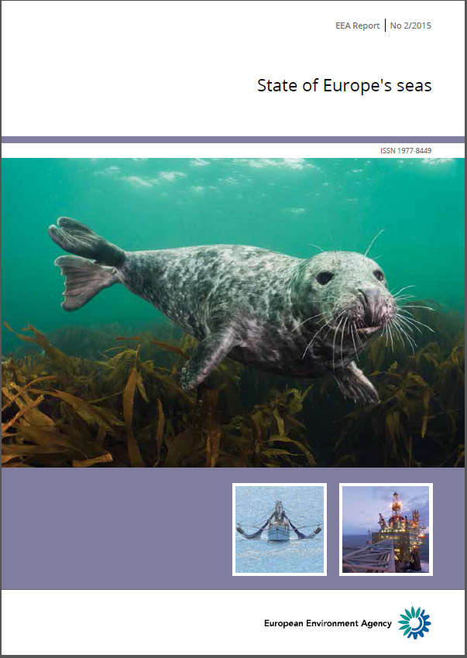
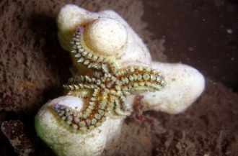
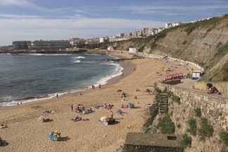
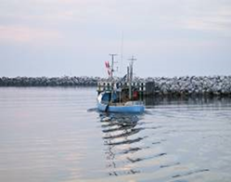
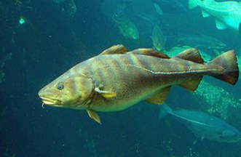
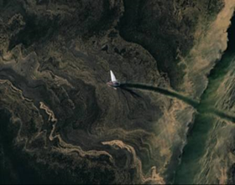
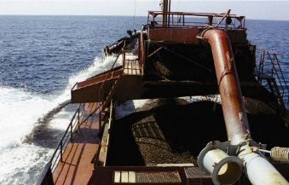
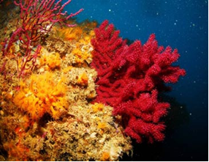
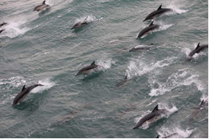
Balancing use with limits of the planet
http://www.eea.europa.eu/publications/state-of-europes-seas

Slide 18
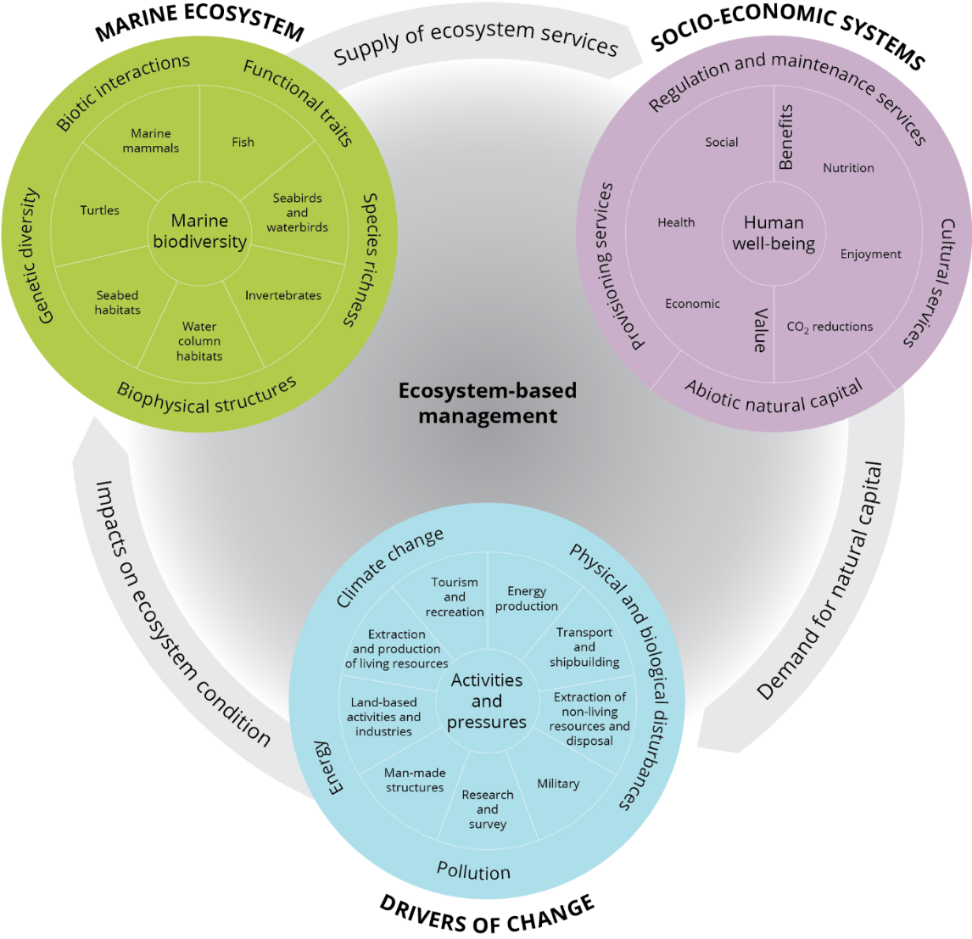
Part of the solution:
Ecosystem-based management for the seas
Spatial approach
Multiple objectives
Recognising connections
Cumulative impacts

Slide 19
Transitions to a better marine environment
SUSTAINABILITY
2020 targets
MSFD target (Good Environmental Status)
Halt biodiversity loss
Fisheries below Max. Sustainable Yield
20-20-20 targets
2050
Vision in 7EAP
Reduce GHG 80-95%
Water blueprint
Zero impacts (air)
SDGs ?
WFD targets
Nature Directives targets
MSFD Baseline
2014/2018
TIME
2014-2018 thematic policies timelines and deadlines
2020/2030 comprehensive policies (Europe 2020, 7th EAP), or specific targets
2050 long term visions and targets with a societal transition perspective

Slide 20
Policy objectives and synergies
2015
Implementatation of marine, CFP, water, and nature objectives
2020
Halting biodiversity loss; Achieve GES for marine environment
2050
Natural capital is restored together with its essential contribution to human well being and prosperity
Better prospects are needed to reach 2020 – as well as 2050 objectives
Many cross policy synergies to be gained through better integration
2050?
2020?
2015 marine environment | Status | 2020 outlook | Knowledge
State
Pressures
Activities

Slide 21
Challenges
Use of our marine resources must respect ecological boundaries to achieve 2050 visions of sustainability
Policy visions for economic growth must be aligned with policy targets for securing healthy and clean European seas
Achieving these visions are possible but depends on our actions and investments today including continued cooperation among stakeholders

Slide 22
Understanding past trends and future outlooks
Two major factors explain the uneven progress and prospects:
The changing global context
Competition for resources
Pressures from outside Europe
Planetary boundaries
Systemic characteristics of environmental challenges
Complexity
Uncertainty
Environmental, social and economic interdependencies
© Spyridoula Kressou, Environment & Me /EEA

Slide 23
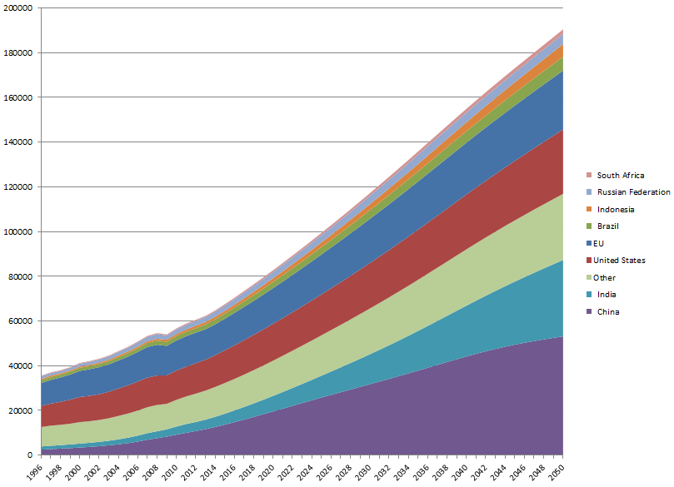
The world economy is expected to about triple in the next three decades
© Ana Skobe, Environment & Me /EEA
© Pirjo Jha, Environment & Me /EEA
Note: gross domestic product expressed in billion 2005 US dollars at purchasing power parity.
Source: OECD 2013: 'All Statistics - OECD iLibrary'.

Slide 24
World resource use is expected to at least double in the next three decades
© Ana Skobe, Environment & Me /EEA
© Spyridoula Kressou, Environment & Me /EEA
Source: Dong Energy
Souce: SERI (2013): SERI Global Material Flows Database. 2013 Edition. Available at: www.materialflows.net

Slide 25
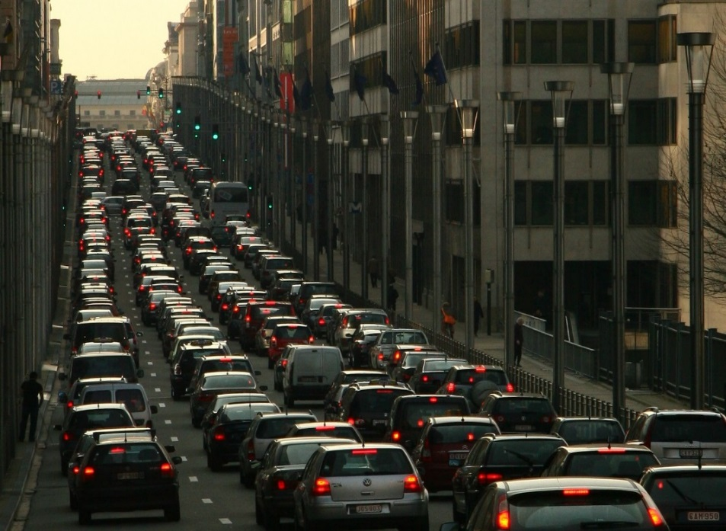
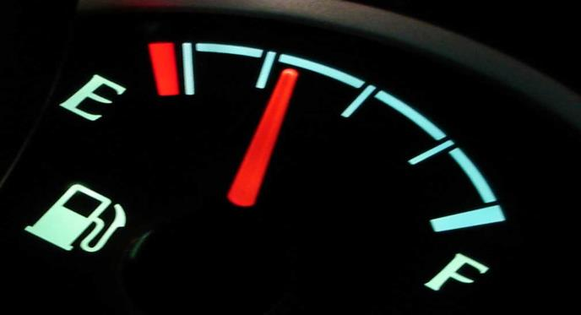
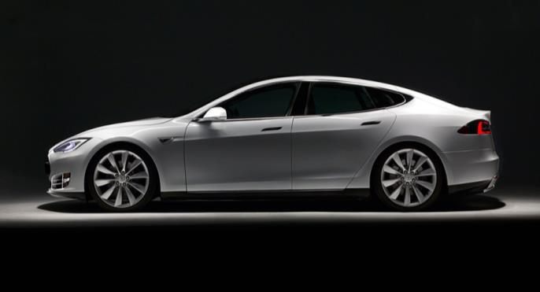
Looking ahead: Systemic challenges require systemic solutions
Not just incremental efficiency gains
Source: Tesla
but fundamental transitions in food, energy, mobility, urban, finance and fiscal systems
through profound changes in dominant practices, policies and thinking.

Slide 26
Achieving the 2050 vision depends on action today: Fostering innovation
Technological, economic and social innovations can support long-term transitions to a green economy
Creating a green economy requires upscaling niche innovations
Publicly funded research has fostered many of the most important and commercially successful innovations
Europe should not be afraid of leading the world on environmental standards: investments and innovation can boost prosperity today
© Victor Troyanov, Environment & Me /EEA

Slide 27
Eco-industries have prospered despite the recession in Europe
Eco-industry value added
Eco-industry employment
Total EU GDP
Total EU employment
© Daniel Danko, Environment & Me /EEA
Source: Dong Energy
Source: Eurostat, 2014.

Slide 28
Environmental policy is a driver of innovation, not a deterrent
Patent applications with European coverage (1978=100, 3-yr moving average)
© Daniel Danko, Environment & Me /EEA
Source: OECD

Slide 29
Looking ahead: Investing today for the long term
European investment needs are huge and today’s choices will have long-term implications
Key criteria for future investments in a green economy:
decarbonisation of society
circular economy jobs
ecosystem services and planetary limits
human health and well-being
Shifting taxation and phasing out environmentally harmful subsidies can stimulate innovation and transition choices.
© Victor Troyanov, Environment & Me /EEA

