Slide 1
EMODnet-Geology
Brussels
23rd November 2012
Alan Stevenson (British Geological Survey)

Slide 2
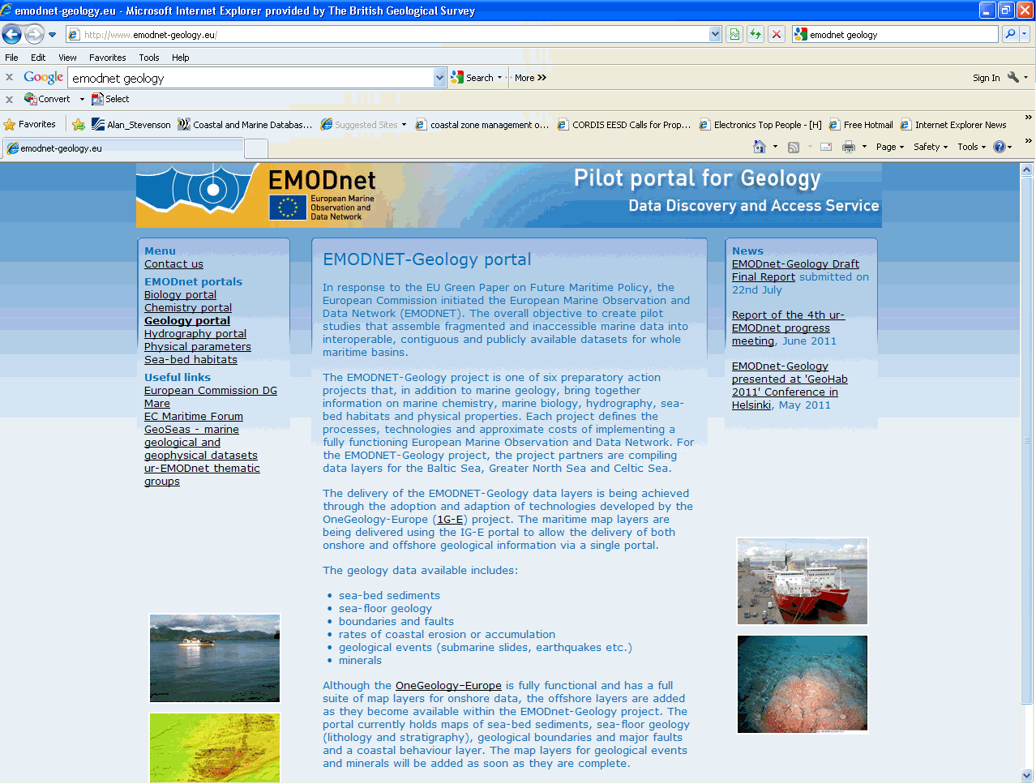
EMODnet-Geology website
http://www.emodnet-geology/eu

Slide 3
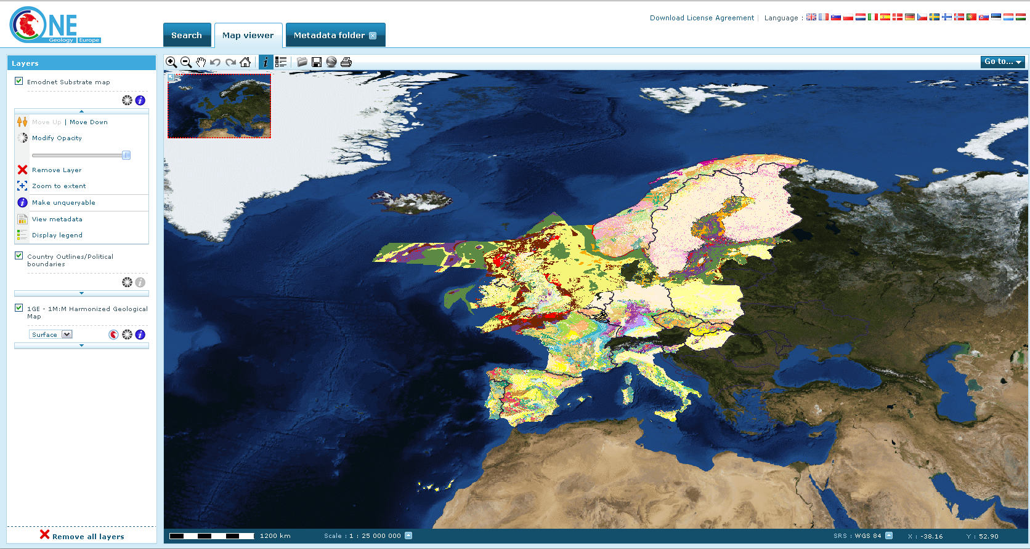
OneGeology-Europe Portal
http://portal.onegeology.org/

Slide 4
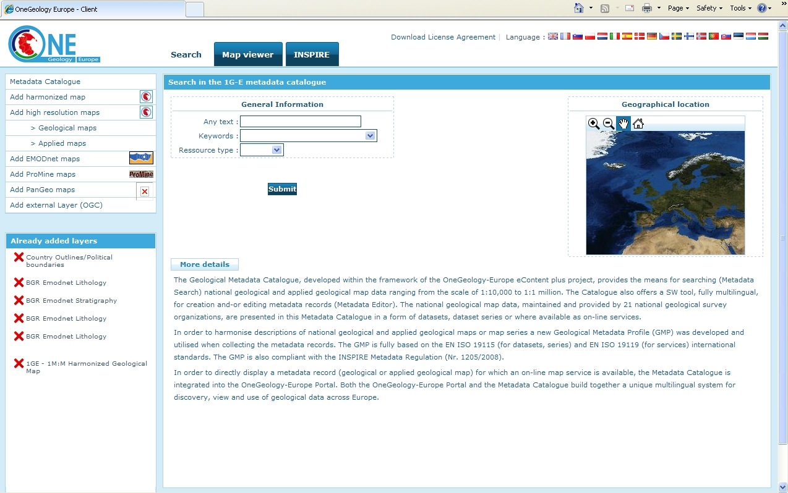
Search facility

Slide 5
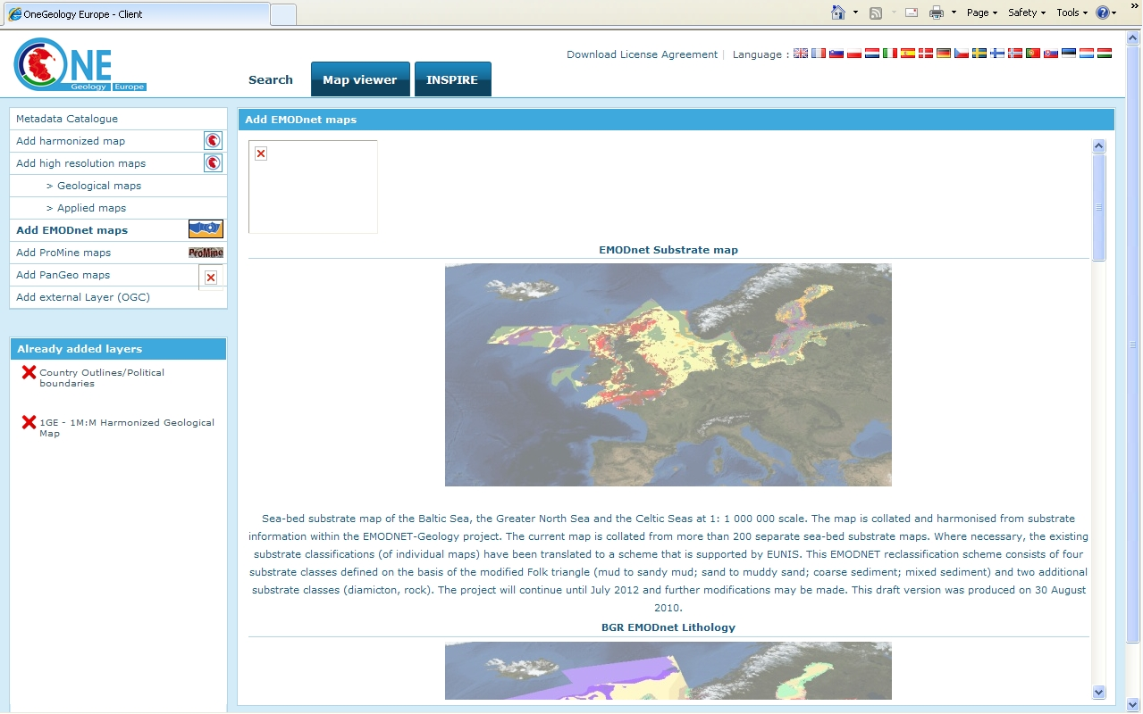
Map layers

Slide 6
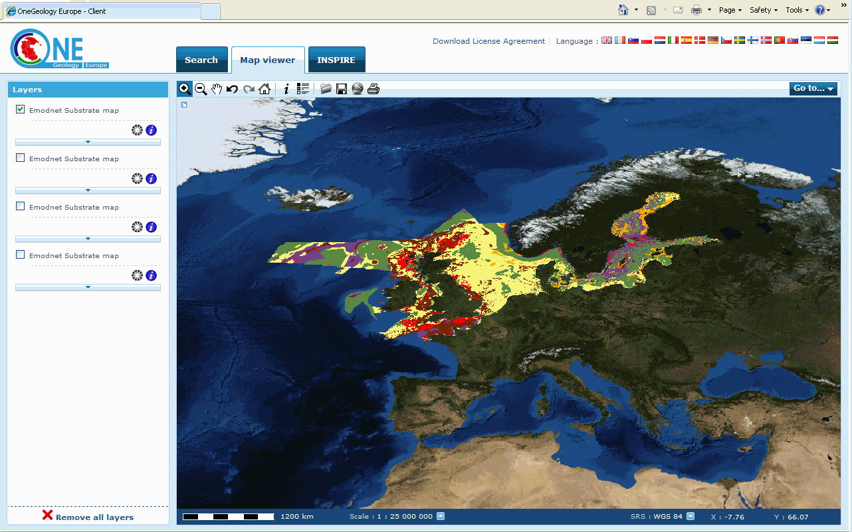
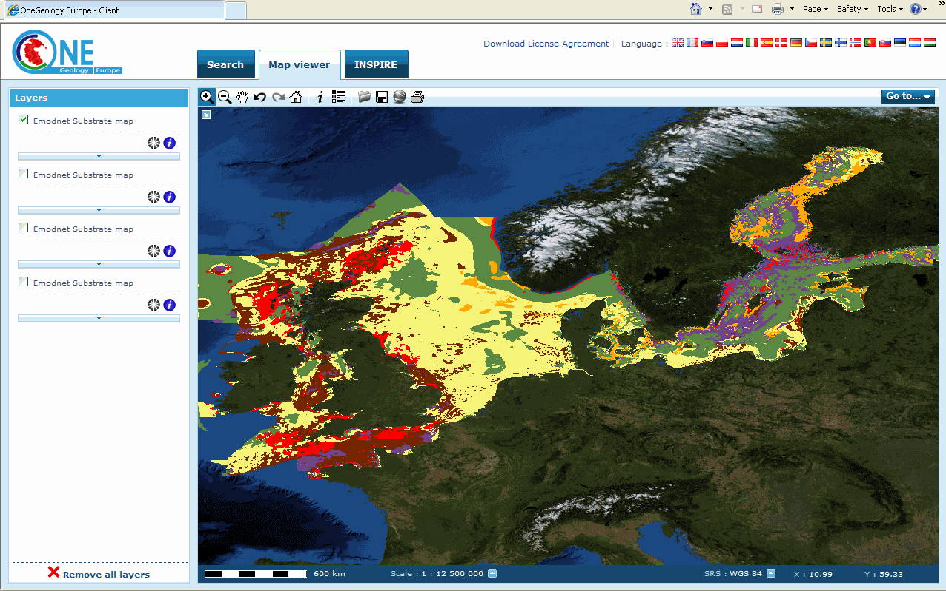
Sea-bed sediment layer

Slide 7
EMODnet-Geology and One-GeologyEurope
Share methodologies and communications objectives
Utilises the Geological Metadata Profile (GMP) – based on ISO 19115 (data) and ISO 19119 (services) standards
Uses GeoSciML (Geoscience Mark-up Language): INSPIRE standard for the exchange of geoscience interpretive (map) data over the internet
Data standards are non-proprietory and provides WMS viewing and WFS download services compliant with INSPIRE implementation rules
Delivering EMODNet-Geology maps which are fully integrated with other harmonised geological map layers
OGE is registered as the European contribution to the geological layer for GEOSS and contributes to GMES.

Slide 8
One Geology – Europe architecture
Based on INSPIRE technical architecture
Includes INSPIRE implementing rules
  Discovery services (INSPIRE, 2009 (2))
  Viewing services (INSPIRE, 2009 (3))
  Download services (INSPIRE, 2009 (4))
Notes:
To ensure that the spatial data infrastructure being developed by EU countries are compatible INSPIRE requires the adoption of implementation rules in specific areas:
These include those relating to metadata (INSPIRE, 2009 (1), discovery services (INSPIRE, 2009 (2), viewing services (INSPIRE, 2009 (3)) and download services (INSPIRE, 2009 (4))
These implementing rules
OneGeology-Europe architecture is based on
the INSPIRE technical architecture, implementing Network services (INSPIRE, 2009
(2), INSPIRE, 2009 (3), INSPIRE, 2009 (4)). This architecture addresses the
“publish-find-bind” pattern, completed by the “agree” process as INSPIRE has also to
deal with rights management.
8

