Slide 1

Mediterranean Sea Checkpoint: a new EMODNET Portal
N.Pinardi (1) and M.De Dominicis
Istituto nazionale di geofisica e vulcanologia
(1) University of bologna

Slide 2
Presentation summary
Main objectives of the project
The working Plan
The partners
Next steps

Slide 3
The Grand Challenges for the
Earth system Science
From the Earth System Science for Global Sustainability:
The Grand Challenges, ICSU, 2010
Forecasting
New technology
for better measurements
of the
Essential Environmental
Variables
EMODNET:
Connecting information and
Data exploration
Innovating
Observing
Determine
what institutional,
economic and
behavioural
changes
can enable effective steps
toward global
sustainability
Determine how to
anticipate, recognize,
avoid and manage
disruptive global
environmental
change.
Responding
Confining

Slide 4
European common target architecture
(from I.Shepherd, 2010)
observation and data collection
archiving at national data centres
thematic assembly groups
sea basin checkpoints
application
2011-2013 North Sea, Mediterranean
check data layers, ensure that the data from different groups are mutually compatible and define priorities for further observations

Slide 5
Mediterranean Sea Checkpoint main objectives
From Green Paper ‘Marine Knowledge 2020: from seabed mapping to ocean forecasting’ (COM-2012-437)
  EMODNET shall provide a single entry point for accessing and retrieving marine data derived .. from the hundreds of databases .. throughout the EU. It would also deliver digital map layers of parameters derived from these primary data for entire sea basins around Europe
In particular for Med Sea Basin Checkpoint should provide a Portal to:
assess, extract the synergies between, and identify the gaps of, the present monitoring data sets for the entire Mediterranean Sea
Disseminate new products based upon the available data for SEVEN challenges

Slide 6
Mediterranean Sea Checkpoint main goals (cont.)
The SEVEN Challenges are:
          Windfarm siting
          Marine Protected areas
          Oil Platforms leak
          Climate and Coastal protection
          Fisheries management
          Marine Environment
          River inputs (loading)

Slide 7
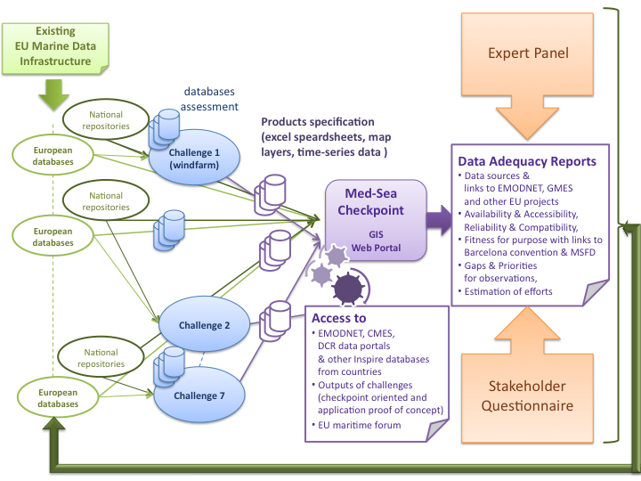
Flow of information

Slide 8
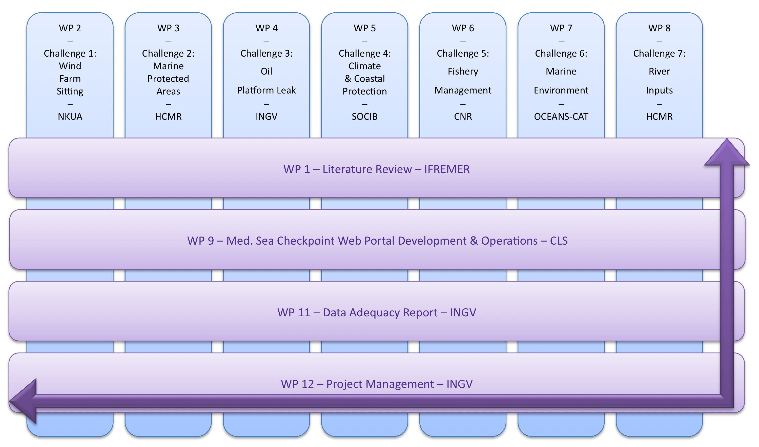
Work Breakdown

Slide 9
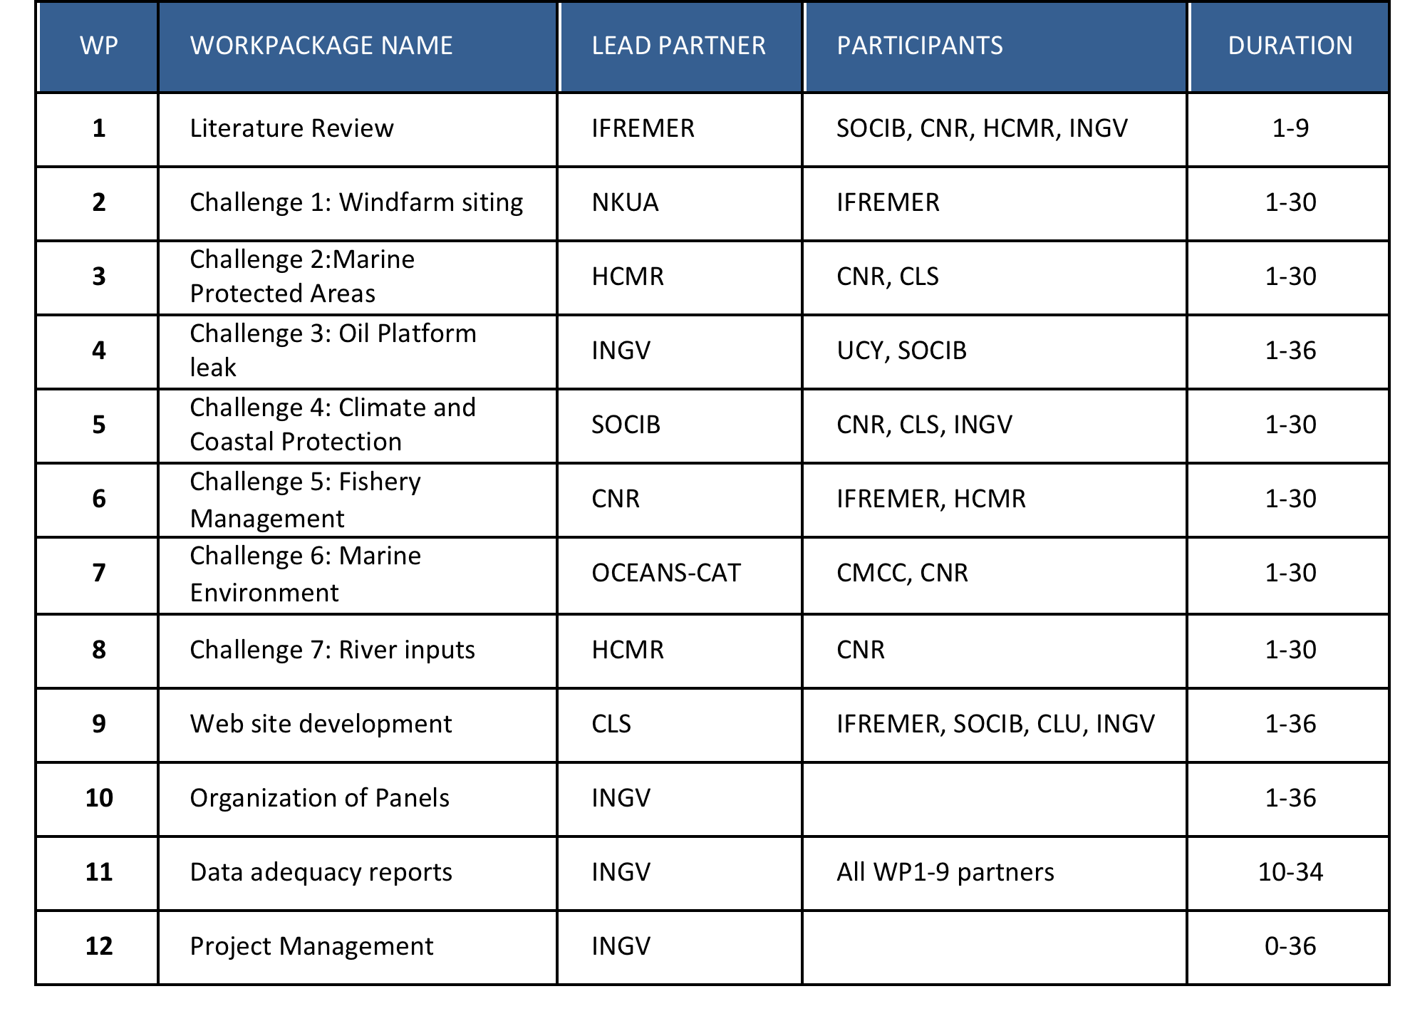
The project work plan

Slide 10
Overall Project deliverables
1) a literature survey summarizing the previous studies on the adequacy of the data in the Mediterranean Sea,
2) a collection of relevant data and catalog of data sources,
3) the development of specific products from available primary and assembled datasets in view of the specific questions for each challenge, providing confidence limits,
4) two Data Adequacy Reports (DAR),
5) a fully implemented Web Portal (EMODnet Med-Sea Checkpoint),
6) a report indicating how the EMODnet Med-Sea Checkpoint Portal could operate once the project has finished

Slide 11
WP 1: Literature Review
Main inputs of this work package will be :
  EMODNet preparatory actions;
  GMES Marine Core Services (MyOcean);
  European Environmental Agency reports for Water Framework Directive and Marine Strategy Framework Directive compliance monitoring;
  European Environment Agency GMES In Situ Coordination evaluation of European infrastructure for marine and ocean monitoring;
  Data Collection Framework and Fish stock assessments;
  Barcelona Convention / UNEP publications for MedPOL compliance monitoring;
  Barcelona Convention /REMPEC publications for oil spill emergency response and pollution abatment;
  EU funded projects which have conducted assessments, observation systems and data inventory at basin scale such as SeasEra, SeaDataNet, Geo-Seas, Jerico, Sesame, Perseus, Tropos, Coconet…
Metadata associated to the main data sources required by the challenges

Slide 12
WP2: wind farm siting
The data sets of relevance are:
  high resolution meteo analyses from EU FP7 previous projects (i.e. MARINA, etc.),
  high resolution waves from models and satellite altimetry developed in EU FP7 previous projects;
  shipping lines from AIS data made available from EMSA,
  bathymetry (numerical values and maps) from EMODnet Thematic Portal,
  seafloor geology from EMODnet Thematic Portal,
  benthic ecosystem structure from EMODnet Thematic Portal,
  electric grid position from network operators and public bodies,
  bird migratory patterns (from literature).
Goal is to assess the feasibility in two locations:
  on border between Spanish and French waters
  on border between French and Italian waters

Slide 13
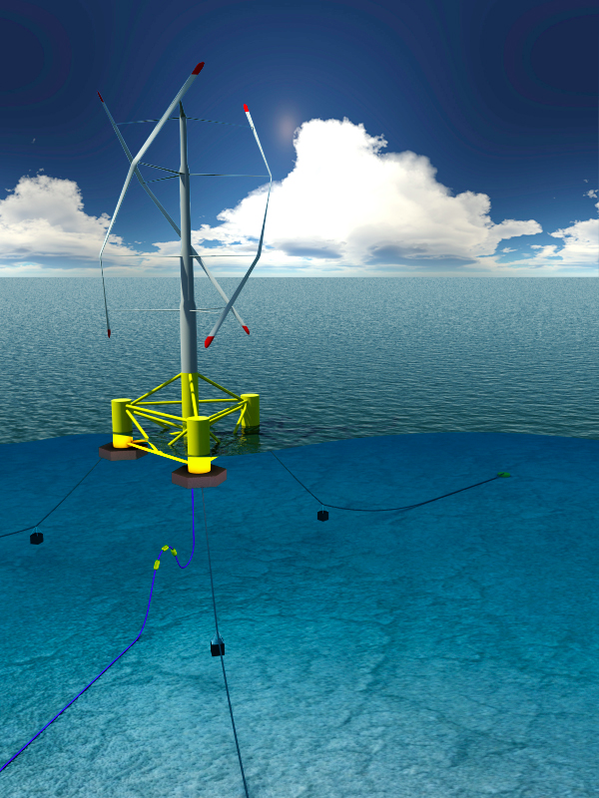
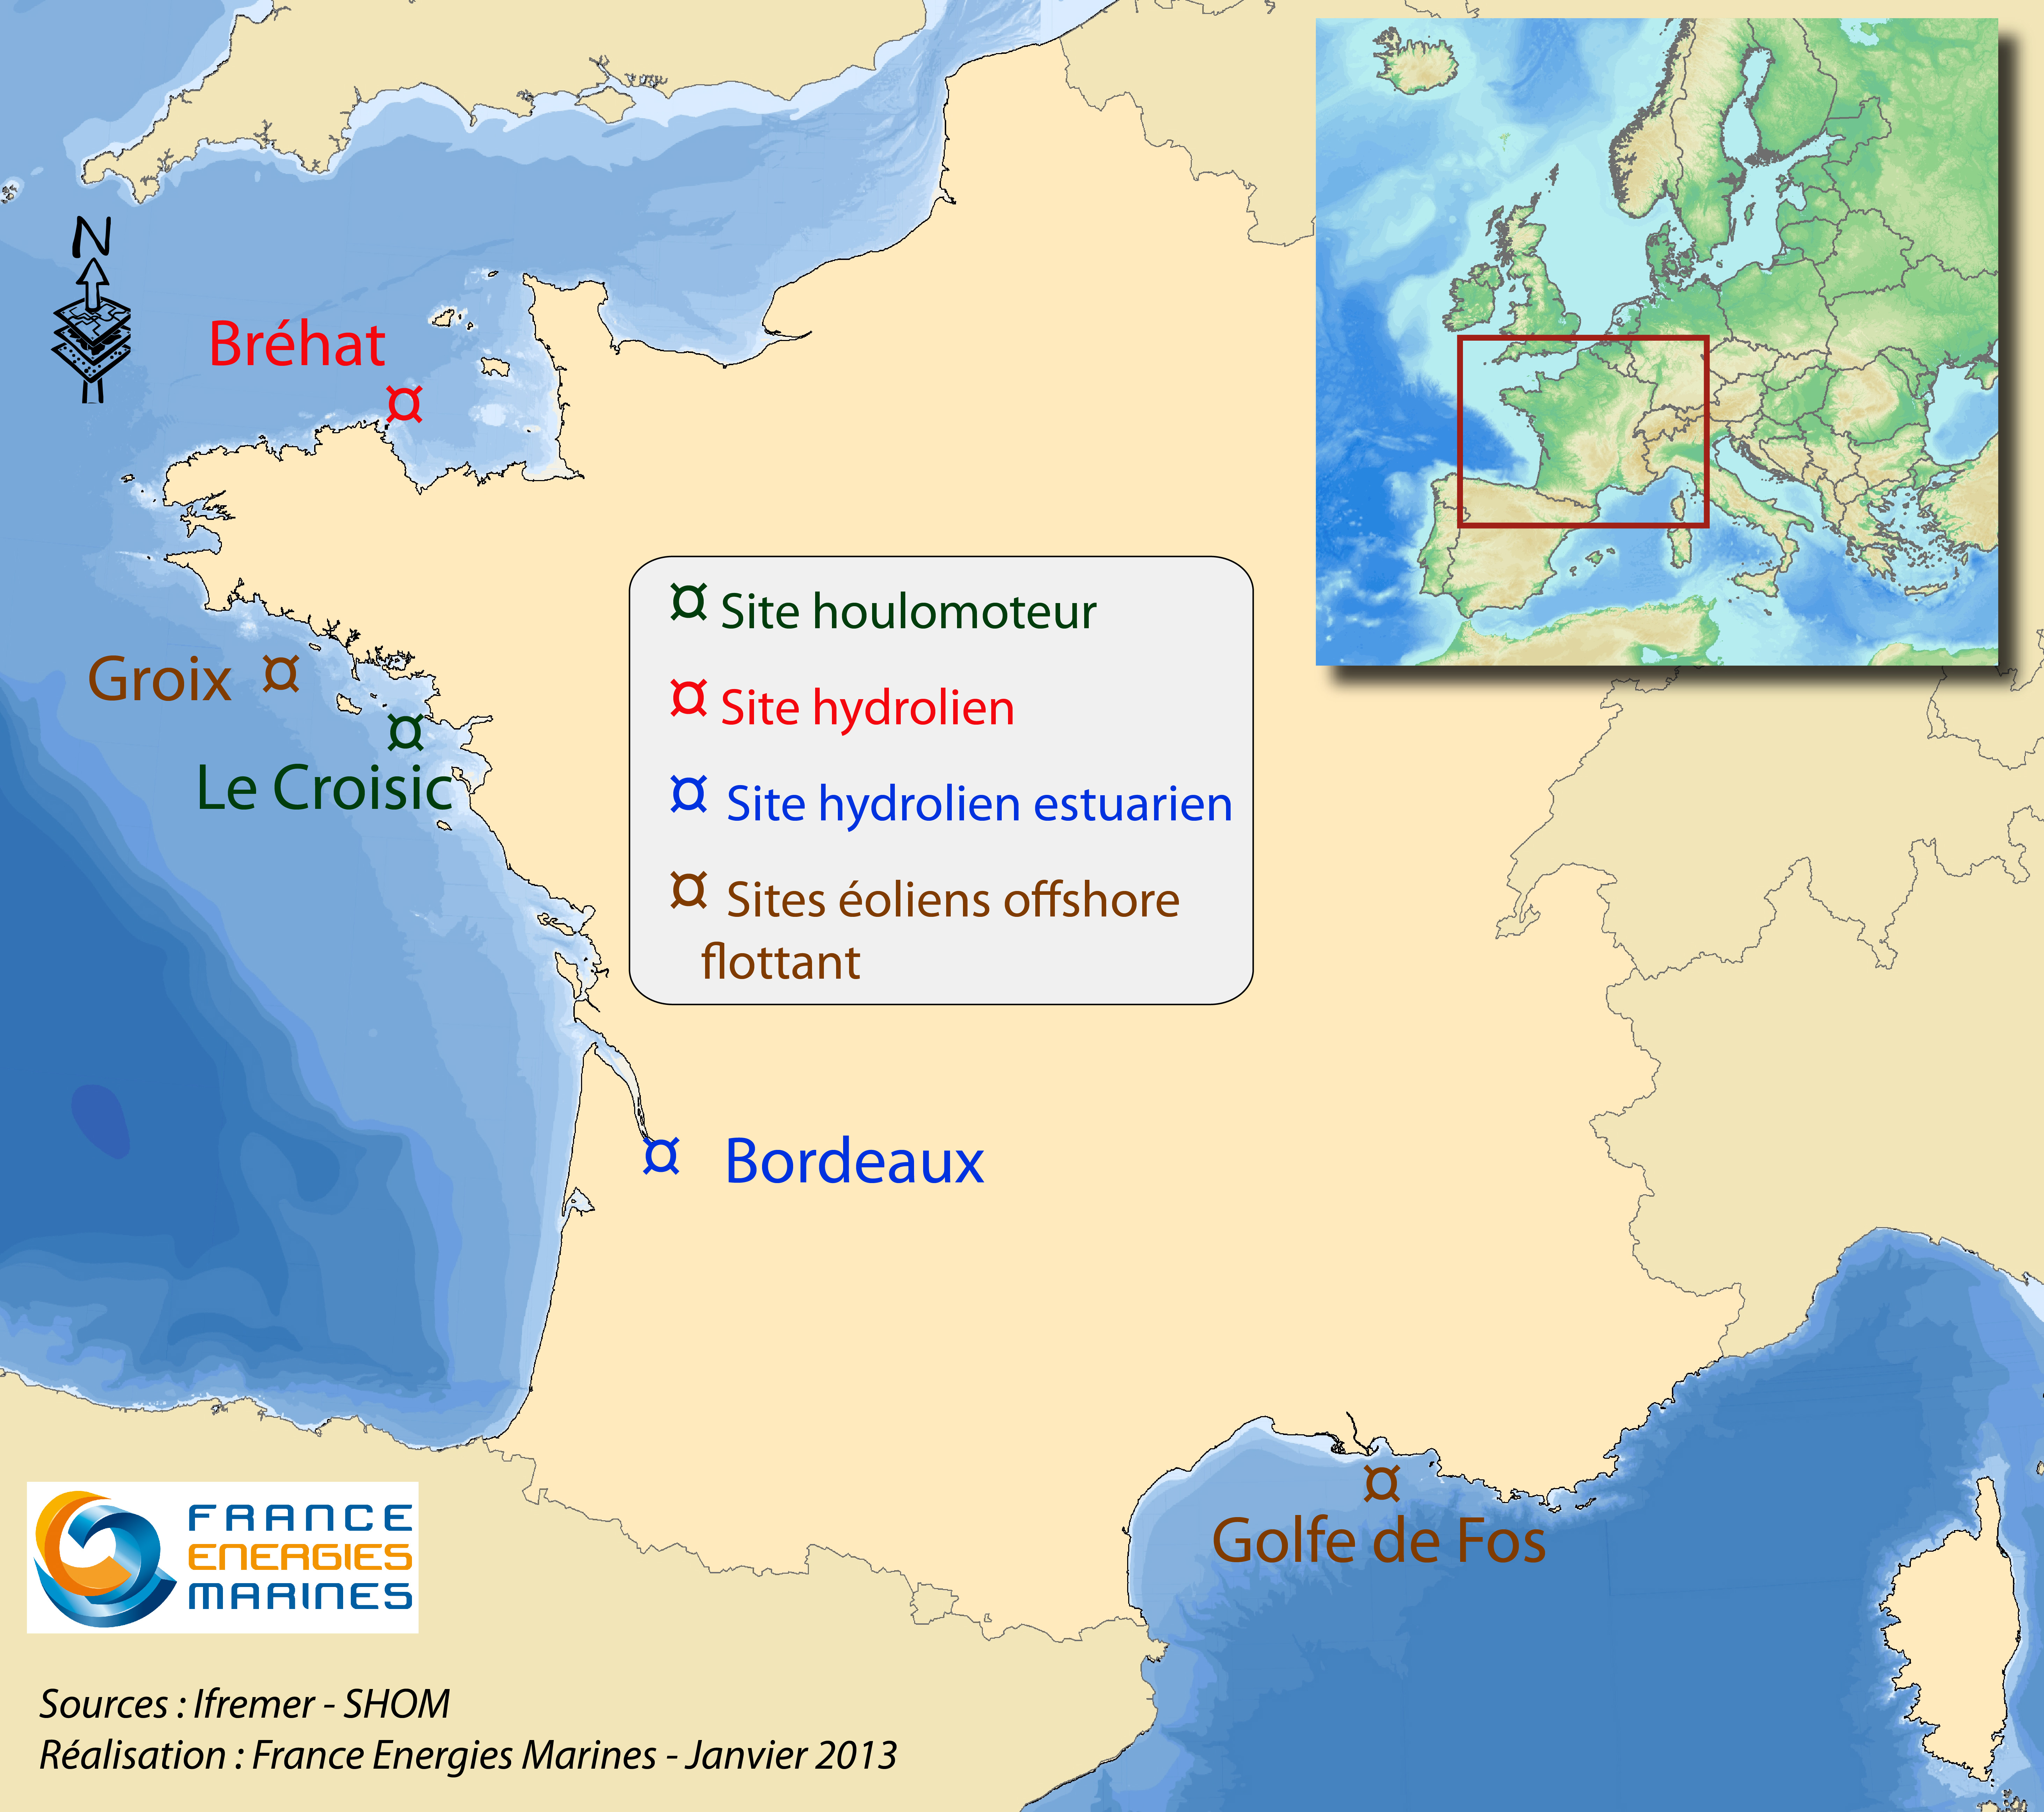
The partner test site
(EDF and France Energies marines)
(65 m depth area)

Slide 14
WP3: Marine Protected Areas
Work to be done with MedPAN, (Status of Marine Protected Areas in the Mediterranean Sea)
Data will be extracted from the EU projects
  CoCoNet (Towards COast to COast NETworks of marine protected areas, coupled with sea-based wind energy potential),
  MMMPA (Monitoring Mediterranean Marine Protected Areas),
  MEDISEH (Mediterranean Sensitive Habitats)
  MyOcean
Determine whether the network constitutes a representative and coherent network as described in article 13 in the Marine Strategy Framework Directive

Slide 15
WP4: Oil Platform leak
Input data for this WP will be:
    - high resolution meteo-oceanographic forecast and analysis for Mediterranean Sea (including winds, currents, Stokes drift and Sea Surface Temperature) provided by the MyOcean service and ECMWF through the national meteorological services;
    - oil spill model with advective-diffusive and weathering parametrizations;
    - oil platform position, date/time of the leak, type of oil, rate of spillage or total amount of oil spilled provided by the Commission or input data from slick satellite observations provided by EMSA;
    - coastal habitats (sea bed habitats and geology) provided by EMODnet portals
Deliver within 24 hours from the time of receipt of the oil platform leak information a Bulletin about oil slick traj. and impacts on the coasts

Slide 16
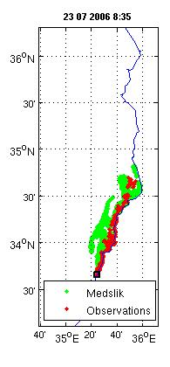
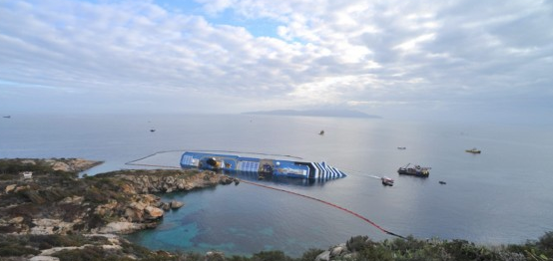
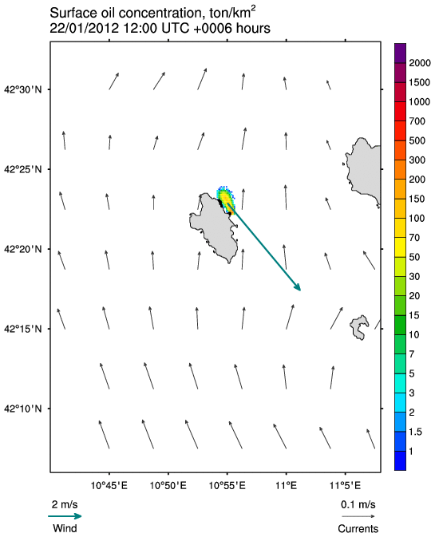
The system for the Mediterranean has been, and is, developed in several EU projects
Real time scenarios for coast guards
and civil protection (2012)
Oil spill accident in Lebanon (2006):
MedslikII gave real time forecasts

Slide 17
WP5: Climate and coastal protection
The relevant data are:
  SST time series (1880-today) from Hadley Center;
  PSMSL tide gauge sea level and if relevant, EMODnet Physics Portal.
  Sea level and anomalies from altimetry (AVISO)
  Re-analysis and reconstructions from MFS/MyOcean, national projects and EU funded projects;
  EEA assessments;
  SeaDataNet Portal historical profiles;
  Sediment balance at the coasts from EU funded projects (eg., EUROSION, CoastView, MICORE);
  National repositories and aerial imagery on shoreline evolution;

Slide 18
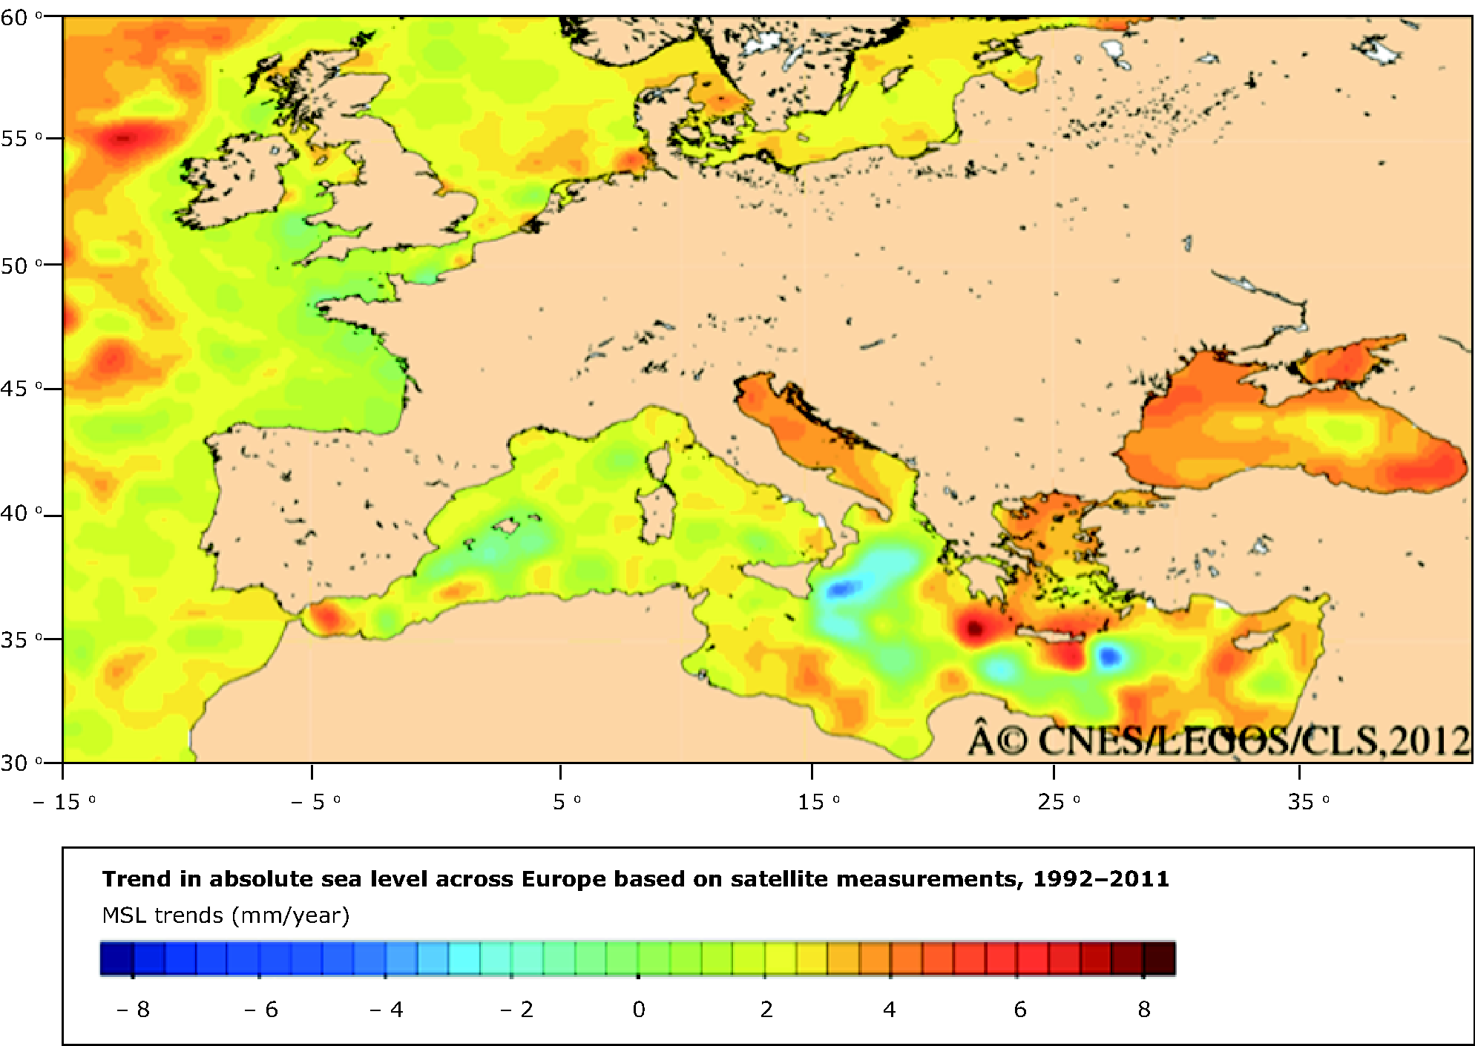

Several climate indices have been already developed in the past
Satellite altimetry
Period 1992-2010
Mean Sea Level
Global:
3.2 mm/yr
Mediterranean:
1.8 mm/yr

Slide 19

WP6: Fishery Management
Data inputs necessary to deliver are:
  FAO database and projects (FishStat, FIRMS, etc.)
  GFCM (General Fishery Council for the Mediterranean) and ICCAT databases
  Database on landings from the different partners / countries
  Data from the EC - Data Collection Regulation (DCR) from the different partners / countries
  Scientific publications expert group reports (STECF, GFCM and ICCAT) and grey literature regarding studies carried out before and after the DCR and supported by EC or MS about catches of fish, mammals, reptiles and seabirds.
Data inputs necessary to deliver data layers (gridded) are:
  Vessel monitoring system (VMS), logbook data of the MS (where available)
  Automatic Identification System (AIS) data (where available)
Scientific publications, grey literature and data sets from studies on the spatial distribution of the trawler fishing effort carried out before and after the DCR and supported by EC or MS.

Slide 20
WP7: Marine Environment
(eutrophication)
The following datasets will be considered for eutrophication:
  Nutrient (inorganic and organic) discharges from rivers and other land-based sources from EIONET and UNEP/MAP MEDPOL data sets, EMODnet Chemistry Portal and WP8 inputs.
  Chlorophyll concentration in the surface waters from satellites other satellite relevant parameters (e.g. water trasparency, coastal/open water classification) from MyOcean service and from WP8.
  Nutrients, oxygen and chlorophyll observations in the water column, including nutrient ratios from EIONET, UNEP/MAP MEDPOL, SeaDataNet Portal and EMODnet Chemistry Portal data sets.
  Ecosystem characteristics (phytoplankton floristic composition, seaweeds and seagrass, zooplankton including jellyfish and other gelatinous species) from literature and EMODnet Habitat Portal.
  Appearance of mucillaginous materials, marine snow and other phenomena affecting the oxygen balance from literature.

Slide 21
WP8: River inputs
Several datasets are available for the Mediterranean Sea :
  the compilation of the EU project SESAME;
  GDRC (Global Runoff Data Centre) data base ;
  the RivDIS (Global River Discharge) database, UNESCO;
  the Mediterranean Hydrological Cycle Observing System (Med-Hycos) database.
  EMODnet Chemistry if data are near the river mouths;
  EWA (european data archive)
  The Water Information System for Europe (WISE) database
  World River Sediment Yields Database of FAO
  MyOcean ocean colour Thematic Assembly Center;
The target parameters are:
  Water discharge
  total suspended sediments (TSS)
  nitrates/ total nitrogen
  phosphates/ total phosphorous
  eels

Slide 22
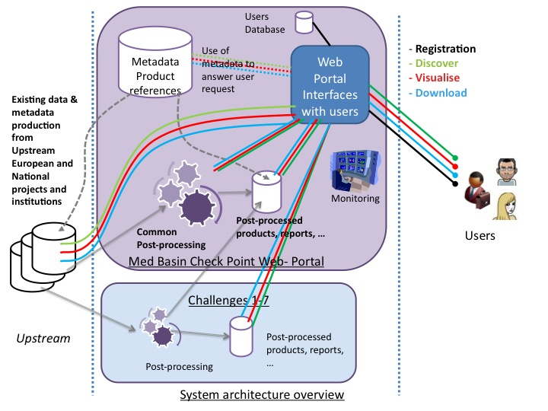
WP9 Web portal development
System and Portal architecture overview

Slide 23
WP10: Organization of Panels
The five scientific experts chosen by the consortium are:
  Monika Peterlin -- Slovenian environmental agency
  Miguel Bernal -- regional international organization for fisheries
  Jan Erik Hanssen – private industry
  Alberto Lamberti – academia – coastal engineering
  Piero Lionello – academia – climate science of the Mediterranean Sea
2 meetings of Panel with external stakeholders (to be decided)

Slide 24
WP11: Data adequacy reports
The DAR (2 versions) will describe:
      1) accuracy of results / data fit for purpose;
      2) synergies between different monitoring and data collection programmes;
      3) required temporal and spatial resolution of the monitoring data for the challenges;
      4) how well the present data collection and monitoring programmes meets the needs of public and private users;
      5) evaluation of data gaps;
      6) trends in data collection and monitoring: is data availability improving or worsening?
      7) cost effectiveness of new technologies;
      8) priorities for data collection or assembly in order to improve the accuracy of the results.

Slide 25
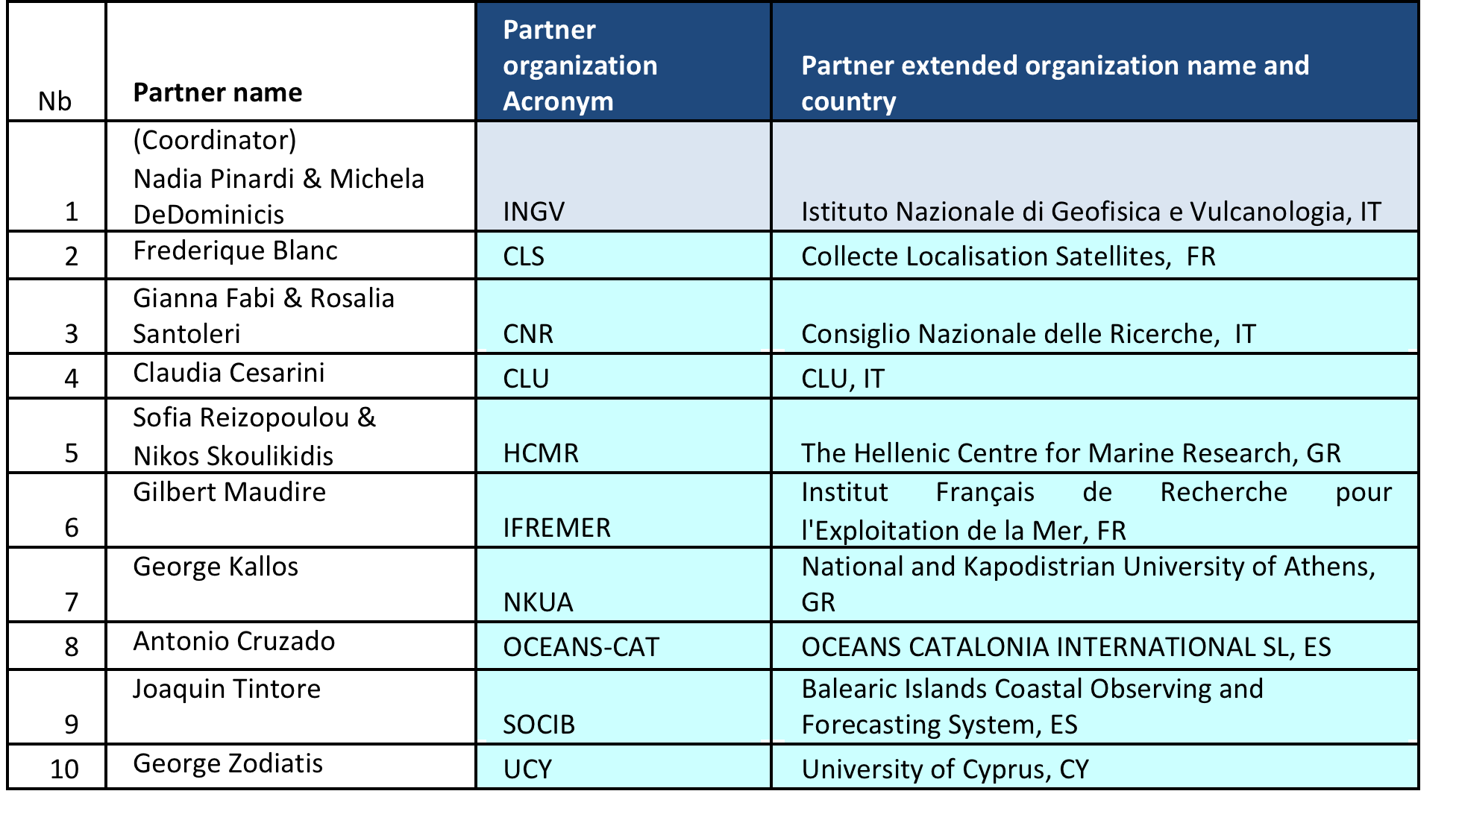
The Partners

Slide 26
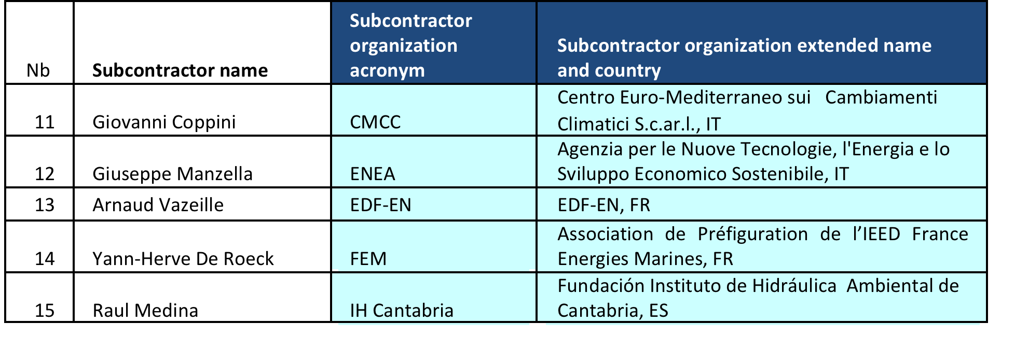
The associate partners

