Slide 1

A Sea for Life
The Marine Strategy Framework Directive
European Commission, DG Environment, Marine Unit
© iStockphoto

Slide 2
Key issues in protecting the marine environment
Land-based pollution (eutrophication & marine litter)
Growing levels of shipping (oil spills, emissions of greenhouse gases, alien species, etc.)
Overfishing (stock collapse, by-catch, proliferation of jellyfish, etc.)
Dredging (disturbance to the sea floor, release of toxic chemicals, etc.)
Off-shore energy production (underwater noise, oil or gas leakages, intense shipping traffic, etc.)
Climate change:
  Rising sea levels may wipe out areas of intertidal habitat
  Increased sea temperatures may alter the distribution of plankton
  Increase in coastal flooding and erosion
In all European seas, marine biodiversity is in poor condition: only 7% of marine species assessments indicate 'favourable conservation status'. (EEA, SOER 2015)

Slide 3
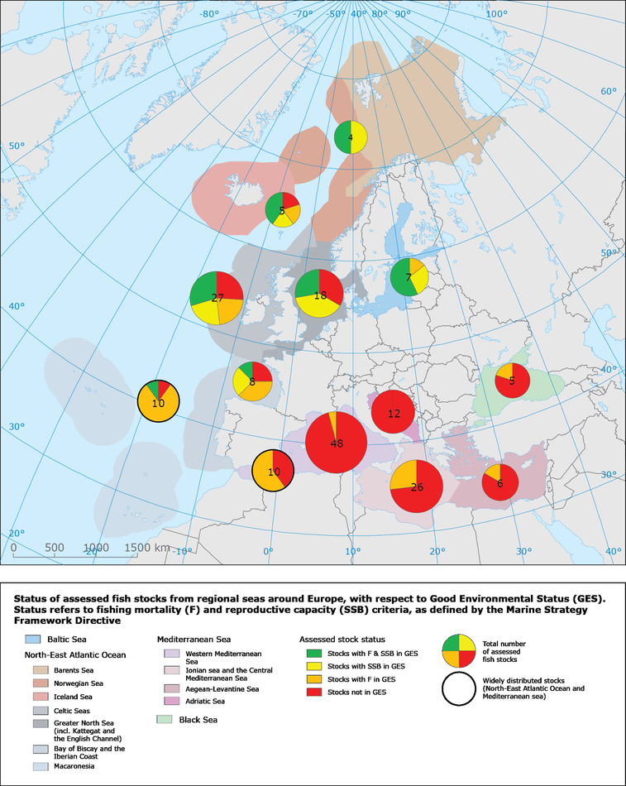
http://www.eea.europa.eu/soer-2015/europe/marine-and-coastal
EEA State-of-the-Environment Report published in March 2015
Includes two briefs, one on marine environment and the other on maritime activities
Detailed technical marine assessment report to be published by summer
Many indicators online, e.g.
GES Descriptor 3 - fisheries
Notes:
Meetings' Conclusions all available on CIRCA

Slide 4
The Marine Directive
EU’s legal instrument for the protection of our seas
Protected: Overall objective of the Directive to achieve or maintain Good Environmental Status (GES) of the EU's marine waters by 2020.
Sustainable: Ecosystem-based and integrated approach to the management of all human activities which have an impact on the marine environment.
Overarching Goal:
Achieve Good Environmental Status of EU’s Marine Waters by 2020
Common: Regional approach to implementation, and establishment of European Marine Regions
Protected
Ecosystems
Clean, healthy, productive seas
Sustainable Uses
of Europe’s marine resources
Common
Approaches
Cooperation at the EU and regional level

Slide 5
Implementation Steps
Main elements of a Marine Strategy:
Initial assessment, objectives, targets & indicators
2012
(+ 6 years)
Implementation of the marine strategy
2016
Six year review of the different elements of the strategy
2018 – 2021
Programmes of Measures
2015
Monitoring Programmes
2014
Initial assessment of current environmental status of MS waters by 15 July 2012
Determination of GES by 15 July 2012
Establishment of environmental targets and associated indicators by 15 July 2012
Establishment of a monitoring programme for ongoing assessment and regular updating of targets by 15 July 2014
Development of a programme of measures designed to achieve or maintain GES by 2015
GES
2020

Slide 6
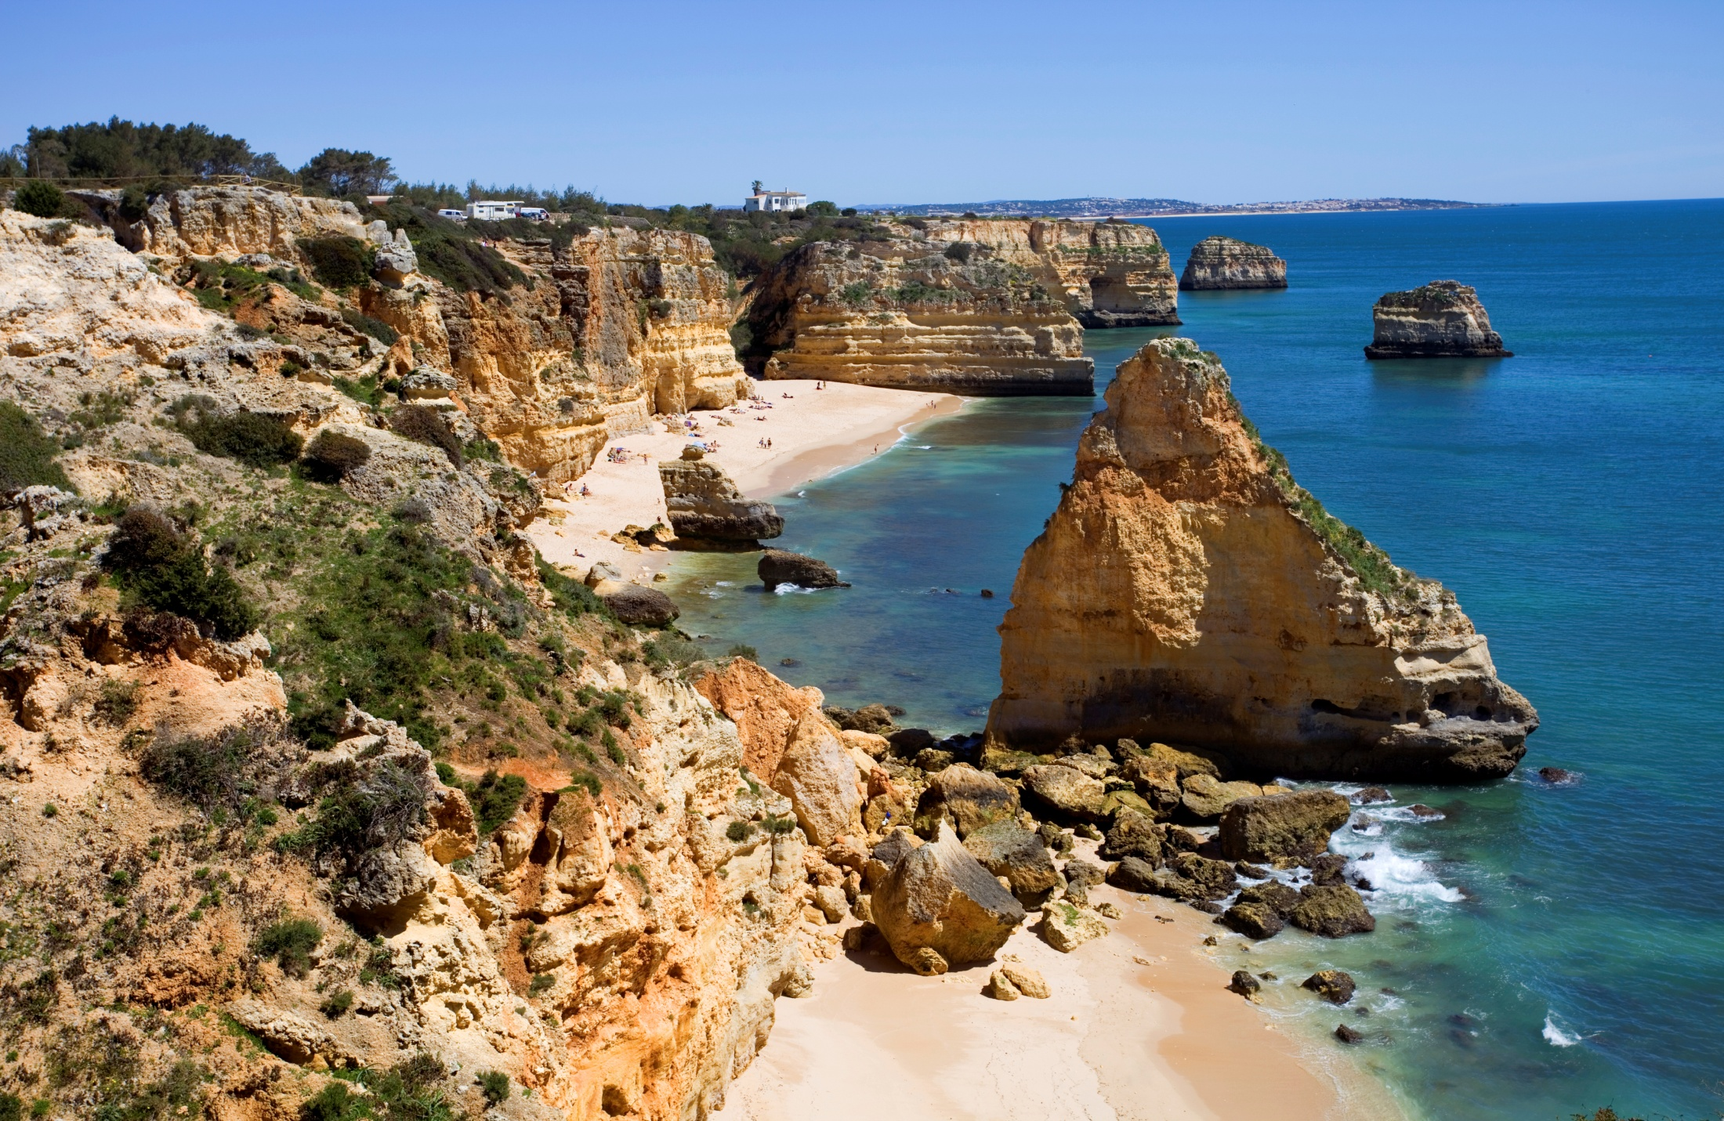
Protected Ecosystems
Overarching Goal:
Achieve GES by 2020
Protected
Ecosystems
Clean, healthy, productive seas
© iStockphoto

Slide 7
Achieve Good Environmental Status (GES)
Good Environmental Status is “the environmental status of marine waters where these provide ecologically diverse and dynamic oceans and seas which are clean, healthy and productive” (MSFD, art. 3(5)).
In addition, GES means that:
  The different uses made of the marine resources are conducted at a sustainable level, ensuring their continuity for future generations
  Ecosystems are fully functioning and resilient to human-induced environmental change
  The decline of biodiversity caused by human activities is prevented and biodiversity is protected
  Human activities introducing substances and energy into the marine environment do not cause pollution effects

Slide 8
11 qualitative descriptors
2010 EC Decision on criteria and methodological standards define criteria and indicators to help Member States determine what each descriptor means in practice.
Ex: Descriptor 3 – The population of commercial fish species is healthy – should be assessed using the three following criteria and subsequent indicators:
Criteria 1: the level of pressure of fishing activity
Indicator: fishing mortality
Criteria 2: the reproductive capacity of the stock
Indicator: spawning stock biomass
Criteria 3: the population age and size distribution
Indicator: high proportion of old, large individuals
In practice: fishing and other human activities affecting populations of commercially exploited fish and shellfish should not push these populations beyond their safe limits.
Descriptors for Good Environmental Status
Biodiversity is maintained
Non-indigenous species do not adversely alter the ecosystem
The population of commercial fish species is healthy
Elements of food webs ensure long term abundance and reproduction
Eutrophication is minimised
The sea floor integrity ensures functioning of the ecosystem
Permanent alteration of hydrographical conditions does not adversely affect the ecosystem
Concentrations of contaminants give no effects
Contaminants in seafood are below safe levels
Marine litter does not cause harm
Introduction of energy (including underwater noise) does not adversely affect the ecosystem

Slide 9
GES: Common principles, tailored indicators
Illustration with Descriptor 10 on Marine Litter
Descriptor 10 – Marine litter does not cause harm to the coastal and marine environment
Characteristics of litter in the marine and coastal environment
Impacts of litter on marine life
Indicators:
Trends in amount of litter washed ashore and/or deposited on coastlines
Trends in amount of litter in water column and deposited on sea-floor
Trends in amount, distribution and where possible, composition of micro-particles
Trends in amount and composition of litter ingested by marine animals
Targets (examples):
X% of overall reduction in the volume of litter on coastlines from 2010 levels by 2020
Less than 10% of northern fulmars (sea bird) having more than 0.1 g plastic particles in their stomach
No increase of micro-plastics by 2020
GES Descriptors
high level, generic across Europe
GES Criteria
will be based on characteristics which define what GES means in each Member State
GES: Indicators & Targets
provide the final level of details. If the targets are met, GES should be achieved

Slide 10
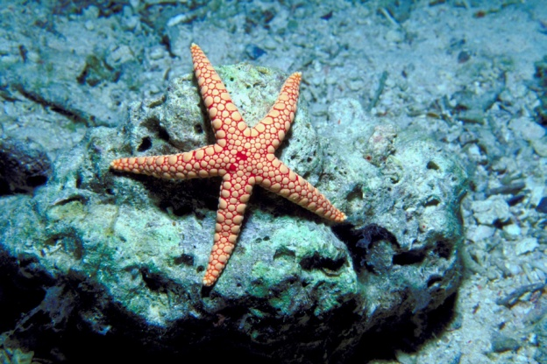
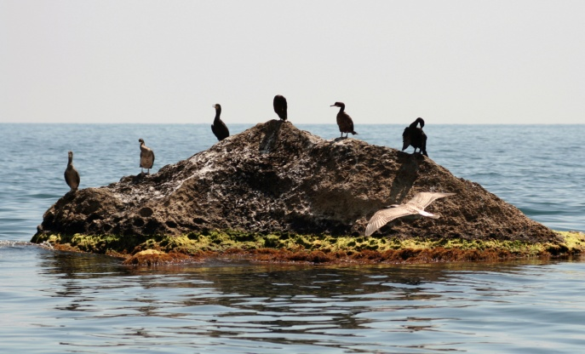
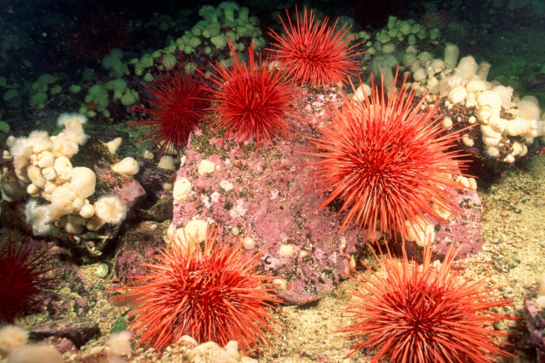
Marine Protected Areas
Marine Protected Areas (MPAs) are areas of our oceans, seas and coasts where species and habitats are protected (through legal or other effective means) from activities that are damaging or that cause disturbance.
The creation of a coherent network of MPAs is in line with:
  EU conservation legislation (Habitats and Birds Directives)
  International obligations (Convention on Biological Diversity)
© Getty Images/Hemera Technologies/AbleStock.com
© iStockphoto
© Getty Images/Comstock
Notes:
Article 13(4) requires MS to include in their Programmes of Measures spatial protection measures contributing to coherent and representative networks of MPAs.

Slide 11
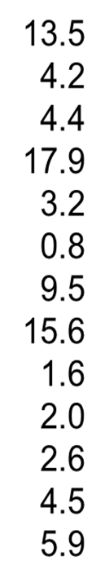
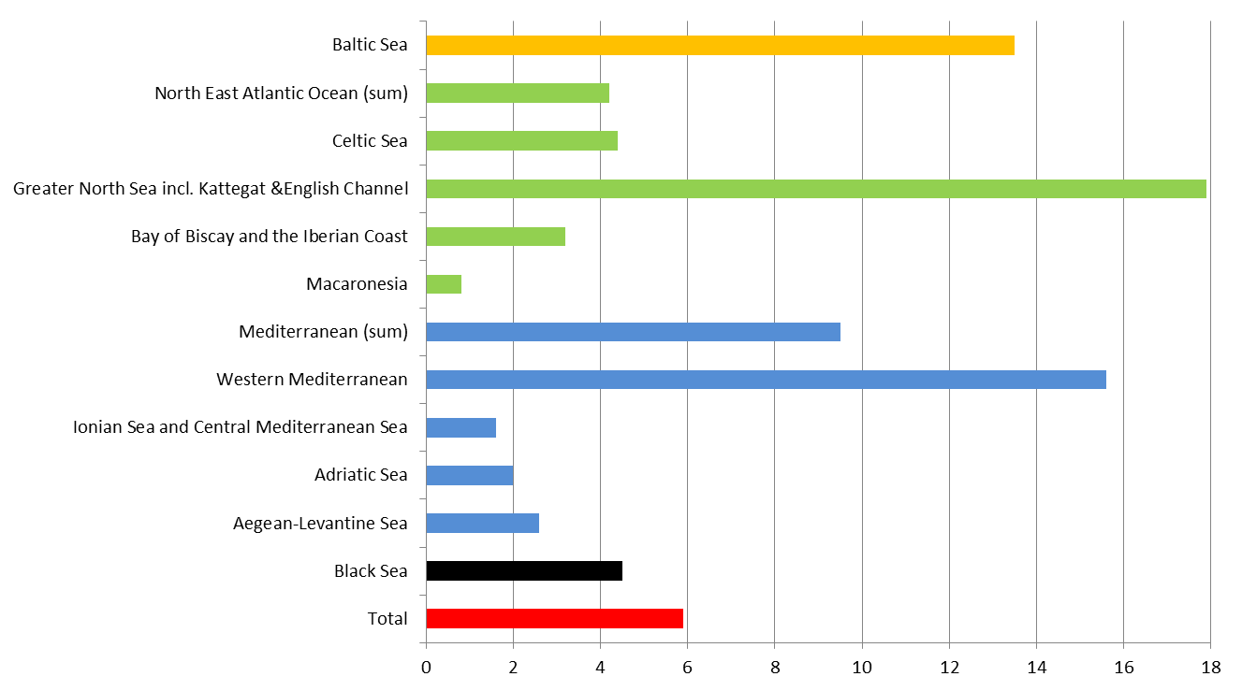
MPA coverage in European Seas, 2012
Notes:
The Commission is preparing a report on the progress made in establishing MPAs in Europe (obligation by art. 21 of MSFD). The findings of the report can be seen on the slide. A new assessment will accompany the art. 16 report on the Programmes of Measures in 2017.

Slide 12
Protected Ecosystems
Overarching Goal:
Achieve GES by 2020
Sustainable
Uses
of Europe’s marine resources
© iStockphoto

Slide 13
Ecosystem-based & Integrated Approach
Objectives:
The collective pressure of human activities is kept within levels compatible with the achievement of GES
The capacity of marine ecosystems to respond to human-induced changes (e.g. climate change) is not compromised
The use of marine goods and services by present and future generations is sustainable
Requirements:
The preservation and enhancement of ecosystems and ecosystem services is systematically taken into account in the development of human socio-economic activities.
The objectives to protect and restore the environment should increasingly set the boundaries for sustainable use of the natural environment
Central to the Marine Directive

Slide 14
Adaptive Management
Key principles
Flexibility and adaptability of the measures to implement the Marine Strategy
Regular update of environmental targets to take into account the changes observed
Integration of the outcomes of future scientific research
Instruments
Monitoring programmes: measure progress towards GES, using targets
Update of Marine Strategy according to the outcomes of the monitoring process
Obligation for Member States to review their marine strategies every 6 years.
Review of:
  The initial assessment of the state of the marine waters
  The environmental targets
  The monitoring programmes
  The programme of measures
“Learning-by-doing” approach to deal with the uncertainties linked to the complex functioning of ecosystems & to climate change

Slide 15
Protected Ecosystems
Overarching Goal:
Achieve GES by 2020
Common
Approaches
Cooperation at the EU and regional level
© iStockphoto

Slide 16
Common Implementation Strategy
Marine Directors: highest level political group focused on the overall implementation of the MSFD
Marine Directors
Working Group on Data, Information and Knowledge Exchange (DIKE)
Working Group on Good Environmental Status (GES)
Working Group on Economic and Social Assessment (ESA)
Marine Strategy Coordination Group (MSCG)
Technical WGs (emerging areas e.g. marine litter or noise)
Marine Strategic Coordination Group: between the high level and the working groups (WG), prepares material for both and oversees the work of the three WG.
Working Groups (WG): provide a platform for discussions between MS to help them with the implementation of the Directive.
  WG on Good Environmental Status (GES): supports MS in their determination of what GES means for their marine waters.
  WG on Economic and Social Analysis (ESA): supports MS with their economic and social analysis of the use of their marine waters
  WG on Data, Information and Knowledge Exchange (DIKE): supports MS with their data reporting obligations
Technical Working Groups: two have been set up, covering Noise and Litter, to provide a forum for exchange focusing on emerging areas of particular concern.

Slide 17
Building on existing EU legislation & policies
Water Framework Directive:
  Objective: achieving ‘Good Status’ for all EU groundwaters, rivers, lakes, coastal waters, etc. by 2015.
  6-year planning cycle, River Basin Management Plans development. First reviewed in 2015.
  Reduces marine pollution from land-based sources and protects ecosystems in coastal waters
Habitats and Birds Directives:
  Europe’s key laws on nature conservation
  Provide special protection for key sites (the Natura 2000 network), animal & plants and habitat types
  Integration of these sites in MPAs network
Common Fisheries Policy:
  Collaborative way for managing the EU’s shared seas and fisheries
  Objective: Ensuring that Europe's fisheries are sustainable and do not damage the marine environment.
  Reformed CFP – Maximum Sustainable Yield
Maritime Spatial Planning Directive
  Define the principles of sound coastal and maritime planning and management. The aim is to
  Promote rational and sustainable use of the sea , balance different interests

Slide 18



The Regional Sea Conventions
The Barcelona Convention for the Protection of the Marine Environment and the Coastal Region of the Mediterranean: Mediterranean Action Plan defining key priorities and governance, adopting principles such as the ecosystem approach and tools such as integrated coastal zone management (ICZM).
The Bucharest Convention on the Protection of the Black Sea against Pollution: Its Strategic Action Plan for Environmental Protection and Sustainable Management of the Black Sea is a pillar of regional cooperation which includes several elements of a marine strategy.
The Helsinki Convention on the Protection of the Marine Environment of the Baltic Sea: has undertaken considerable public participation and produced a Baltic Sea Action Plan in 2007 in line with MSFD requirements.
The OSPAR Convention for the Protection of the Marine Environment of the North-East Atlantic: aims to conserve marine ecosystems and safeguard human health in the North-East Atlantic by preventing pollution.

Slide 19
MSFD Milestones 2012
Implementation deadline (July 2012) for key elements of the MSFD:
Initial Assessment (Article 8)
Good Environmental Status (Article 9)
Environmental Targets (Article 10)
Member States had to report to Commission by 15 Oct 2012

Slide 20

Results of the assessment
Very comprehensive: the first time so much information is gathered on marine environment at EU level
Public consultations and dialogue with stakeholders
Better policy integration (water framework directive, habitats, CFP better taken into account in marine policies)
More cooperation in Regional Sea Conventions
Gaps in information and knowledge identified, but often without a clear plan to address them

Slide 21
MSFD Scoreboard
Reporting obligations
http://ec.europa.eu/environment/marine/eu-coast-and-marine-policy/implementation/scoreboard_en.htm
Last updated 2 Feb 2015
 | Art. 26 | Art. 7 | Art. 8/ 9/10 | Art 11
Belgium
Bulgaria
Croatia
Cyprus
Denmark
Estonia
Finland
France
Germany
Greece
Ireland
Italy
 | Art. 26 | Art. 7 | Art. 8/ 9/10 | Art 11
Latvia
Lithuania
Malta
Netherlands
Poland
Portugal
Romania
Slovenia
Spain
Sweden
UK
Received
Part received
Not received
Notes:
HR now reported on everything: Art 8(1)(a)(b), Art 9, art 10, Art 11 except Art 8(1)(a)(c)
Based on fish scoreboard available on website http://ec.europa.eu/environment/marine/eu-coast-and-marine-policy/implementation/scoreboard_en.htm
Compared to last version from November, more "green" in the Article 11 column, but still some reports missing that were due almost 4 months ago (15 October 2014): legal follow-up from the Commission very soon.

Slide 22
Follow-up to Article 12 Recommendation
MS Replies (Status 2 February 2015)
Belgium
Bulgaria
Croatia
Cyprus
Denmark
Estonia
Finland
France
Germany
Greece
Ireland
Italy
Latvia
Lithuania
Malta
Netherlands
Poland
Portugal
Romania
Slovenia
Spain
Sweden
UK
MS sent a reply to the Commission
MS did not send a reply to the Commission
Notes:
MS replies now all available on CIRCA.

Slide 23
Article 12 Follow up
Future oriented : let's fix it now
To increase adequacy: Revision of the Commission Decision 2010/477 on GES
To improve coherence: strengthen the role of Regional Seas Conventions
Advice to incorporate data/knowledge gaps in monitoring programmes
Advice to review targets and relate them to (coordinated) programmes of measure
To support MS through tailor made projects

Slide 24
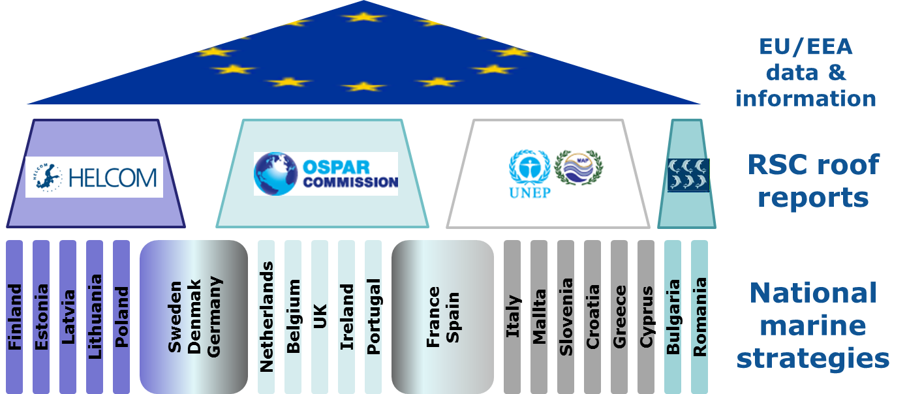
Strengthen role of RSCs

Slide 25
MSFD: Monitoring and Measures
Next steps (for Member States):
– preparation of Monitoring Programmes (Article 11) – deadline 15 July 2014
– preparation of Programmes of Measures (Article 13) – 2015 / 2016

Slide 26
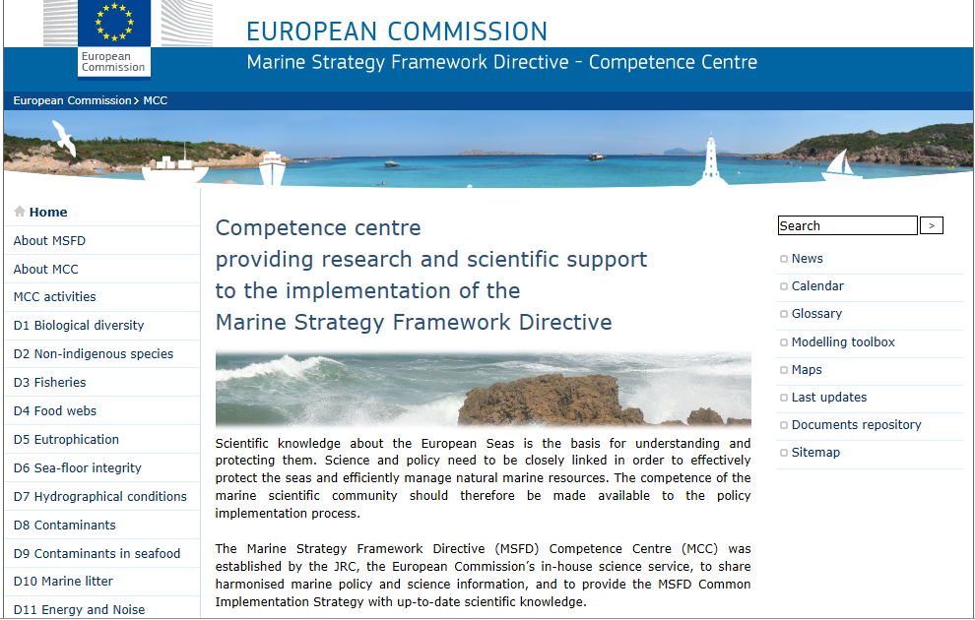
http://mcc.jrc.ec.europa.eu/
Notes:
Meetings' Conclusions all available on CIRCA

Slide 27
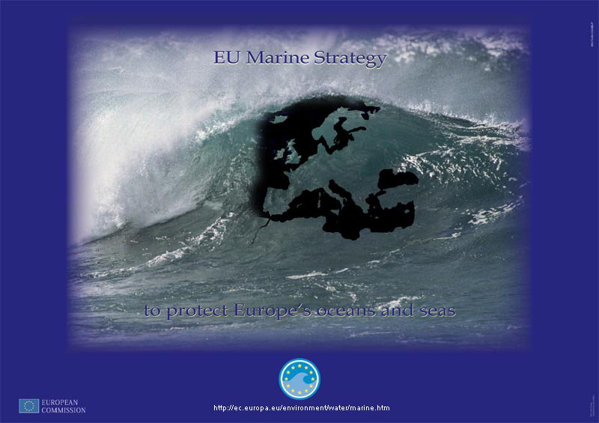
http://ec.europa.eu/environment/marine

