Slide 1
Common Information Sharing Environment
Enhancing maritime domain awareness and responsiveness in Europe
Call for proposals - ICT interoperability improvements at national level
Overview of national projects (2014)

Slide 2
Call for IT interoperability
Outline
Financial aspects
Objectives of the call
Types of activities
Criteria for selection
National projects
Conclusions

Slide 3
Financial aspects
Yearly calls for proposals opened to national authorities
European Maritime and Fisheries Fund (EMFF) for 2014-2020
Budget set aside to support the integration of maritime surveillance at national level and across MS

Slide 4
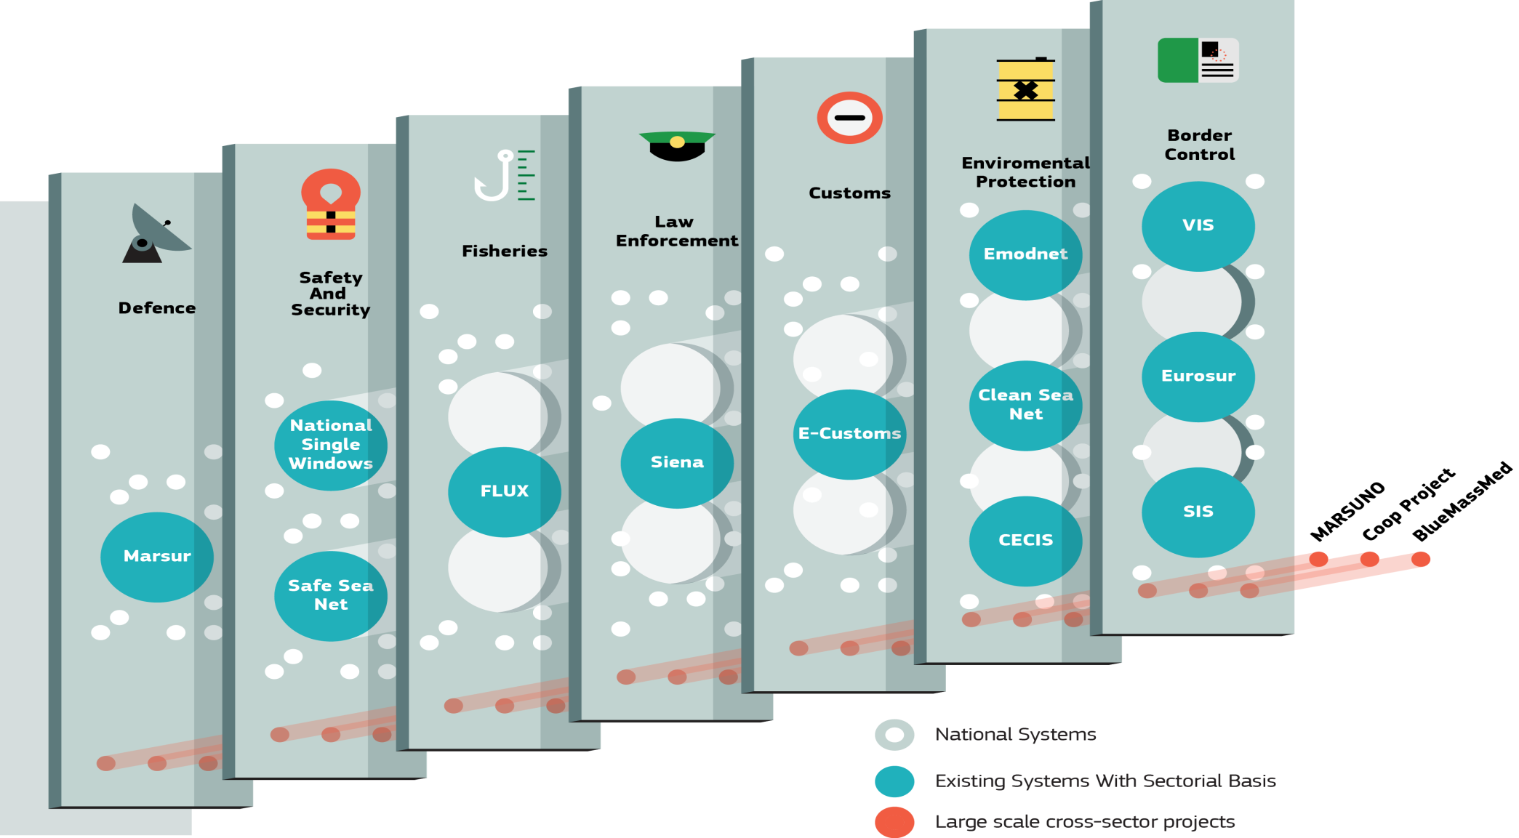
Call for IT interoperability
Objective of the call (2014)
Enhance the information exchange across sectors and borders by supporting the improvement of IT interoperability between national authorities’ systems

Slide 5


Call for IT interoperability
Types of activities
  Studies on systems interoperability improvements
  IT interoperability developments

Slide 6
Call for IT interoperability
Criteria for selection
Number of maritime sectors
Uptake of CISE interoperability solutions
Consistency and complementarity with existing EU and regional information exchange systems
Breadth of the data-exchanges (number of core data entities)
Justification of the expected added-value

Slide 7
Call for IT interoperability
National projects 2014
FiN CISE – Finland (study + IT developments)
Hellenic CISE – Greece (study + IT developments)
SAIS - Spain (study + IT developments)
SMACS IT2I - Spain (study + IT developments)
CISEROM – Romania (study)
501-YIN – Portugal (study)
602-SINKER – Portugal (IT developments)

Slide 8
National projects 2014
FiN CISE – Finland
Objective
Create a maritime situational picture and distribute it to the cooperative parties to support their activities
Partners
■ Finnish Border Guard ■ Navy■ Transport Safety Agency ■ Finnish Transport Agency ■ Finnish Environment Institute
Outputs
Enterprise architecture
National requirements
A service channel to connect databases
Interface solution(s) for system-to-system sharing
Pilot-case to connect legacy systems - first nationally and then to the EUCISE interface

Slide 9
National projects 2014
Hellenic CISE – Greece
Objective
Achieve an Integrated National Maritime Surveillance Awareness and an Enhancement of Cross Border Exchange of Information Capabilities
Partners
■ Hellenic Ministry of Defence (Navy) ■ Coast Guard ■ Demokritos Institute
Outputs
Situational Picture Manager for the HCG
CISE adaptors - Interface between legacy systems & CISE node
Use cases for national cross-sectorial information exchange
Fusion and data mining tools

Slide 10
National projects 2014
SAIS - Spain
Objective
Develop an IT system to support the exchange of surveillance information among national authorities and provide interoperable interface to exchange information with European maritime authorities
Partners
Ministry of Interior - Guardia Civil (4 sectors)
Outputs
Maritime information platform to publish information services
Web-based capability to create, manage and use the maritime information services
Interoperability and extension capabilities for the integration of services
Real-time cross-border information exchange

Slide 11
National projects 2014
SMACS IT2I - Spain
Objective
Improve cross-sectorial exchange between three ops centres by developing a new service layer associated to existing systems
Partners
■ Spanish Customs Agency ■ Fisheries Control Agency ■ Navy
Outputs
Cross-sectorial data exchange service oriented architecture
Legacy system adaptation
Software design and development
Organisational interoperability

Slide 12
National projects 2014
CISEROM – Romania
Objective
Design the most suitable integrated technical solution for implementation of CISE in Romania (CISEROM)
Partners
■ Romanian Border Police ■ Naval Authority ■ National Agency for Fishery and Aquaculture
Outputs
Definition of a solution to facilitate the control, management and fusion of data
Interface definition to exchange data between the national CISEROM and the existing maritime IT systems
Definition of services to be used

Slide 13
National projects 2014
501-YIN – Portugal
Objective
Diagnose the current maritime surveillance information sharing status and define the next steps to improve it.
Partners
13 - ■ DGPM ■ AT ■ DGAM ■ DGRM ■ DGT ■ FAP ■ GNR ■ GPIAM ■ IPMA ■ MP ■ PJ ■ PM ■ PSIS
Outputs
Specifications for a common technological solution for maritime surveillance information sharing
Gaps and cost-benefit analysis
Legal framework study
Legal handbook for info sharing
Technological architecture for info sharing
National action plan for info sharing

Slide 14
National projects 2014
602-SINKER – Portugal
Objective
Develop technological capabilities to make available, at the national node of CISE - NIPIM@R, information services which can be used among the involved authorities
Partners
7 - ■ DGPM ■ DGAM ■ DGRM, DGT, MP, PJ, PSIS
Outputs
Fisheries control services - 3
Nautical leisure boats services - 4
Marine pollution services - 4
Marine environment and fisheries services - 4
Coastal and maritime risks services - 4
Police investigation support services - 1

Slide 15
Call for IT interoperability
Conclusions
Concrete national actions:
  In-depth studies/evaluations (6)
  Identification of operational needs (5)
  Design national nodes (3)
  Definition of added-value information services (4)
  Improvement of cross sector organisation (4)
  Study on legal interoperability (1)
  Impact of CISE specification on existing systems (3)
  Definition of a complete technical architecture (1)
  Definition of piloting projects (2)
  Sectors covered: 3 – 7

Slide 16
Call for IT interoperability
Conclusions
Concrete national actions:
  Build-up and test advanced IT solutions (5)
  Development of national node(s) (2)
  Development of CISE adaptors (4)
  Information service development and testing (3)
  Development of specific interfaces (4)
  Enhanced maritime situational picture (1)
  Correlation/fusion/data mining technologies (1)
  Publication platform to other administrations (1)

Slide 17
Call for IT interoperability
Conclusions
Significant uptake of CISE interoperability solutions
(CISE data and service models, hybrid architecture…)
Complementarity and consistency with EU and regional systems

Slide 18
Information on the 2015 Call for Proposals
  Timelines
  Publication November 2015
  Deadline for applications: end March 2016
  Signature of grants September 2016
  Eligible activities
  studies identifying needs and requirements for the improvement of cross-sectoral information exchange
  ICT interoperability developments of national surveillance systems

Slide 19
Guidelines on the 2015 call for proposals
  Ineligible activities
  Projects covering less than three sectors
  Studies and ICT developments aimed to fulfil the requirements of any EU legislation for the maritime domain.
2016 Call for proposals
Focus on information services (development and implementation)

Slide 20
Thank you for your attention

