Slide 1
WaveFarm
Matthew Pech
08 March 2023

Slide 2
AW-Energy
WaveFarm Project
BlueInvest Day 2023

Slide 3
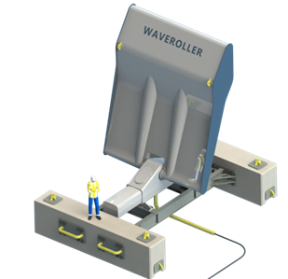
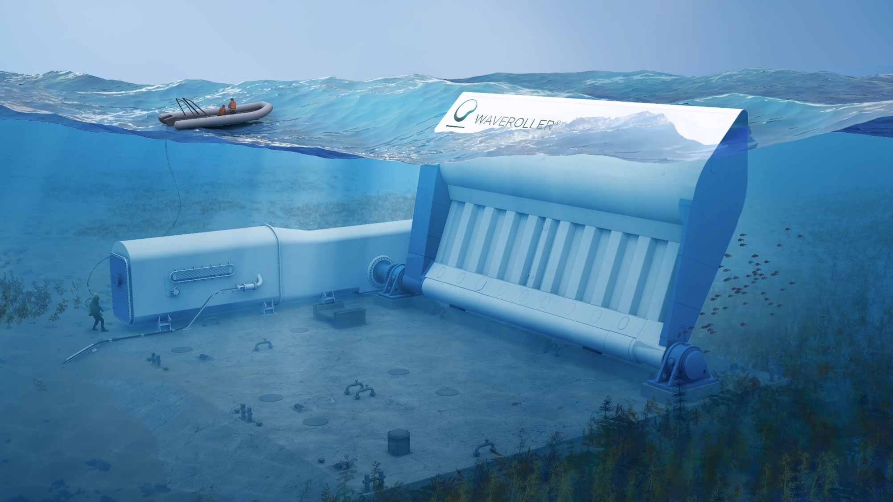
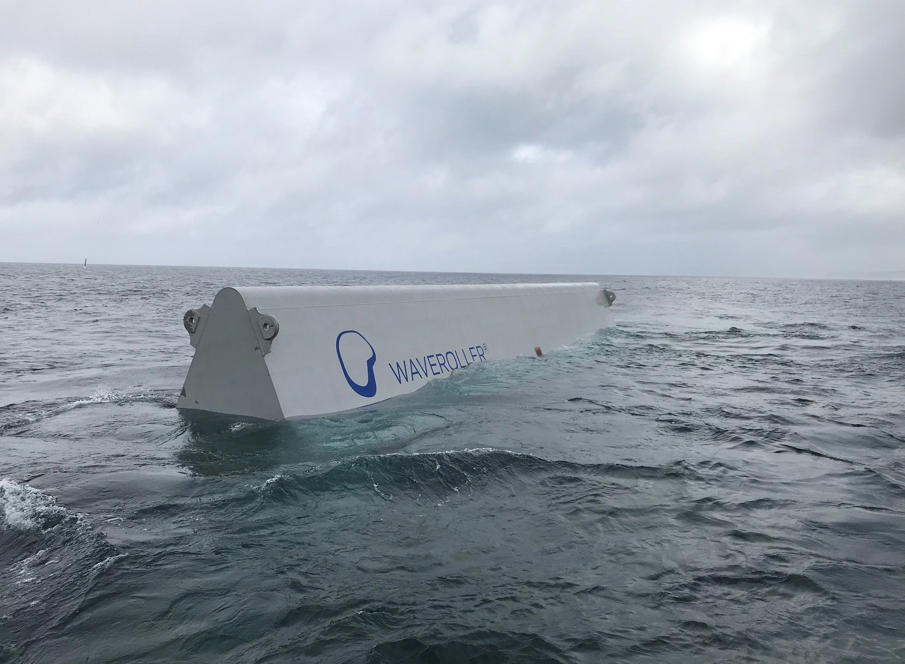
Our Solution: WaveRoller®
Unique & patented technology that captures and converts wave surge energy into electrical power
■ Panel Forced back-and-forth by the strong wave surge force
■ Power-Take-Off (PTO) converts and stores energy captured by the panel, transmitted to shore as smooth electricity
■ Control system smart, responsive system that optimises energy yield and meets grid code
3

Slide 4
WaveFarm Project
Preparing AW-Energy to delivery first large-scale WaveFarm
Technical Objectives
WaveRoller structural design adapted for WaveFarms
WaveFarm layout design & grid integration design complete
WaveFarm batch manufacturing, delivery and deployment process planned
Commercial Objectives
Roadmap for market replication and global sales developed
Business model for new lifecycle services developed
Template EPCM contracts, warranty and operations manuals created
4

Slide 5
Post-Grant Financing Strategy
Three strategic areas to secure future financing
Commercial Sales
Continued dialogue with customers to develop deployment locations
Revised product portfolio to create easier entry to market
Strategic Investors
Curating existing relationships with potential investors
Approach new investors with good strategic fit
Participation in events which allow outreach to new investor groups
Other EU or similar grant funding
Monitoring opening of grant calls, checking alignment with strategic direction
Networking to increase awareness of new funding channels
5

