Slide 1
SETIPWind
04 October 2022
Funded by the European Union. Views and opinions expressed are however those of the author(s) only and do not necessarily reflect those of the European Union or CINEA. Neither the European Union nor the granting authority can be held responsible for them.
Iván Pineda
Director of Innovation, WindEurope

Slide 2
SETIPWIND: Administrative name of the EU-funded project ETIPWind: Public name of the platform

Slide 3
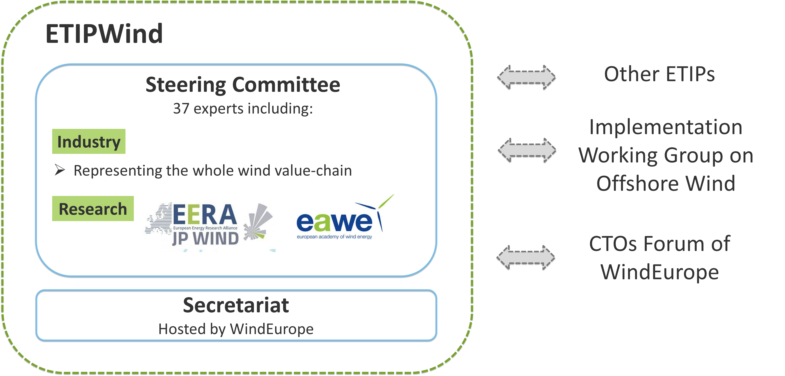
What is ETIPWind?
European Technology & Innovation Platform established in 2016.
Initiated by the European Commission in the framework of the SET Plan.
Industry and research experts who provide policy and research recommendations to the European Commission and advocate for a faster deployment of wind energy in Europe.

Slide 4
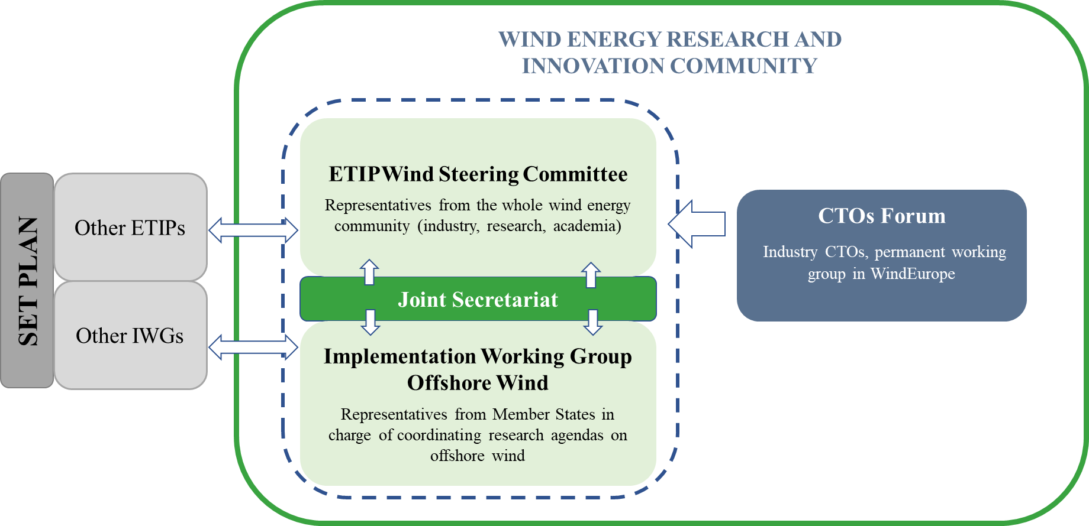
ETIPWind structure
Executive Committee -> Steering Committee
Advisory Group -> CTOs Forum

Slide 5
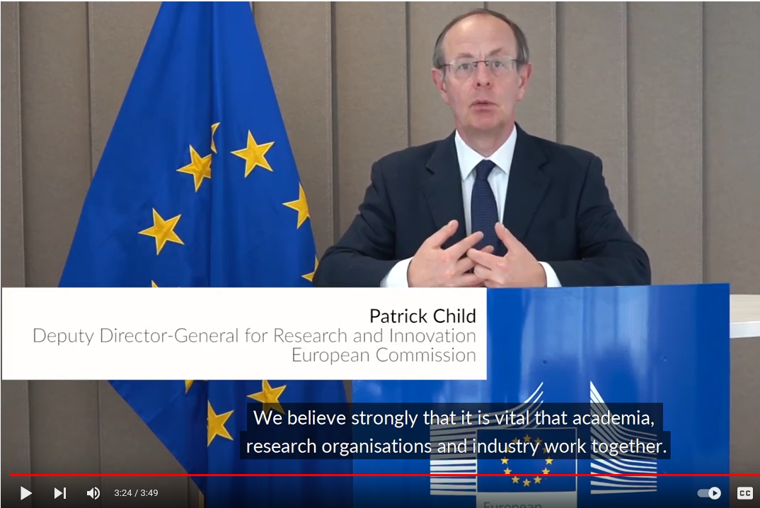
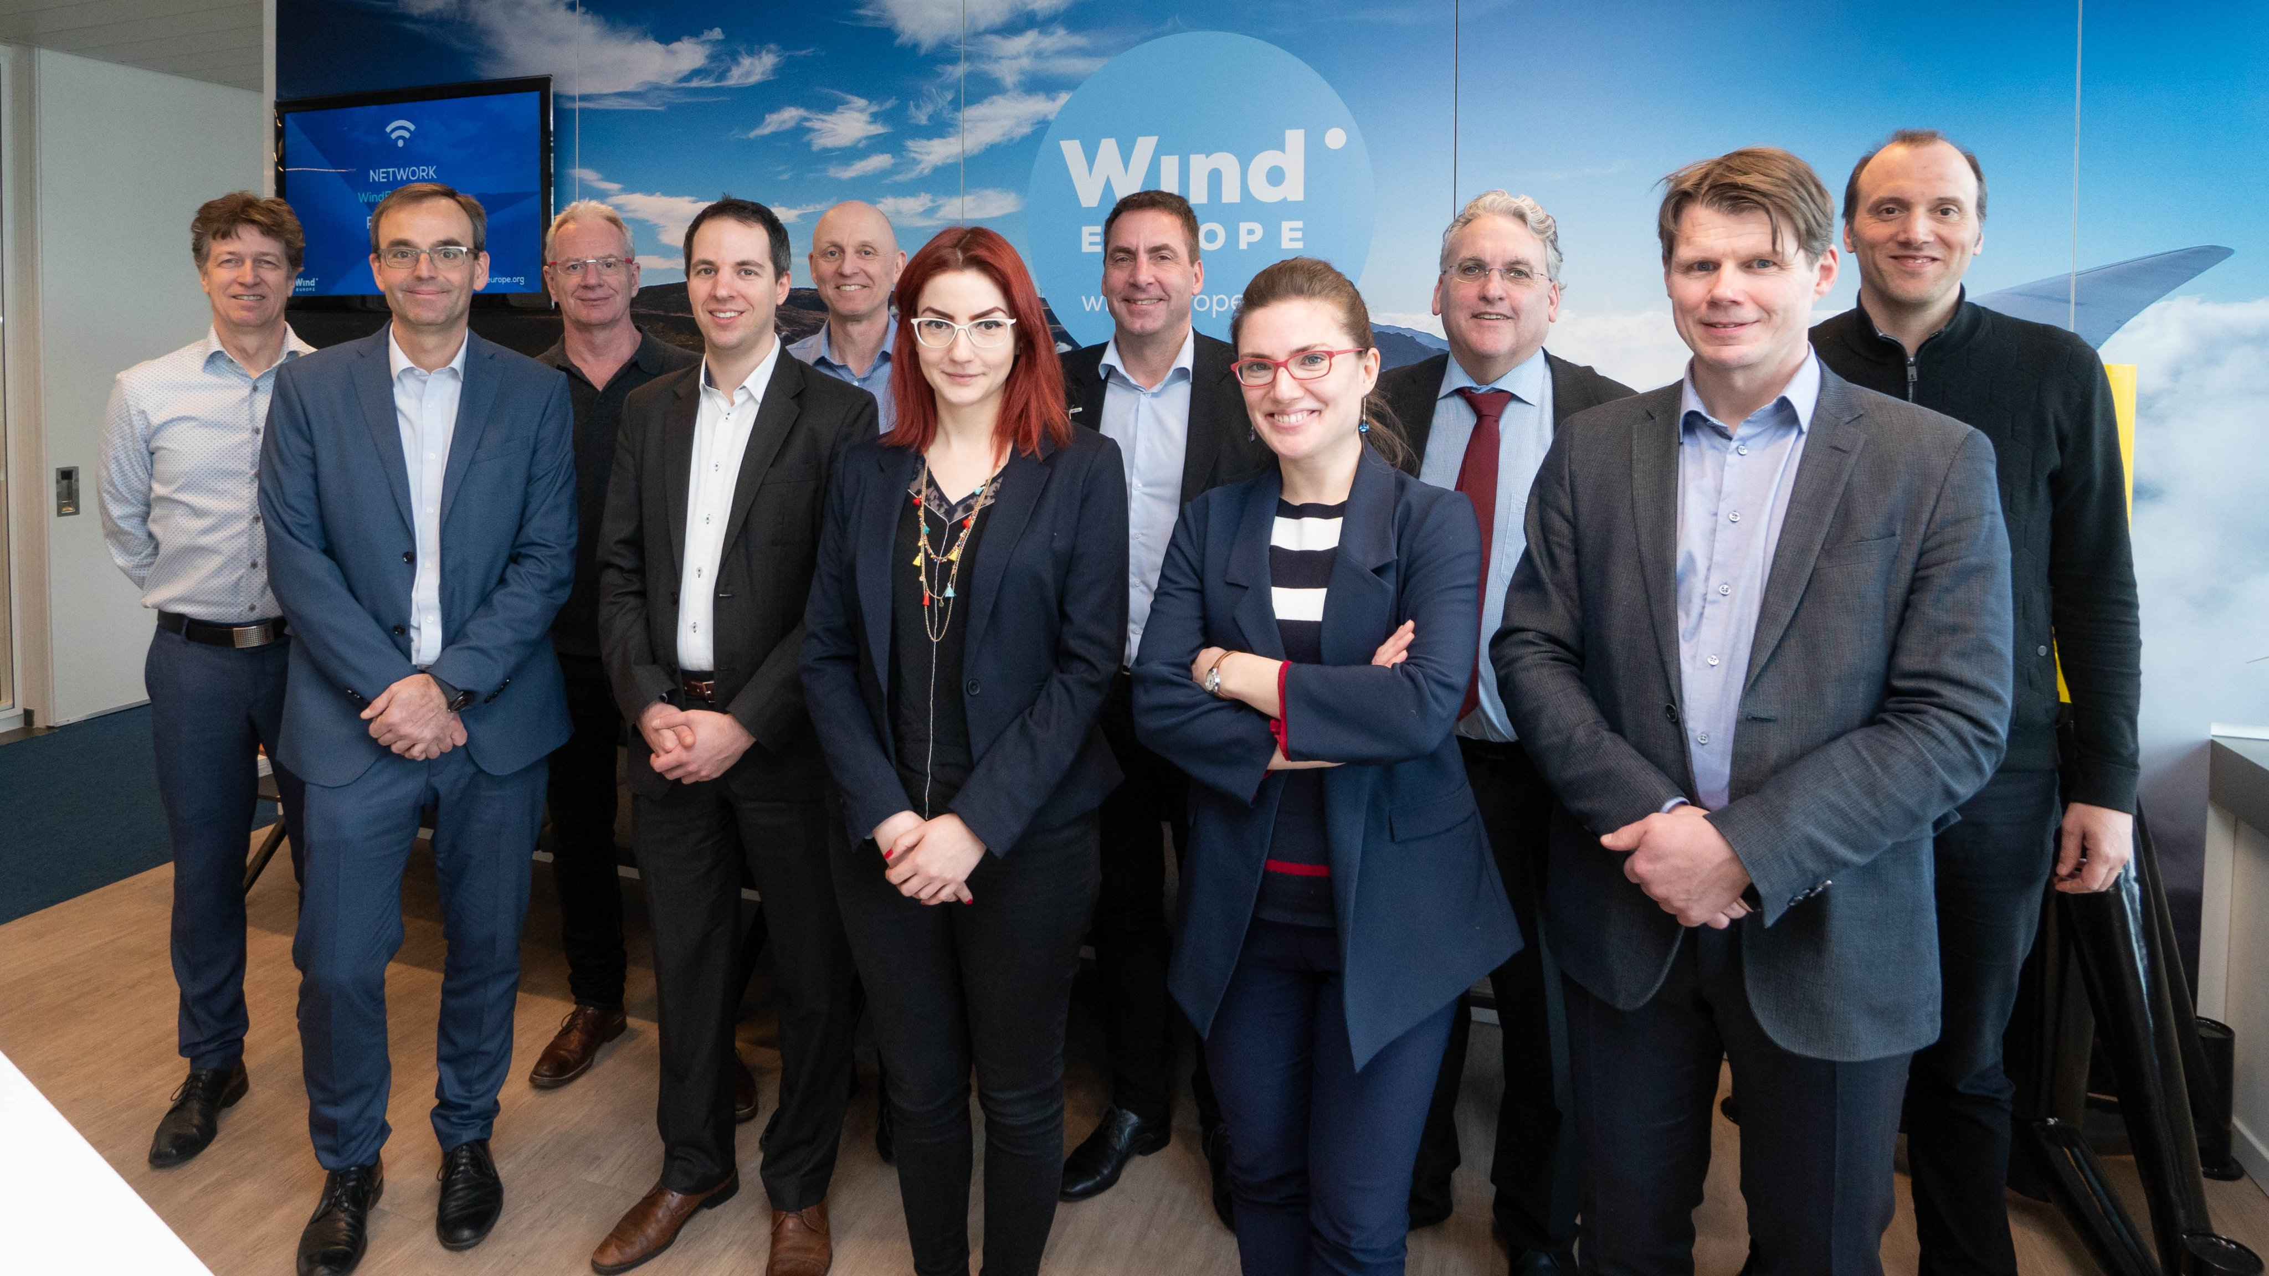
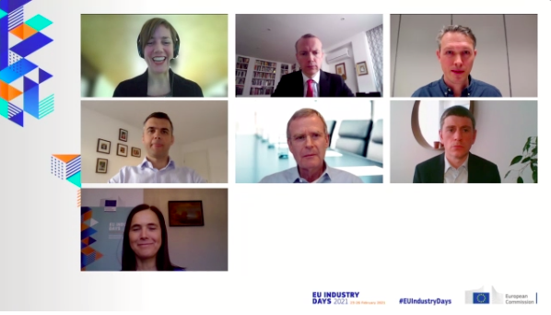
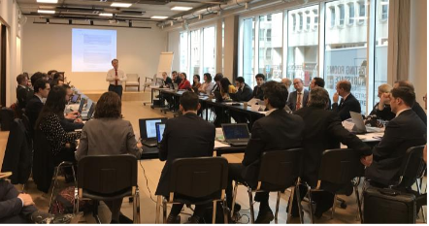
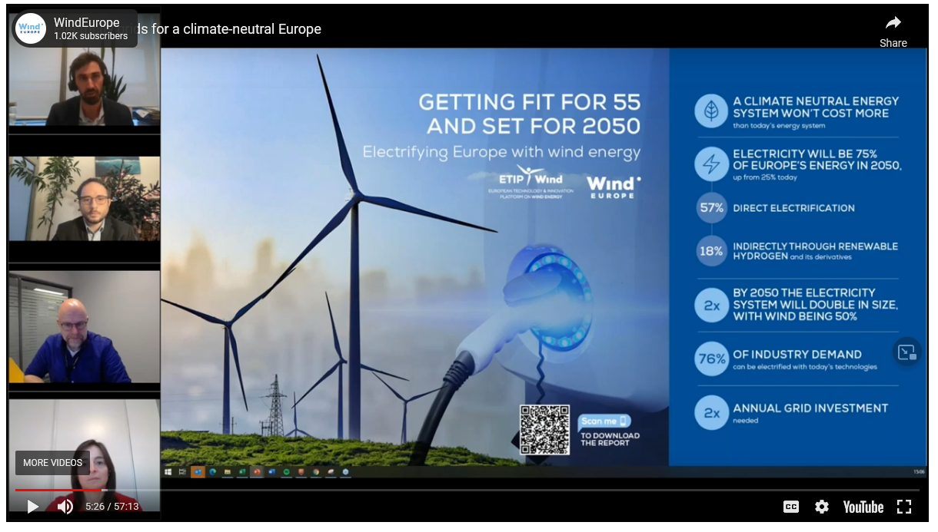
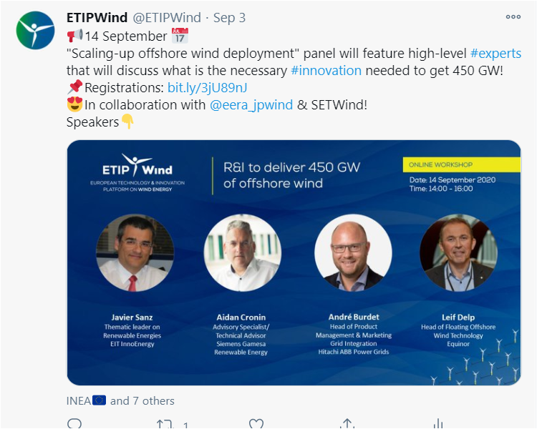
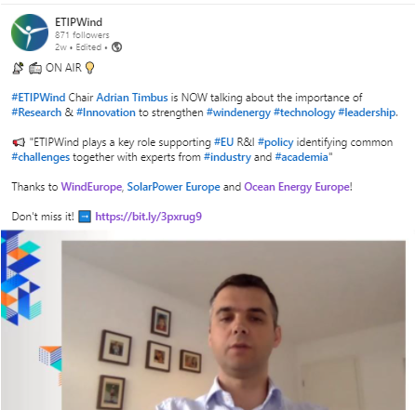
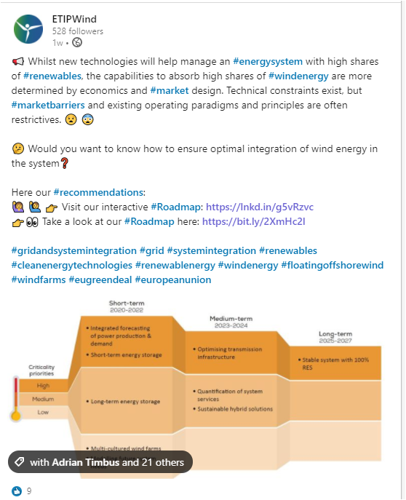
ETIPWind key activities
COLLABORATIONS
MEETINGS
WORKSHOPS & EVENTS
PUBLICATIONS
COMMUNICATION ON INDUSTRY’S PRIORITIES
Notes:
MEETINGS:
-With Steering Committee
-With IWG on Offshore Wind
-With national and EU policy makers
PUBLICATIONS:
-ETIPWind roadmap
-Fort for 55 and set for 2050
-Floating offshore wind
-SRIA
-How wind is going circular…
WORKSHOPS & EVENTS:
-In previous period:
Workshops: Six organized, 1,008 participants, 740 video views
Webinars: Three organized, 697 participants, 843 video views
COLLABORATIONS:
-In previous period:
Joint activities: 51 activities, 8 IWG meetings, ETIPSNET, IEA wind, IF expert group, …
Meetings: 43 high-level meetings, 35 policy-level meetings

Slide 6
ETIPWind Roadmap
Notes:
6 main pillars:
-Grid & System Integration
-Operations & Maintenance
-Next General Technologies
-Offshore balance of plant
-Floating offshore wind
-Skills & human resources
-> This roadmap will be updated.

Slide 7
Key objectives driving the ETIPWind Work Programme
Provide timely and targeted R&I recommendations to the European Commission
Engage with national policy makers to ensure measures are implemented at national level
Disseminate the industry’s R&I priorities and raise awareness about R&I needs for wind
Foster collaboration with other SET Plan bodies and align with other sectors
Ceate a European knowledge hub for wind R&I
Widen participation to ETIPWind’s governance and ensure representativeness
Develop a finance and sustainability plan for the platform

Slide 8
Overview of the ETIPWind Work Programme (2022-2025)
2022
2023
2024
2025
EU milestones
EU elections
New College
Draft NECPs
EC
assess
Final NECPs
Horizon Europe WP 2023-24
Horizon Europe Strategic Plan
Horizon Europe WP 2025-27
ETIPWind Publications
Updated SRIA
Technology Roadmap
Fact
sheet #1
Fact
sheet #2
R&I
Stats
R&I
Stats
R&I
Stats
Kick-off
Event
SRIA Event
Event new Inst.
Final Event
Events and collaborations
Workshop #1
Workshop #2
Workshop #3
Joint ETIP activities
Joint ETIP activities
Joint ETIP activities
Joint ETIP activities

Slide 9
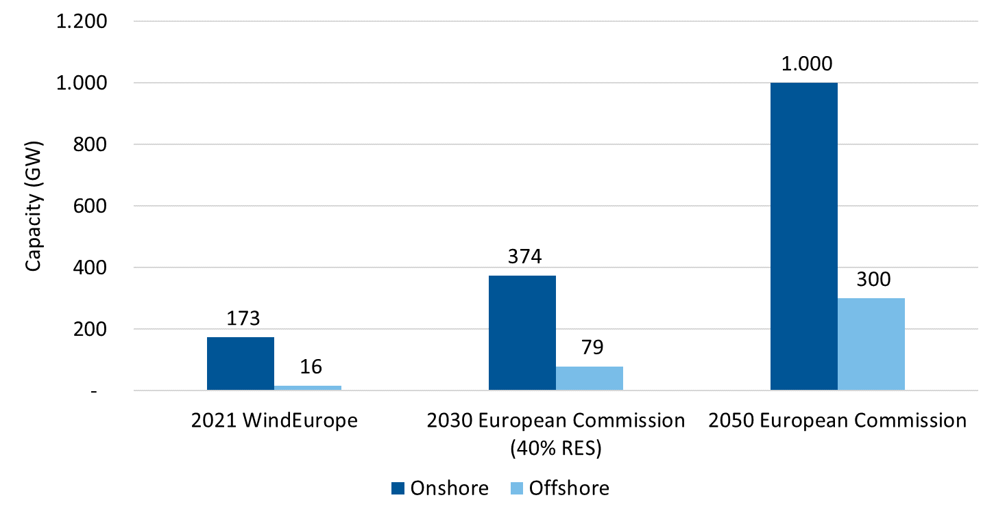
Huge increase in wind capacity coming
+60 GW
(45% RES)
EU-27. Source: WindEurope, 2030 & 2050 EC ALLBNK (2030 Impact Assessment)
Notes:
The EU is now asking for 510 GW of wind by 2030. That’s 39 GW a year of new wind that we have to build between now and then.

Slide 10
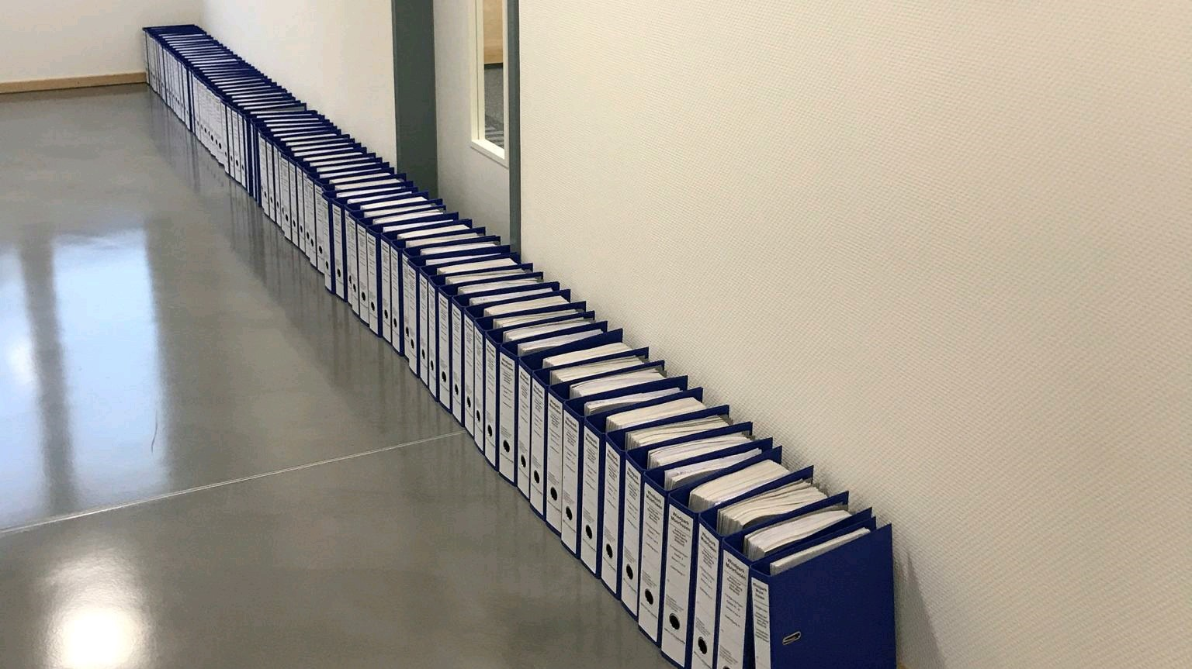
The wind industry is facing several challenges
Raw materials dependency and supply-chain bottlenecks
Permitting rules
RES-based electrification
Notes:
-> Research should align with those challenges and help finding new solutions:
1)Permitting rules:
-Digitalisation solutions and co-existence measures for wind energy with nature and society
2)Raw materials dependency and supply-chain bottlenecks:
-Innovations to increase circularity (recycling, re-purposing, composite, new materials, …)
3)RES-based electrification:
-New solutions to help electrifying industry, households, transport and other sectors; to upgrade our energy system (grids & infrastructure) and make it more resilient.

Slide 11
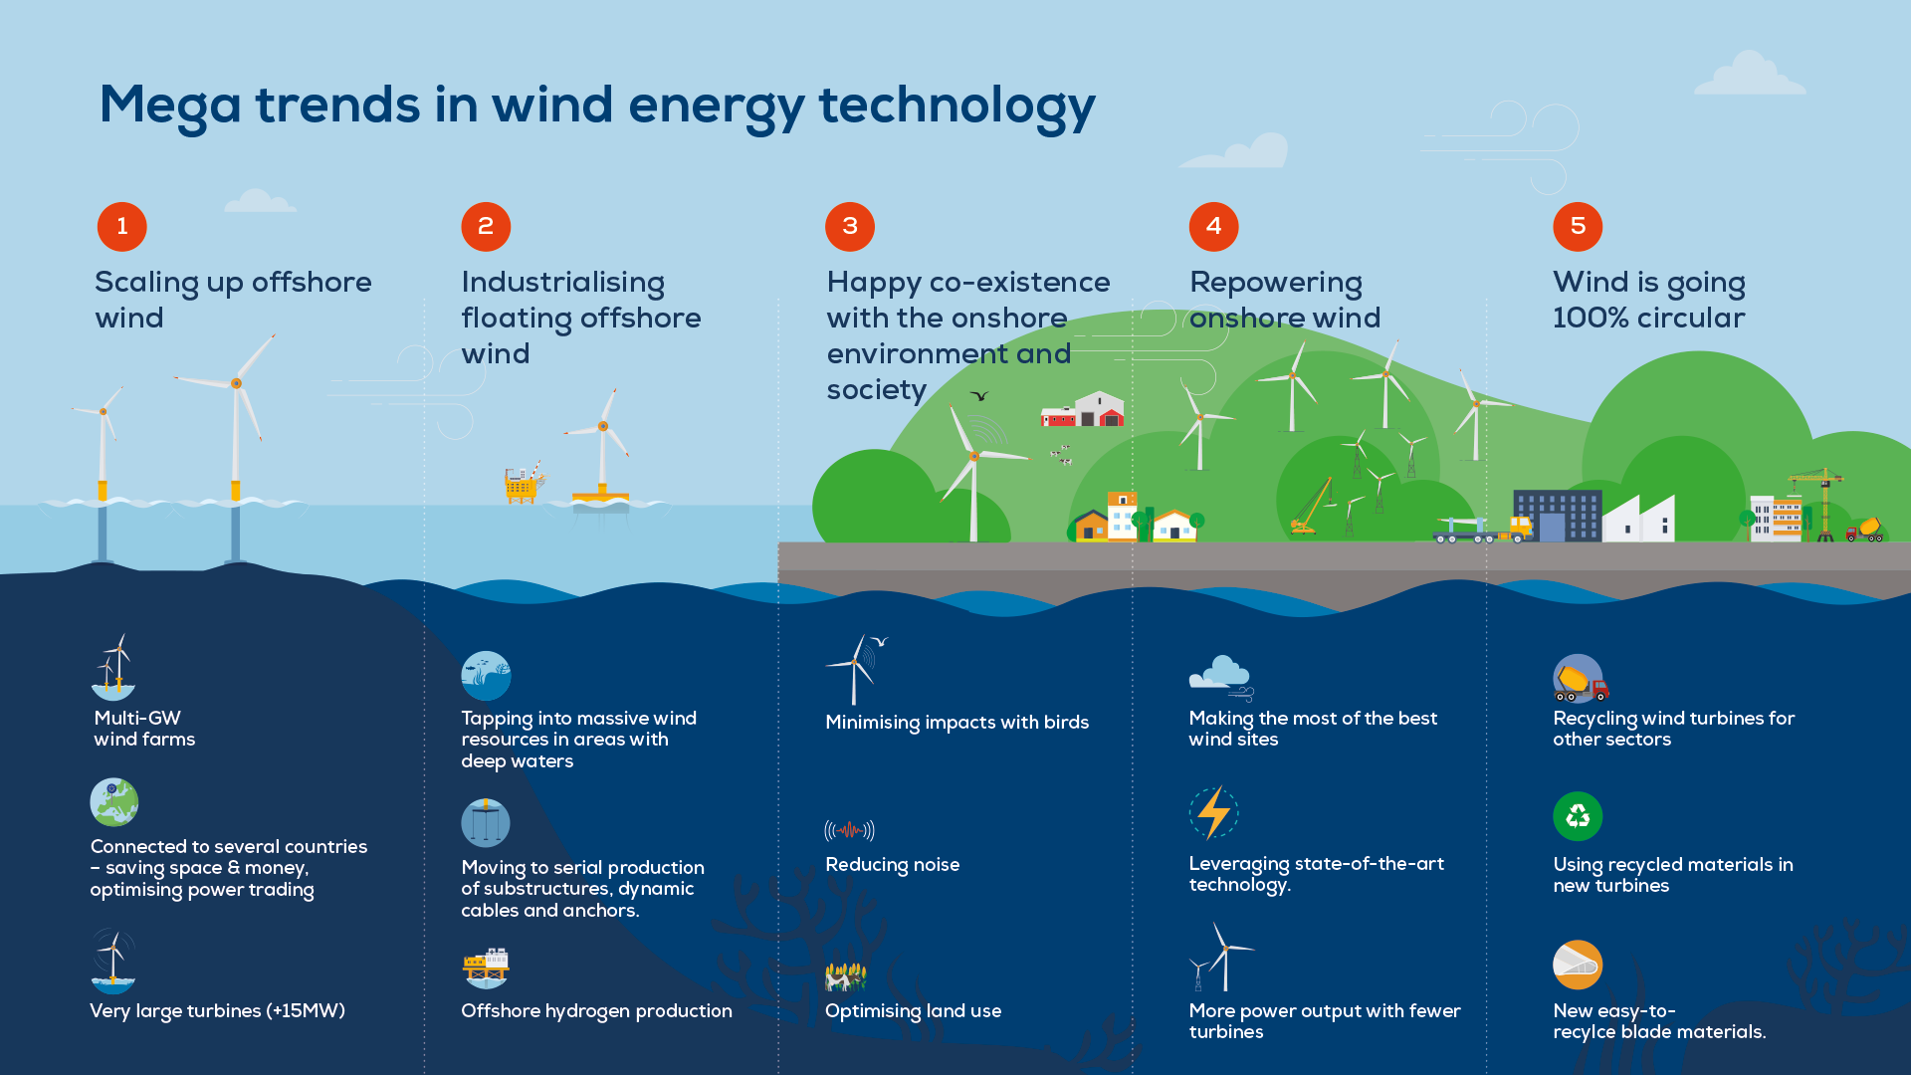
Developing new solutions but also supporting acceleration of wind energy development
Notes:
Mega trends infographic shows there is space to develop new solutions.
But 80% of the efforts need to be on development of current solutions to accelerate wind power deployment.

Slide 12
Developing new solutions but also supporting the acceleration of wind energy development

Slide 13
How can you involve in ETIPWind?
Join us at our events & workshops
Provide your input and feedback on our publications
Follow us on social media
Subscribe to our newsletter to get updates on wind energy R&I and activities of the platform

Slide 14
Thank you! Contact: secretariat@etipwind.eu

