Slide 1
Annual Forum of the EUSBSR and the revision of the EU Strategy for the Baltic Sea Region (EUSBSR)
DG REGIO – D1 Competence Centre Macro-Regions and European Territorial Cooperation
Notes:
The Annual Forum this month in Jurmala Latvia marked the completion of a comprehensive review of the Strategy's Action Plan which the Commission carried out with the concerned Member States and other stakeholders in 2014 and early 2015.

Slide 2
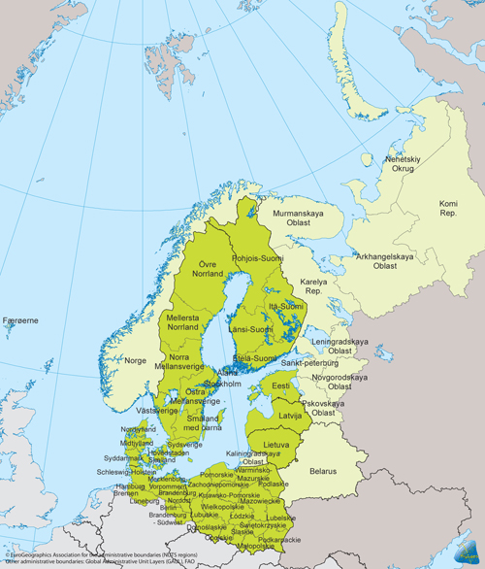
EU Strategy for the Baltic Sea Region
First macro-regional strategy in the EU (set up 2009);
8 EU member states; 85 million people (17% of EU population)
Better and more effective use of existing policies, funding, institutions and legislation
Three objectives: "Save the Sea", "Connect the Region", "Increase Prosperity"
Notes:
EUSBSR was the first macro-regional strategy in the EU (set up in 2009). Eight member states participate with a population of 85 million people. The aim was and is better and more effective use of existing policies, funding, institutions and legislation. It had – and still has three objectives: "Save the Sea", " Connect the Region" and "Increase Prosperity".
Today, we have three macro-regional strategies in addition to the EUSBSR - we have the Danube (or EUSDR) and the Adriatic (EUSAIR). One is in the making Alps (EUALPS) which is the first macro-regional strategy which is not centred on some "water way".

Slide 3
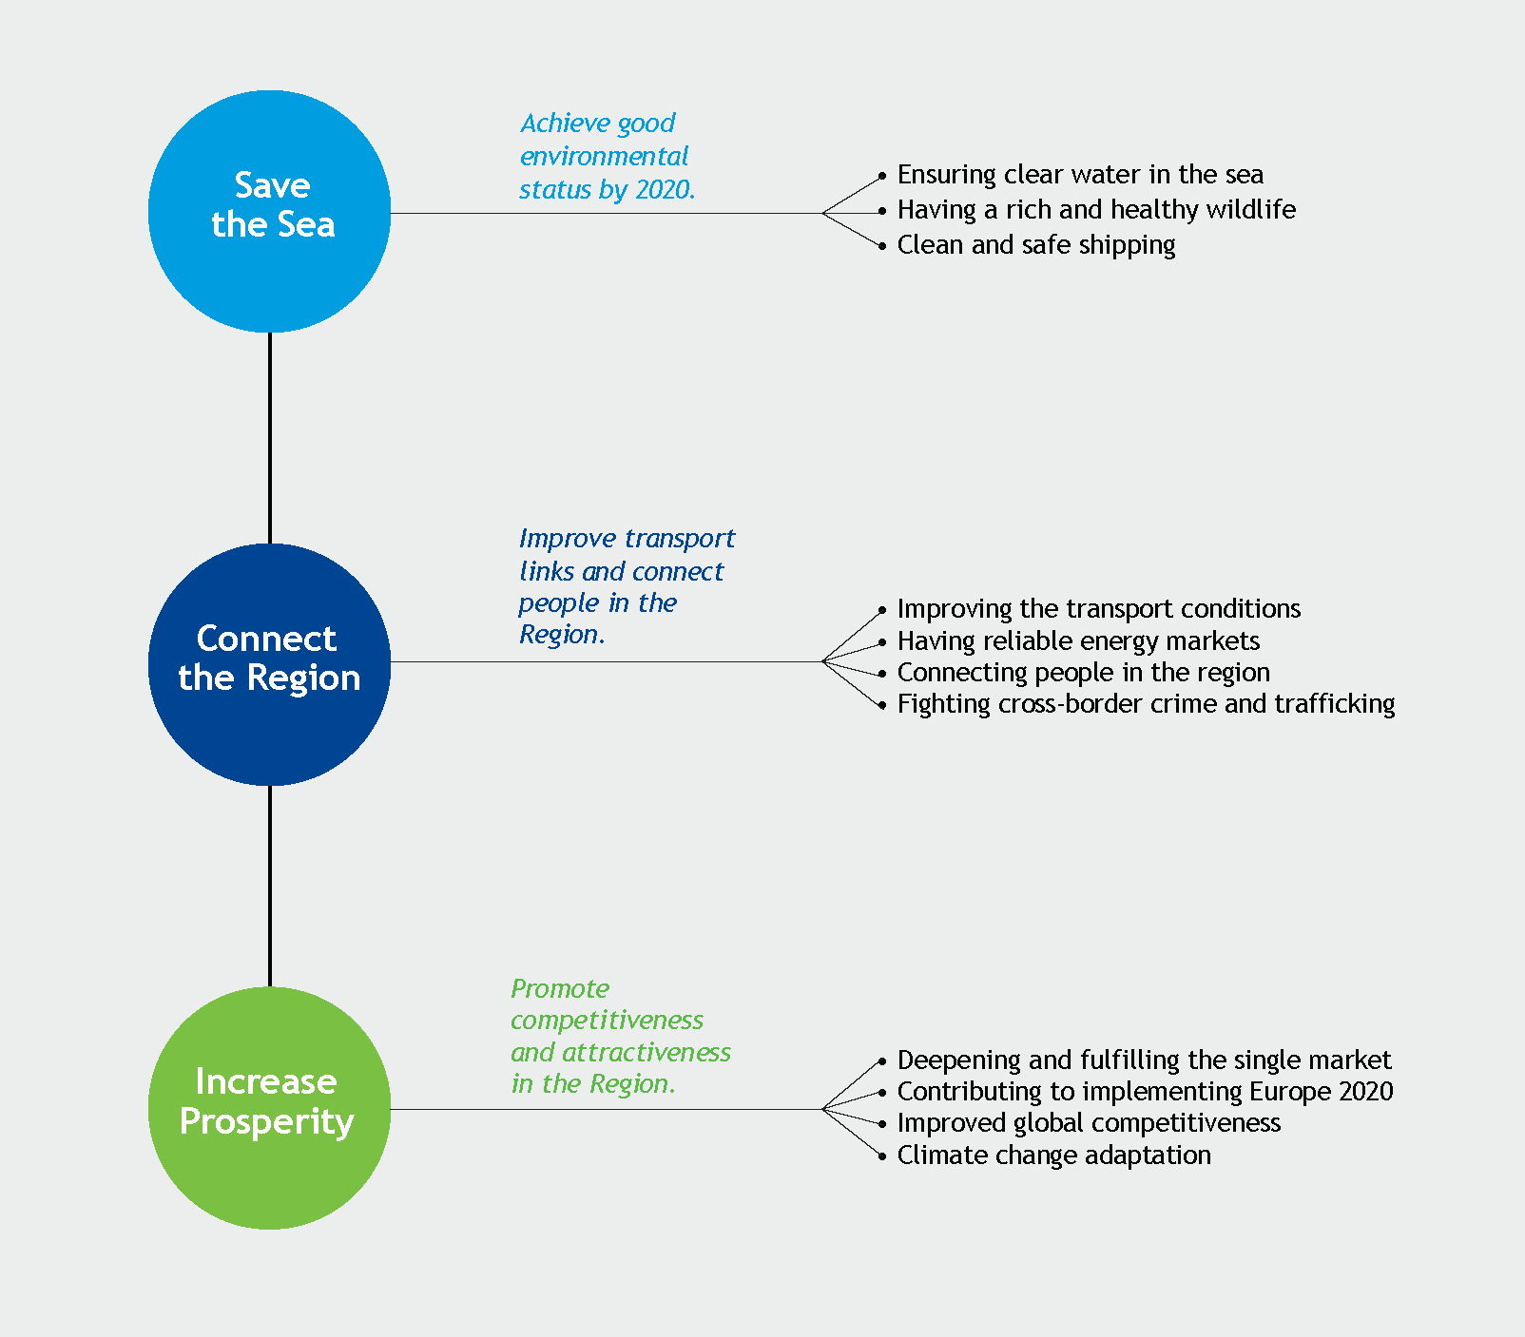
Objectives and sub-objectives
Notes:
The EUSBSR have three objectives and a set of sub-objectives. The objectives are:
Save the Sea
Connect the region
Increase Prosperity
To each set of objectives there is tied a set of sub-objectives.
The overall aim of "Save the Sea" is to achieve good environmental status by 2020. The sub-objectives of the "Save the Sea" are:
Clear water in the sea – address the eutrophication of the Baltic Sea (and its lakes)
Rich and healthy wildlife – preserving the eco system of the Baltic Sea
Clean and safe shipping – clean and safe shipping is becoming essential for the region

Slide 4
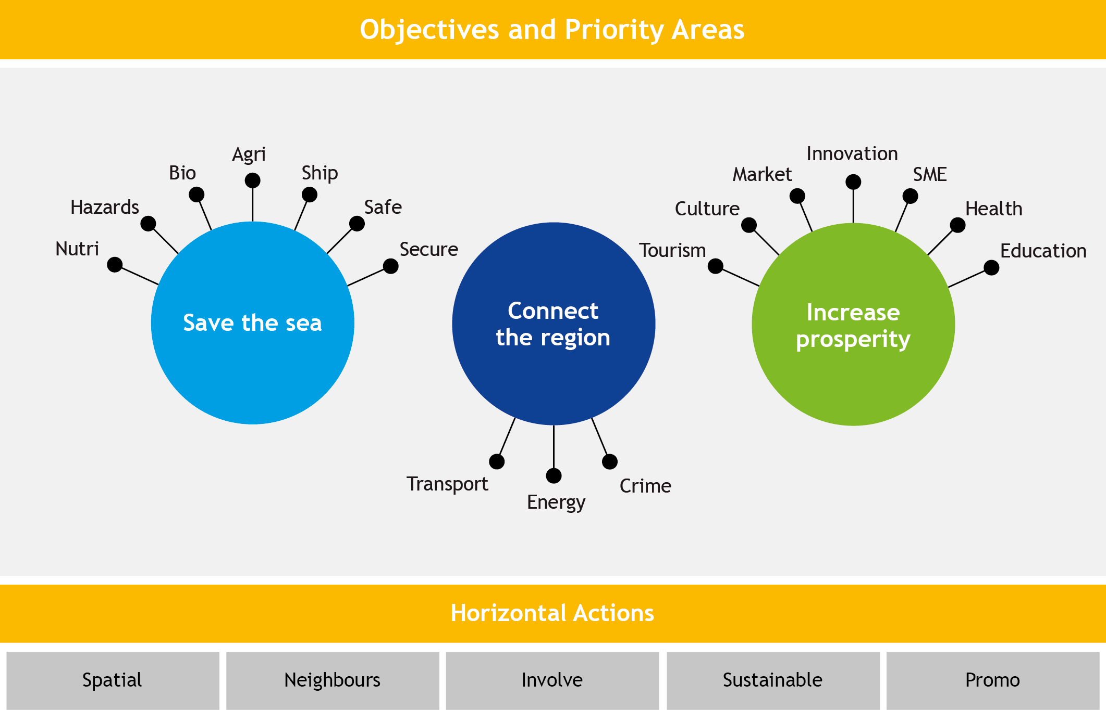
Objectives, priority areas and horizontal actions (pre-review)
Notes:
Policy areas and horizontal actions are not tied to objectives anymore

Slide 5
Expected results (examples):
Reduction/decreasing trend in the number of shipping accidents
Elimination of illegal discharges by 2021
Improved environmental status, e.g. reduced nutrient inputs by 2021
Increased innovation capacity/performance for each country by 2020 (as measured by Innovation Scoreboard)
Achievements:
Mobilisation of projects across borders (120 Flagship projects)
Increased knowledge and joint initiatives
Better coordination of existing networks: Strategy as reference point
Involvement of neighbouring non-EU countries
Better implementation of EU legislation
Notes:
An overview of the expected results of the EUSBSR and some achievements

Slide 6
Why a review of the Strategy?
To streamline and focus
To re-confirm sustained commitment
To update and re-align the work programme
To achieve synergies/avoid overlaps with existing networks
Review process:
Individual screening/interviews of all 22 policy areas
REGIO Discussion paper (analysis)
Consultation with geographical units and interservice meeting with DGs
Extensive discussions and agreement with National Coordinators
Request for revision/update of each policy area
Endorsement at 'Macro-regional High-level Group' (3 June); Annual Forum in Latvia (15/16 June)
Notes:
With the review we wished to concentrate and focus better on the three objectives of the strategy - an extensive consultation with Member States concerned and stakeholders in the Baltic Sea Region was carried out in 2014 and early 2015. It is – now – more streamlined and focused. It also includes a chapter on the role of regional organisations/networks.

Slide 7
Results of the Strategy review
More focus on a reduced number of areas (from 22 to 17)
Updated work programme of all policy/horizontal areas
Clarification on the role and added-value of regional organisations (new chapter)
Simplification of procedure and clearer scrutiny for Flagship projects (template)
Clarified governance: e.g. 'National Coordinators', 'Policy Areas'
Voluntary rotation of coordination responsibilities for the policy/horizontal areas ( e.g. 3 years)
Notes:
Result of the revision:
More focus on a reduced number of areas (from 22 to 17)
Updated work programme of all policy/horizontal area
Clarification on the role and added-value of regional organisations
Simplifications of procedure and clearer scrutiny of Flagship

Slide 8
Challenges
Creating stronger links between Strategies and programmes
Using all funding sources available
Communicating results
Notes:
This Action Plan now comprises of 13 Policy Areas and 4 Horizontal Actions – which represent the main areas where the EUSBSR can contribute to improvements, either by tackling the main challenges or by seizing key opportunities of the region. Typically, one member State coordinates each policy area or horizontal action, and they work on its implementation in close contact with the Commission and all stakeholders i.e. other Member States, regional and local authorities.
They need to ensure that the Action Plan is consistent with all EU polices, and in particular Europe 2020 strategy as well as the Integrated Maritime Policy with its Blue Growth Strategy.

Slide 9
The maritime dimension of the EUSBSR
The EUSBSR has a strong maritime dimension
One objective is called "Save the Sea"
Policy areas like "Ship" , "Safe" and "Nuri" and "HA Spatial Planning" are focused on maritime issues or industry
EUSBSR has a strong focus on the environment, but it offers a good basis for further development of initiatives in areas such as shipping, surveillance and preservation of marine environment
Notes:
The EU strategy has a very strong maritime dimension – one of the objectives is called "Save the Sea". Many of the policy areas and horizontal actions have a strong maritime focus.
EUSBSR has a strong focus on environmental issues, but is laying the foundation or help establish a good framework for economic development based on maritime industry. The work under (launched) EUSBSR offers a good basis for further development of initiatives in areas such as shipping, surveillance and fisheries management.
Activities such as coastal tourism, fisheries and aquaculture are highly depended on a healthy environment and a clean sea
The maritime industry has the opportunity to become leading in clean maritime industries like alternative fuels, provision of green port facilities and efficient shipping. The work with LNG have the potential, I am told, to set standards for short sea shipping.
Coastal environmental monitoring and surveillance are economic activities in the their own right
.

Slide 10
PA SAFE to become leading region in maritime safety and security
Actions
Develop co-operation in maritime surveillance and information exchange
Ensuring safe navigable fairways by improving resurveying of shipping routes
Improve safety of navigation by means of e-navigation and new technology
Winter navigation
Enhancing the safety of oil, hazardous and noxious substances
Ensure that crews serving on-board vessels are well trained
Develop preparedness for emergency situations
Notes:
The primary aim of the policy area is for the Baltic Sea Region to become a leading region in maritime safety and security, thereby i.e. contributing to reducing risk of maritime accidents in the Baltic Sea but also help develop new products and services on the back of this.
Actions
Develop co-operation in maritime surveillance and information exchange
Ensuring safe navigable fairways by improving resurveying of shipping routes
Improve safety of navigation by means of e-navigation and new technology
Winter navigation
Enhancing the safety of oil, hazardous and noxious substances
Ensure that crews serving on-board vessels are well trained
Develop preparedness for emergency situations

Slide 11
PA Ship – Becoming a model for clean shipping
Actions
To create infrastructure for alternative fuels in the Baltic Sea Region
To support measures reducing emissions from ships
To develop shore-side facilities to foster clean shipping measures
Notes:
Maritime traffic in the Baltic Sea is important but there is also a need to act jointly to minimise ship based pollution. PA Ship focuses on - as supplement to other work being done in the region - project-based policy dialogue and to develop projects to address policy objectives
PA Ship as PA Safe address the overall objectives of the Strategy
Actions
To create infrastructure for alternative fuels in the Baltic Sea Region
To support measures reducing emissions from ships
To develop shore-side facilities to foster clean shipping measures
For example the policy area has supported three projects on development of infrastructure and value chain of LNG in the Baltic Sea Region

Slide 12
Links
European Union Strategy for the Baltic Sea Region
https://www.balticsea-region.eu
Policy area "Ship" and "SAFE"
https://www.pa-safe.dma.dk

