Slide 1
JRC activities in support of CISE development
Technical Advisory Group
18th November 2015

Slide 2
Main activities
Support to EUCISE 2020
Maintenance of the CISE data model and service model
CISE Handbook
Experimentation platform (Test-Bed)
Notes:
Should we add the activities linked to the TAG? (secretariat of the TAG) – this is quite obvious

Slide 3
Support to EUCISE 2020
  Background documents and lessons learned from previous project
  Specific studies (e.g. Access Rights management and Security)
  Maintain the CISE data and service model
  Participation to technical workshops:
    eSens
    Security
  Participation to Work Package work
  Review of documents from WP3, WP4 and WP5 and requirements
    Coherence with CISE hybrid vision
    Coherence with CISE data and service model and past lessons learned on technical aspects
Notes:
should we describe the agreement with EUCISE…

Slide 4
Maintenance of the CISE data and service model
Baseline: CISE Data and Service Model from the CoopP
Updated with the Incubator project (2014) lessons learned
Type of updates to the Data Model:
    On request from WP4: to modify the MeteoOceanographicCondition entity, to deal with PollutionIncident, documents of type Stream, etc…
    Clarification of the documentation for better integration into EUCISE 2020 requirements
  Type of updates on the service model:
    Clarification of the documentation for better integration into the EUCISE 2020 requirements

Slide 5
CISE Handbook
Creation of the website (inc. Collaborative functions)
Drafting of the technical content (e.g. data/service model)
Beta version planned by the end of 2015 (only for COM)
First version mid-2016
Content drafted in 2016 with the possible participation/validation of group of experts (including the TAG)
Planned public release: end of 2016
(as per the Communication COM(2014) 451 - 8 July 2014)

Slide 6
Experimentation platform
Experimental developments based on the Incubator project with the following objectives:
    Testing technologies, to provide a better technical advice
      Subjects: architecture of the gateway, access right control, security, eSens components assessment, advanced registries functionalities, assessment of the complexity to integrate in a Legacy System
    Support to the future EUCISE 2020 validation
      Testing the conformity with the data model/service model
    Reference implementation for testing purpose
      To help the development of future participants to CISE network
    Validation platform for CISE participants
      To check the conformity with the CISE interoperability specifications, equivalent to SafeSeaNet commissioning tests

Slide 7
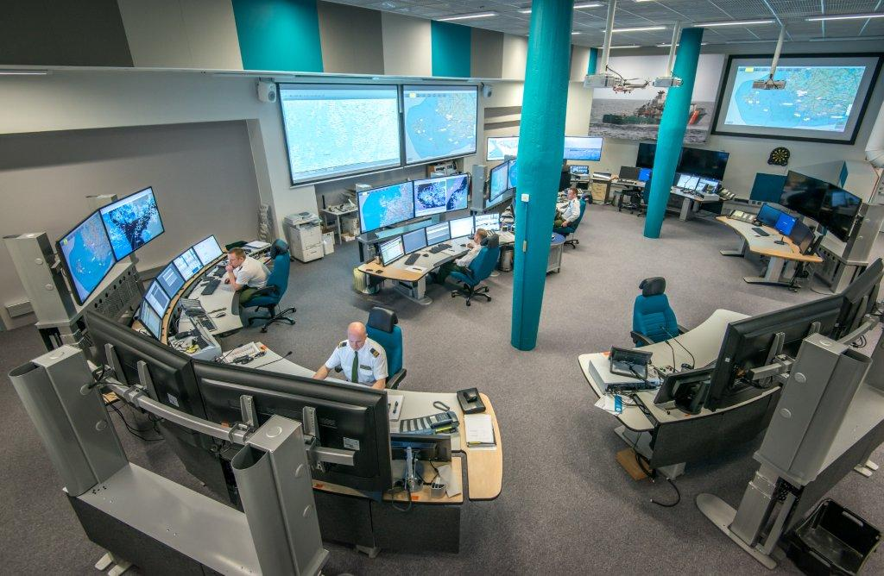
Thank You
https://webgate.ec.europa.eu/maritimeforum/en/cise

