Slide 1
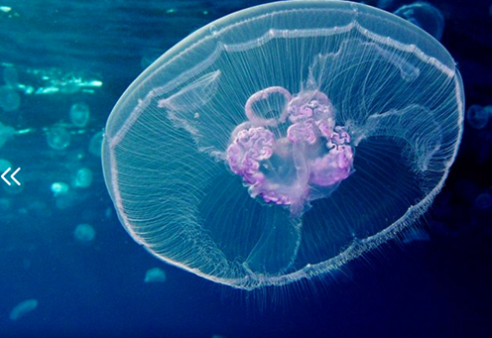
THE PILOT BLU CLOUD
Federica Foglini¹ and Rosmarie Leone²
Federica.foglini@ismar.cnr.it, rosmerie.leone@esa.int
¹ CNR-ISMAR
² ESA
http://ever-est.eu/

Slide 2
What are the gaps and obstacles that need to be overcome to realise the Pilot Blue Cloud?
Interadoperability barriers and data access policy.
Marine scientists are still lacking an awareness of data provision, services and technologies.
Higher level product data quality versus raw data distribution and provenance information.
Critical thinking: data are taken too naively as "absolutely true" whereas they represent recursive approximations of reality.
The capacity to have a global perspective in addressing the research scope.

Slide 3
What is the most pressing need to realise the Pilot Blue Cloud in the short/midterm?
Paradigm shift to large scale multidisciplinary research.
Reward collaboration within marine research team for solving global challenges.
Foster a shared, comprehensive and holistic view in decision making o support decision making in coastal and marine environment;

Slide 4
As a user of the Pilot Blue Cloud; what would you need it to do?
Harmonising Data access entry point and portal and adoption of common standards build on community recommendation
Optimisation of IT resources trough the implementation of virtual collaboration services on a big scale
Leverage and integrate existing basis of data clouds relative both to natural environment (morphology, physical processes, biological communities) and human impacts and uses (mining, dumping, construction of infrastructures, interventions on coastal erosion etc.)
Need to prepare and coordinate strategies of intervention (rapid environmental assessments) in case of natural or anthropogenic disasters.

