Slide 1
Copernicus
EU-China Blue Year Event
Brussels, 1 June 2017
Richard Gilmore
European Commission
DG GROW/Copernicus programme

Slide 2
Table of contents
Introducing the Copernicus Programme
History, main components
Marine-relevant aspects

Slide 3
COPERNICUS HISTORY
Recent marine-relevant developments:
- Q4 2015: Marine Service starts
- Feb 2016: Sentinel 3a launched
- Q2 2017, OLCI instrument operational
Baveno Manifesto
GMES – Flagship of EU Space Policy
EC-ESA Agreement on GMES
Copernicus Regulation and Data Policy
Long-term commitment to develop EO env. monit. services using & developing European skills & tech.
1998
2005
2008
GMES → Copernicus
2013
2001
2006
2011
2014
Gothenburg EU Summit
EC - GMES Bureau
Start of GMES GIO
Start of
Full service operations
GIO = GMES Initial Operation
Notes:
GIO- GMES Initial Operations

Slide 4
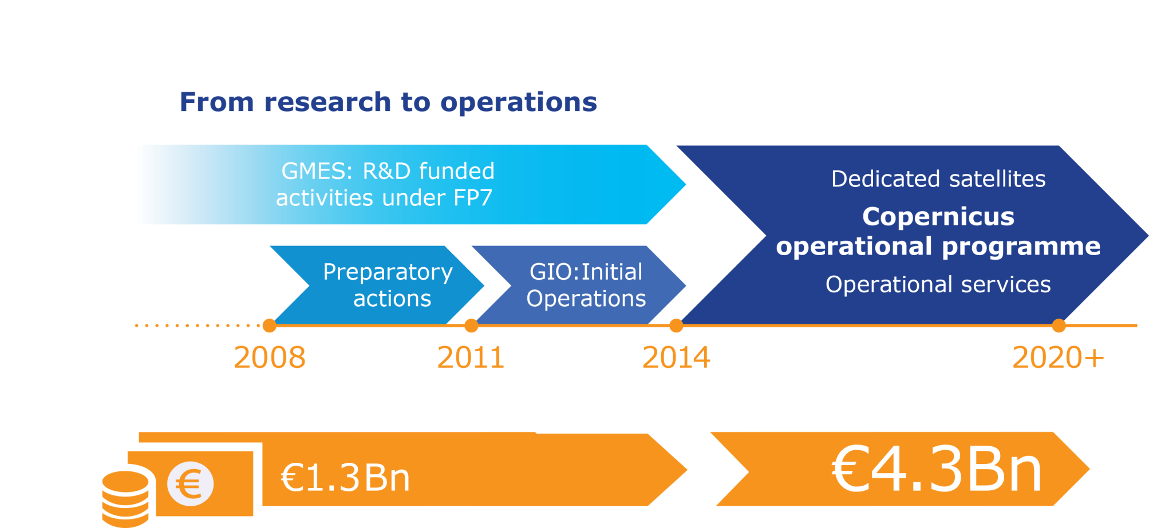
COPERNICUS FUNDING
Notes:
Current MFF period (2014-2020): full operationalisation for the Copernicus Infrastructure and Services
Adequate budgetary provisions to:
Reach the key milestones by 2017
Ensure the smooth running of the programme on a 24/7/365 basis
Lay the necessary groundwork for the future

Slide 5
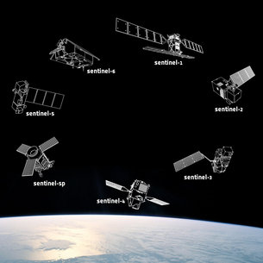
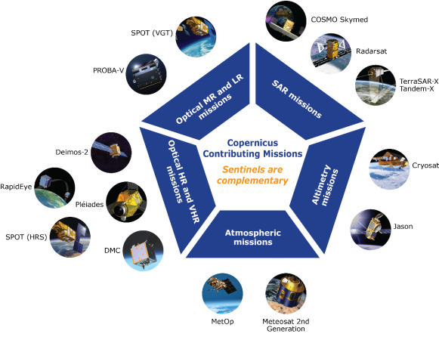
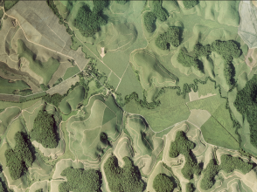
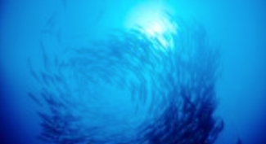

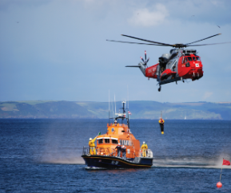

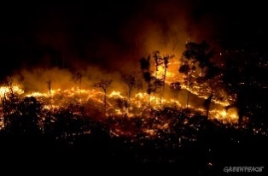

COPERNICUS ARCHITECTURE
6 services use Earth Observation data to deliver …
Contributing missions
Sentinels
…added-value products

Slide 6
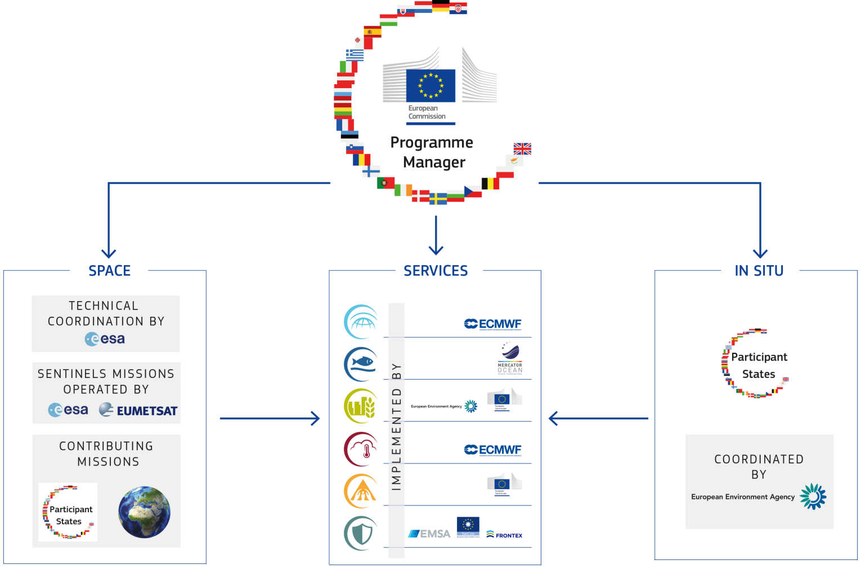
COPERNICUS GOVERNANCE
Notes:
Copernicus in situ component provides in situ data access internally to Copernicus services. It is not delivering in-situ data to the end-users.

Slide 7
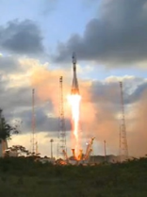
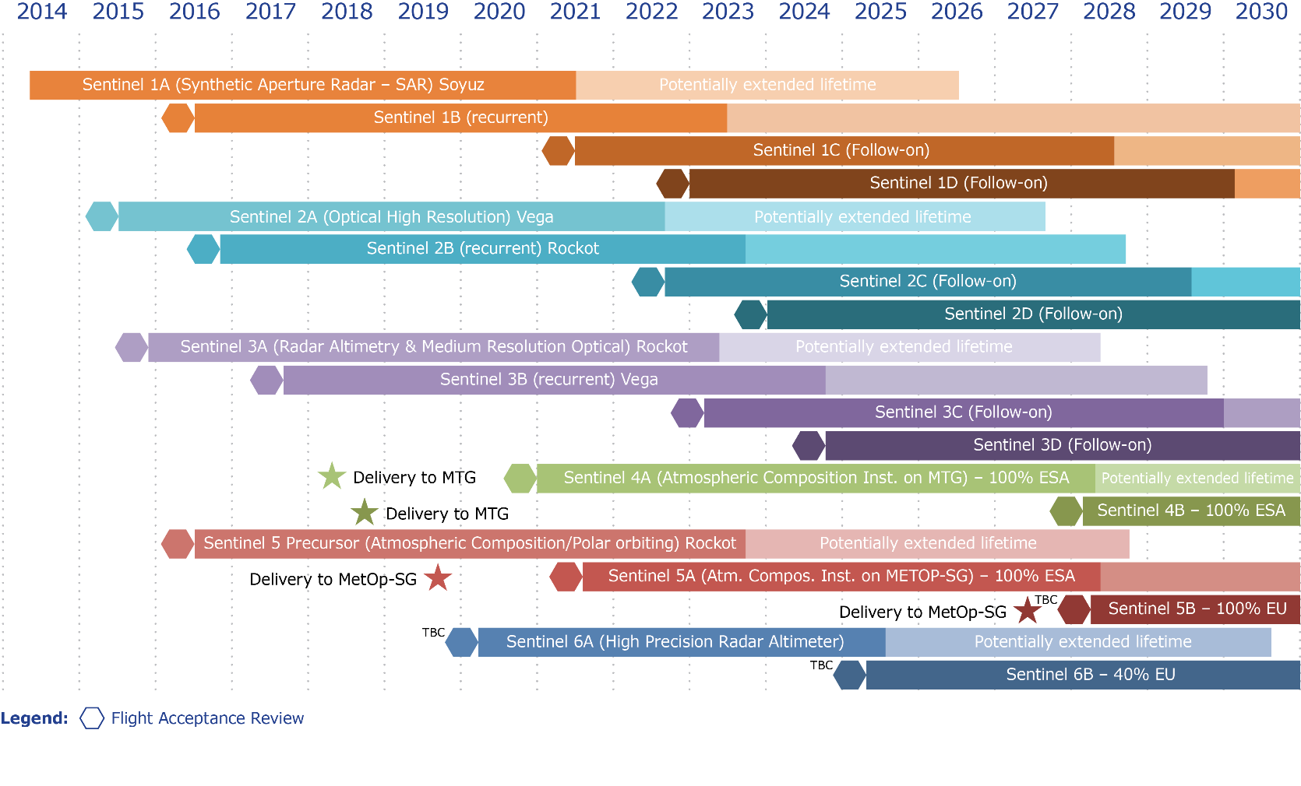


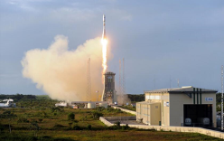
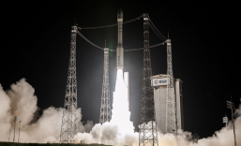

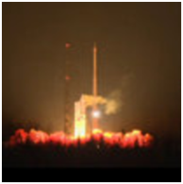
SENTINEL FAMILY DEPLOYMENT SCHEDULE

Slide 8
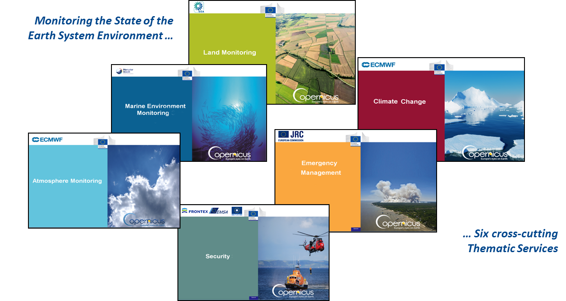






COPERNICUS SERVICES
The Six COPERNICUS SERVICES
FULL, FREE AND OPEN
✓
✓
✓
✓
✓
✓
✓
✓
✓
✓
= operational
✓ = in ramp up

Slide 9
Why is the marine sector so important?
“Blue Economy”, 5 million jobs, gross added value almost €500bn/year
90% of international trade is maritime
Half of the world's population lives within 100 km of coast
EU coastline (where many human and economic activities take place) is 7 times longer than US, 4 times longer than Russia
Global potential ocean energy resources exceed present and projected future energy needs
The ocean plays a critical role in the climate system
Therefore a major policy priority (International Ocean Governance, Blue Growth, Marine Strategy Framework Directive, EU Water Framework Directive, UN Sustainable Development Goals…)

Slide 10
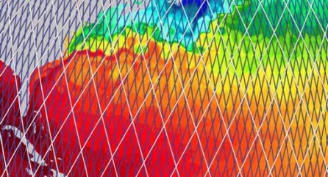
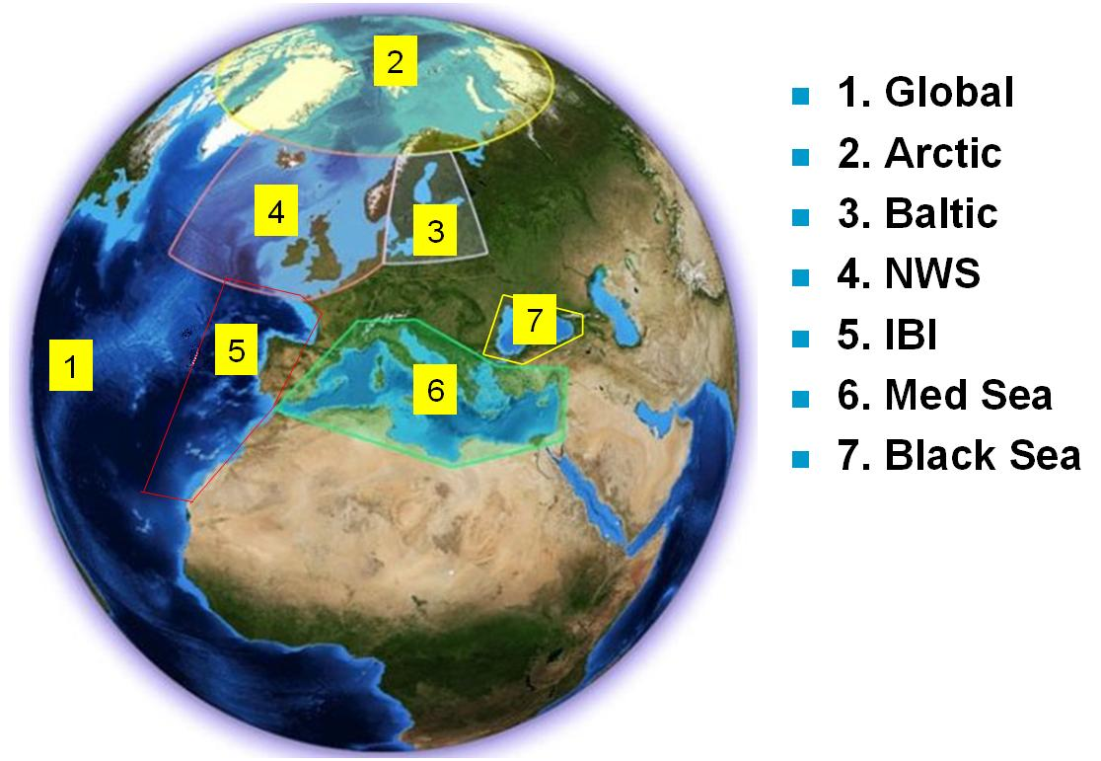
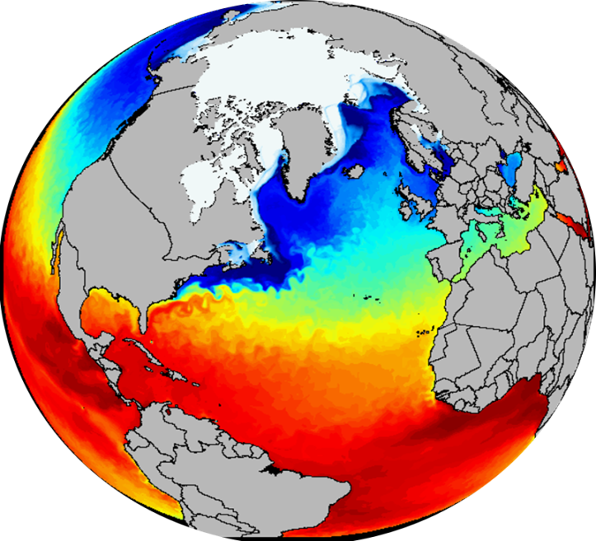
Marine Environment Monitoring Service
Ice
Currents
Sea Level
Biogeochemistry
Global and Regional
Real time and Reanalyses
Satellite & In Situ obs. and Models
Temperature
Salinity
A 3D and consistent
estimation of the ocean

Slide 11
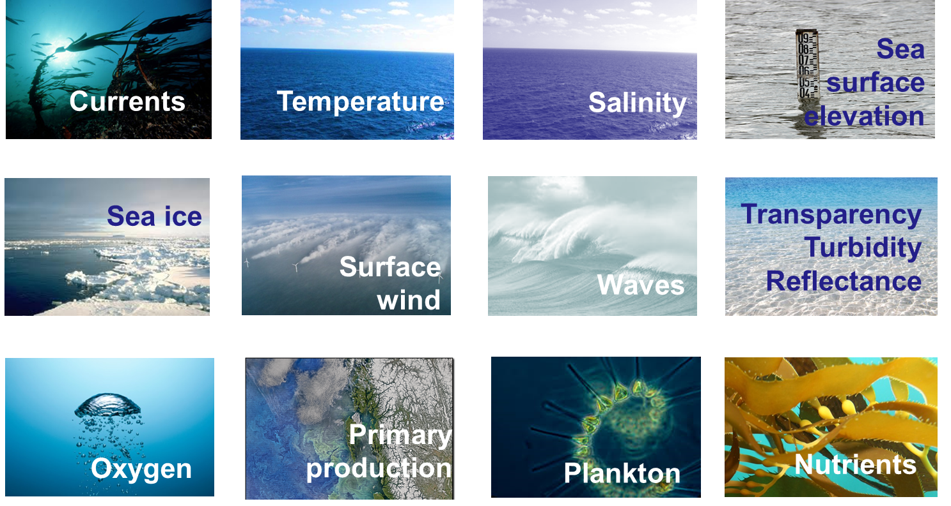

Slide 12
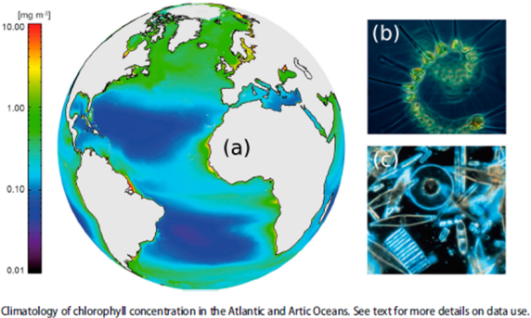
Marine Service, key milestones
CMEMS is fully operational since 2015, builds on the MERSEA/MyOcean research & pre-operational development heritage
Copernicus Entrusted Entity: Mercator Océan
Currently V3 running, 152 products, new release on 19 APR with waves
V4 in preparation (in particular will bring improvements to biogeochemistry parameters, inclusion of Ocean Monitoring Indicators)
Close to the 10k user mark
Mainly EU, but also strong international
use (America 16%, Asia 16%)
1st Ocean State Report published this year, will now
be published annually (e.g., global chlorophyll):

Slide 13


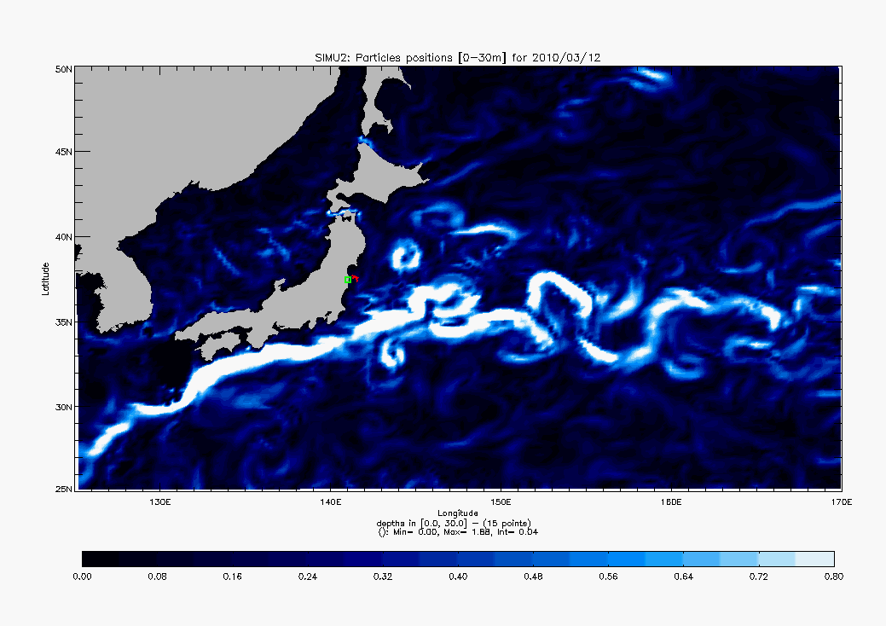


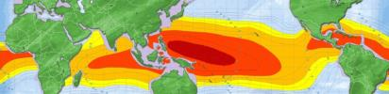
Examples of Marine application areas
Ship routing
Support to offshore activities
Coastal management
Oil-drift forecasting
Sea-ice forecasting
Search and rescue
Fisheries
Algae bloom
Water-quality management
…
But also Climate Change…
Sea-level rise (one of the main indicators for Climate Change)
…

Slide 14
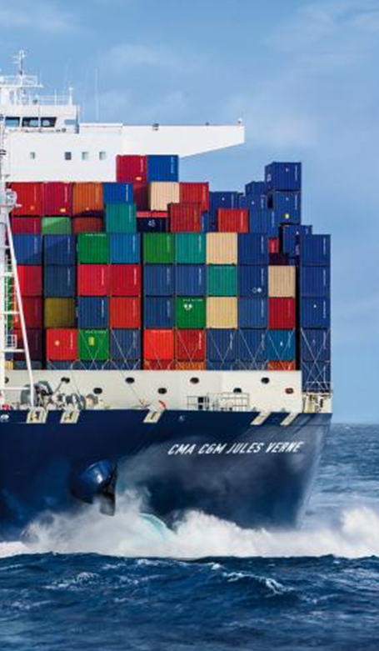

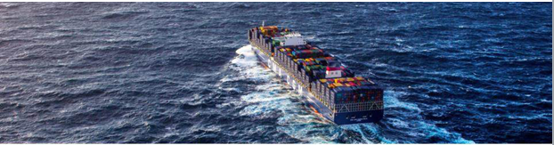
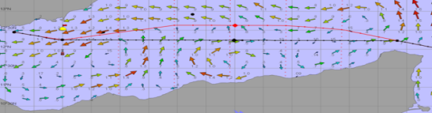
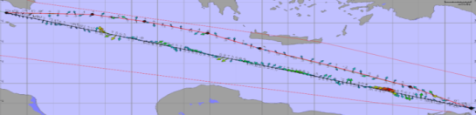
Saving Fuel / Shipping Company
To reduce fuel consumption for ecological & economical reasons
3 options:
Optimize engines, propellers, hulls…
Improve organization…
Take benefit of Meteorology/ Operational Oceanography (current observations and forecast)
Shipping
Companies
0.4% = Average thanks to "current routing"
(Line Europe-China Q2 2015)
Target: Save 1% thanks "current routing" (current forecast reliability) would lead to 60,000t fuel saving for the whole CMA-CGM fleet > 180,000t C02.
By courtesy of CMA-CGM – CMEMS Workshop
ESS The Hague – May 31st 2016

Slide 15
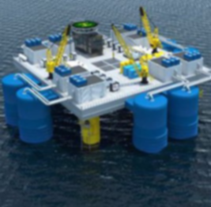

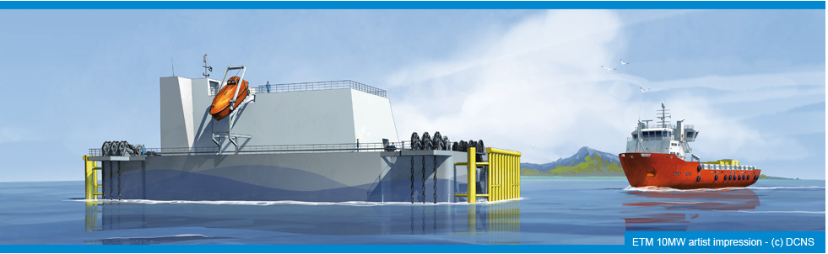
Exploring new sources of energy: OTEC
Ocean Thermal Energy Conversion (OTEC) exploits the difference in temperature between warm surface waters and cooler deep water. To be economically feasible there must be a difference in temperature of more than 20°C between the water at the surface and at depth. OTEC brings value in tropical regions.
Renewable
Energy
industry

Slide 16
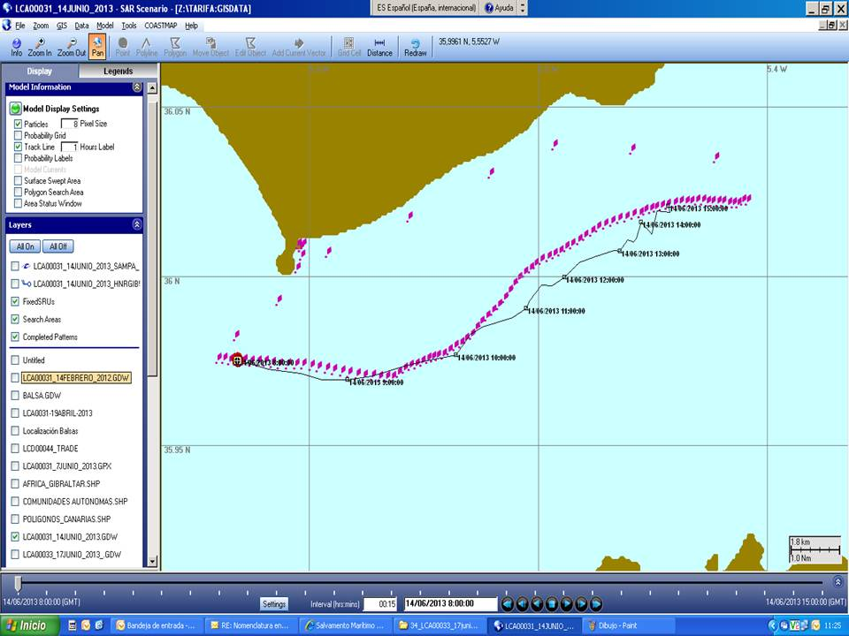
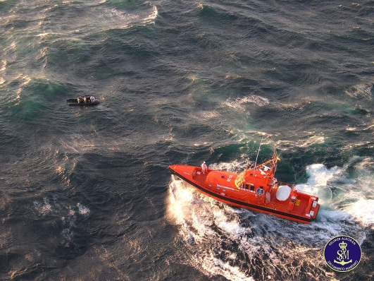
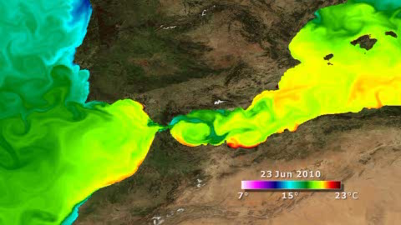

Search & Rescue in the Gibraltar Straits
Search & Rescue in the Gibraltar Straits
SAR
Agencies
« Resultados
muy satisfactorios ! »
José C. Maraver Romero ,
SaseMar controller in Tarifa
Reliability assessment of Copernicus Marine Service
Forecast during a SAR exercice

Slide 17

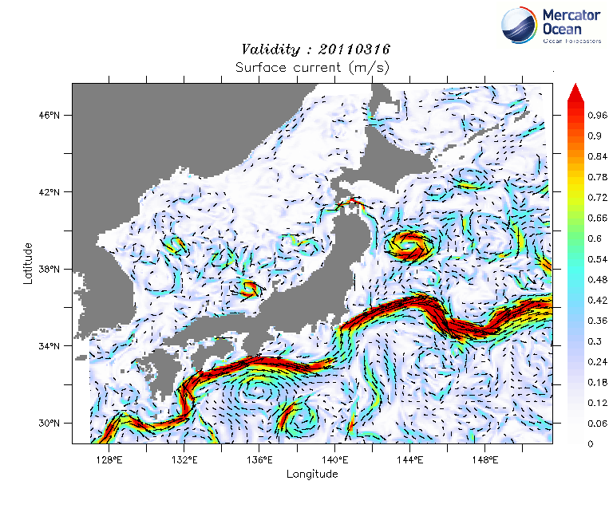
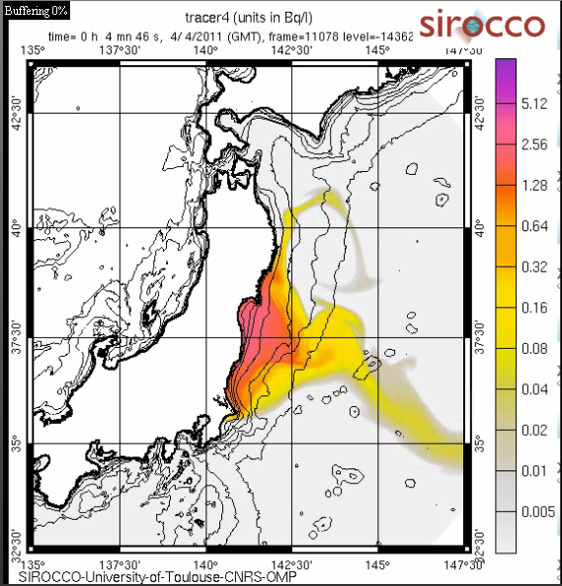
Contributing to Risk Mitigation Plan (Fukushima)
Immediate overview of the pollution drift
Public
Authorities

Slide 18


Combatting Marine Litter and plastic pollution
Drift computation based on CMEMS reanalysis over 10 years help the expedition optimize and finetune the itinerary in order to detect the potential pollution convergence areas in the North Atlantic.
NGO

Slide 19

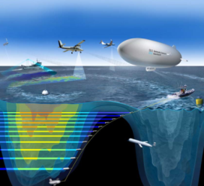
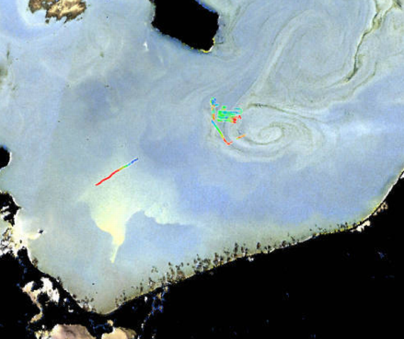
Understanding algal bloom dynamics
Algal bloom in Baltic sea as seen by Sentinels
Swirls correspond to algae concentrations, suspended matter and chlorophyll
Key to understand ocean productivity and fish stocks
Eddies form and collapse in few hours
Observed structures interlock with ocean currents and scale down to submesoscale of only few km
Heavily influence ocean circulation and energy transport

Slide 20
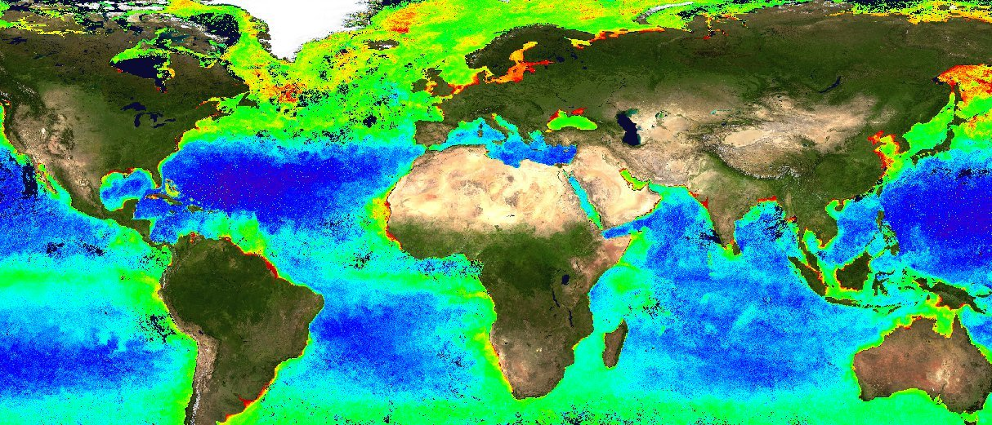
Sentinel 3 – global Chlorophyll a concentrations
Sentinel-3 OLCI chlorophyll-a concentration (mg/m3): The dark blues have the lowest concentrations, followed by the light blues, then greens, yellow, and finally red which has the highest concentration of Chlorophyll a.

Slide 21
Thank you for your attention

