Slide 1

EMBRC -
European Marine Biological Resource Center
K. Deneudt, I. Nardello
Pilot Blue Cloud Workshop
March 28th, 2017
Brussels

Slide 2
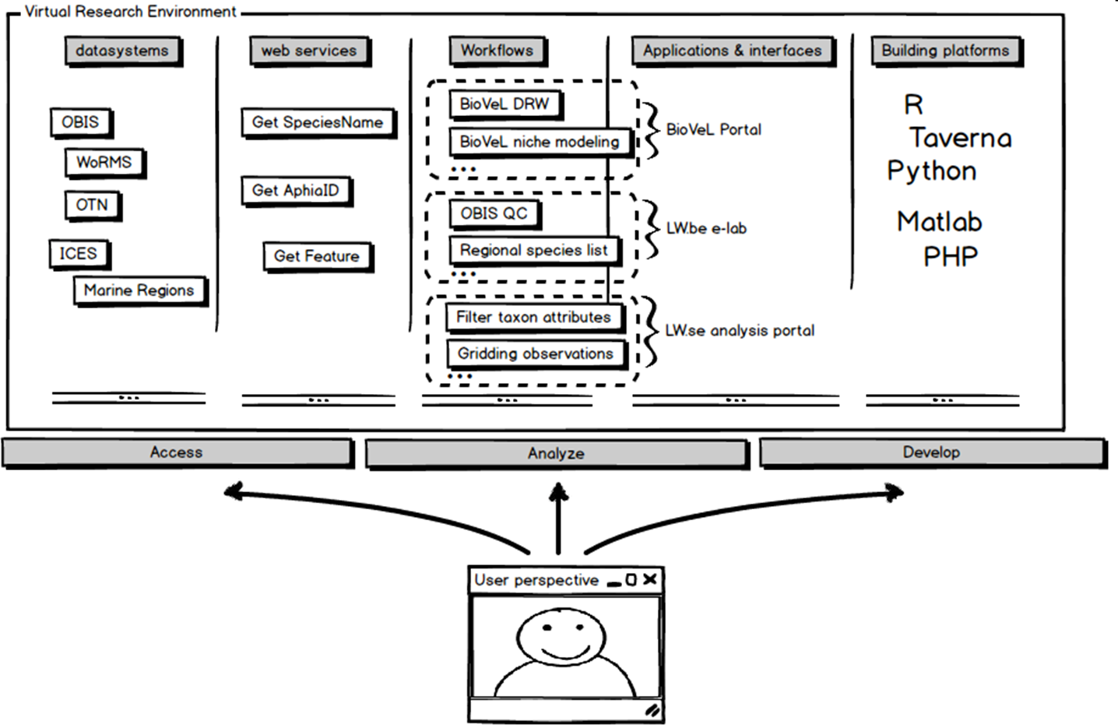
1) As a user of the Pilot Blue Cloud; what would you need it to do?
Single sign-on
Retrieve & Access - Virtual access to data
Analyse & Develop - Virtual access to analytical tools & development environment
Store - Provide private and shared repositories for storing raw and intermediate data
Publish - Provide tools and incentive for publishing final research data
© VLIZ

Slide 3
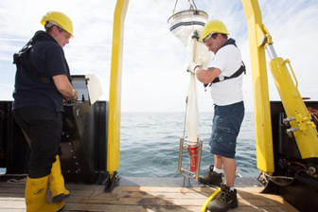
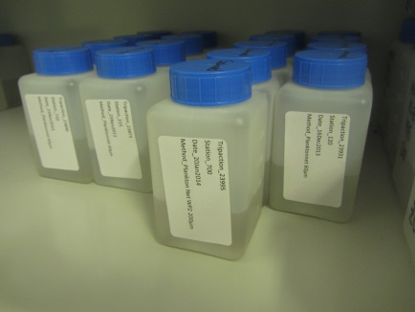
2) What is the most pressing need to realise the
Pilot Blue Cloud in the short/midterm?
Central authentication system - > single sign-on
Data Storage capacity - > in support of community-based repositories
Reliable cloud server capacity -> in support of community based systems
Persistent Identifiers - > Identification of origin
??!
Portal X
Portal X
Portal Z

Slide 4
3) What are the gaps and obstacles that need to be overcome to realise the Pilot Blue Cloud?
Empower and connect community-based initiatives and systems
Lower treshold for using cloud infrastructure
Connect RI output and respect RI identity
Strengthen interaction with large data infrastructures
Development of lacking systems and repositories

