Slide 1
Coastal Mapping
WP2 – Share experiences, standards and best practices
ISPRA
carlo.innocenti@isprambiente.it

Slide 2
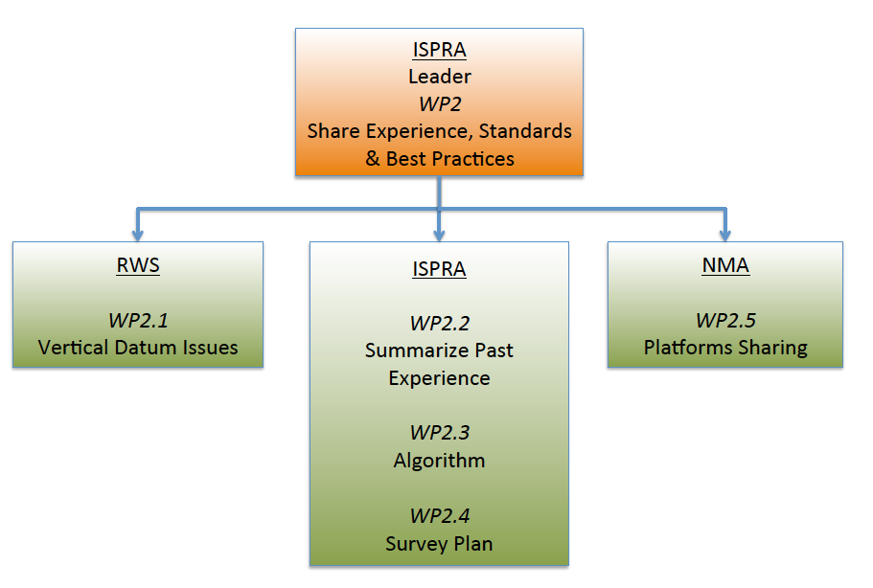
WP2: Share Experience, Standards and Best Practices

Slide 3
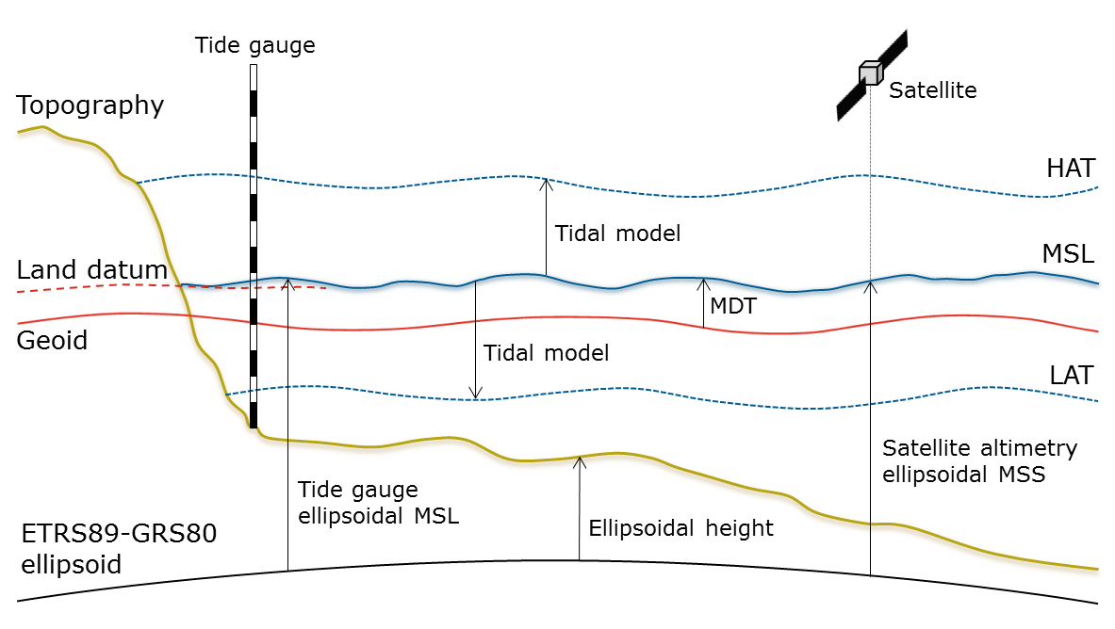
WP2.1: Vertical datum issues
Assess consistency of existing vertical datums
Recommend a standard datum for coastal mapping

Slide 4
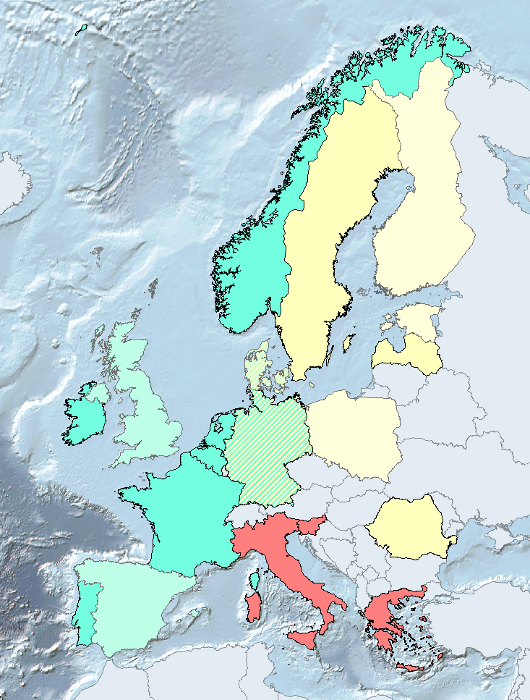
Consistency of vertical datum
Questionnaire on VD:
Height systems on land
Tidal datums
Definition of Chart Datum
Relation of VD to ETRS89
Developments
Chart Datum (reference level for nautical charts):
LAT (approx)
MSL
Low water

Slide 5
Towards a standardized datum
ETRS89-GRS80 ellipsoid
Ellipsoidal referenced surveying
Data combination on land and sea
Requires separation models
European Vertical Reference System
Only available on land
Based on traditional leveling
For marine applications realization should include a geoid
Harmonized datum on the maritime basin level
Requires involvement and commitment of stakeholders
Baltic Sea Chart Datum 2000 (implemented 2020)
North Sea and Atlantic: LAT
Baltic Sea and Mediterranean: MSL

Slide 6
WP2.2: Summarize past experience
Analyze different experiences of coastal data acquisitions gathering information about:
Survey site information
Scope of the survey
Type of instruments
Products obtained
Estimation of the costs

Slide 7
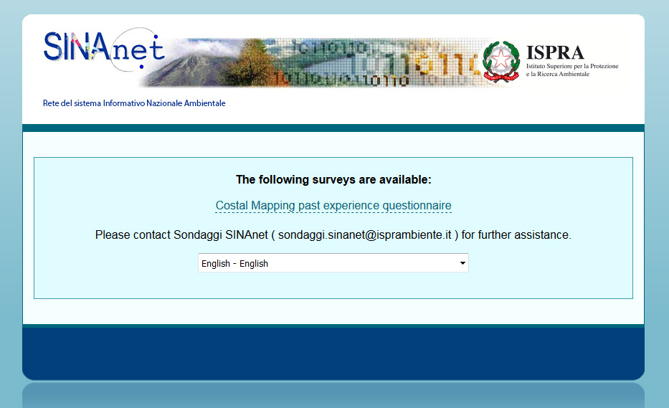
The on-line questionnaire
The questionnaire has been developed using LimeSurvey (freeware software) and hosted on ISPRA server from 22/12/2015.

Slide 8
Structure of the questionnaire
The questionnaire is divided in 3 main pages:
Study site information
extension – elevation – morphological characteristics – tidal range – turbidity – Secchi disk
Survey information
scope of acquisition – instrument/sensor - platform
Other information
product obtained – reference system – IHO standard – survey cost – data availability

Slide 9
Information gathered
Feedback from 15 partners
645 response to the past experience questionnaire
487 by excel table
158 by the on-line form

Slide 10
Analysis of the distribution of the answers
Where data were collected
With which instrument
For which purpose
At which cost

Slide 11
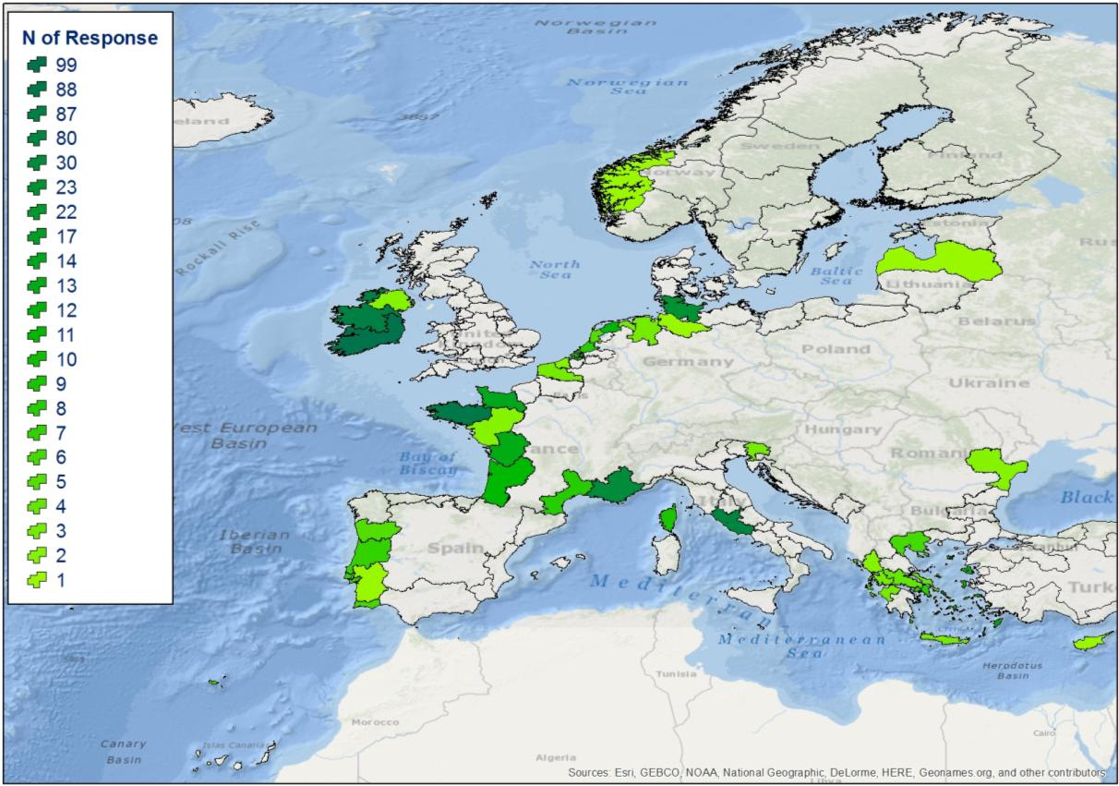
Where data were collected

Slide 12
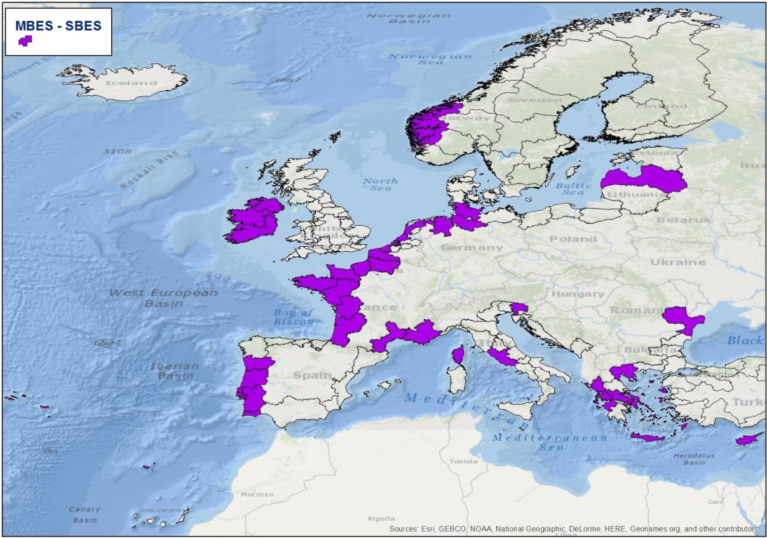
Instrument : MBES - SBES

Slide 13
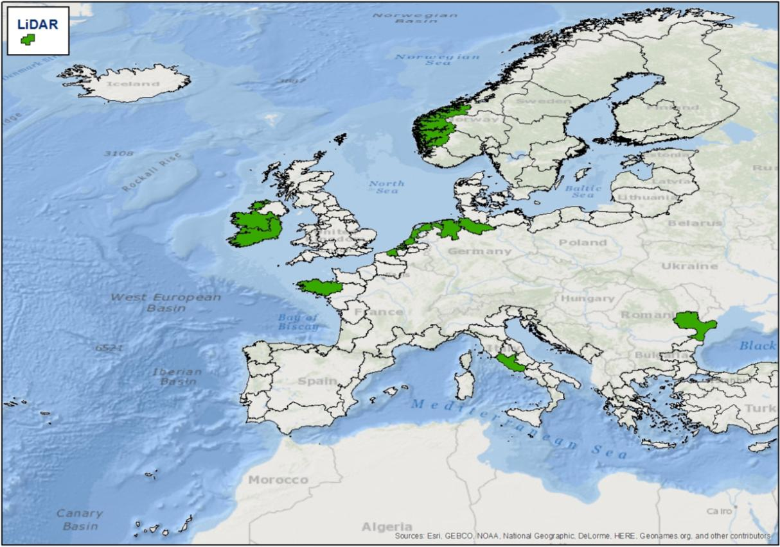
Instrument : LiDAR

Slide 14
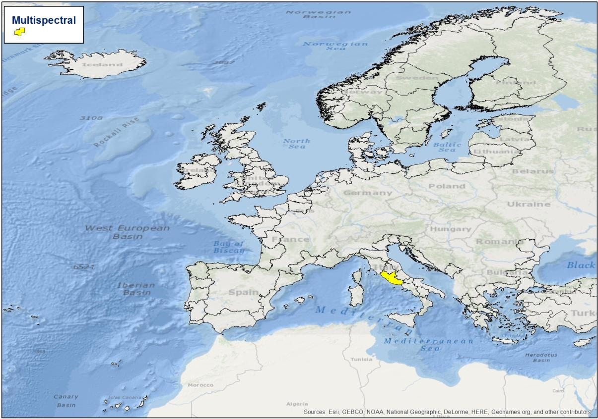
Instrument : Multispectral

Slide 15
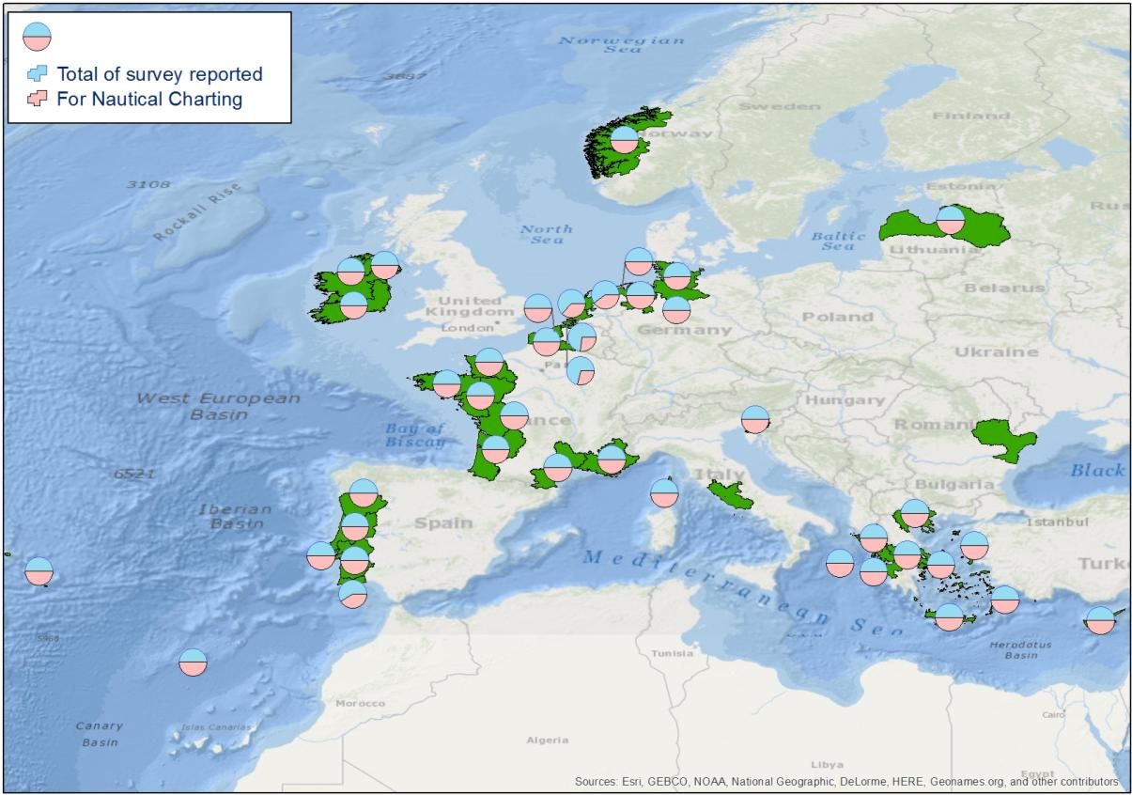
Purpose : Nautical Charting

Slide 16
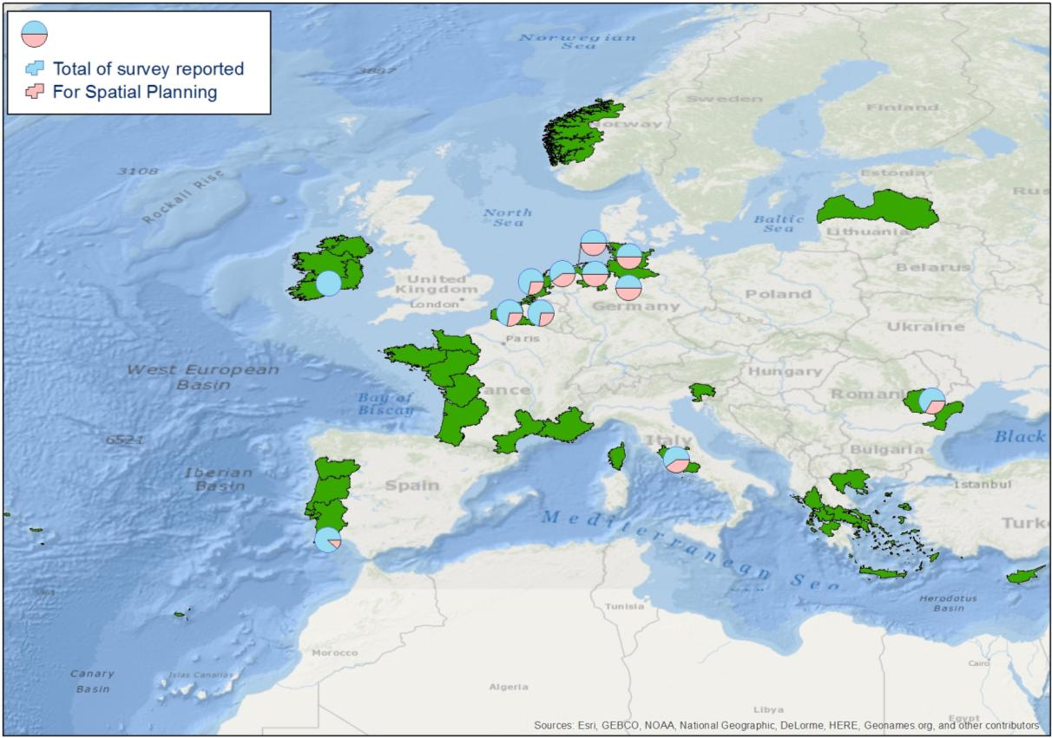
Purpose : Spatial Planning

Slide 17
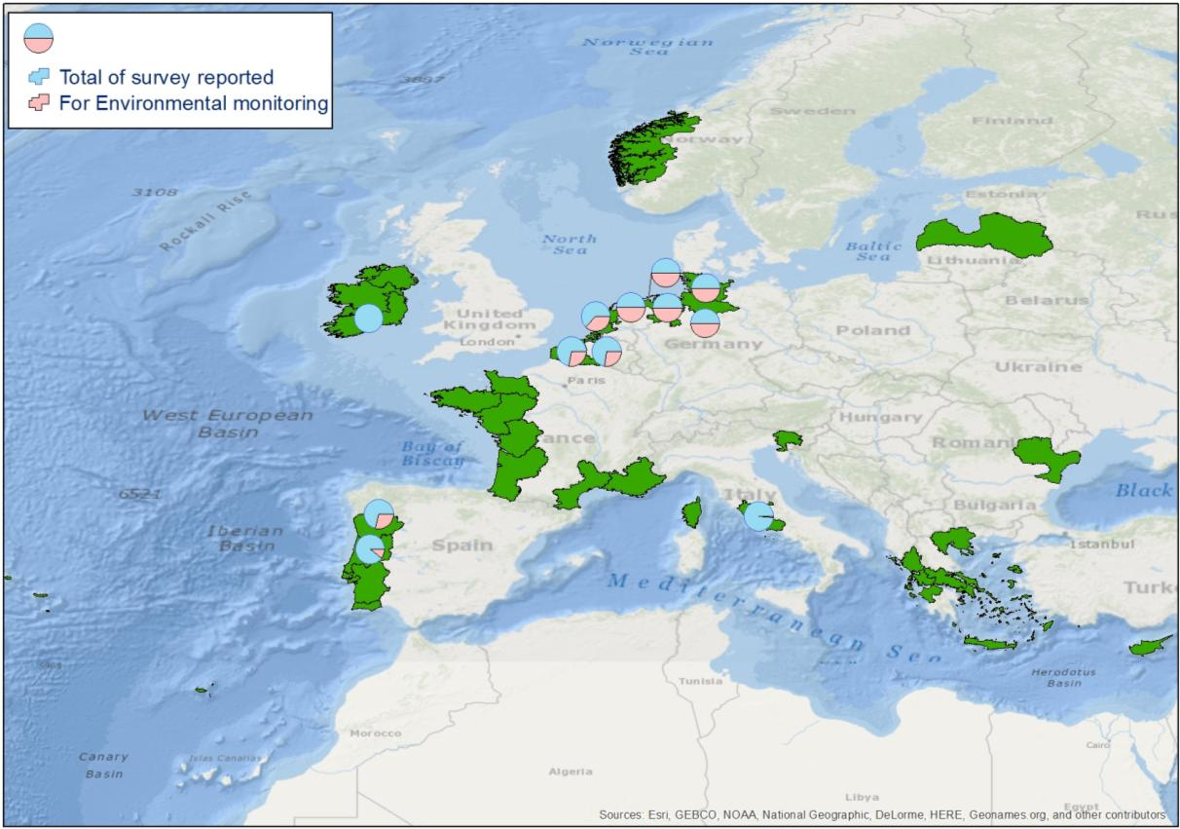
Purpose : Environmental monitoring

Slide 18
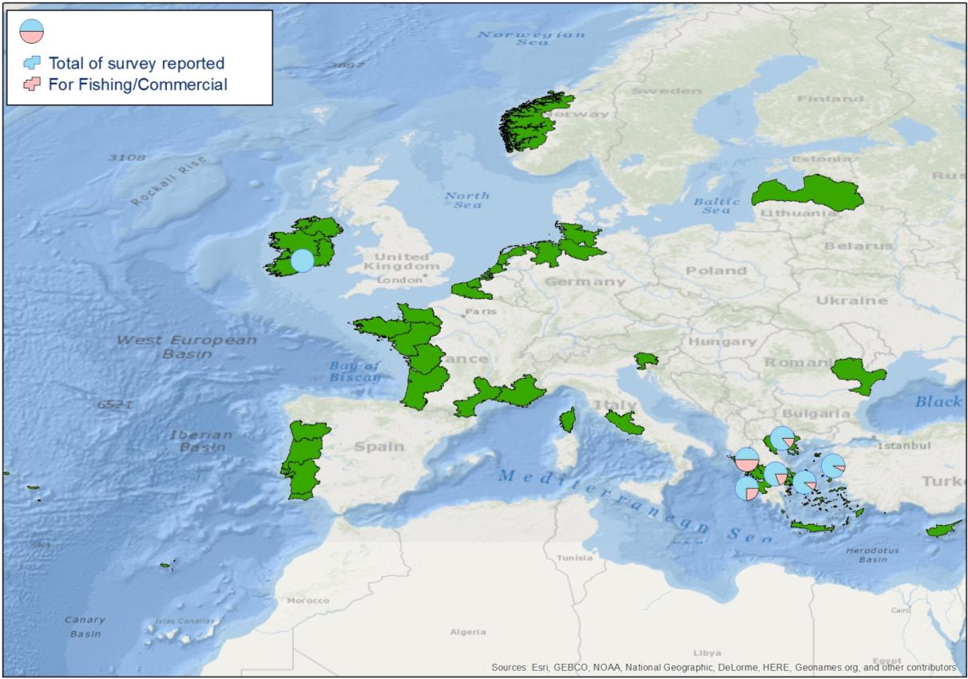
Purpose : Fishing Commercial

Slide 19
Purpose : Coastal Management

Slide 20
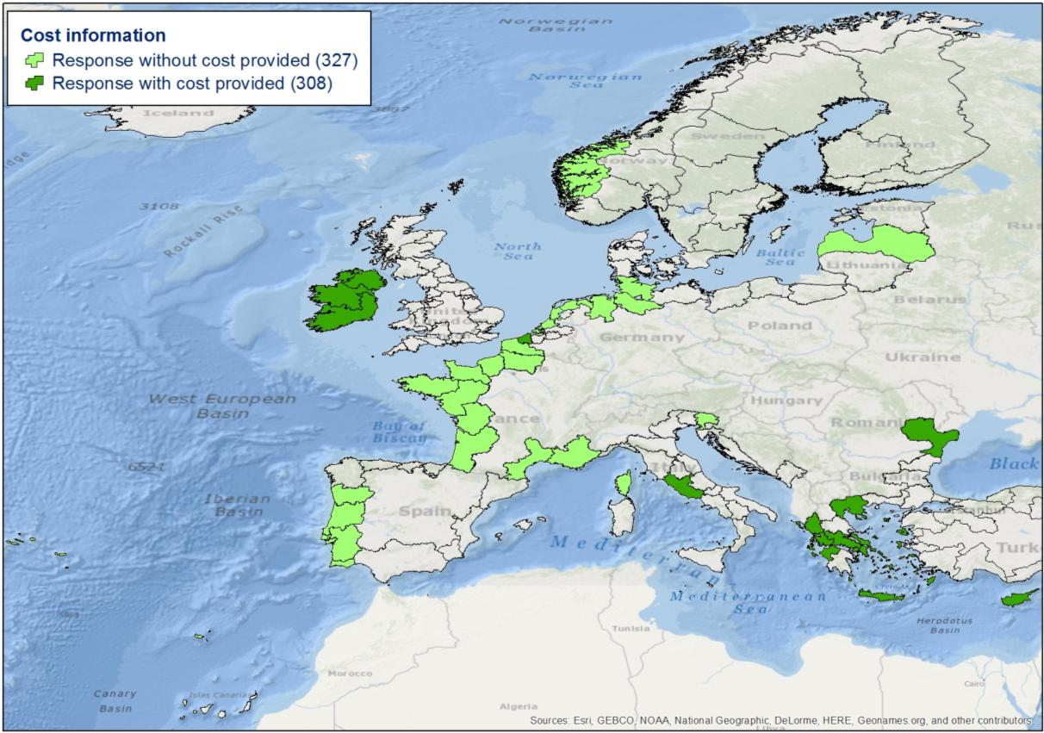
COST

Slide 21
Critical elements emerged
some areas have not been investigated due to the lack of some European member in the partnership
the partners involved are mainly Hydrographic Offices, and their past experiences are focused on nautical charting which creates a bias in the database of the past experience
The “cost” informations were few and dishomogeneous
 | Survey | N° Cost Provided | Cost Max (€/km2) | Cost Min (€/km2) | Cost Mean (€/km2) | Standard deviation
LIDAR | 85 | 25 | 4022 | 352 | 1961 | 1267.1

Slide 22
WP2.3: Develop and test an algorithm for choosing most appropriate surveying method
The CMP (Coastal Mapping Planner) is designed to help the coastal mapping planning at regional and transnational scale
It will help the EU planners giving indication about optimal survey techniques for different mapping scenarios

Slide 23
CMP characteristics
Different detection technologies can be compared in relation to their ability to obtain the desired products, currently :
3 technologies (MBES, LIDAR & HYPERSPECTRAL)
9 selectable products
It has a scalable structure that easily permits to add instruments and products
It takes into account the environmental characteristics of the survey area:
Elevation
Secchi disk depth

Slide 24
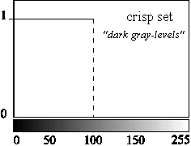
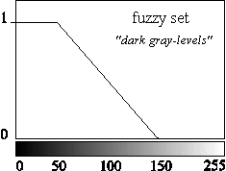
Basic concepts
The CMP uses the fuzzy logic that permits:
a more natural definition of the environmental variables;
to translate more naturally the knowledge of the expert.
Shallow
Shallow

Slide 25
MBES rules
If water is deep then MBES is suitable
If on land then MBES is not suitable
If water is shallow then MBES is marginal
If water is very shallow then MBES is not suitable

Slide 26
LiDAR and Airborne Hyperspectral rules
If depth/secchi disk ratio is bad AND not on land then Lidar (or Air. Hyp.) is not suitable
If depth/secchi disk ratio is poor AND not on land then Lidar (or Air. Hyp.) is marginal
If on land then Lidar (or Air. Hyp.) is suitable
If depth/secchi disk ratio is good then Lidar (or Air. Hyp.) is suitable

Slide 27
 | LiDAR | MBES | Air.Hyp.
Low resolution DSM | Suitable | Suitable | Not Suitable
High resolution DSM | Suitable | Suitable | Not Suitable
High resolution DSM for navigational purposes (Special order/Order 1a) | Not Suitable | Suitable | Not Suitable
High resolution DSM for navigational purposes (Order 1b) | Suitable | Suitable | Not Suitable
Shore line | Marginal | Not Suitable | Suitable
Vegetation presence map | Marginal | Marginal | Suitable
Vegetation cover type map | Not Suitable | Not Suitable | Suitable
Floor Cover Type map | Marginal | Suitable | Suitable
Properties of the Emerged Sediment | Not Suitable | Not Suitable | Suitable

Slide 28
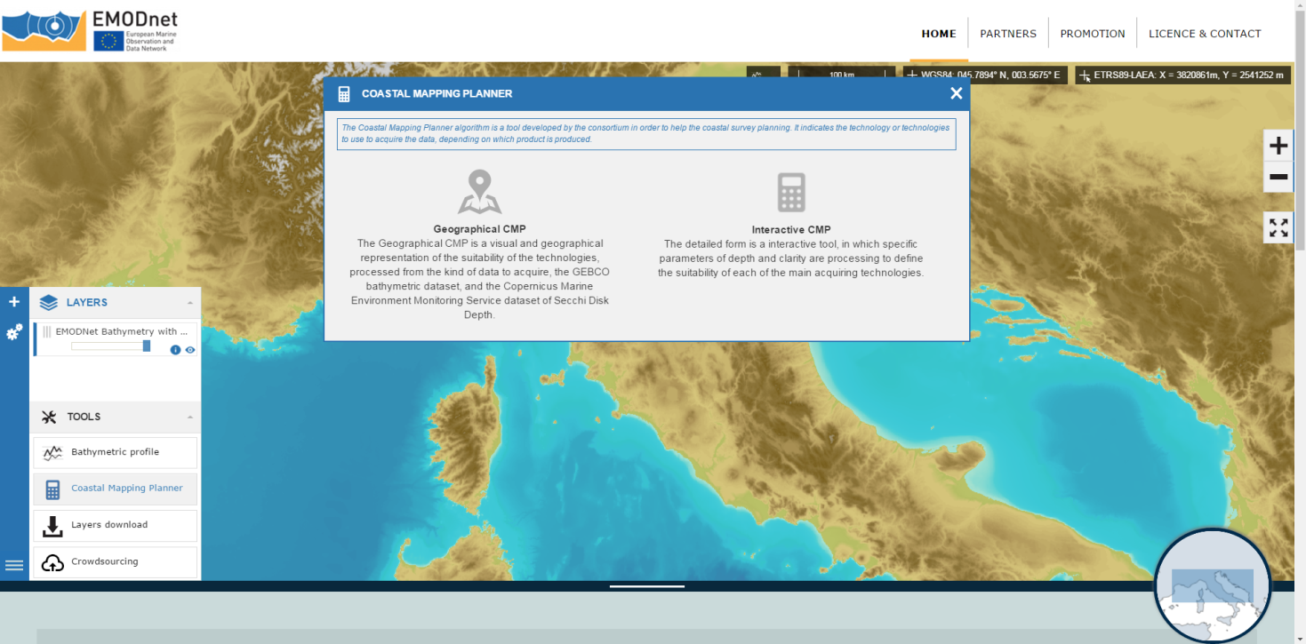

Slide 29
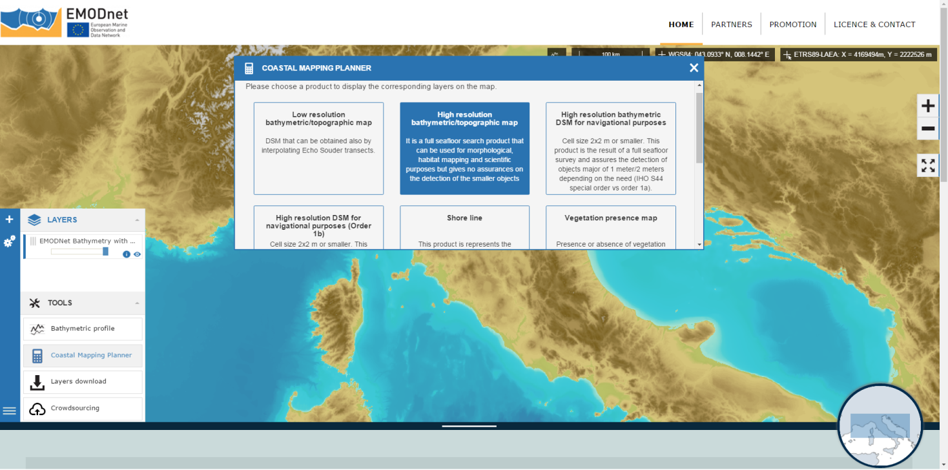

Slide 30
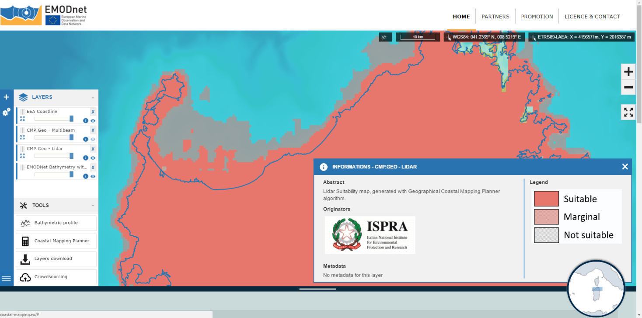

Slide 31
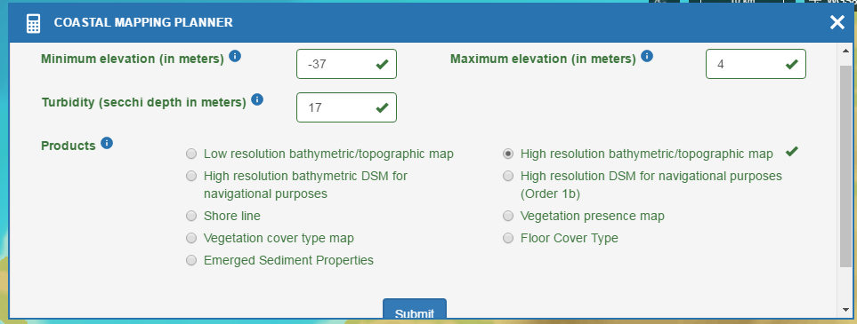
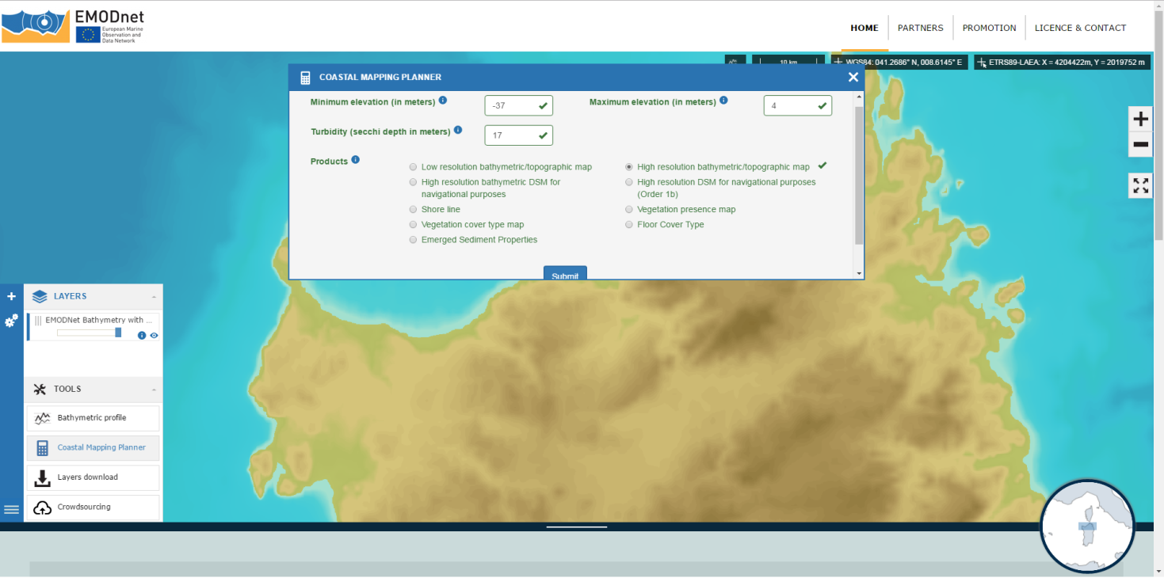

Slide 32
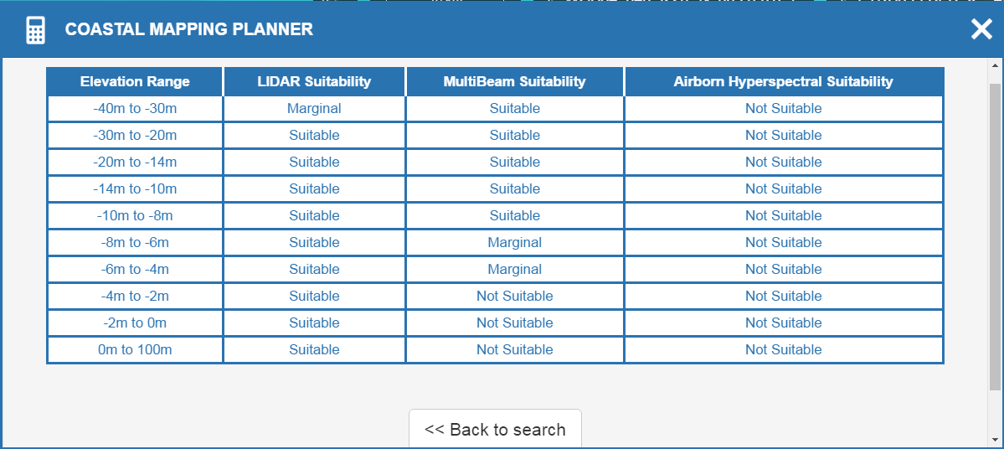

Slide 33
WP2.4: Build a technical & economical strategy
Define the functions that permit to estimate the cost of a survey for different acquisition technologies and different environmental characteristics
Analyze the past experiences data
Discuss the partner knowledge in a working group

Slide 34
Cost Function: Results

Slide 35
Cost Function: Results

Slide 36
WP2.4 results
Conclusion: the past experiences are not sufficient to build a reliable cost function valid on the whole of Europe
Possible development: other environmental variables, together with surface, should be investigated to model a reliable function to quantify the time cost of the survey

Slide 37
WP 2.5 – Sharing platforms
Research of the main platform categories in order to evaluate the possible technical synergy effects
Review sharing platforms through cooperation, and combining efforts in order to maximize the survey potential

Slide 38
Findings (technical)
Survey once, use multiple times and for different purposes
Requires high resolution mapping
While keeping induced errors to a minimum
Necessitates combining different types of sensors
To maximize the number of data types collected
Size matters, near shore surveys limits the types of survey platforms which may be used.

Slide 39
Findings - mutualisation of means
Combining efforts
Shared planning may result in improved cross border mapping efficiency
Predictable income situation for vessel owners
Unresolved national restriction on both survey permissions and data distribution
Combining tenders
Increased volume results in reduced price
Avoids overlapping efforts
Increase focus on data requirements and standards

Slide 40
Conclusions
Survey platform of choice is a surface vessel
The surface is the ideal spot for mapping many data types
keeping induced errors to a minimum
maintaining high position accuracy
Current development of USV ‘unmanned surface vessels’ will significantly reduce survey cost while increasing efficiency.
New submersible survey instruments holds great promises towards our goal of ‘surveying once, and reusing many times.’

Slide 41
Conclusions cont.
Varying national restrictions does limit shared efforts
Permissions required to perform near shore surveys
Limitations on who may have access to data surveyed
Differing policy's on what data resolution that may be freely distributed
Combined tenders is still desirable
Increased focus on cross border issues that need to be resolved
Reduced price for all stakeholders involved

Slide 42
Issues to be resolved
Definition of requirements and standards for the different data types
National restrictions on data aquisition and management needs to be adressed

Slide 43
Thank you!

