Slide 1
EEA coastline for analysis
Dataset, QA, future work
Oscar Gomez

Slide 2
Motivation
Different coastlines → used for different purposes
The process: gather user needs, look at available data, and assemble a “unique” coastline
Opportunities:
EU-Hydro available (link continental and marine waters), CLC2006 finalised
Reference data group at EEA

Slide 3
User needs
Protected areas:
statistics for marine and terrestrial N2000 are different because of different coastlines
Many protected sites include very small islands
MSFD marine subregions
Data integration: continental vs marine, WFD water bodies.

Slide 4
Existing coastlines
CLC coastline http://www.eea.europa.eu/data-and-maps/data/corine-land-cover-2000-coastline
Good delineation land/sea
Rich attributes (CLC, Eurosion)
Incomplete
NOAA GSHHS http://www.ngdc.noaa.gov/mgg/shorelines/gshhs.html
EU-Hydro
Derived from Image2006 (tide height corresponds to that of the scene)
Incomplete (islands, countries, …)

Slide 5
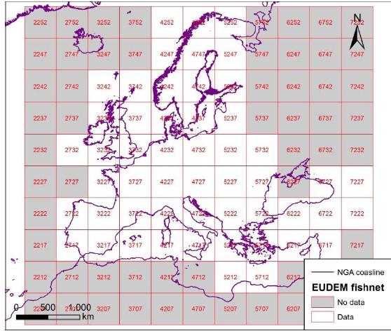
EU-Hydro coverage

Slide 6
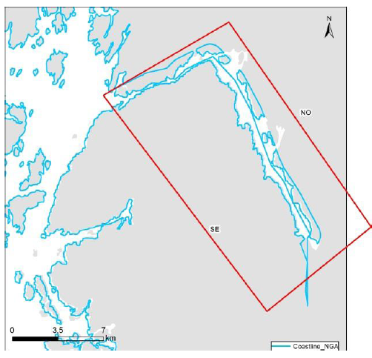
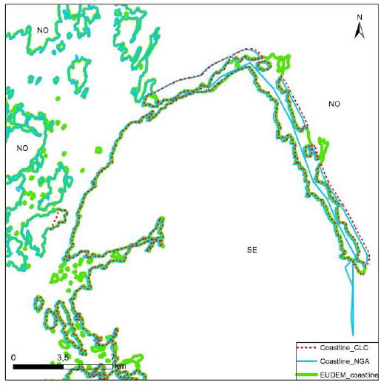
Delineation differences

Slide 7
Methodological process
Gather user needs (February)
Explore methodological options (February)
Construction of the coastline (March)
Internal QC and corrections (April)
Draft publication (April)
Improvements after feedback (May)
Dissemination
External QA (June)
Refinements (December)

Slide 8
Technical choice
2 options were evaluated:
A patchwork of different datasets (CLC, NUTS, …, difficult to maintain)
EU-Hydro as core, and adding additional areas from GSHHS as auxiliary coastline.
2nd option was chosen (easier maintenance, but following satellite instead of lower tide)

Slide 9
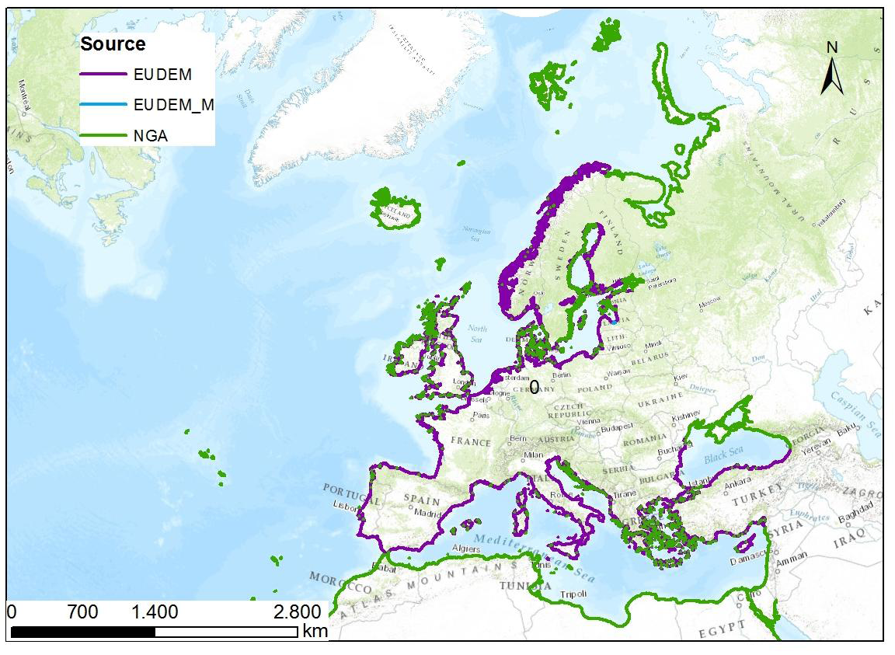
Result

Slide 10
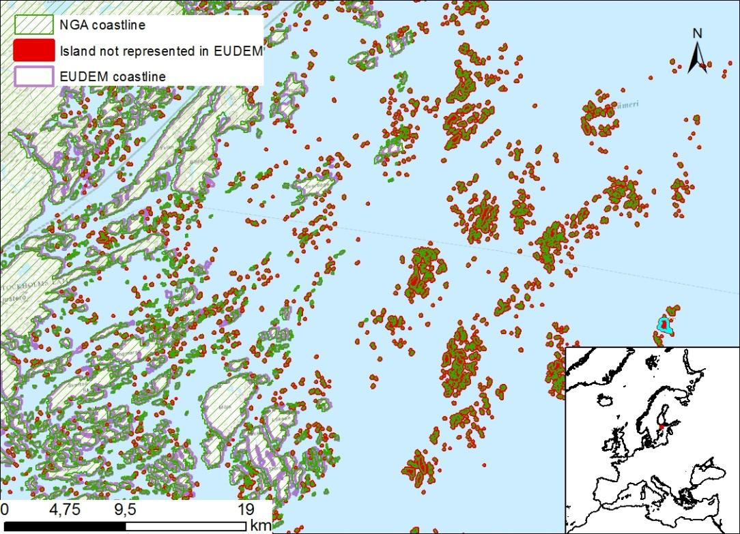
Adding islands

Slide 11
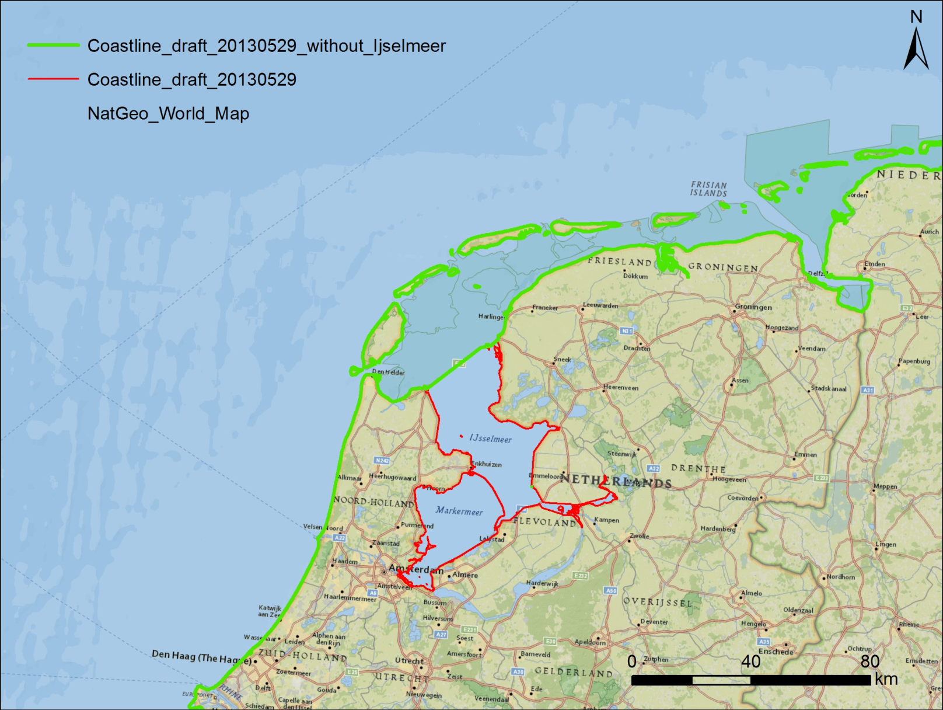
Internal QC (I)

Slide 12
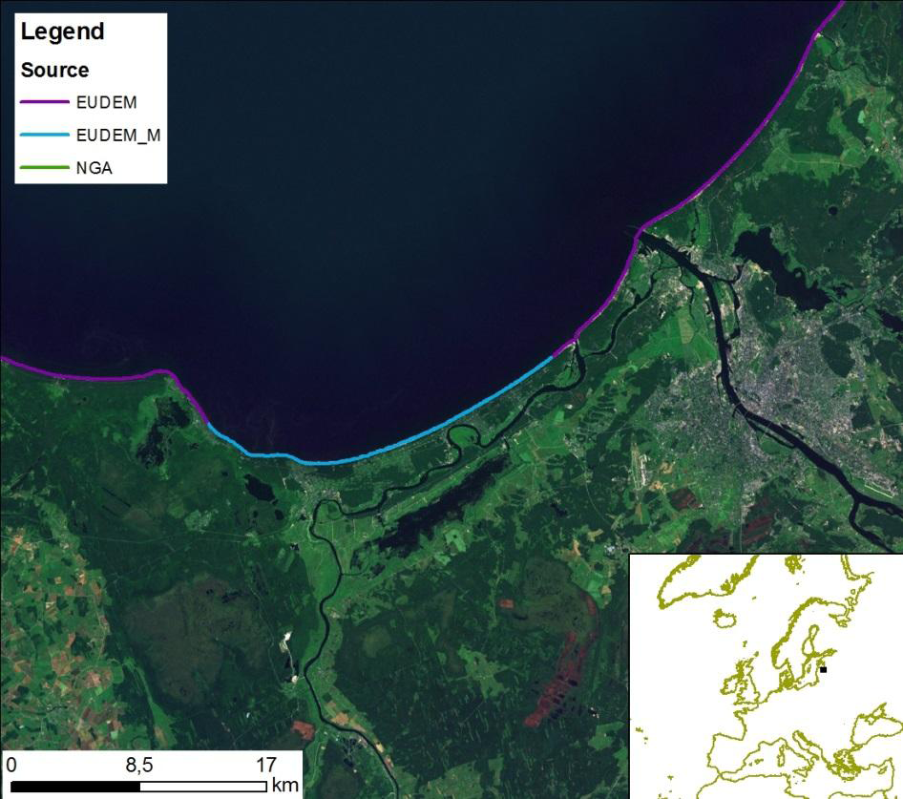
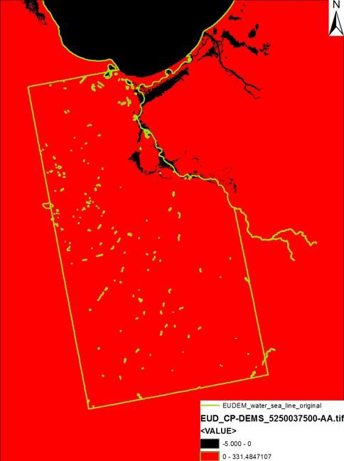
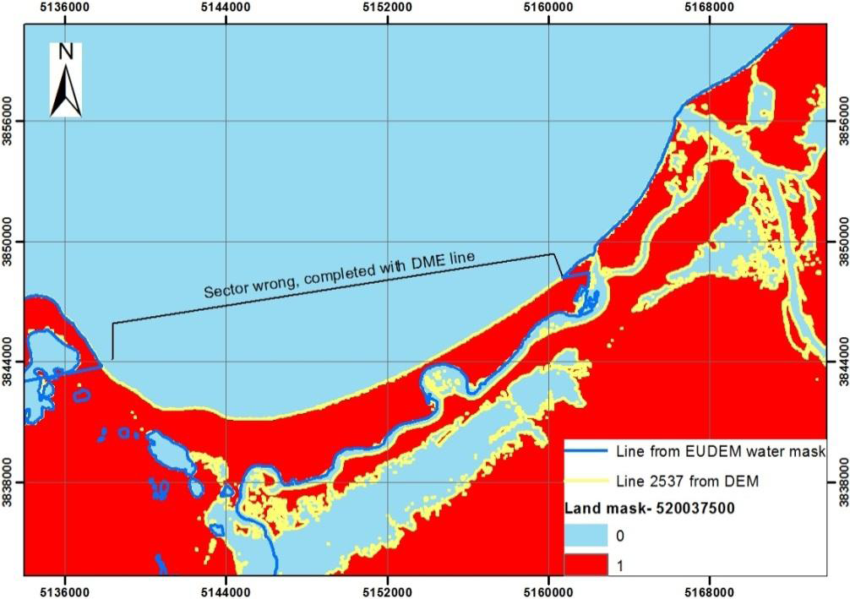
Internal QC (II)

Slide 13
Publication and dissemination
EEA Dataservice: http://www.eea.europa.eu/data-and-maps/data/eea-coastline-for-analysis/
Being used by:
N2000 barometer (DG ENV)
Partners at EEA marine group and ETC/ICM (MSFD)
ETC/SIA
We are receiving feedback on issues to correct

Slide 14
Quality assurance (external)
30x30km grid along the coastline
4 types of errors were analyzed:
Adjustment distance: Average deviation in metres to Bing Maps in the cell
Serious errors: geographical features or infrastructures which haven’t been digitized
Topological errors, discontinuities
Non digitized islands

Slide 15
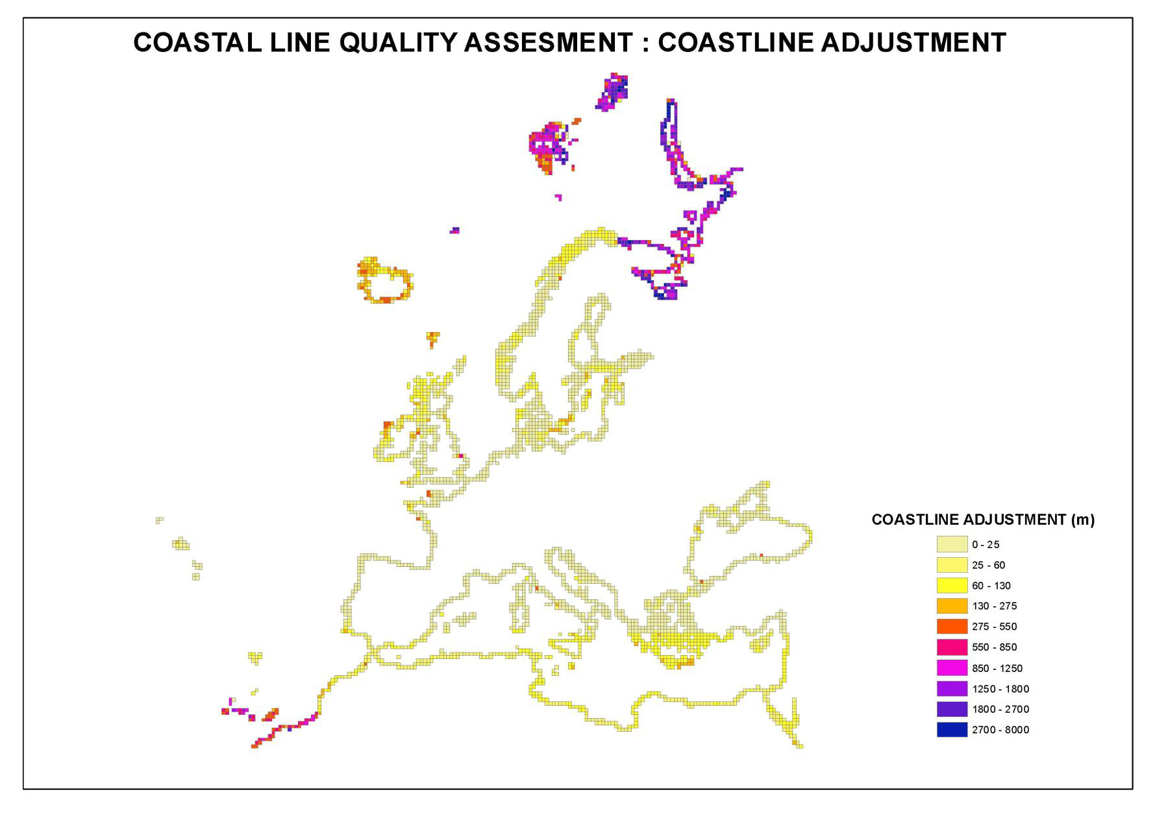

Slide 16
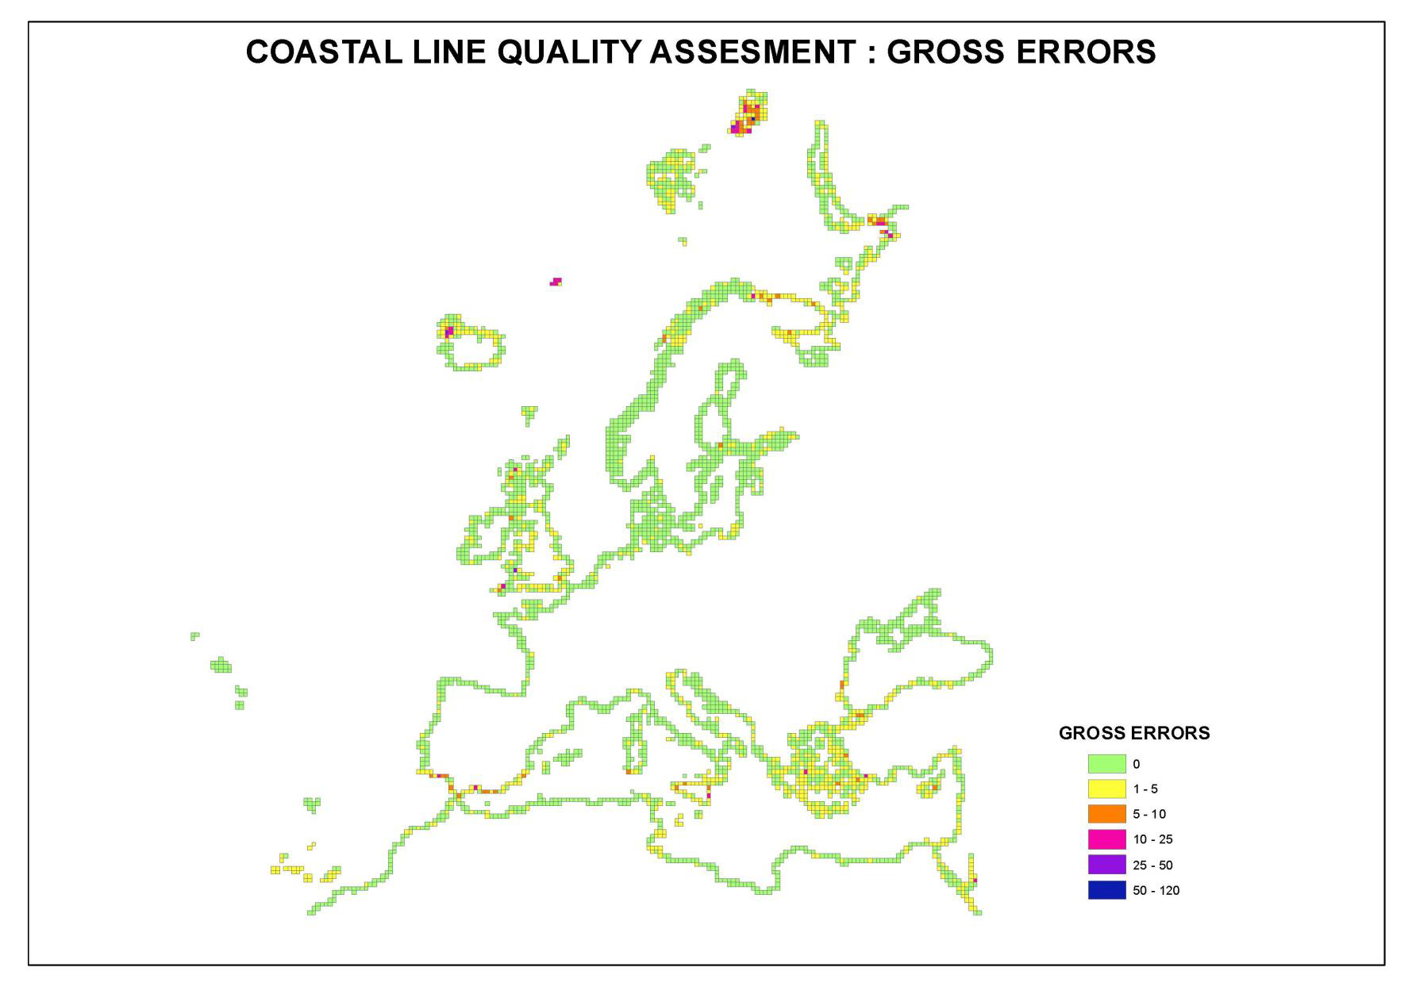
Serious errors (omission)

Slide 17
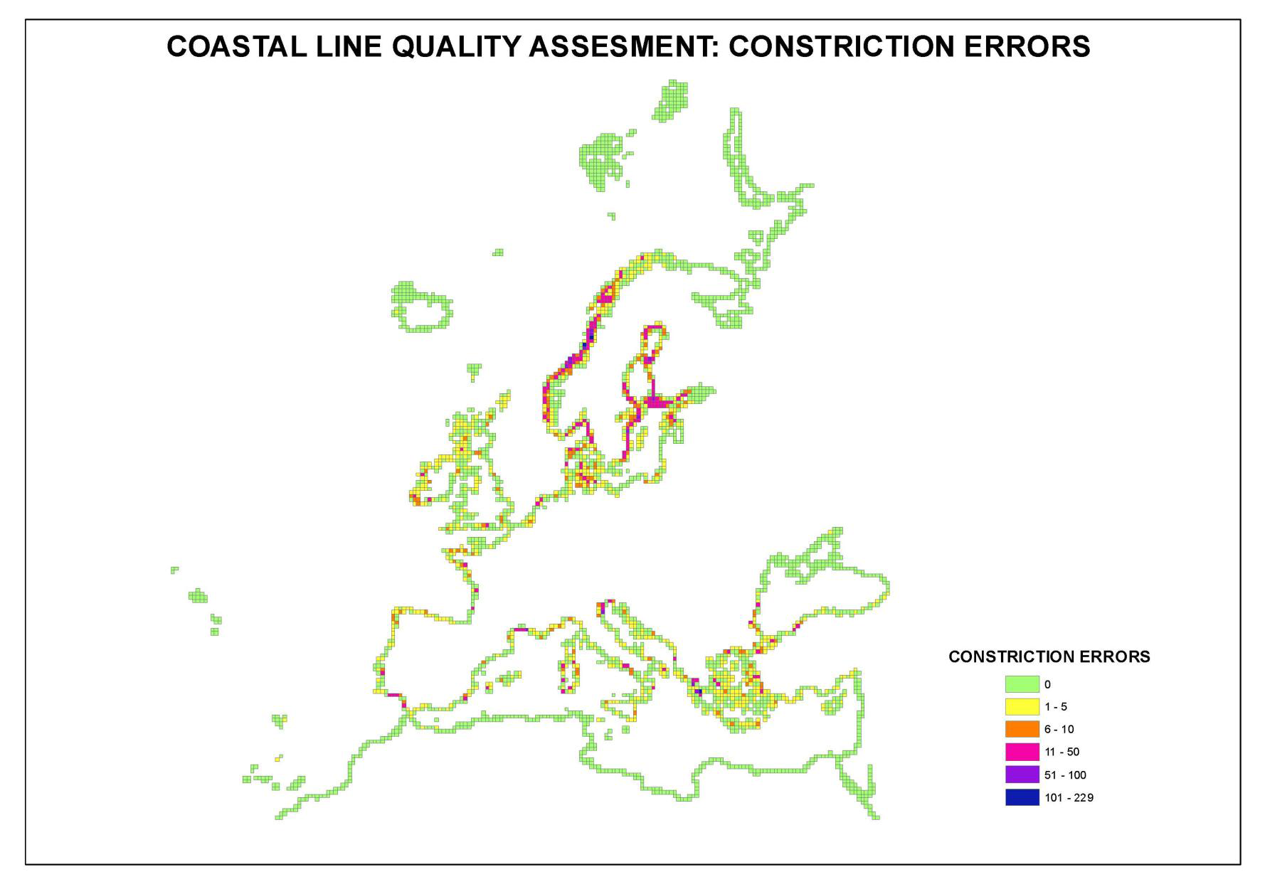
Continuity errors (commission)

Slide 18
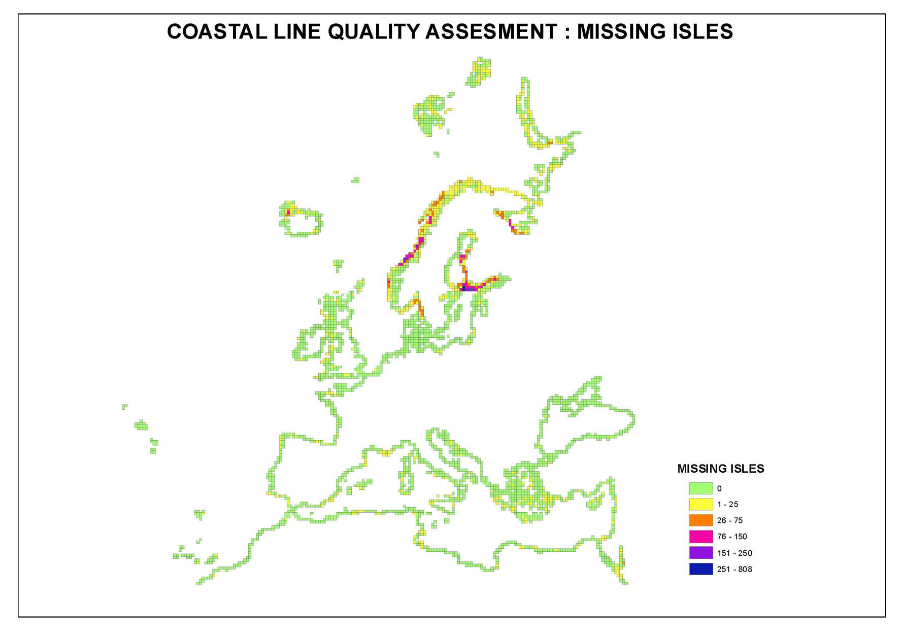
Missing islands (omission)

Slide 19
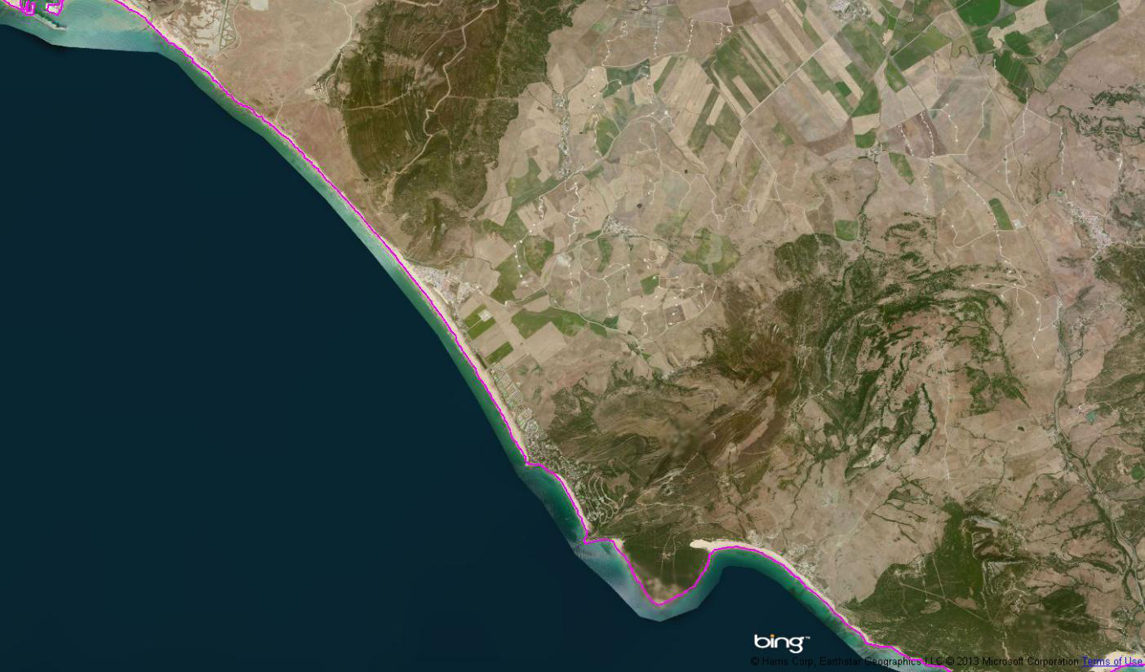
Adjustment

Slide 20
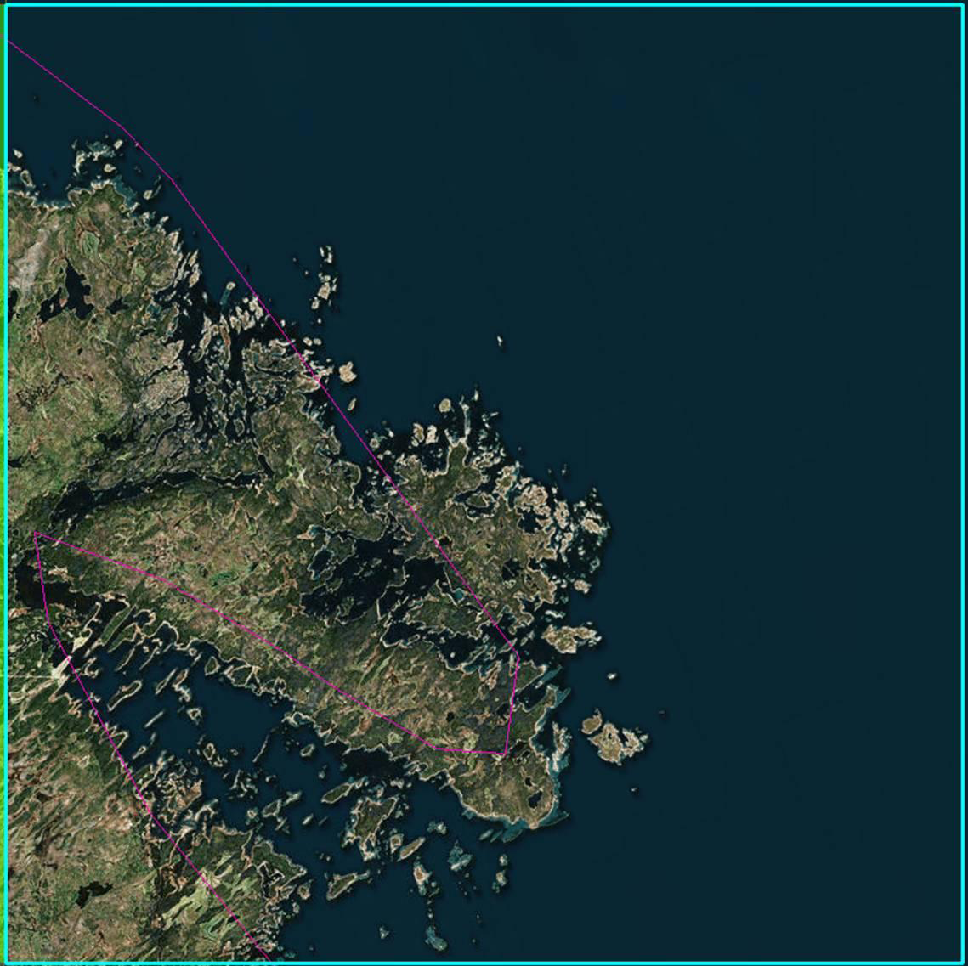
Serious error and omission example

Slide 21
Future work (potential)
Improvement opportunity of geometry:
Delegation agreement RDA (Copernicus)
Improvement of EU-Hydro → also coastline?
Time frame: end 2014
Integration of attributes, and national data (linear referencing)
Make consistent baselines (adapting those from Eurosion) → zoning (internal, territorial waters, contiguous zone, EEZ)

Slide 22
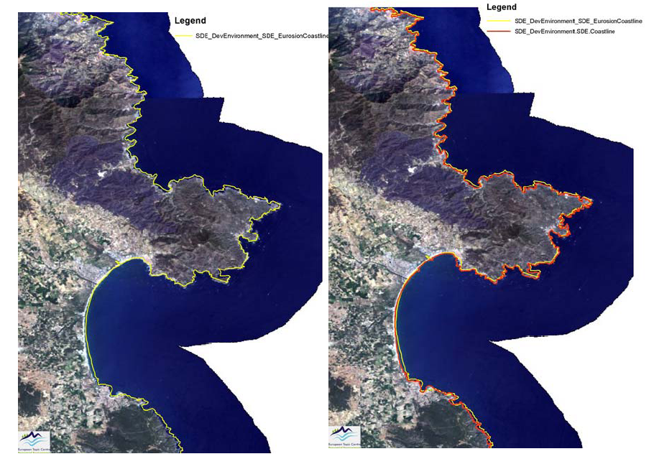
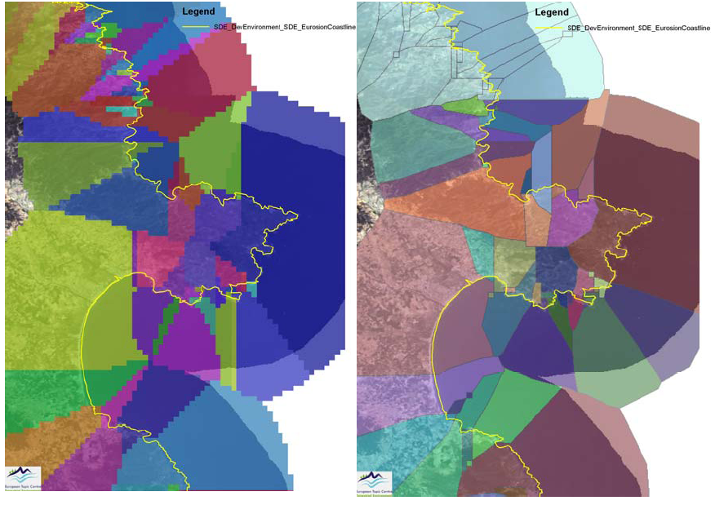

Slide 23
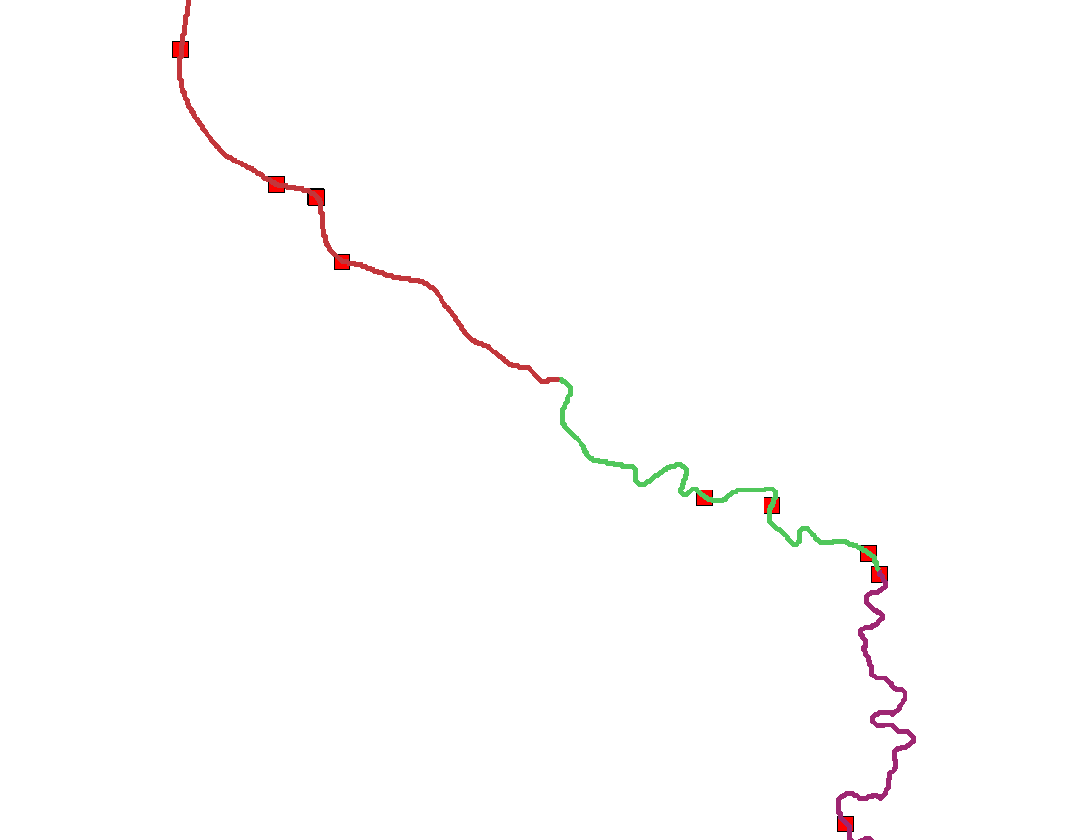
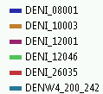
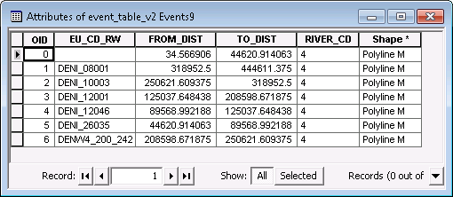
Linear referencing allows for showing national
water bodies on European reference datasets

Slide 24
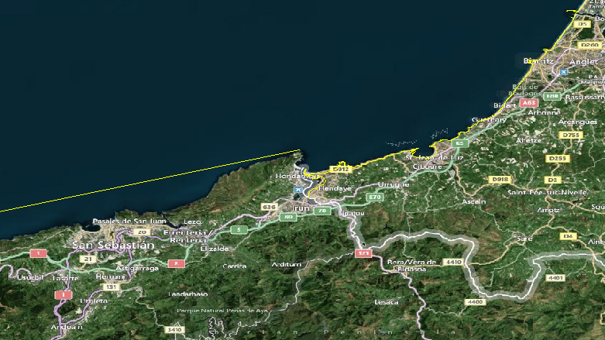
Baselines

Slide 25
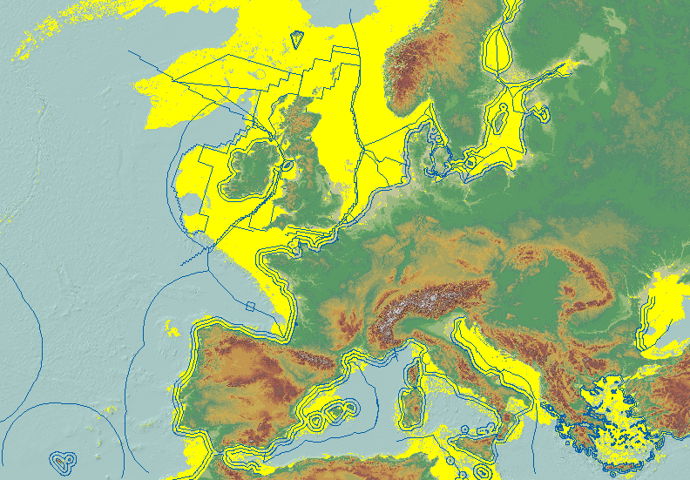

Slide 26
Thank you! Questions?
oscar.gomez@eea.europa.eu

