Slide 1
Synergies and clustering between maritime projects
28/06/2023 EMFF Workshop on Digitalisation
Sustainable Blue Economy unit, D3, CINEA
Notes:
Good morning and welcome
Charlotte Jagot senior project advisor in the SBE unit which manages the European Maritime, Fisheries and Aquaculture Fund (EMFAF) the new programme for the period 2021-2027. The Unit is also managing ongoing projects and actions under the European Maritime and Fisheries Fund (2014-2020).

Slide 2
CINEA
EUROPEAN MARITIME FISHERIES
AND AQUACULTURE FUND
CONNECTING EUROPE FACILITY 2 Transport and Energy
RENEWABLE ENERGY FINANCING MECHANISM
EUROPEAN CLIMATE, INFRASTRUCTURE AND ENVIRONMENT EXECUTIVE AGENCY
HORIZON EUROPE
Climate, Energy and Mobility
JUST TRANSITION MECHANISM
Public Sector Loan Facility pillar
INNOVATION FUND
LIFE PROGRAMME
Notes:
The European Climate, Infrastructure and Environment Executive Agency manages several programmes that contribute to the EU Green Deal

Slide 3
Overview of EMFF digitalisation projects
Notes:
This workshop is the second workshop under the EMFF contract called synergies and clustering between maritime projects.
The objective of this contract is threefold:
- First to evaluate the impact of these projects
- Second but also to allow projects to gain visibility
- Third to network and to share experiences with other projects under other EU pogrammes
Today is our first thematic workshop that is looking at skills. It is a bit special because at the end of the year, there will be a new call for proposals on blue careers and this workshop is a milestone to take stock of what has been done and what should be prioritised for the future

Slide 4
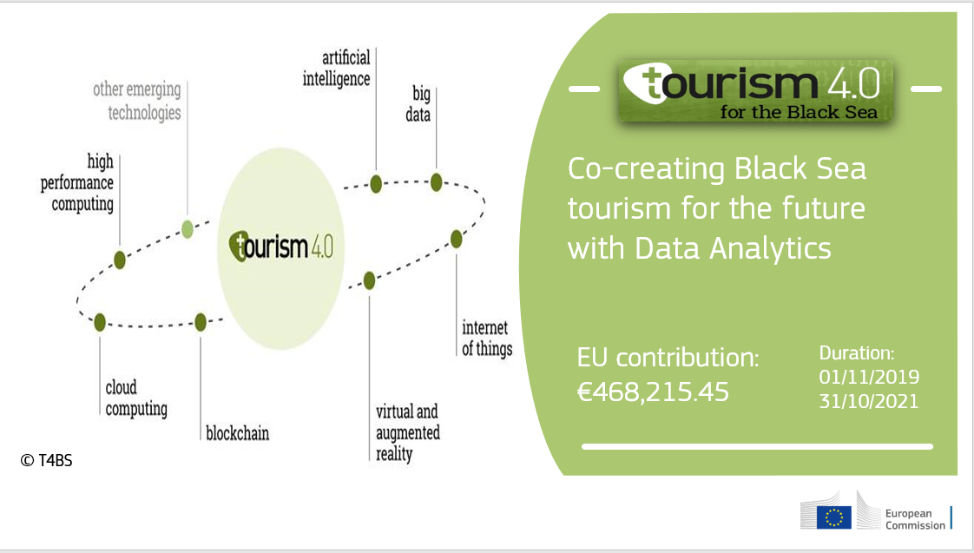
Digitalisation in fisheries, aquaculture and tourism
About 10 projects with a wide variety:
- Digital tools for safety of fishers & sustainable management of small-scale fisheries
Smart feeding systems for shrimps and fish
Internet of Underwater Things for underwater cultural heritage
The future of tourism with data analytics

Slide 5
More info about projects? Check the story

Slide 6
Thank you
Notes:
Thank you for your attention.

