Slide 1
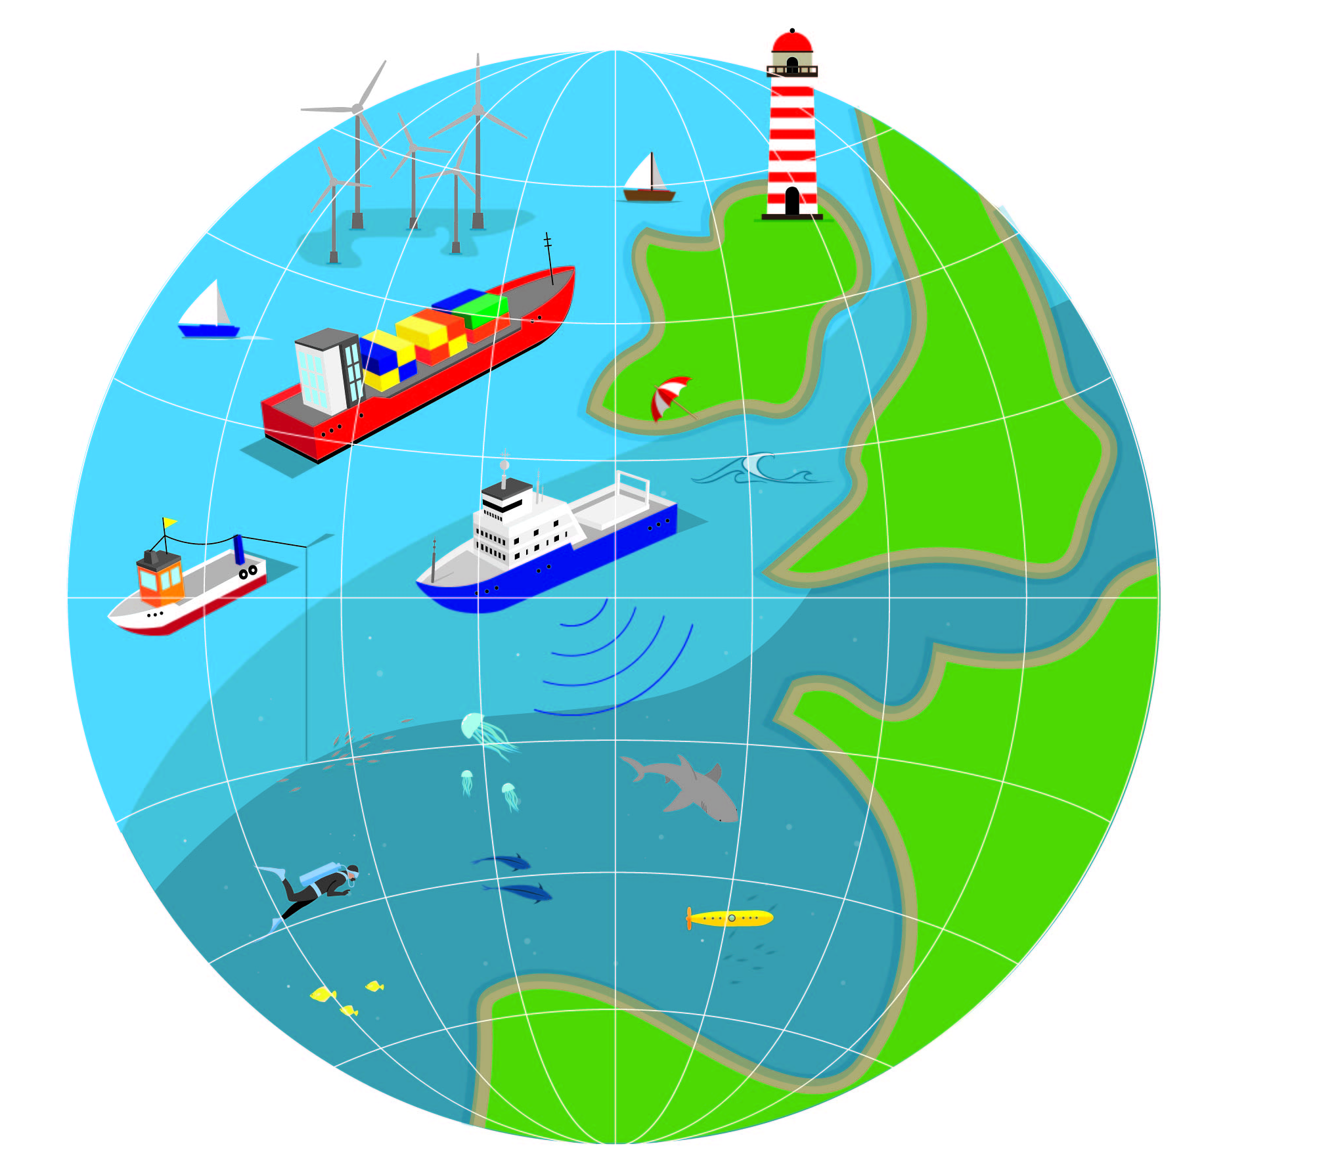
European Atlas of the Seas – Marine Litter Quiz
www.european-atlas-of-the-seas.eu

Slide 2
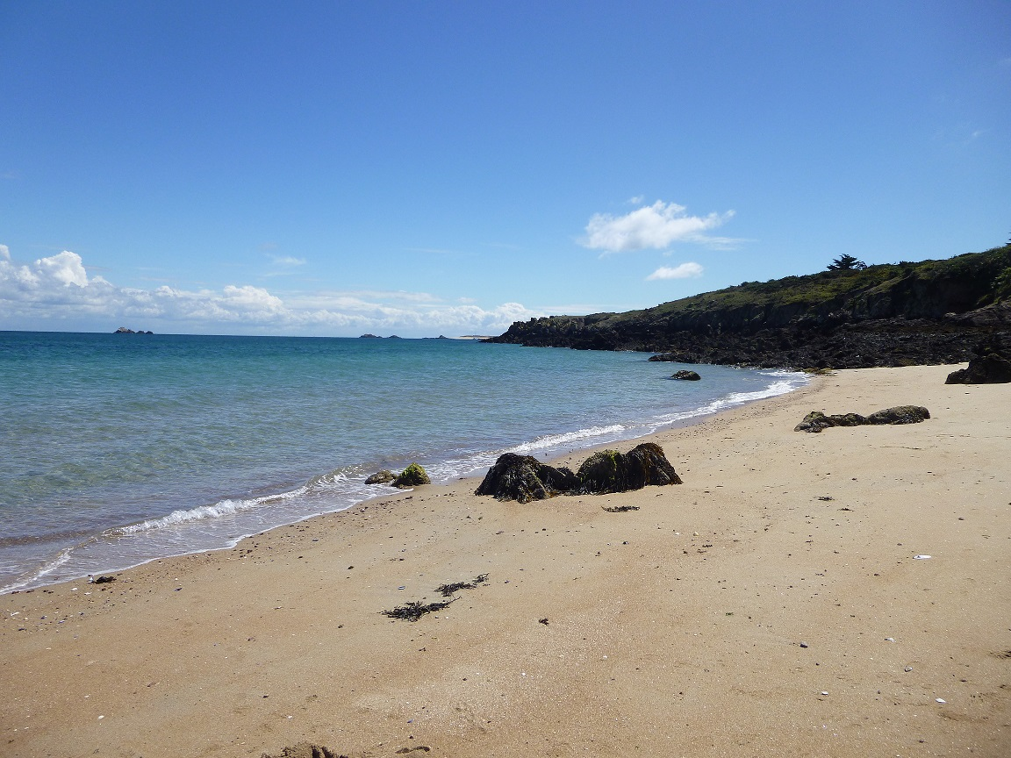
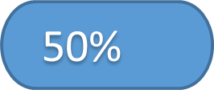
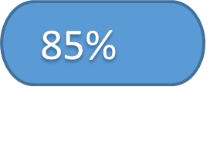
Worldwide, what percentage of marine litter consists in plastics?

Slide 3
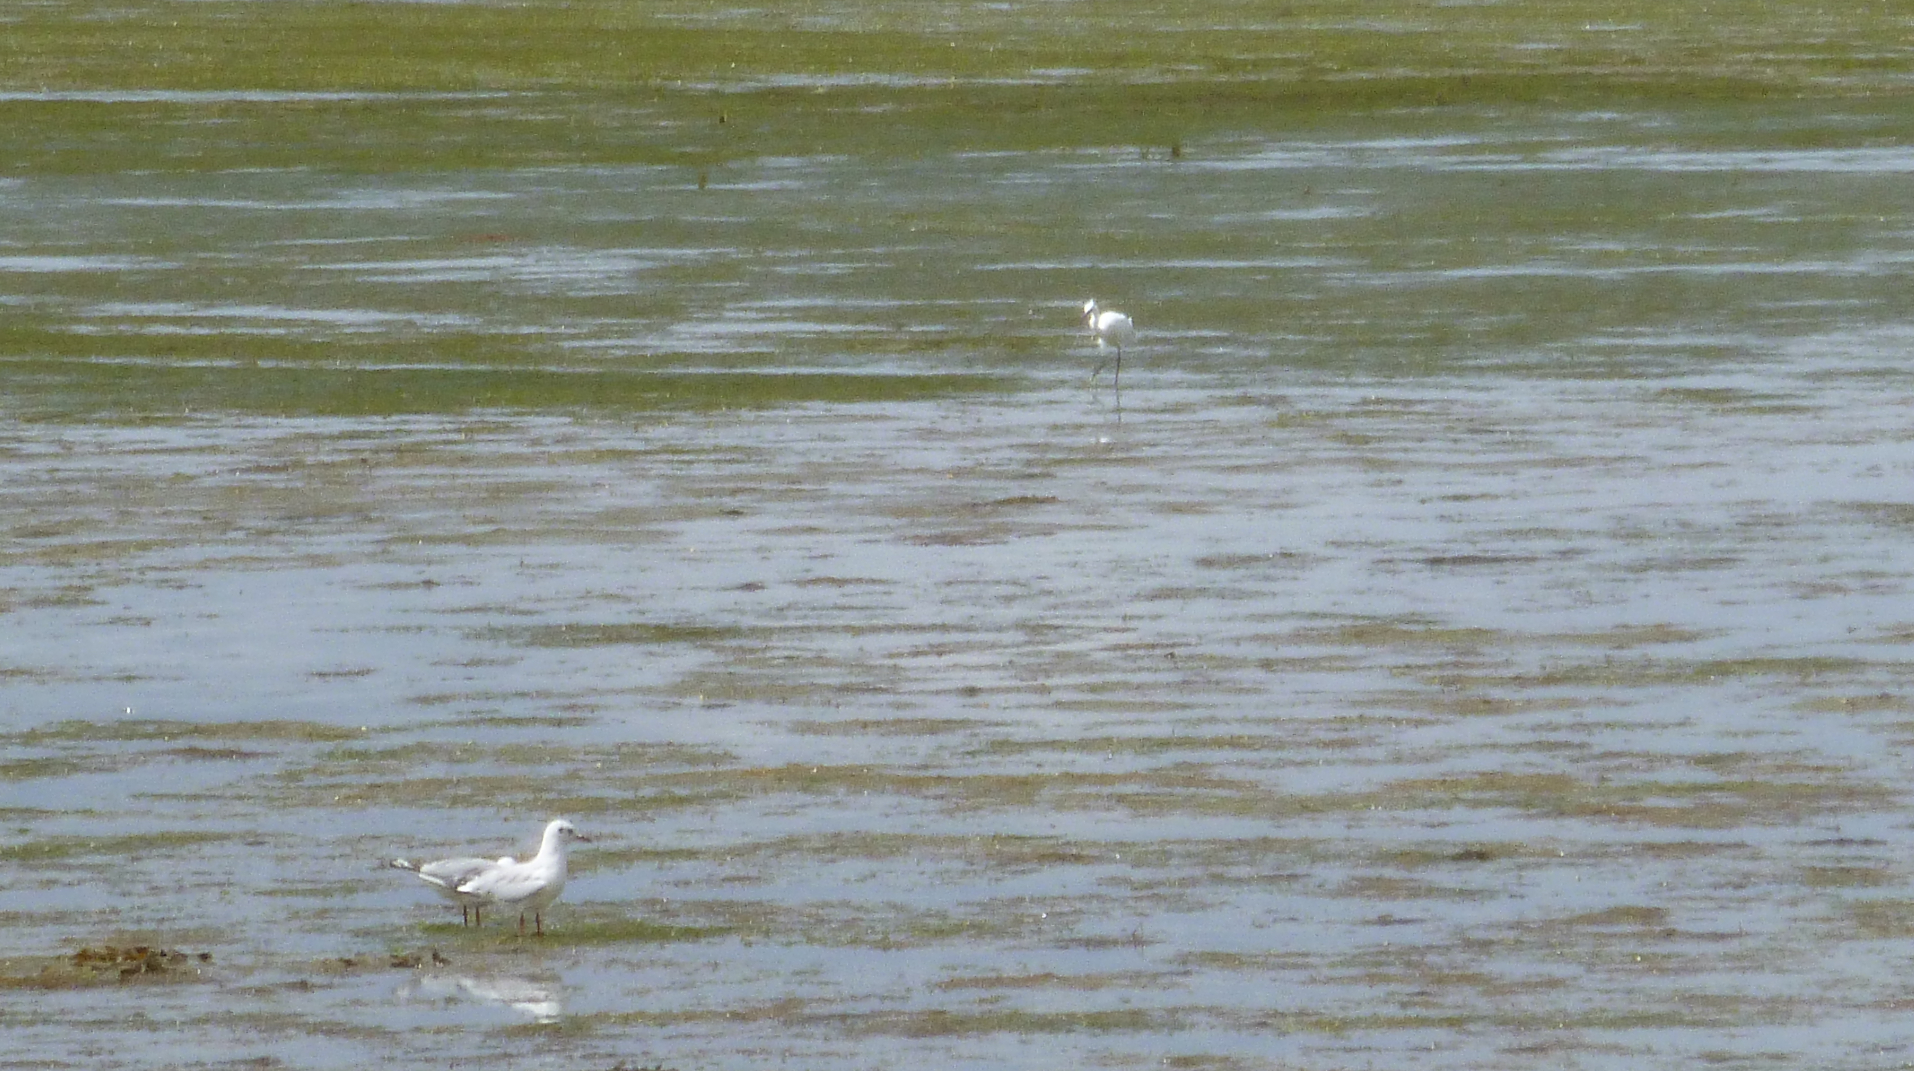
That is not the answer... Let’s try again!
www.european-atlas-of-the-seas.eu

Slide 4
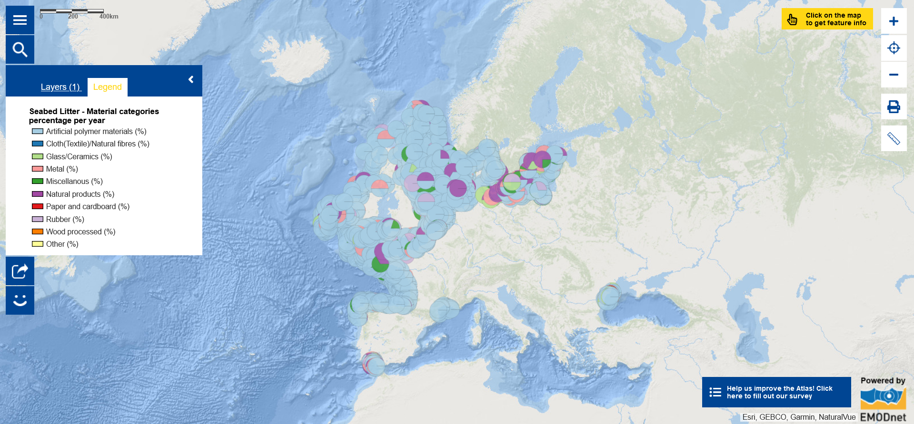
Globally, plastics account for 85 % of marine litter. Have a look at seabed litter in Europe.
(Source for the answer: https://www.un.org/sustainabledevelopment/blog/2023/08/explainer-what-is-plastic-pollution/).

Slide 5
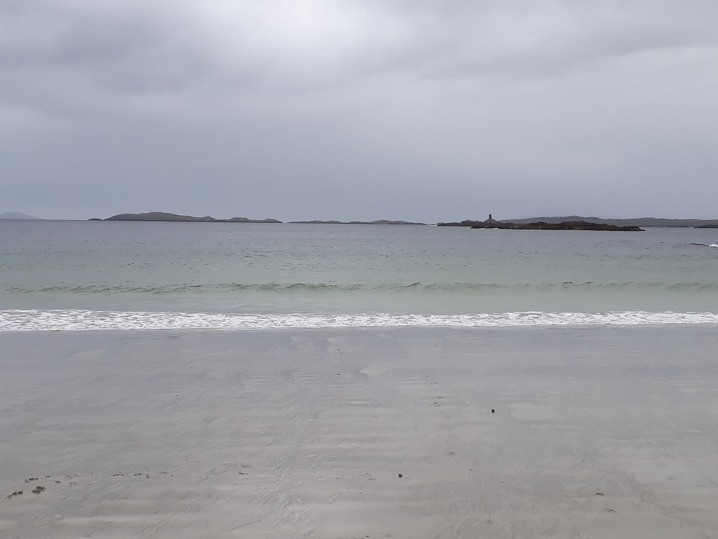
How much plastic is currently in the ocean and seas?

Slide 6
That is not the answer... Let’s try again!
www.european-atlas-of-the-seas.eu

Slide 7
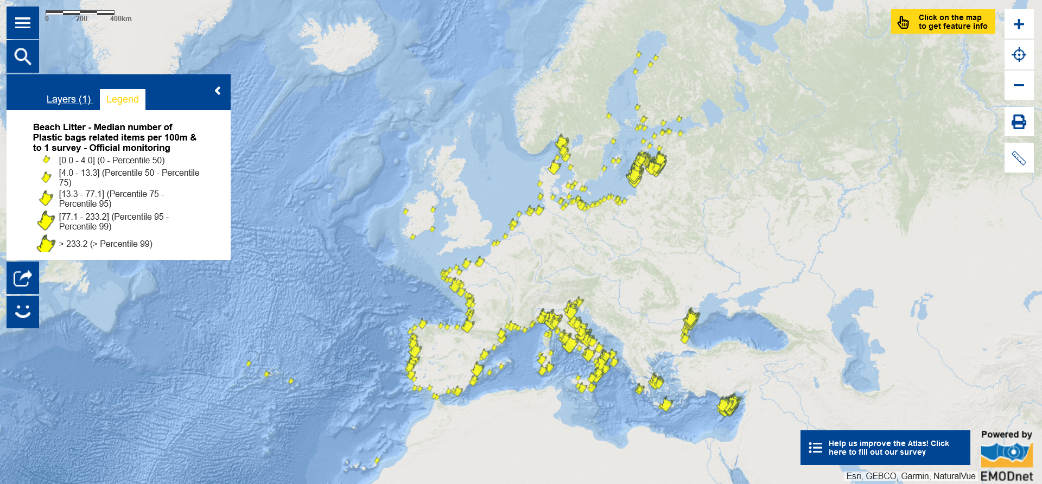
Over 120 million tons of plastic are currently in the ocean and seas. Have a look at plastic bags in beach litter in Europe.
(Source for the answer: https://marine.copernicus.eu/explainers/phenomena-threats/plastic-pollution)

Slide 8
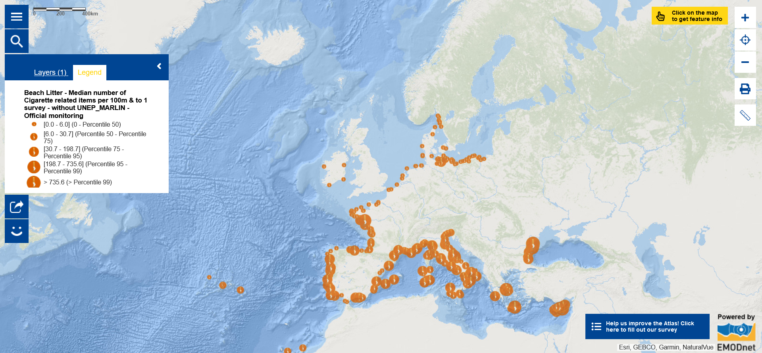
Have a look at cigarette related items in beach litter in Europe.

Slide 9
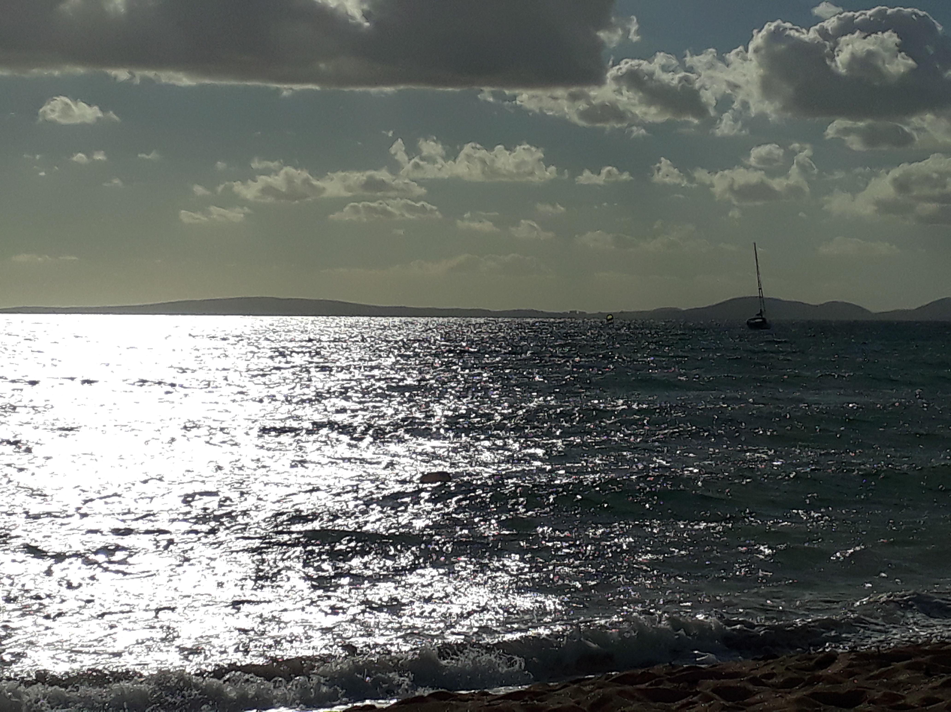
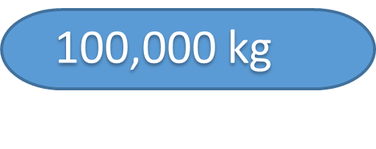
Enaleia works with fishers towards a sustainable marine ecosystem. How much marine plastic have they collected since 2018?

Slide 10
That is not the answer... Let’s try again!
www.european-atlas-of-the-seas.eu

Slide 11
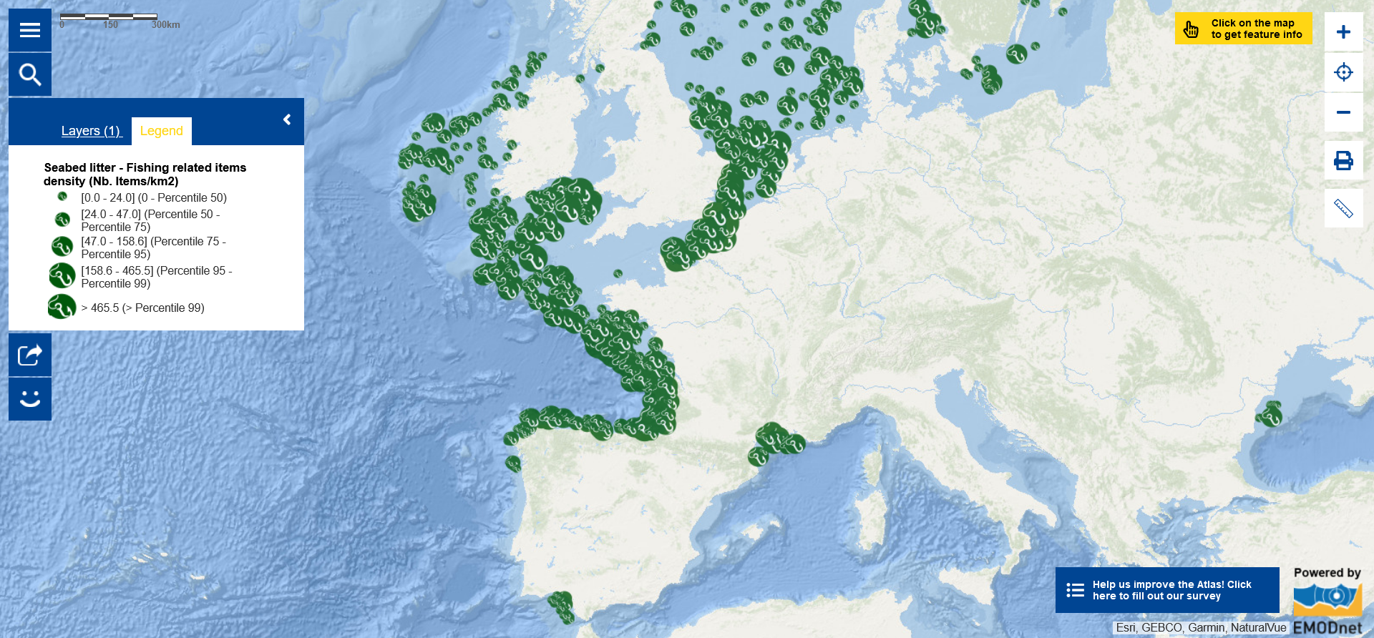
900,000 kg of marine plastic have been collected since 2018 in the framework of Enaleia activities. Have a look at information on fishing related items in seabed litter.
This map shows the density of fishing related items at the seafloor expressed as the number of items collected by fish-trawl surveys over the period of one year. Note that the absence of collected data in some areas does not mean they are free from fishing related items.
(Source for the answer: https://enaleia.com/)

Slide 12
Enaleia is one of the many members of the EU4Ocean Coalition working on solutions to address plastic pollution. Dive into the EU4Ocean map in the Atlas to discover others!

Slide 13
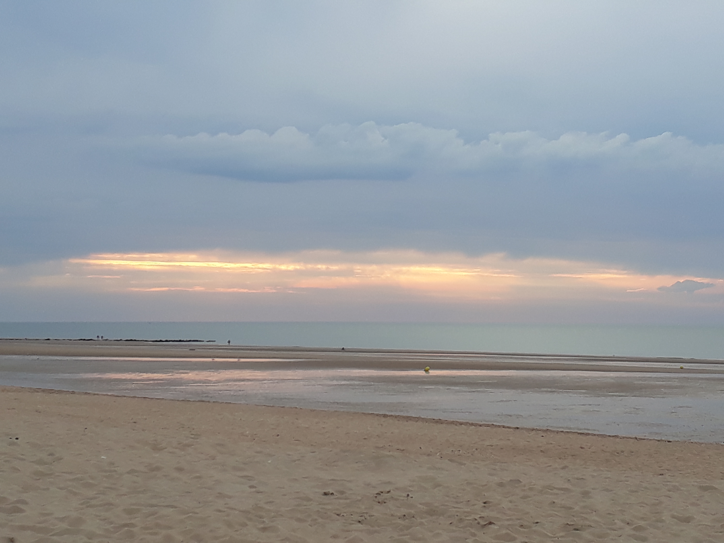
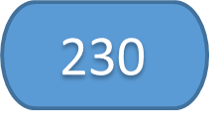
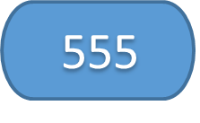
How many events were organised in 2023 as part of the #EUBeachCleanup campaign?

Slide 14
That is not the answer... Let’s try again!
www.european-atlas-of-the-seas.eu

Slide 15
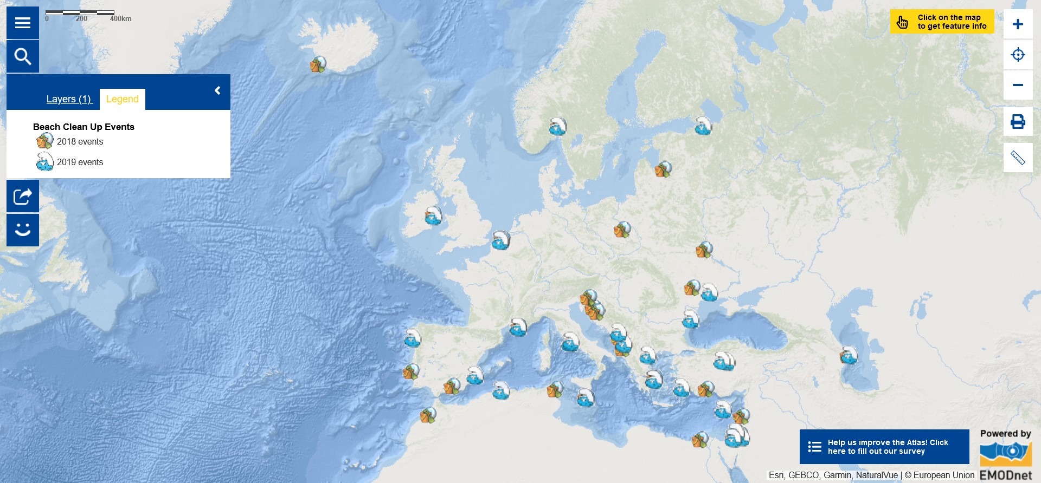
In 2023, 45,700 participants took part in 555 events, in 44 countries across all inhabited continents. Have a look at past events.
Get Ready!
10 June - 31 October 2024
(Source for the answer: https://oceans-and-fisheries.ec.europa.eu/eu-beach-cleanup_en)

Slide 16
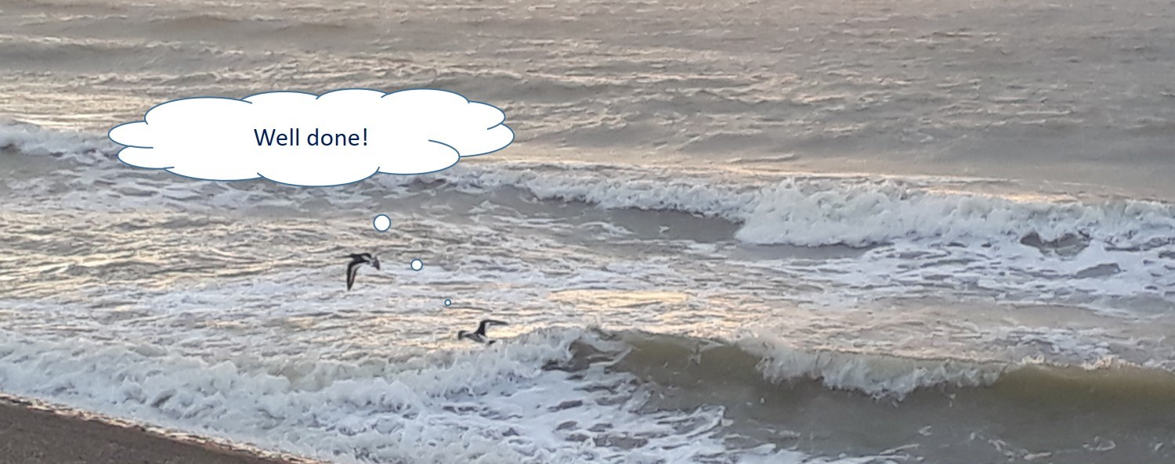
EMODnet Secretariat, , CC BY-NC-ND 4.0

Slide 17
Dive in and explore the European Atlas of the Seas!
www.european-atlas-of-the-seas.eu
© European Union 2023
Unless otherwise noted the reuse of this presentation is authorised under the CC BY 4.0 license. For any use or reproduction of elements that are not owned by the EU, permission may need to be sought directly from the respective right holders.
Pictures included in the slides: EMODnet Secretariat, CC BY 4.0
Notes:
Tim short

