Slide 1
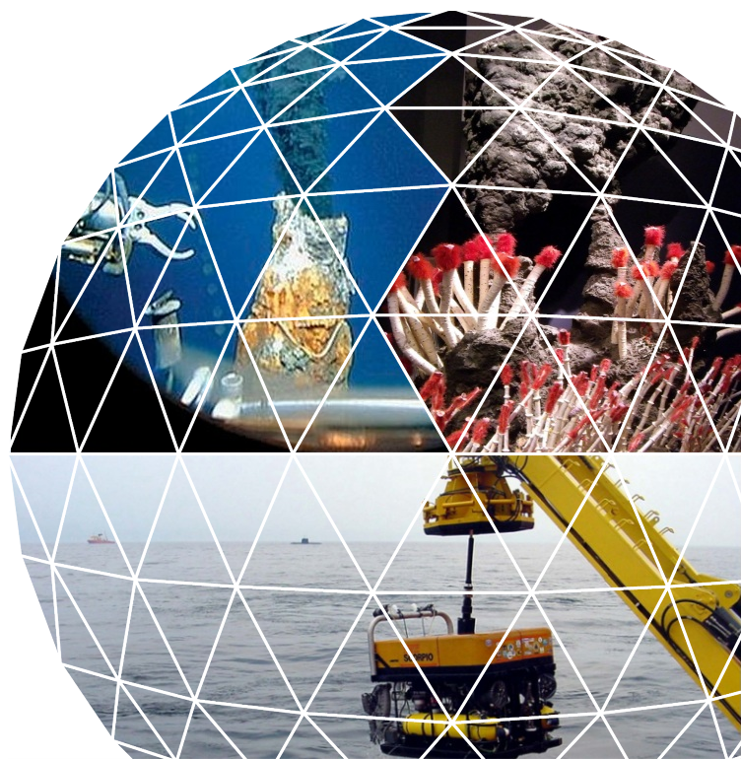
Study to investigate the state of knowledge of Deep Sea Mining
Steering Committee meeting on the draft final report
Brussels, 1 July 2014
Notes:
Zie notes onder elke slide!

Slide 2
Short overview of state of play
Key messages from the study findings
Some further details from (new) individual tasks
Pending actions towards study finalisation
Detailed comments from the SC members
Planning

Slide 3
Key messages from the study findings
Three deposit types (nodules, crusts, SMS) are of very distinct character and differ in potential and impacts
  Metal content & presence of high value metals
  Location and depth
  Sea bed technology requirements
Substantial increase of exploratory activity compared to 1/2 decades ago (nodules, followed
SMS closed to exploitation (Solwara I - 2016)
Explotation other might still take another 10-15 years
Opportunities for Europe:
Offers potential for EU technology supply;
Not likely a major job generator for Europe in the short run;
Security of supply arguments mainly valid for nodules and crusts (strategic/geopolitical argument);

Slide 4
Key messages from the study findings
 | SMS | Nodules | Crusts
Main metals | Cu, Zn, Au, Ag | (Mn), Co, Cu, Ni, traces of REE | Co, Ni, Cu, Pt, Th, Te, (Li), other REE
Security of supply? | No, metals abundantly present in terrestrial resources | Yes (Co) | Yes (various)
Sea bed potential | Small deposits, not likely economical unless larger found | High potential for Co, large reserves expected | High potential for Co (larger than terrestrial)
Technology advancement | Most focus on this (Nautilus) | Very deep, specific technological challenges | Less investigated so far + complex resource assessment
Commercial interest | Largest income generation possible if reserves large enough | Max 2-3 projects in parallel before Co market is affected (small global demand)

Slide 5
Key messages from the study findings
Economic potential not for granted:
  Size & number of deposits
  Further exploration to identify/estimate resources
  Potential in EU waters smaller than Pacific on short term
  But some potential areas envisaged
  Higher costs of extraction relative to terrestrial resources + still sufficient resources on land
  Scarcity of global resources not visible (yet)
  Wide range of uncertainty in cost estimations
Technical feasibility requires a number of challenges to pass:
  Extraction never done at commercial scale yet
  Need for 1) better resource modelling & more efficient techniques (input for commercial operations), 2) sea bed device, 3) vertical transport
  Most advanced for SMS, least for crusts

Slide 6
Key messages from the study findings
Environmental concerns are high
  Many unknowns about existing eco-systems
  Impacts of mining activities yet to be explored and only known from small scale
  Strong scientific base in Europe, potential to assist others + to advise on sustainable approaches
Legal framework not fully developed
  ISA in process of defining exploitation regime for The Area
  EEZ of countries various discussions to align (e.g. Pacific SIDS cooperation)
  Possible role for EU in this domain

Slide 7
Further details on some (new) tasks
Additions from interim report:
  Geology information
  Economic analysis
  Projects analysis and overview
Furthermore
  Technical analysis extended/updated
  Legal analysis completed
  Environmental analysis refined & updated

Slide 8
Geology analysis
Data base composed of all known sites for the three deposit types
Key data (location, size, composition) for each site added
Map layers developed for integration into EMODnet (submitted end May)
Suggestions for areas of future interest

Slide 9
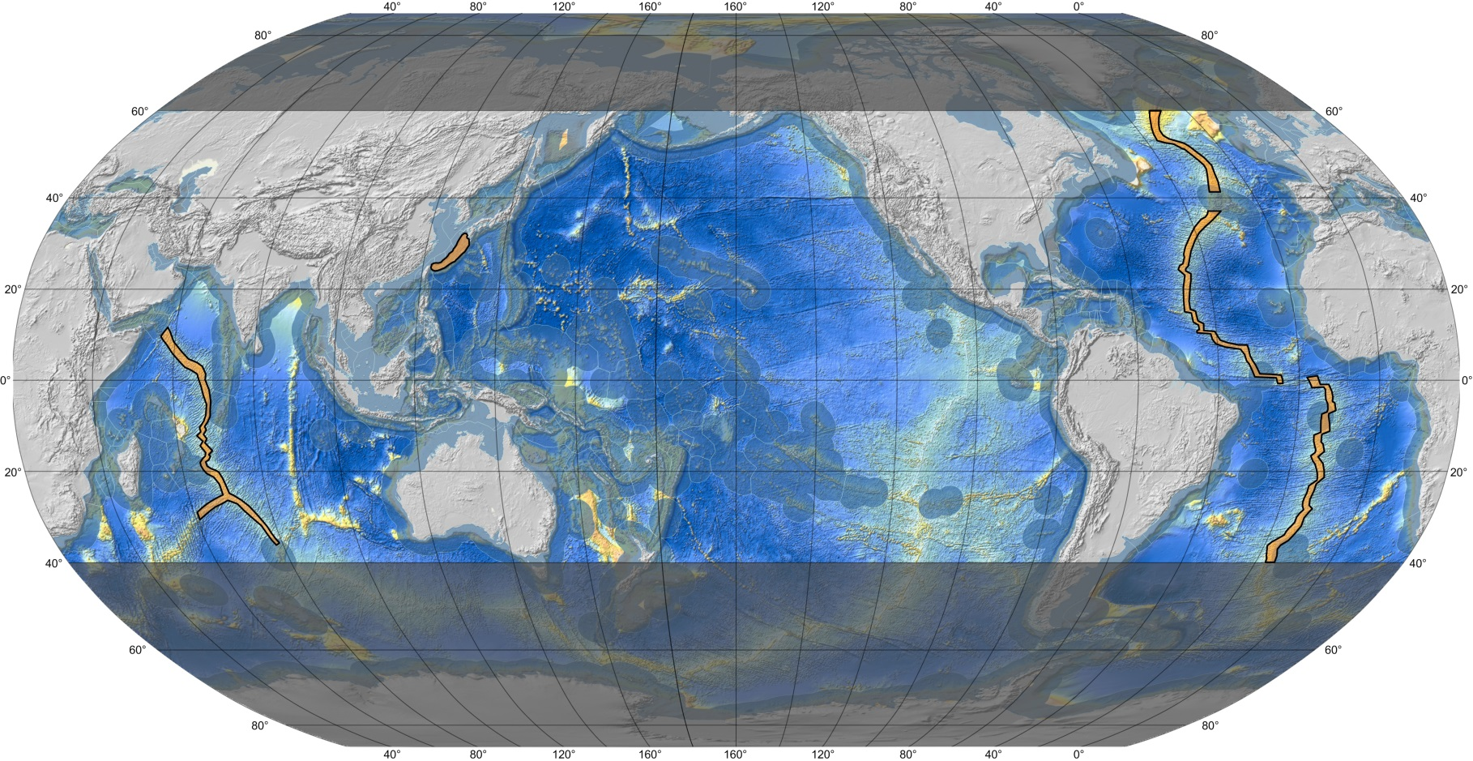
Task 4: Location of possible future area of interest with respect to seafloor massive sulphides. Grey shaded areas indicate likely limits of ship-based exploitation work due to weather conditions

Slide 10
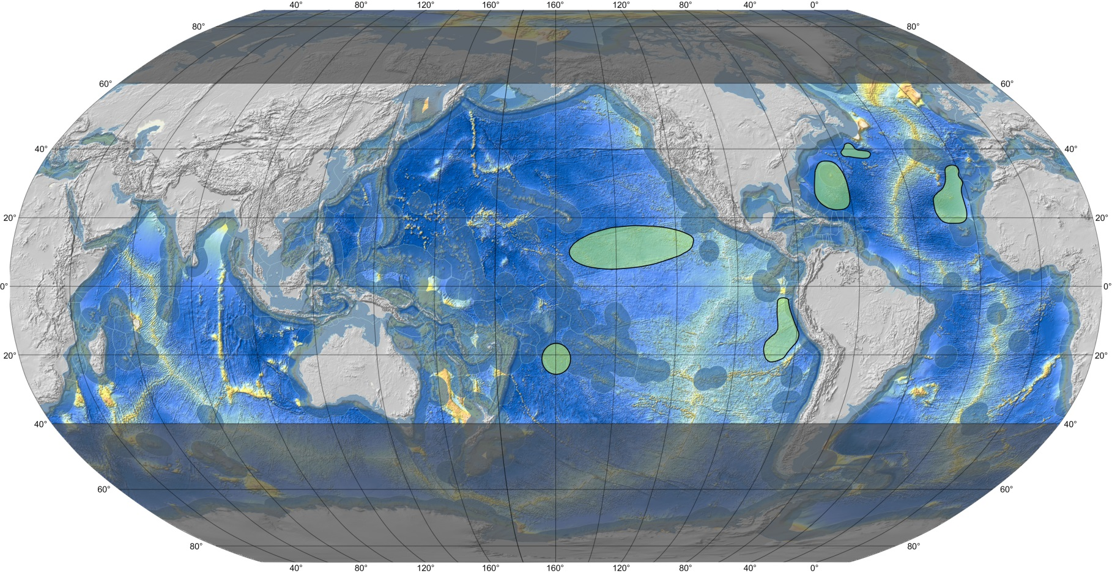
Task 4: Location of possible future area of interest with respect to manganese nodules. Grey shaded areas indicate likely limits of ship-based exploitation work due to weather conditions

Slide 11
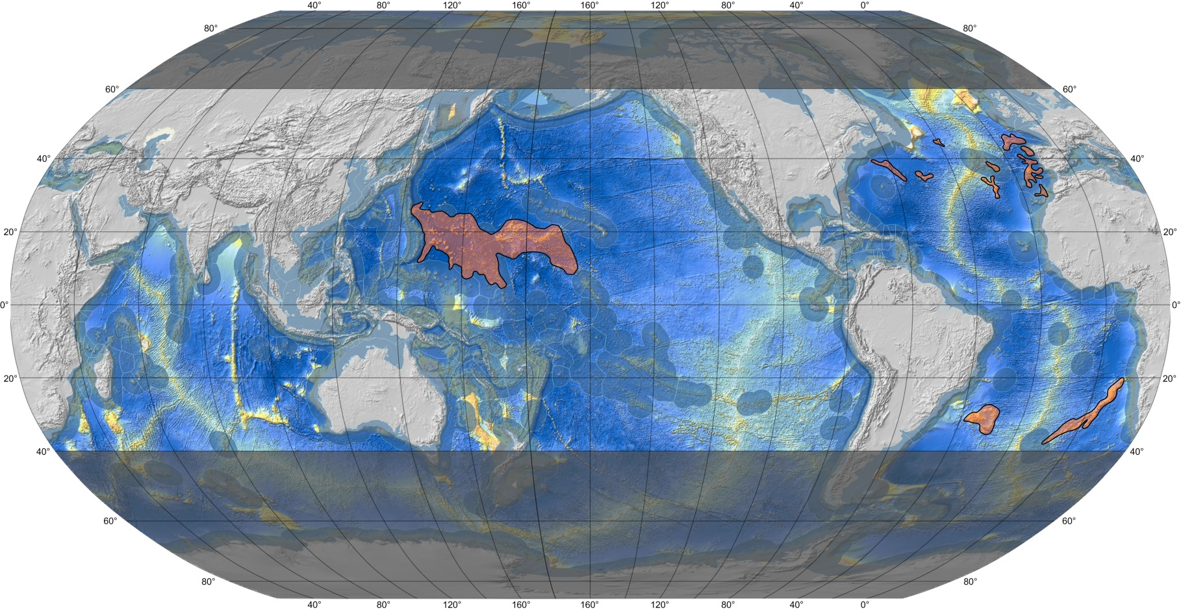
Task 4: Location of possible future area of interest with respect to ferromanganese crusts. Grey shaded areas indicate likely limits of ship-based exploitation work due to weather conditions.

Slide 12
Economic analysis
Deposit | Most relevant metals | Commercial interest | Security of supply (criticality) | Price/ton 2013
SMS | Copper | Medium/high | Low | 4,686
 | Zinc | High | Low | 1,138
 | Gold | High (depending on grade) | Low | 26,776,178
 | Silver | Medium | Low | 401,643
Polymetallic nodules | Manganese | Medium (abundant alternative supply; market uncertainty) | Low | 1,540
 | Cobalt | High | High | 16,735
 | Copper | Medium/high | Low | 4,686
 | Nickel | High | Low | 10,041
 | Trace metals (REE, Molybdenum, Lithium) | Medium (traces) | High | 8,702
Cobalt rich crusts | Manganese | Medium (abundant alternative supply; market uncertainty) | Low | 1,540
 | Cobalt | High | High | 16,735
 | Nickel | High | Low | 10,041
 | Platinum | Medium | Medium | 30,123,200
 | Other trace metals (REE, Tellurium) | Medium | High | 8,702

Slide 13
Economic analysis
Economic growth is main driver for demand
Mining industry structure (juniors → seniors)
Huge variety in cost estimates (order of 0.5-1.5 bn EUR investment)
As well as in revenues (composition, which metals to be extracted, volumes)
SMS appear commercially most attractive, then nodules. However balance tips depending on assumptions
Need for sufficient production volume
Reserve size should be sufficient to operate for 15-20 years
Exploration costs not included in cost estimate (sunk costs)
Recycling is an interesting alternative source where further improvements can be gained, but quite a long way to go before it can fully replace mining. In growing market by definition insufficient to meet demand.

Slide 14
Projects analysis
Map of current licenses and applications

Slide 15
Projects analysis
Licenses ISA 2001-2011 only for nodules; applications for SMS and crusts more recent
No exploitation licenses yet (regime being developed, see legal analysis)
EEZ country licenses however entirely on SMS, incl. 2 for exploitation. No commercial interest for nodules and crusts yet
ISA concludes that:
  There is little evidence of any sense of urgency for commercial development, and that
  Most programmes continue to be prolongued scientific research campaigns, without any commercial viability.
Pacific island states see DSM as an opportunity for revenue generation
In most exploration governmental or national agencies involved (e.g. KIOST, JOGMEC, BGR)

Slide 16
Technology analysis
TRL assessment – summary of level of advancement
 |  | SMS | Nodules | Crusts | Notes
Exploration |  | moderate | high | moderate | Challenge esp. Related to drilling (high costs/high intensity vis-a-vis current findings)
Resource estimation |  | moderate | moderate | low | 2D modelling fairly developed, 3D modelling poses requirements
Extraction and Materials Handling | excavation | low | low to moderate | very low | hardly any experience for crusts, only exploratory level for the others
 | vertical transport | low | low | very low | no longer term higher capacity testing
 | surface operations | moderate | moderate | moderate | similar development stage/requirements for each deposit type
Logistics |  | high | high | high | Technologies mature; ship-to-ship transhipment may pose challenges still
Processing |  | moderate | low | low | Depend on metal composition and extraction aims (which metals to take out from the ores)

Slide 17
Technical analysis update
Notion that there is no mature market yet
Value chain stage | EU position | Rating
Exploration | Technology providers + equipment operators; competitive edge varies a bit between specific components | High
Resource assessment, evaluation and mine planning | Some specialised companies in EU but not alone | Average
Extraction | Key components (cutting, grabbing, grinding) developed in Europe | High
Vertical transport | Infant technology but key developers based in the EU | High
Surface operations | EU well-placed re vessel technology | Average to high
Logistics | No unique position | Average
Processing | No unique position | Average

Slide 18
Legal analysis update
International law
Basic legal framework for DSM is set out in Part XI of UNCLOS & the Part XI DSM Agreement
DSM in areas subject to coastal State jurisdiction is subject to coastal State law
DSM in the Area subject to a specific regime regulated by the International Seabed Authority (ISA)
The EU and Member States are members of ISA – opportunity to assist/influence & provide expertise
The exploration aspects of the Mining Code have been established as ISA regulations
ISA is currently developing the exploitation aspects, benefit sharing to be addressed subsequently
Few formal linkages with other international instruments
ITLOS advisory opinion on the scope of State sponsorship

Slide 19
Legal analysis update
EU law
Unsurprisingly given absence of DSM in EU waters, EU law does not directly address DSM
DSM would be subject to SEA Directive but not EIA Directive
Birds, Habitats & Marine directives do not prevent DSM but May impact how and where it is undertaken
Limited application of Environmental Liability Directive
Waste legislation application may be challenging
New MSP&ICZM Directive will apply
Accounting Directive applies to DSM as an extractive industry

Slide 20
Legal analysis
National law
Description of DSM Of selected Member States, OCTs and third countries
Legislation on DSM in the Area
Many countries have yet to adopt this
Where adopted tends to be old but updated
Legislation on DSM in areas under national jurisdiction
A number of countries do not have relevant legislation
In most cases 'DSM' legislation is just terrestrial mining legislation applied to the sea - query appropriateness?
Need for specific legislation eg Portugal, PNG, USA
Risk of lower standards being applied/enforced compared to the Area

Slide 21
Environmental analysis update
Main environmental concerns: While the major impacts from mining will be similar for the three types of mineral deposit considered here, namely:
  loss of substrate,
  the effects of mining on the seabed, the operational plume and re-sedimentation and
  the discharge plume and its effects on pelagic and/or benthic fauna depending on the depth of discharge.
There are also impacts specific to each deposit depending on the geomorphological setting, differing physical conditions, the scale of operations, and the technology used for extraction.

Slide 22
Environmental impacts
Impact | Nodules | SMS | Crusts | Potential for recovery
Removal of habitat | Destruction of habitat and associated organisms. | Destruction of habitat and associated organisms by initial mining and pollution of the environment by chemical toxins. | Destruction of habitat of attached epifauna | For nodules likely to be extremely slow. For SMS relatively short (months to years). On off-axis vent sites likely to be of longer term - probably tens to hundreds of years. For crusts tens to hundreds of years.
Sediment laden plumes near seabed containing particle load | Can result in the smothering of seabed animals. Will affect suspension feeders on other nodules in the licensed area and on any seamounts in the vicinity of mining operations. | Smothering of seabed animals by the particulates especially proximal to the mined area and downslope. Potential poisoning of animals in all areas affected by the plume due to the chemical toxins. | Smothering of seabed animals | For nodules likely to be slow especially in areas heavily impacted by plume fallout. For SMS it will probably take a few years. In the off-axis vents recovery from chemical pollution may take tens to hundreds of years. For crusts tens to hundreds of years if epifaunal organisms are impacted on bare rock surfaces.
Sediment laden plumes in water column | If plumes are released in the photic zone (c200 metres) they will cause a reduction in light penetration and in temperature. These are likely to reduce plankton growth with knock-on impacts to whole food chain. Sediment load likely to affect feeding of gelatinous zooplankton. High nutrient load from deep waters introduced into oligotrophic waters may stimulate primary production and of different species than those normally occurring in the area. | Impacts similar to nodules. Toxins in the plumes could cause loss of organisms at all levels in the food chain and could impact commercial fish stocks | Similar to nodules. Additionally, high nutrient load from deep waters introduced into oligotrophic waters may stimulate primary production and of different species than those normally occurring in the area. | Recovery will be rapid once activity ceases

Slide 23
Environmental impacts
Impact | Nodules | SMS | Crusts | Potential for recovery
Size and ecosystem function fractionated impact on life | Shifts in sediment grain size distribution. This changes the habitat in terms of the sizes of life that will either be benefited or be impacted negatively | Shifts in sediment grain size distribution. May also include changes in fine scale (biologically relevant) bathymetry. | Changes the habitat in terms of the sizes of life that will either be benefited or be impacted negatively | These effects may be long lasting as background sedimentation rates are low.
Noise | Masking effects on marine mammals. Low frequency noise could travel up to 600 km and have strong impacts on marine mammals within 15 km |  |  | Impacts on species may vary from immediate recovery to long-term effects potentially influencing behaviour and survival.
Potential loss of ship or pollution from ships | Pollution of surface waters | -
Tailing disposal on land/sea | Pollution | - |  | Long term

Slide 24
Pending actions towards finalisation

Slide 25
What we need to do still
Consistency between sections & proper storyline
Developing conclusions and recommendations
  Inputs from this meeting much appreciated
Thorough proofreading at Ecorys side still needed
Language check
Tidy up annexes, completing literature list, abbreviations etc.
Receiving and processing your further (written?) comments

Slide 26
Planning
Continue pending actions (ongoing)
Acquiring comments from SC (until end of July, pref earlier)
Submit final report by 28 August

Slide 27

THANK YOU!

