Slide 1
PART 1 - REPORT:
Overview of algae-related business &
youth support initiatives
+
PART 2 - DATABASE:
European algae project database

Slide 2
PART 1 - Overview of algae-related business & youth support initiatives

Slide 3
Report Content
Current Algae Education & Career Pathways
Current Algae Business Pathways
Gap Analysis
Inspiration from other sectors + outside the EU
26 Recommendations:
16x Education: from primary to vocational & professional levels
10x Business: from start-up support to international policy
7 Key Takeaways

Slide 4
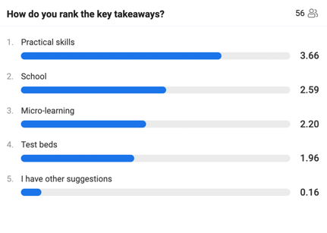
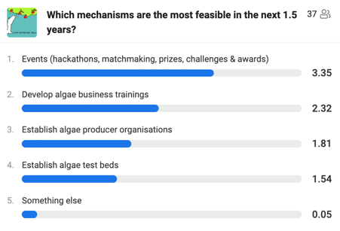
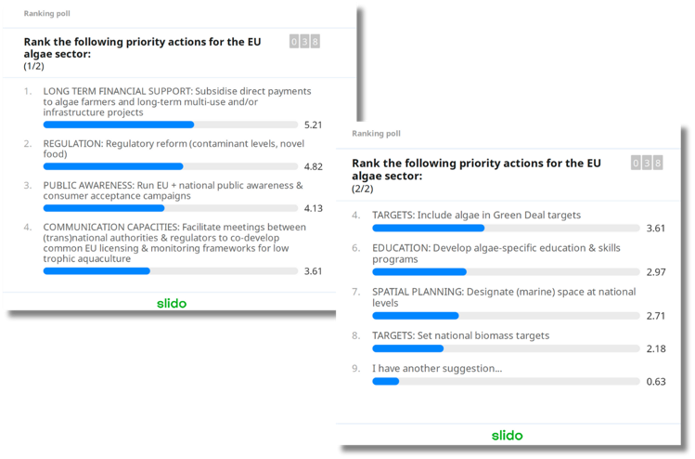
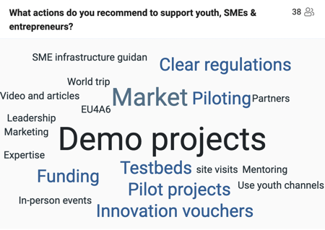
Methodology
Desk research & surveys conducted with >150 EU4Algae stakeholders at events and in Working Group 7 on Youth & Entrepreneurship

Slide 5
Gaps Identified
Youth & Education
Algae are generally absent from curricula at primary, secondary, vocational, entrepreneurial and professional levels in Europe
Fast-track entry to algae jobs is hindered by the absence of low-barrier training such as on-demand learning, micro-credentials and practical placements
Gatekeepers (e.g. authorities, regulators, large companies, consumers) lack the knowledge, capacities and administrative frameworks to support growth of the sector
Business
Critical value chain support gaps are identified among regulators, government and education, the latter two of which are key industry catalysts
Algae businesses rely heavily on short-term research projects for funding due to an absence of long-term business support mechanisms (e.g. subsidies)
Lack of gatekeeper awareness results in a lack of action, which perpetuates an unfavourable regulatory and fiscal policy landscape compared to other sectors (e.g. agriculture) and regions (e.g. Asia)
Notes:
Up- and re-skilling of adult professionals through innovative delivery methods such as on-demand and e-learning will:
1. fast-track recruitment to the sector
2. educate gatekeepers (local authorities, regulators, consumers, large companies etc.) to create an enabling environment

Slide 6
7 Key Takeaways
Youth & Education
1. TEACH ALGAE IN SCHOOLS: Put algae on the curriculum
2. FOSTER ON-DEMAND LEARNING: Develop dynamic micro- and e-learning offers
3. FOSTER PRACTICAL SKILLS: Facilitate practical placements
4. BUILD CAPACITIES: Educate regulators, governments and other gatekeepers
Business
5. ALLOCATE TEST BEDS: Create space for businesses to experiment, validate & demonstrate their products and services
6. INCENTIVISE INVESTMENT: Create a level playing field
7. DRIVE CONSUMER DEMAND: Create market pull
Who?
TEACHERS
ONLINE EDUCATION PLATFORMS
COMPANIES & ASSOCIATIONS
PUBLIC AUTHORITIES
PUBLIC AUTHORITIES
EU POLICYMAKERS + MINISTERS OF AGRICULTURE & FISHERIES
NGOs + SALES & MARKETING COMPANIES

Slide 7
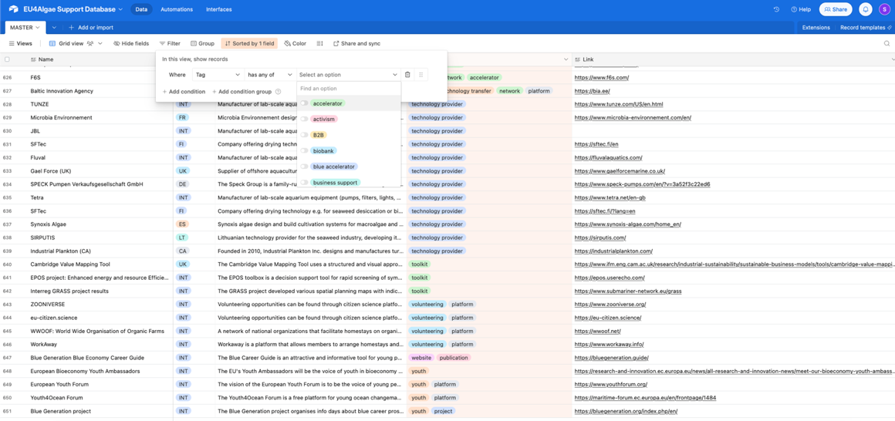
Annex = EU4Algae Support Database Content
Non-exhaustive list of examples:
Accelerators
Associations & networks
Biobanks
Careers
Certification
Competitions
Conferences
Hackathons
Consultancy
Crowdfunding
Databases
Matchmaking platforms
Study & training opportunities
Funding
Projects
Spatial planning resources
Food business resources
Industrial symbiosis resources
Technology providers
Scientific publications
…and much more!
*not exclusively algae-specific resources!
…but potentially relevant

Slide 8
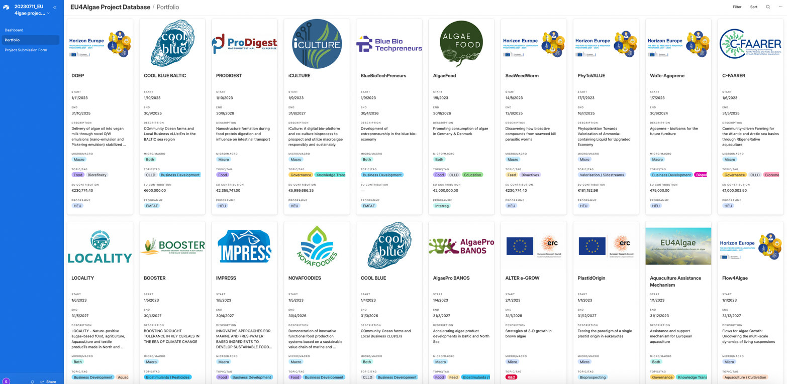
PART 2 - European algae project database

Slide 9
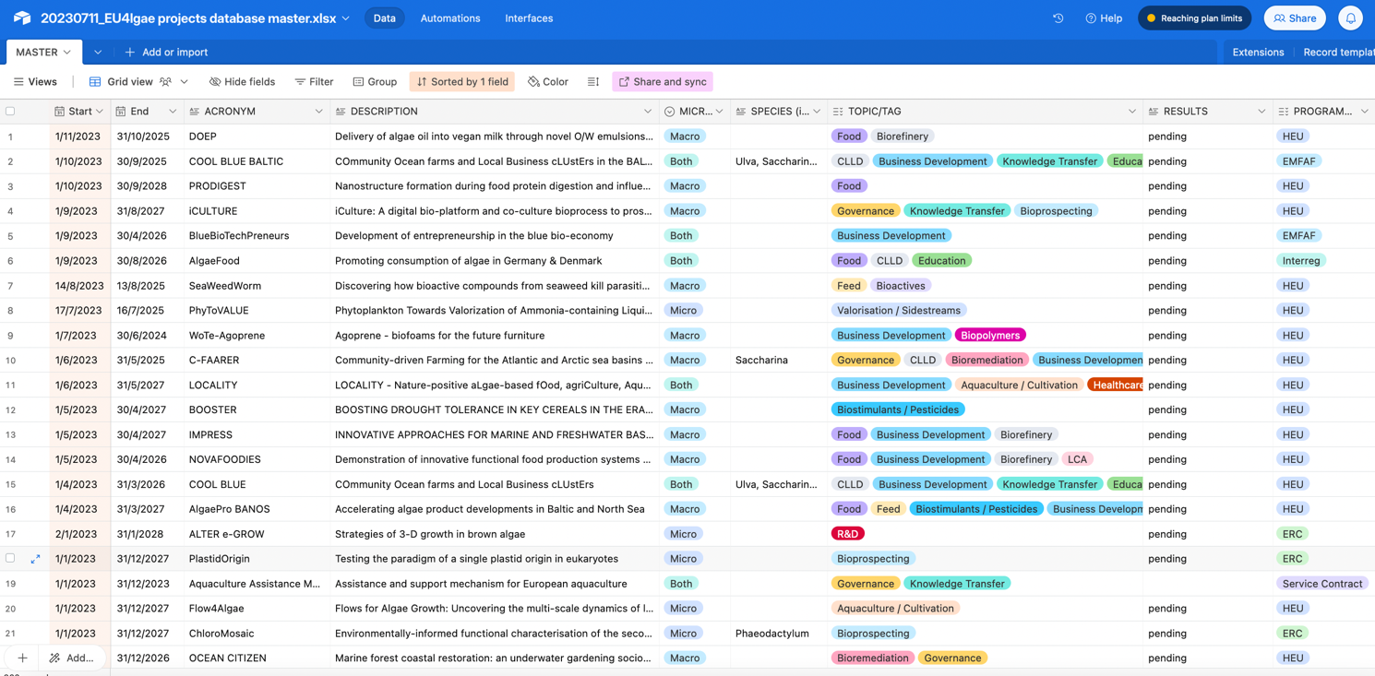
A searchable, user-friendly database

Slide 10
Scope & Methodology
“Algae-related projects”
projects either directly or indirectly involving algae, e.g. --->
>850 European projects since 1985
Multiple EU Funding Programmes
FP1-7, Horizon, Interreg, LIFE, ERC, EMFAF, EIT Food, BlueBioCoFund, COST actions, EEA Grants, JRC, Service contracts
Collected from
Funding Programme representatives
Desk research (CORDIS + keep.eu data queries / keyword searches)

Slide 11
Data & Use-cases
Data:
Start / end date
Title & description
Macro/Micro/Both & Species (if available)
Topic / Tag
Link to Results page (project website or CORDIS)
Funding Programme
Budget
Link to Website & CORDIS Factsheet
EU4Algae Working Group Relevance
Project logo
Use-cases:
Find project results
Find projects on specific topics
Facilitate cross-project collaboration
Facilitate continuation of previous research
Overview of research efforts as input for policymaking
First iteration for further refinement & development!

Slide 12
Tags
Aquaculture / Cultivation
Bioactives
Biofouling
Biopolymers
Bioprospecting
Biorefinery
Bioremediation
Biostimulants / pesticides
Business Development
Carbon capture
CLLD (community-led local development)
Construction
Education
Feed
Food
Genetics
Governance
HABs (Harmful Algae Blooms)
Healthcare
Invasive species
Knowledge Transfer
LCA (life cycle assessment)
Monitoring
Multi-Use
Photosynthesis
Pigments
Pollution
R&D
Valorisation & Side-streams
Wastewater treatment

Slide 13
Tagging Methodology
Tagged according to project focus area
based on project description + keywords
Tags were consolidated and refined
100% accuracy not possible for all 850+ projects (due to missing information)
“best guess” approach where information is lacking
Entries may have multiple tags
Entries can be sorted & filtered by tag
e.g. projects from 2020 tagged “bioremediation + governance”

Slide 14
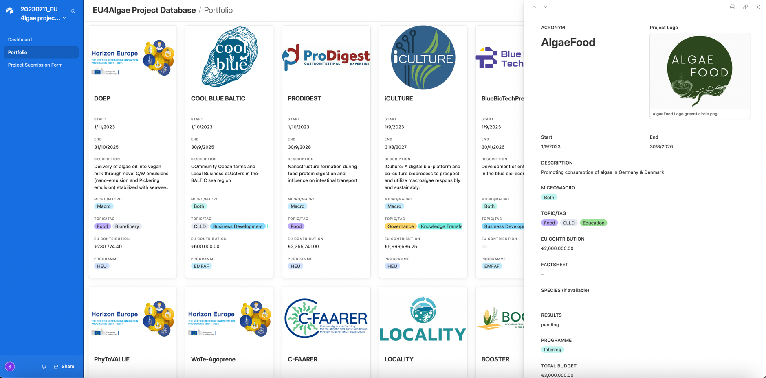
*Free AirTable account required to access dashboard, portfolio & project submission form

Slide 15
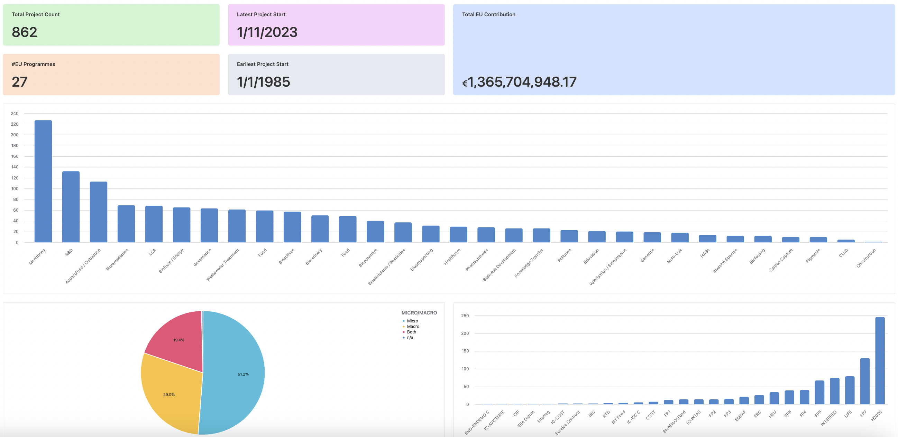
*excl. funding pre-2003

Slide 16
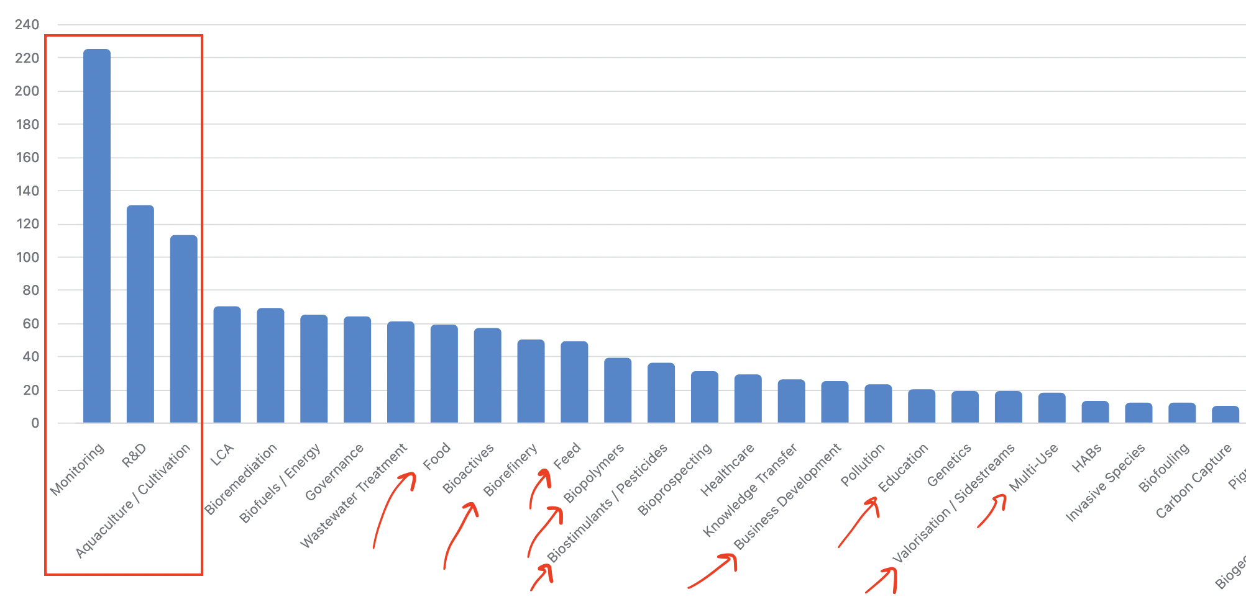

Slide 17
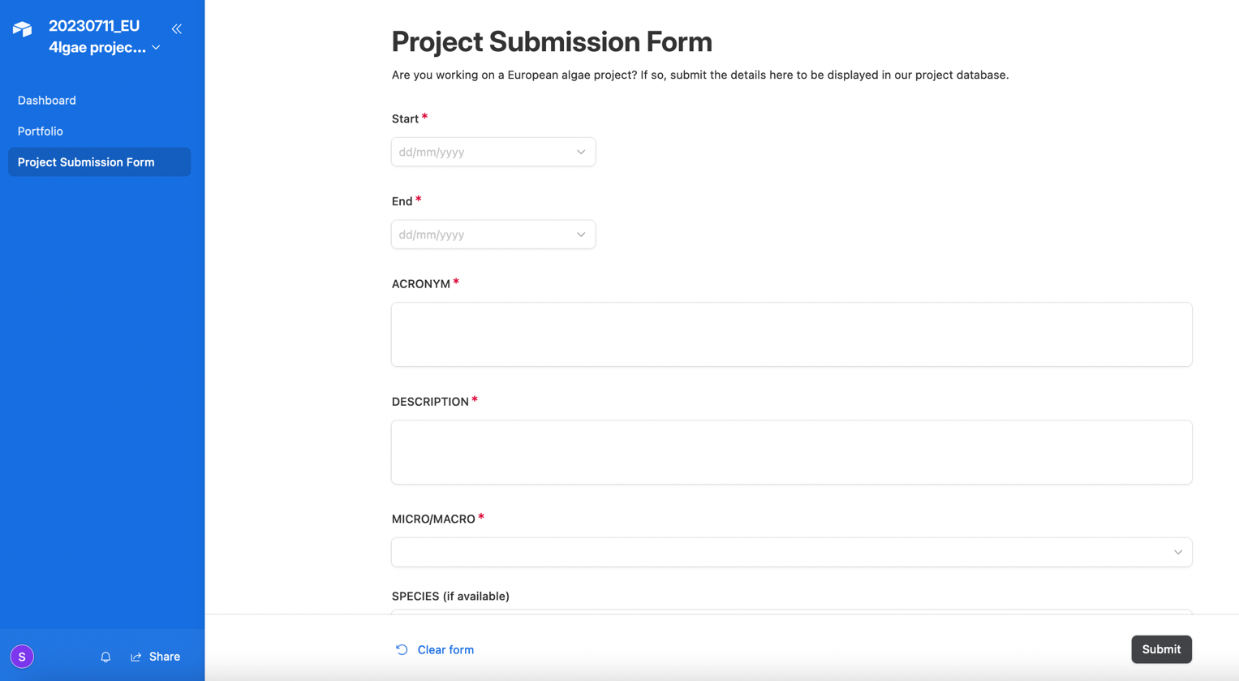
Ongoing Maintenance & Data Entry
*Free AirTable account required to access dashboard, portfolio & project submission form

Slide 18
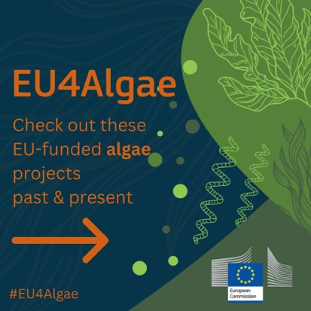
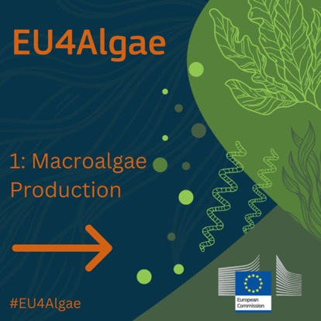
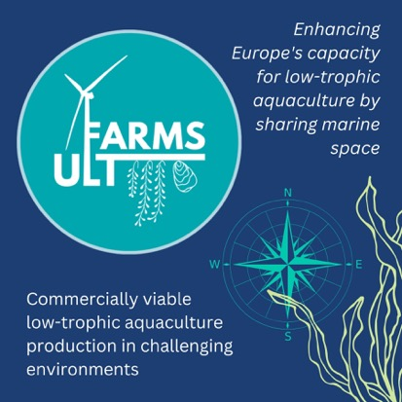
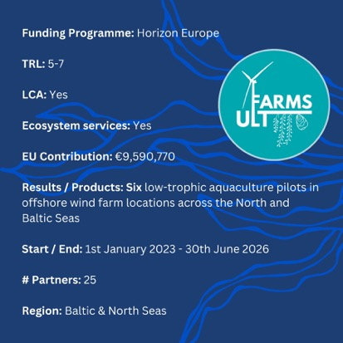
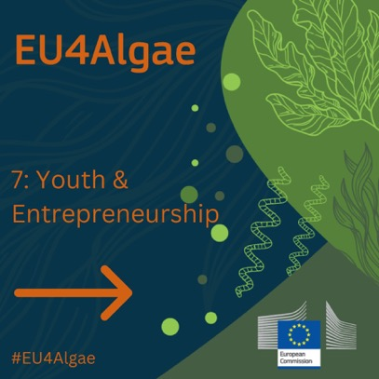
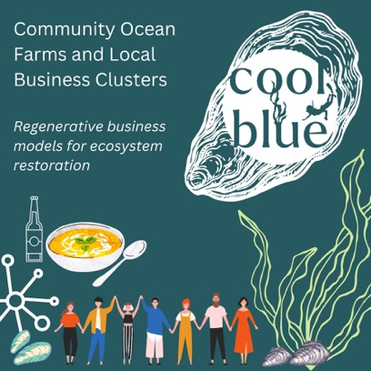
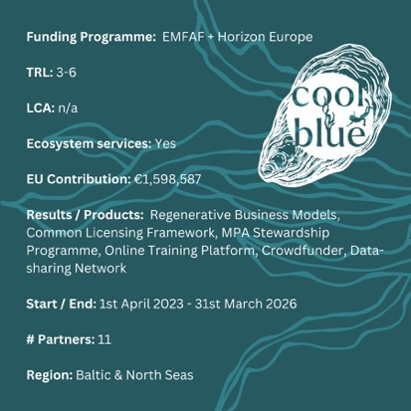
Communication, Dissemination & Exploitation
Via social media from Q1 2024…

Slide 19
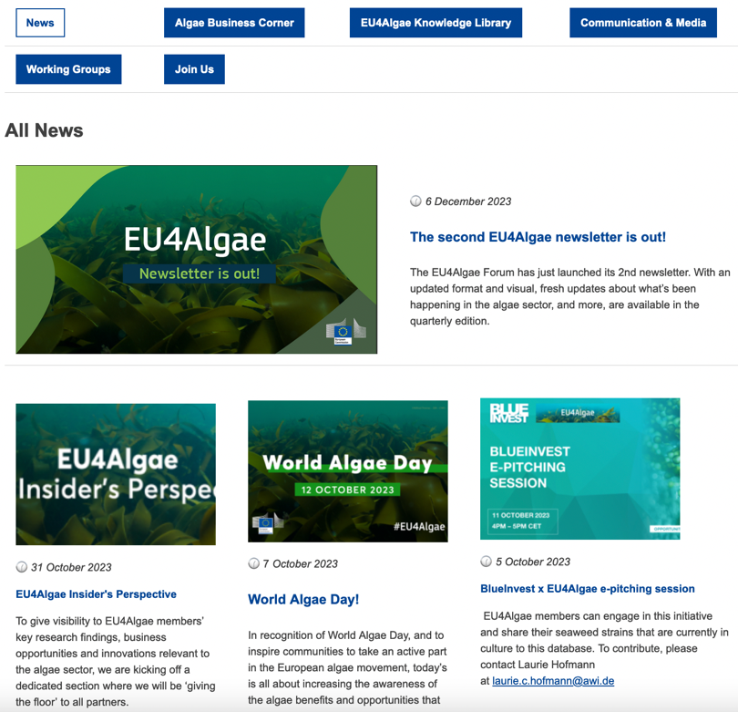
Available on Maritime Forum from Q1 2024 (tbc)

Slide 20
Thank you!
Frederick Bruce
Consultant & Project Manager
s.Pro – sustainable projects GmbH
Founding member of the SUBMARINER Network for Blue Growth EEIG
Seaweed Tea

