Slide 1
Analysis of the maritime dimension of the "Juncker Plan" The blue economy in the future implementation of the European Fund for Strategic Investments (EFSI)
MEMBER STATES EXPERT GROUP ON MARITIME POLICY. Brussels, 25.06.2015
Juan Ronco, EU-Commission - DG Fisheries and Maritime Affairs

Slide 2
Second Pillar: Reach real economy
European Fund for Strategic Investments (EFSI)
First Pillar: Mobilising Finance for Investment
Third Pillar: Removing barriers to investment

Slide 3
First Pillar: Mobilising Finance for Investment

Slide 4
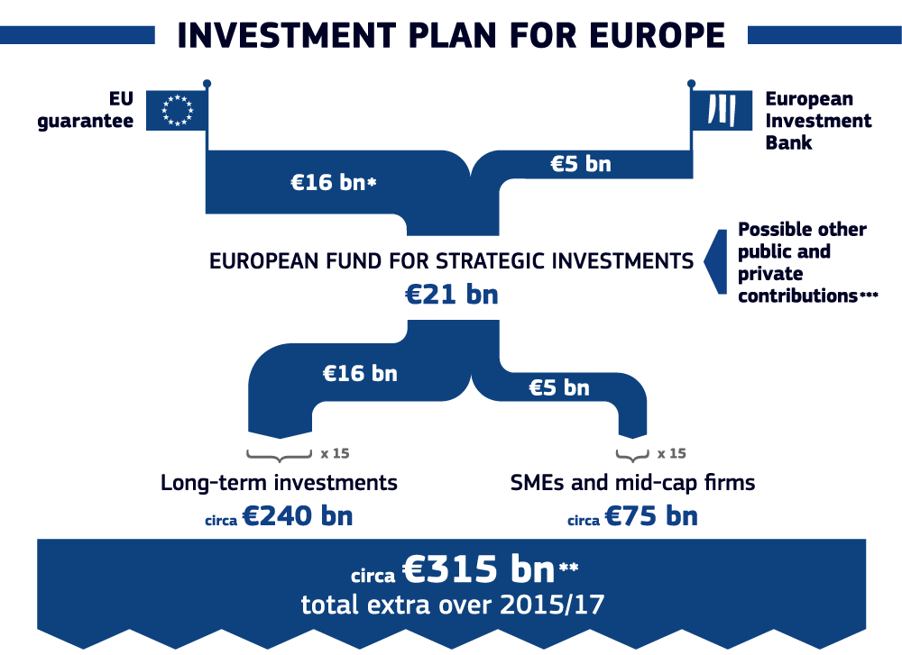

Slide 5
EFSI eligible sectors
Infrastructure & Innovation
Development of infrastructure
Transport
Energy interconnections
Digital infrastructure
Environmental infrastructure
Natural resources
Urban development and mobility
Research and development and innovation
Investment in education and training, health, information and communications technology
Development and modernisation of the energy sector, including, renewable energy and energy and resource efficiency;
SMEs and Mid-Caps
Access to finance

Slide 6
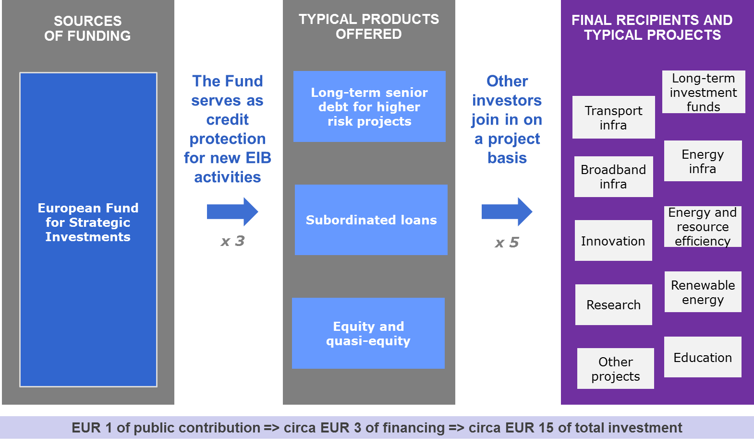
Long-term investments

Slide 7
SME Window of EFSI
Support to SMEs and mid-caps is foreseen in the EFSI regulation. A specific SME Window of EFSI to be created, implemented via the EIF, through agreements between the EIF and financial intermediaries signed in 2015-2018.
Financial support must be additional to what will have been delivered under the existing and already foreseen programmes in the period 2015-2018.
The SME Window should have a budget of up to EUR 5 billion, of which:
EUR 2.5 billion provided by EIB at its own risk, to enhance the RCR mandate
EUR 2.5 billion provided by the EIB but guaranteed fully by the EU under EFSI

Slide 8
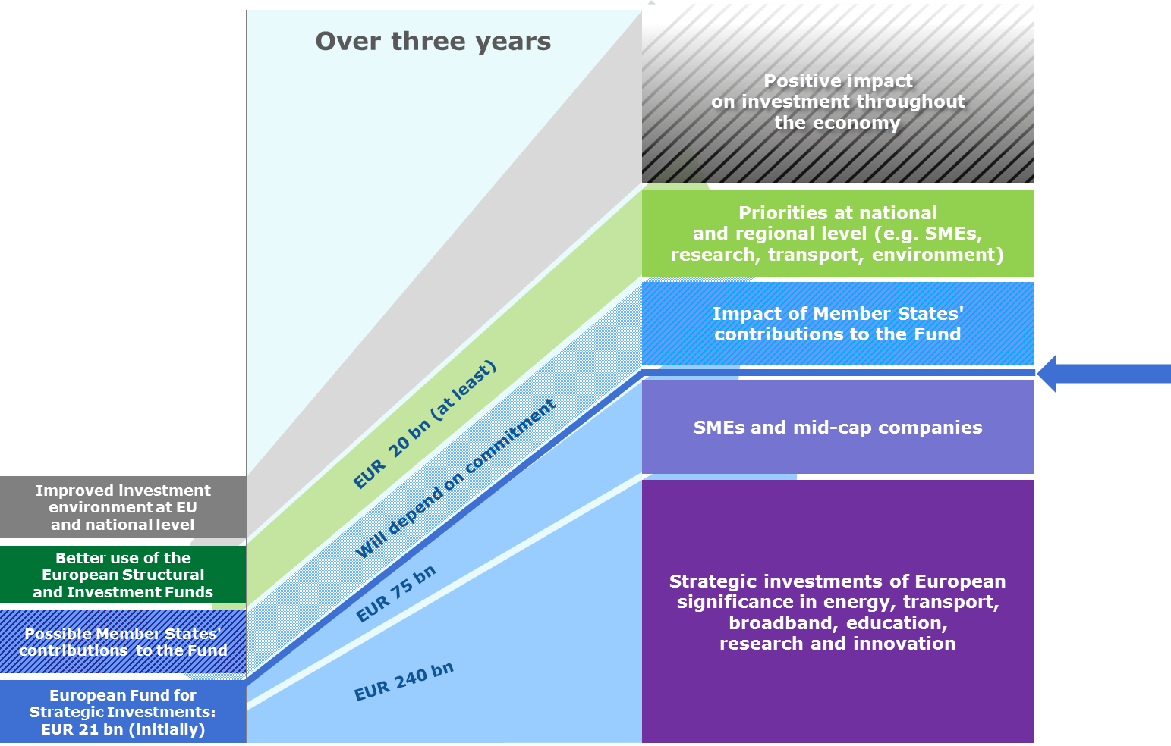
Mobilising finance for investment – leverage

Slide 9
EFSI key aspects
Leverage EU -> EIB - > total financing
Crowd-in NPBs and Private sector
Risk-taking
Additionality
vs market
vs EIB current activity and EU instruments
Governance
Independence
Project selection criteria
Speed of implementation

Slide 10
Second Pillar: Reach real economy

Slide 11
Second Pillar: reach real economy
A pipeline of viable projects
The EC-EIB-MS Taskforce: 2000 projects, for EUR1.3 trillion (of which EUR500bn in the next 3 years)
European transparent project pipeline (EC-EIB-MS)
Advisory services
European Investment Advisory Hub
Technical assistance
Pooling resources & expertise

Slide 12
EU Investment Project Portal (EIPP) Different from the "Pipeline"
Purpose:
Provide clear information on investment opportunities in Europe through a standardised online database.
Give clarity and confidence to investors – particularly long term investors – to help them find projects.
Identify possible projects where advisory support could add value.
The portal is expected to be available as of the second half of 2015.

Slide 13
EU Investment Project Portal (EIPP) Different from the "Pipeline"
Who can submit projects to the portal and how?
Any legal EU-based entity (not individuals).
Submissions can be made through an online form.
Private/public companies, public authorities (central/regional/local authorities) will be allowed to submit project applications.
Possible criteria for publishing projects on the Portal
Projects in support of EU objectives and values.
Reasonable expectation project can start within the 3 years following its submission.

Slide 14
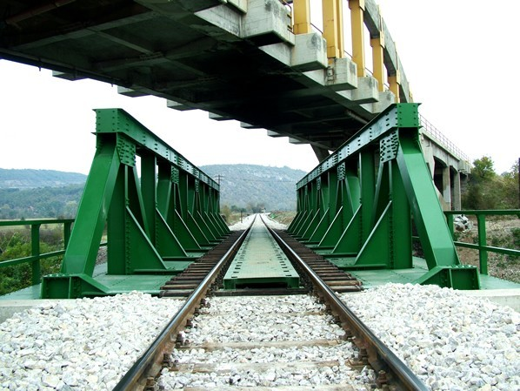
Project Pipeline with Promotion Purpose
Common evidence shows that while liquidity may be abundant among certain financial investors, they need a credible forward looking pipeline in order to step up their efforts to invest
PIPELINE is an important building block serving as a connecting BRIDGE between EU's Investment Potential and available financial liquidity worldwide
The joint COM-EIB-MS Task Force on Investment demonstrated that the investment potential in the EU is there by identifying more than 2000 potentially viable projects over an ambitiously short period of 2 months)

Slide 15
EFSI pipeline and the "Blue Economy"
EFSI proposal accompanied by an illustrative list of projects prepared by EC, EIB and Member States -> 2500 projects for €1.300bn,
469 projects, representing around 19 % of total, identified has having an impact (direct/indirect) on the blue economy.
Worth €297.58 billion, or around 22 % of the total investment of €1,300
Maritime related infrastructure”, counting for 420 projects and representing €274 bn investment, got the lion’s share:
“Port connections” 108 projects, worth €52 billion,
“Port infrastructure” 65 projects, for a total investment value of €12.5 billion.

Slide 16
European Investment Advisory Hub (EIAH)
a joint initiative of the Commission and EIB, building on existing advisory services
EIAH will enhance the capacity of public authorities and project promoters in Member States to identify, prioritise, prepare, structure and implement strategic projects with a European added-value.
EIAH will :
establish a single entry point
establish a coordination mechanism for existing and new advisory programmes and TA initiatives
ensure a platform for cooperation and provide guidance to public and selected private counterparts seeking advisory support for project preparation, use of EU financial instruments and access to finance.

Slide 17
European Investment Advisory Hub (EIAH)
i. Single point of entry
for advisory services (matching of TA demand with services available) with a support team (helpdesk) for public and private project promoters, Managing and Procuring authorities and National Promotional Banks (NPBs).
it will encompass a web portal (with links to existing and new advisory programmes) that will become a reference point for guidance and support to potential investors and public authorities for investments within the Union.

Slide 18
European Investment Advisory Hub (EIAH)
ii. Strengthened advisory support
to coordinate and provide synergies, i.e. bring together current advisory services under a single advisory hub
to deploy new services to cover unaddressed needs (e.g. projects under EFSI), thereby creating a comprehensive offer of project preparation advisory services within the EU.

Slide 19
European Investment Advisory Hub (EIAH)
iii. Platform for cooperation
• will provide methodological guidance in areas such as public procurement (including PPPs and value for money assessments), financial instruments, project structuring;
• develop guidelines, manuals, factsheets, case studies;
• coordinate networking platforms for capacity building activities and exchange of good practice for TA and facilitate networking events, training and e-learning modules;
• enhance cooperation with and between existing and newly established NPBs.

Slide 20
EFSI work plan
EFSI Regulation
Commission proposal (13 January 2015)
Council agreed on its negotiation position (10 March 2015)
Negotiations Council - European Parliament (28 May 2015)
Vote in EP (24 June 2015)
Adoption of Regulation (Summer 2015)
EFSI EC-EIB Agreement
Negotiation ongoing
EIB/EIF
Pipeline / warehousing (2015)
Set-up organisation and EFSI governance

Slide 21
Third Pillar: Removing barriers to investment

Slide 22
Third Pillar: Removing barriers to investment
Simple, better and more predictable regulation at all levels
Making most of the Single Market
Capital Markets Union
Energy Union
Digital Single Market
Services Market
Structural reforms in the Member States

Slide 23
Thank you!

