Slide 2
Maritime Policy and the Oceans
It's the oceans, ****
Europe's maritime policy:
2007 Blue Book
2008-2009 IUU Regulation
2009 Communication on international dimension
2012 Blue Growth Communication and Limassol Declaration
2014 MSP Directive
2014 Maritime Security Strategy
2014 CFP Reform
2012- … Sea Basin Strategies and, and, and…

Slide 3
International Ocean Governance
The Mission (letter)
"Engaging in shaping international ocean governance in the UN, in other multilateral fora and bilaterally with key global partners."
The objective
Consultation
Listening Tour
Political initiative

Slide 4
International Ocean Governance?
It's the oceans, ****
50% of O₂, 30% of CO₂
Europe: 500 bn. GVA, 3-5 mn. Jobs
WWF: 24 tn. Gross value (world level)
Technology:
further away
under more adverse conditions
deeper under water
9bn. People in 2050 – and resource hunger

Slide 5
And there's more
Maritime Spatial Planning
MPAs and networks of MPAs
Biodiversity in Areas Beyond National Jurisdiction
Development of the blue economy in coastal areas (outside the EU)
Maritime Security
Bilateral Partnerships

Slide 6
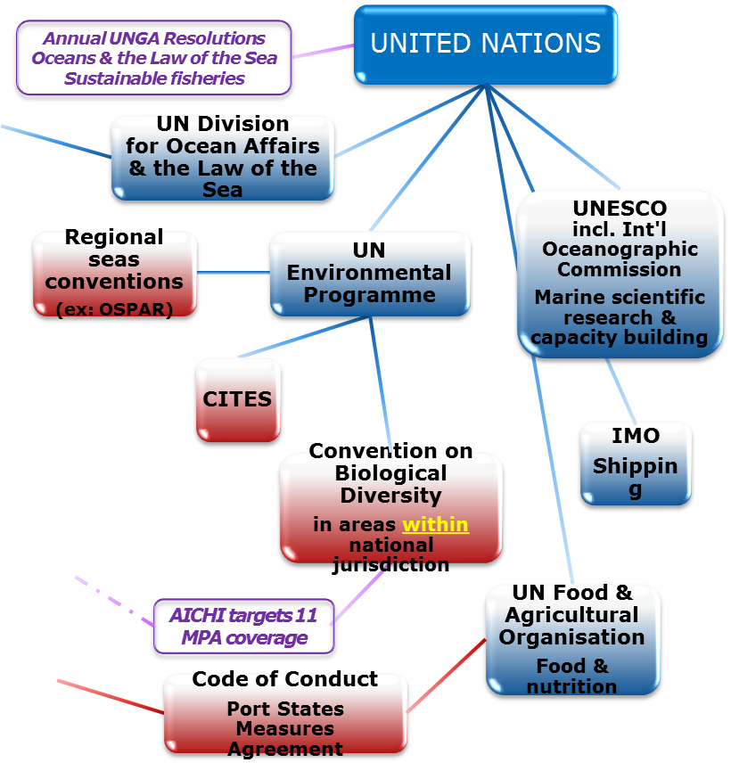
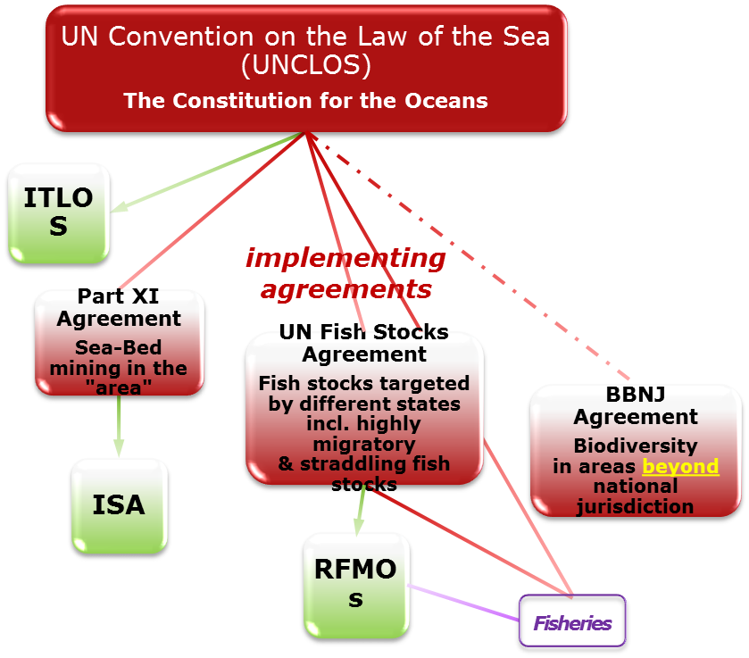
And there's this…

Slide 7
It's a hit…
Global Oceans Commission
World Ocean Summits
Rio +20 Sustainable Development Goal "Oceans"
The issues (for example):
Seabed Mining
IUU
Marine Litter
Climate change

Slide 8
The process
Open Consultation
No predetermined issues
Launched on 4 June – concludes 15 September
Consultation document plus online survey
Via: Maritime Policy Website
http://ec.europa.eu/dgs/maritimeaffairs_fisheries/consultations/ocean-governance/index_en.htm
And: https://ec.europa.eu/eusurvey/runner/IOGsurvey2015

Slide 9
Commissioner Vella Listening Tour
High-level events
Bilateral Contacts
Meetings at working level
Conferences

Slide 10
What can you do
Contribute to the consultation
Provide us with info on interesting events
Pass the information on to stakeholders
Bilateral contacts

Slide 11
Thank you…

