Slide 1

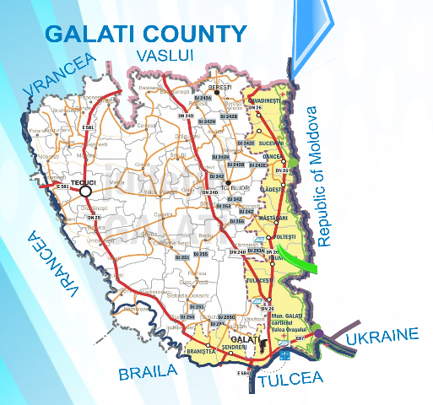
The role of FLAGs on
Euroregions and Black Sea Basin
Association for Sustainable Development
“PRUT – DUNARE” Galati, Romania
ELENA CARDAS
European Affairs Adviser

Slide 2
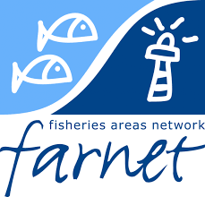
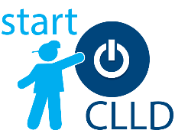

WHO WE ARE…
FARNET is the community of people implementing Community-Led Local Development (CLLD) under the European Maritime and Fisheries Fund (EMFF). This network brings together Fisheries Local Action Groups (FLAGs), managing authorities, citizens and experts from across the EU to work on the sustainable development of fisheries and coastal areas.
CLLD is a tool that enables local fisheries communities to address these challenges by proposing and testing new solutions. FARNET is there to help them make it happen. Decision-making on the use of CLLD funding is delegated to local partnerships that bring together the private sector, local authorities and civil society organizations.
Fisheries Local Action Groups (FLAGs), these partnerships take decisions within the framework of a local strategy, developed in response to specific needs and opportunities identified locally. Funding available is targeted primarily at creating employment and new economic activity as well as improving the quality of life in areas affected by a decline in fishing activities or by other specific challenges hindering the viability of local fisheries communities.

Slide 3
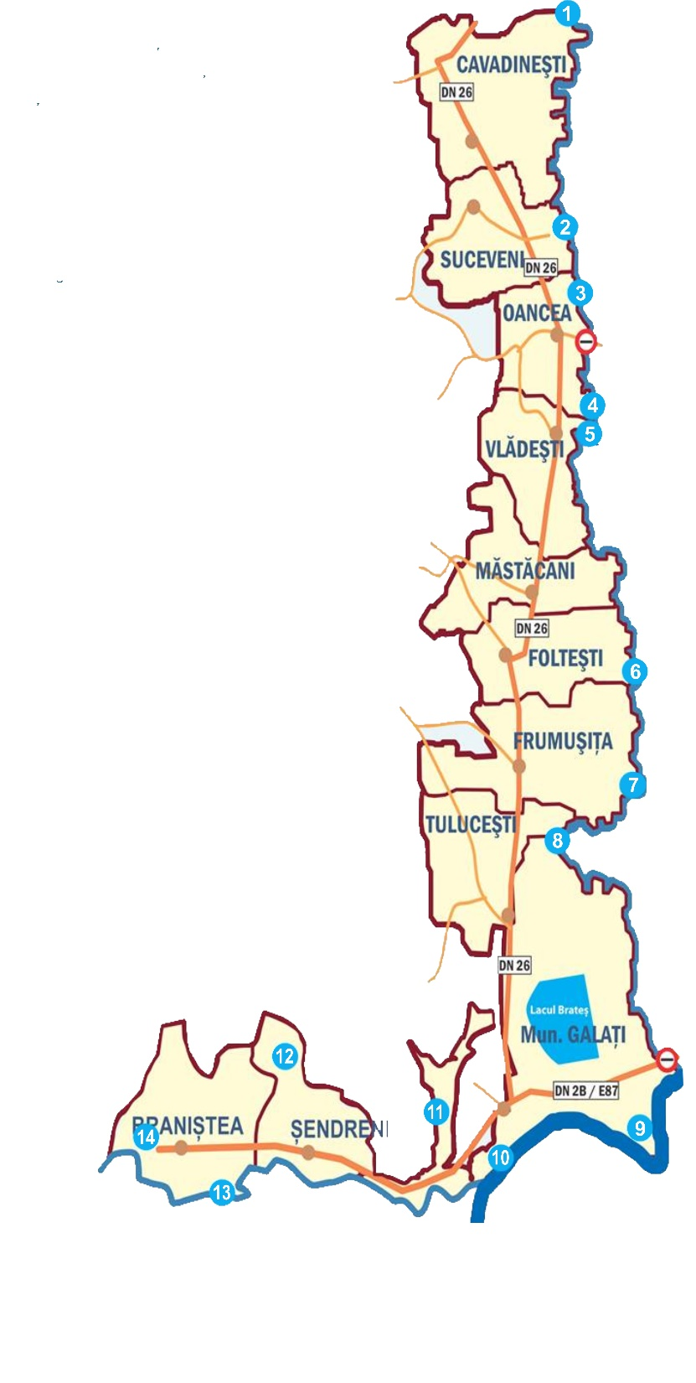
FLAG Partnership…
LOCAL
AUTHORITIES
PRIVATE SECTOR
BUSSINESS SUPPORT ORGANIZATIONS
FISHERMEN ASSOCIATIONs
NGOs
CIVIL SOCIETY
RESEARCH INSTITUTE FOR AQUACULTURE
FLAG
PUBLIC PRIVATE PARTNERSHIP

Slide 4
ROLE…
FLAG
Bottom - Up Approach
COMMUNITY NEEDS
STRATEGY
DEVELOPMENT
RESOURCE
FOR AREA
ENLARGE THE ACTIVITY SPHERE
Info Multiplier
Mediator

Slide 5


Strategy Achievements 2007-2013
Impact…
37 public and private beneficiaries of projects
Grant awarded: 3.004.136,85 Euro
School Workshops
Provided by Fishermen
By Lower Danube University
Unequal access of children from rural areas compared to urban children in extra curricular activities
Needs
Youth involvement in the extra-curricular activities
Youth involvement in the development of their communities
Project RESULTS…
Involvement of youg people in traditional fisheries and aquaculture activities
Rediscover local values and reawakening the feeling of local pride – promotion of local culture and the environment
Increasing motivation of local authorities to be actively involved in funding opportunities for community development

Slide 6

COOPERATION FOR DEVELOPMENT
Source: https://twitter.com/hashtag/umbrella
FLAG is an umbrella organization visible at local, national and regional level

Slide 7
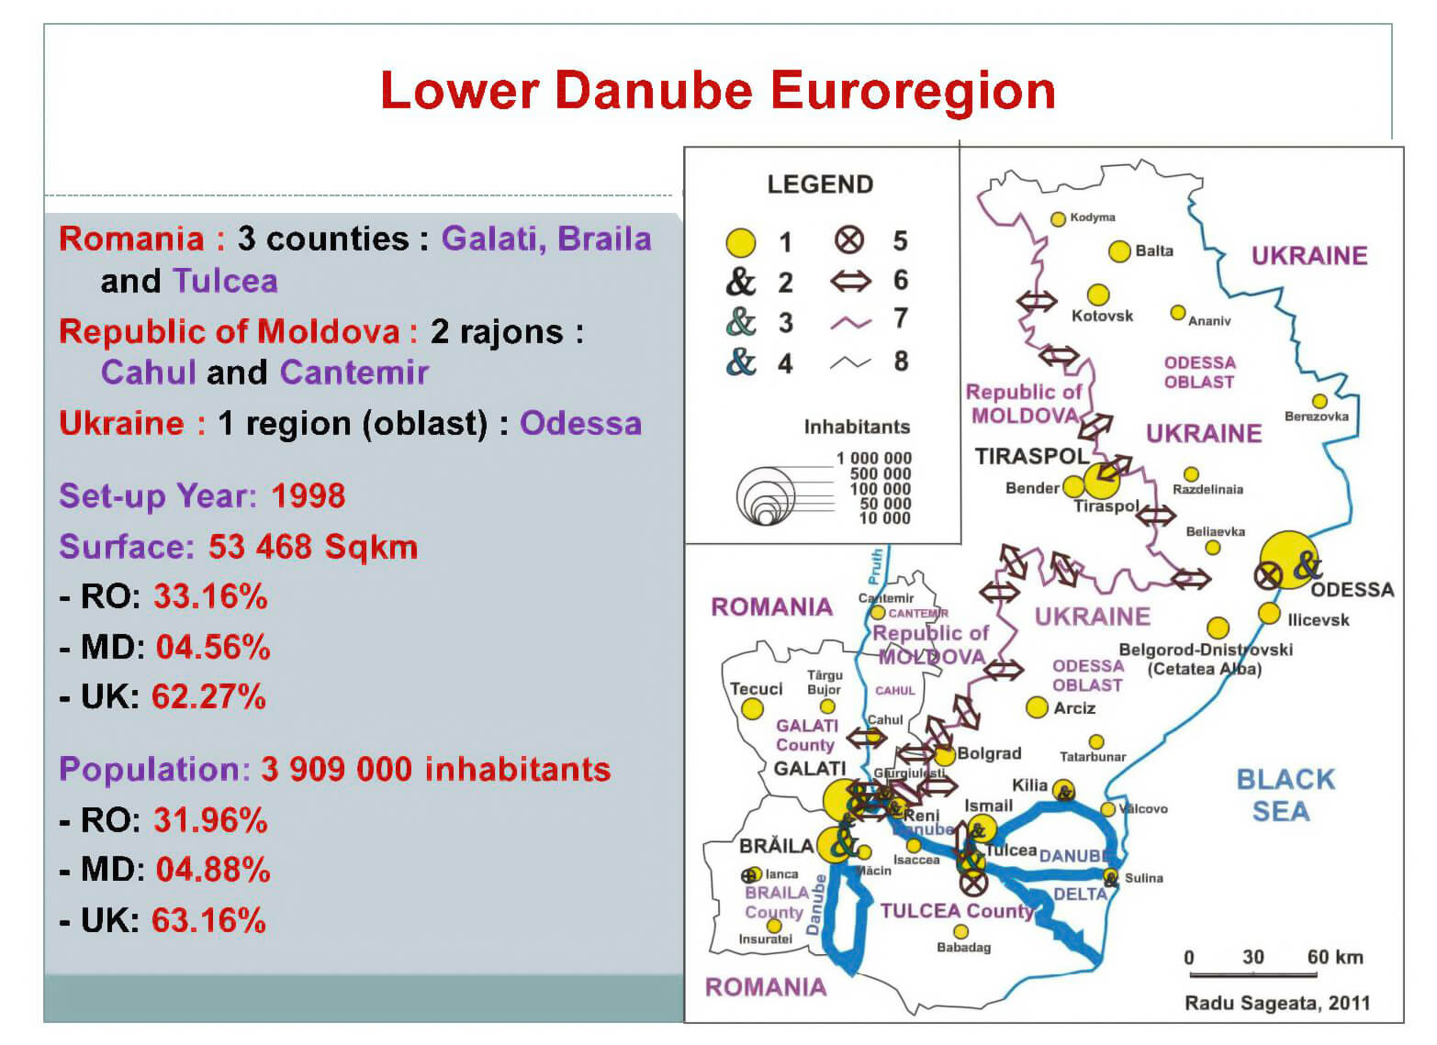
EUROREGIONS – LOWER DANUBE
GALATI is located at the border of Romania and Europe …
This is the reason why the concept „cross-border cooperation” has a special meaning.
Moreover, we are encouraged to cooperate by the geography, by the history but MORE IMPORTANT by the common values on the Danube's coast.
Visit card:
19 years of cooperation within the Euroregion
6 partner in the region
about 4 millions inhabitants from 3 countries
common projects and common activities

Slide 8
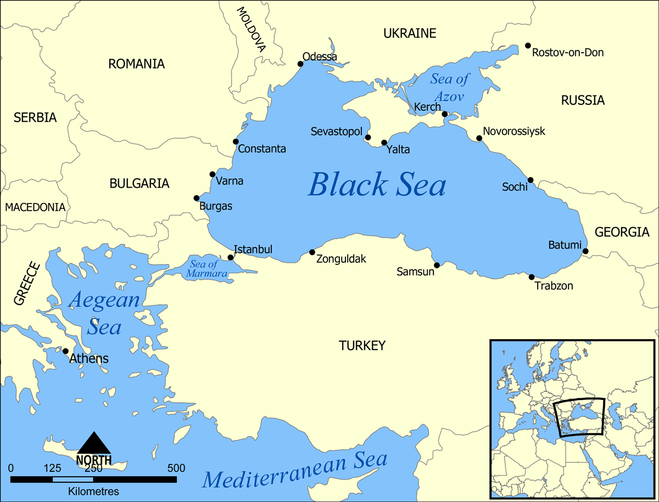
BLACK SEA BASIN
BLACK SEA BASIN MEANS ANOTHER LEVEL OF COOPERATION

Slide 9

Type of cooperation projects…
FLAG WILL SHARE ITS EXPERIENCE AND WILL IMPLEMENT
FLAG ENGAGEMENT AS NETWORK
FLAG WILL PROMOTE CYCLING TOURS ALONG ITS TERRITORY.
FLAG WILL PROMOTE ITS TERRITORY TRADITIONS AND NATURAL PROTECTED AREAS THROUGH EUROVELO 6.
FLAG Galati is well positioned to foster cooperation in the area

Slide 10
THANK YOU FOR YOUR ATTENTION
ELENA CARDAS
European Affairs Advisor
ASSOCIATION FOR SUSTAINNABLE DEVELOPMENT
“PRUT - DUNARE” GALATI, ROMANIA
Contact details: Phone: +4 0236 344 026
Mobile: +4 0725 417 713
Fax: +4 0236 344 026
E-mail: office@flagalati.ro

