Slide 1


EuroGOOS perspective on a Pilot
Blue Science Cloud
Glenn Nolan,
Vicente Fernandes,
Patrick Gorringe,
Erik Buch and
Dina Eparkhina
Pilot Blue Cloud Workshop, Brussels, March 28th 2017

Slide 2
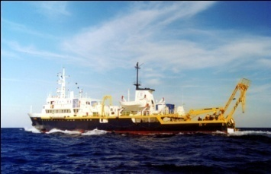
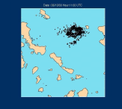
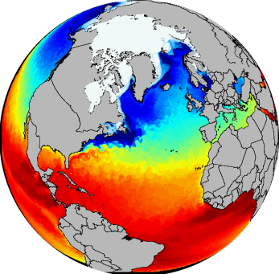
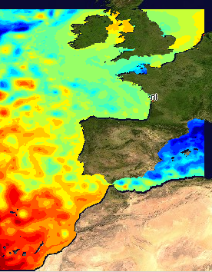
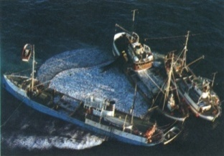
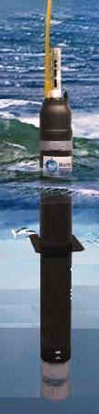
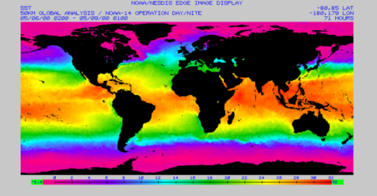
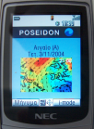
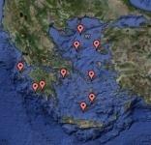
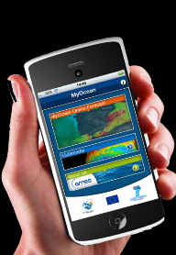
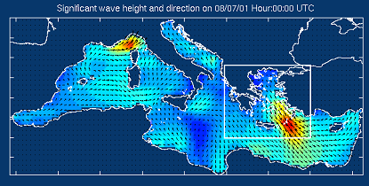
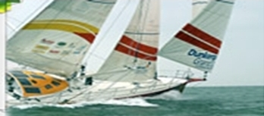
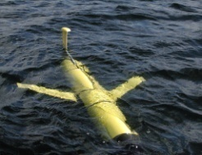
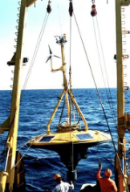
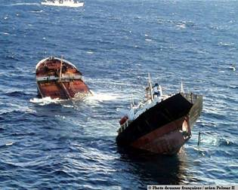
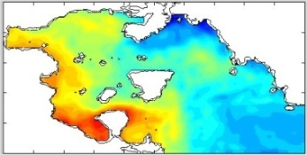
Centralised
Copernicus
De-centralised
EU Countries
Marine Core Service
Downstream Services
De-centralised
EU Countries
Observations
Processing & Modeling
Services
End Users
Common framework for seamless services at various geographical scales

Slide 3
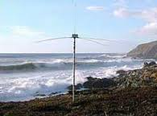
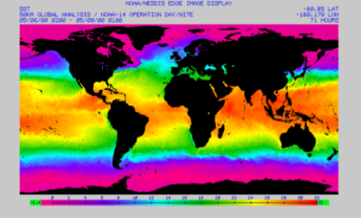
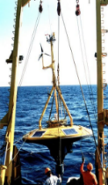
Open Marine data value Chain
AGGREGATORS
Data Portals and Data Repositories
Strengthen cooperation between public and private entities
INTERMEDIATE USERS
INNOVATIVE SERVICES AND PRODUCTS
SME
EMODnet
(Real Time data or data products)
Ingestion activity proposed by SDN
CMEMS
(RT and Historical data,
models and forecasts)
Observations and monitoring activities
(in situ and Satellite)
FINAL USERS
Research
Public bodies/policies:
  MSFD - MSP
Civil Society
Industry
  Fisheries
  Aquaculture
  Maritime, coastal and cruise tourism
  Marine Transport
  Biotechnology
  Marine Energy
ORIGINATORS
Research Projects
Public national bodies
Industry (O&G, Renewable, etc)
SeaDataNET
(Archived data )
Enhanced internet at sea. New technologies (some low cost)
FEEDBACKS NEEDED!!
REQUIREMENTS??

Slide 4
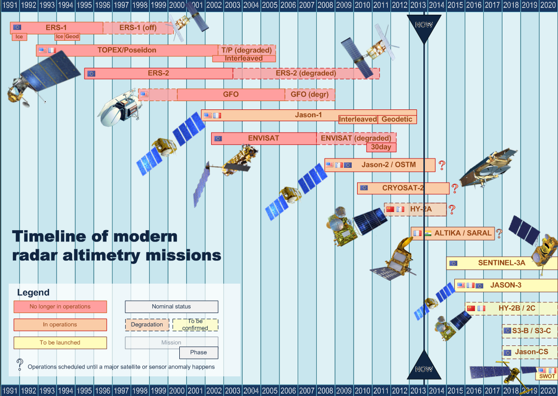
Some missions are generating 1Tb of data per day! !
Hard to process/store at individual member state level

Slide 5
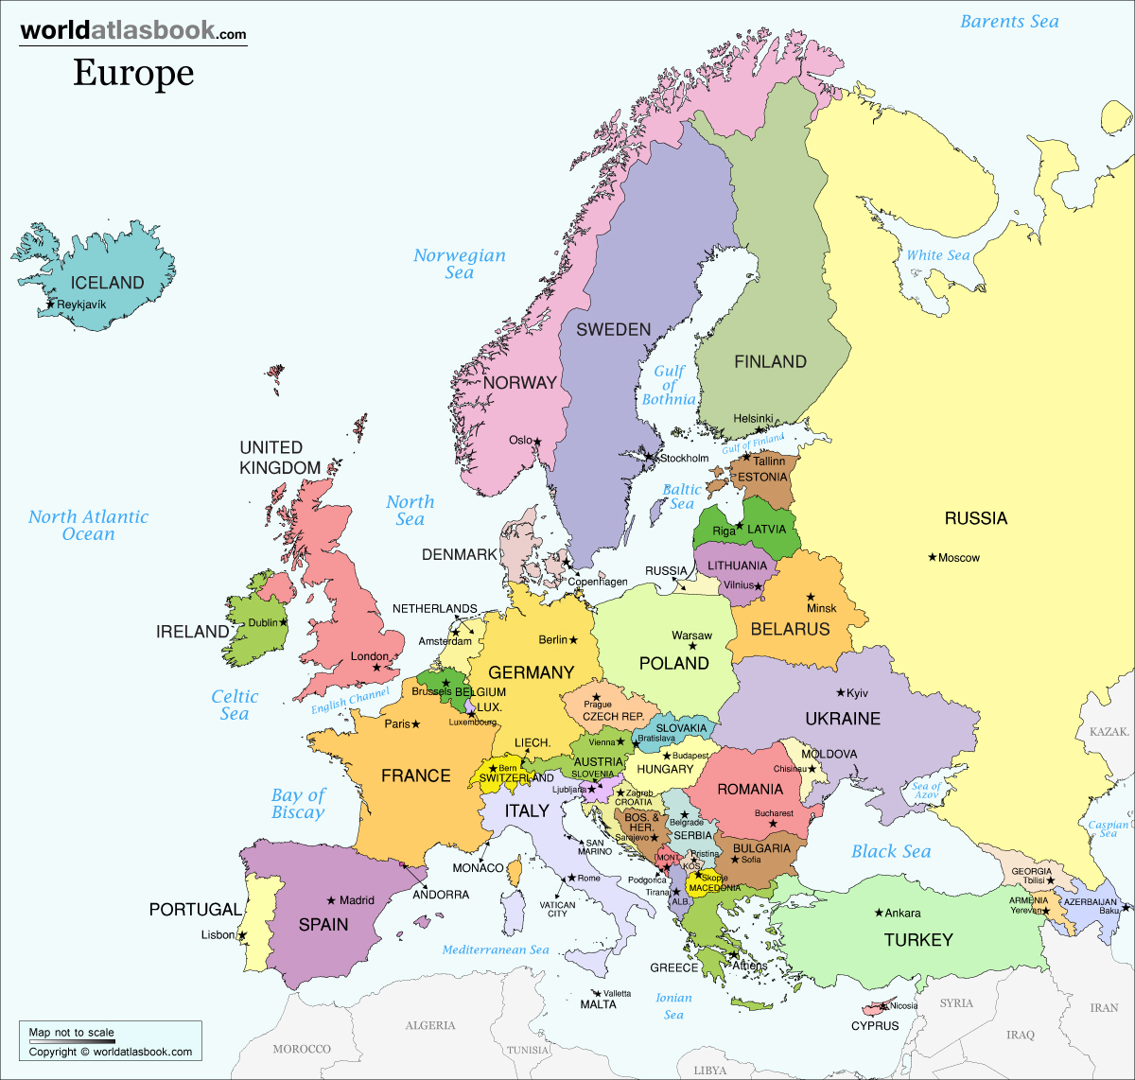













Sustained
MSFD
CFP
Inclusive
IMP
Blue Growth
MSP
INSPIRE
Common
Ocean Gov
Focal point
WFD
Habitats D.

Slide 6
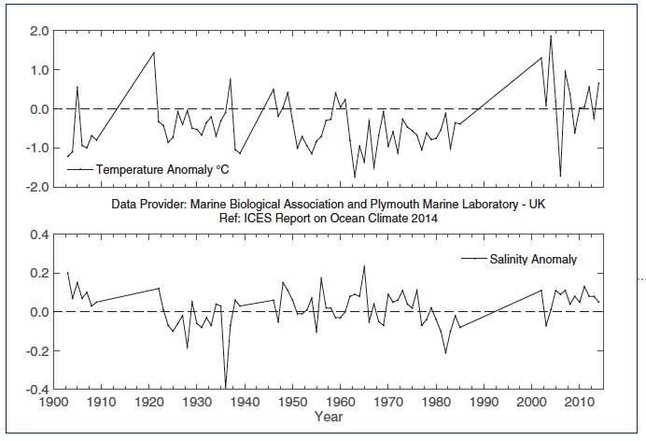
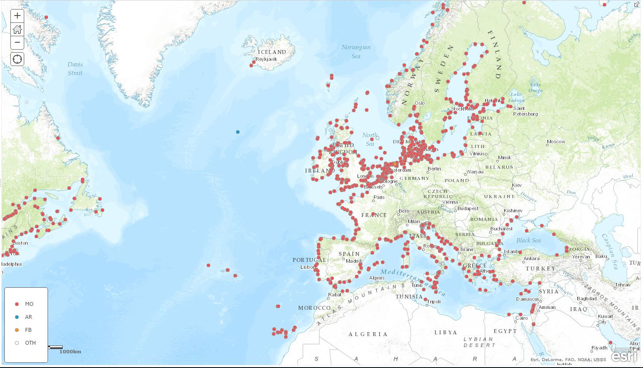
What is missing ?
Spatial gaps
  horizontal – SE European seas;
  vertical – deep sea is under-sampled;
Temporal gaps
  few complete time series;
Parameter gaps
  biogeochemical; sensors are now
  available;
Long term commitments
  more than 70% based on short term
  research funding;
Integrated monitoring strategy at
European level
  Reduce overlaps; maximize synergies

Slide 7
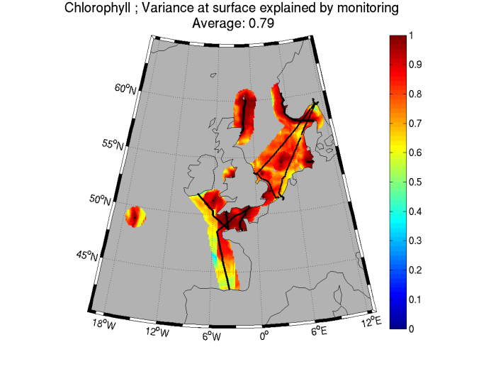
Operational ecology
Present state of the ecosystem
Ecosystem forecast
Reliable what/if scenario simulations
Prediction of biohazards
Prediction of future trends

Slide 8
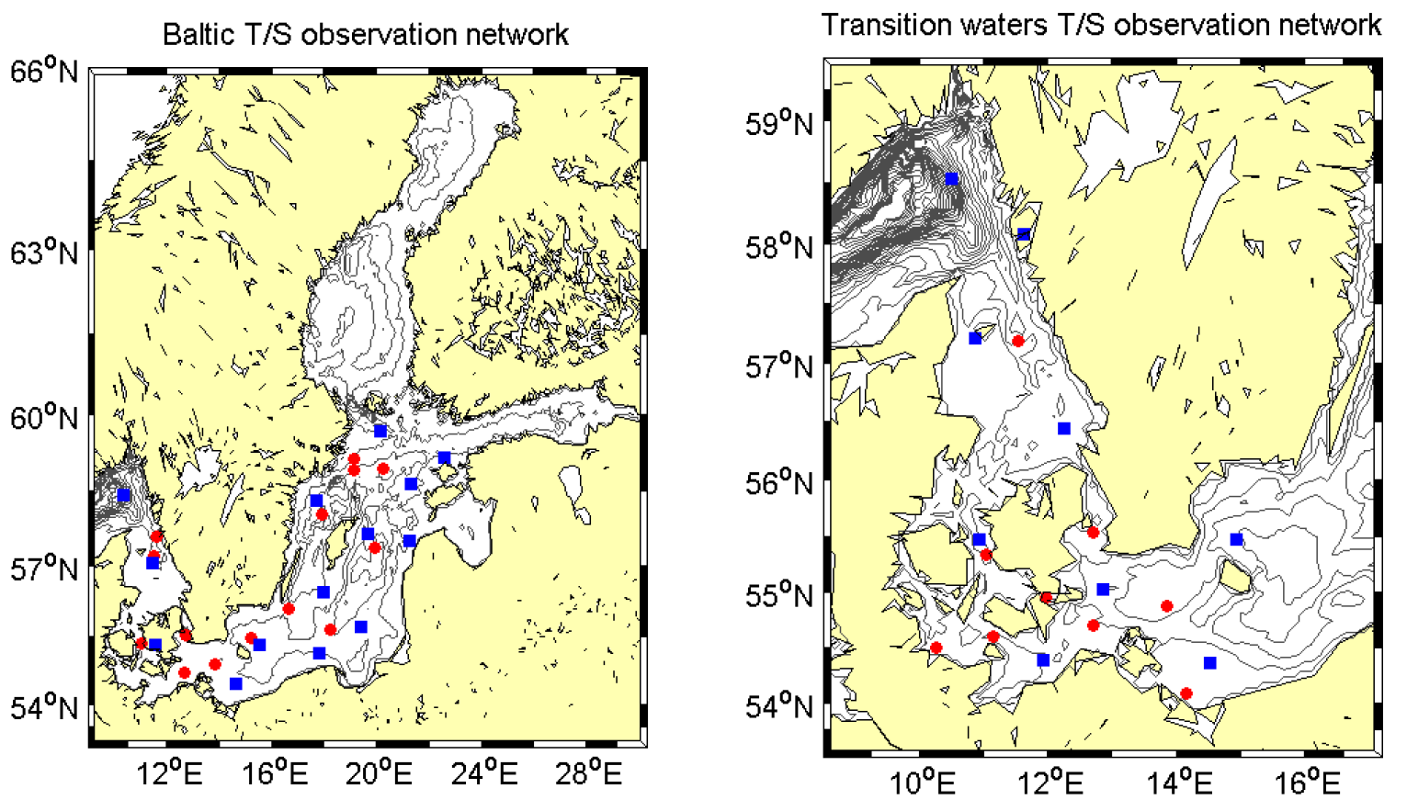
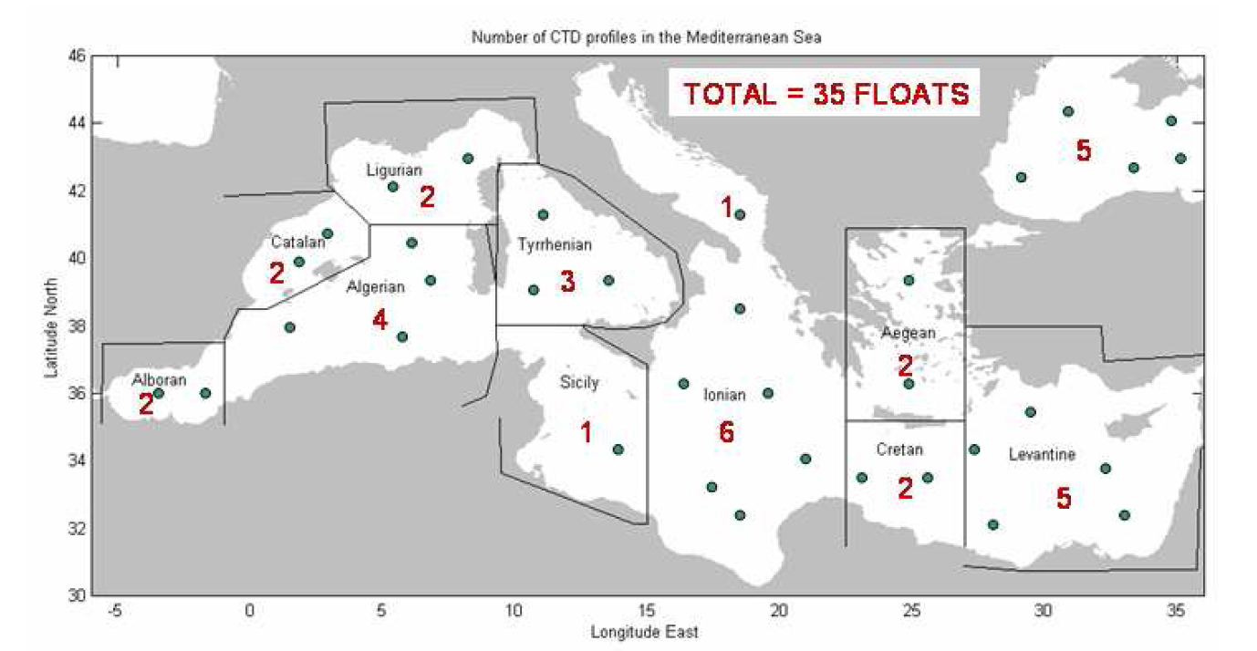
Observing System Simulation Experiments
Computationally expensive
Some in AtlantOS project
Help with EOOS roll out: “EOOS simulator””
EOOS Simulator

Slide 9
MSFD
MSP
CFP
Operational users
Products/services for Blue Growth sectors
Policy
Evidence-base
Ocean Literacy & Citizen science
CMEMS
EMODnet
DCF
Ocean Observations
Other
Collect once
Use many times
Scientific knowledge and Innovation
Direct collection by industry
Regional conventions and assessments
Many other uses
Climate studies and assessments

Slide 10
Essential Ocean Variables and readiness level
CONCEPT PILOT MATURE
Physics
Sea State
Ocean surface vector stress
Sea Ice
Sea level
SST
Subsurface temperature
Surface currents
Subsurface currents
SSS
Subsurface salinity
Biogeochemistry
Oxygen
Inorganic macro nutrients
Carbonate system
Transient tracers
Suspended particulates
Nitrous oxide
Carbon isotope (¹³C)
Dissolved organic carbon
Biology and Ecosystems
Phytoplankton biomass and productivity
HAB incidence
Zooplankton diversity
Fish abundance and distribution
Apex predator abundance and distribution
Live coral cover
Seagrass cover
Mangrove cover
Macroalgal canopy cover

Slide 11


glenn.nolan@eurogoos.eu
Website
www.eurogoos.eu
Twitter
twitter.com/EuroGOOS
E-mail
eurogoos@eurogoos.eu

