Slide 1
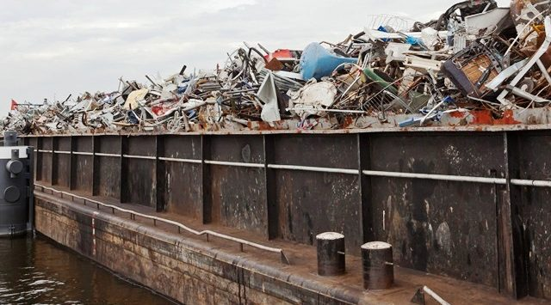
Port Reception Facilities Directive
ships shall pay an indirect fee, irrespective of delivery of waste to a port reception facility;
should not create a disincentive for fishing port communities to participate in existing delivery schemes for passively fished waste
Member States shall
ensure that monitoring data on the volume and quantity of passively fished waste is collected, and shall report such monitoring data to the Commission.
carry out inspections of ships calling in their ports corresponding to at least 15 % of the total number of individual ships calling in the Member State annually

Slide 2
Directive on the reduction of the impact of certain plastic products on the environment
extended producer responsibility
for fishing gear containing plastic
national minimum annual collection rate
of waste fishing gear containing plastic for recycling.
monitor fishing gear
containing plastic placed on the market of the Member State
waste containing plastic collected
report to the Commission
text agreed by Council and Parliament

Slide 3
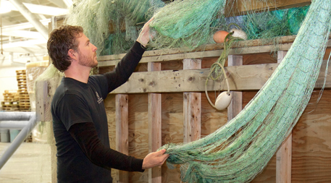
Responsibility of Producers (Directive 2008/98/EC on waste)
costs
separate collection of waste,
its subsequent transport,
and treatment
reporting system in place to gather data
on the products placed on the market of the Member State
and data on the collection and treatment of waste

Slide 4
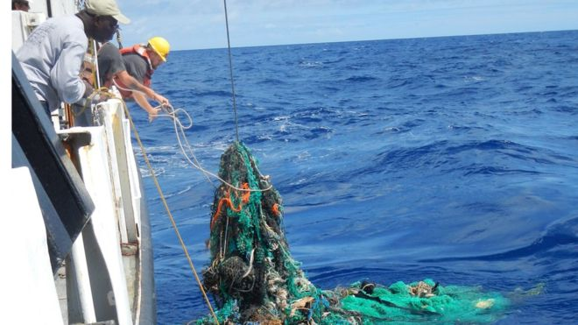
Revision of Fisheries Control Regulation
reporting lost gear
eased and improved through the use of logbooks (electronic) for all categories of vessels.
retrieval
removal of derogation to vessels < 12m to carry on board the necessary equipment
marking of gear
extended to recreational fisheries.
under consideration by Council and Parliament

Slide 5
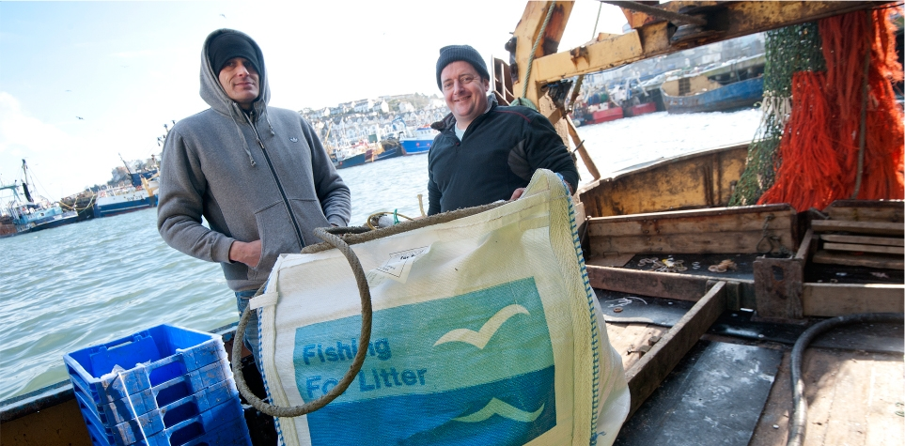
European Maritime and Fisheries Fund
2014-2020
14 coastal Member States committed to the collection of lost fishing gear.
108 operations by 2023.
€50 million, of which more than €30 million from the Fund.
2021-2027 Commission proposal
financial support for the collection of lost fishing gear and marine litter from the sea
investments in ports to provide adequate reception facilities for such recovered material

