Slide 1
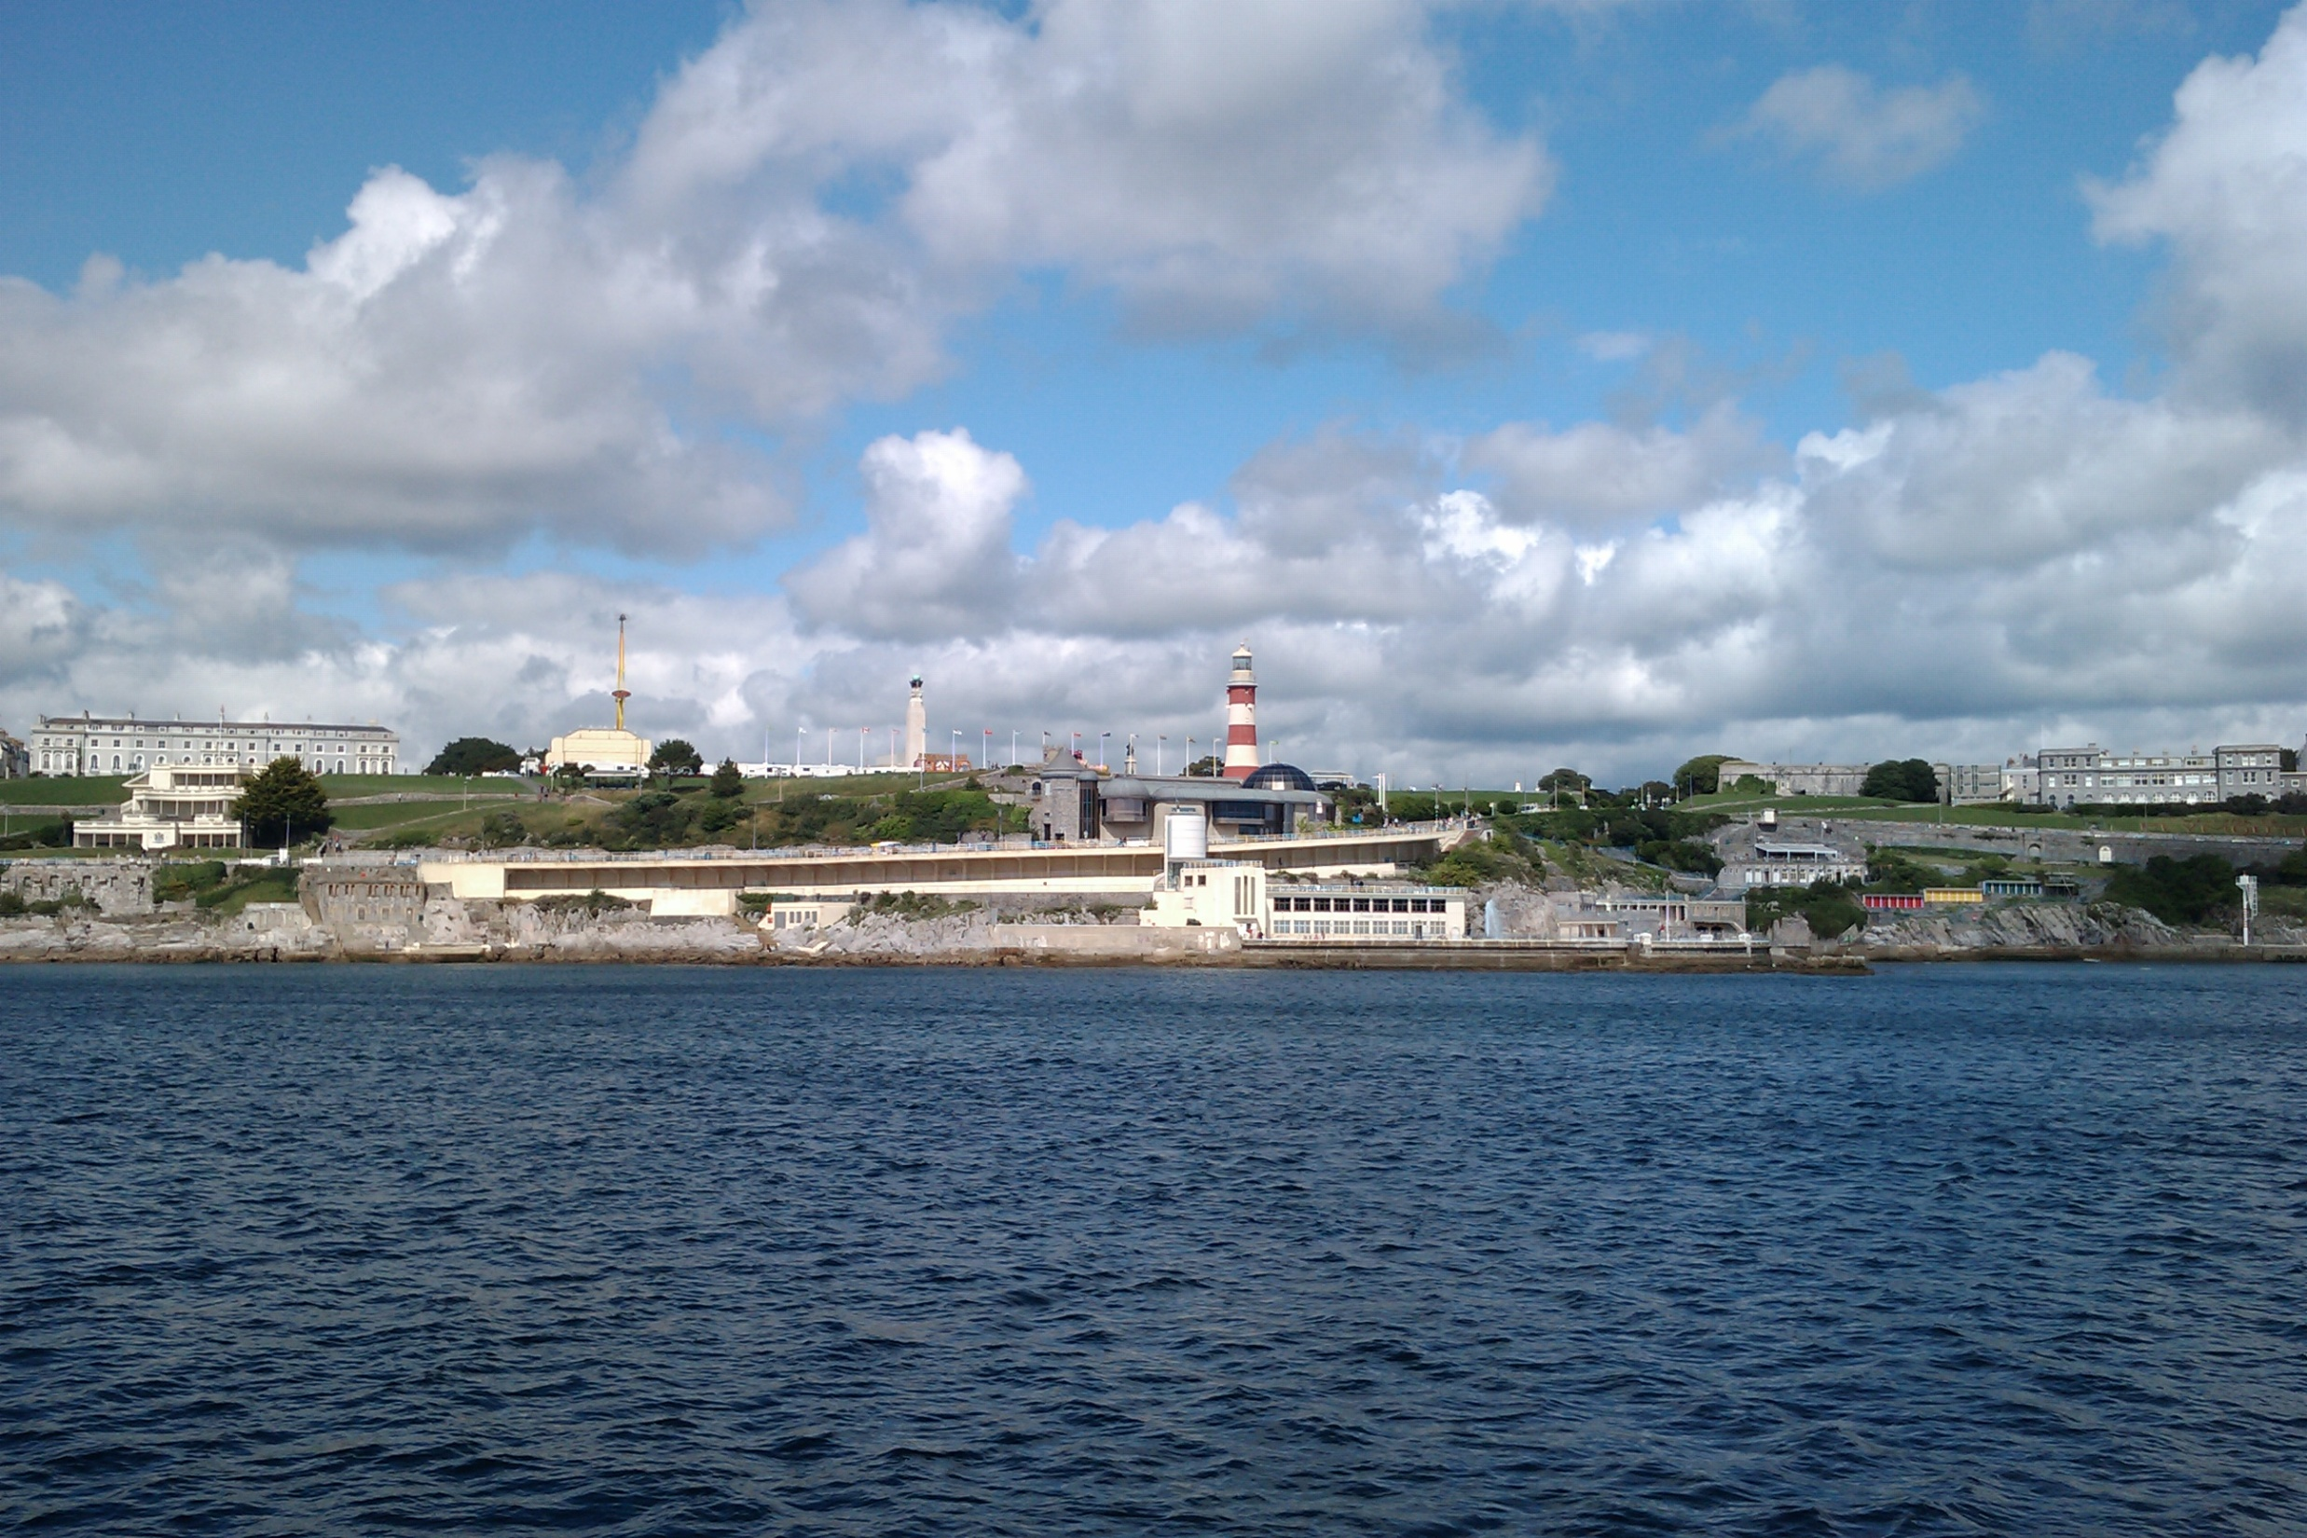
Why is it so hard to set MSFD targets?
Abigail McQuatters-Gollop
Notes:
Reminds me the MSFD is about more than reports and excel spreadsheets

Slide 2
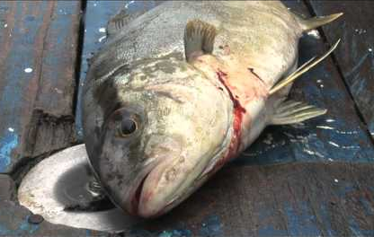
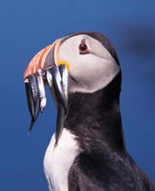
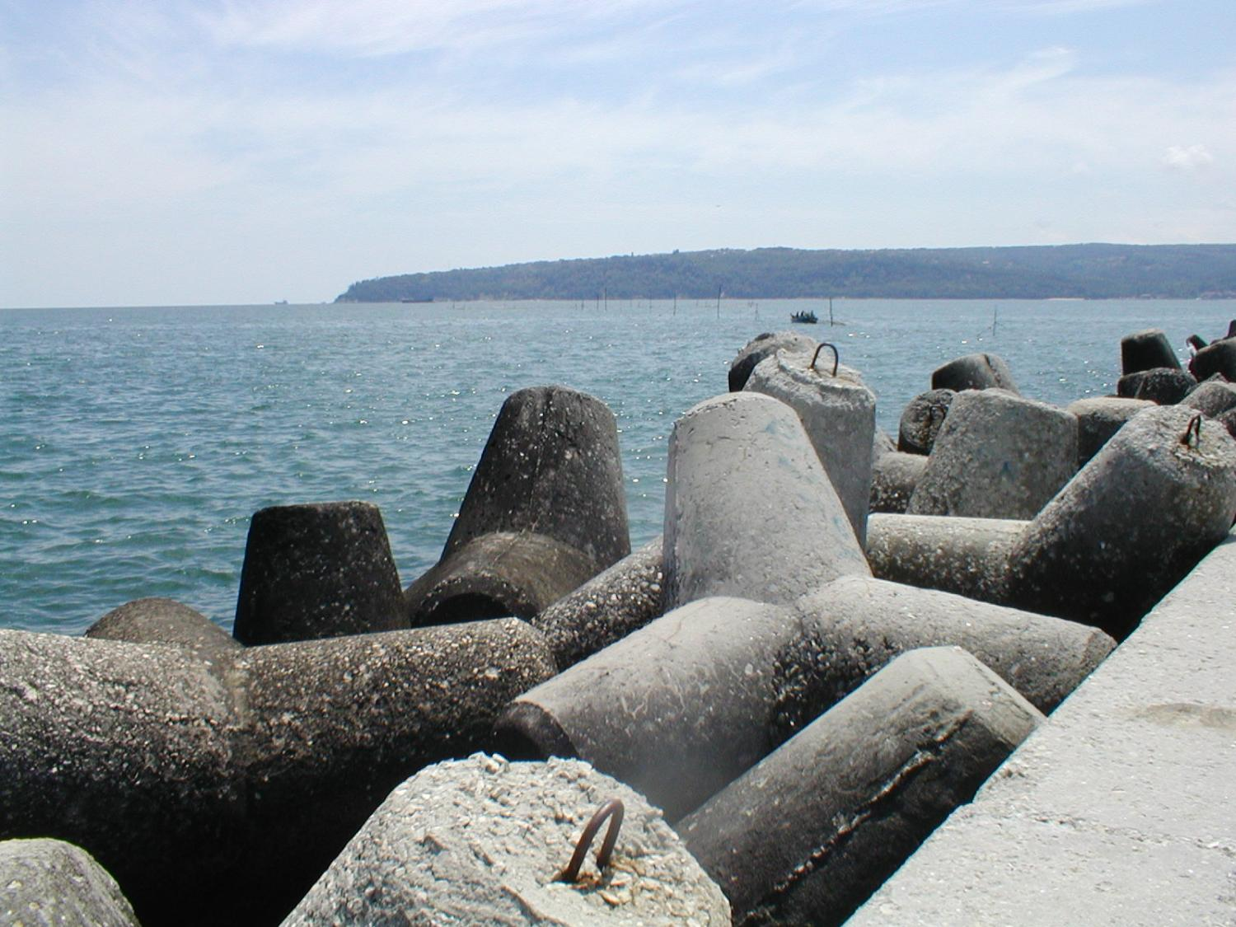
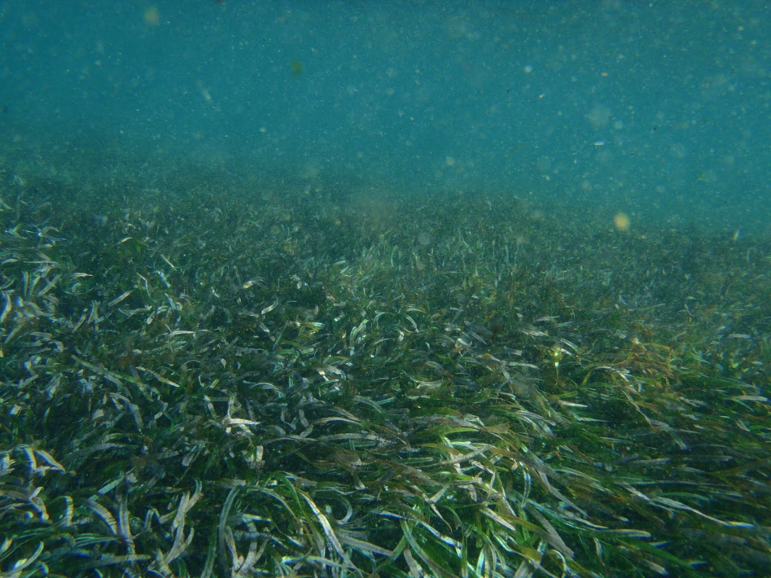
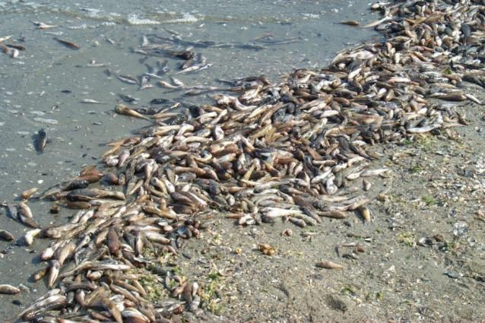
EU marine policy: a lack of integration
Notes:
Manage a whole ecosystem like this, we need a holistic approach. Europe doesn’t have a history of holistic management
2. Each of these directives manage one aspect of the ecosystem. But what about gaps? Or contradictions?
Common Fisheries Policy -> fish
Habitats and Species Directive -> habitats
Birds Directive -> birds
Urban Waste Water Treatment Directive -> P
Nitrates Directive -> N
Water Framework Directive -> coastal nutrients

Slide 3
Marine Strategy Framework Directive (MSFD): Good Environmental Status (GES)
Notes:
SO the MSFD was passed to integrate these policies, fill gaps, manage our seas holistically. But MSFD really only thinks about the anthropogenic pressures

Slide 4
Biodiversity Descriptors:
D1 Biodiversity
D4 Food webs
D6 Sea floor integrity
Ecosystem Components:
Marine mammals Sedimentary benthic habitats
Seabirds Rock & reef habitats
Non-comm fish Pelagic habitats
Notes:
SO the MSFD was passed to integrate these policies, fill gaps, manage our seas holistically. But MSFD really only thinks about the anthropogenic pressures

Slide 5
Marine Strategy Framework Directive (MSFD)
MSFD uses INDICATORS to monitor towards TARGETS for Good Environmental Status
Milestones
Initial assessment
Determination of GES
Establishment environmental indicators & associated targets
Establish and implement
monitoring programme
Programme of measures to achieve or maintain GES
Entry into operation of the programme of measures
Criteria and methodological standards decided
Achieve GES
DATE
2010
2012
2014
by 2015
by 2016
2020
nowSeas
EVA ROTH &TIM O’HIGGINS
Notes:
What we are doing now is selecting indicators and establishing env targets
V little guidance on indicators, setting targets or even what is GOOD env status

Slide 6
Climate change: an unmanageable pressure
Notes:
But...
Anything we manage has to be managed in the face of climate change which is essentially an unmanageable pressure. This has to be considered when developing indicators and setting management goals and targets. We are locked in for >100yrs.
So we need to be able to manage anthropogenic pressures but against a background of unmanageable climate change

Slide 7
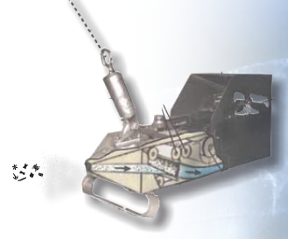
The Continuous Plankton Recorder (CPR)
SAHFOS
Ships of Opportunity (SOOPs)
Unchanged methodology (80 years)
Longest, most spatially extensive oceanic monitoring program in the world
~ 1 million samples
500 plankton taxa + indicator of phyto biomass
Microplastics
Water sampler
Sample archive
Notes:
Luckily we have lots of data on plankton
Open sea
80th anniversary

Slide 8
Notes:
Luckily we have lots of data on plankton
Open sea
80th anniversary

Slide 9
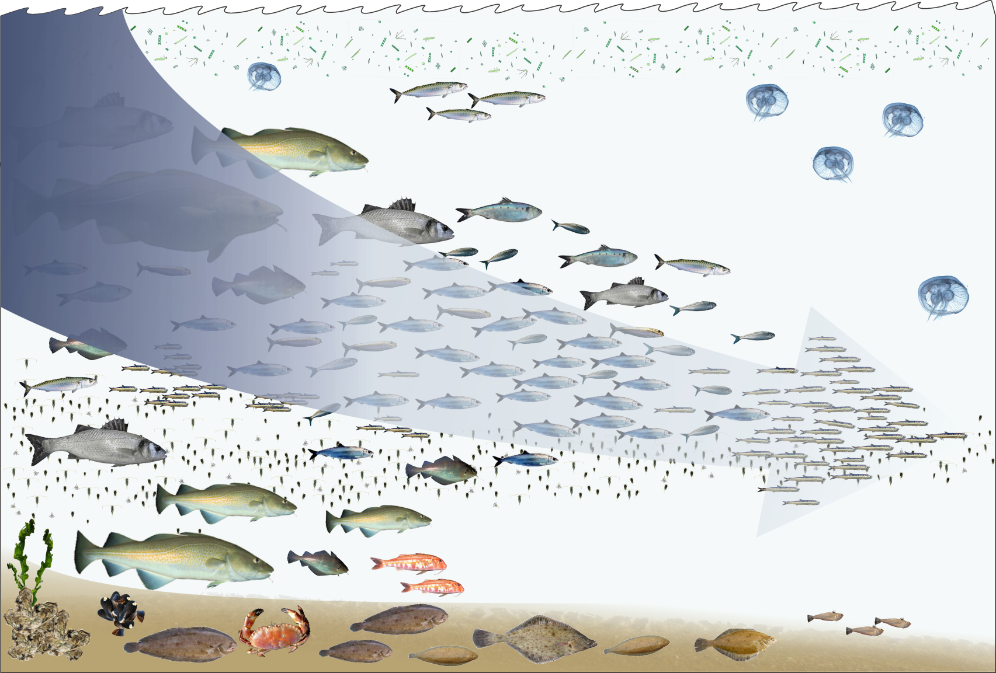
How good is good?
1920
1977
Past
Present
Notes:
But even if we pick the perfect indicators to tell us about our seas how do we set a target for GES?? How good is good? And WHAT is good environmental status?
So we have this problem of Shifting baselines
Target setting
When we are setting env targets, how do we decide WHAT is good environmental status? My gma would obv have different views on GES than i would
What must we consider when setting GES targets against a back ground of major large-scale ecological changes?

Slide 10
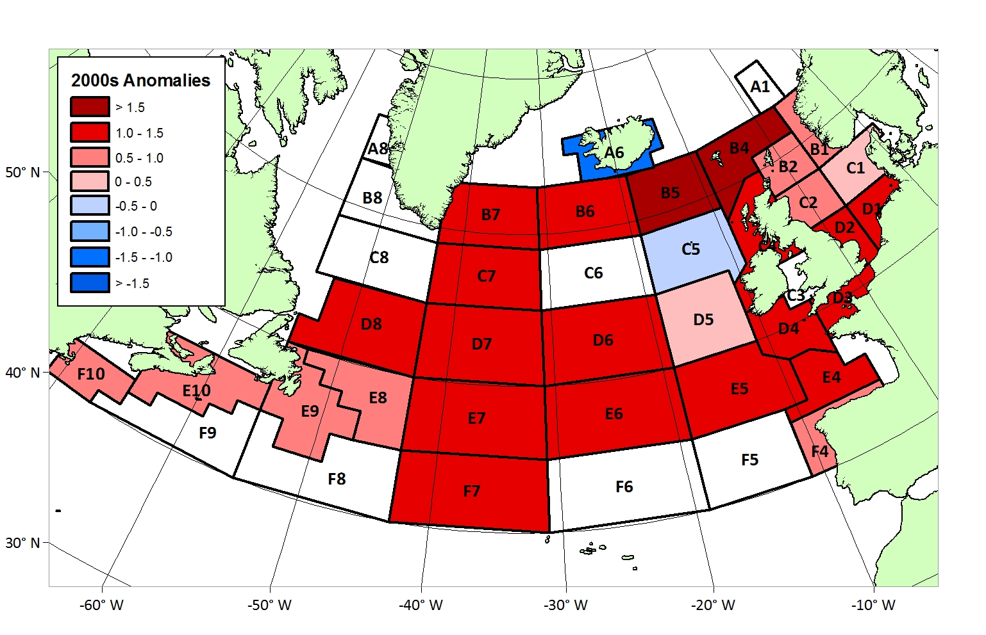
Basin-scale change
McQuatters-Gollop et al 2011 Nature
Updated from Edwards et al (2001) ICES Journal of Marine Science
Notes:
CPR has identified lots of changes in the North Atlantic plankton
With the CPR survey we’ve observed changes in phytoplankton biomass
PCI – estimate of phytoplankton biomass
At the North Atlantic basin scale

Slide 11
Regime shifts
Updated from Edwards et al (2001) ICES Journal of Marine Science
Notes:
When we look closer at the NEA and North Sea this inc is also visiable
And actually we now know that a climate-driven regime shift has occurred in the NEA
1980s- regime shift, SUDDEN, multiple trophic levels, region-wide, stepwise, hydroclimatic
Not only change in phyto biomass but also in bloom seasonality
Unpredictable – how do we manage? Large sudden (< a decade) changes will exceed any ecological target we set

Slide 12
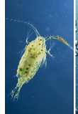
Biogeographical shifts
1000 km shift!
Beaugrand et al, Science
Notes:
In addition to regime shift there have been gradual climate-driven changes in the north atlantic
During last 50 years there has been a progressive incr in the presence of warm-water/sub-tropical species into the more temperate areas of the NEA and a poleward retreat of the colder-water species
Calanoid copepod groups
1000 km shift northward
Trophic consequences -> lead to Cal hyper then cal hel and fin example (for consequences)

Slide 13
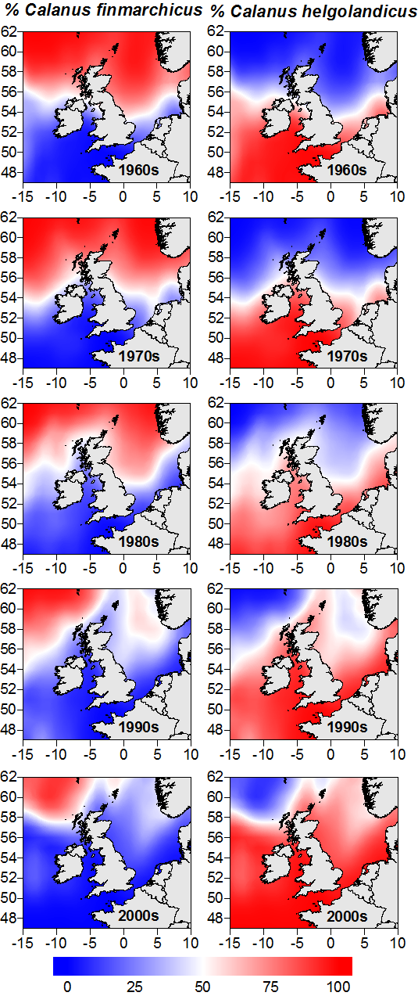
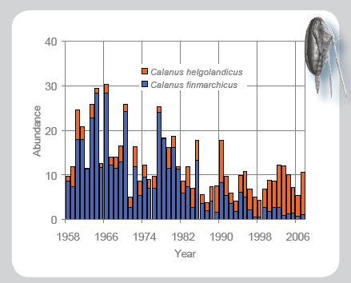
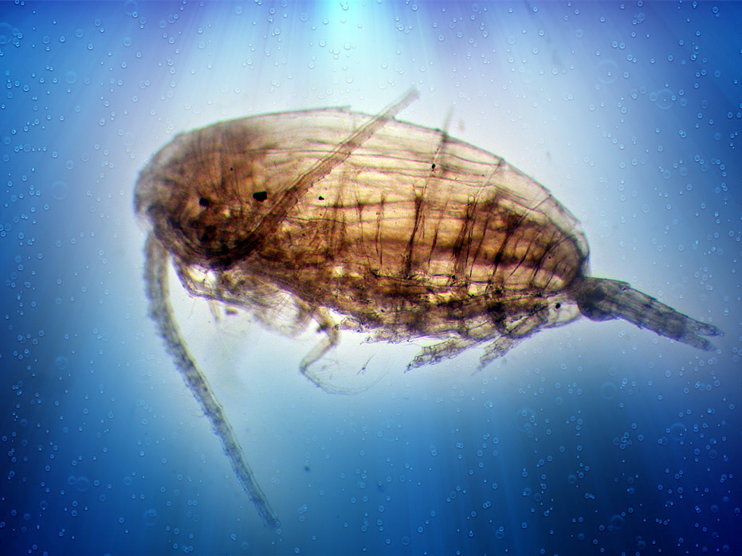
C. Helgolandicus
warm
C. Finmarchicus
cold
SAHFOS
Notes:
As the climate has warmed fin has moved north out of north sea and has been replaced by hel
Although they look the same there are trophic difference, cal fin is cod food
Not replacing in equal biomass –decline in total copepod biomass
Trophic consequence

Slide 14
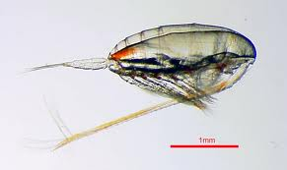
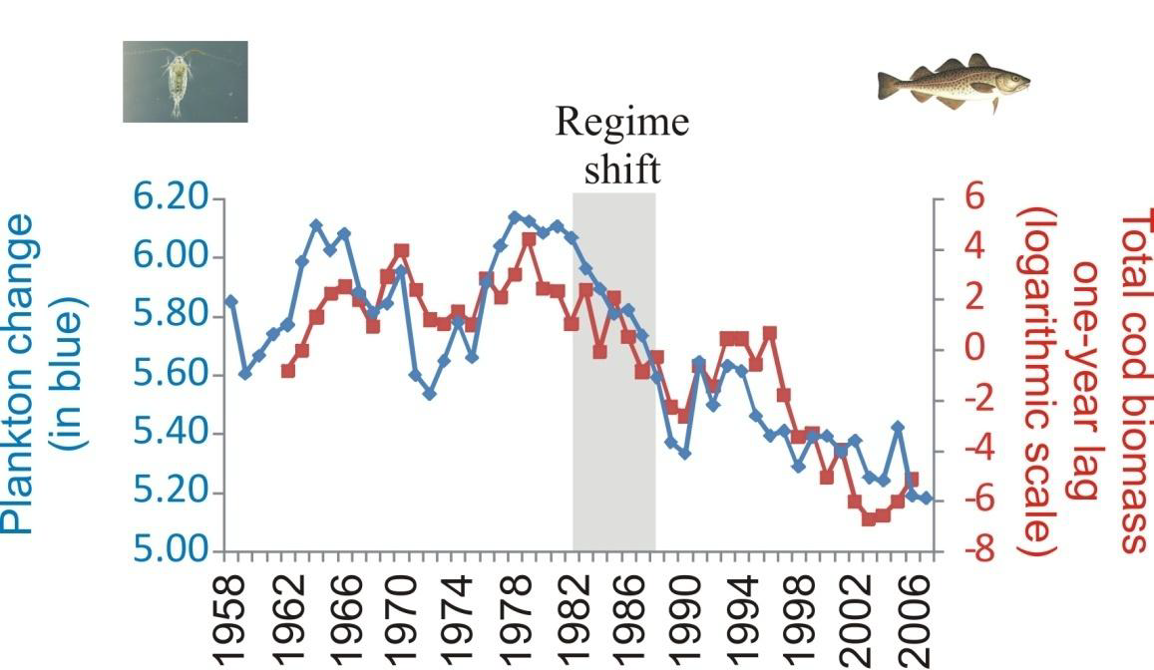
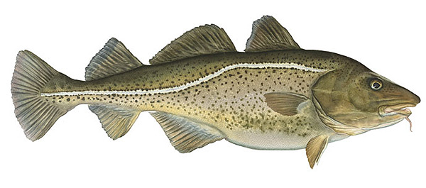
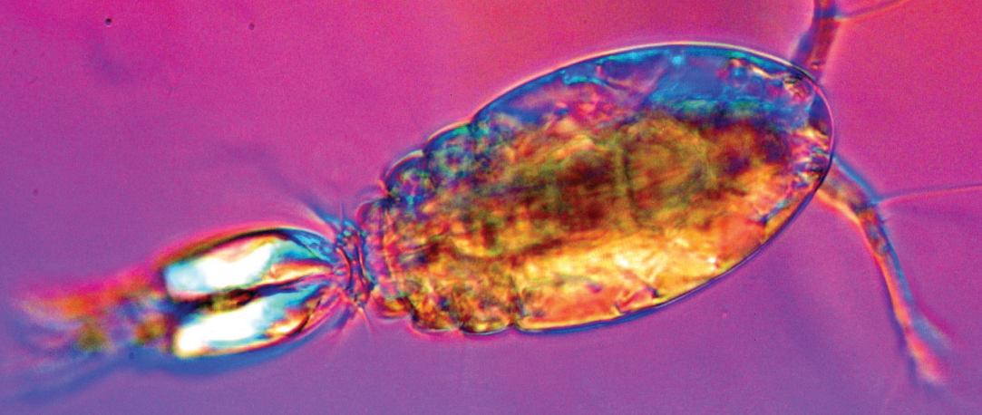
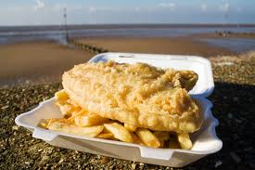
Unrealistic expectations
Beaugrand et al Nature 2003
Notes:
So who cares about copepods? Well plankton are awesome in themselves but changes in the plankton also resonate upwards thru the foodweb
We all know that cod are overfished in the NS.
Fish affected by SST directly but also indirectly through copepod zooplankton prey
Plankton change – PC1 of an index of plankton attributes like prey abundance and size
1980s – climate effects on plankton in comb with fishing reduced cod recruitment and SSB declined (mulitple pressures!)
This climate role means that however well we manage, we may not get cod back.
How do we set a target for this?? May not be a popular choice as people WANT to eat cod
Could look like the measures we are taking to manage fishing aren’t working
However. need to look for more appropriate, sustainable fisheries – fish fight mackerel bap

Slide 15
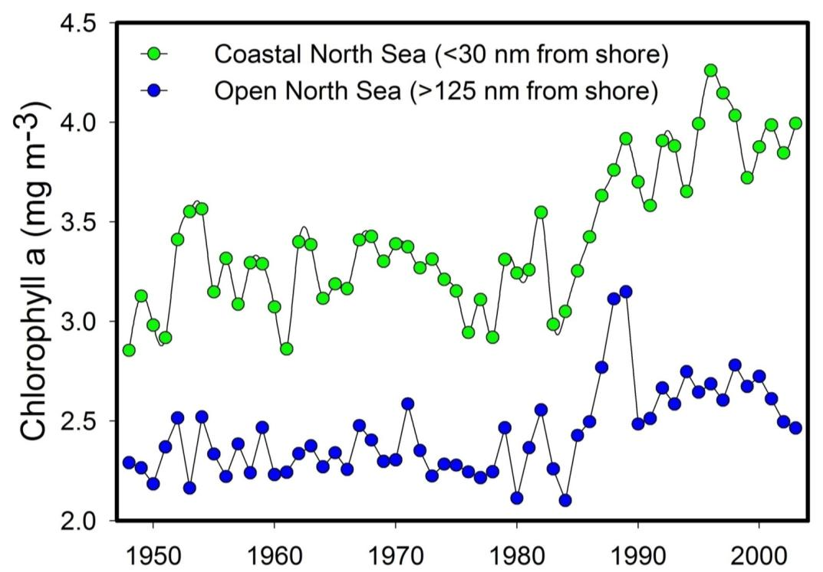
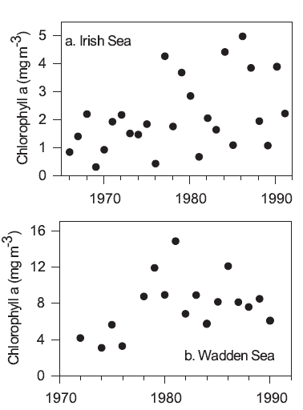
Separating the signals
McQuatters-Gollop et al 2007
Cloern 2001
Notes:
Part of management is determining if a change is anthro (and can therefore be managed with a measure) or if it’s natural variability or climate change.
This is a key challenge/research questions.
Perspective! Difference between offshore-onshore plankton can be used to determine drivers of change (or at least if manageable) bc we need to know if the changes we are seeing in our marine env are anthropogenically-driven, and therefore manageable, changes. Or primarily climate related and we are unable to do anything about them.
Need to focus on what we CAN manage and do the best we can.
One way to separate these signals is by comparing coastal to oceanic datasets and looking for changes...

Slide 16
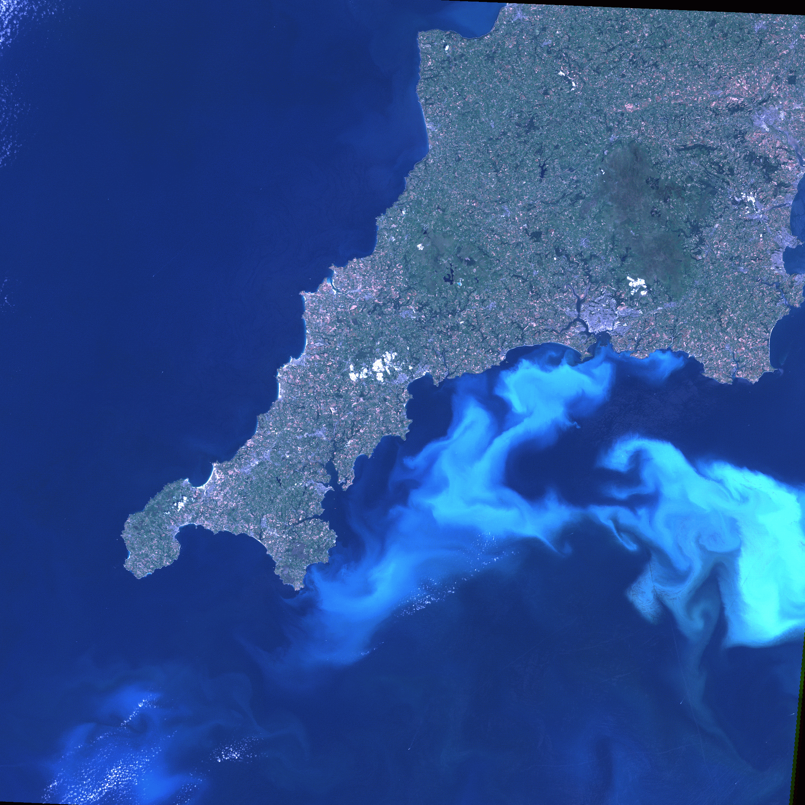
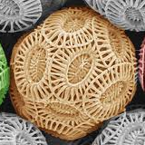
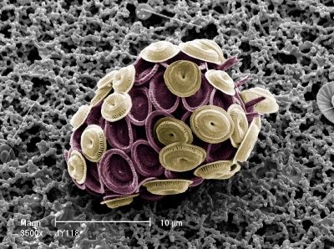
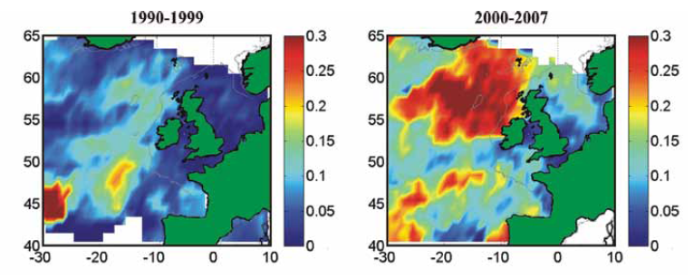
Lack of understanding
McQ-G, Edwards, Beaugrand SAHFOS
Notes:
Lack of understanding
Tipping points
Healthy v acidic cocco
So as the sea becomes more acidic we should see a decrease in calcareous plankton. Right?
But that’s not what we see.
How can we manage what we don’t even understand?

Slide 17
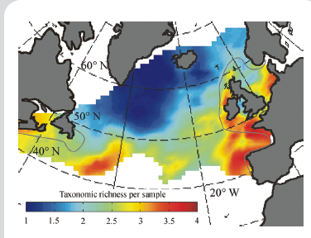
Subjectivity
Is biodiversity always good?
G. Beaugrand & M. Edwards PNAS (bottom) & GCB (top)
Notes:
We’ve been talking about GES. But what if what we think is good, ISN’t good? Biodiversity is usually considered good, D1 says we should maintain biodiversity.
The most productive regions of the world in terms of big, edible fish are the temperate and cold latitudes – that’s where tuna and cod come from.
Compare – temperate seas to tropical = high diversity, but low biomass in tropical. Trophical waters have clear blue water – while cold and temperate waters are productive and full of plankton which supports fish biomass.
Diversity increasing due to warming...but biomass decreasing and plankton community tending toward smaller-sized fraction
So is increased biodiversity is it what we want in this case? Knowing that inc biodiversity in the plankton is resulting in decreasing productivity (following on to smaller-sized fish communities) and reduced carbon drawdown?

Slide 18
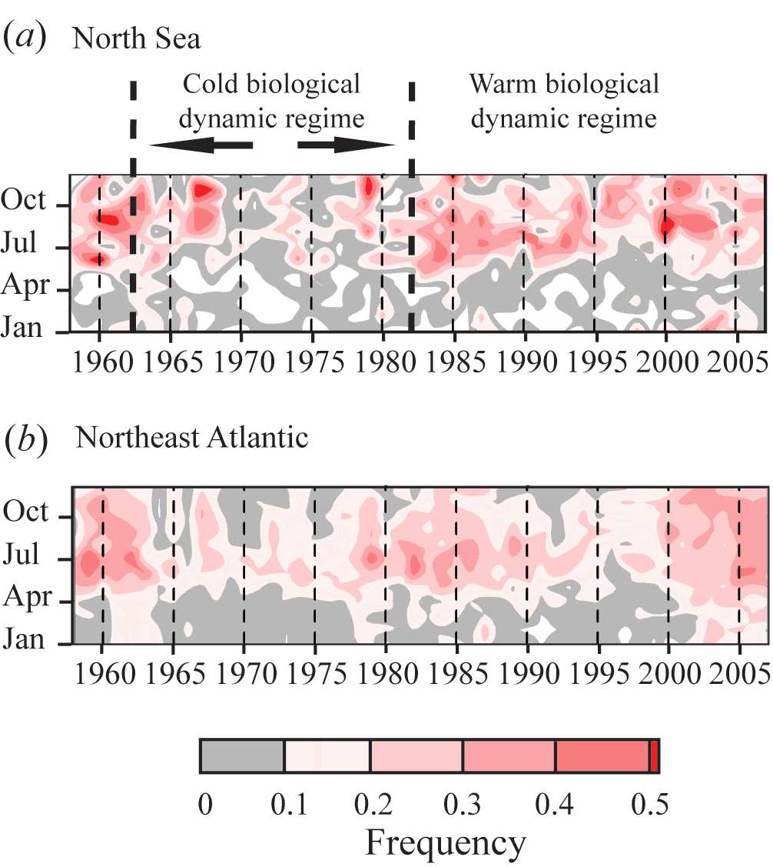
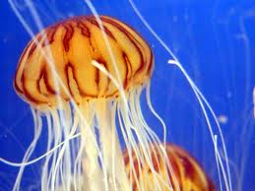
Trophic links
Licandro et al Biology Letters
Notes:
Jellyfish increasing and often considered bad bc they prey on fish and compete with fish for food

Slide 19
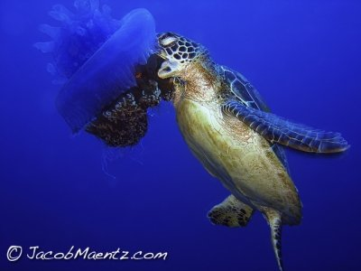
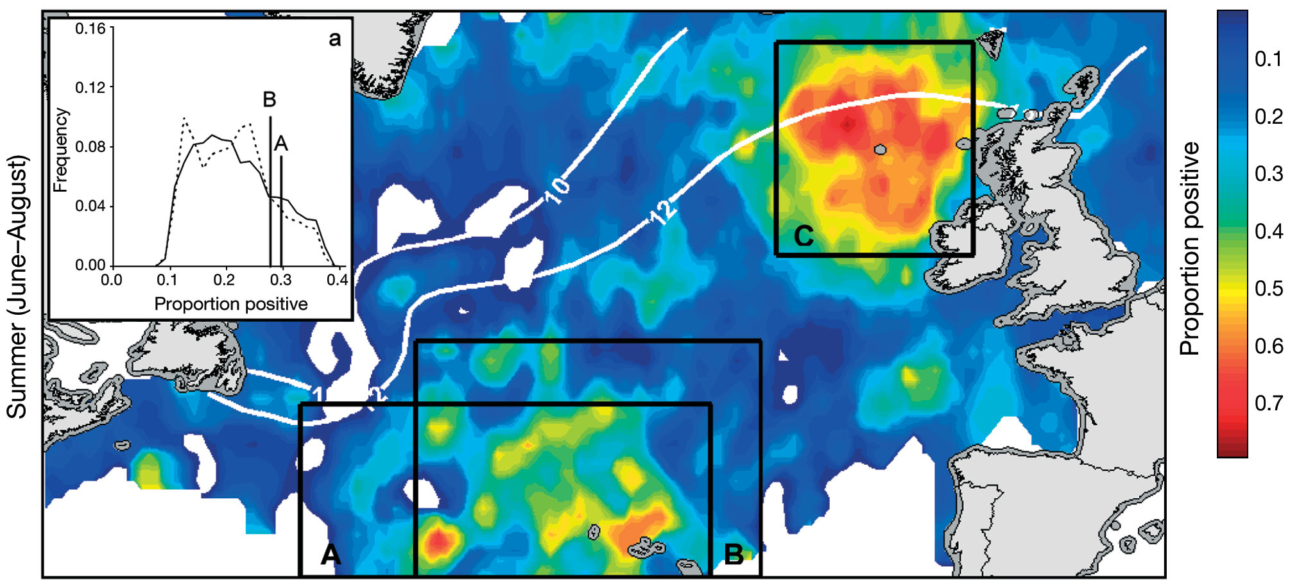
Trophic links
Witt et al 2007
Notes:
Subjective
How we manage for one trophic level affects others – we have lots of plankton data which we could use to help manage turtles
Conservation
Conundrum
how do we use that conflicting information to set a target?

Slide 20
Challenges....
Climate
Multiple pressures
Difficulty separating signals
Lack of understanding
Subjectivity
Unrealistic expectations
Trophic complexity
Notes:
So there’s this list of challenges – but what do we do about them? how do we deal with them?
So there are a lot of challenges we must consider when developing indicators and setting management targets:
Climate : can have a confounding, or exacerbating, or mitigating, influence on the sea. Can interact with management.
Multiple pressures: holistic approach needed, laid out in MSFD, but we must make sure this does not get lost (or watered down) during implementation
Signals: how can we manage a system if we aren’t sure which changes are manageable and which are not?
Understanding: how can we manage the sea if we don’t understand why changes are occurring?
Subjectivity: is what we are aiming for really what we want? The MSFD calls for maintenance of biodiveristy – but if plankton biodiv increases that will likely mean fewer fish to eat.
Expectations: Maybe we can’t manage the sea the way we want to, maybe we can’t always have cod, maybe we’ll have to make more sustainable choices
Complexity: the way we manage, or don’t manage, one trophic level could have consequences for other trophic levels. Again, the holistic approach suggested by the MSFD really is crucial

Slide 21
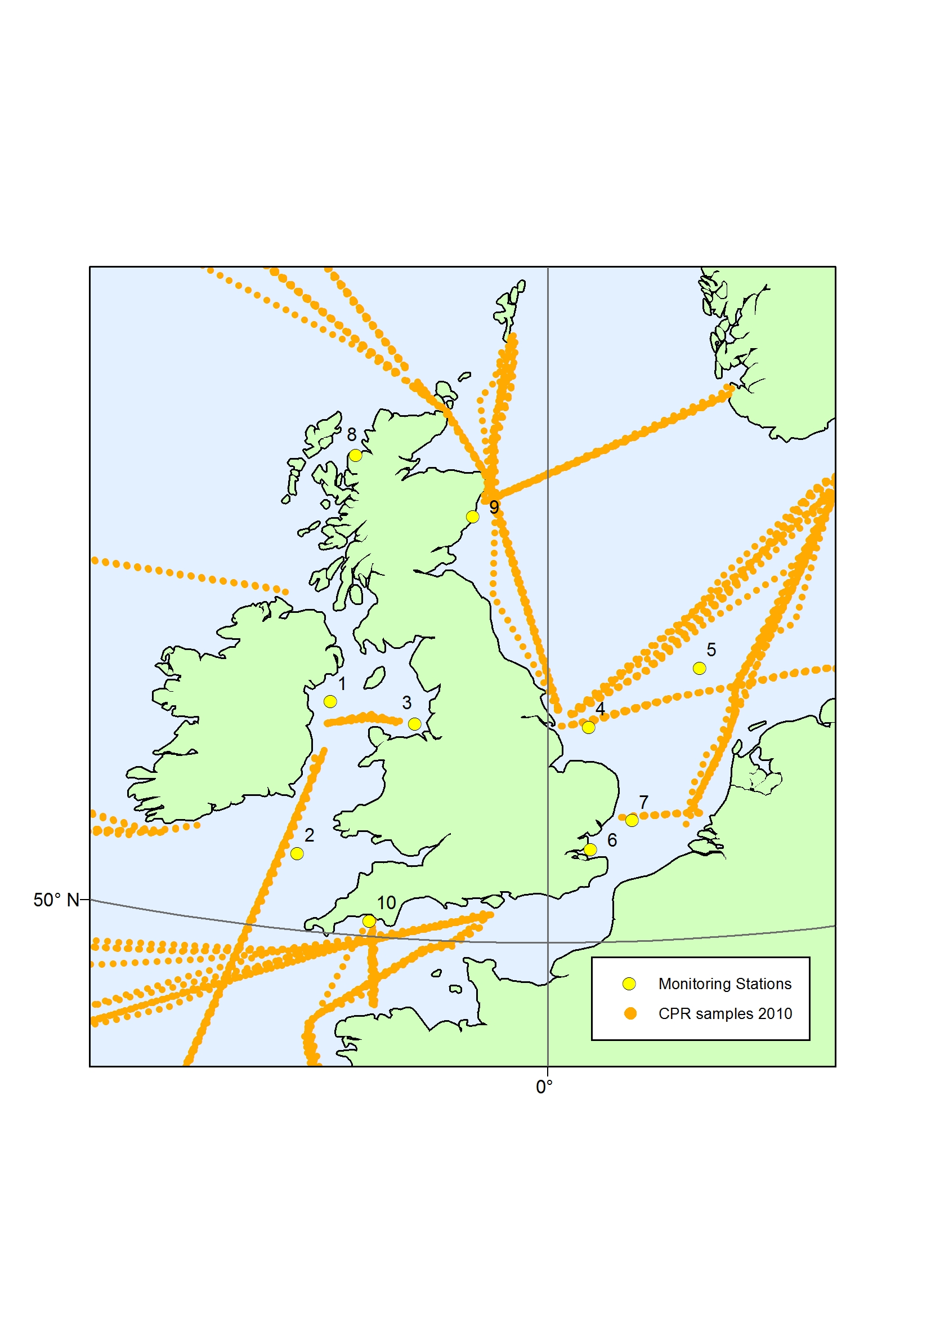
Notes:
Ubiquitous targets for all pelagic indicators

Slide 22
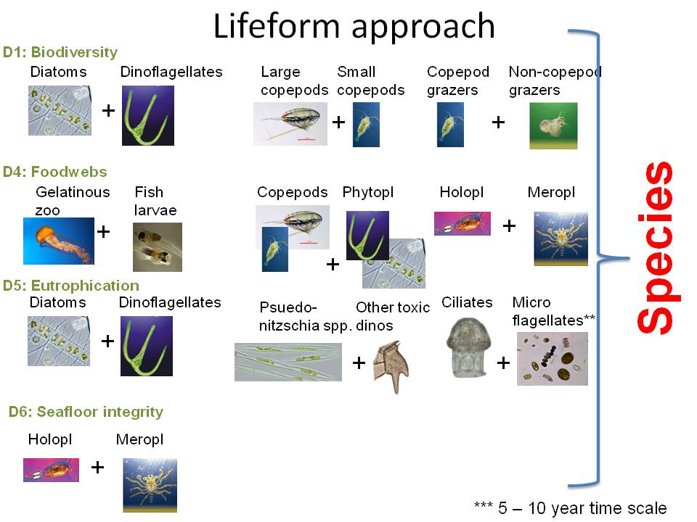
UK approach: to pelagic indicators
Notes:
UK example just a summary, no detail, you can ask me later.
Plus the biomass indicators
For the indicators under Descriptor 1, the PI consists of lifeforms that are likely to reflect changes in the dominant groups of phytoplankton and zooplankton i.e. the ratio between diatoms & dinoflagellates; large and small copepods; copepod grazers and non-copepod grazers.
For Descriptor 4, the emphasis of the PI is energy flow through the ecosystem, so lifeform pairs have been selected to provide an indication of changes in: the transfer of energy from primary to secondary producers; the pathway of energy flow and top predators; benthic/ pelagic coupling (i.e. the interaction between the seafloor and the water column).
Benthic-pelagic coupling is the primary focus of the PI for Descriptor 6, which use a lifeform pair of changes in holoplankton, which are fully planktonic and benthic meroplankton, of which only part of the lifecycle is planktonic.
The lifeforms selected for the PI under Descriptor 5 – Eutrophication, aim to determine whether nutrient enrichment has resulted in a shift in algal species composition, especially towards dinoflagellates and microflagellates (many species of which cause harmful toxic algal blooms) and changes in the potentially toxin-producing dinoflagellates and diatom - Pseudo-nitzschia spp.
All lifeform pairs together can be used to assess Criterion 1.7: Ecosystem structure.

Slide 23
UK approach: to pelagic targets
‘the plankton community is not significantly influenced by anthropogenic drivers’
Notes:
Ubiquitous targets for all pelagic indicators

Slide 24
...so consider
How much change is manageable?
How do we set management targets?
Holistic approach crucial
Notes:
So when setting management indicators and targets we need to think about:
Manageable change: how much of the change that we are observing is even manageable at all? No try to manage things that we can’t, but think about the unmanageable drivers when we are setting up management plans and deciding targets.
Targets: Where do we set targets when our environment is unpredictable? Will targets move (climate change)? The only solution to this is more research and adaptive management.
Holistic approach – ecosystem components connected, fish-plankotn, plankton-turtles, the way we manage one component has impacts on others
How can YOU as a scientist help?

Slide 25
Unanswered questions
Aggregation?
Spatial and within descriptors
Who assesses each dataset?
What if there are no data?
Baselines v reference conditions
Comparability within regional seas

Slide 26
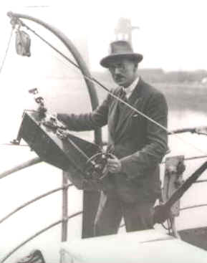
Thank you
Abigail McQuatters-Gollop
SAHFOS
abiqua@sahfos.ac.uk
Notes:
CPR funding consortium
Ships crews
The CPR analysts – there have been 105 of us which Sir Alister himself was the first

