Slide 1
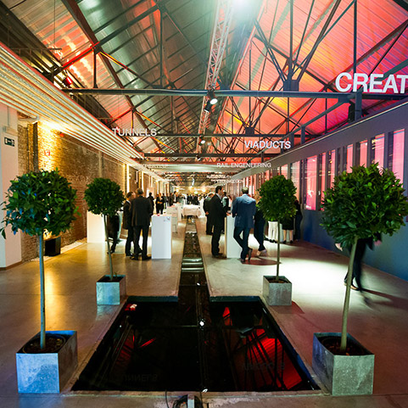
Conference
Evolving EOOS:
Connecting communities for end-to-end solutions
21-23 November 2018,
The Egg, Bara Street 175, 1070 Brussels, Belgium

Slide 2
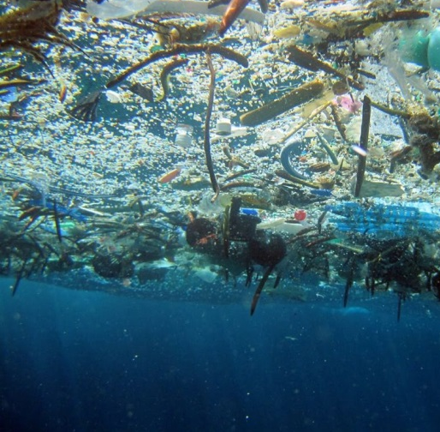
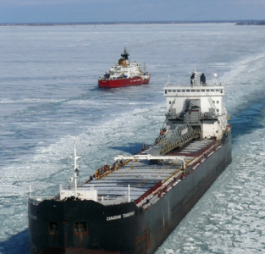
EOOS Communities
Monitoring and assessment
Industry
Operational oceanography
Policy
Marine stations and laboratories
Marine time-series
Society/Citizen Science

Slide 3
EOOS Conference – Concept
Summary
Dates: 21-23 November 2018 - from Wednesday morning until Friday Lunch
Location: Brussels, The Egg, Bara Street 175, 1070 Brussels, Belgium - www.theeggbrussels.com
EOOS event developed in collaboration with EMB, EuroGOOS and the EOOS Steering Group with inputs from a Conference Advisory Committee and linked to a one-day forum (8 March 2018, Brussels)
Organisational, communication & logistic support provided by the EMODnet Secretariat in collaboration with Secretariats of European Marine Board & EuroGOOS
Expected number of participants: between 200 and 250
Targeted stakeholders / audience: The full value chain of EOOS and full diversity of stakeholders from Research and operational ocean observation community, industry, policy, society…European and International.
Budget: estimated 100k euro

Slide 4
EOOS Conference – Aims and objectives
Aim: connect & gather support from broad range of stakeholder communities, strengthen the momentum for the EOOS strategy and implementation by providing a wider perspective and forward look on the development of EOOS.
Objectives:
showcase current and planned ocean observing and monitoring capability by presenting insights from major ongoing activities;
connect and align diverse observing and monitoring communities and those that rely upon their outputs and services;
assess the economic case for sustained observation/monitoring in Europe;
identify gaps and requirements as well as cost effective solutions that will contribute to evolving an efficient, inclusive and effective end-to-end EOOS;
assess the EOOS strategy and implementation and identifying further concrete joint actions to advance the EOOS agenda.

Slide 5
EOOS Conference – Focus and scope
Scope: reflects EOOS scope itself: all-encompassing, taking into account the systematic collection of all kinds of data from the marine environment, focusing on the European effort, but set within a global context.
Focus: building common understanding towards a well-coordinated & sustained ocean monitoring/observing activity to increase our understanding of the short-medium to long term changes of the system and to underpin an ecosystem based management of our marine and coastal environment supporting blue green growth
The Conference should address and progress the four main actions underpinning the development of EOOS:
Align and connect existing initiatives to ensure efficiency and value for money;
Identify gaps in the European observing capacity and foster initiatives to fill those gaps;
Promote observing capacities which can benefit multiple sectors including research, policy, management and industry; and
Ensure that European ocean observing is integrated into the global observation system(s) by providing a focal point for interaction with international programmes (e.g. GOOS, GEOSS) and partner initiatives outside of Europe.

Slide 6
EOOS Conference – Proposed format
High level political opening & closing sessions (+call for action)
Short invited presentations & discussion panels covering relevant studies, projects, observing/monitoring efforts + perspectives from MSs, European networks, agencies and DGs
Focus on plenary thematic sessions with sufficient time to foster coherence and joint discussions with topical/regional focus
Specific thematic/regional breakout sessions or side meetings (if desirable and/or requested)
Ensure sufficient time for networking
Posters/exhibition to bring in wider community

Slide 7
EOOS Conference – Proposed structure
Opening Session: Setting the Scene - EOOS state of play, strategy & early implementation actions
Making the case for sustained observations and monitoring – Cost-benefit assessments and non-economic value use cases involving business, public sector, civil society and research community
Current and future monitoring and observing activities – Thematic sessions: Overview of activities and perspectives from key stakeholder communities
Building a fit for purpose EOOS: Gaps and requirements – Results of gap analyses, data stress-tests and requirements studies
Evolving EOOS: Future priorities and next steps – Commitments and actions for joining up European monitoring and observation efforts
Closing Statements: Conclusions & Conference Messages

Slide 8
EOOS Conference – Expected main outputs
Endorse the EOOS Strategy
Formulate broadly-supported recommendations on future priorities for ocean observation/monitoring and next steps to deliver an integrated EOOS
➔ Conference message “Evolving EOOS” and a call to action from wide stakeholder groups
Highlight a number of possible joint actions and steps that could be taken by key stakeholders to implement the EOOS Strategy

Slide 9
EOOS Conference – Draft Programme
Day 1: EOOS status and main building blocks
High level policy kick-off and EOOS end-to-end
EOOS: Key components and priorities
Panel discussion with focus on key priorities identified in the Strategy document; OR making the case for Ocean Observing efforts
Major observing integration projects, efforts and initiatives at Sea-basin scale (parallel)
Plenary closing of the day
Reception: Connecting the dots for EOOS - Themed poster pitch presentations

Slide 10
EOOS Conference – Draft Programme
Day 2: Assessing gaps and connecting communities
Welcome and recap on day 1
Keynote International on ocean observing development OR Economic analysis of benefits of monitoring eg OECD
EOOS: Are observation and monitoring efforts fit for purpose?
EOOS: Where are the gaps in the cycle? (Panel)
EOOS: Interconnecting communities, observations and data”
Keynote: Big Data and the Ecosystem Approach
Overview of observation efforts and monitoring programmes
Panel discussion
Industry: From user to producer, and everything in between (potentially a breakout session if more sessions required)
EOOS By Society, for Society
Reception: Connecting you and me for EOOS: stakeholders

Slide 11
EOOS Conference – Draft Programme
Day 3: Evolving EOOS
EOOS Future priorities and next steps
Plenary recap of main points from the Conference discussions
Focus talk on sustainability and system requirements as cross-cutting to all four EOOS themes
Panel: Future priorities in ocean observation and next steps to deliver EOOS with EC, stakeholder representatives (European and International e.g. EuroGEOSS, GOOS) – the EOOS Strategy / Implementation Plan / Joint Actions / Conference Statement
Open discussions with audience
Closing Session – Final reading and delivery of the EOOS Conference Message* (To whom? To EC officials, to JPI-O, to other stakeholders, MB reps?)

Slide 12
Other ideas for potential sessions, topics, keynotes
Innovative funding options for in situ ocean observation e.g. Interreg, Structural funds, industry-society partnerships (potentially a breakout session)
Demonstrations of new applications or innovative uses of EMODnet data and products; (potentially a breakout session)
Consider keynote taking Future look at the next generation of observing and monitoring tools and approaches – captivating and inspirational talk by a charismatic ocean explorer and/or future oriented science-tech talk on advanced ocean observing technology, the “Digital Ocean” or “Big and Linked Data Challenges”;
Consider Keynotes from non-European expert(s) on monitoring and observing programmes in other parts of the world (IOOS in the US, Chinese monitoring activities by State Oceanic Administration in China, IMOS in Australia, …) and global coordination efforts such as IOC’s GOOS which is developing a new strategy in 2017;
“making the case” with cost benefit studies etc.
https://ioos.noaa.gov
www.Imos.org.au
http://www.goosocean.org/

Slide 13
Conference Milestones
Beginning of June : Deadline abstract submission
8 : EOOS Forum + Launch of the website & registration open for the conference
End of June : Notification on abstract acceptance
Mid-Sept : Final programme
9 : Advisory Committee + draft programme
Mid-April : Call for abstracts
8 : Forum report
1 : Registration closing date
21-23 : EOOS Conference
March
April
May
June
July
August
September
October
November
Communication & Promotion

Slide 14
Linking EOOS Forum & Conference
EOOS Forum presents and discusses key aspects of EOOS Strategy & Implementation Plan advanced draft proposals
EOOS Conference
Before and during Conference, gather wide support to endorse elaborated Strategy and Implementation plan
revisit early actions & promote communities to connect and propose additional actions & future directions
Call for further joint actions
Points gathered at the Forum in March 2018 could feed into development of the EOOS call for action (conference message) drafted April-October 2018 by the EOOS SG & with feedback from Conference Advisory Committee.
Notes:
EOOS Conference focus: “What is the European capability now, and where are we going?” The multi-day would therefore take a broad and in-depth look at the range of ongoing initiatives, gap analyses and other studies, combine a view on existing capability with a longer-term horizon scan. It should bring together key stakeholders at local, regional, national, European and global level.
EOOS Forum focus on Sustainability and funding streams at the Member State level to gain short to mid-term EOOS support for further developments. Key target audience will be ocean observation funders implementing agencies/institutes, users.

