Slide 1
GEBCO
The General Bathymetric Chart of the Oceans
The name is used for the organisation,
the people involved,
and the products

Slide 2
GEBCO
The General Bathymetric Chart of the Oceans
GEBCO is over 100 years old
today, it has developed from being a series of paper charts into a series of digital products fit for the 21st century

Slide 3
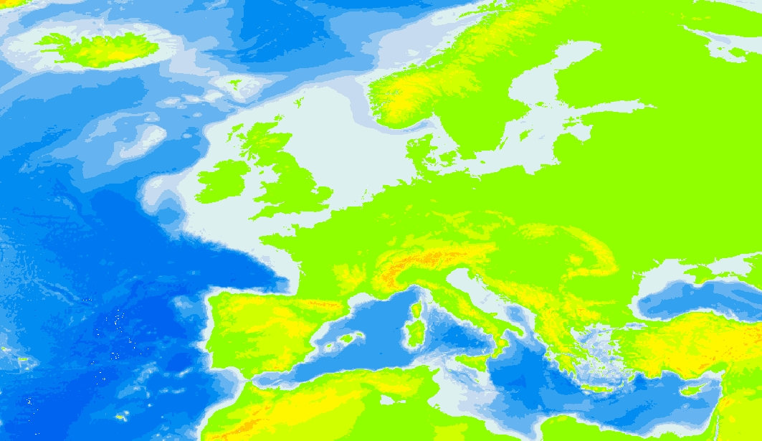
GEBCO
but most people think of this…

Slide 4
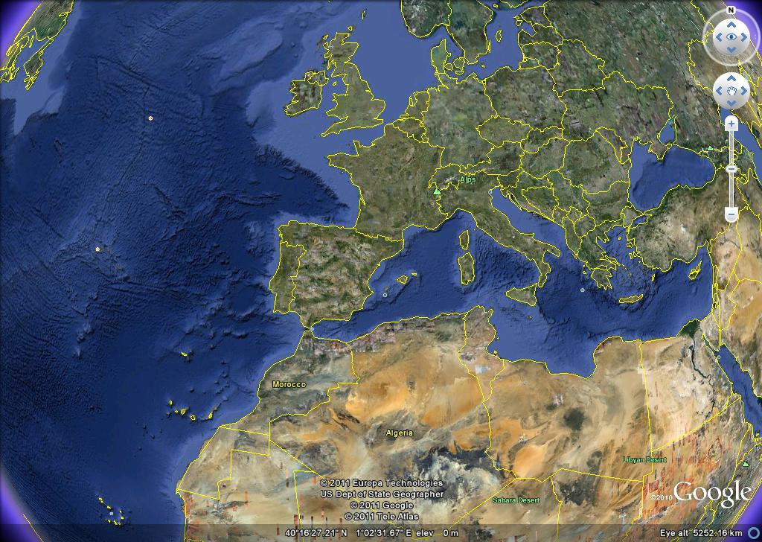
GEBCO
or this…

Slide 5
GEBCO
the organization operates in affiliation with
The International Hydrographic Organization (IHO)
“A subsidiary mission is the application of hydrographic data to support
science, and to promote its use in geographic information systems…”
Intergovernmental Oceanographic Commission – IOC
(of UNESCO)
“The IOC assists Member States of the UN to address their individual and collective ocean and coastal problems through the sharing of knowledge, information and technology and through the co-ordination of national programmes.”

Slide 6
GEBCO
GEBCO, the organization
is a network of volunteers, both individuals and organizations,
who cooperatively produce bathymetry of the world ocean
GEBCO, the products
are a series of descriptions in maps, numerical grids and
nomenclature of what is known of the physiography of
the World Ocean at a scale appropriate to the
amount of data available at the time of publication
GEBCO, the people
operates a program to train younger scientists and
hydrographers in oceanic bathymetry
and to build capacity in their home countries

Slide 7
GEBCO
the organization….
GEBCO Guiding Committee
Sub-Committee on Undersea Feature Names (SCUFN)
Technical Sub-Committee
(TSCOM)
Sub-Committee on Regional Undersea Mapping (SCRUM)

Slide 8
GEBCO
the organization….
GEBCO Guiding Committee
establishing standards for data quality and data access
maintaining a network of experts in data collection and interpretation
encouraging broad participation with other data suppliers
within a common data warehouse framework
establishing new access channels between data holdings and end users

Slide 9
GEBCO
the organization….
Sub-Committee on Undersea Feature Names (SCUFN)
SCUFN maintains and makes available the IHO-IOC GEBCO Gazetteer of Undersea Feature Names
prepares and maintains lists standardised feature definitions
ensures that proposed names will adhere to the guidelines of IHO-IOC Publication B-6, and the feature’s existence will be supported by valid evidence
ideally SCUFN has 12 members, 6 appointed by IOC and 6 by the IHO

Slide 10
GEBCO
the organization….
Technical Sub-Committee (TSCOM)
TSCOM “looks after” many aspects of technical detail as regards the updating, maintenance and quality of the GEBCO products
has the power to create and disband further working groups to look into specific areas (e.g. GEBCO cookbook)
is usually composed of 10 experts who are there for their expertise,
and not their affiliation (i.e. IOC or IHO)

Slide 11
GEBCO
the organization….
Sub-Committee on Regional Undersea Mapping (SCRUM)
SCRUM's aim is to build a closer collaboration with regional mapping efforts and coordinate, as well as encourage, the incorporation of their compilations into GEBCO
current areas of focus are the South East Pacific, Indian Ocean and the Southern Ocean
this effort is being very strongly supported by direct funding from the Nippon Foundation

Slide 12
GEBCO
in general, support comes from...
Individual members’ home organizations
(Government, Academia and Industry) support participation
US Government supports GEBCO by funding work at the
National Geophysical Data Center
and Lamont-Doherty Earth Observatory (GMRT)
IOC supports DCDB
(Data Center for Digital Bathymetry – Boulder, Colorado, USA)
UK Government supports the Bathymetric Editor and Digital Data Manager
Private Charitable Foundations such as the Nippon Foundation
and the Margaret Kendrick Blodgett Foundation both provide funding

Slide 13
GEBCO
GEBCO, the people
operates a program to train younger scientists and
hydrographers in oceanic bathymetry
and to build capacity in their home countries
this program is funded by the Nippon Foundation,
a Private, non-Profit Japanese grant-making organisation
before the involvement of the Nippon Foundation, the global
participation within GEBCO looked like this

Slide 14
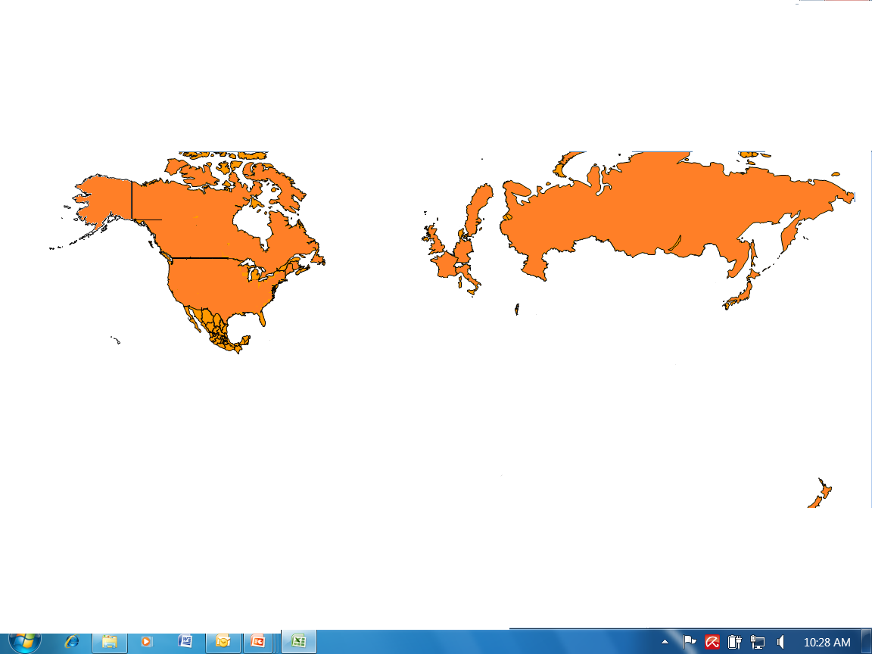
GEBCO

Slide 15
GEBCO
GEBCO, the people
operates a program to train younger scientists and
hydrographers in oceanic bathymetry
and to build capacity in their home countries
This program is funded by the Nippon Foundation,
a Private, non-Profit Japanese grant-making organisation
Before the involvement of the Nippon Foundation, the global
participation within GEBCO looked like this
Now, with the involvement of the Nippon Foundation, the global
participation within GEBCO looks like this

Slide 16
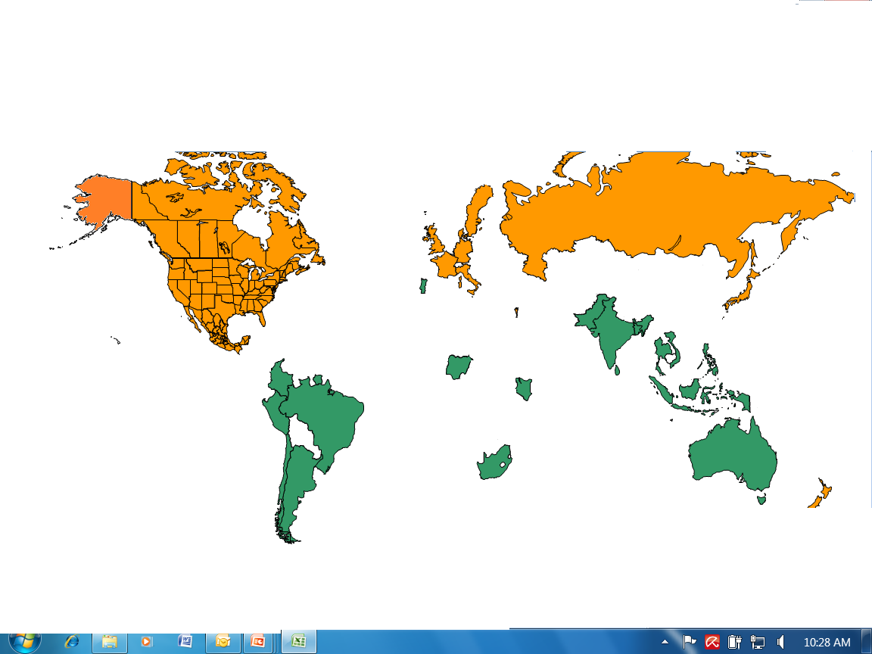
GEBCO

Slide 17
GEBCO
Products…
bathymetric maps of the world ocean, in paper and digital versions
global grid of topography covering the entire world at a resolution
of 30 arc-seconds
worldwide digital data bank of oceanic soundings
(Data Center Digital Bathymetry)
http://www.ngdc.noaa.gov/mgg/bathymetry/iho.html
Gazetteer of Undersea Feature Names
viewing and download of 100m resolution grids - GMRT
(via Lamont-Doherty Earth Observatory)
www.ldeo.edu
Under Development….
Regional Undersea Mapping programmes – grids (printed maps)
(S E Pacific, N Indian Ocean, Southern Ocean)

Slide 18
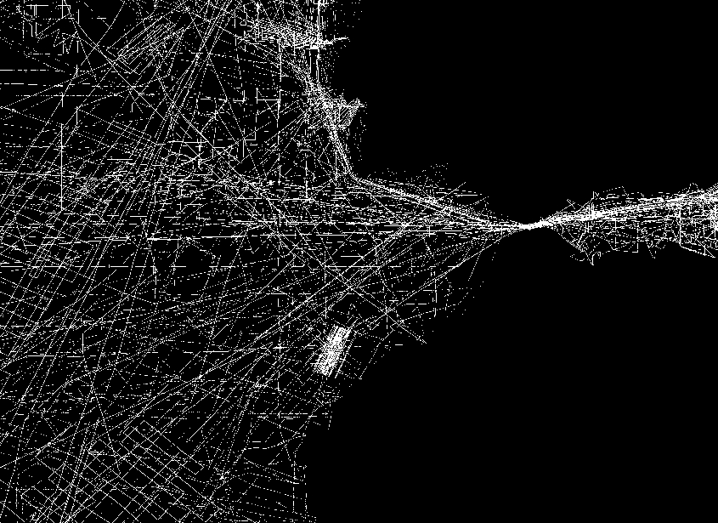
GEBCO
the maps are built mostly from sparse data
the interpolations between data points/surveys can often lead to
“steps” and other apparent anomalies in the seabed model

Slide 19
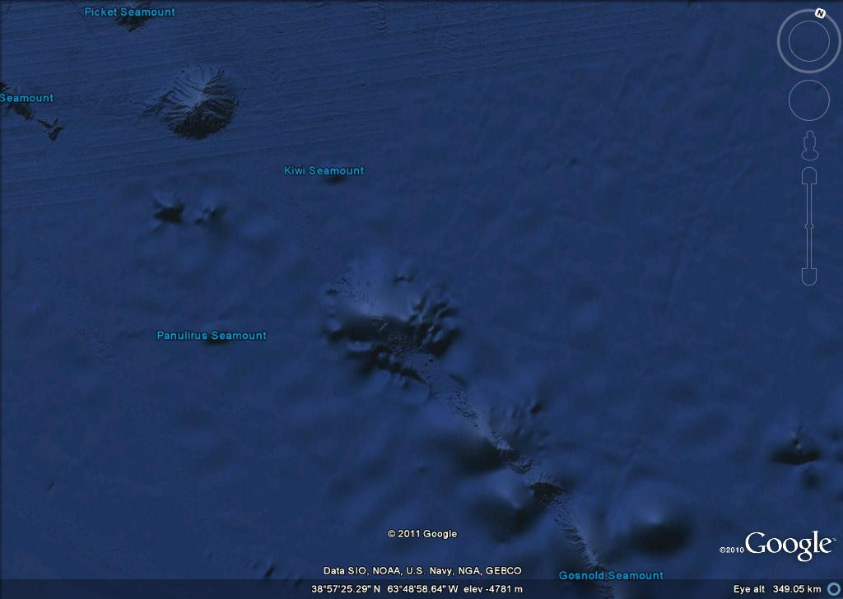
GEBCO
the “steps” produced when real data and gravity-derived interpolations are juxtaposed – (prior to reprocessing)

Slide 20
GEBCO
Now, the focus is on
enlarging the GEBCO Community (people)
getting more data submitted to the International Data Banks
attribution of data sources
obtaining higher resolution data
involvement of regional participants
outreach
digital delivery

Slide 21
GEBCO
Data Ingestion
possibly best described by very brief review of GEBCO digital product
initial digital product was based upon CONTOURS from Series 5 charts
contours were then replaced by areas of primary DATA
interpolated areas between sounding lines – inc multibeam surveys
were replaced by interpolations from the
Smith & Sandwell predicted bathymetry
interpolated areas were (and are continuing to be)
ALWAYS replaced by REAL DATA

Slide 22
GEBCO
each data “spot” is a 30 arc-second tile
the interpolations between data points/surveys use the Smith & Sandwell predicted bathymetry from satellite altimetry

Slide 23
GEBCO
Data Ingestion
primary DATA – includes
soundings – single beam lines and multibeam surveys
from government, academia and commercial sources
data compilations e.g. IBCAO
Electronic Navigational Chart (ENC) soundings
harvetsed by Hydrographic Offices around the world following
an IHO request on behalf of GEBCO

Slide 24
GEBCO
Data Ingestion
most data used in GEBCO is from public sources
however some data has been given “for GEBCO use only”
e.g. some restricted US Navy data is comingled with public data
or interpolated areas and is NOT attributed as “real” data
some is commercial data e.g. OLEX, Survey company,
and ENC soundings
Current issues include:
working toward a common data warehouse framework
for keeping a “copy” of all CLEAN data that were used in grid generation
(rather than a duplicate of NGDC holdings)
what metadata to store…

Slide 25
GEBCO
EMODnet connections….
The Bathymetric Editor (me) is now working as part of EMODnet team
attended recent EMODnet meeting in Athens (12-13 Sep)
3 EMODnet participants attended recent GEBCO Meeting
In La Jolla, California (3-5 Oct)
Presentations were made by people from both projects to show
the nature of what each were trying to achieve and to explore ways
in which they could work together for mutual benefit

Slide 26
GEBCO
any questions?

