Slide 1
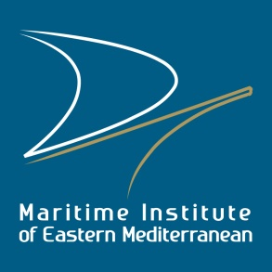
The Tree of Blue Growth
>>Turning a Vision into Reality<<
“The Maritime Institute of Eastern Mediterranean is a novel non-profit organization, aiming to promote Research, Technology and Innovation as well as Education and Training within and for the Maritime industry; and to act as a Forum and a Think-Tank but also as an Incubator of Business Opportunities on Maritime and Sea Affairs in the context of Sustainable Development, by encouraging and facilitating the Dialogue, Networking and Cooperation among all the sector’s stakeholders in the Eastern Mediterranean Region”

Slide 2


The Tree of Blue Growth by MarInEM
>>Turning a Vision into Reality<<
The Fruits of Blue Growth
Employment
Growth
Social Coherence
Stability
Innovation
Diversification
Competitiveness
The Fertilizer
Research-Innovation-Technology
Institutions
MaRITeC-X
The Grafting
Re-Training & Up-Skilling (continuous)
Faculty of Marine Science & Technology @ UCY
Shipping and Finance @ CUT
Cyprus Maritime Academy @ UNic
Marine Engineering Program – Maritime Studies @ FU
Mediterranean Maritime Academy
Maritime Training Centers
The Branches
Education & Training Institutions
[Age 18-28]
The Trunk
Mentoring
[Age 15-25]
Blue Career Centre of Eastern Mediterranean & Black Sea
Ocean Literacy
[Age 5-15]
Sea Peoples’ Resurgence
The Roots
Institutions,
Strategies and
Infrastructures
Integrated Maritime Policy
Cyprus Foundation of the Sea
Larnaka Blue City
Pyrgotelis Zoitos Award
Research & Training Vessel
Marine Parks & Artificial Reefs & Aquariums
Maritime Heritage - Museums
Sectorial Clusters – Pelagos; Proteus
Regional Cooperation

Slide 3

The Roots: Institutions, Strategies & Infrastructures
The Cyprus Foundation of the Sea: an institution established by the Shipping Industry (led by the Cyprus Shipping Chamber and MarInEM) with the support of the Government of Cyprus in order to:
  promote Marine and Maritime Knowledge and Innovation
  support the growth, competitiveness and job-creating potential in Cyprus and the Eastern Mediterranean
  foster an integrated approach on marine and maritime affairs, by acting as an institutional umbrella of existing initiatives, activities, organizations and projects

Slide 4
Larnaka Blue City: a strategic framework of actions developed by MarInEM for the Larnaka Municipality aiming at:
  the transformation of Larnaka into a Regional Blue Economy, Education, Training and Research Center
  the promotion of the Integrated Maritime Policy of the EU in Cyprus and in the area
Few indicative actions are the creation of a Marine Park in the Bay of Larnaka and the establishment in Larnaka of the new Faculty of Marine Science and Technology of the University of Cyprus.
The Pyrgotelis Zoitos Award for outstanding contribution to the advancement of Marine Technology
  to be awarded - as from 2019 - during the biennial international shipping conference “Maritime Cyprus”- to individuals with distinguished accomplishments and experience in the Marine Technology field
  The award was proposed by MarInEM, endorsed by respective stakeholders and announced on 10/10/2017 at a ceremony in Larnaka at the presence of the IMO’s Secretary General, linking the Maritime Heritage of Cyprus with today’s aspirations.
  Pyrgotelis Zoitos was a Cypriot shipbuilder honored by the Ptolemy for the Innovative ships he had built for them

Slide 5
The Roots: Institutions, Strategies & Infrastructures
Promotion of clusters in the Mediterranean Region through capacity-building European projects such as:
  PELAGOS (Promoting innovative nEtworks and cLusters for mArine renewable energy synerGies in mediterranean cOasts and iSlands)
This project aims at fostering cooperation and at increasing the innovation capacities of actors in the Blue Energy field in the Mediterranean Region, through the creation of a transnational Blue Energy (BE) Cluster that will promote novel technologies and provide a mix of support activities to beneficiaries such as technology providers, enterprises, financial operators, authorities, NGOs end citizens. The project will contribute to the joint identification and exploitation of opportunities in the Blue Energy sector in the Mediterranean insular and coastal regions through fine-tuning existing know-how, skill development, thus fuelling economic growth and creating new jobs.
PROTEUS (PROmoting security and safeTy by crEating a MED clUster on Maritime Surveillance)
This EU-funded project aims at exploiting the growth potential of the emerging Maritime Surveillance (MS) industry that can play a crucial role in the socio-economic development of the Mediterranean Region (MED) and in the creation of new job opportunities. This objective will be addressed through the establishment of a MED MS Cluster, fostering innovation and R&D capacities, knowledge and technology transfer, as well as transnational cooperation among the involved key MS actors, focusing on maritime security and safety mechanisms in the MED region. The Cluster will offer customized services in order to identify and exploit technologies related to MS and will achieve transferability through the creation of concrete linkages with other Blue Growth sectors that face common challenges and growth opportunities.

Slide 6

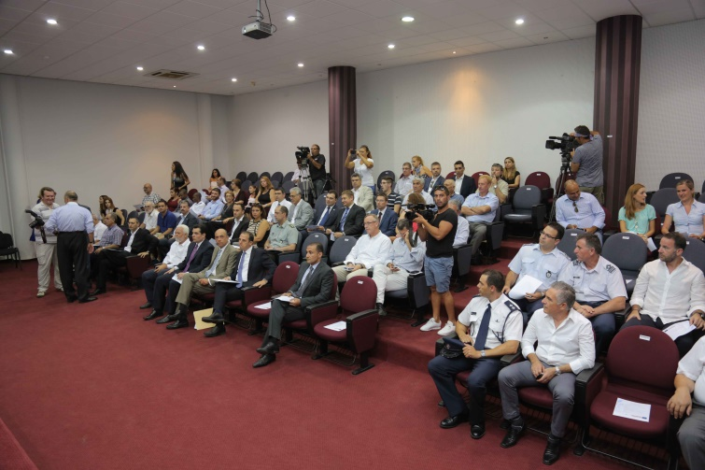
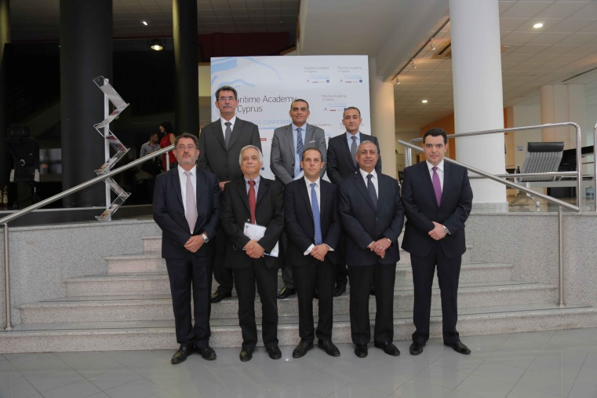
The Roots: Institutions, Strategies & Infrastructures
Initiatives at national level
  Involvement of MarInEM in the creation and implementation of national Blue Growth-related strategies through participation in governmental committees’ working groups on marine and maritime issues (e.g for the development of the national Integrated Maritime Policy)
  Provision of support to the Cypriot government on regional maritime issues (e.g maritime/cruise tourism, maritime education etc)
  Cooperation with the Joint Rescue Coordination Center and the Ministry of Defence in Maritime Surveillance matters

Slide 7
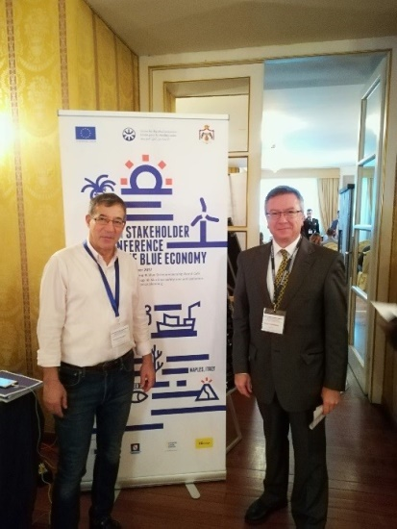
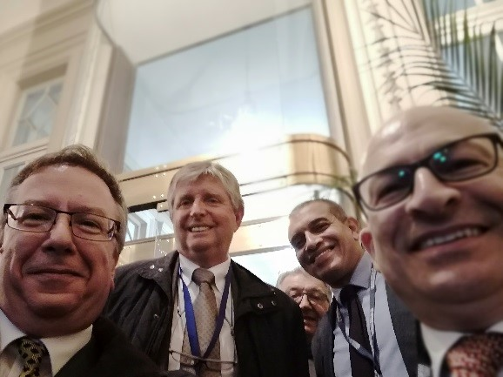
The Roots: Institutions, Strategies & Infrastructures
Regional Cooperation Initiatives
Involvement of MarInEM in the creation of the 1st Cruise East-Med Forum to take place in 2018 with the aim of promoting cruise tourism in the Eastern Mediterranean Region
Promotion of intra-regional cooperation on Blue Growth issues in the Eastern Mediterranean Region in the framework of regional institutions such as the UfM
  On the basis of MarInEM’s recommendations, scientists and academics from academic institutions in Egypt, Jordan, Lebanon participated in the UfM Regional Stakeholder Conference on Blue Economy-Workshop 11 “Blue mission in the Mediterranean region: promoting youth employability throughout developing skills and building capacities in the marine and maritime sectors”

Slide 8
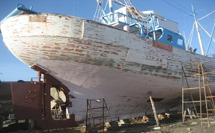
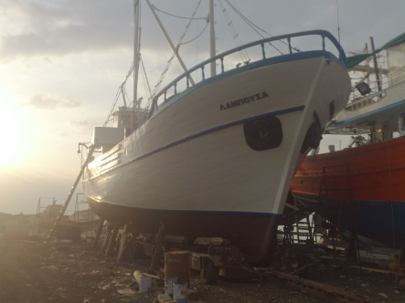
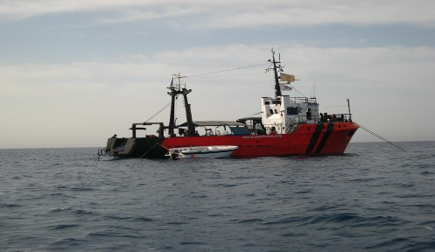
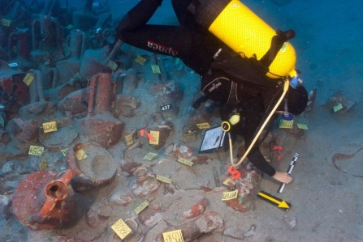
The Roots: Institutions, Strategies & Infrastructures
Contribution to Maritime Heritage
Provision of technical support of MarInEM to the renovation of the Lambousa boat especially with regards to naval architecture and marine engineering aspects
Lambousa Boat became the 1st floating marine museum in Cyprus
Provision of technical support of MarInEM to the excavation of the Mazotos shipwreck
Supporting the creation of a Maritime Heritage Centre and Museum

Slide 9

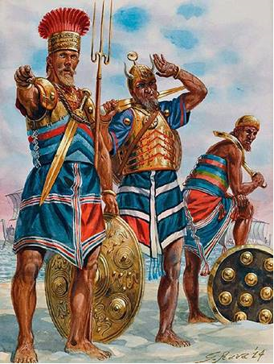
The Trunk: Ocean Literacy & Mentoring
“Sea Peoples’ Resurgence”: A novel Ocean Literacy initiative under development by MarInEM; to be fully deployed in 2018 targeting initially the children aged between 5-15 years old
  Objective:
    bringing the children closer to the sea and helping them understand individual and collective responsibilities towards the oceans and the seas and our dependence on them
    building a civic relationship with the ocean
  Method: Utilization of the geography, the history, the art, the music, the culture, the archeology, and the myths of the region and promotion of trans-disciplinary (e.g. artistic, cultural, educational and scientific) activities.
  Indicative activities: organization of summer schools/boot camps for children in cooperation with sea scouts and nautical clubs, visiting ships; building of small floating structures, interacting with marine scientists and engineers, old seafarers and fishermen; divers, archaeologists; publishing of a series of comics and possibly video games utilizing the Sea Peoples’ story and linking it with modern issues
  This initiative already enjoys local and public support and aspires to evolve into a movement that will help the younger generations come closer to the sea
The term "Sea Peoples" is a modern name given to various seaborne and land invaders, raiders and a loose confederation of clans (like Vikings) who troubled the lands of the Near East and Egypt during the final period of the Bronze Age. Who these people were and were they come from, no one knows for certain. Many attempts have been made to determine the origins of the various groups of Sea Peoples using textual and iconographic evidence, as well as the material culture of the Sea Peoples identified in Cyprus and the Levant This material culture is characterized foremost by locally made Achaean-style pottery; as such, a considerable Aegean presence has been argued in the multi-ethnic Sea Peoples coalition.
Several scholars have puzzled over whether the Sea Peoples were responsible for the collapse of some of the Late Bronze Age civilizations or simply one of several catalysts that put that collapse in motion. For sure the Sea Peoples movement was one of the largest and most important migration in history which changed the face of the ancient world more than any other single event before the time of Alexander the Great.
Once the children get closer to; become fascinated and fall in Love with the Sea and its many aspects; they need to be MENTORed in respect to the education, training and employment opportunities and challenges that the Sea entails.

Slide 10
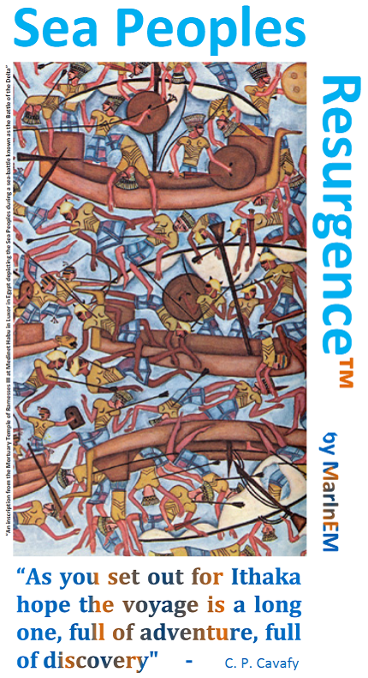
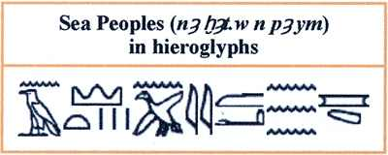
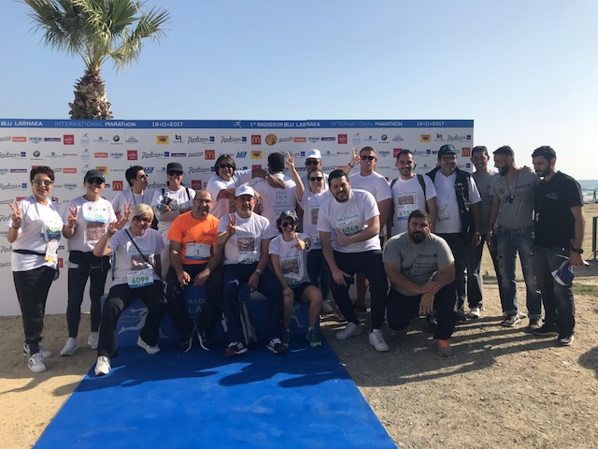
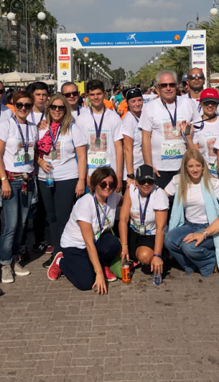
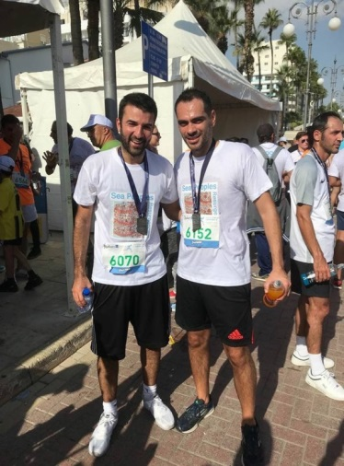
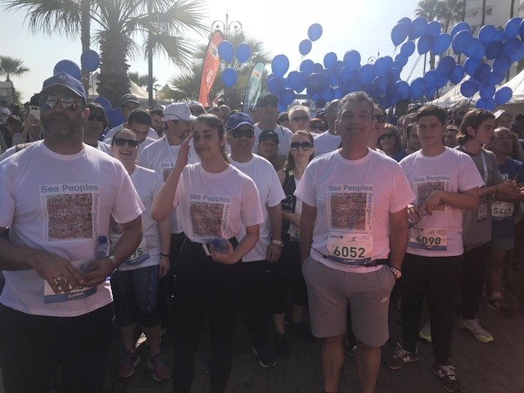
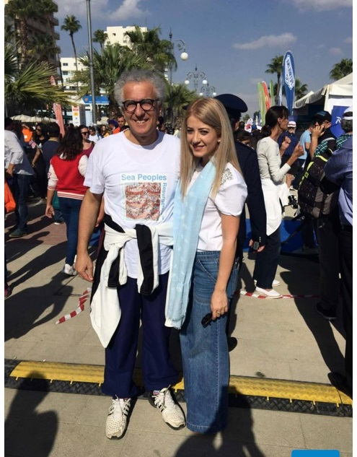
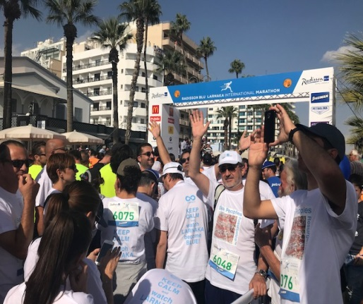
The “Sea Peoples’ Resurgence™”
>>Building a Civic Relationship with the Sea<<
  Participation of more than 100 people in the 1st International Radisson Blu Larnaka Marathon (19/11/2017) wearing Sea Peoples’ T-shirt

Slide 11
The Trunk: Ocean Literacy & Mentoring
Mentoring activities: targeting young people between 15-25 years old
Blue Career Centre of Eastern Mediterranean & Black Sea
MENTOR is an EU funded project which aims at the setting up of the Blue Career Centre for the Eastern Mediterranean Sea and Black Sea, a regional platform which will actively promote dialogue between business stakeholders, education & training institutions, research organizations, regulators, the civil society as well as the EU and the Union for the Mediterranean. This Centre will act as a facilitator of synergies and mediator of change, by fostering cooperation between these stakeholders in jointly developing and carrying out measures to close the skill gap, tackle unemployment and make “blue careers” more attractive to the young people of the area. In other words, by supporting activities that will increase employability in key Blue sectors of the region, namely the ones of Maritime Transport (shipping, ports, ship-repairs and shipbuilding), Cruise and Nautical tourism, Aquaculture and Offshore Oil and Gas, the Blue Career Centre will provide prospects for young jobseekers in the above sectors, while supporting businesses in finding the right staff with proper qualifications. In this way, the Centre will respond to the major concerns and challenges that the marine and maritime sectors face, the skills gap and the shortage of qualified professionals.
Duration: 1/02/2017-31/01/2019 Total Budget: €689.762
Partners:
National Technical University of Athens (NTUA), Greece
Agricultural University of Athens, (AUA), Greece
Maritime Institute of Eastern Mediterranean (MarInEM), Cyprus
Cyprus Chamber of Commerce and Industry (CCCI), Cyprus
Marine Cluster Bulgaria (MCB), Bulgaria
Constanta Maritime University (CMU), Romania
Observers: Arab Academy for Science, Technology and Maritime Transport (Egypt), Jordan Academy for Maritime Studies (Jordan), Istanbul Technical University (Turkey)

Slide 12

The Branches: Education & Training Institutions
The young adults (18-28) who love the sea and would like to work in sea-related professions, will have to acquire the necessary theoretical and practical knowledge and experience in appropriate educational and training institutions.
Such institutions in Cyprus; with whom MarInEM has a close relation; linking them with the industry and its needs and mentoring its students and graduates are the following:
  The Cyprus University of Technology- Department of Commerce, Finance and Shipping
  The Cyprus Maritime Academy (University of Nicosia) –Nautical Science, Marine Engineering, Marine Electro-technology, Maritime Hospitality
  Frederick University – BSc in Maritime Studies & Marine Engineering Program
  Mediterranean Maritime Academy
  University of Cyprus- the recently announced Faculty of Marine Science & Technology
  Odysseus Maritime Training Centre
  More maritime training centers are expected to be created in the future as the demand for qualified and skilled personnel in the marine and maritime industry is increasing including Training Centers for the Offshore Oil & Gas Industry.

Slide 13

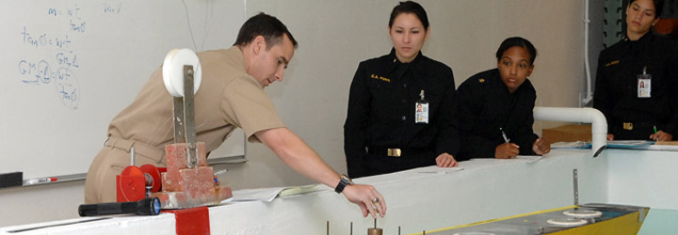
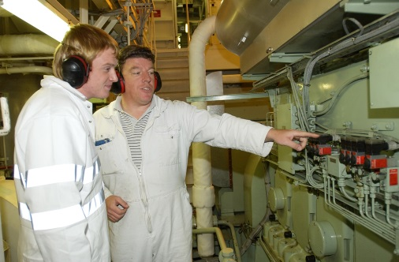
The Grafting: Re-Training & Up-Skilling
The pursuit of continuous training is deemed necessary for the acquisition of additional specialized skills & experience (up-skilling) which will generate more and better career advancement opportunities for the young adults.
Re-training and up-skilling schemes are pursued and provided by the same institutions that provide the basic theoretical and practical knowledge and training (Cyprus University of Technology, University of Cyprus, University of Nicosia, Frederick University etc) with the active support of MarInEM and the Maritime industry of Cyprus.

Slide 14

The Fertilizer: RTDI Institutions
For the young adults who wish to be employed in RTDI-intensive sectors of the marine and maritime industry, the necessary institutions need to be created.
Marine and Maritime Research, Innovation, Technology Centre of Excellence (MaRITeC-X)
“MaRITeC-X” is an ambitious project that has been granted funding from the European Commission under the HORIZON2020 Programme, call H2020-WIDESPREAD-2016-2017 and more specifically for the topic WIDESPREAD-04-2017 - Teaming Phase 1. The project’s main objective is the creation of a Centre of Excellence in Cyprus that will foster scientific and business excellence in - the crucial for Cyprus - Marine and Maritime sectors, including the - rapidly emerging - Offshore Energy sector. The Centre will be aligned with the overall Smart Specialization Strategy for Cyprus (S³Cy) and the European priorities on specific pillars with competitive advantages to the Cypriot economy. In this context, it will promote partnerships and synergies between top institutions and businesses, active in the fields of research, technology and innovation for the Blue Economy, thus contributing to the transfer of knowledge, the development, application and dissemination of cutting-edge technologies, the exchange of best practices and the development of a critical mass of infrastructure and human capital in the Eastern Mediterranean region.
Duration: 1/09/2017-1/09/2018 Total Budget: €399.691,25
Partners: Larnaka Municipality (Cyprus), Limassol Chamber of Commerce and Industry (Cyprus), Maritime Institute of Eastern Mediterranean (Cyprus), GeoImaging Ltd (Cyprus), SignalGenerix (Cyprus), Marine Institute (Ireland), Smartbay Ireland (Ireland), University of Southampton (United Kingdom)

Slide 15

The Fruits of Blue Growth
Employment
Social Cohesion
Stability
Innovation
Diverisfication
Competitiveness
Growth

