Slide 1
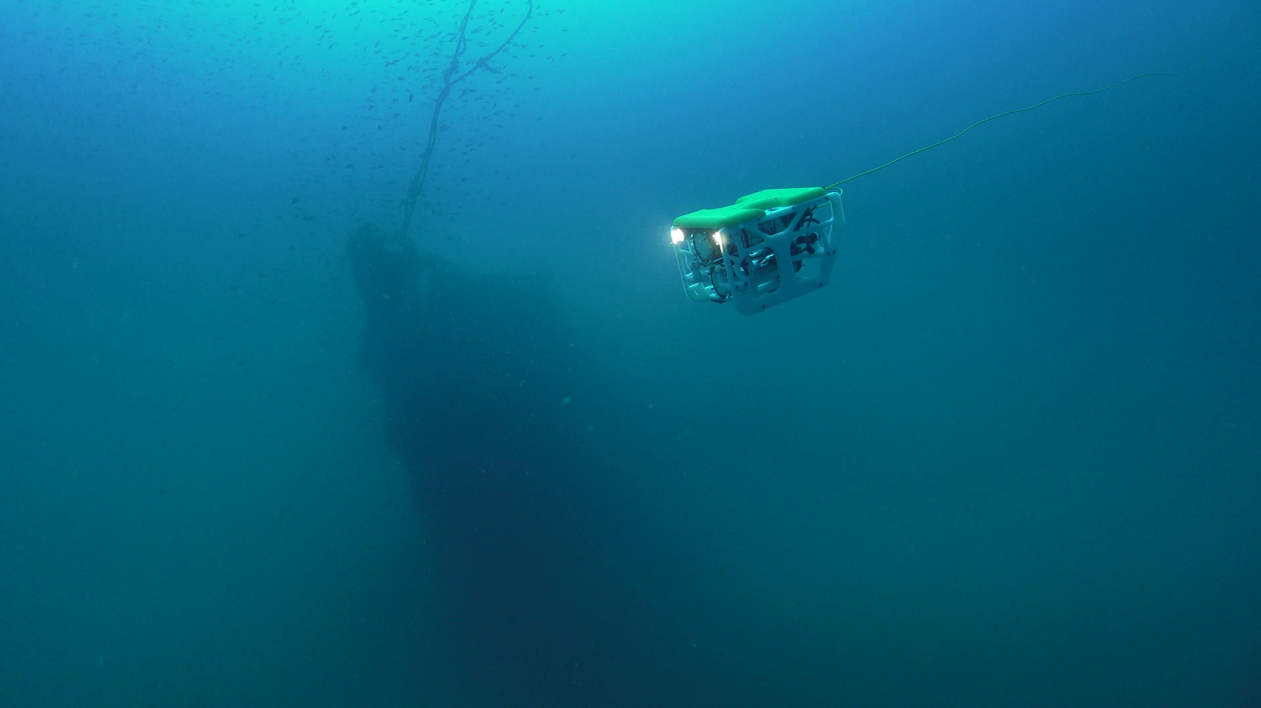
Making Underwater Exploration Accessible to Everyone

Slide 2
Company Roadmap
Business Development Roadmap
Launch!
Awards & Acceleration Programs
Sibiu Nano launched on IndieGoGo
Lanzadera accelerator programme
Startup of the Year, INFO-CLH
Startup of the Year. AJE- Bankia
Finalists South Summit & RobotUnion
Company founded
First ROVs sold
2016
2017
2018
2019
Prototyping
Internationalization
Sibiu Nano MVP!
Océano Azul (maritime)
Startup of the Month, INFO
Startup of the Year, Murcia

Slide 3
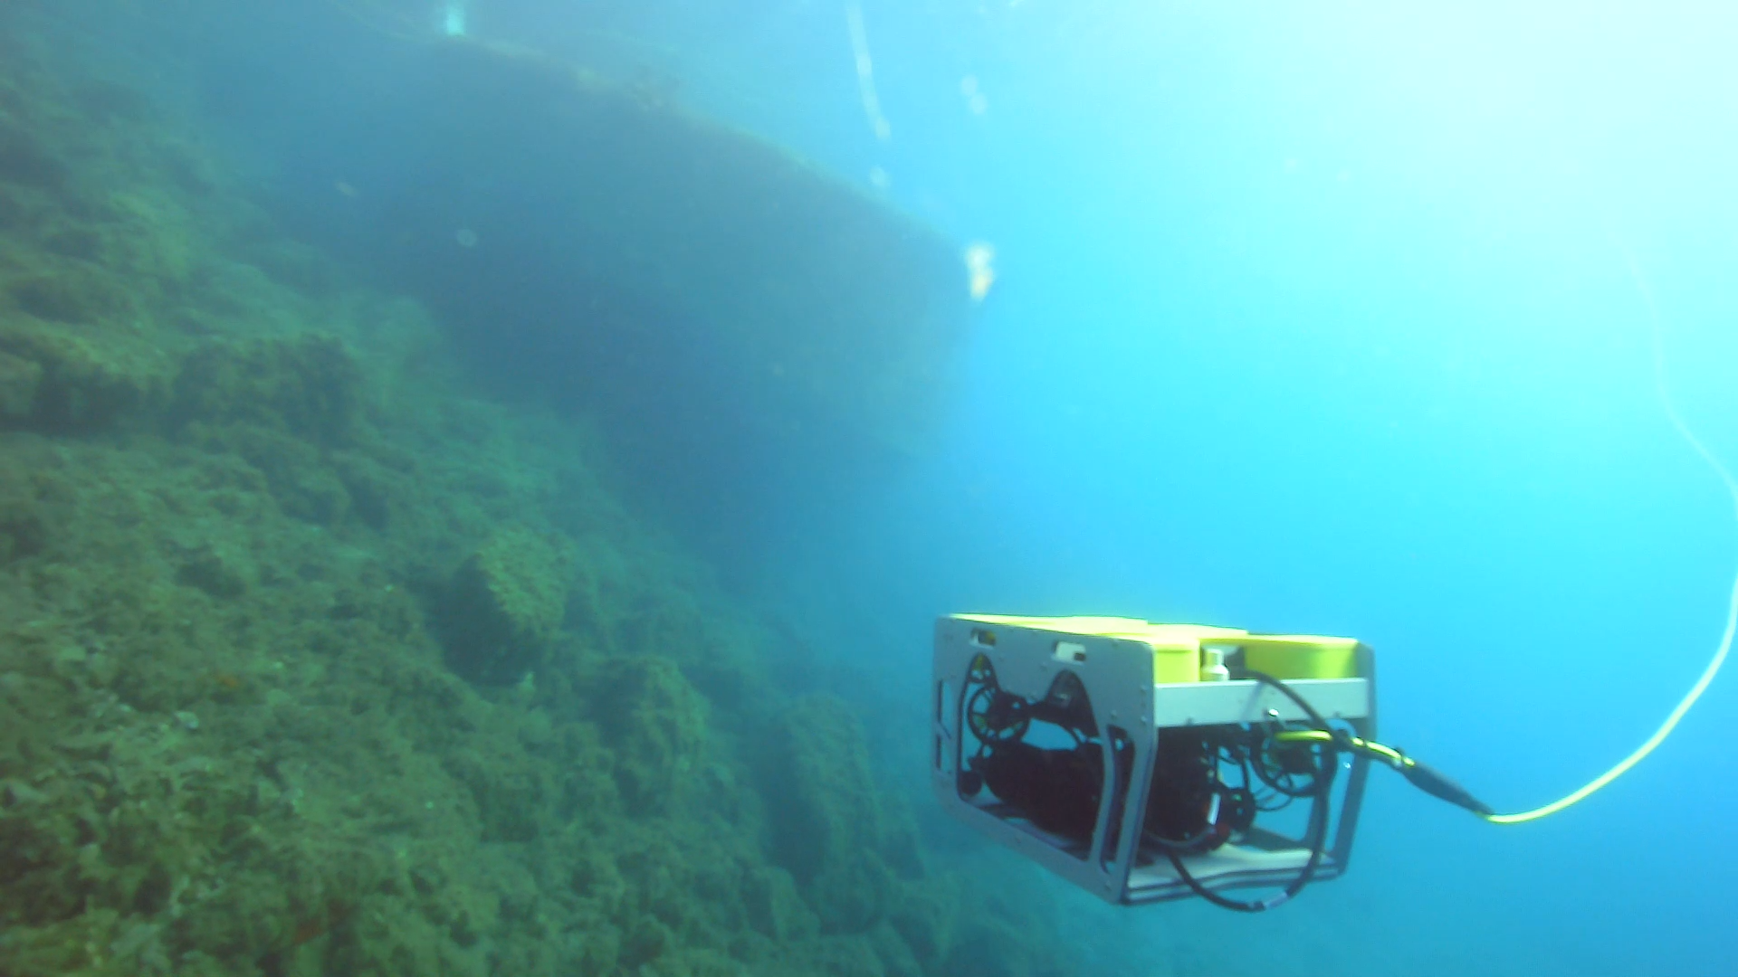
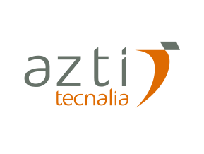
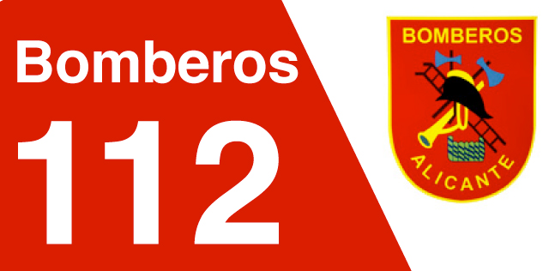
ABOUT OUR COMPANY
Target markets - verticals
Aquaculture
Thermal generation
Water cycle companies
Environmental consultants
Commercial divers (inshore)
Ports and marinas
Shipowners
Search And Rescue
Public & private research institutes

Slide 4
Market Research, 2020 Projections
TAM – Total Addressable Market
Market Size 2020
Verticals M$ | Geography %
Oil & Gas: 238,9 | North America: 39,18
Military & Defense: 88,2 | APAC: 19,27
Scientific Research: 60,1 | Europe: 18,79
Other Applications: 15,9 | Africa & Middle East: 11,80
 | Latin America: 10,96
$403M
$403M
SAM – Serviceable Available Market
$25M
Verticals M$ | Geography %
Scientific Research: 42,7 | Europe: 18,79
Other Applications: 10,3 | LATAM: 10,96
 | Middle East: 3,23
$25M
SOM – Serviceable Obtainable Market
$3M
Total revenue: 0,224M | Geography %
 | Europe: 19,79
$3M
“Global Observation Mini ROVs Market 2017-2025 by Application, Size, Payload Option and Region”, September 2017, Grace Market Data

Slide 5
Company Milestones
3.000.000
Business Development Roadmap
Important Milestones & KPIs
1.500.000
508.000
225.000
42.000
2016
2017
2018
2019
2020
Nido Robotics founded
Market study
Co-founder located
4 ROVs sold
24 ROVs Sold
First hire
FFF Round
71 ROVs sold
Seed Round
Team size = 13
300 ROVs sold
Chile SpA
LATAM & EMEA
H2020 Phase 1
Series A
Team Size = 21
Sibiu HCEV
+ APAC
H2020 Phase 2
Team size = 30

Slide 6
Unique Selling Point
Making underwater exploration accessible to everyone!
Brand Promise
World’s best support and service
Open-frame & open-source software
Field upgradeable & serviceable
Adaptable to changing business needs
Most competitive price on the market

Slide 7
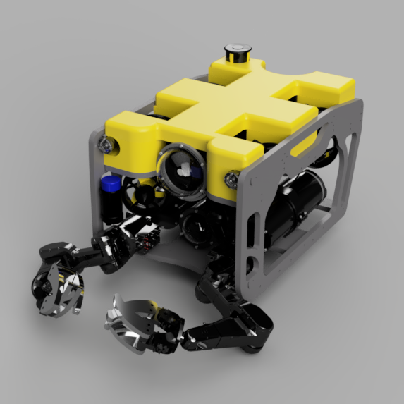
Sibiu HCEV
Industry best payload capacity
6 DOF
MOD 500m
Hybrid Power Supply
Plug & Play Payloads
Object Recognition
SLAM
3D Environment Recreation
Notes:
High power propulsion with 6 degrees of freedom of movement. This thruster configuration, using 8 independent thrusters, allows for interesting use cases where the ROV need to full mobility in any direction. It also allows or active compensation of changes in centre of gravity (CG) when using manipulators or adding sensors and other payloads.
Maximum Operating Depth down to 500m. Based on our conversations with current and prospective customers, we have been able to establish that the most relevant depth rating needed does not go beyond 500m. However, in the cases where additional depth is required, we expect to be able to increase this by changing some materials on an ad-hoc basis.
Hybrid surface / battery powered. This is a very innovative idea in the mini-ROV market, where all current solutions are either one or the other. Nido Robotics already have ample experience developing battery driven mini-ROVs, and initial studies have been carried out to implement power over the tether. The batteries will be the main power source for the ROV, and as contingency against power line failure. The power transmitted over the tether will serve to continuously recharge the batteries, permitting uninterrupted operations 24/7, lower equipment footprint wet-side, lower cable diameter and a lower cost.
Plug-and-play interface (physical and software) for sensors and other payloads. This will be achieved by setting up an interface for plugging external hardware to the ROV, and an API for easy integration of such hardware, taking key learnings from the EnviroSense package.
Object recognition. This technology will allow our Sibiu HCEV to detect specific targets in the video (different types of fish, contaminants, assets), categorize them and track and/or count these objects. This has multiple applications, amongst others surveying of contamination, fish stock assessment, “sense and avoid” in navigation, to mention a few.
Human Machine Interface. The current HMI used on the Sibiu Nano and Sibiu Pro has some advanced capacities, including real time display of sensor data, real time video streaming and recording, and so on. The proposed development will bring the HMI above the current state of the art by including capacities like: real time annotations embedded to the video stream, live streaming to internet and 3d environment representation.
Capacity to recreate environments and structures in 3D by using different cameras, generating 3D meshes that allow to create elevation and surface maps. This is helpful in semi-autonomous navigation but also to digitally recreate archaeological finds, and to create models of plants that were not that well documented when built. This part requires having the capacity to receive data from several sensors / payloads, i.e. Inertial Measurement Units, Doppler Velocity Logs, cameras, stereo and structured light cameras, hydro-acoustic positioning systems (system from Water Linked AS will be used for this purpose), Forward Looking Sonars (FLS), Side Scanning Sonars (SSS), altimeters, and integrating and interpreting this data in realtime on the topside control station, allowing for a 3D representation of the environment to be created, and positioning the ROV within this representation.
We also intend to explore the possibilities of recording and uploading system data to the cloud. This last part will allow Nido Robotics to explore new business models, i.e. pay-per-use / hardware as a service.

Slide 8
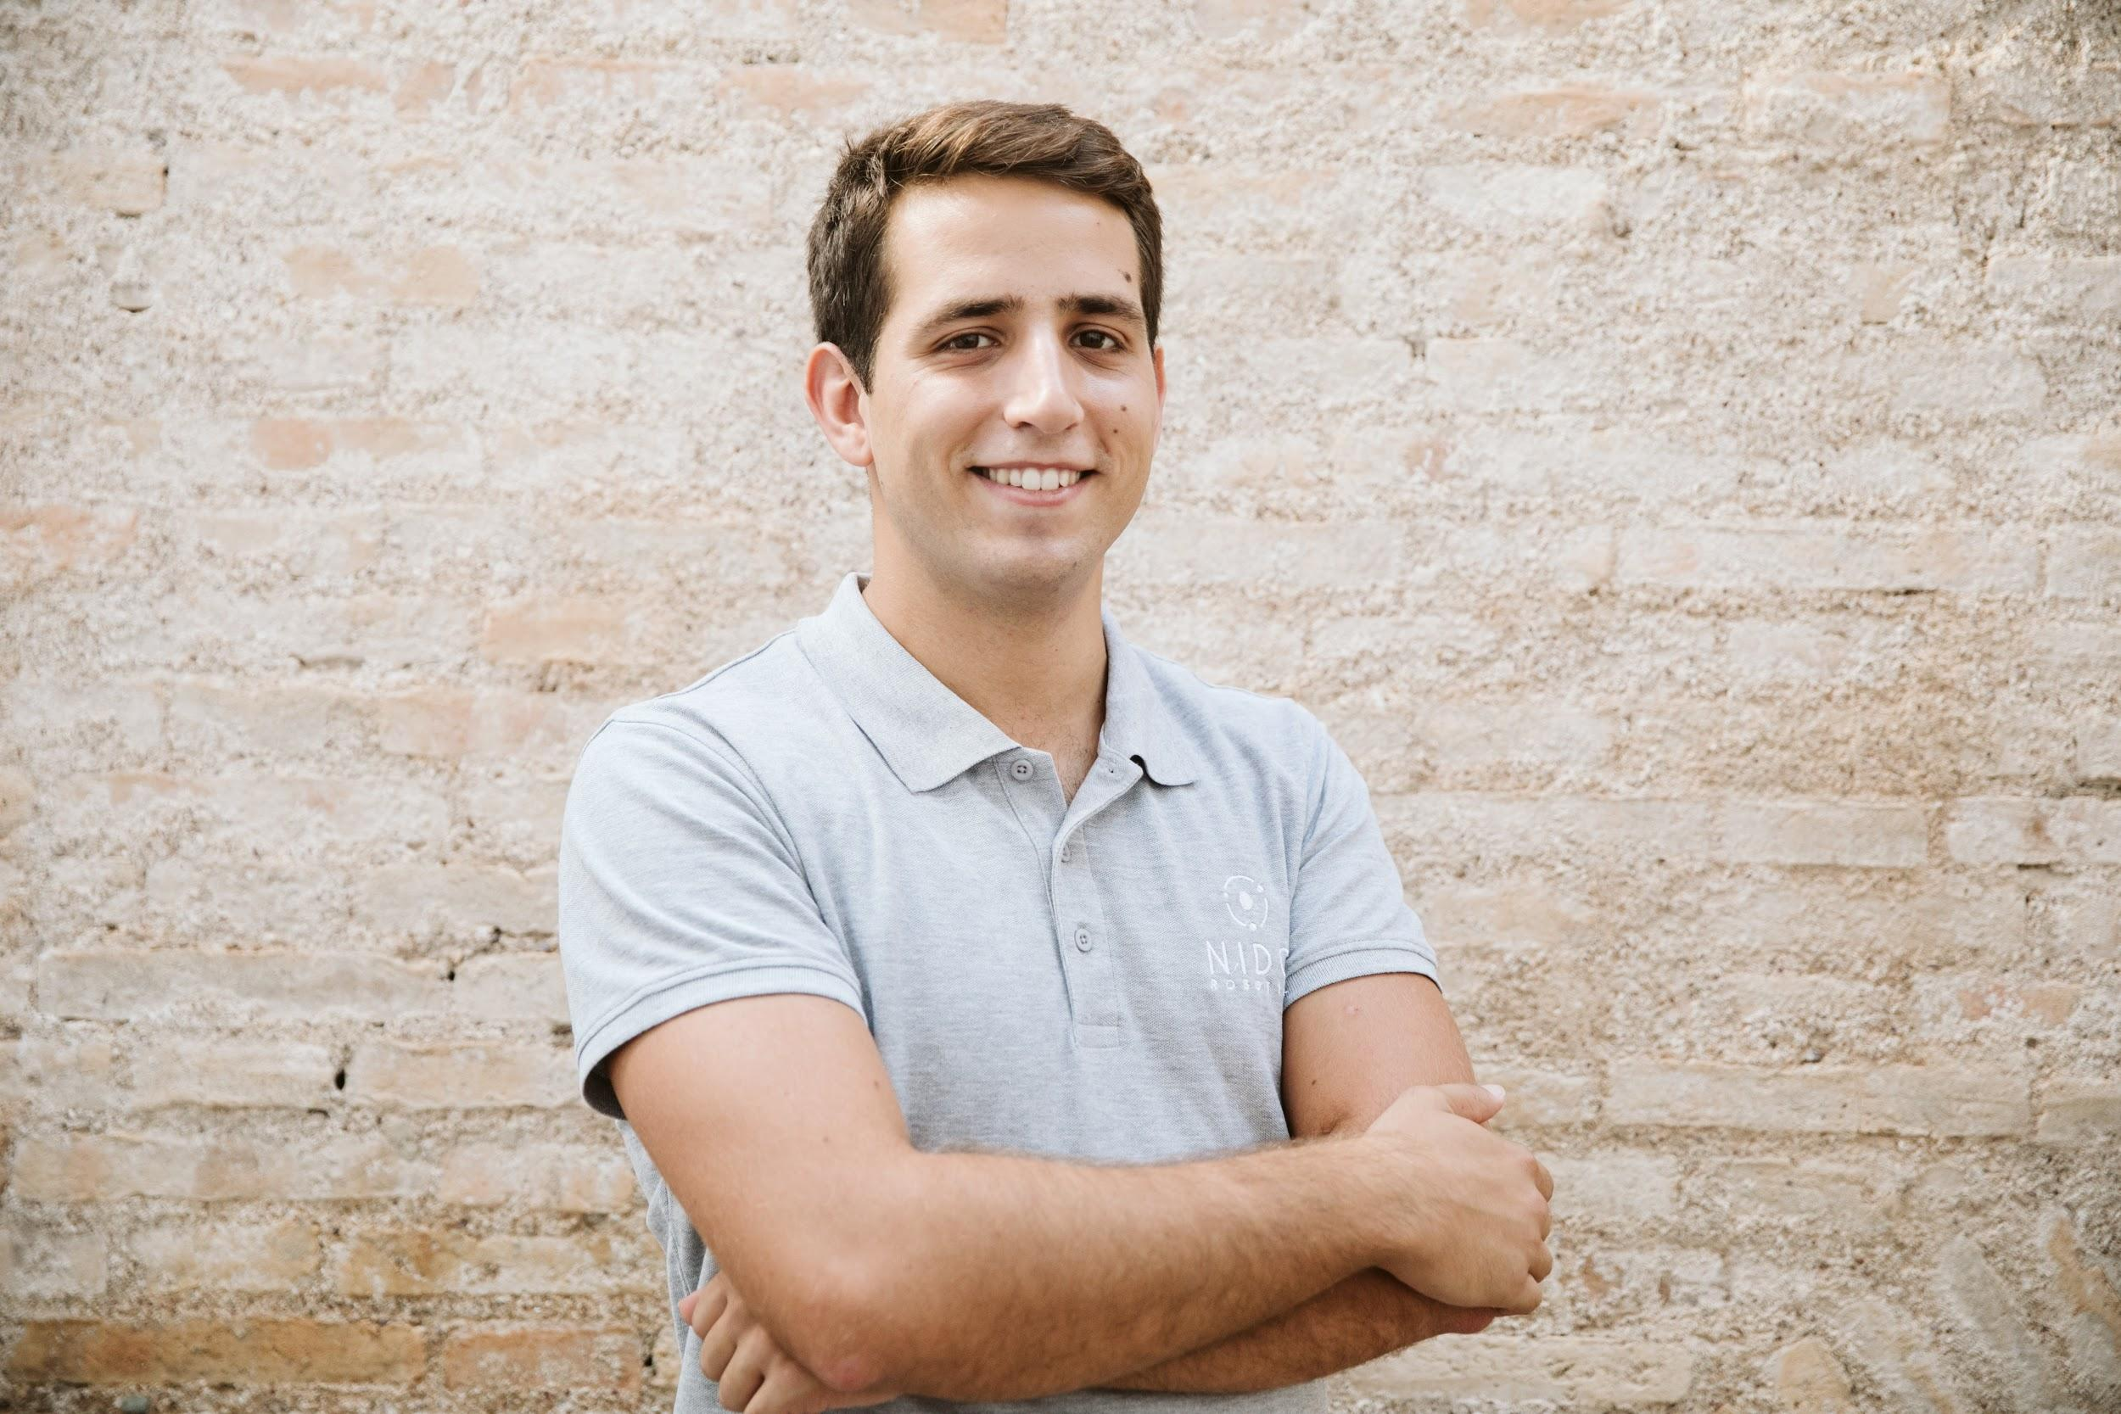
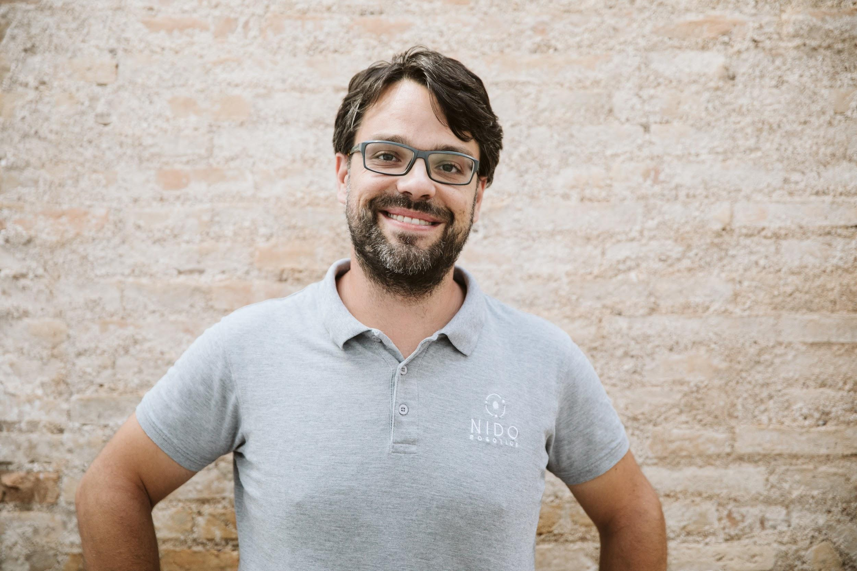
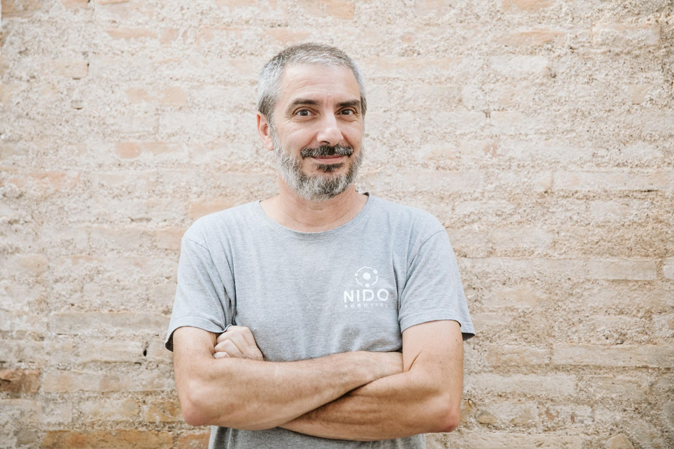
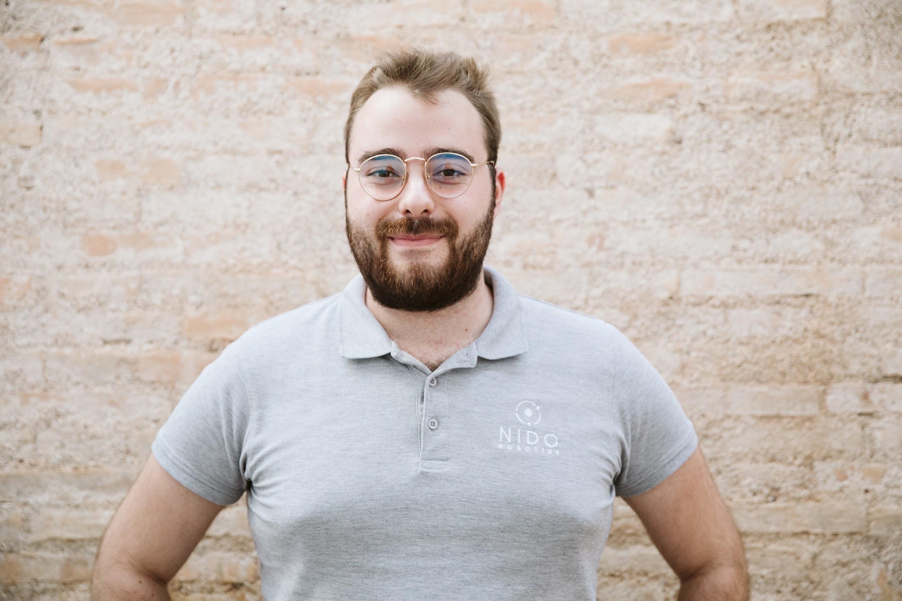
Capt. Roy Torgersen
Founder & CEO
Enrique Gonzalez
Co-founder & CTO
Tony Conchillo
Sales
Dr. María López
Marketing
Tono Fuentes
Production
Alejandro Jimenez
Finance & HR

Slide 9
Why are we here?
1. Distribution Partners 2. Dev Partners 3. Investors for Series-A
Notes:
High power propulsion with 6 degrees of freedom of movement. This thruster configuration, using 8 independent thrusters, allows for interesting use cases where the ROV need to full mobility in any direction. It also allows or active compensation of changes in centre of gravity (CG) when using manipulators or adding sensors and other payloads.
Maximum Operating Depth down to 500m. Based on our conversations with current and prospective customers, we have been able to establish that the most relevant depth rating needed does not go beyond 500m. However, in the cases where additional depth is required, we expect to be able to increase this by changing some materials on an ad-hoc basis.
Hybrid surface / battery powered. This is a very innovative idea in the mini-ROV market, where all current solutions are either one or the other. Nido Robotics already have ample experience developing battery driven mini-ROVs, and initial studies have been carried out to implement power over the tether. The batteries will be the main power source for the ROV, and as contingency against power line failure. The power transmitted over the tether will serve to continuously recharge the batteries, permitting uninterrupted operations 24/7, lower equipment footprint wet-side, lower cable diameter and a lower cost.
Plug-and-play interface (physical and software) for sensors and other payloads. This will be achieved by setting up an interface for plugging external hardware to the ROV, and an API for easy integration of such hardware, taking key learnings from the EnviroSense package.
Object recognition. This technology will allow our Sibiu HCEV to detect specific targets in the video (different types of fish, contaminants, assets), categorize them and track and/or count these objects. This has multiple applications, amongst others surveying of contamination, fish stock assessment, “sense and avoid” in navigation, to mention a few.
Human Machine Interface. The current HMI used on the Sibiu Nano and Sibiu Pro has some advanced capacities, including real time display of sensor data, real time video streaming and recording, and so on. The proposed development will bring the HMI above the current state of the art by including capacities like: real time annotations embedded to the video stream, live streaming to internet and 3d environment representation.
Capacity to recreate environments and structures in 3D by using different cameras, generating 3D meshes that allow to create elevation and surface maps. This is helpful in semi-autonomous navigation but also to digitally recreate archaeological finds, and to create models of plants that were not that well documented when built. This part requires having the capacity to receive data from several sensors / payloads, i.e. Inertial Measurement Units, Doppler Velocity Logs, cameras, stereo and structured light cameras, hydro-acoustic positioning systems (system from Water Linked AS will be used for this purpose), Forward Looking Sonars (FLS), Side Scanning Sonars (SSS), altimeters, and integrating and interpreting this data in realtime on the topside control station, allowing for a 3D representation of the environment to be created, and positioning the ROV within this representation.
We also intend to explore the possibilities of recording and uploading system data to the cloud. This last part will allow Nido Robotics to explore new business models, i.e. pay-per-use / hardware as a service.

Slide 10
“Ideas are easy.
Execution is everything.”
John Doer, (KPCB)

Slide 11
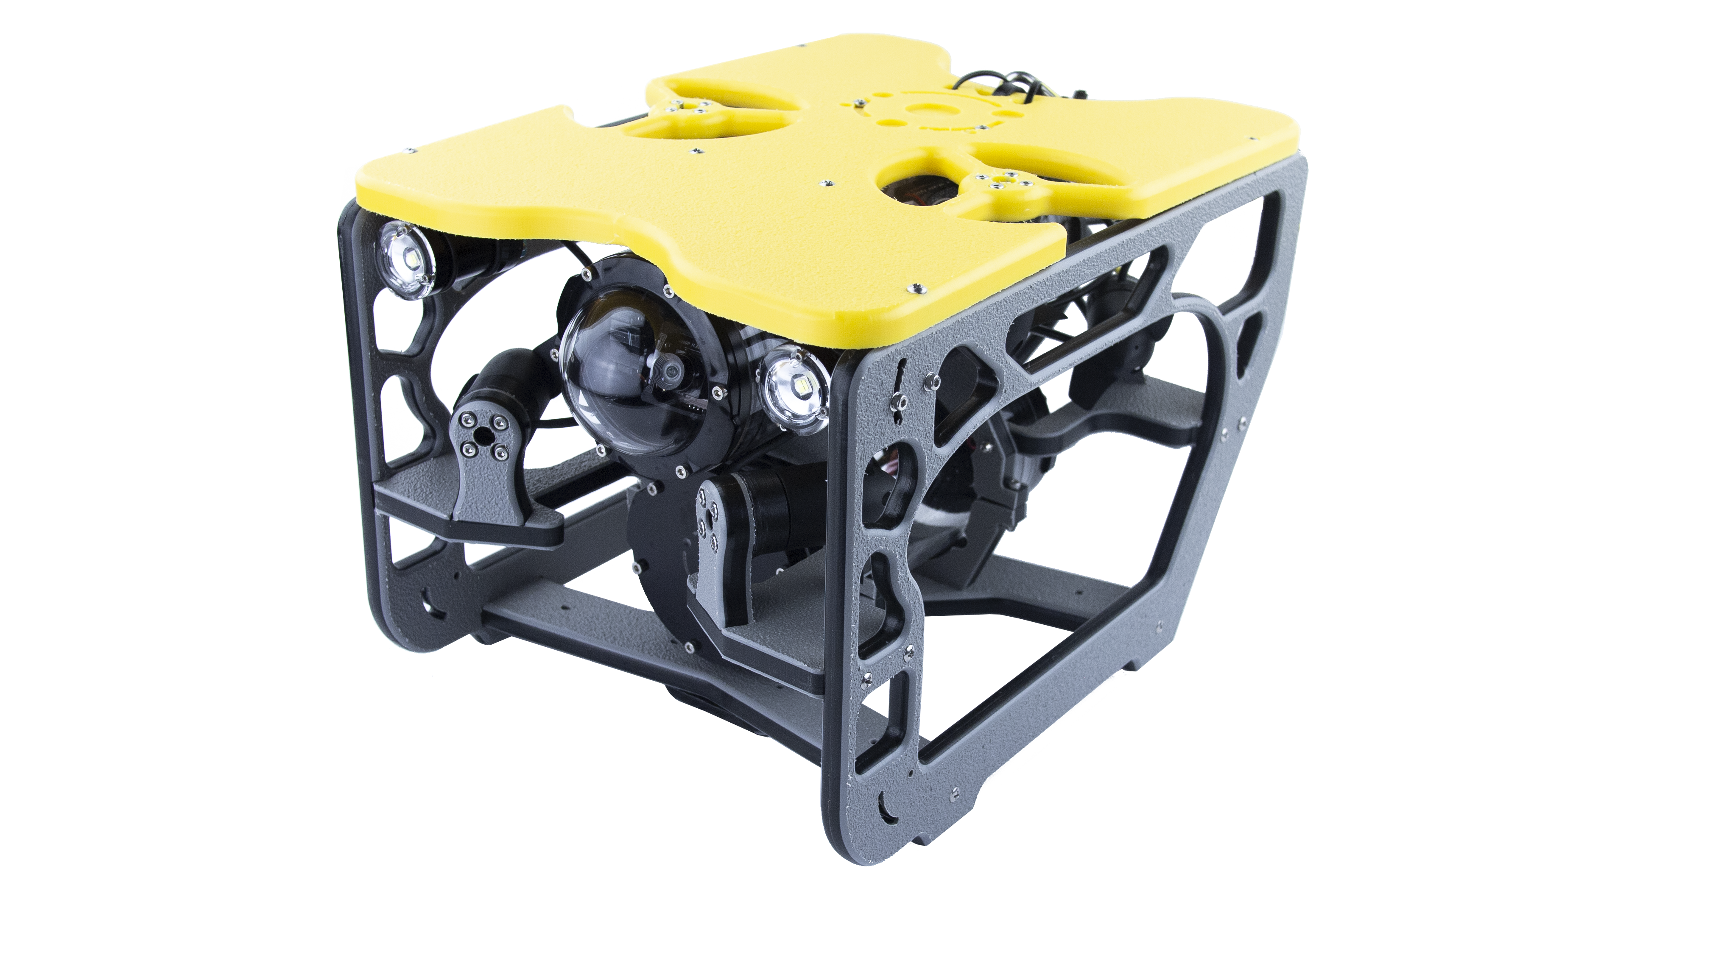
OUR PRODUCTS
The Sibiu Nano
The most accessible professional ROV on the market
€
1599
from
Sibiu nano
DYI Kit
Ready to dive
DYI Kit or Ready To Dive versions offered
Full HD Camera
Limited payload capacity
Shallow water <100m
For inshore / protected waters
Weights 5 kg
Profit Margin
BOM Cost

Slide 12
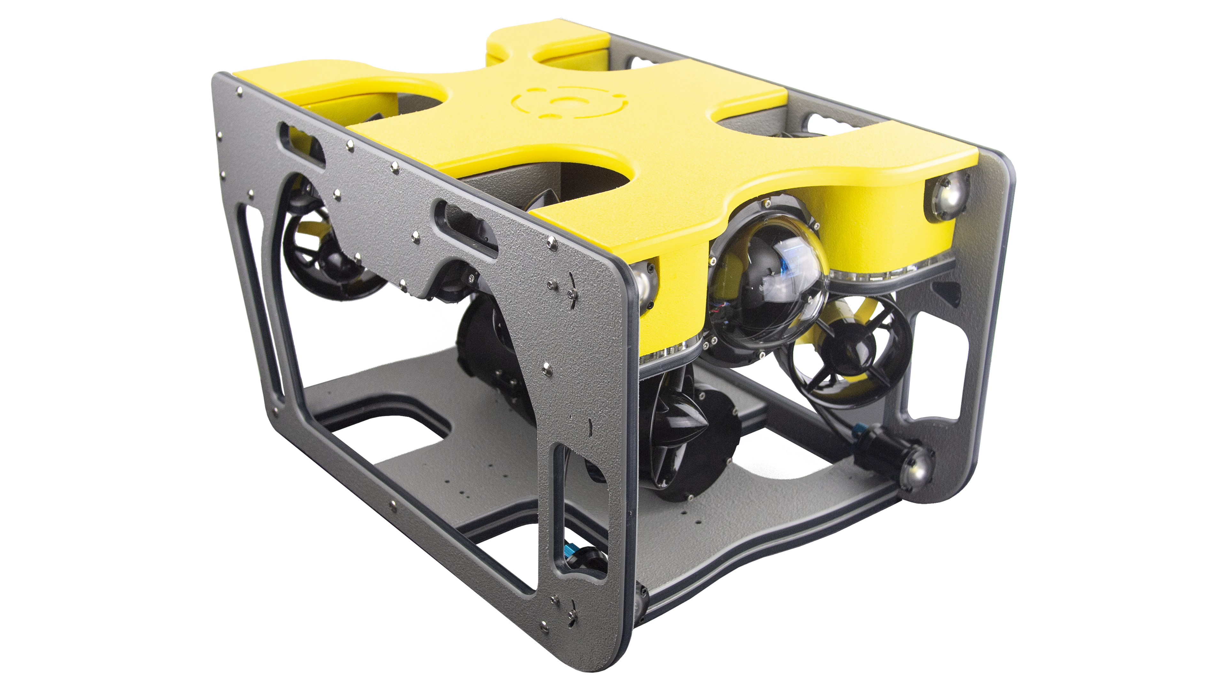
OUR PRODUCTS
The Sibiu PRO
Payload carrying professional observation class ROV
€
9000
from
Sibiu PRO
Highly adaptable to different operational scenarios
Full HD Camera
3Kg payload capacity
Medium depths <300m
For coastal waters
Weights 15 kg
PRO
Profit Margin
BOM Cost

Slide 13
Unfair advantage
Our secret sauce
Frugality
avoiding waste
operational efficiency
Great Pool of talent
Low cost of living
In-house prototyping facility = ultrashort time-to-market

Slide 14
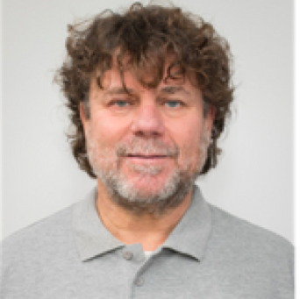
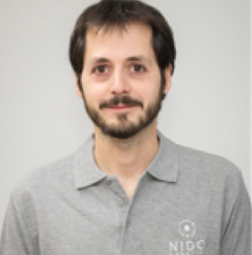
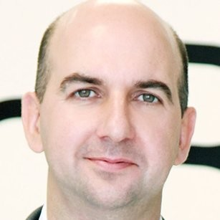
Dr. Jose L. Costa Krämer
Scientific Advisor
Miguel de Paco
Software Advisor
Dr. Manuel Latorre
Bizdev Middle East
Victor Hidalgo
Financial Advisor
Emilio Fernández-Martos
Operational Excellence
Ricardo Fisas
Internationalization
Notes:
Advisory Board

Slide 15
Market Research, 2017
TAM – Total Addressable Market
Market Size 2017
Verticals M$ | Geography %
Oil & Gas: 149,9 | North America: 40,86
Military & Defense: 55,5 | Europe: 19,79
Scientific Research: 42,7 | APAC: 16,91
Other Applications: 10,3 | Africa & Middle East: 11,72
 | Latin America: 10,72
$287M
$287M
SAM – Serviceable Available Market
$11M
Verticals M$ | Geography %
Scientific Research: 42,7 | Europe: 19,79
Other Applications: 10,3
$11M
SOM – Serviceable Obtainable Market
$0,2M
Total revenue: 0,224M | Geography: Europe
$0,2M
“Global Observation Mini ROVs Market 2017-2025 by Application, Size, Payload Option and Region”, September 2017, Grace Market Data

Slide 16
Market Research, 2020 Projections
TAM – Total Addressable Market
Market Size 2020
Verticals M$ | Geography %
Oil & Gas: 238,9 | North America: 39,18
Military & Defense: 88,2 | APAC: 19,27
Scientific Research: 60,1 | Europe: 18,79
Other Applications: 15,9 | Africa & Middle East: 11,80
 | Latin America: 10,96
$403M
$403M
SAM – Serviceable Available Market
$25M
Verticals M$ | Geography %
Scientific Research: 42,7 | Europe: 18,79
Other Applications: 10,3 | LATAM: 10,96
 | Middle East: 3,23
$25M
SOM – Serviceable Obtainable Market
$3M
Total revenue: 0,224M | Geography %
 | Europe: 19,79
$3M
“Global Observation Mini ROVs Market 2017-2025 by Application, Size, Payload Option and Region”, September 2017, Grace Market Data

Slide 18
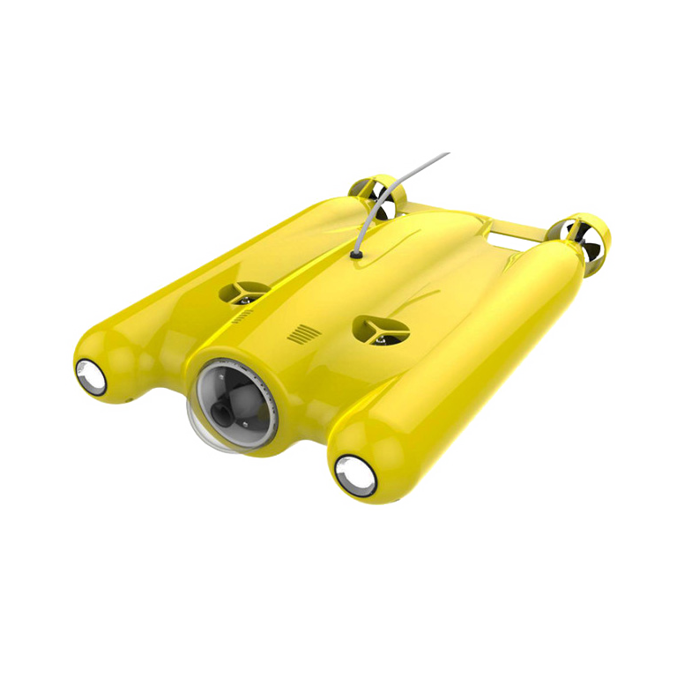
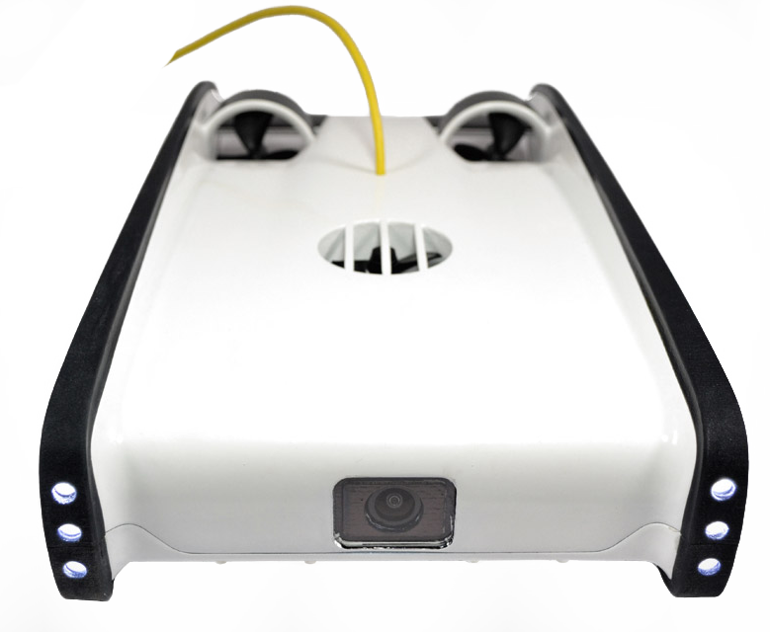
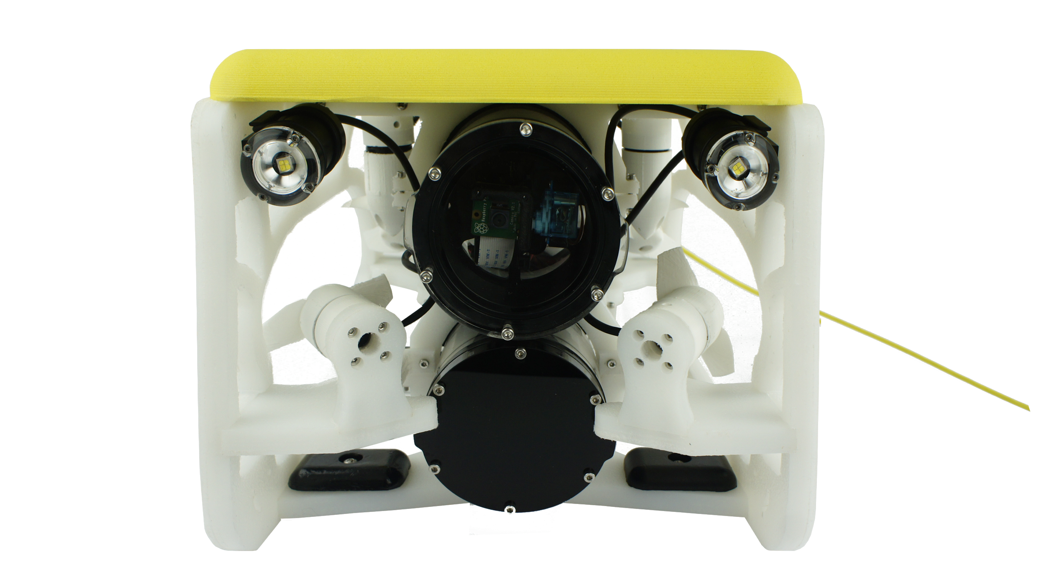
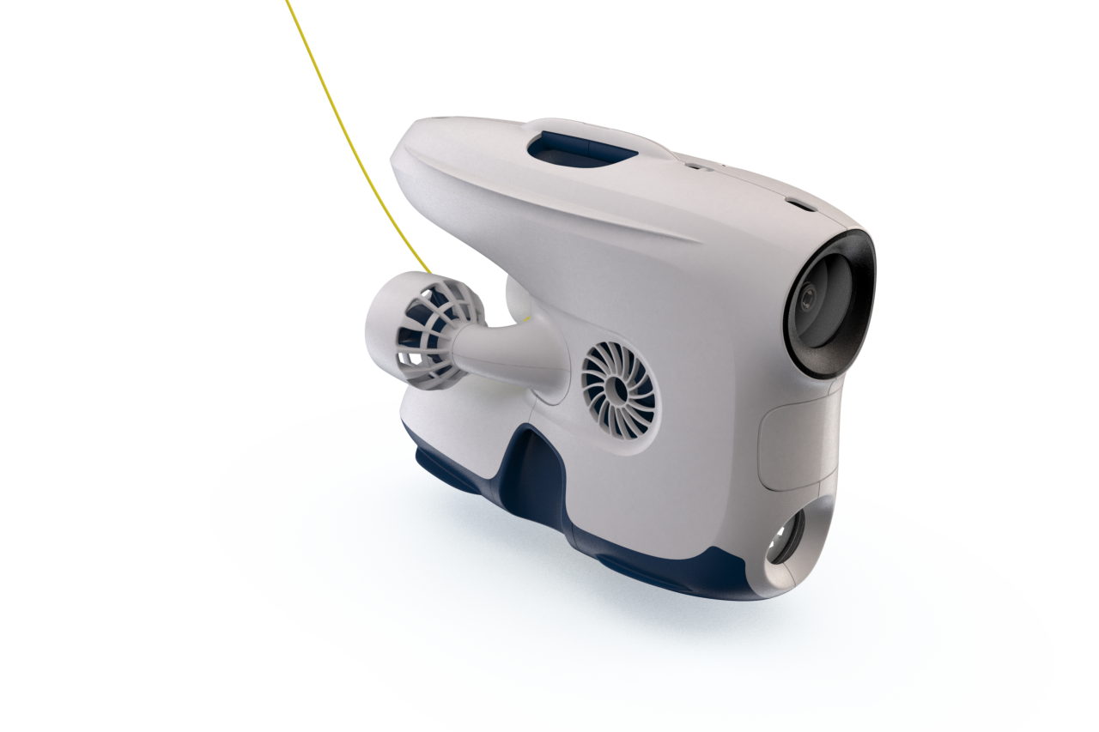
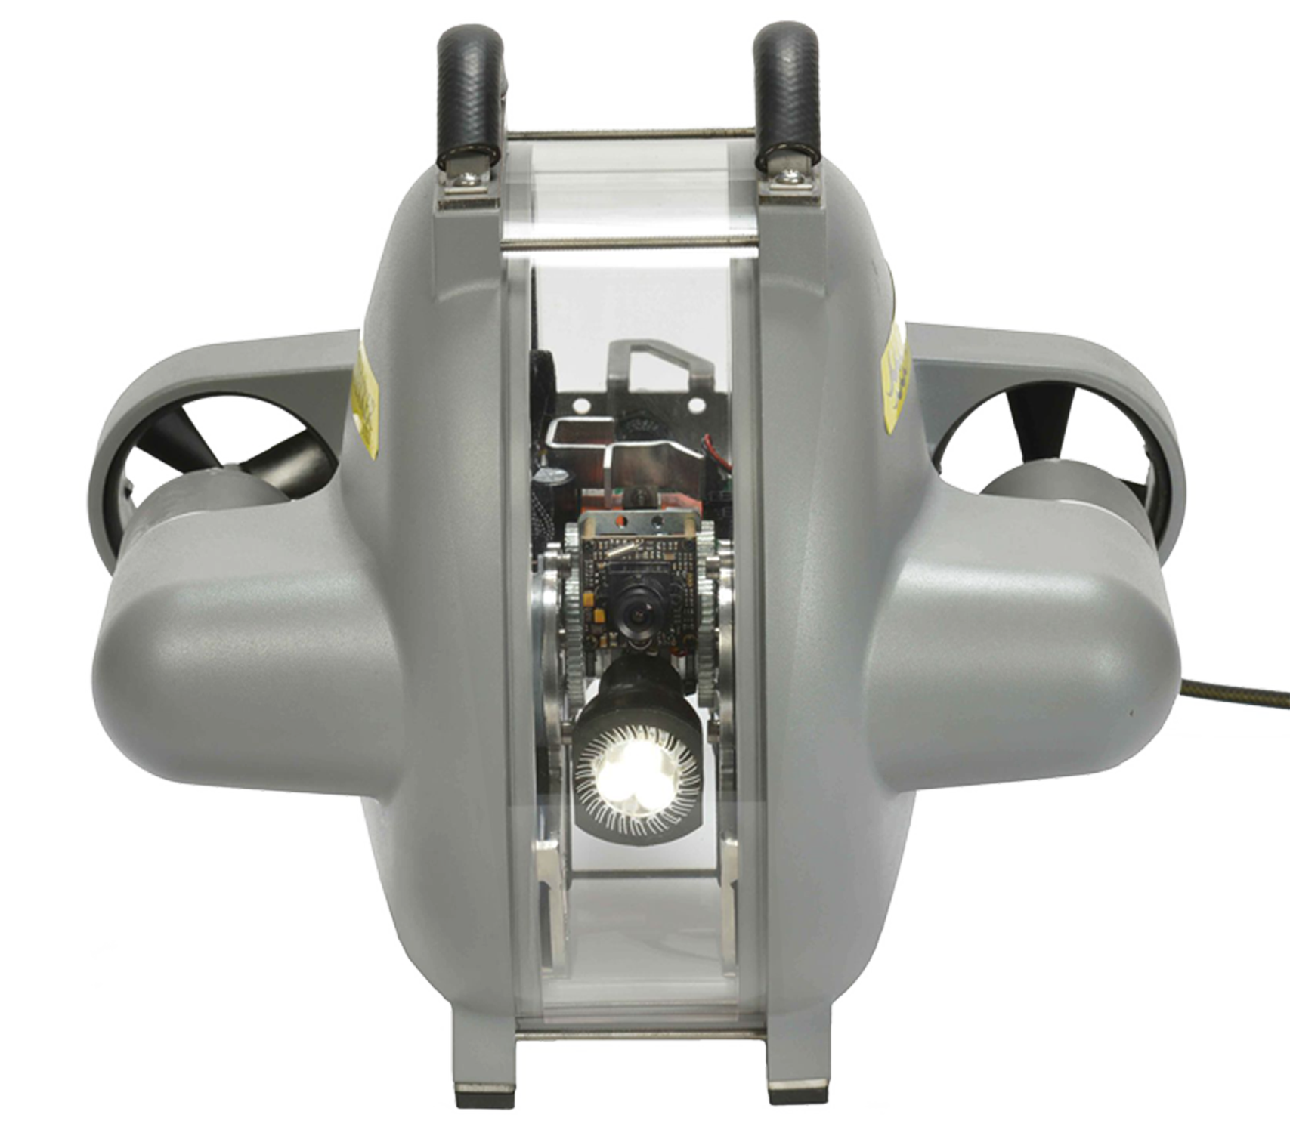
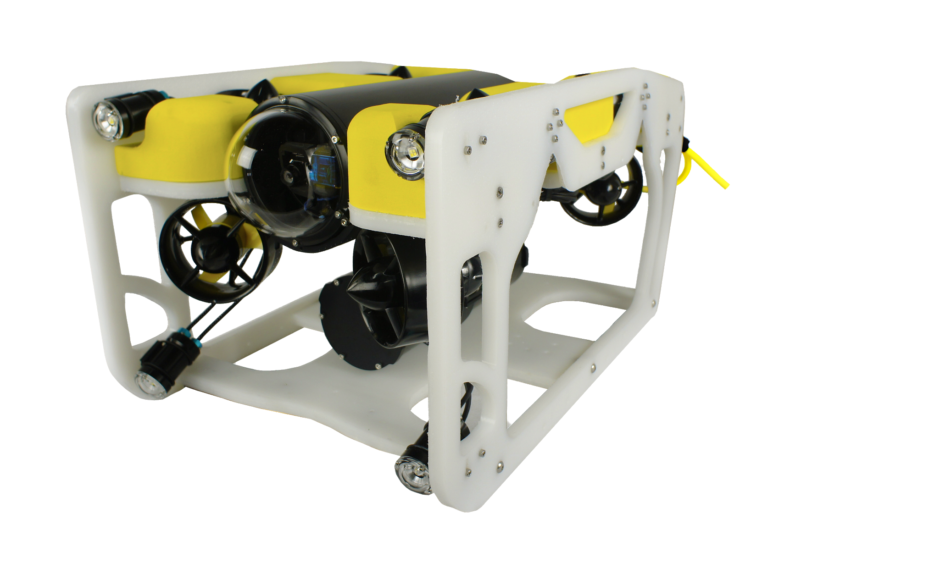
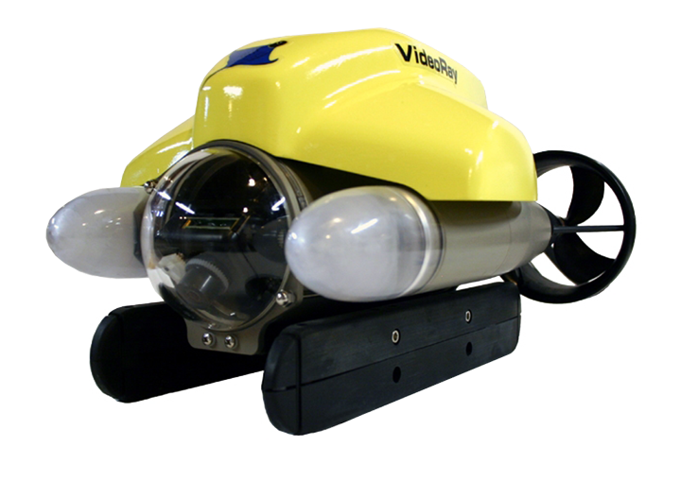
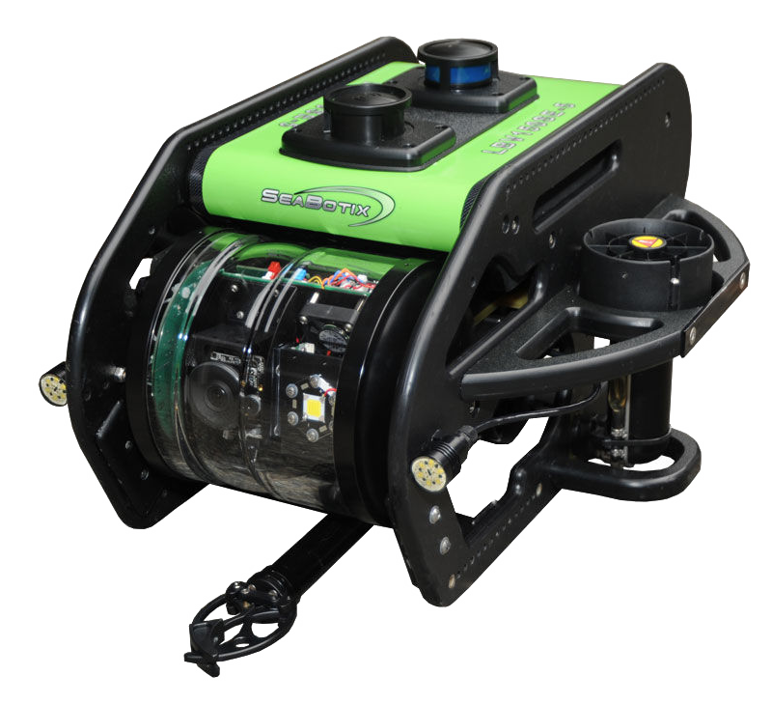
Affordable
Consumer
Industry
Expensive
Notes:
At Nido Robotics we make underwater robots with an unparalleled price-performance ration for inspection purposes. Our main differentiator is our capacity to very easily adapt the robots to different use-cases. We also strive to differentiate in our service level.

Slide 19
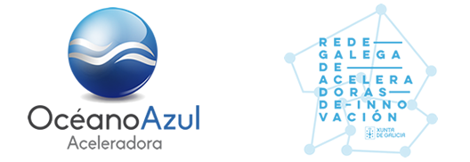
70
24
6

Slide 20
Marketing Strategy
Marketing Strategy – Bullseye Framework for Building Traction
Inner Circle
Sales – current direct sales team 2 person, expected to grow to 5 person by end of 2019
Business Development (Partner / Distributor Network)
Trade shows
Middle circle
Inbound marketing – content creation & Social Networks
Search Engine Marketing
Target market blogs
Outer circle (long shots)
Traditional PR
Non-traditional PR
Speaking engagements / conferences

Slide 21
Marketing Strategy
Marketing Budget 2019 – 66.040€ (4% of projected revenue)
Human Resources
We have an inhouse team of marketing & PR professionals whose responsibility it is to create quality content and work with tools like Brand24, Hotjar, HubSpot and other similar tools to continuously measure the impact of our efforts and maximize ROI.
42%
Online
Our online inbound marketing strategy is intended to support our sales department and partner network with qualified leads, and to establish and maintain our brand globally. We will also use external agencies to produce regular high quality audiovisual content.
38%
Offline
Many of our prospective customers still function in an offline environment. For this reason, attending major trade shows and displaying adds in offline media in our regions and sectors of interest. Examples are our ongoing communication campaign in Subacuatica Magazine and our attendance at the Oceanology International Americas trade show in February 2019.
20%

Slide 22
Inbound Lead Qualifiers
Outbound Prospectors
Sales Development Engineers
Account Executives
Closing New Sales
Deliver World Class Experience, Increase CLTV, Stimulate Referrals
Customer Success Engineers
Notes:
Sales team organization

Slide 23
Product development Roadmap

Slide 24
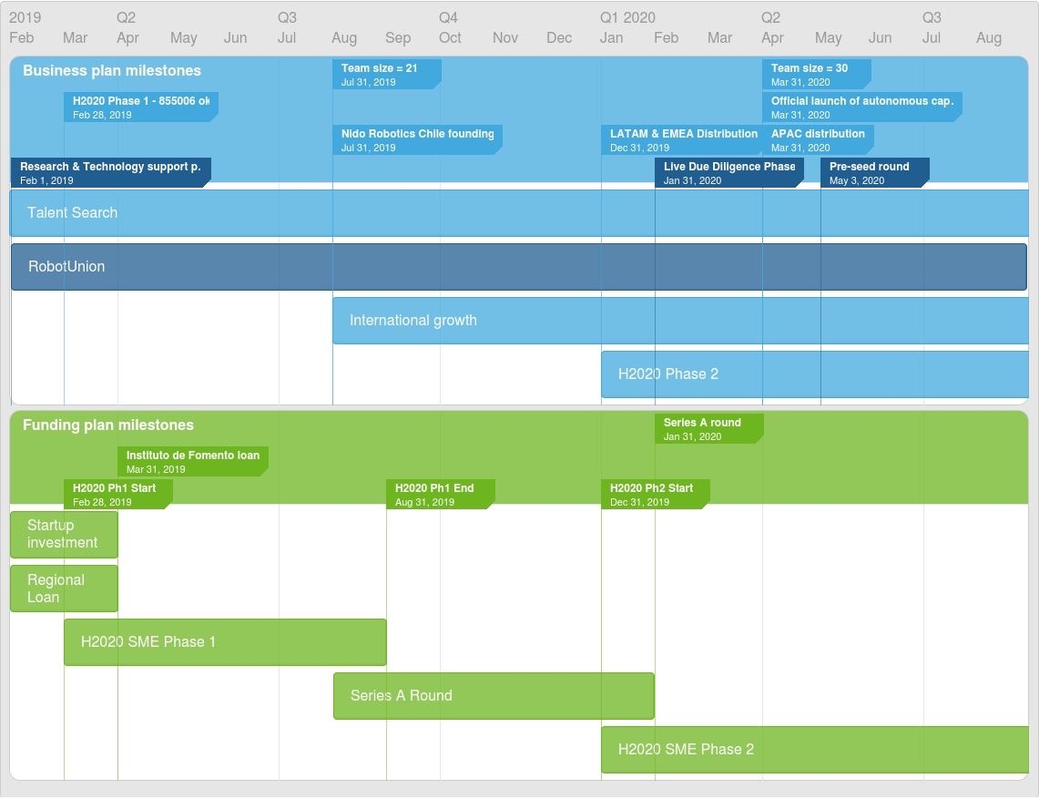

Slide 25
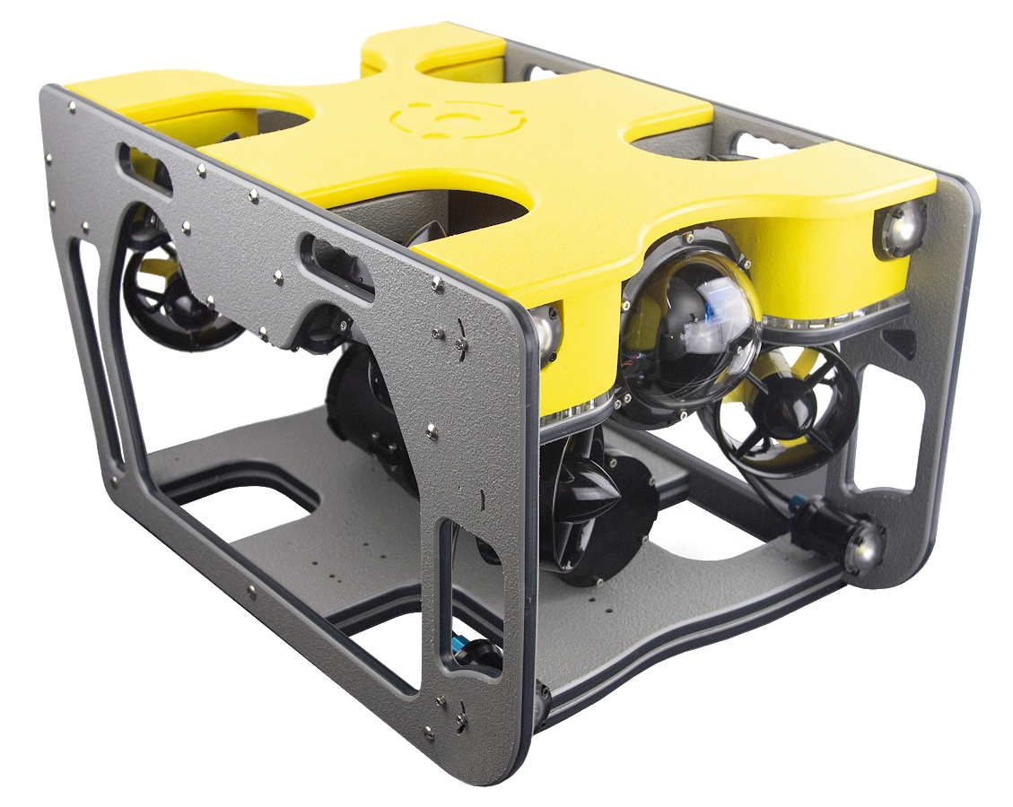
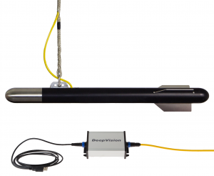
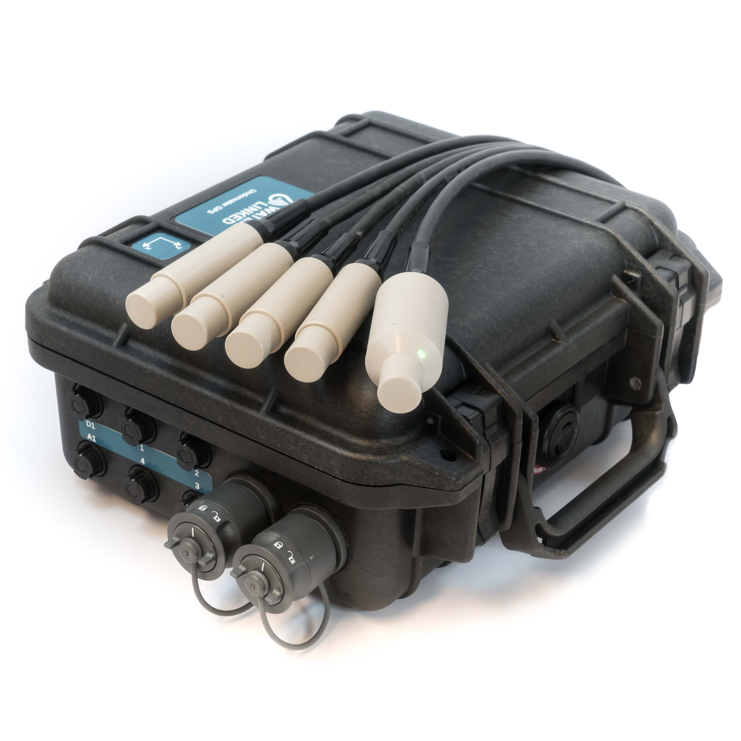
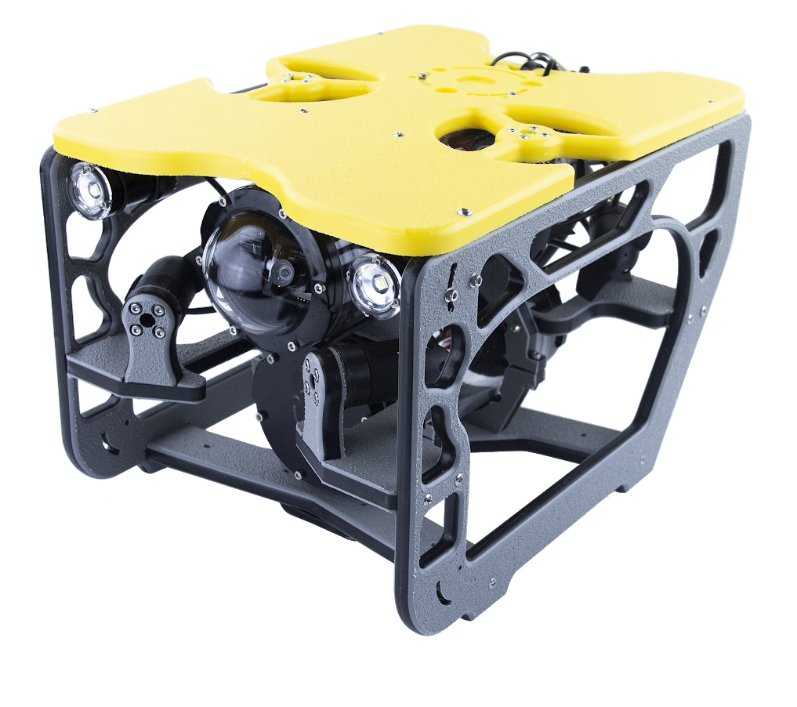
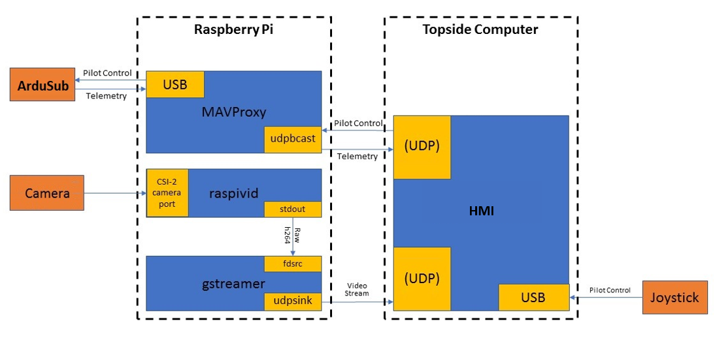
Technologies used
Technologies used

Slide 26
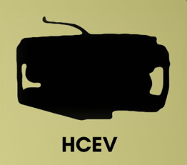
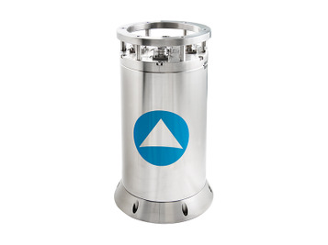
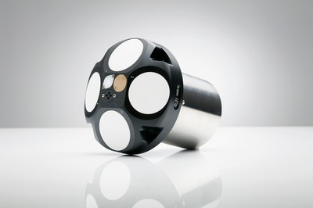
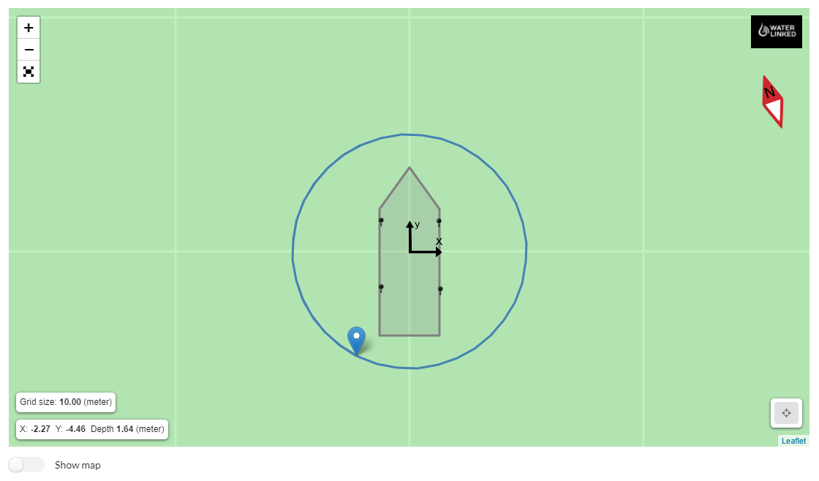
Technologies to develop
Technologies to develop
Development phases:
Dead reckoning
Visual input
Acoustic input

Slide 27
Whole Product Model
It’s not only about robots.
Robots
Payloads
Services
Sibiu Nano
Sibiu Pro
Sibiu HCEV*
EnviroSense (Environmental sensors)
Acoustic positioning and tracking system
Sonars
Cavitation Cleaning System
Autonomous Navigation System*
Maintenance Plans
Training
Inspection Services

