Slide 1


Marine Economic
Monitoring and Evaluation
LU Wenhai
Brussels, Belgium
2 June 2017
Notes:
Good morning, I am honored to give presentation to introduce what we have done in terms of marine economic monitoring and evaluation.

Slide 2
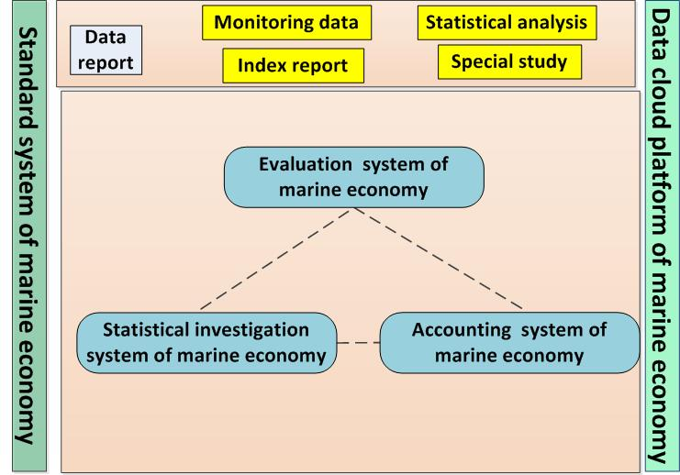
Framework
Base——Statistical investigation system and Accounting system
Major body——evaluation system
Quality guarantee——Standard system
Carrier——Data cloud platform.
Notes:
The monitoring and evaluation system of marine economy is consist of 6 main parts, where the Statistical investigation system and Accounting system form the base, the evaluation system forms the major body, the standard system guarantees the quality of the system and the Data cloud platform system carry the whole system.

Slide 3
1
Marine Economy Monitoring
CONTENTS
2
Marine Economy Evaluation
3
Proposals for international collaboration
Notes:
Today, I would like to focus on the following 3 parts in my presentation.
the monitoring part which help us to know the general information about the marine economy,
the evaluation part which enable us to know much better and deeper about marine economy from different aspects
and the proposals for international collaboration at last.

Slide 4
1
Marine Economic Monitoring
Notes:
Let’s begin with the marine economic monitoring.

Slide 5
1.1 monitoring scale
1.1.1 Industrial scale
Industrial Classification for Marine Industries and Their Related Activities(GB/T 20794-2006)
Marine economy: refers to the summation of industrial activities that explore, use and protect the Marine, and the activities related to them.
Marine industry: refers to the production and service activities that explore, use and protect the Marine. Marine industry include the production and service activities that :
Obtain product from Marine directly,
Make the first processing to the product that obtain from the Marine,
Applied directly to Marine or Marine exploration,
Using seawater or Marine space as the basic element of its production,
And marine scientific, research, management and service.
Marine-related industry: refers to the industries that has technical or economic relationship with Marine industries, based on different kinds of input-output connections.
Notes:
Monitoring system bases on efficient data collecting, where setting the statistical scale both industrially and geographically play a very important role.
In terms of the industrial scale, we have released the a national-level standard early in 2006 to determine what is Marine economy included and excluded.
In our definition, Marine economy refers to the summation of industrial activities that explore, use and protect the Marine, and the activities related to them, which consists of Marine industry and Marine related industry.

Slide 6
Classification
Marine Economy
Marine industry
Marine-related industry
major Marine industry
Marine Scientific Research, Education, Management and Service
Marine agriculture and forestry
Marine Fishery
Marine information service
Offshore Oil and Gas Industry
Marine equipment
manufacturing industry
Marine Mining Industry
Monitoring and forcast service
Shipbuilding Industry
Insurance and social security
Marine-related products and material manufacturing industry
Marine Salt Industry
Scientific study
Marine Chemical Industry
Technological service
Marine-related building and installation industry
Marine Biomedicine Industry
Marine geological prospecting industry
Marine Engineering Building
environmental protection
Marine whole sailing and retailing
Marine Electric Power Industry
Seawater Utilization Industry
Marine education
Marine-related service industry
Marine Communications and Transportation Industry
Marine management
Coastal Tourism
Social and international organizations
Notes:
This is the specific industrial classification within the standard, which include 12 major Marine industries, 10 marine scientific research education management and service industries and 6 Marine –related industries.

Slide 7
Comparison with
< International Standard for Industrial Classification >
Industrial Classification for Marine Industries an Their Related Activities (GB/T 20794-2006)
Category | Sub-category | 3-digit code | 4-digit code
2 | 28 | 107 | 380
International Standard Industries Classification (ISIC/REV.3)
Category | Sub-category | 3-digit code | 4-digit code
17 | 60 | 159 | 292
GB/T 20794-2006 related to
16 | 48 | 91 | 144
Notes:
This is the comparison between our standard and the international standard for industrial classification. We can see from this table that our classification nearly covered all the categories in the international classification, which is 16 out of 17.

Slide 8
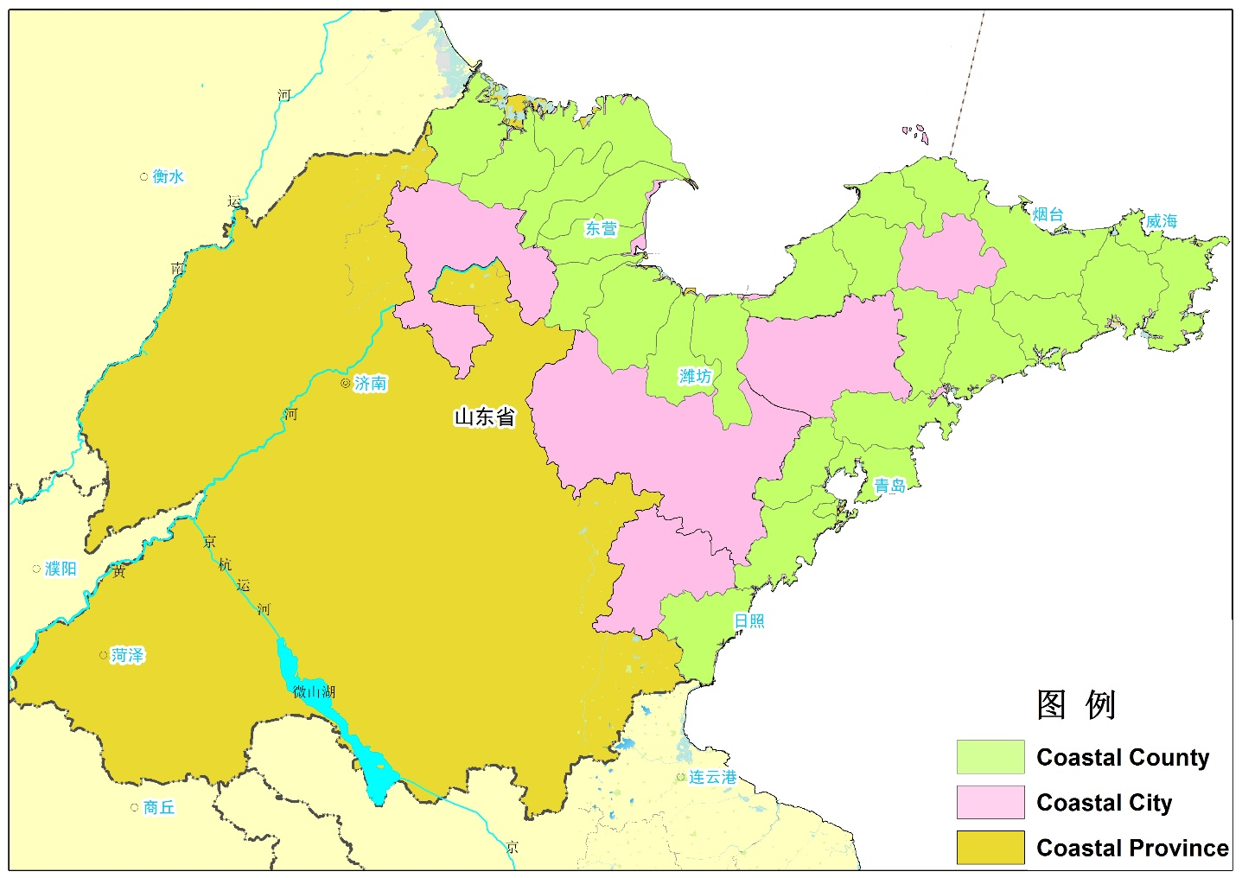
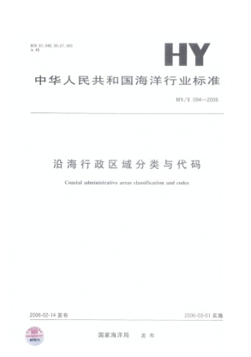
1.1.2 Geographic scale
Coastal Province：the coastal region in a broad sense, refers to the province with coastlines (continental and island coastlines).
Coastal City ：refers to the municipalities directly under the Central Government and the prefecture-level cities with coastlines (including all the districts, counties and county-level cities under them).
Coastal County： the coastal region in a narrow sense, refers to the counties, county-level cities and districts with coastlines.
Shandong Province case
Notes:
In terms of the geographic scale, we also released a standard, which provide the definition about which area should be taken into consideration in our data collecting system.
We take coastline as the only character to judge coastal area. A province with coastline is a coastal province, a city with coastline is a coastal city, a county with coastline is a coastal county.
Take Shandong province for example, the yellow part represent the whole coastal province, the pink parts represent the 7 coastal cities within Shandong province, and the green parts represent the 35 coastal counties within 7 coastal cities.

Slide 9
Status of China’s coastal area
Coastal Province | Coastal City | Coastal County
Total | 54 | 238
Tianjin | 1 | 1
Hebei | 3 | 11
Liaoning | 6 | 22
Shanghai | 1 | 5
Jiangsu | 3 | 15
Zhejiang | 7 | 35
Fujian | 6 | 34
Shandong | 7 | 35
Guangdong | 14 | 55
Guangxi | 3 | 8
Hainan | 3 | 17
Notes:
This is the latest statistic about the coastal area in China.

Slide 10
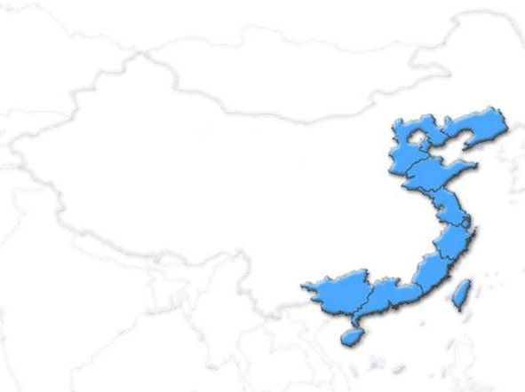
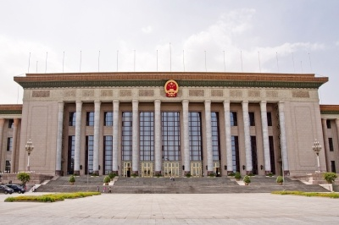
1.1.3 Data resource
National Marine Statistics Information Network
Liaoning
Marine-related enterprises
More than 20 national ministries or departments
Marine management
Departments in Coastal areas
Hebei
Tianjin
National Bureau of Statistic
General Administration of Custom
National Energy Administration
China Development Bank
Ministry of Education
Ministry of Science and Technology
Ministry of Land and Resources
Ministry of Transport
Ministry of Water Resources
Ministry of Agriculture
Ministry of Industry and Information Technology
Ministry of Environmental Protection
National Tourism Administration
Chinese Academy of Sciences
China Earthquake Administration
China Meteorological Administration
China State Shipbuilding Corporation
China Shipbuilding Industry Corporation
China National Petroleum Corporation
China Petrochemical Group Corporation
China National Offshore Oil Industry Corporation
China National Salt Industry Corporation
Marine or Fishery
Departments in
11 coastal provinces
and cities and
5 specific cities
with independent
planning status.
Shandong
Jiangsu
Shanghai
Zhejiang
Fujian
Guangdong
Guangxi
Hainan
Dalian
Shenzhen
Qingdao
Xiamen
Ningbo
Notes:
Our data mainly comes from 3 parts, national ministries and department, Marine management Departments in Coastal areas and Marine-related enterprise.

Slide 11

1.2 Ways for monitoring
1.2.1 Regular form-filling program
According to the Statistics Law of the People’s Republic of China, the State Marineic Administration (SOA) applies for the approval from the National Bureau of Statistics(NBS), and the provincial and multiple Marine administrations implement the program to collect data.
Statistics Law of the
People’s Republic of China
Marine Statistical data-collecting program
Gross Marine Product Accounting data-collecting program
Notes:
The way we use to obtain data rely mostly on the regular form-filling method. With the approval of National bureau of Statistics, we mainly implement 2 programs to collect data, Marine Statistical data-collecting program and Gross Marine Product Accounting data-collecting program.

Slide 12
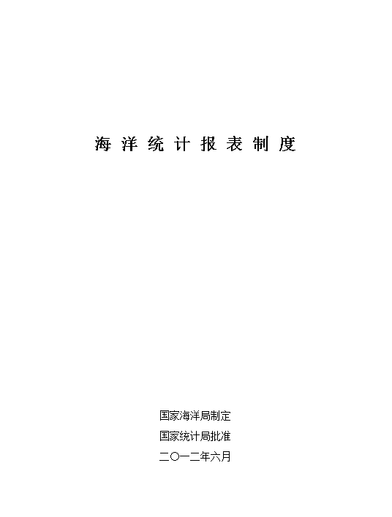
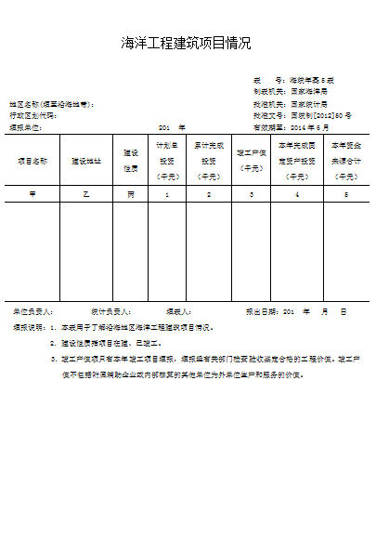
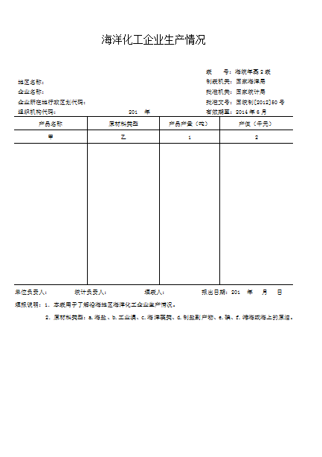
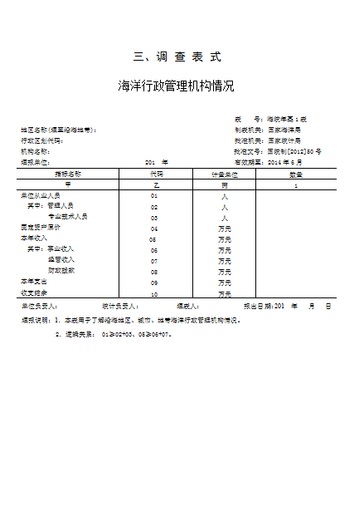
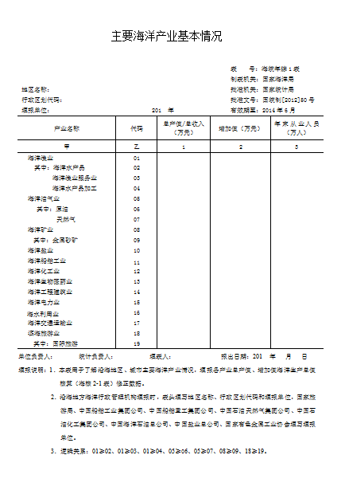
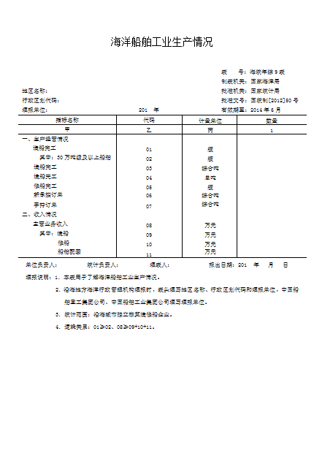
Marine Statistical data-collecting program
In 1999, the first ——Integrated Marine Statistical Collecting Forms institution ——was approved by NBS, it has been implemented for more than 20years, and experiencing many revising and adjusting according to different standards. Recently, according to the Statistic Law, It will be revised every two years.
Component:
--Tables :70
--Indicators :more than 1600
Contents:
-- Production and operating activities of every major Marine industries
-- Production and operating activities of Marine-related enterprises
-- Marine scientific and research
-- Marine technical service
-- Marine education
…
Marine Statistical
data-collecting program
Forms for
data-collecting
Notes:
The Marine Statistical data-collecting program start from 1999, which consists of nearly 70 tables. It is used to collect the comprehensive information of marine economy in every aspect. These are the forms for data-collecting.

Slide 13
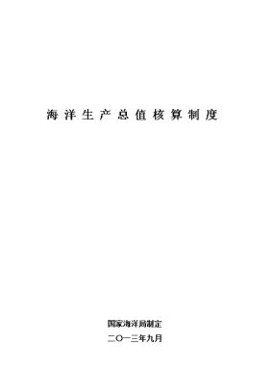
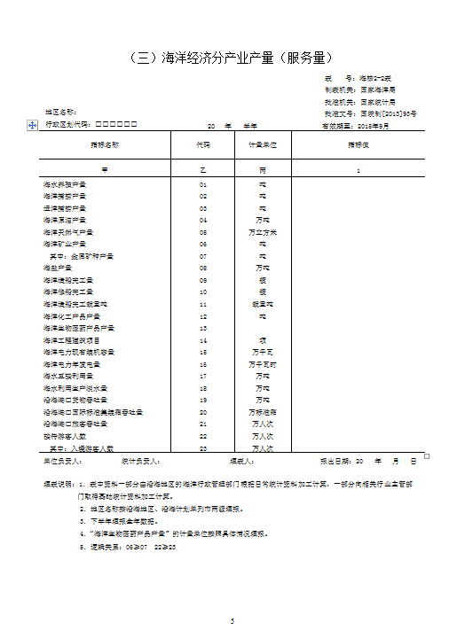
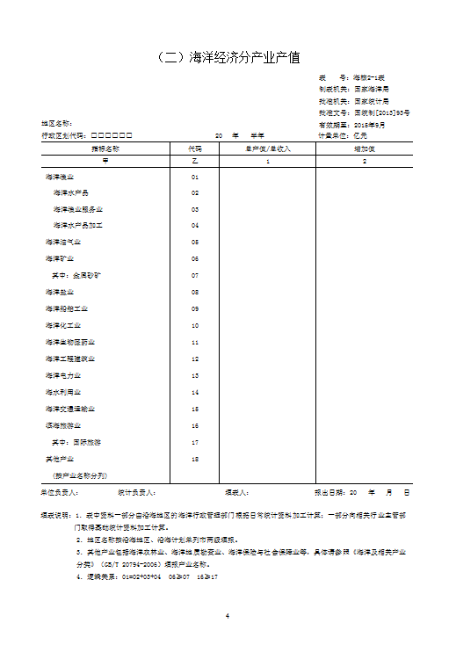
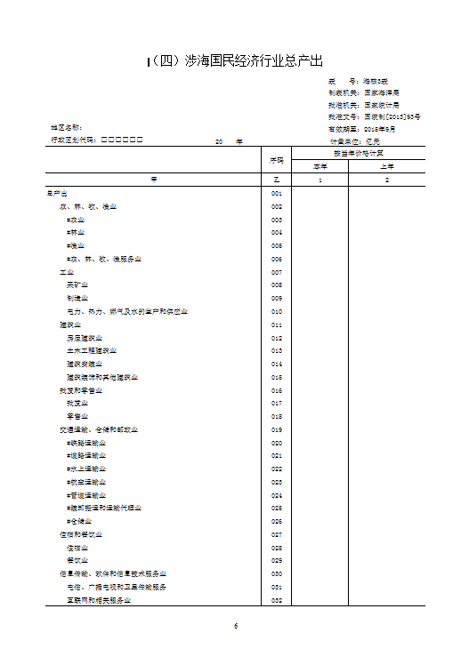
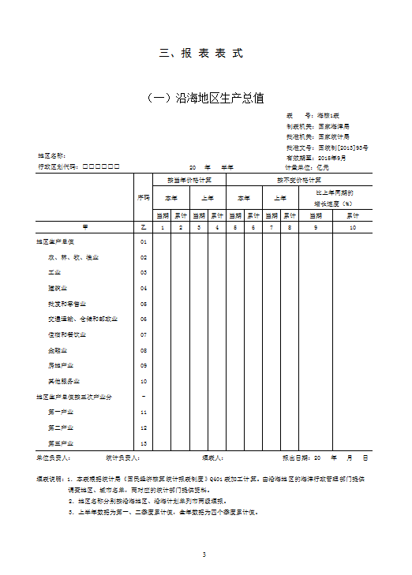
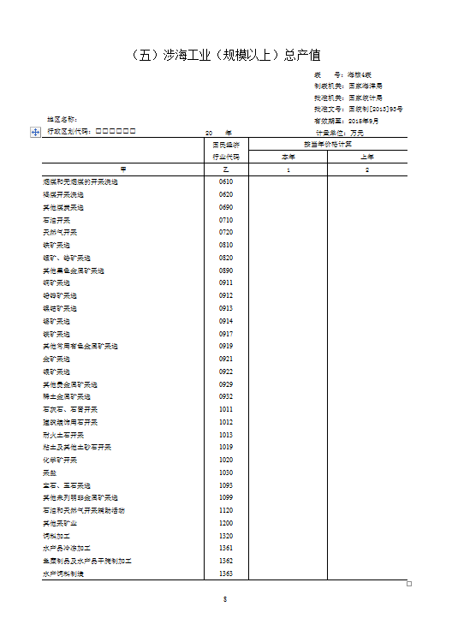
Gross Marine Product Accounting data-collecting program
In 2006, the SOA formulated the “GDP accounting system" (NBS, [2006] No.21). Implementation of the system made Marine economic statistics undergo a qualitative leap, which is a new milestone in the work of Marine economic statistics.
Component:
--Tables:6
--Indicator :more than 300
Contents:
-- Coastal Gross Domestic Product
-- Output value of Marine economy by industry
-- Volume of Marine economy by industry
-- Gross output of Marine -related sectors under national classification
-- Gross output value of Marine -related industry under national classification
-- Component of coastal Gross Domestic Product
-- Input-output tables with 135by 135 department in coastal area
Gross Marine Product Accounting
data-collecting program
Forms for
data-collecting
Notes:
The Gross Marine Product Accounting data-collecting program start from 2006, which consists of nearly 6 tables. It is used to collect the special information for generate gross Marine product accounting. These are the forms for data-collecting.

Slide 14
Revising history
Marine Statistical Report program
First revise,
added the
content about marine biomedicine、marine electric power and so on （[2004]No.40）
Fourth revise, added the content about marine services、culture activities and so on（[2012]No.50）
Second revise by means of 《Industrial Classification for Marine industries
and their related activities 》（[2007]No.29）
Establish the Integrated Marine Statistical Report Program（[1999]No.53）
Third revise to improve statistical indicator
[2009]No.42）
Fifth revise, undergoing
1999
2002
2004
2006
2007
2008
2009
2011
2012
2013
2015
Establish Marine Statistics Quick-Report program to improve time efficiency（[2002]No.209）
Establish Goss Marine Production Accounting program to reflect Marine economy comprehensively（[2006]No.21）
First revise to
adjust submit time and renew the explanations of the indicator （[2008]No.116）
Second revise to improve statistical indicator （[2011]No.7）
Third revise to adjust Marine-related industries（[2013]No.93）
Goss Marine Production Accounting Program
Notes:
This is the revising history for the 2 programs.

Slide 15
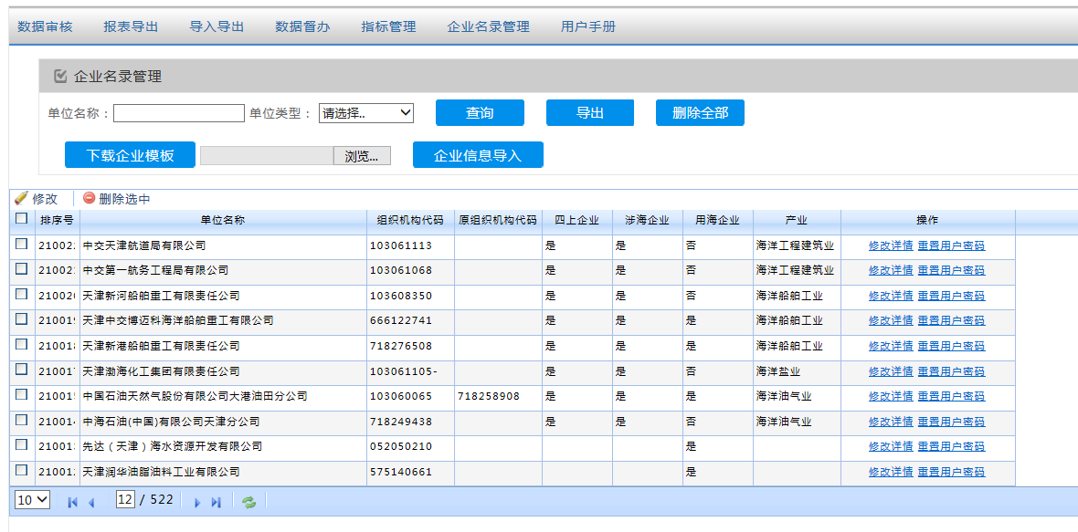
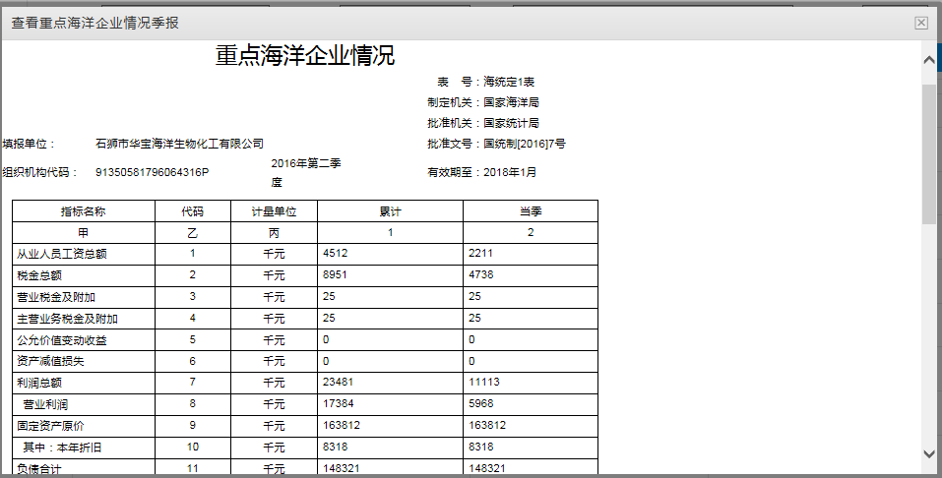
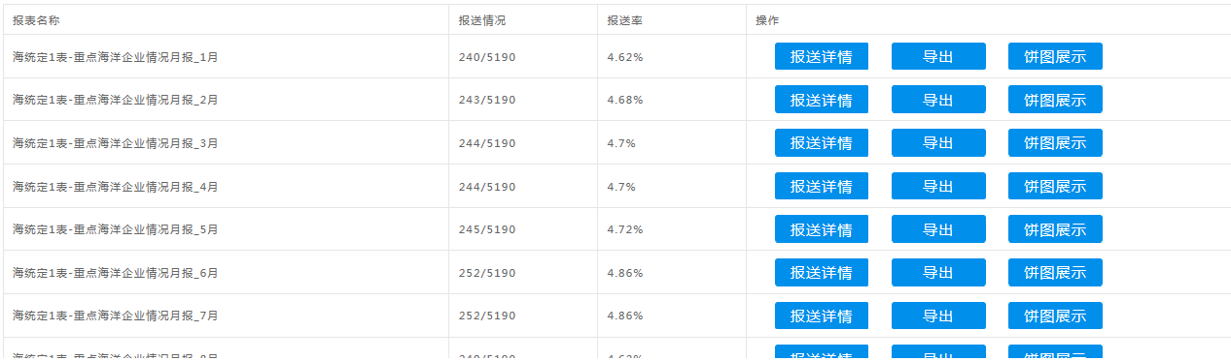
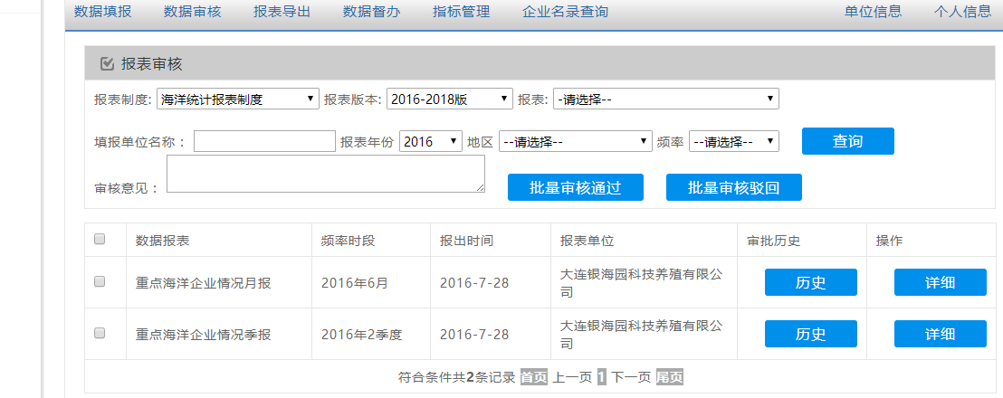
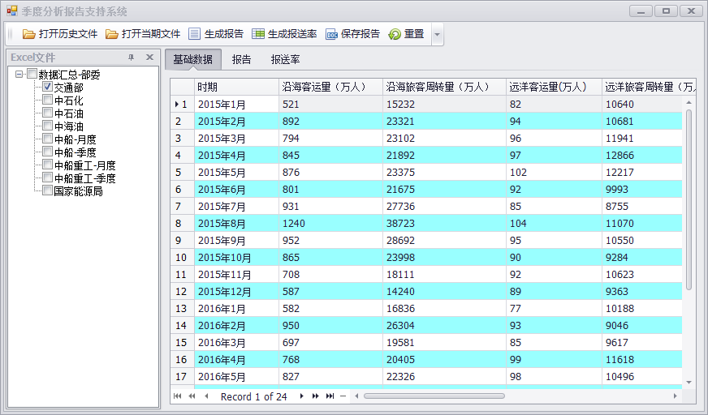
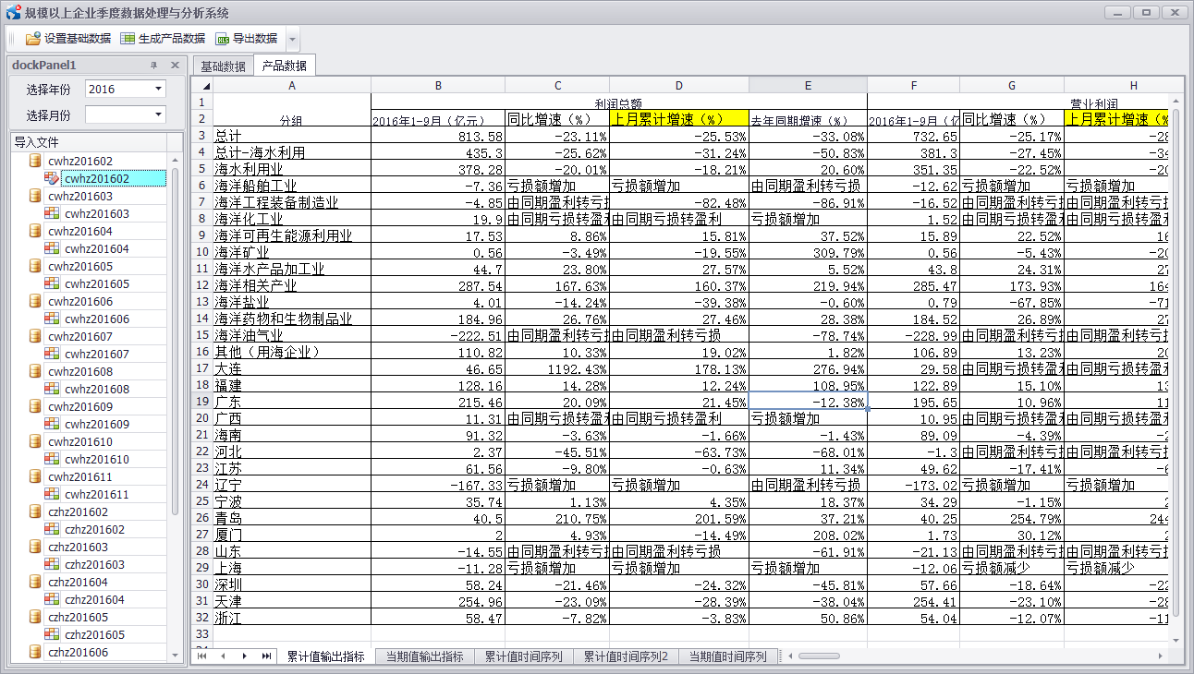
Software system
Enterprise directory management
Online form-filling
statistic of filling rate
Level-by-level data checking
Data normalization
Data computation
Notes:
These are the softwares we developed for data processing.

Slide 16
The Monthly and Quarterly Report for Marine Economic
Monthly report start from september 2016 | Quarterly report start from Spring 2016
The Performance Analysis of The Marine Industrial Enterprises above Designated Size The Performance Analysis of The Marine Service Industry Enterprise above Designated Size The Analysis on Energy Consumption of The Marine Enterprises The Analysis of The Marine Foreign Trade The Analysis of The "blue 100" Marine Economic Stocks Price Index The Analysis of sea area use Analysis of seawater aquatic products, marine transportation and crude oil prices The Performance Analysis of The Marine enterprise | Management status of marine industrial enterprises above designated size Management status of marine renewable energy utilization enterprises above designated size Management status of marine biomedicine enterprises above designated size Foreign trade Supply side industrial structure adjustment Listed companies financing
Notes:
Base on the data collected, we explored the monthly and quarterly report for marine economy, to quickly reflect the status and the trend of marine economic development. But it is only for inner reference now.

Slide 17

China Marine Statistical Yearbook
（1990－2016）27 Volumes
0.Summary of China's Marine economic development
1.Integrated data
2.Marine economic accounting
3.Major Marine industrial activities
4.Production capacity of major Marine industries
5.Marine-related employment
6.Marine science and technology
7.Marine education
8.Marine environmental protection
9.Marine administration and public-good service
10.National and coastal socio-economy
11.Part of the worlds Marine economic statistics data
Notes:
We also released the china marine statistical year book, to provide comprehensive and systematic statistical data. And it is bilingual.

Slide 18


1.2.2 Marine economic accounting system
Statistic is only those elements which is hard to see what is it , while accounting is the temple that could show us what is it looks like.
Notes:
Another way to obtain data is to do marine economic accounting.
As are shown in the two pictures, statistic is only those elements which is hard to see what is it like as a whole, while accounting is the temple that could show us what is it looks like.

Slide 19






General Framework of Marine Economic Accounting System
Principal
Accounting
Basic
Accounting
Subsidiary Accounting
Marine economy input-output accounting
Gross Marine Products (GOP)
accounting
Marine natural resources accounting
Marine resources and environment and social activities
Marine economy fixed assets accounting
Marine foreign trade
accounting
Notes:
This is the general framework of marine economic accounting system, which consists of principal accounting, basic accounting and subsidiary accounting. Now we have achieved the gross Marine Products accounting, the other parts are under study.

Slide 20
The accounting methodology of GOP
Data collection and processing
Enterprise
accounting
Added value
ratio
Separating
coefficient
Delphi
Speed prediction
Sampling survey
Marine-related industry accounting
Marine industry accounting
Input-Output method
Control of data quality
Notes:
This is the accounting methodology of GOP.
We mainly apply Enterprise accounting method, Added value ratio method, or Separating coefficient method to generate the added value of each major marine industry, and apply input-output method to generate the added value of Marine-related industries.

Slide 21
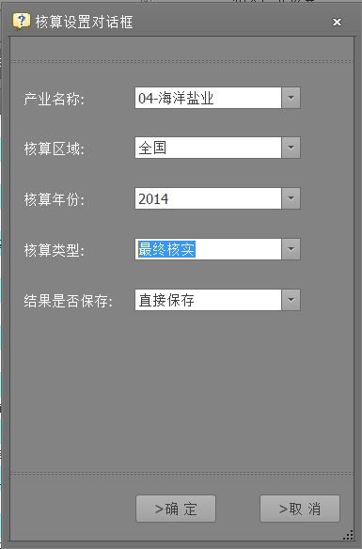
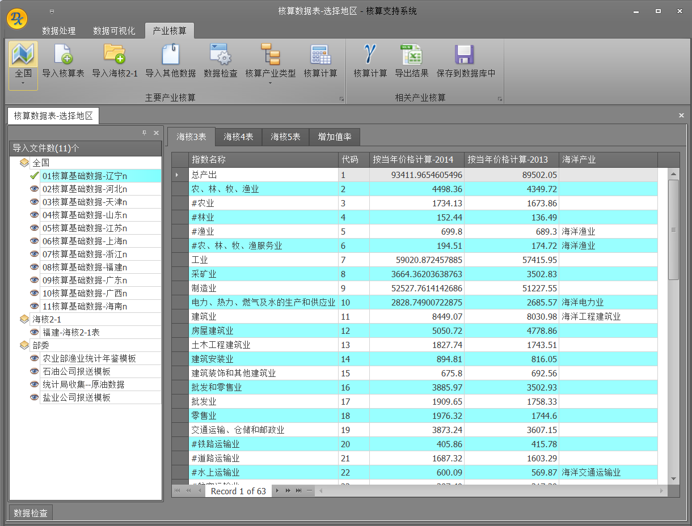
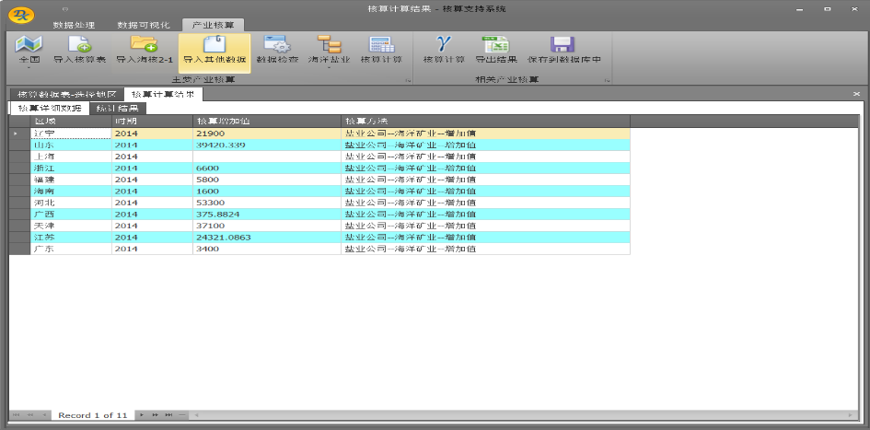
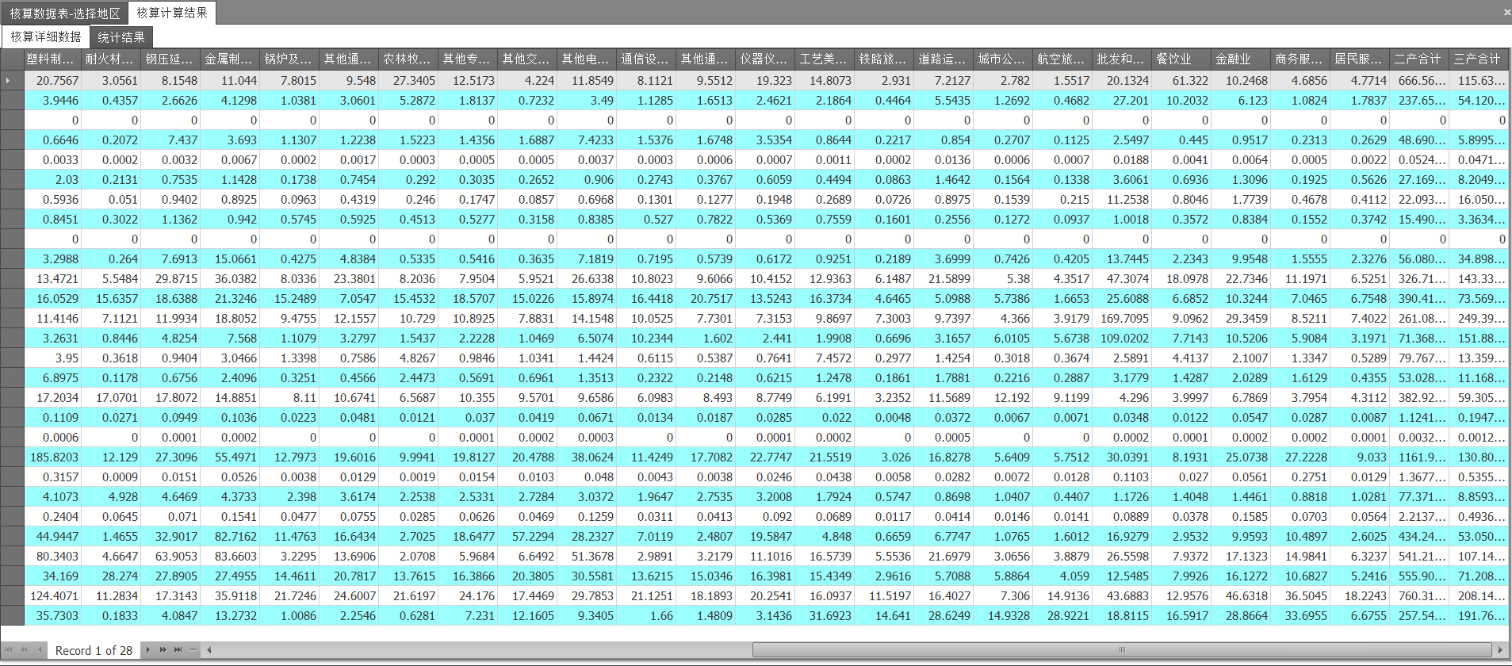
Marine economic accounting software system
Coefficient setting
Data import
Accounting on major marine industry
Accounting on marine -related industry
Notes:
These is the software we developed for accounting.

Slide 22
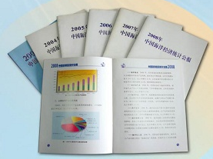
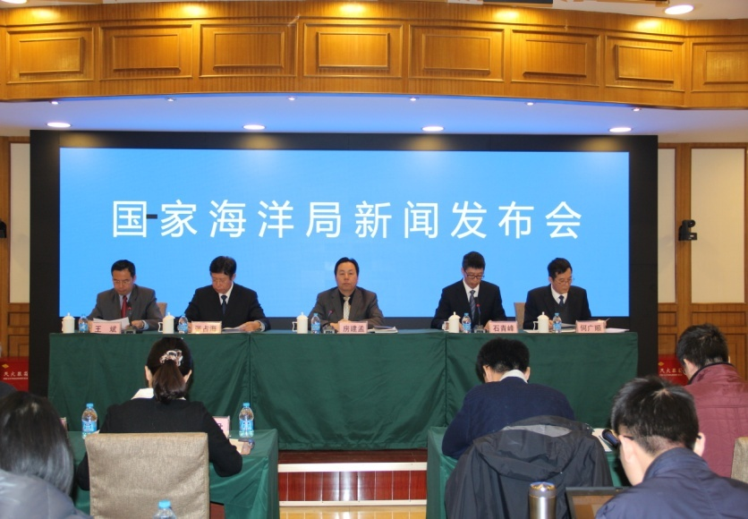
China Marine Economic Statistical Bulletin
（2003－2016）14 Volumes
China Marine Economic Statistical Bulletin
Contents:
Development of Marine Economy
Development of Major Marine Industries
Development of Regional Marine Economy
Press Conference
Notes:
We usually released the marine economic accounting data on China Marine Economic Statistical Bulletin through the press conference in February or March the next year.

Slide 23
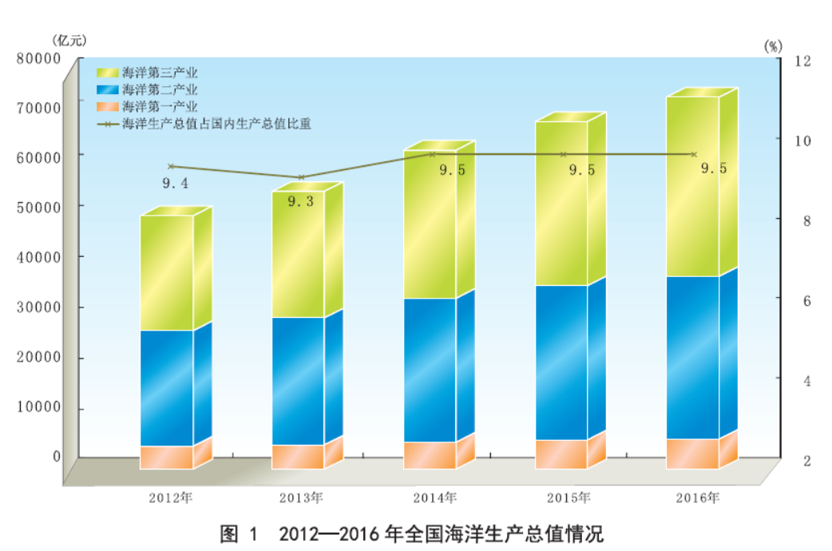
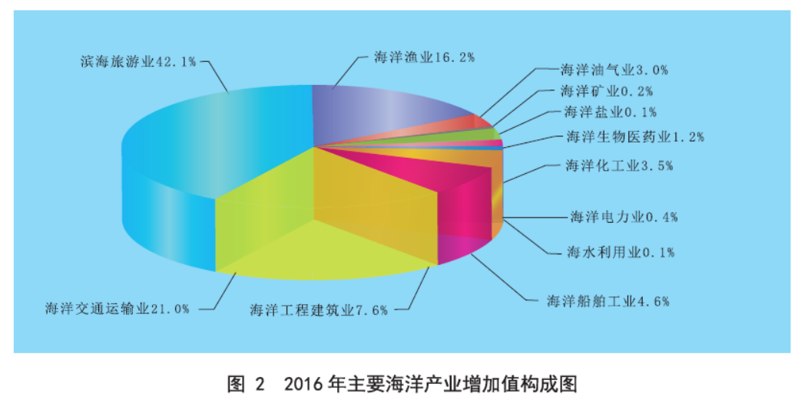
According to the latest released 2016 China Marine Economic Statistic Bulletin, the national Gross Marine Product amounts to7,050.7 billion RMB (equivalent to 1,061.5 billion dollars), 6.8% up from the previous year(at comparable price),accounting for 9.5% of GDP.
GOP, its growth rate and three industrial composition in 2014-2016
Industrial composition of major marine industries in 2016
Notes:
According to the latest released 2016 China Marine Economic Statistic Bulletin, the national Gross Marine Product amounts to7,050.7 billion RMB (equivalent to 1,061.5 billion dollars), 6.8% up from the previous year(at comparable price),accounting for 9.5% of GDP.

Slide 24
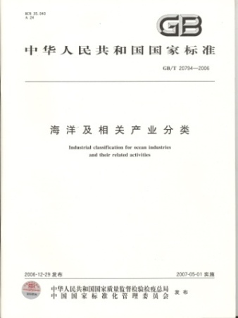
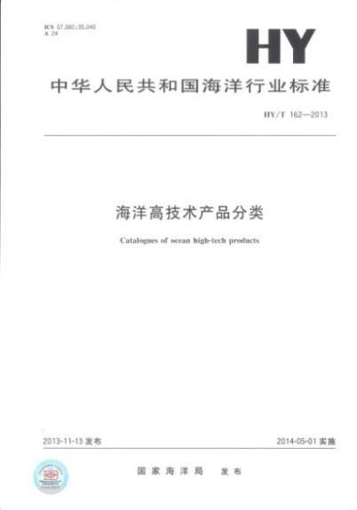
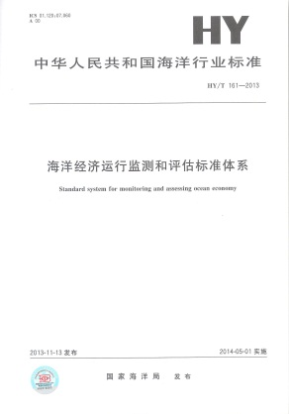
Standards published—1 National-level standard and 5 industrial standards
《 Industrial Classification for Marine Industries and Their Related Activities 》（GB/T 20794-2006）
《 Coastal administrative areas classification and codes 》（HY/T 094-2006）
《 Classification for Marine high-tech industries 》（ HY/T 130-2010）
《 Index system for Marine economy 》（HY/T 160-2013）
《 Catalogues of Marine high-tech products 》（ HY/T 162-2013）
《 Standard system for monitoring and assessing Marine economy 》（HY/T 161-2013）
Notes:
These are the standards we have published for our data collecting.

Slide 25
2
Marine Economic Evaluation
Notes:
Secondly, the marine economic evaluation.

Slide 26
Issuing schedule of marine economic evaluation results
Name | Contents | Frequency | Issuing Date | Remark
China Marine Development Index report | Reflect the overall development of Marine economy and Marine issues with the comprehensive index. | Yearly | September next year | Public
China Marine Economic Development Index | Reflect the marine economic development status with the comprehensive index | Yearly | November next year | Public
Marine Economic Climate Index Report | Reflect the booming state of marine economy with the comprehensive index. | Yearly | November next year | inner reference
The "blue 100" Marine Economic Stocks Price Index | Reflects the development of the Marine economy from the perspective of the stock market. | Day | Real time | inner reference
Report on China’s Economy Development | Analyze the yearly development status of Marine economic overall and in the pilot areas. | Yearly | September next year | Public
Notes:
These are the major results out of the marine economic evaluation.

Slide 27
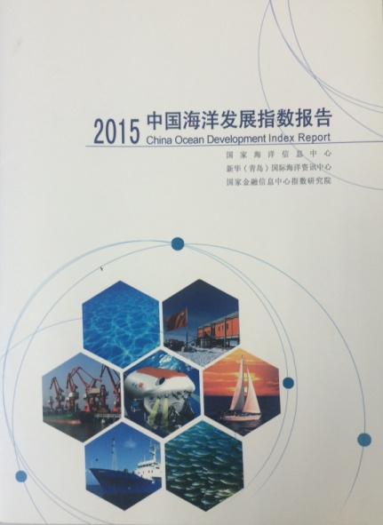
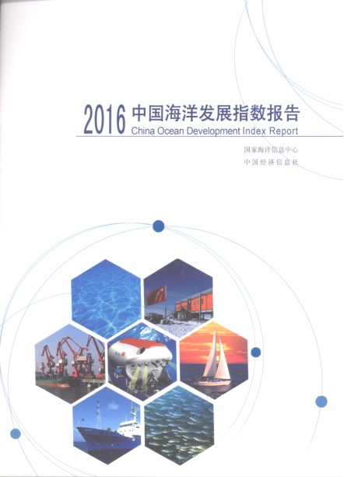
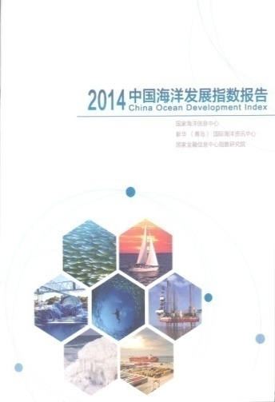
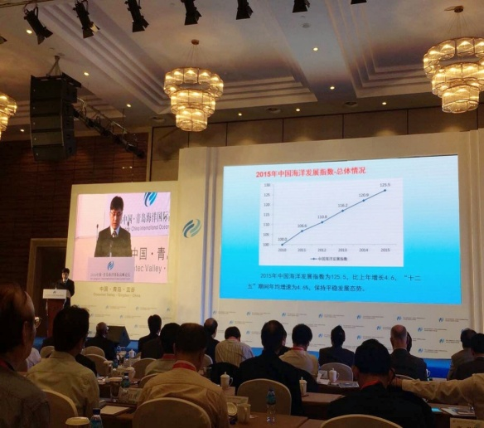
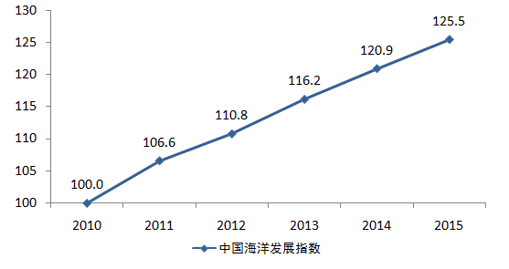
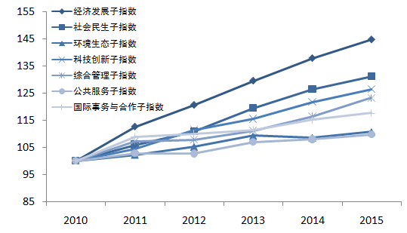
China Marine Development Index (2014-2016) 3Volumes
The China Marine Development Index is a quantitative evaluation about the overall development of Marine economy and Marine issues in a certain period.
economic development
social livelihood
environmental ecology
scientific innovation
Comprehensive governance
Public service
International issues and cooperation
China Marine Development Index
2016 China Marine Development Index
Press Conference
Notes:
The latest China Marine Development Index was released in September 26th 2016, it uses 7 parts of indicators to Reflect the overall development of Marine economy and Marine issues with the comprehensive index.

Slide 28
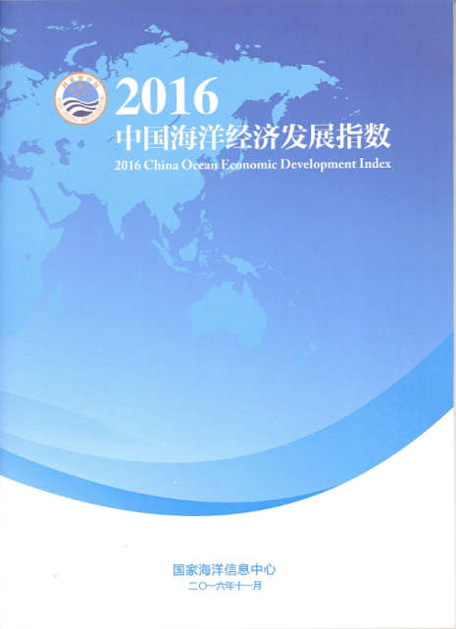
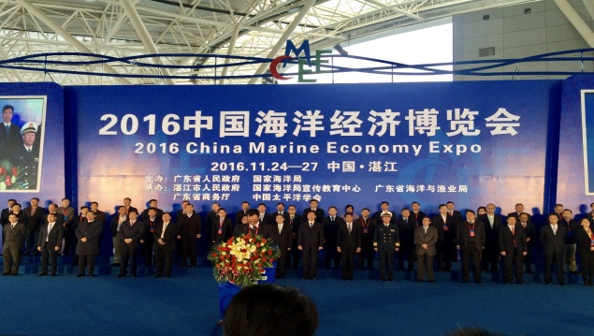
China Marine Economic Development Index （2016）
November 24th, 2016, NMDIS released the initial 2016 China Marine Economic Development Index Report.
The China Marine Economic Development Index is a comprehensive index to reflect marine economic development status, which includes:
Developmental level
——size, composition, benefit, openness
Developmental achievements
——stability, livelihood improvement
Developmental potential
——innovation driving force, resource and
environmental bearing capacity.
China Marine Economic Development Index
Press Conference
China Marine Economic Development Index
Developmental level sub-Index
Developmental achievements sub-Index
Developmental potential sub-Index
2016 China Marine Economic Development Index
Notes:
In November 24th, 2016, we released the initial 2016 China Marine Economic Development Index Report.
We use indicators of Developmental level, Developmental achievements, and Developmental potential to focus on the marine economic development status with the comprehensive index in a more specific aspect.

Slide 29
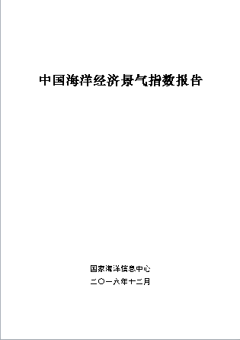
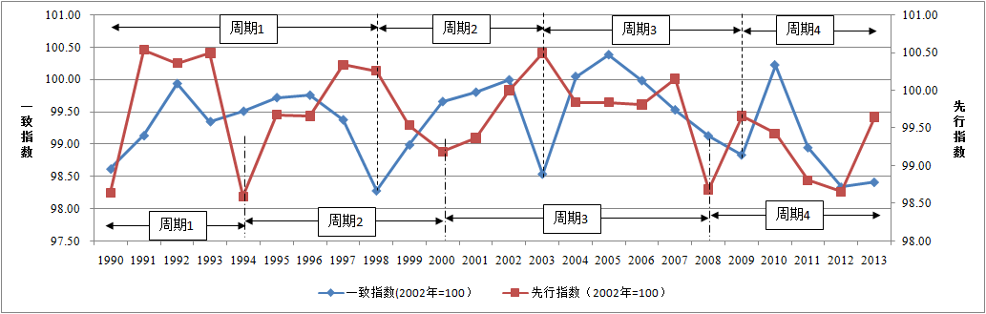
Marine Economic Climate Index Report（2015－2016）2 Volumes
Marine Economic Climate Index Report
Marine Economic Climate Index is a comprehensive description on the
development status of marine economy, which is used to reflect the booming
state of marine economy at present . It consists of coincident indicator, leading
indicator and lagging indicator.
Due to data limitation, we can only achieve yearly index analysis, quarterly and
monthly climate index is to be studied.
Period 1
Period 2
Period 3
Period 4
Coincident indicator
Leading indicator
Period 1
Period 2
Period 3
Period 4
Coincident indicator,
2002=100
Leading indicator,
2002=100
Notes:
We explored the Marine Economic Climate Index to reflect the booming state of marine economy with the comprehensive index.
Due to data limitation, we only finished the yearly climate index, the quarterly and monthly climate index is under study.

Slide 30
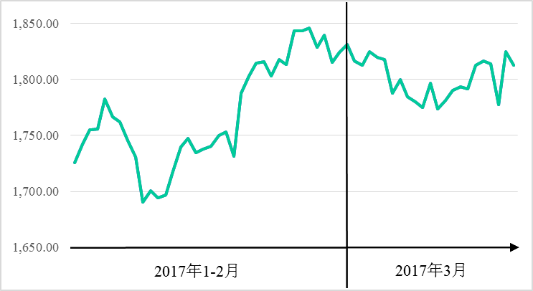
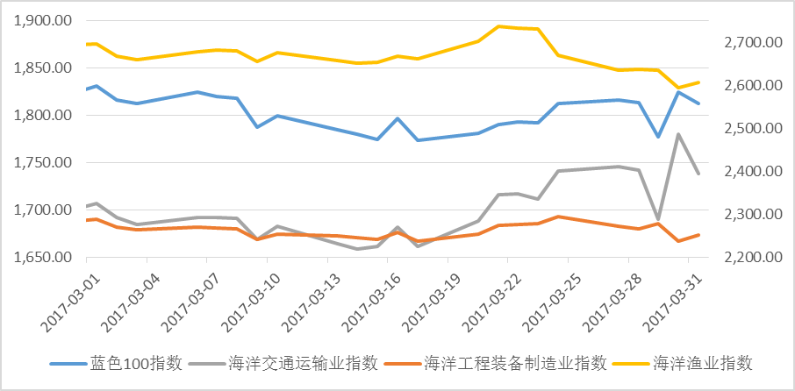
The "blue 100" Marine Economic Stocks Price Index
The index is an indicator of changes in the overall price level of the Marine economy. It picks up 100 stocks in both the Shanghai and Shenzhen stock markets that are part of the Marine economy, and by using the pie weighted synthesis, it reflects the development of the Marine economy from the perspective of the stock market.
January and February,2017
March,2017
Blue 100 index
Marine transportation index
Marine engineer and equipment manufacturing index
Marine fishery index
Notes:
We explored the blue 100 marine economic stocks price index to reflects the development of the Marine economy from the perspective of the stock market. But it is only for inner reference now.
“蓝色100”海洋经济股票价格指数是描述海洋经济股票总价格水平变化的指标。指数选择沪深A股中规模大、流动好且属于海洋经济范畴的100只股票，利用派许加权综合计算得出，从股票市场运行的角度反映了中国海洋经济的发展情况。

Slide 31
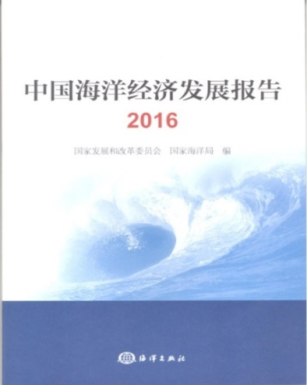
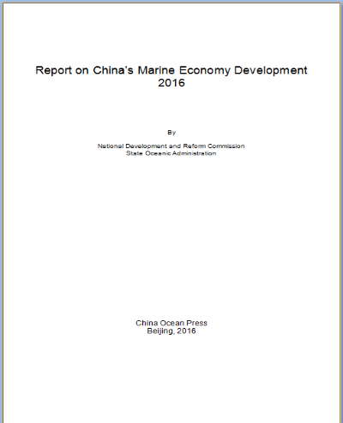
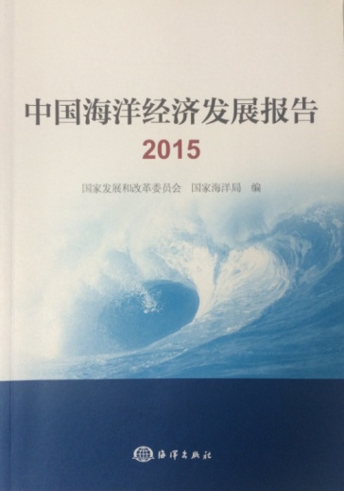
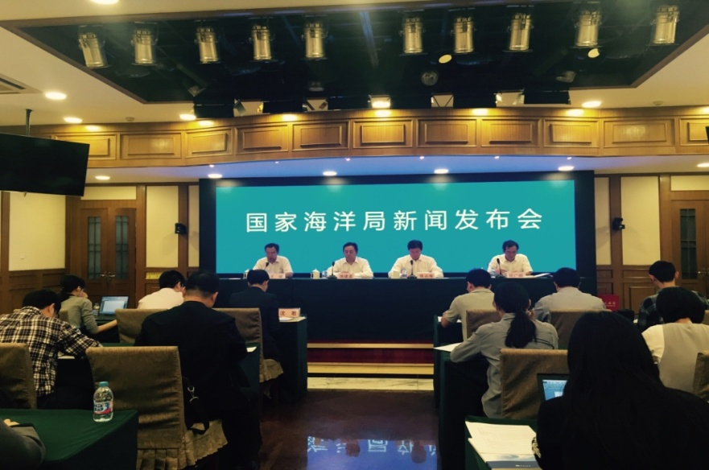
Report on China’s Economy Development（2015－2016）2 Volumes
Part 1 Summary report
Chapter 1. National development of Marine economy during the twelve five-year-plan period
Chapter 2. National development of Marine economy in 2014
Chapter 3. The trend and forecast of national Marine economy
Part 2 Sub-summary report of Marine economic pilot area
Chapter 1. Shandong peninsula Blue Economy economic zone
Chapter 2. Zhejiang Marine Economy demonstration area
Chapter 3. Guangdong Marine Economy pilot area
Chapter 4. Fujian Strait Blue Economy pilot area
Chapter 5. Tianjin Marine Economy Scientific demonstration area
Part 3 Assessment report of Marine economic pilot area
Chapter 1. Achievements of the pilot areas
Chapter2. Remained Problems
Chapter 3. Work to be done next
Report on China’s Economy Development
Press conference
Notes:
And we also released the Report on China’s Economy Development to describe and analyze the yearly development status of Marine economic overall and in the pilot areas.

Slide 32
3
Proposal of international cooperation
Notes:
Last but not the least, the proposals.

Slide 33



Collaboration in the past
October 25-29,2015, sponsored the Symposium :The Marines in National Income Accounts: Seeking Consensus on Definitions and Standard, in Monterey, California USA.
October 25-28,2016, hold the Second Symposium :The Marines in National Income Accounts: Definition, Classification and Methodology, in Tianjin China.
Hold regular academic exchanges and visits with other countries such as U.S.A.、Canada、Australia、Malaysia and so on.
Notes:
In the past few years, we have sponsored and hold two symposiums in the study of marine economic accounting, and made some valuable achievements. Besides we hold some academic exchanges and visits with countries like U.S.A., Canada, Australia, Malaysia etc.
2016年10月，举办第二届蓝色经济国际研讨会，共有来自7个国家、4个国际组织、美国驻华使馆等国家和机构的60多名代表参会。

Slide 34
Cooperation proposal in the future
Introduce Non-market value into GOP Accounting in the governmental statistic.
Seeking joint effort to study Blue Economy in concept, classification and methodology.
Promote studies and cooperation on international standard for blue economy
Combining the Belt and Road Initials, carry out data exchange and sharing with countries along the Belt and Road, establish the Blue Economy database to improve the development level of Blue Economy all over the world.
Notes:
In the future, we would like to strengthen cooperation in the areas more than the following aspects:
Firstly, Introduce Non-market value into GOP Accounting in the governmental statistic.
Secondly, Seeking joint effort to study Blue Economy in concept, classification and methodology.
Thirdly, Promote studies and cooperation on international standard for blue economy
Fourthly, Combining the Belt and Road Initials, carry out data exchange and sharing with countries along the Belt and Road, establish the Blue Economy database to improve the development level of Blue Economy all over the world.

Slide 35
Thanks！
National Marine Data and Information Service, SOA
Email:lu-wenhai@163.com
Tel:+8602224010852
Fax:+8602224010926

