Slide 1
What opportunities does the EIB offer to the ocean energy sector
Brussels
5th October 2015

Slide 2
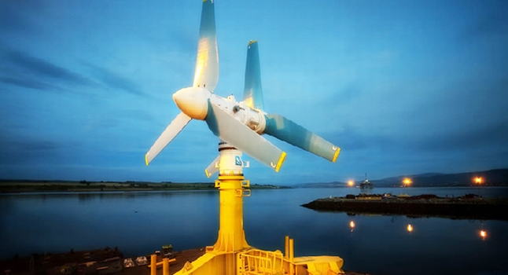
Case study MeyGen
REIF £17.2m debt equity mix – all commercial terms
Crown Estate - £10m enhanced rent product
DECC - £10m grant
HIE £3m Grant
Private equity
This is as near to a project finance deal as we could achieve; fully (very) diligenced
It was very hard to do
It is a pathfinder project for the world

Slide 3
Post MeyGen
Siemens AG become Atlantis second largest shareholder on the back of the acquisition by Atlantis of MCT.
Atlantis conducted a capital raise in the public markets in London for the explicit purpose of project development and were 100% oversubscribed by institutional investors.
The supply chain has invested in Atlantis and in the sector (Global Energy providing a long term debt note to help fund the acquisition of MCT).
Atlantis have opening up the world’s first multi tidal turbine assembly facility at Nigg Energy
Corporate and commercial interest in the tidal power sector in Scotland is strong. Interest is coming in from large European utilities, OEM’s and supply chain participants.
Atlantis recently sold 50% of their interests in Canada to DP Energy, to create a larger project with more industry consolidation with their partners Lockheed Martin.
Tim Cornelius recent appointment to the Board of Ocean Energy Europe.

Slide 4
Structure
Atlantis
REIF
TPSH
Project
Project
Project
Project

