Slide 1
information sharing: the experience of EMSA
Leendert Bal /
Head of Department Operations
Brussels, 17 June 2016;
Technical Advisory Group

Slide 2
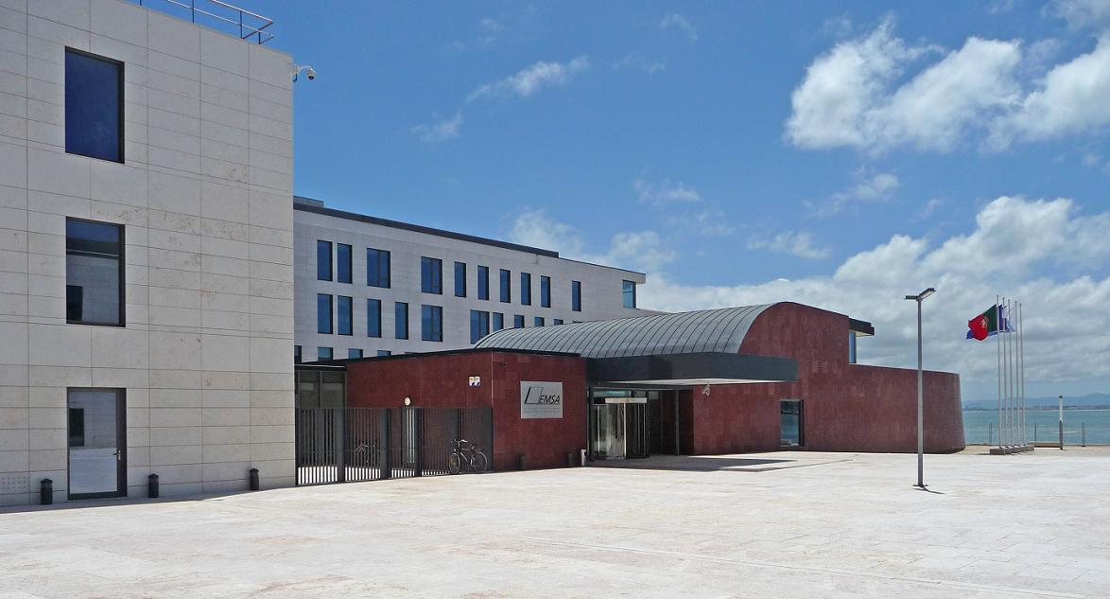
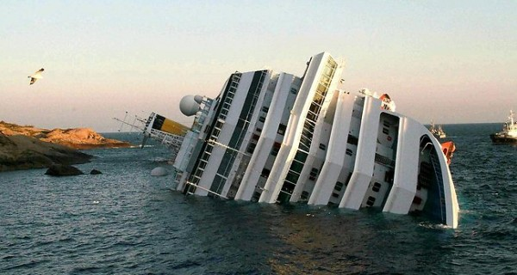
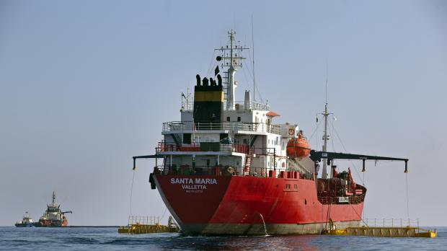
European Maritime Safety Agency
Regulatory Agency of the European Union
Own legal identity
Maritime safety, security, prevention and response to marine pollution by ships, oil and gas installations
Technical and operational support to EU Member States and Commission
~235 staff,
24 nationalities
~90 staff in Operations Department
Annual overall budget:
~53 million Euros
HQ Lisbon, Portugal

Slide 3
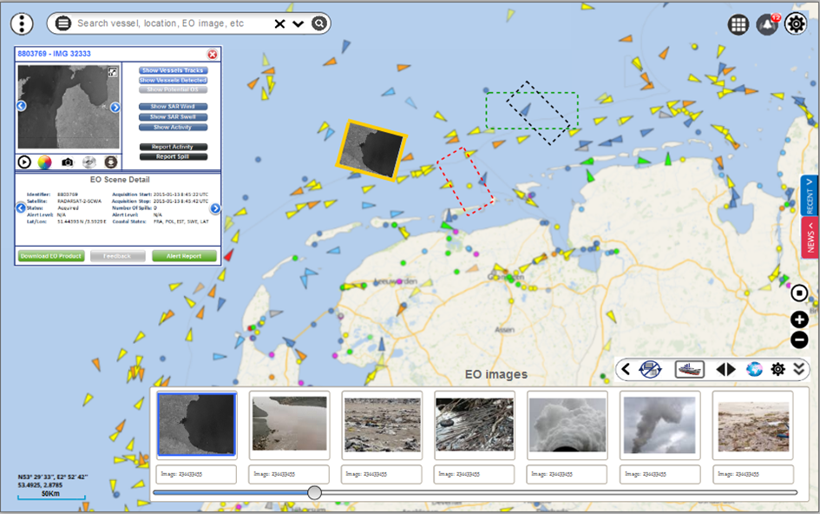
Data sharing principles & practices (1)
  EMSA is following a functional approach: the authority that fulfils the task at national level is getting the data. There is no community approach.
  EMSA is an institutional service provider.
  In case of EMSA, Member States have decided to collect, exchange and distribute data by or via the EU level: an EU Agency as a technical tool for collective data sharing, instead of bilateral exchanges at national level. All data sharing is by definition cross border.
Notes:
Topics to be presented

Slide 4
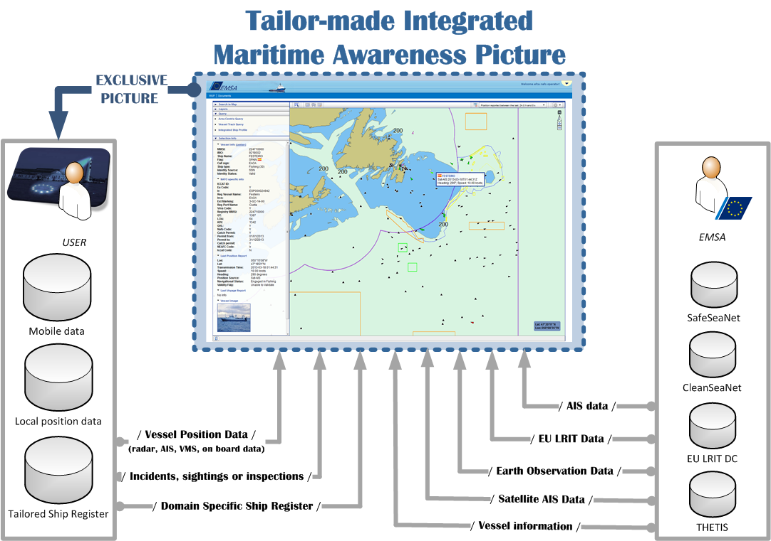
Data sharing principles & practices (2)
  “The maritime picture” does not exist. No “one size fits all” solution is provided, but tailor-made maritime pictures, including selective data for particular users (permit information, security information, local assets, local environmental conditions, etc.)
  Data sharing relates to the “maritime picture” and beyond: port notifications (80.000 per month), HAZMAT notifications (14.000 per month), HAZMAT emergencies, Port State Control inspections, other inspections of EU maritime legislation, emissions, incidents/accidents (180 reports per month), accident investigation, pollution detection, pollution response capabilities, maritime security, ship waste information
Notes:
Topics to be presented

Slide 5

Data sharing principles & practices (3)
  Information is a hybrid collection of data:
    Data (T-AIS) owned by Member States as coastal states: EMSA is system administrator or central node
    For LRIT owned by Flag States, EMSA hosts the central node for all data centres in the world (International Data Exchange - IDE)
    (Satellite) data provided by companies: liability regarding the end use of data
    LRIT regulated by IMO; responsibility for end-to-end use: LRIT data (flow) is audited by IMSO
    Direct costs associated to data: satellite imagery, LRIT position reports, SAT-AIS
    Multi-user licensing: costs depend on and increase with more users
Notes:
Topics to be presented

Slide 6
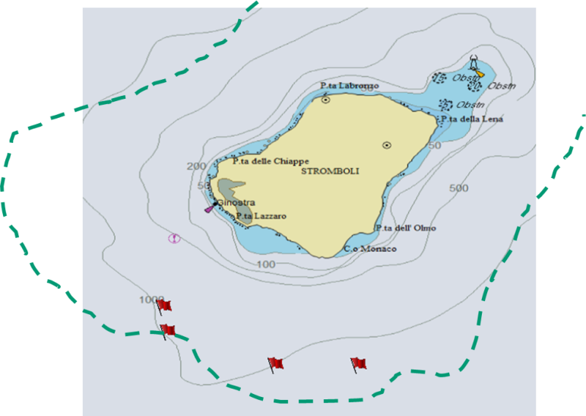
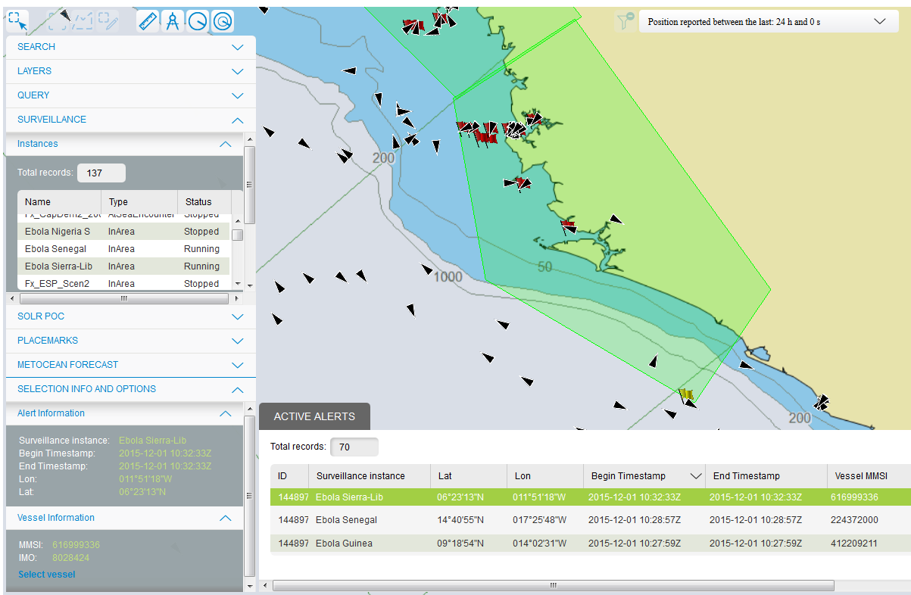
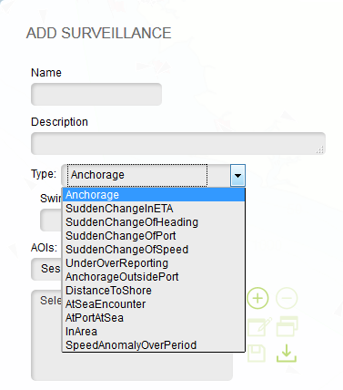
Data sharing principles & practices (4)
  Applying intelligence to the maritime picture:
  . Data fusion (e.g. ship track build from different sources)
  . Data correlation (e.g. filtering of unidentified vessels)
  . “Abnormal Behaviour Monitoring (ABM)” (algorithms to automatically detect e.g. “rendez-vous at sea”, sudden change of course, speed, in or out area, etc.
  . SAR SURPIC (Search-and-Rescue Surface Picture)
  . Analysis/probability identification of oil pollution at-sea
  . Fore- and hindcasting of oil spills (regional cooperation)
  . Forecast modelling of use of dispersants (DUET)
Notes:
Topics to be presented

Slide 7
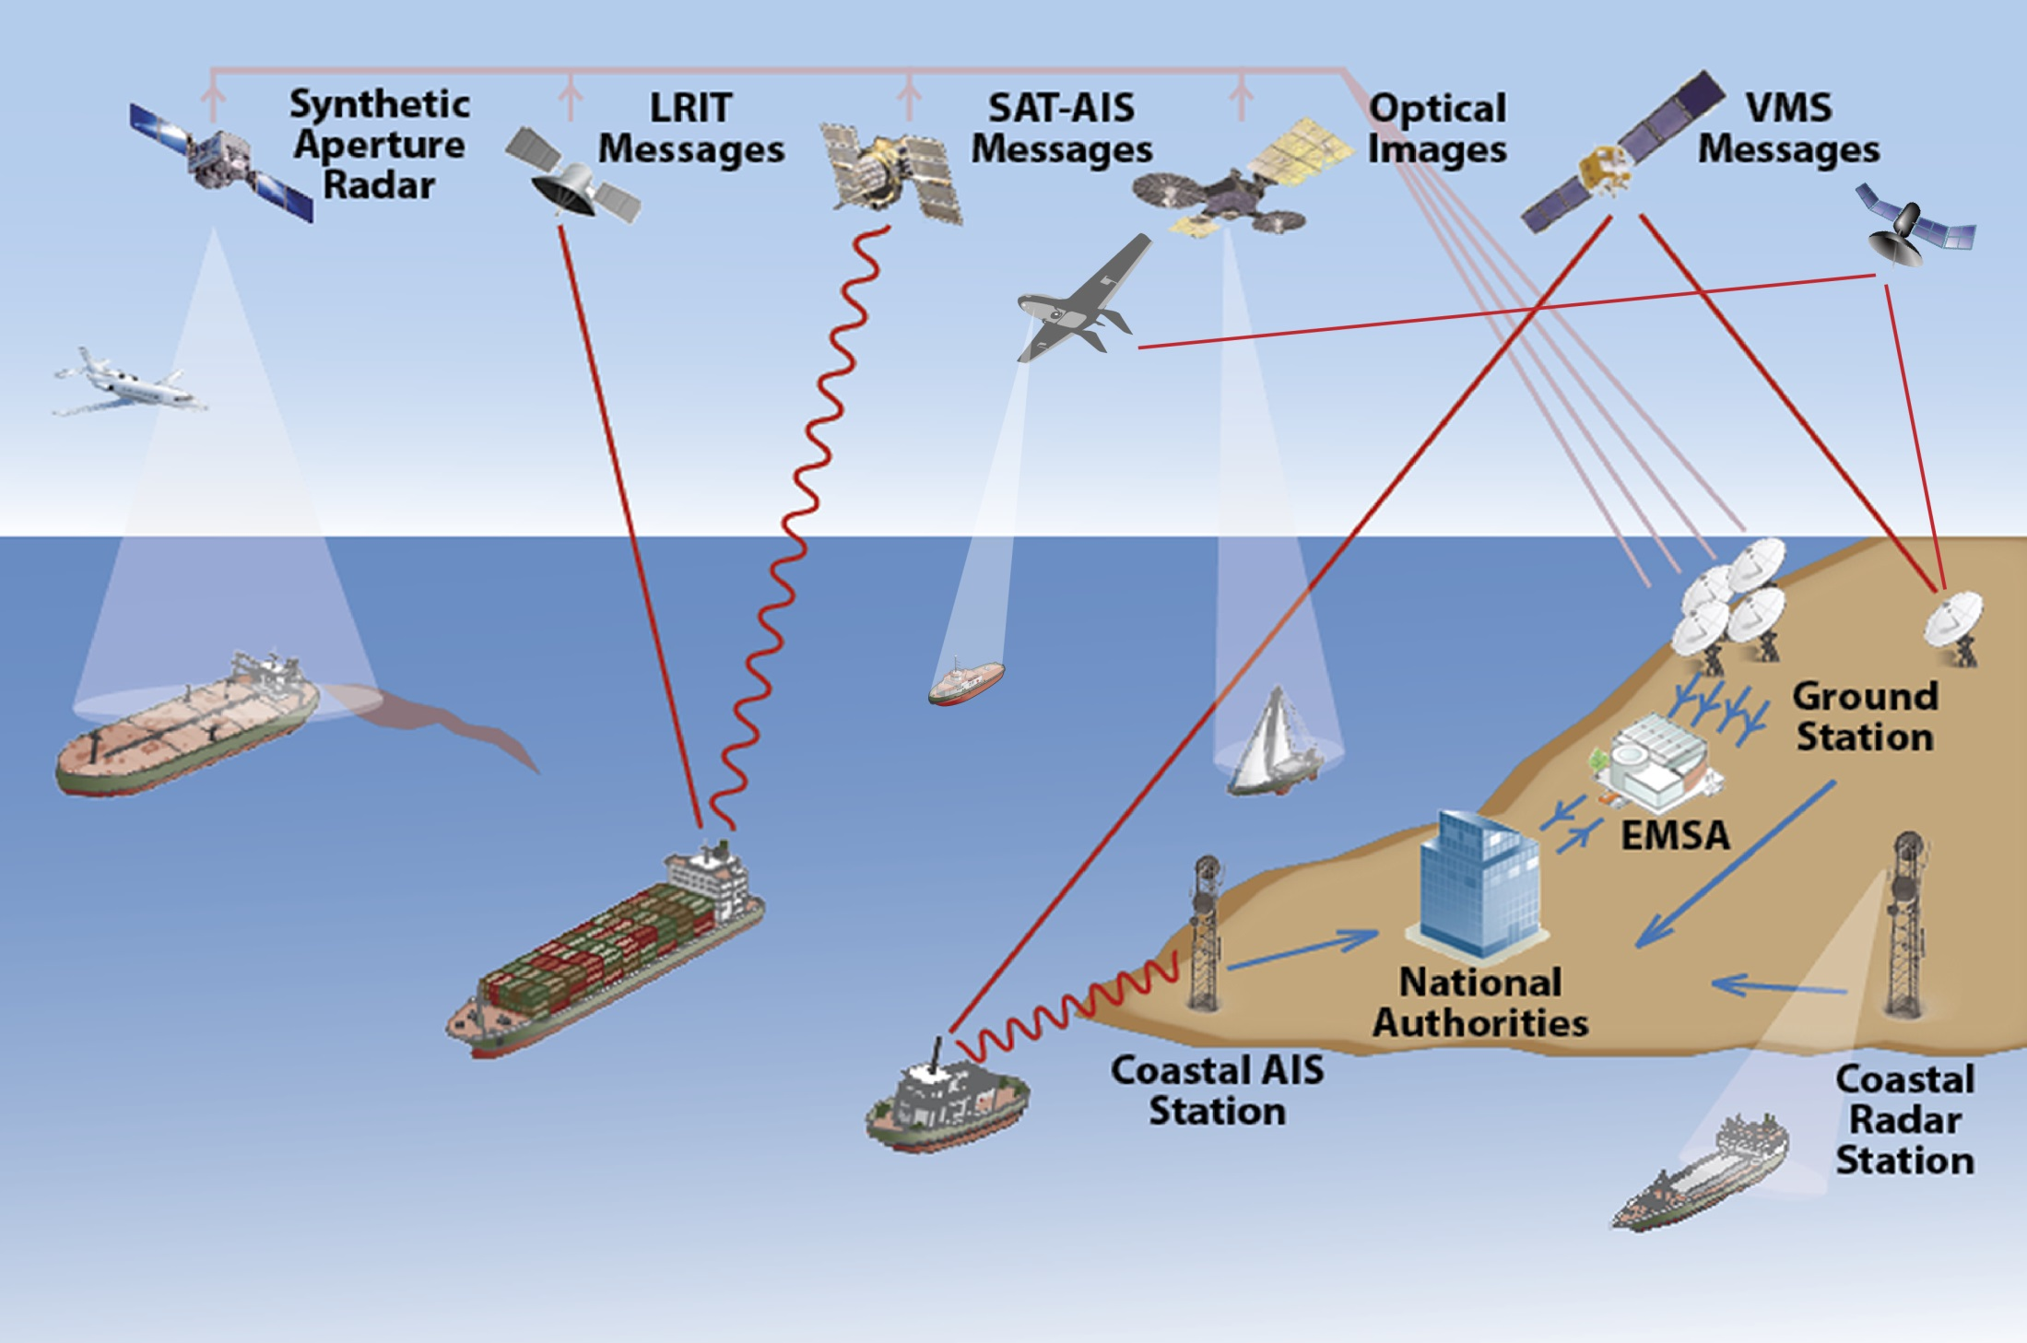
Multiple sources for the “maritime picture”
SAT-COM
RPAS

Slide 8
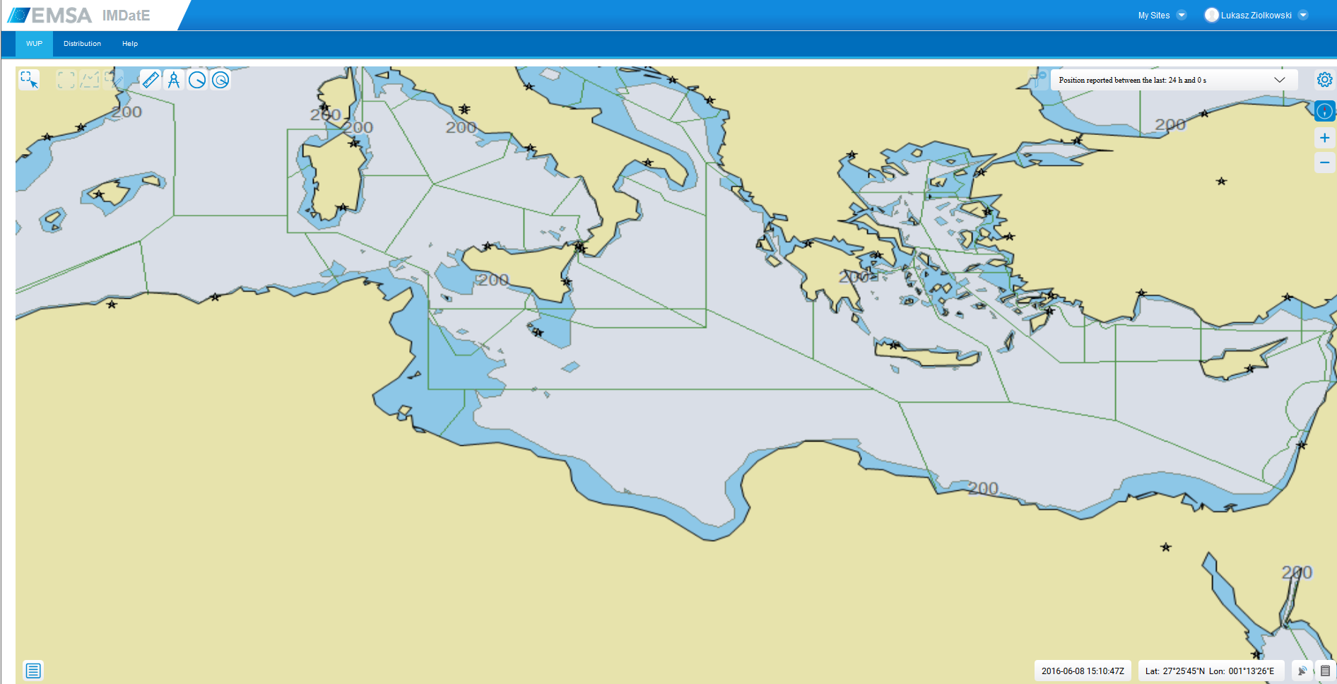
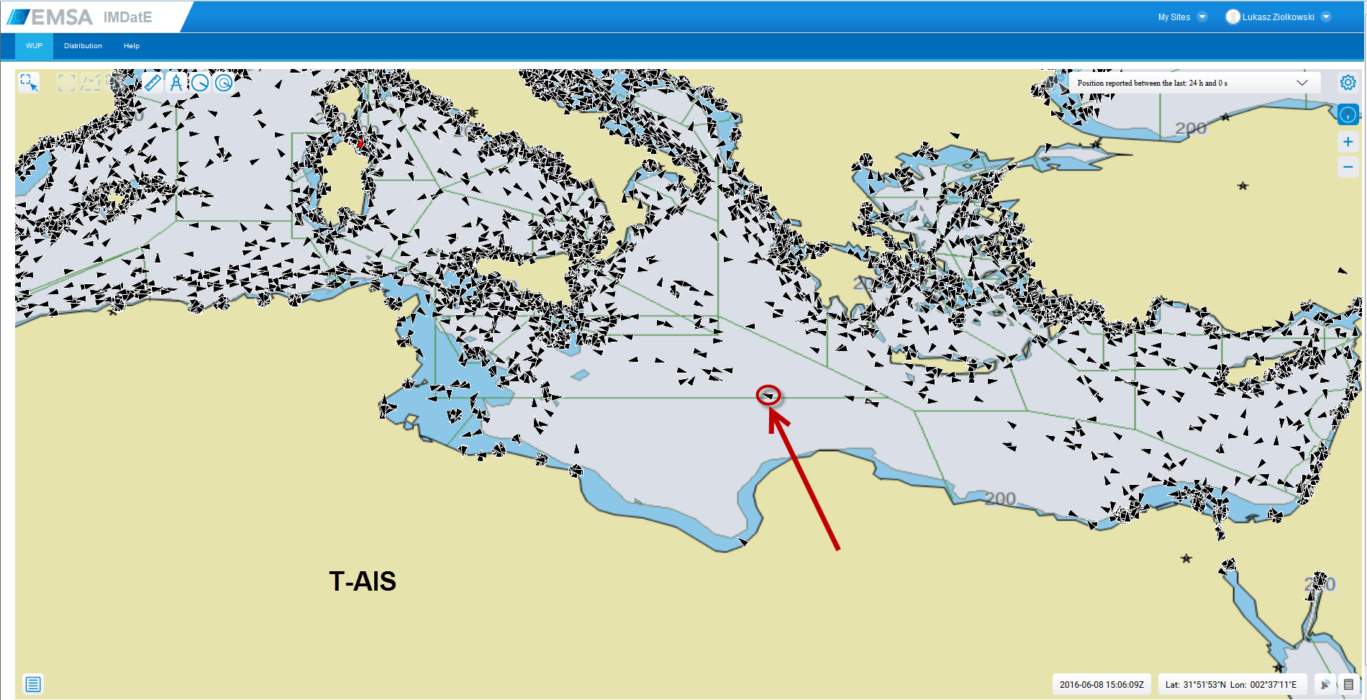
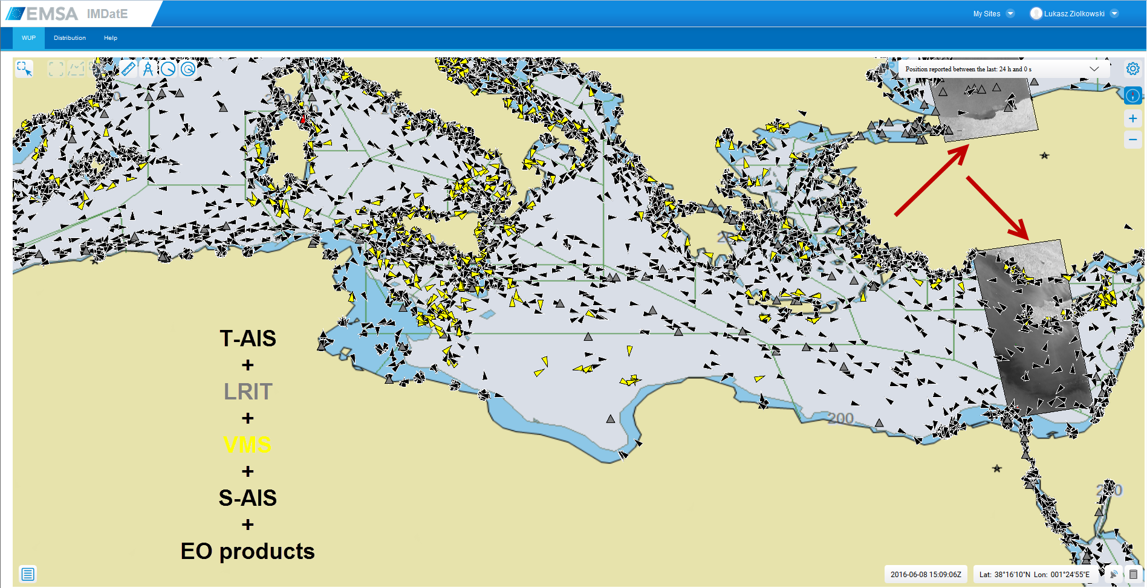
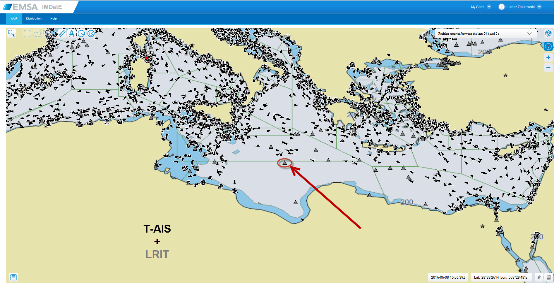
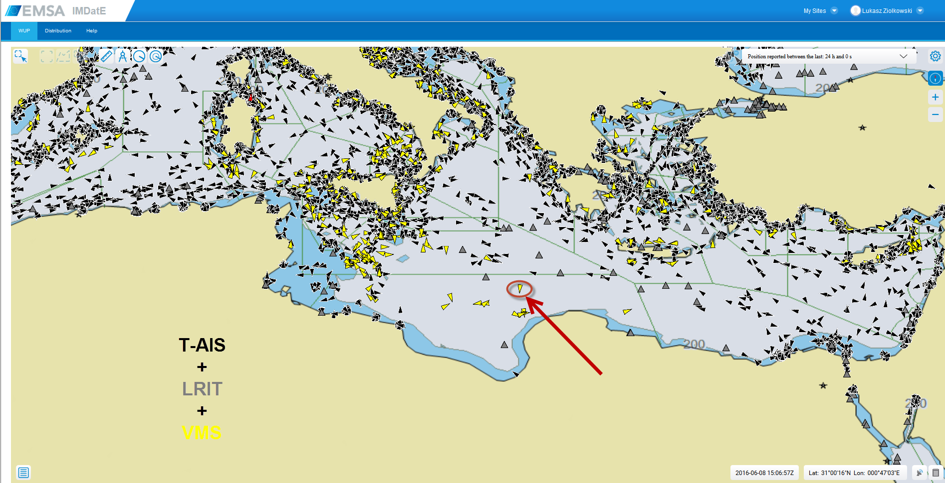
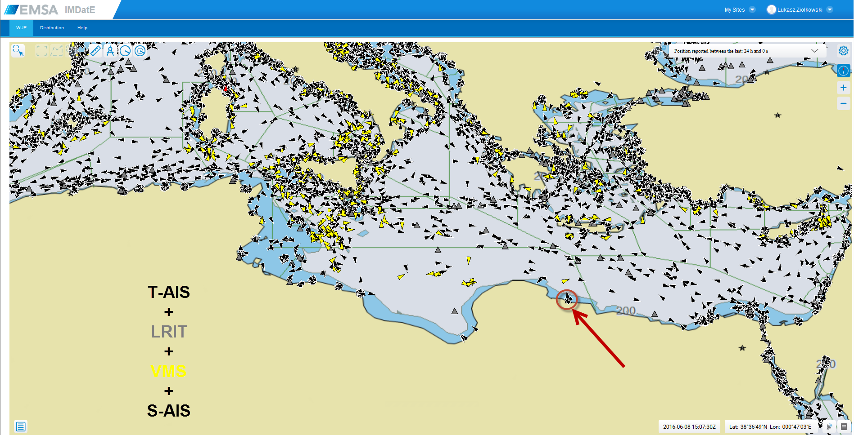
Integrated Maritime Services
  How do we integrate data?

Slide 9
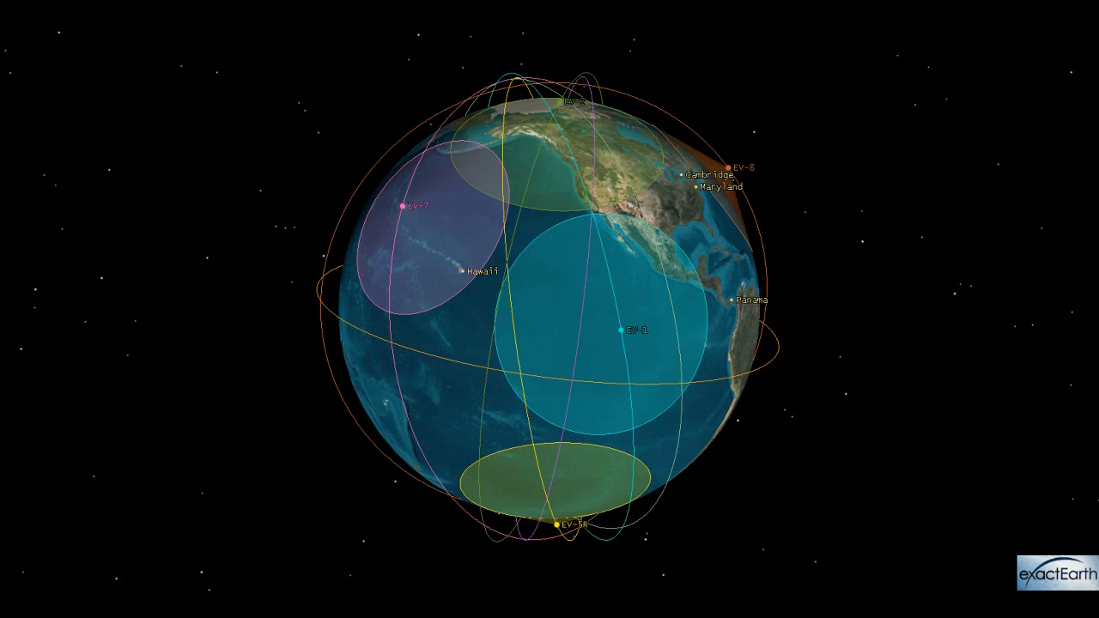
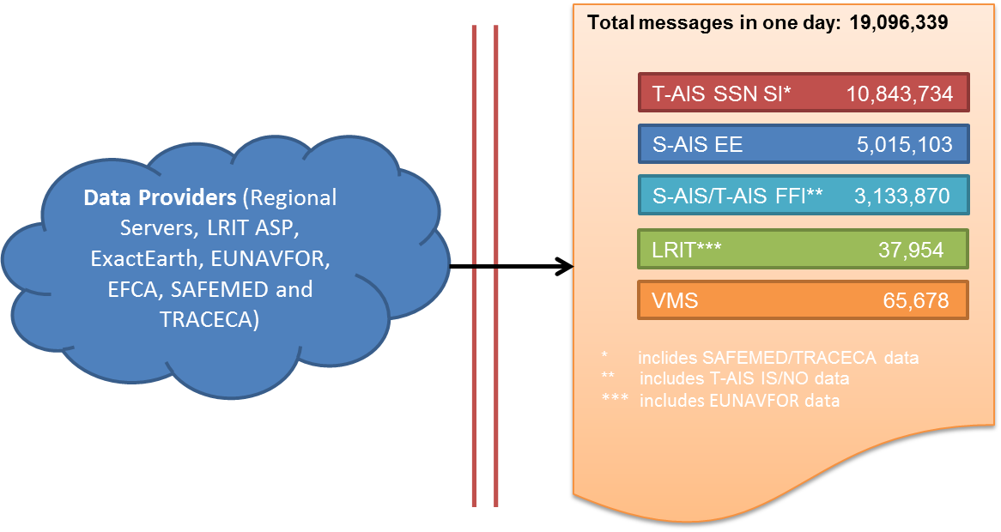
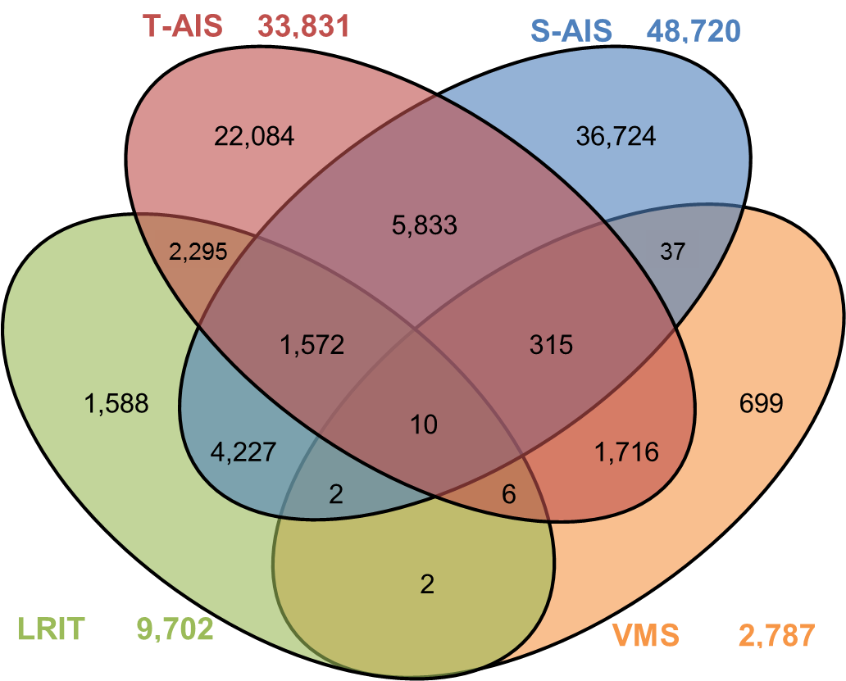
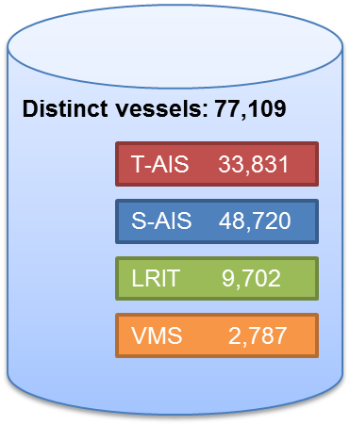
Ship positioning data on a given day
Figure 1 – Number of messages received at EMSA in one day
Figure 2 and 3 – Number distinct vessels (MMSI) detected in 1 day period per source
Information based on data received on 12 April 2016

Slide 10
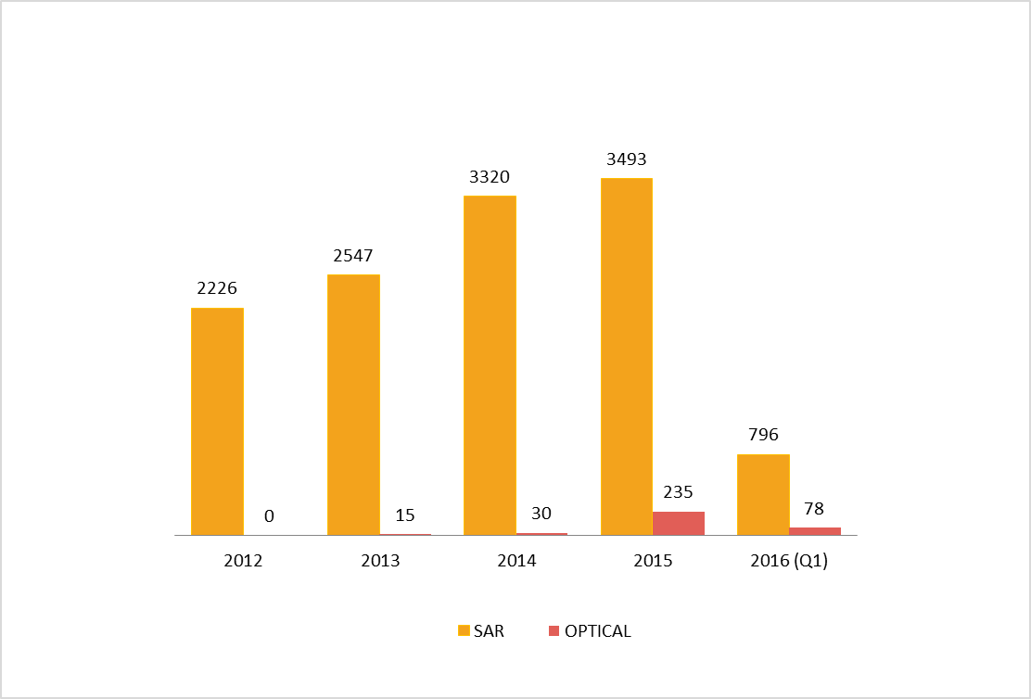
Satellite Imagery- Acquisitions
DELIVERED SATELLITE IMAGERY per year
3800*
450*
* Estimated

Slide 11
Overall distribution of IMS users
Notes:
IMPORTANT: this infographic contains data for ALL IMS services, not just for the Member State Service.

Slide 12
Users of EMSA information services
51 Countries
. EU Member States, EFTA Member States (Norway, Iceland)
. Canada, Russia (Paris MoU PSC)
. Candidate Countries (Turkey, Montenegro, Albania, etc.)
. European Neighbourhood Policy countries (Med., Black and Caspian Sea)
. European Overseas Territories and related countries (Greenland, BES, etc.)
618 Organizations (mainly Member States Authorities: Ports, MRCCs, Navies, Coast Guards, etc.)
7 989 individual user accounts (2 500 PSC and maritime legislation e-learning accounts)
approx. 5 400 individual data users
Data from 31/12/2014 (Adapted from “Inventory of EMSA services” report)

Slide 13

Access and Security
  Data sets are not classified, but are not public data. Data governed by access rights/profiles. Rights are stemming
  from legislation. Users
  are registered. National Competent Authorities attribute rights for certain sets. Commercial data protected by Conditions of Use because of intellectual property rights.
  For data access no community exists: there are 74 different access rights (excl. combinations).

Slide 14
Access and Security
Data access to EMSA systems and information is secured through:
  authentication (you are who you claim to be),
  authorisation (you are allowed to access to the resources configured for you)
  encryption (data cannot be spied upon nor changed in transit).
In case of human access this is done by using the typical Userid and password combination plus a digital certificate ensuring the encryption and server identity
In case of the machine2machine communications, in addition to the above, a second digital certificate is used to identify the user. This is called 2 way SSL (secure sockets layer)

Slide 15



Cross sector data sharing
2 user communities are covered by the EMSA mandate
  Maritime safety, security and prevention of pollution caused by ships
  Marine pollution, preparedness and response
  - DG ECHO/ERCC (SLA)
  Data sharing arrangements with other user communities:
  Fisheries control
  - MARSURV service to EFCA (SLA since 2012)
  - Coast Guard cooperation with EFCA and Frontex
  Customs
  - BlueBelt project 2012 (DG MOVE, DG TAXUD, industry)
  - eManifest project 2016-2017 (DG MOVE, DG TAXUD, industry)
  - OLAF (EU anti fraud office)
Notes:
Topics to be presented

Slide 16




Cross sector data sharing
  Border Control
  - Services to Frontex (SLA since 2013)
  - Coast Guard cooperation with Frontex and EFCA
  General law enforcement
  - MAOC-N (SLA since 2014)
  Defence
  - EU NAVFOR ATALANTA (SLA since 2011)
  - EU NAVFOR Sophia (SLA since 2015)
  - CleanSeaNet and IMS services to Navies (e.g. F and PT) (CoU)
Notes:
Topics to be presented

Slide 17
European Maritime Single Window
(EU SW) Prototype
Previous Project (2014-2015):
  National Single Window Prototype
  To support implementation of Reporting Formalities Directive
  Closed
New Project (2016-2017):
  European Maritime Single Window prototype
  Enhance previous NSW prototype
  Include cargo formalities (as part of eManifest pilot project)
  14 Member States actively contributing
  (e.g. User requirements)
  Other Initiative
  Co-operation with Eurostat to developing pilot projects on NSW / SSN could be used to support EU maritime statistics
17

Slide 18
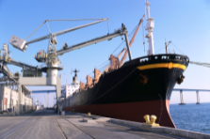
Data reporting interfaces
Ship data providers submit the information via:
System Interface (XML, Web Services)
Web user interface
Spreadsheet files
Relevant information is distributed to each authority
Ship Data Provider
Customs
Notification
Security
Border control
XML
WEB
XLS
MSW
Health
WEB
Maritime Safety
Port authority
…
18

Slide 19
Schedule
Success of the pilot project depends on active participation by Commission, Member States maritime and customs authorities and industry stakeholders:
  Consultations are being carried out during meetings and correspondence – 2 meetings held
  A second phase will depend on results of first phase and decisions taken during the Evaluation of the first phase
Activities – First phase | Target date
Definition of project scope, business rules, process and data model | January/March 2016
Definition of project specifications | April/May 2016
Design and development of prototype | June/September 2016
Operational Testing – all stakeholders | October/December 2016
Evaluation – conclusions and recommendations | January/February 2017

Slide 20
Governance
CISE concept for 2020
Governance unknown, “voluntary process”?
How will user rights be respected and controlled?
Will there be cost sharing for data and SW developments (algorithms)?
Data contribution: quid pro quo
Existing cooperation
Governance is improved with the Commission’s new High Level Steering Group for Maritime Systems and Services
Legal basis for increased interagency cooperation (between EMSA-Frontex-EFCA) with adoption of the border package

Slide 21
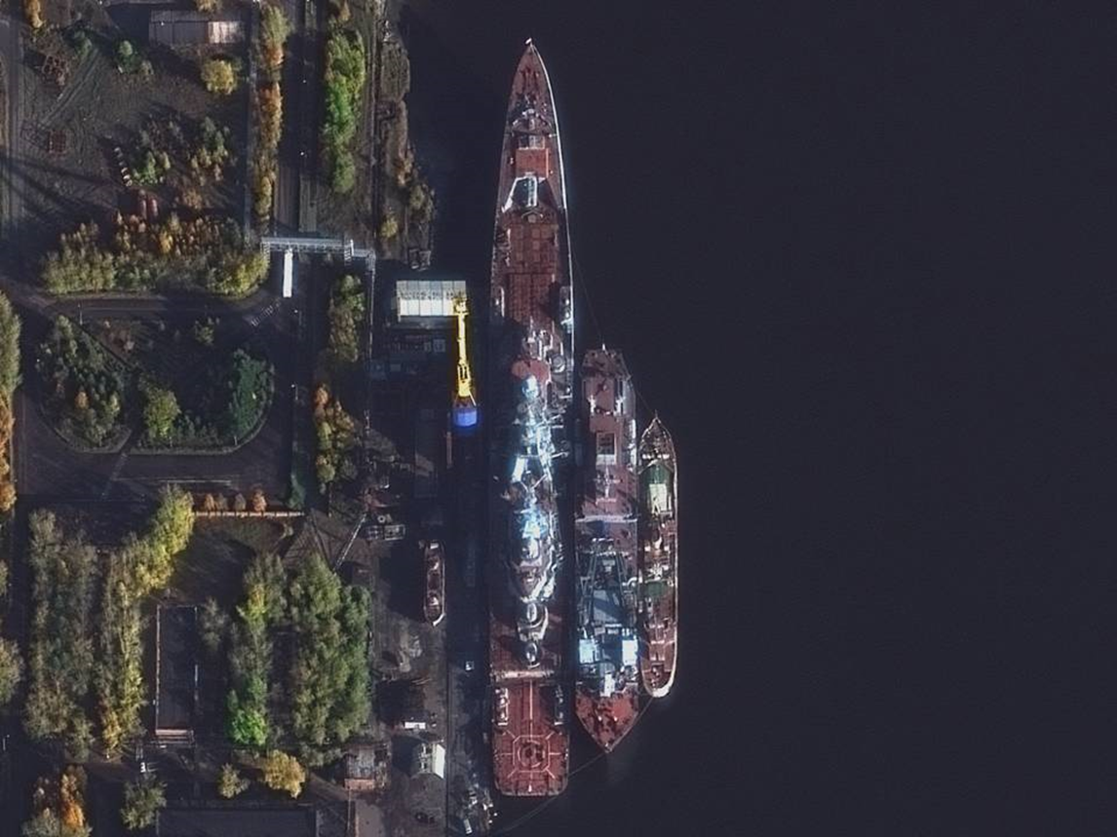
emsa.europa.eu

