Slide 1

Bruxelles, June 19 2012 THE MARINE OBSERVATION AND DATA EXPERT GROUP
http://www.magicproject.it
Aims, state, and future perspectives of the Magic Project
5 years geohazard project (2007-2012) involving the whole Italian Marine Geology scientific community

Slide 2

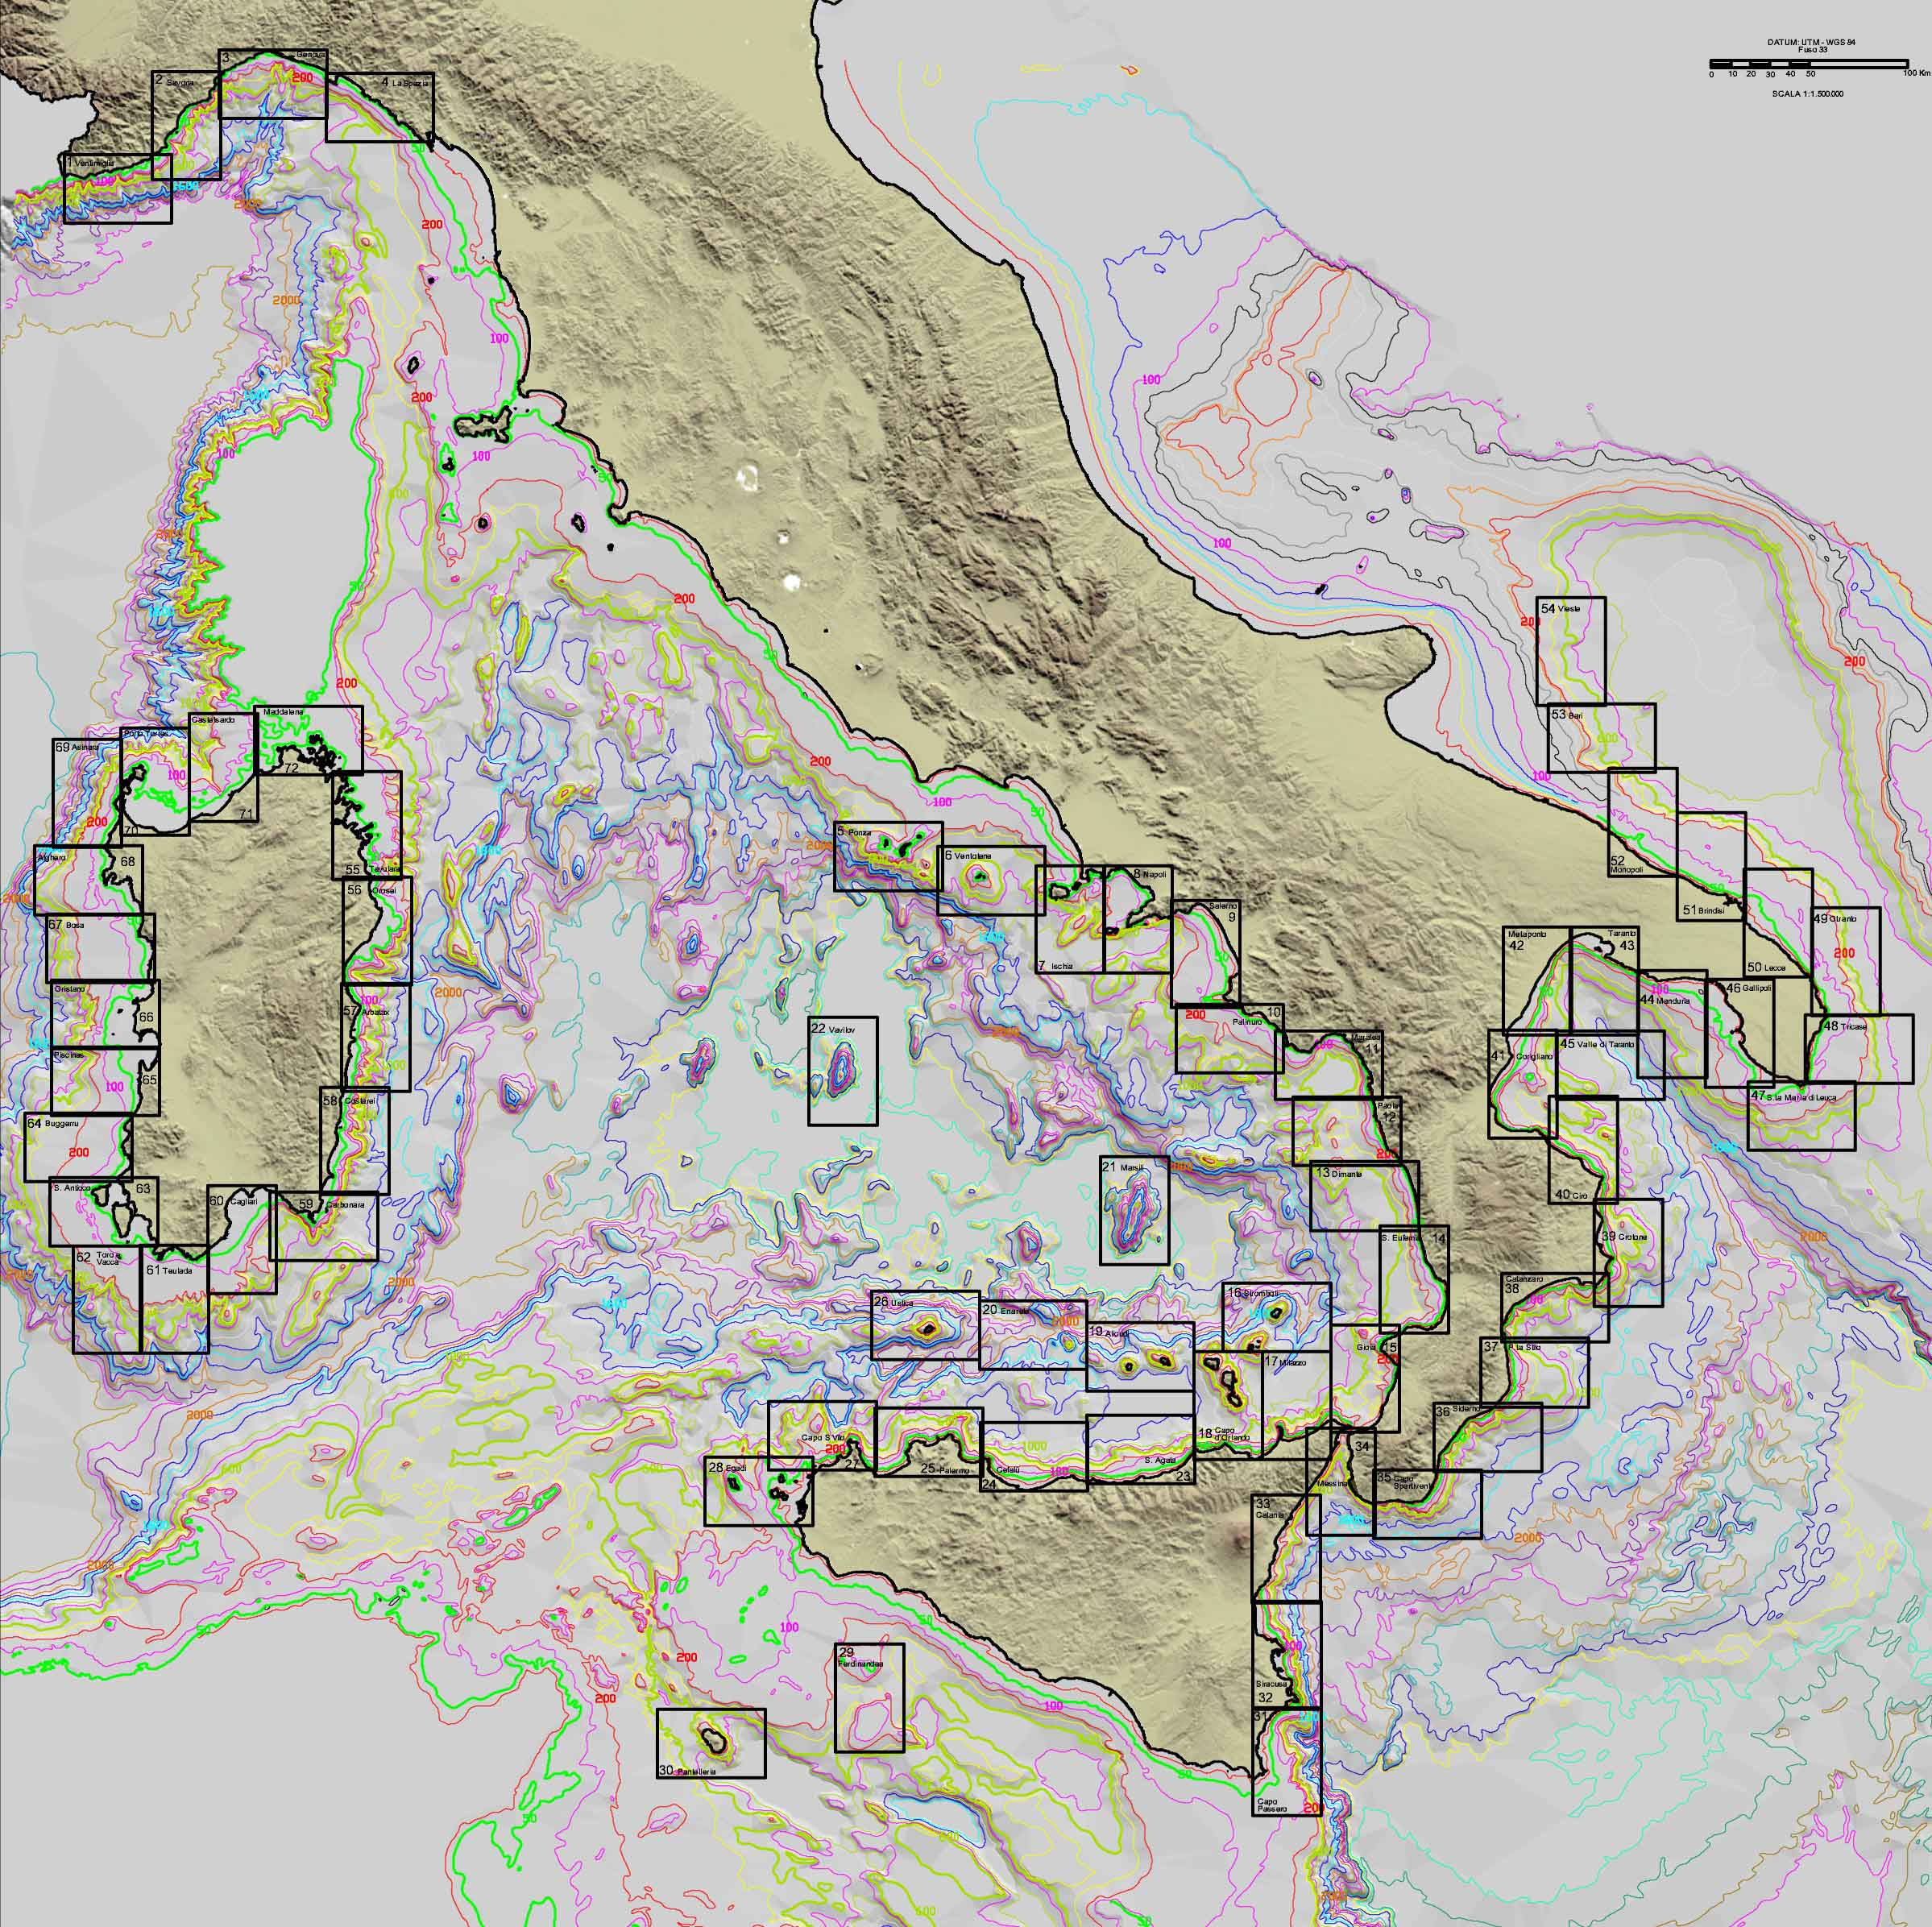


MAGIC project: MArine Geohazard along the Italian Coasts
Multibeam mapping (1:50.000)
of most of the Italian margins
In the depth range 50-500m
5-year period:
December 2007-December 2012
Funded by the Italian Civil
Protection Department (DPC)
Aims of the Project:
provide DPC a basic tool for monitoring
and managing marine geohazards and risk
5.25 M€ direct funding +
2 M€ ship-time CNR co-financing
The whole Italian Marine Geology scientific community is involved in the project

Slide 3

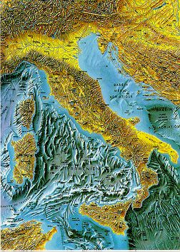

CNR Roma - Istituto di
Geologia Ambientale e Geoingegneria
CNR Bologna - Istituto per le Scienze del Mare
CNR Napoli - Istituto per l’Ambiente Marino e Costiero
Università di Genova
Università di Trieste
Università di Roma
“La Sapienza”
Università di Palermo
Università di Cagliari
Università di Milano Bicocca
Università di Sassari
Università del Sannio
Ist. Naz. Oceanografia
e Geofisica Sperimentale,
Trieste

Slide 4
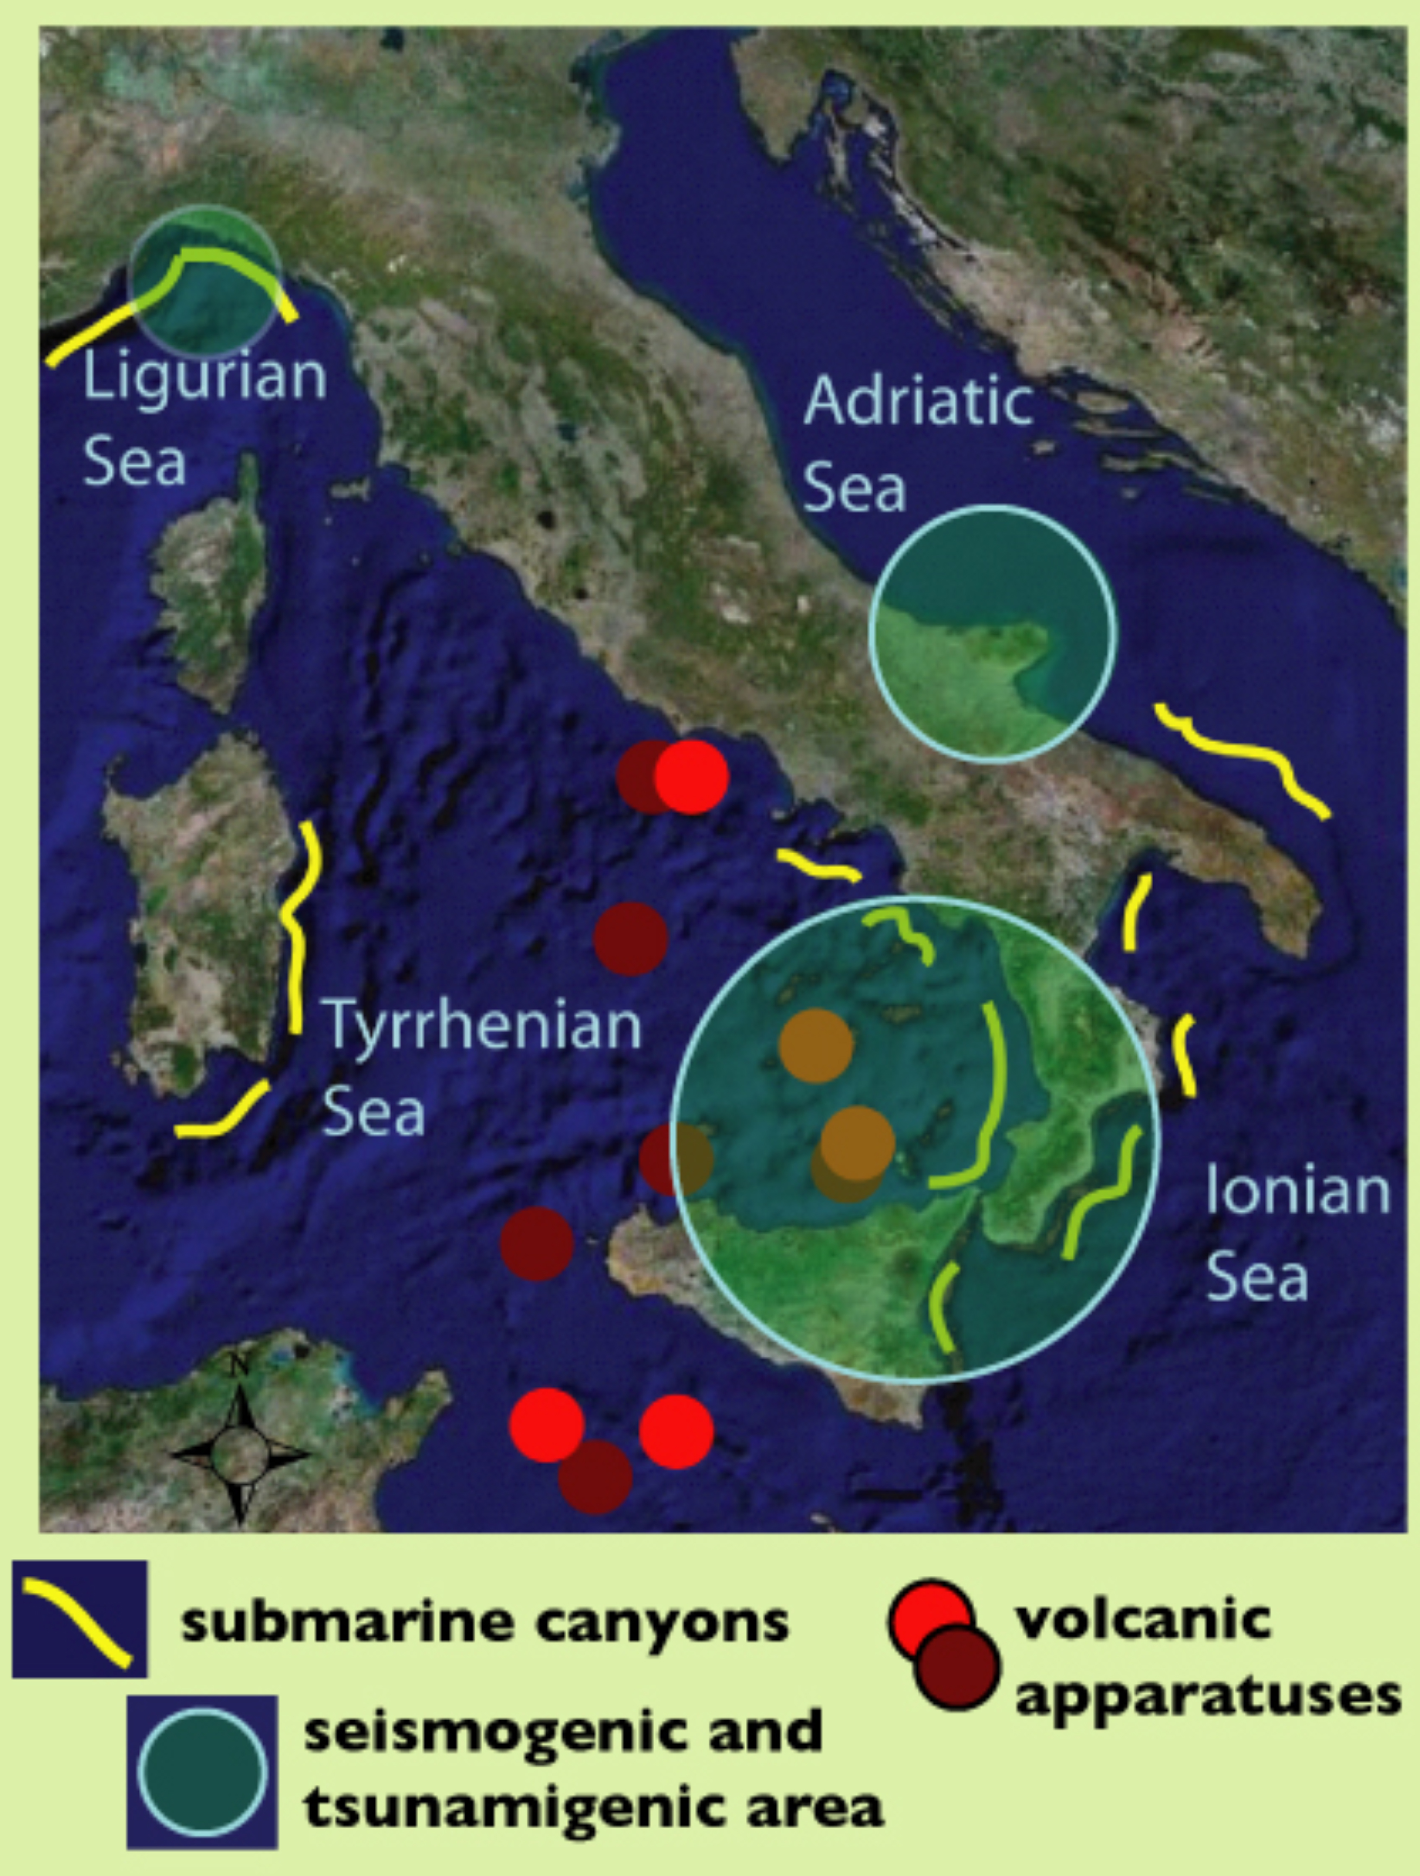
MAGIC project: MArine Geohazard along the Italian Coasts
Tyrrhenian basin and Sicily Channel:
Volcanic activity
Strong seismicity
Ionian and South Adriatic:
Fault systems related with tectonic deformation and seismicity on land
All margins:
Canyon incision and sediment instability

Slide 5
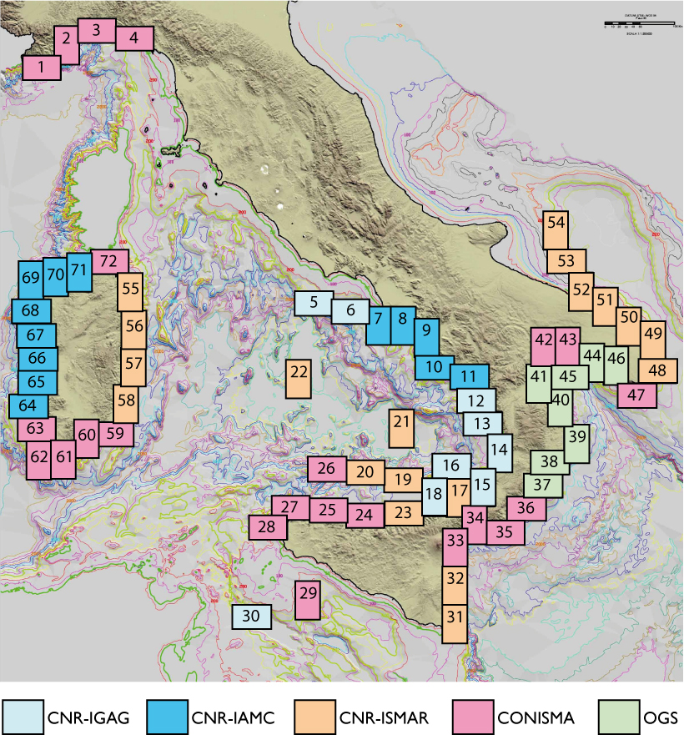

MAGIC project: MArine Geohazard along the Italian Coasts
Project Partners
CNR (Consiglio Nazionale delle Ricerche)
- IGAG Istituto per la Geologia Ambientale e Geoingegneria - Roma
- ISMAR Istituto per le Scienze Marine - Bologna
- IAMC Istituto per l’Ambiente Marino e Costiero - Napoli
CoNISMa (Consorzio Nazionale Interuniversitario per le Scienze del Mare)
- University of Genova
- University of Trieste
- University of Rome Sapienza
- University of Palermo
- University of Cagliari
- University of Sassari
- University of Milano - Bicocca
- University of Sannio (Benevento)
OGS Istituto Nazionale di Oceanografia e Geofisica Sperimentale - Trieste
Main Contractor CNR-IGAG, Rome
Project Leader: Prof. Francesco L. Chiocci
University of Rome La Sapienza – CNR IGAG

Slide 6
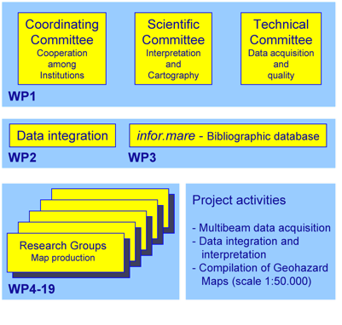
MAGIC project: MArine Geohazard along the Italian Coasts
Structure of the project
Each sheet is under responsibility of one of the 15 research groups, whose leaders form the Scientific Committee.
Apart from shiptime (2/3), funding is mainly devoted to fellowships and contract of young researchers .
Interpretation criteria and processing procedures are defined by collaborative approach in the committees
Respect of timetable, processing procedures, interpretation criteria is centralised at the
CNR-IGAG Rome Institute

Slide 7
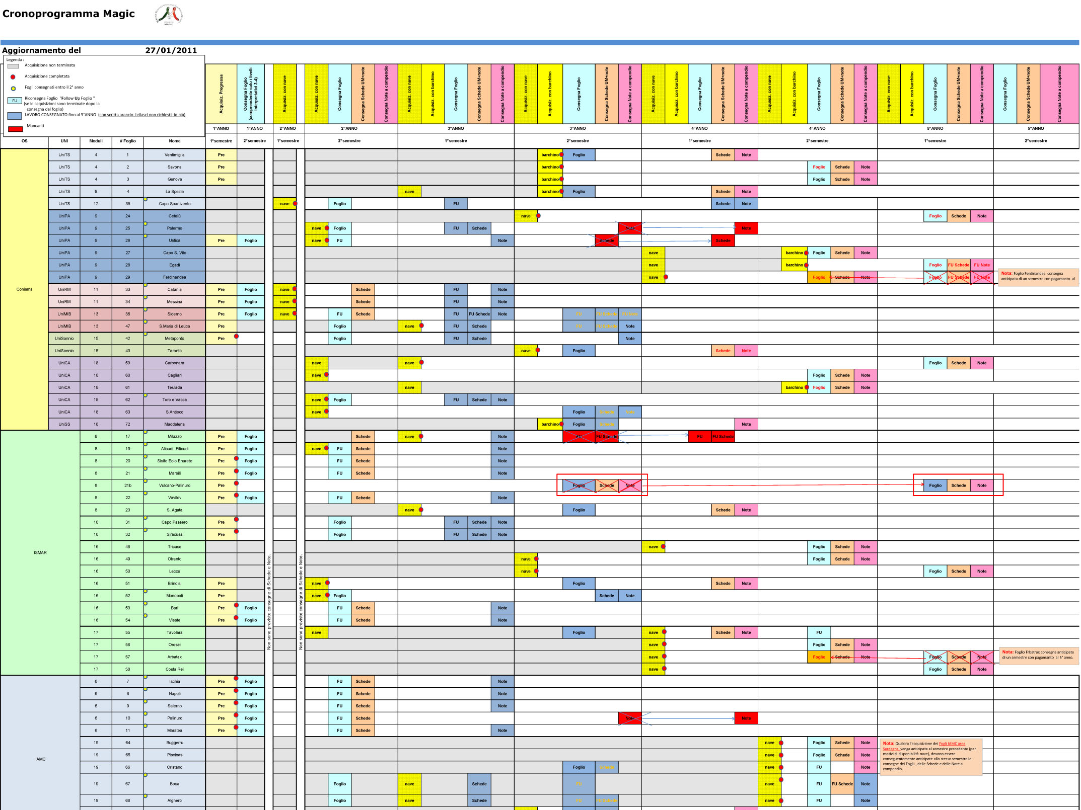
All the project milestones have been timely accomplished so far;
All the deliverables will be ready by the end of the project

Slide 8
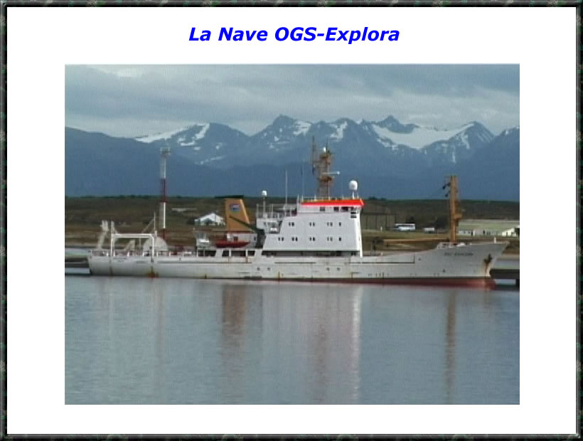
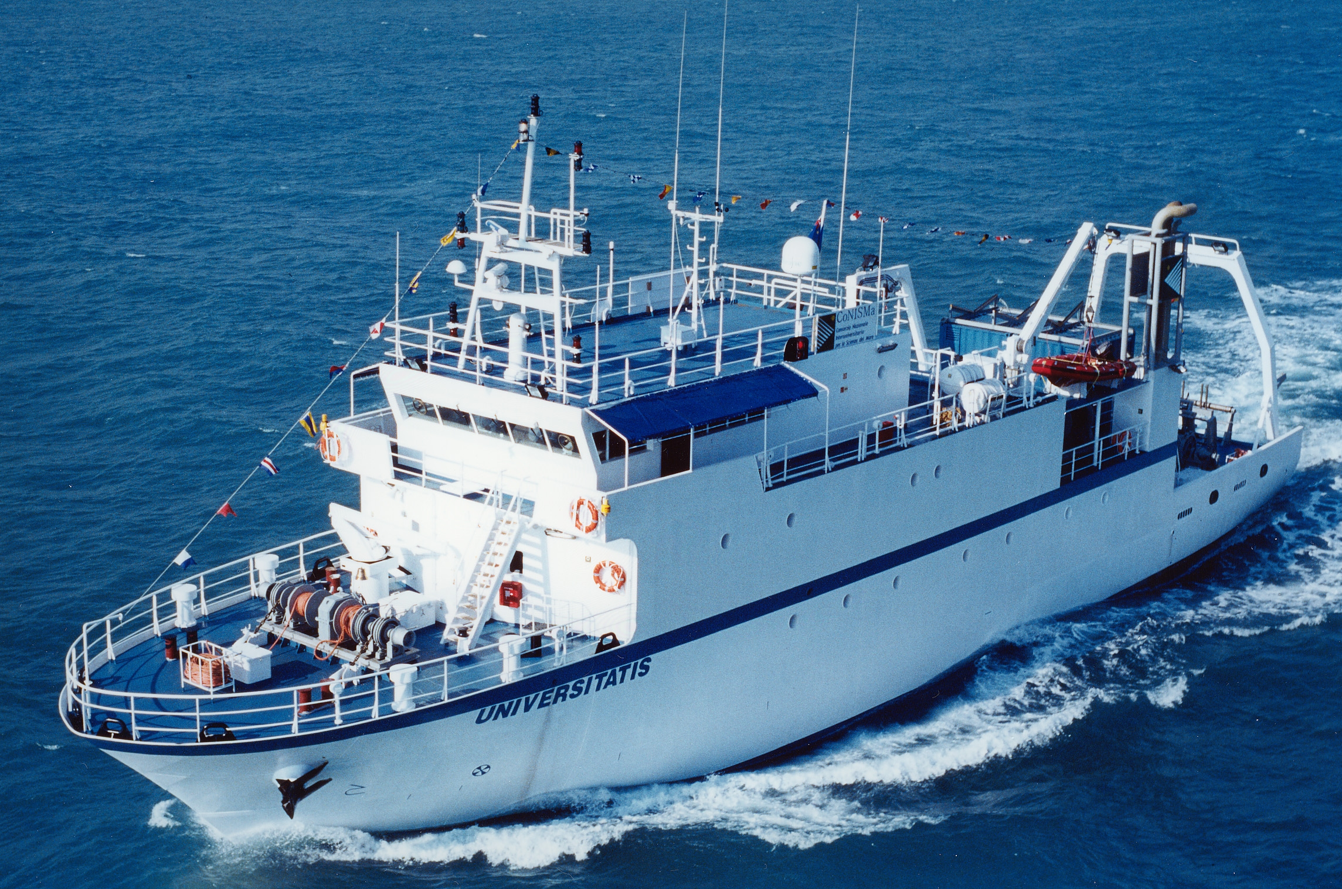
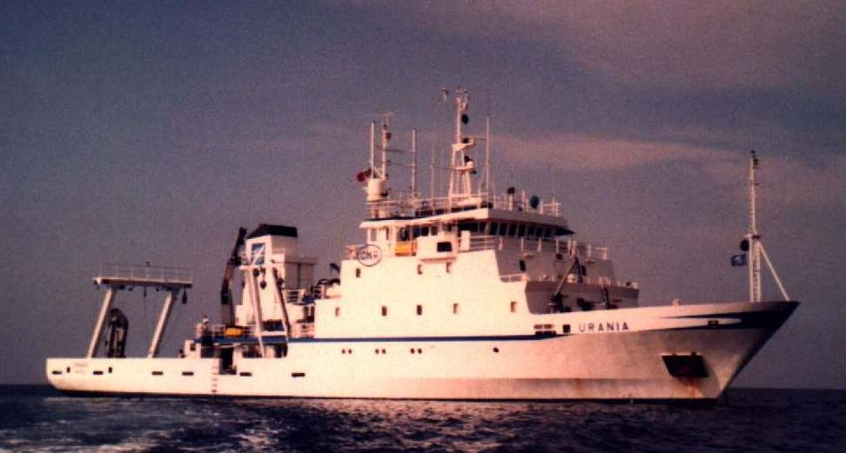
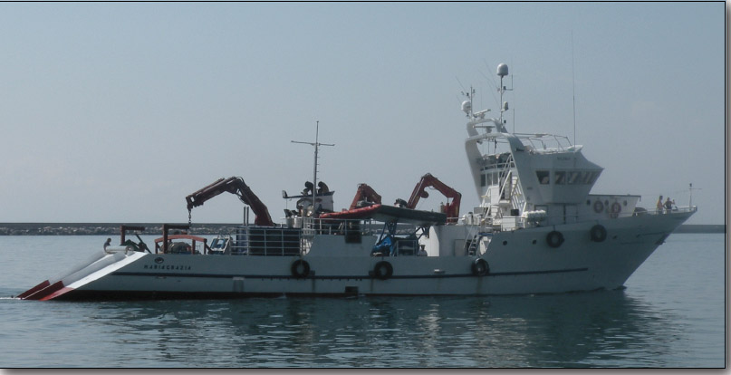
N/O Universitatis (CoNISMa)
700TS 45m
100 kHz, 25-1000 m
12-24 kHz, 100-8000 m
450 kHz, 0-120m
50 kHz, 50-2600m
N/O Explora (OGS)
1400TS 72m
N/O Urania (CNR)
1000TS 61m
N/O Thethis (CNR)
N/O Maria Grazia (CNR)
450 kHz, 0-120m
100 kHz, 25-1000 m
50 kHz, 50-2600m
BUT THE COST IS WATER DEPTH DEPENDENT

Slide 9
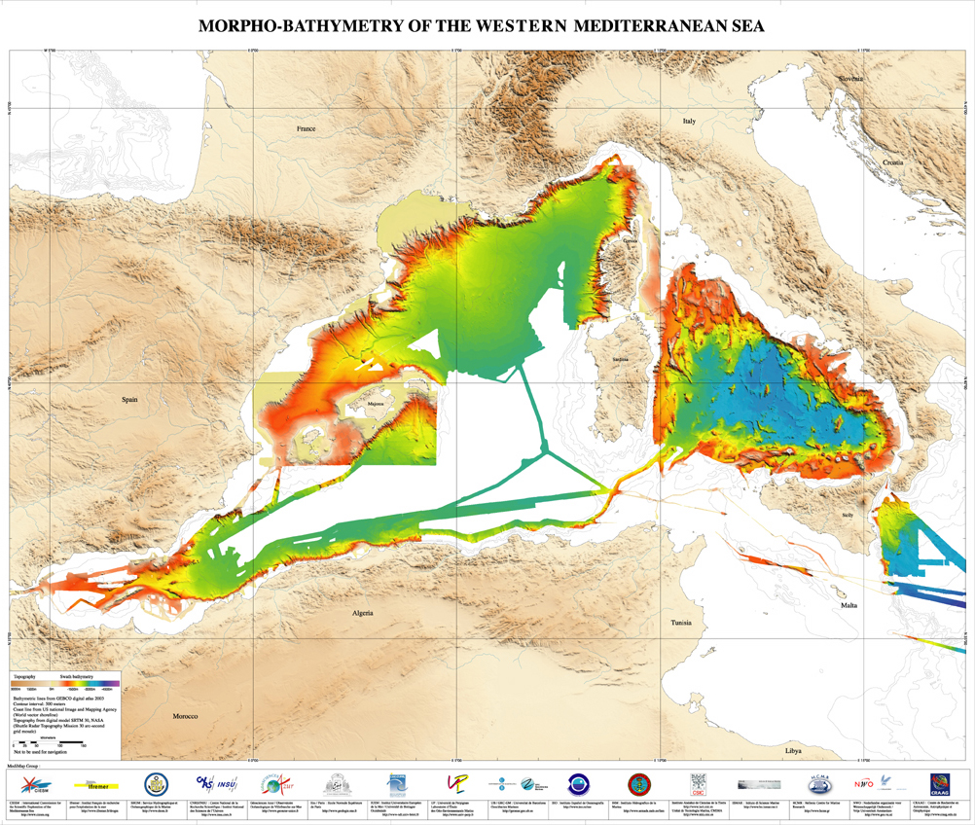
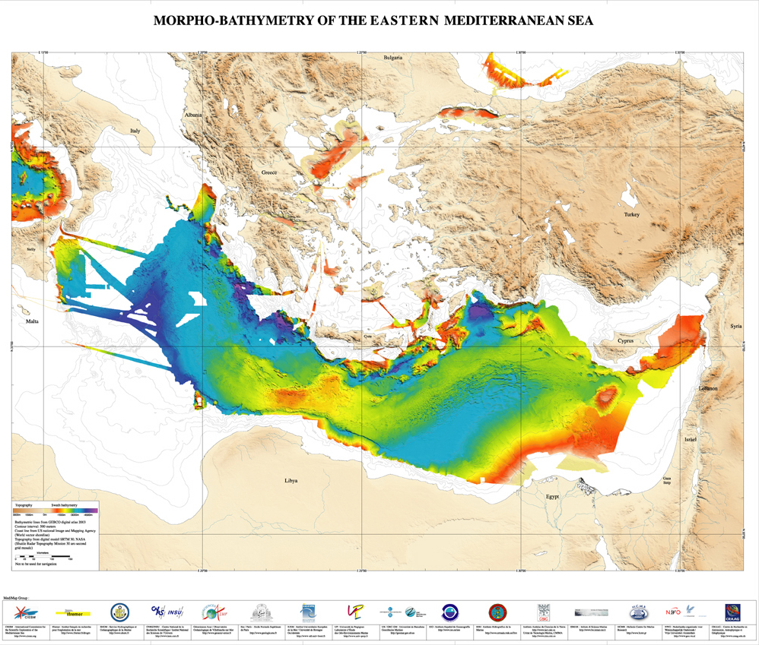
MEDIMAP/CIESM
Ifremer-Brest
ISMAR-CNR Bologna
CNRS-Insu
Universitat de Barcelona
Universitat de Madrid
Universidad de Granada
Universiteit Amsterdam3
Unitat de Tecnologia Marina, CMIMA/CSIC, Barcelona.
Eurostrataform, Eurodelta and Eurodom
ESF Eurocores projects
West-Med and Spacoma
Spanish RTD projects
Grandes and Prodelta

Slide 10
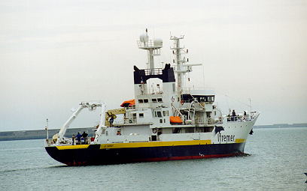
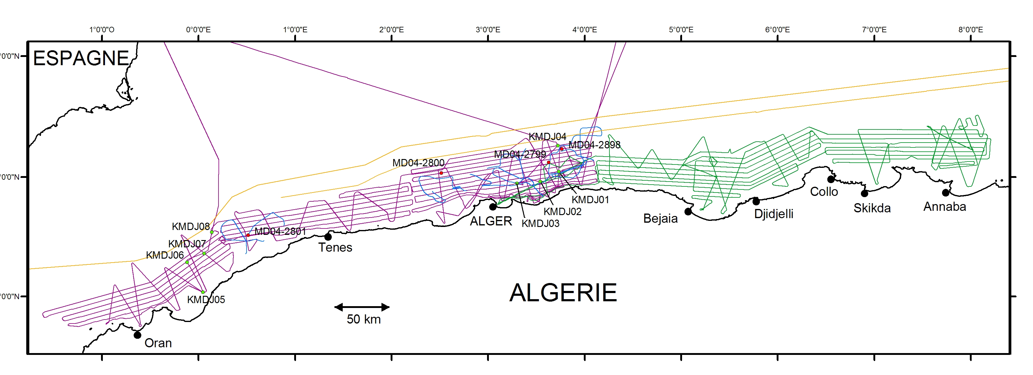
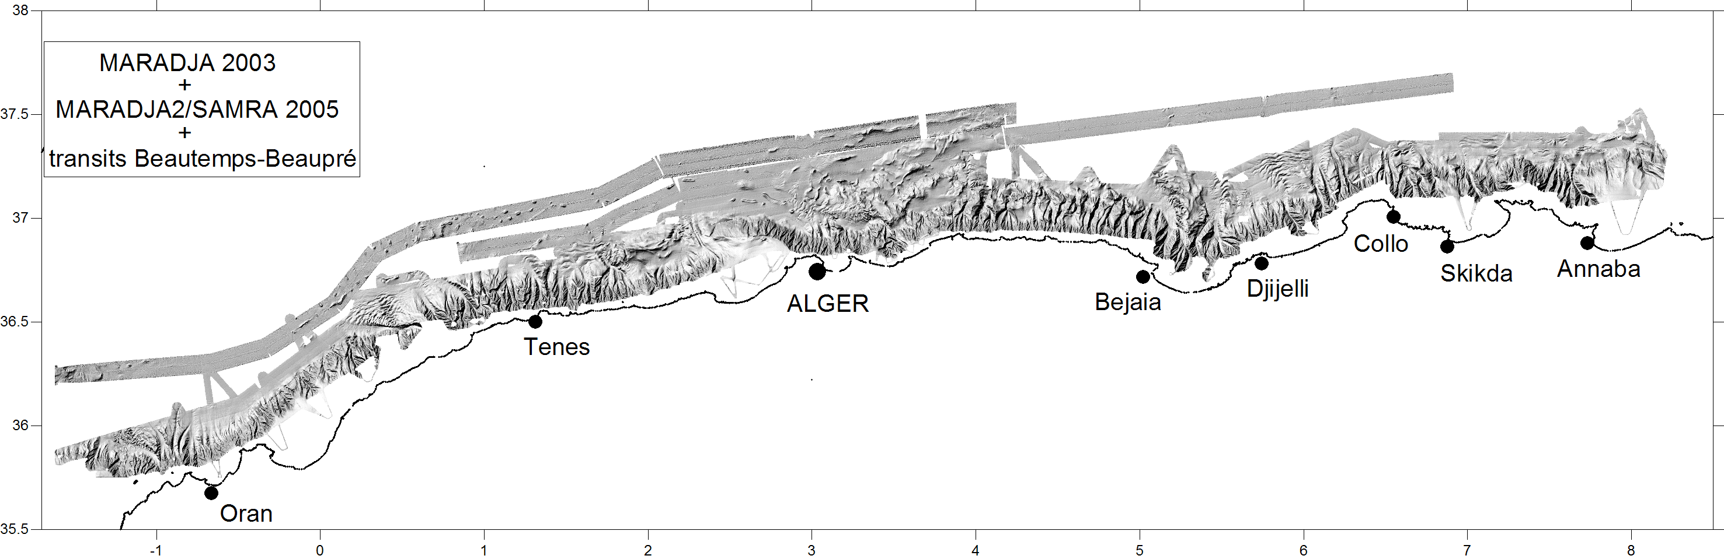
Algeria: Cruises MARADJA 2003 - 2005

Slide 11
Shiptime/water-depth relationship for full seafloor coverage
Cost (€/km²)
Depth
Water depth 10m = 5,5km²/day
100m = 55 km² /day
1000m = 550 km² /day

Slide 12
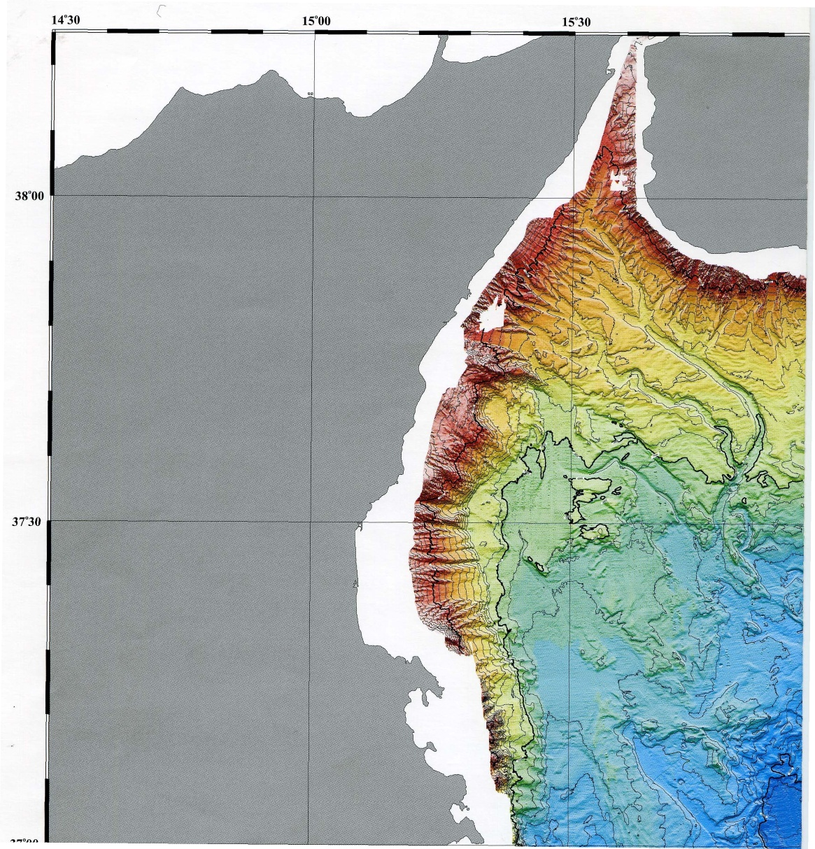
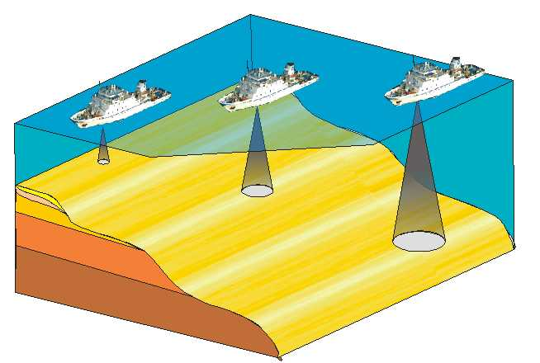
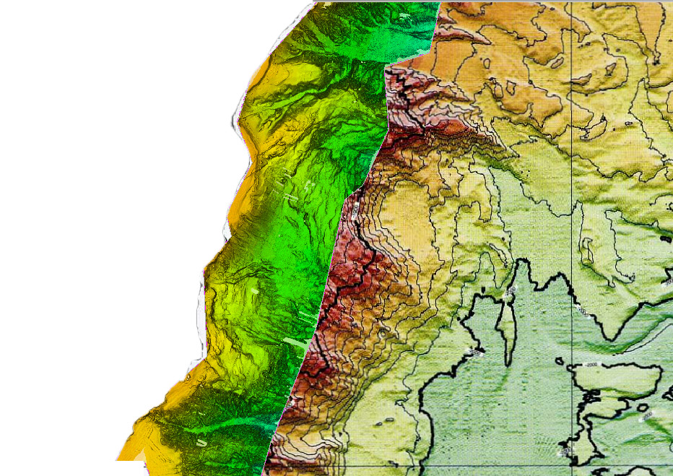
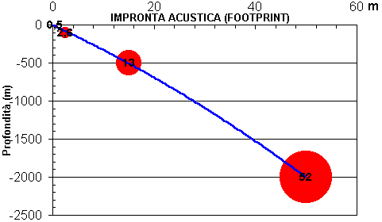
50km
Seafloor coverage for one shiptime day (24h) of data acquisition
1000
100
2000
10
Ionian
Sea
3000
Water depth
Marani et al., 2004

Slide 13
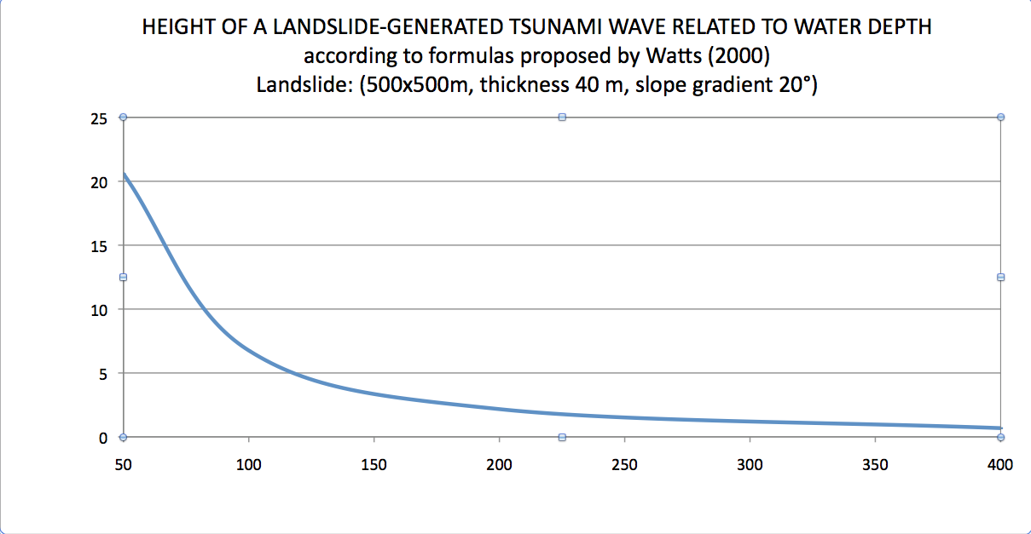
wave height .
cost (euro/km²) .
water depth
water depth
BUT IF THE COST IS WATER DEPTH DEPENDENT,
THE RISK IS WATER DEPTH DEPENDENT AS WELL ….

Slide 14
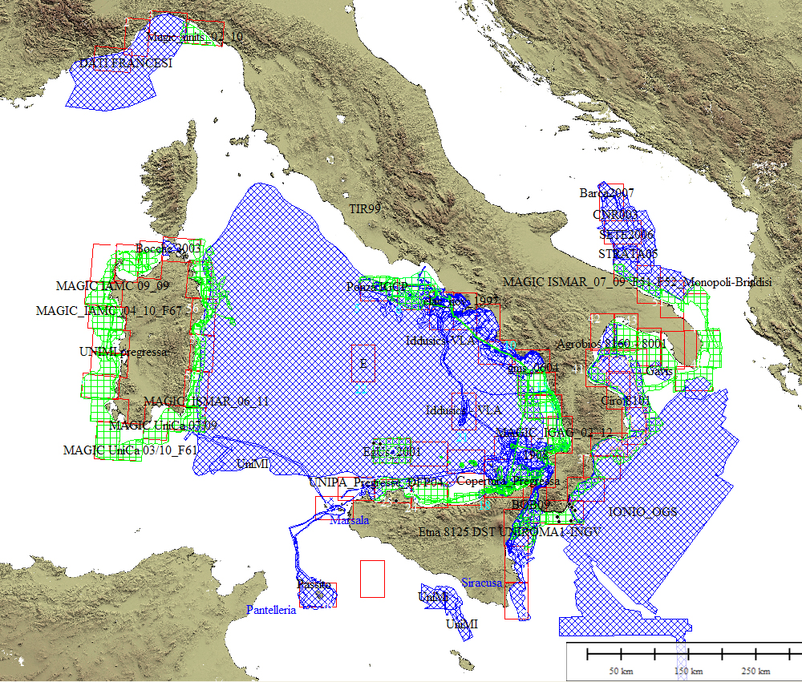
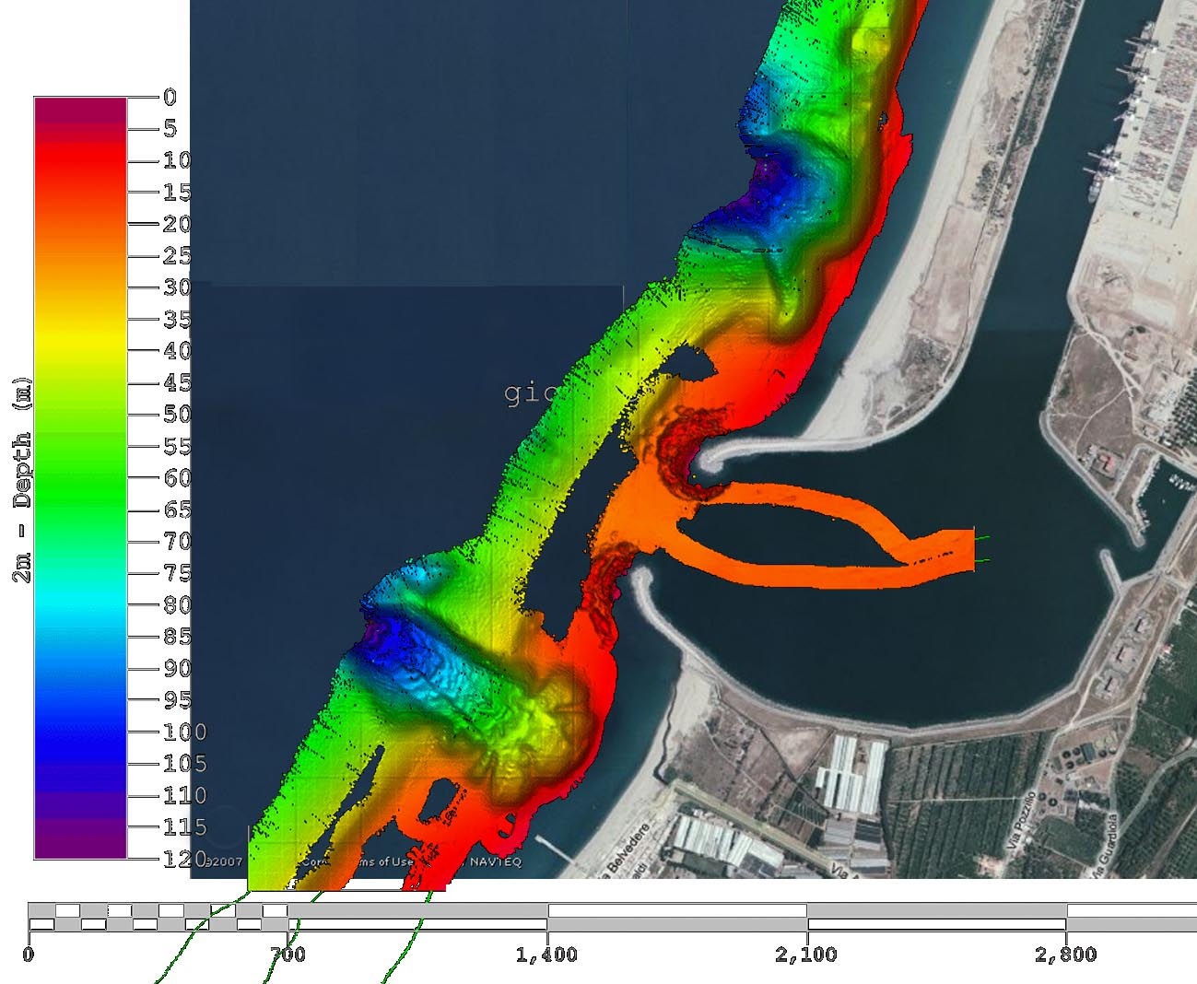
Therefore MaGIC project acquired data along the more geologically active continental margins, with a reference depth range between 50-500m.
It can be extended to deeper water if time allows (low-cost) and to shallow water if needed (e.g. canyon head)
It can be narrowed to outer shelf if not relevant features are present
12/7/1977
Landslide 5.5 Mm³
Tsunami wave Hmax=5m

Slide 15




Goals of MaGIC project:
1) To realise the Map of Geohazard features of the Italian Seas (72 sheets, 1:50.000)
2) To create a high-resolution bathymetric database
3) To create a database of maps from scientific literature (infor.mare sub-project)
INTEREST FOR CIVIL PROTECTION
To identify areas with high risk, hypothesise causes and manage operations during emergencies, land planning (?)
Managing emergencies understanding of what happened
Quick identification of state of knowledge and competencies in a given area
FALL OUT FOR SCIENTIFIC RESERACH
Understand, by comparing features and interpretations, mass wasting processes in our tectonically active country
Quadruplication of the amount of multibeam data acquired until now, needed base for any scientific study
Previous knowledge synthesis tool

Slide 16
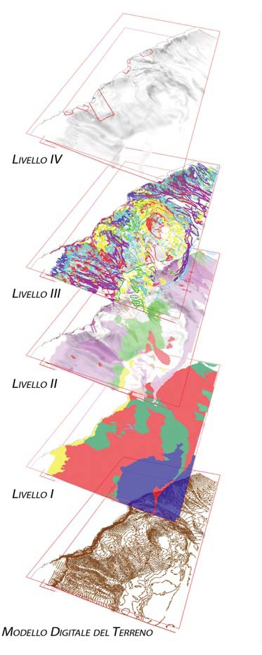
  Criteria of representation
  of geohazard features of the Italian Seas
1 - show all the available information, maintaining a good readability of the map in terms of geohazards
2 - set up criteria to define, identify and map geohazard features homogeneously
3 - establish a hierarchy among the information, trough different mapping levels
FOUR LEVEL REPRESENTATION
1st Physiographic domains
(1:250.000 areas)
2nd Morphostructural units
(1:50.000 areas + database)
3rd Morphpologic features
(1:50.000 vectors)
4th Critical points
(detailed scale - variable highlights)

Slide 17
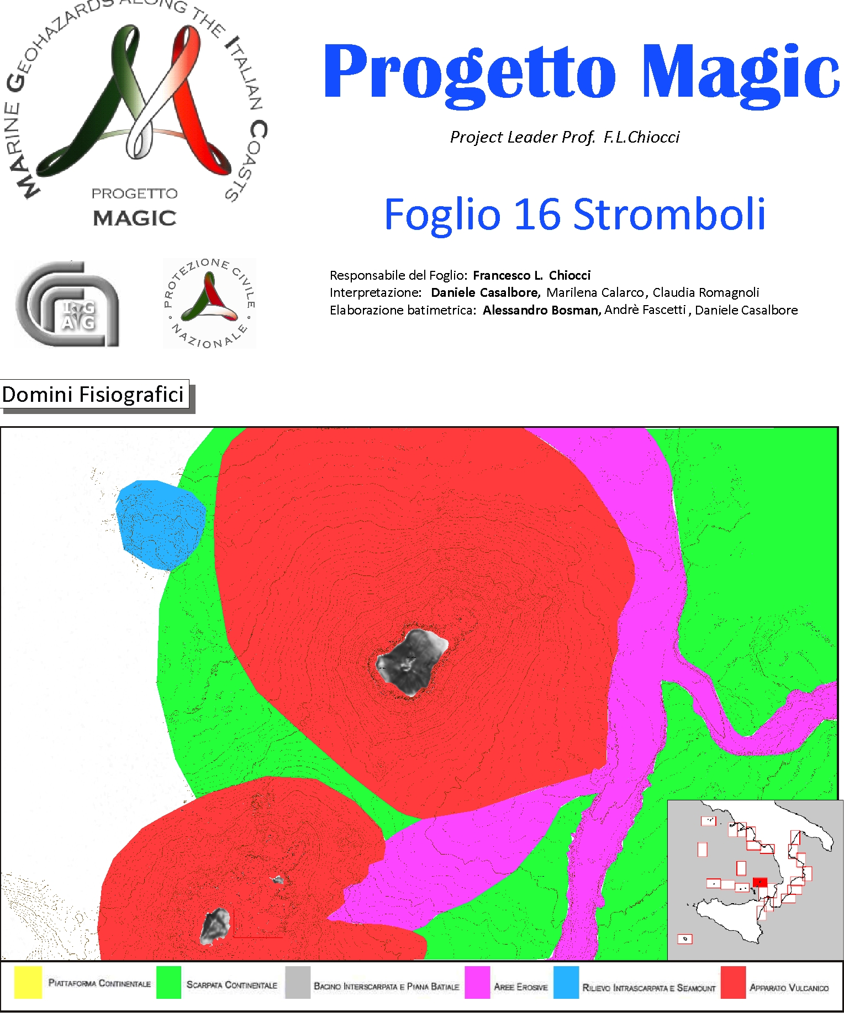
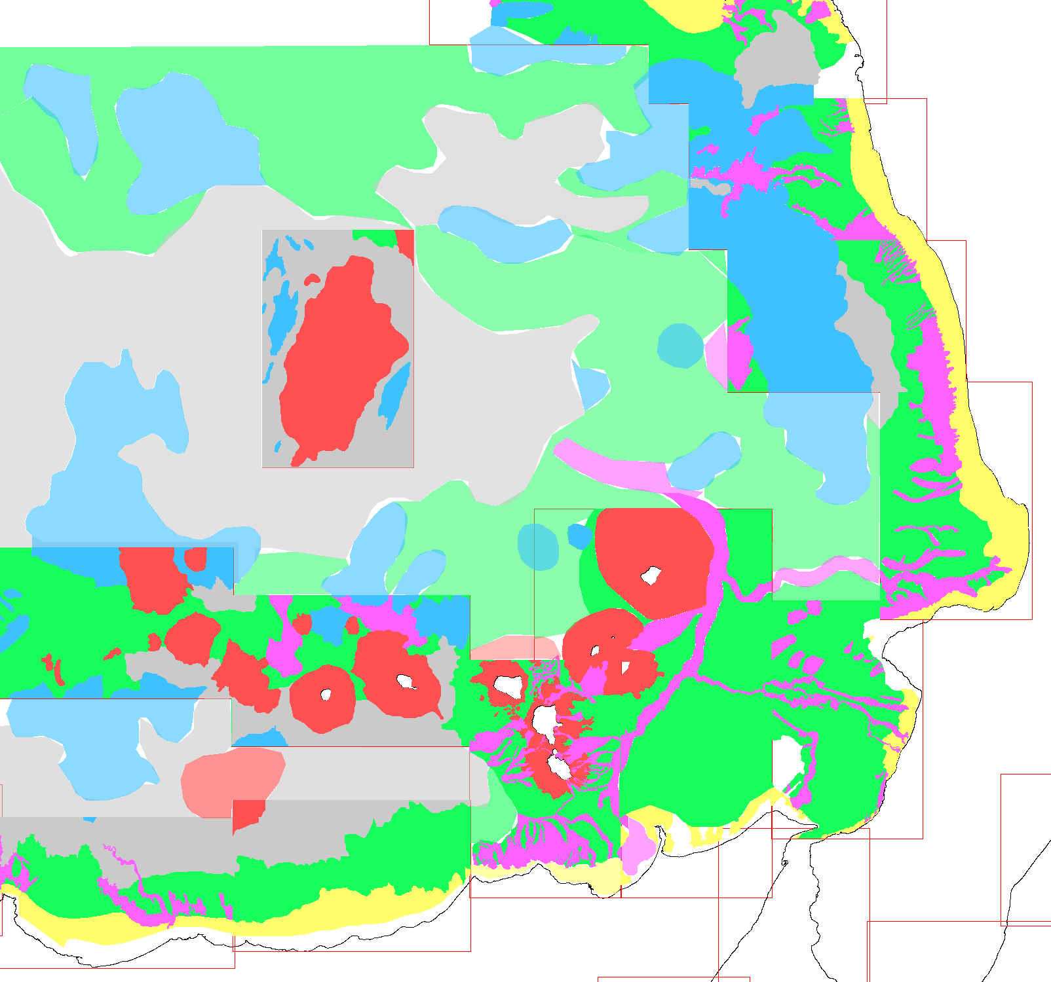
FOUR LEVEL REPRESENTATION
Ist Physiographic domains
(1:250.000 areas)
2nd Morphostructural units
(1:50.000 areas + database)
3rd Morphpologic features
(1:50.000 vectors)
4th Critical points
(detailed scale - variable highlights)
5 km

Slide 18
Level 2: Morhostructural unit
FOUR LEVEL REPRESENTATION
1st Physiographic domains
(1:250.000 areas)
2nd Morphostructural units
(1:50.000 areas + database)
3rd Morphpologic features
(1:50.000 vectors)
4th Critical points
(detailed scale - variable highlights)
Erosional Channels and Canyons (CCE)
Single Slide (FRS)
Widespread Erosion Area (ERD)
Erosional Amphiteatre Thalweg (TAE)
Bedform Area (FOF)
Fluid Escape Area (FUF)
Represented as color areas in 1:50.000 maps
+ accompanying data sheet for each unit
Unchannalised Flux Area (FNC)
Rocky bedrock Area (ASL)
Volcanic bedrock Area (AFV)
Tectonic Line (LIT)

Slide 19
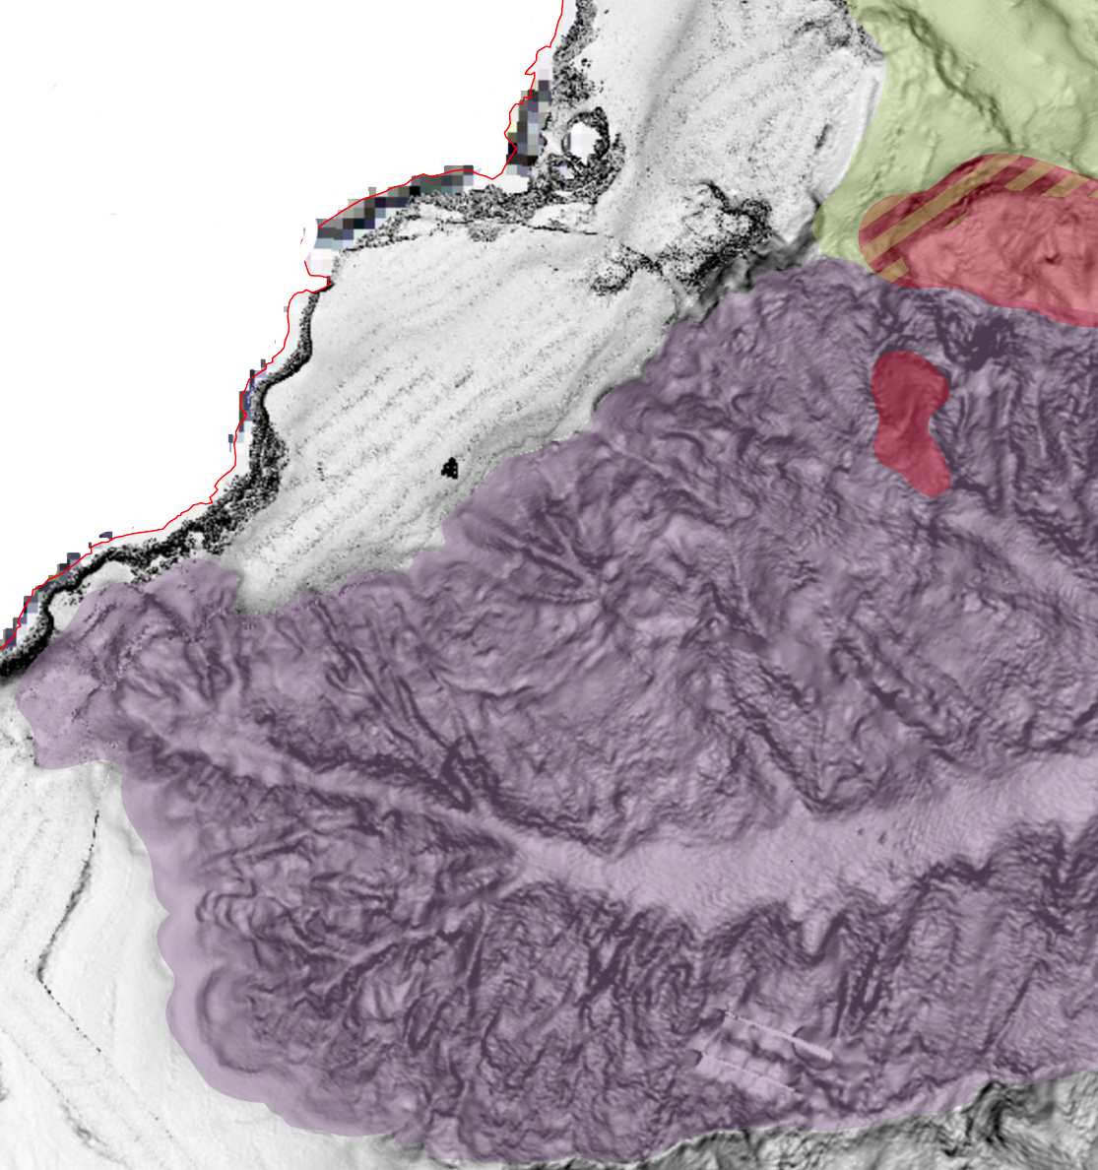
Rocky Bedrock Area (ASL)
Erosional Channels and Canyons(CCE)
Single Slide (FRS)
Sheet 33 (Catania)
1 km

Slide 20
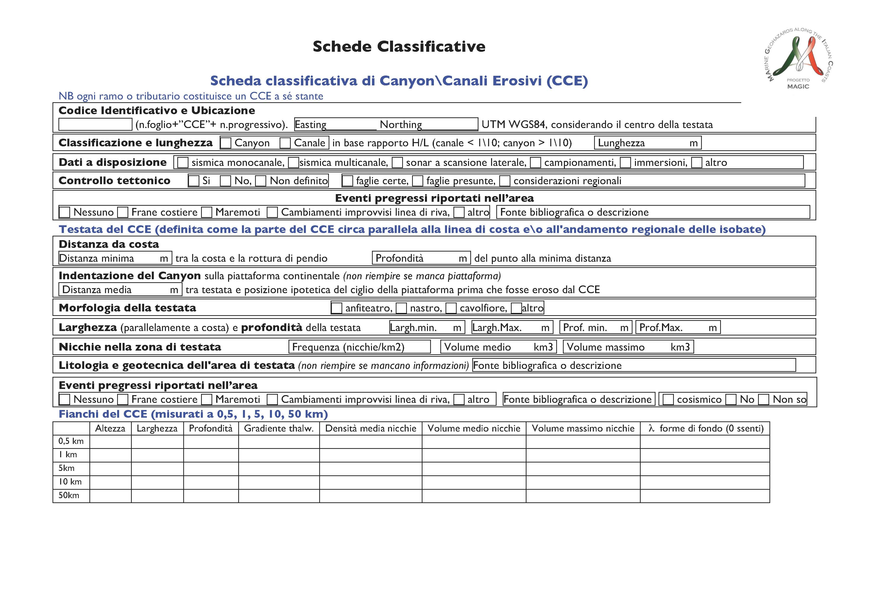

Slide 21
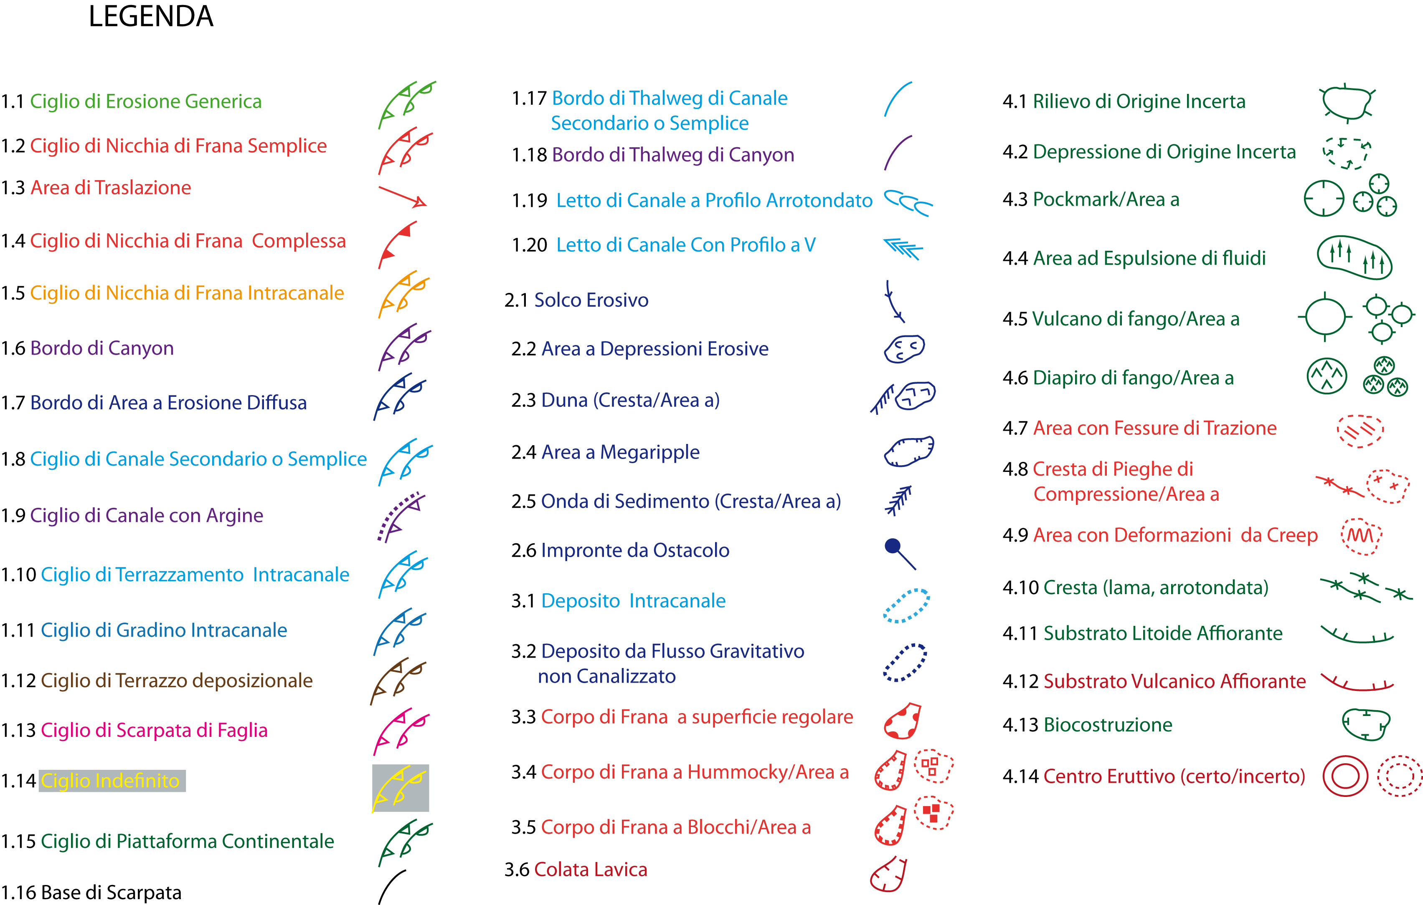

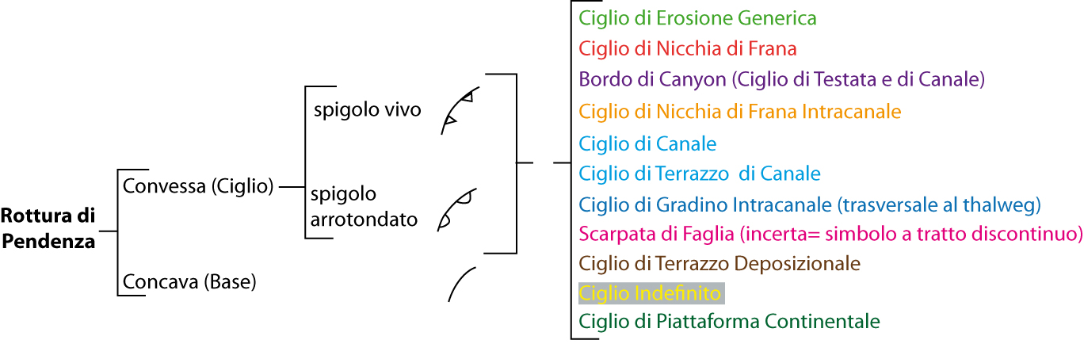
3rd Level - Morhobathymetric elements (EM)
FOUR LEVEL REPRESENTATION
1st Physiographic domains
(1:250.000 areas)
2nd Morphostructural units
(1:50.000 areas + database)
3rd Morphpologic features
(1:50.000 vectors)
4th Critical points
(detailed scale - variable highlights)

Slide 22
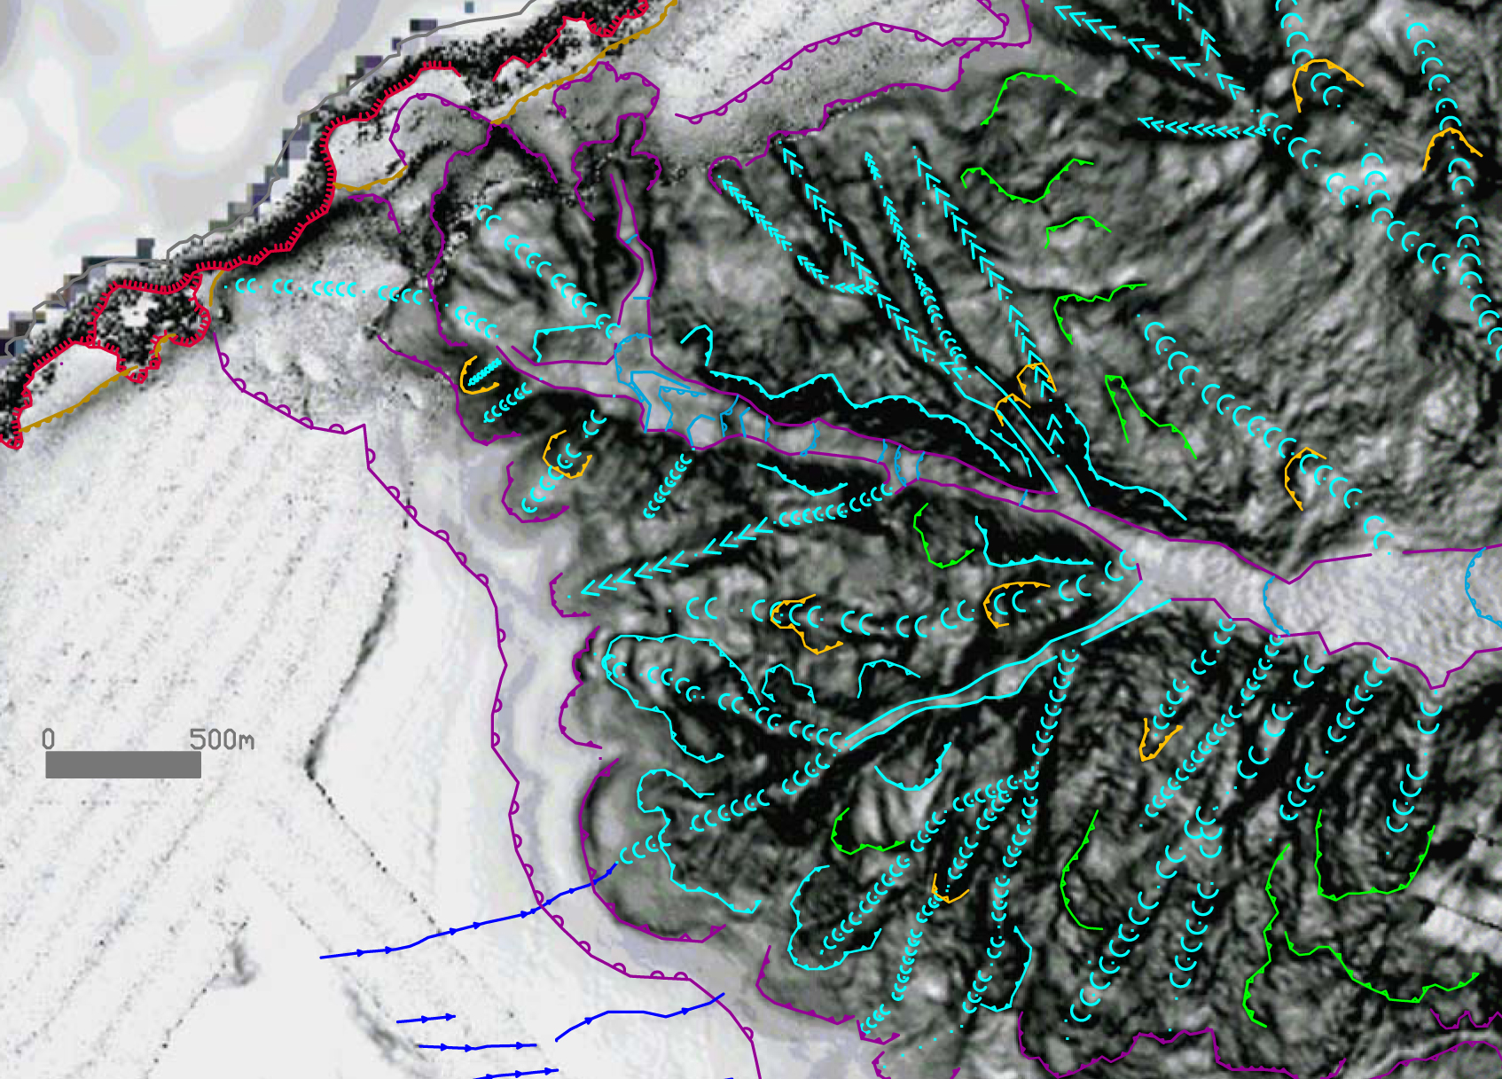
Sheet 33 (Catania): 3rd Level - Morhobathymetric elements (EM)

Slide 23
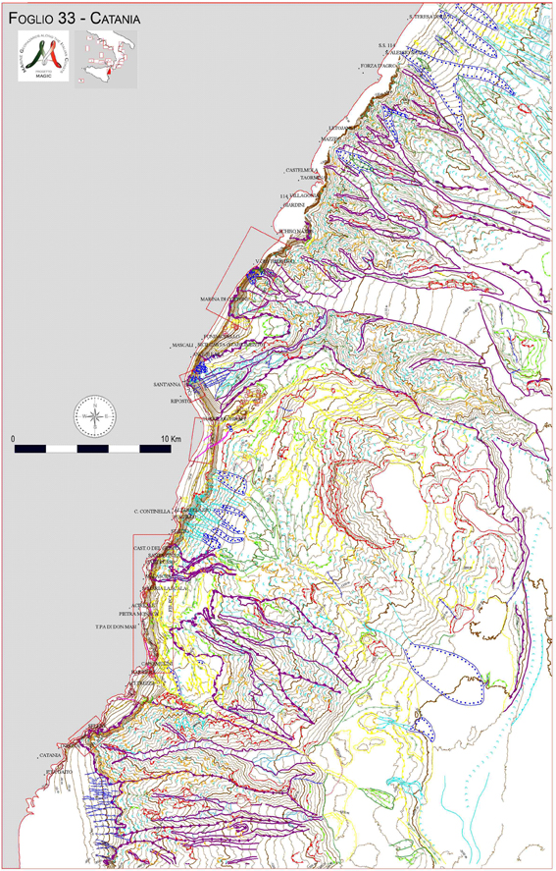
4th Level : Critical Point (PC)
FOUR LEVEL REPRESENTATION
1st Physiographic domains
(1:250.000 areas)
2nd Morphostructural units
(1:50.000 areas + database)
3rd Morphpologic features
(1:50.000 vectors)
4th Critical points
(detailed scale - variable highlights)
Represented as boxes in 1:50.000 maps and described in monographs

Slide 24
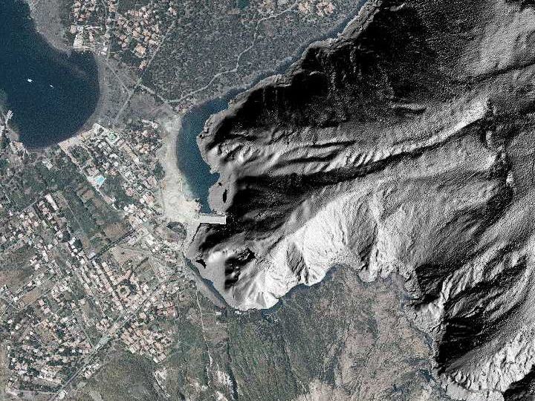

Slide 25
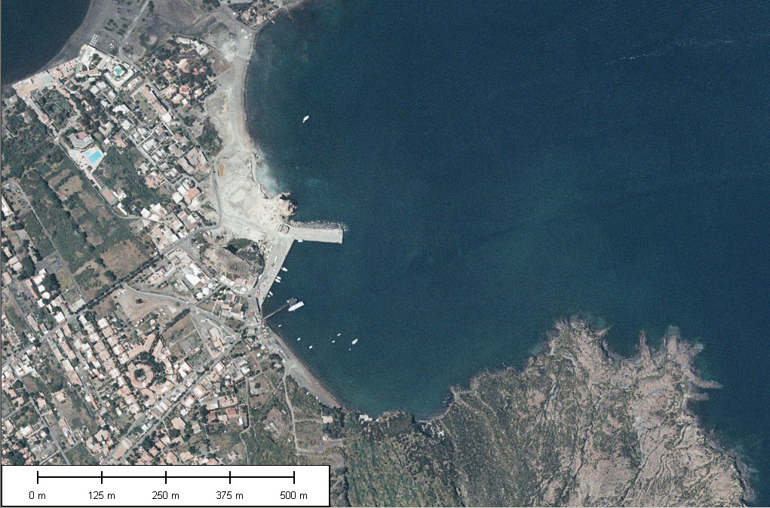
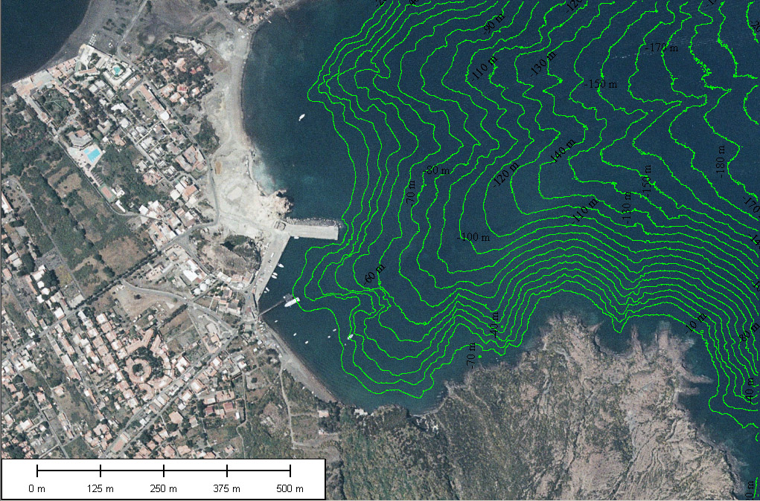
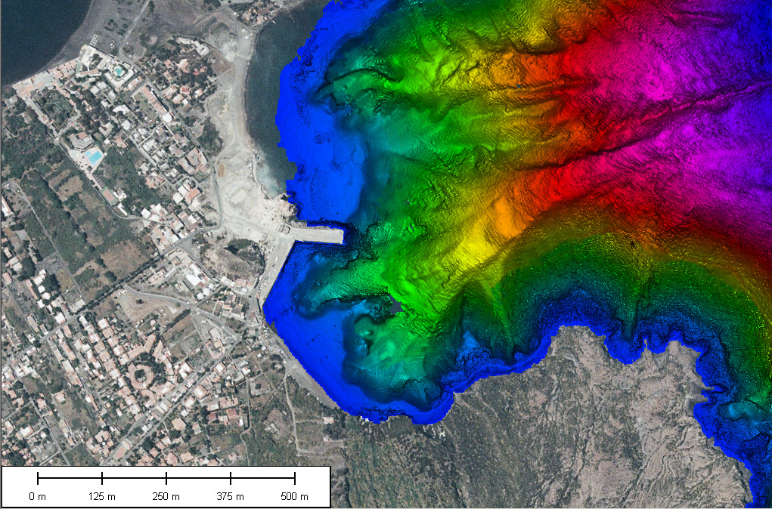

Slide 26
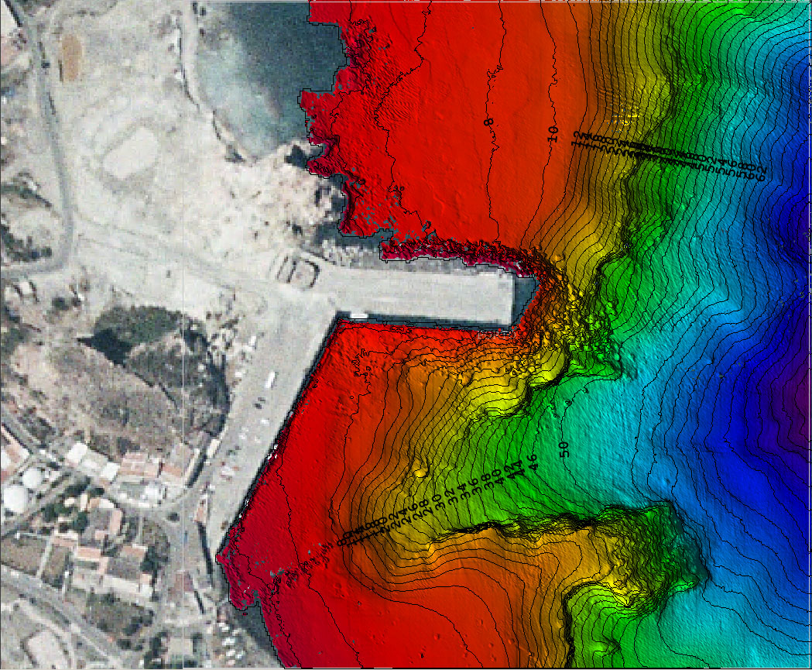

Slide 27
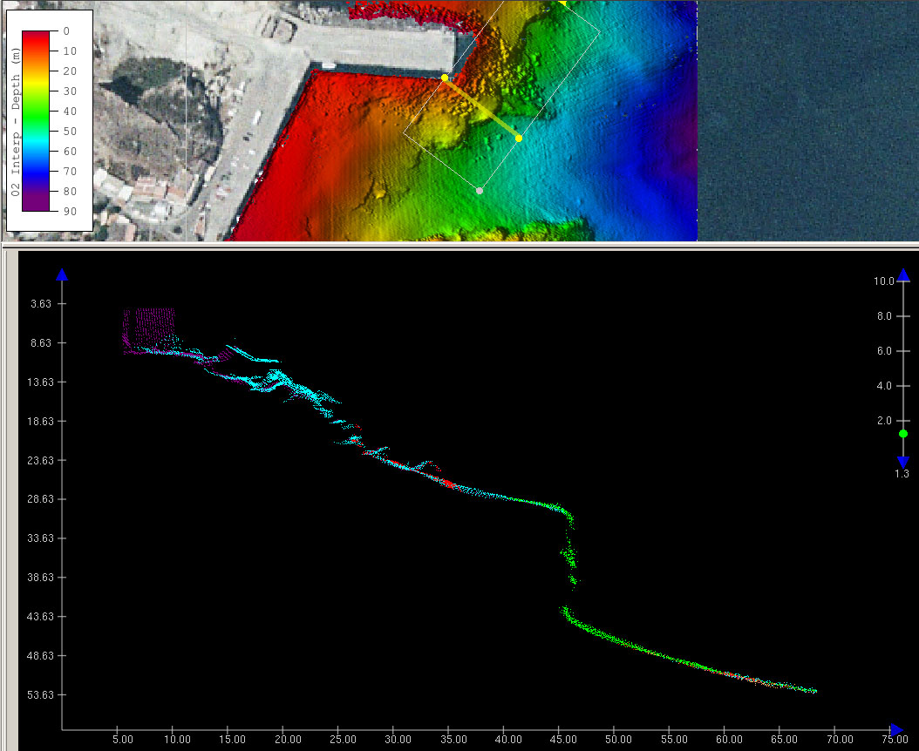
10 m

Slide 28

DATA OUTREACH
An Atlas is expected to be published by 2013, to spread the result obtained by MaGIC project over the scientists, end users and general public.
This is the first draft of the format of the Atlas

Slide 29
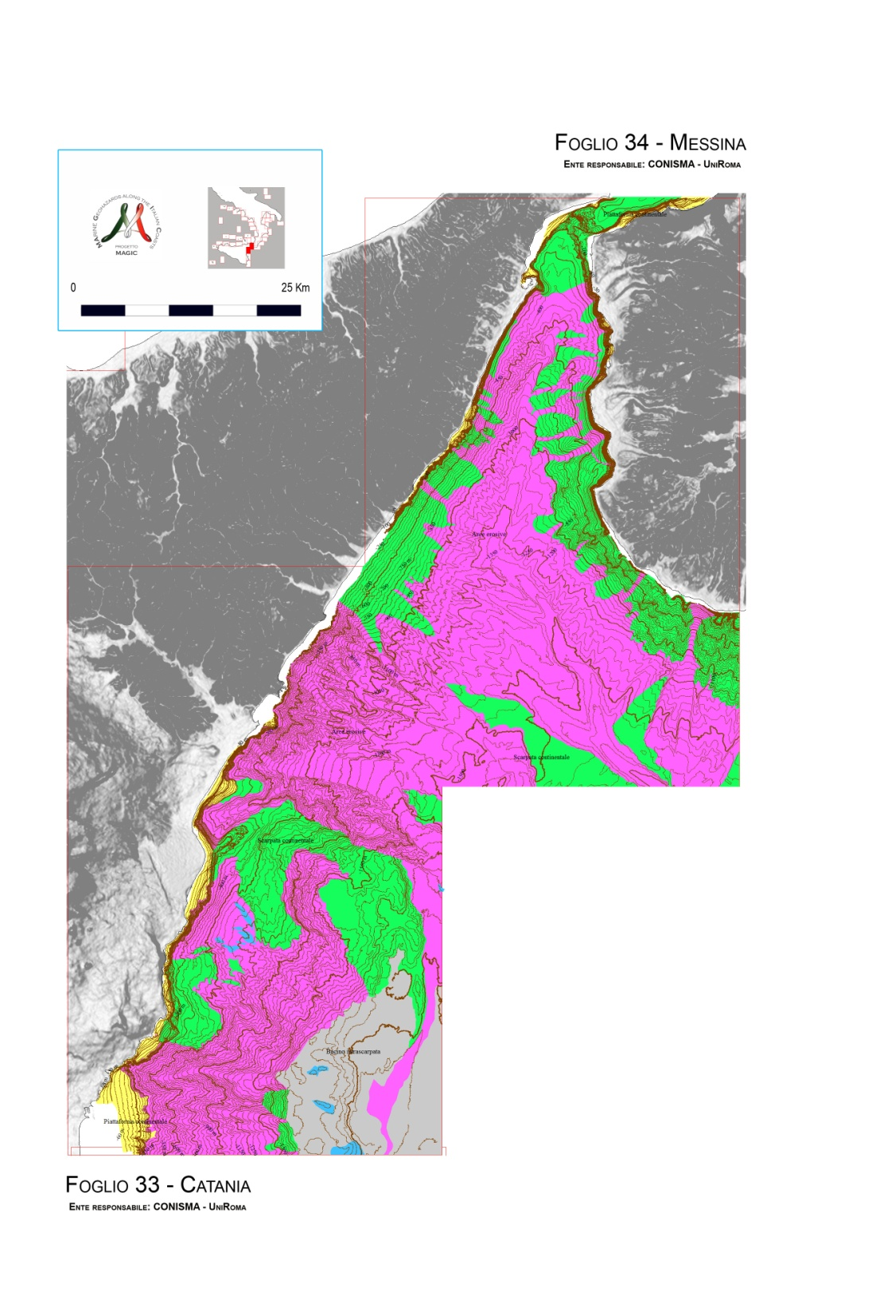
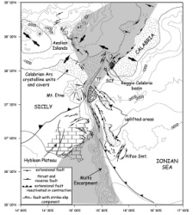
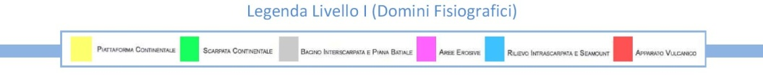
SICILIA NORD-ORIENTALE
SICILIA NORD-ORIENTALE
Inquadramento geodinamico dell’area dello Stretto di Messina
Pippo, pippol, pluto, plutoPippo, pippol, pluto, plutoPippo, pippol, pluto, pluto o, pippol, pluto, plutoPippoo, pippol, pluto, plutoPippoo, pippol, pluto, plutoPippoo, pippol, pluto, plutoPippoo, pippol, pluto, plutoPippoo, pippol, pluto, plutoPippoo, pippol, pluto, plutoPippoo, pippol, pluto, plutoPippoo, pippol, pluto, plutoPippoo, pippol, pluto, plutoPippoo, pippol, pluto, plutoPippoo, pippol, pluto, plutoPippoo, pippol, pluto, plutoPippoo, pippol, pluto, plutoPippoo, pippol, pluto, plutoPippoo, pippol, pluto, plutoPippoo, pippol, pluto, plutoPippoo, pippol, pluto, plutoPippoo, pippol, pluto, plutoPippoo, pippol, pluto, plutoPippoo, pippol, pluto, plutoPippoo, pippol, pluto, plutoPippoo, pippol, pluto, plutoPippoo, pippol, pluto, plutoPippoo, pippol, pluto, plutoPippoo, pippol, pluto, plutoPippoo, pippol, pluto, plutoPippoo, pippol, pluto, plutoPippoo, pippol, pluto, plutoPippoo, pippol, pluto, plutoPippoo, pippol, pluto, plutoPippoo, pippol, pluto, plutoPippoo, pippol, pluto, plutoPippoo, pippol, pluto, plutoPippoo, pippol, pluto, plutoPippoo, pippol, pluto, plutoPippoo, pippol, pluto, plutoPippoo, pippol, pluto, plutoPippoo, pippol, pluto, plutoPippoo, pippol, pluto, plutoPippoo, pippol, pluto, plutoPippoo, pippol, pluto, plutoPippoo, pippol, pluto, plutoPippoo, pippol, pluto, plutoPippoo, pippol, pluto, plutoPippoo, pippol, pluto, plutoPippoo, pippol, pluto, plutoPippoo, pippol, pluto, plutoPippoo, pippol, pluto, plutoPippoo, pippol, pluto, plutoPippoo, pippol, pluto, plutoPippoo, pippol, pluto, plutoPippoo, pippol, pluto, plutoPippoo, pippol, pluto, plutoPippoo, pippol, pluto, plutoPippoo, pippol, pluto, plutoPippo Pippo, pippol, pluto, plutoPippo, pippol, pluto, plutoPippo, pippol, pluto, pluto o, pippol, pluto, plutoPippoo, pippol, pluto, plutoPippoo, pippol, pluto, plutoPippoo, pippol, pluto, plutoPippoo, pippol, pluto, plutoPippoo, pippol, pluto, plutoPippoo, pippol, pluto, plutoPippoo, pippol, pluto, plutoPippoo, pippol, pluto, plutoPippoo, pippol, pluto, plutoPippoo, pippol, pluto, plutoPippoo, pippol, pluto, plutoPippoo, pippol, pluto, plutoPippoo, pippol, pluto, plutoPippoo, pippol, pluto, plutoPippoo, pippol, pluto, plutoPippoo, pippol, pluto, plutoPippoo, pippol, pluto, plutoPippoo, pippol, pluto, plutoPippoo, pippol, pluto, plutoPippoo, pippol, pluto, plutoPippoo, pippol, pluto, plutoPippoo, pippol, pluto, plutoPippoo, pippol, pluto, plutoPippoo, pippol, pluto, plutoPippoo, pippol, pluto, plutoPippoo, pippol, pluto, plutoPippoo, pippol, pluto, plutoPippoo, pippol, pluto, plutoPippoo, pippol, pluto, plutoPippoo, pippol, pluto, plutoPippoo, pippol, pluto, plutoPippoo, pippol, pluto, plutoPippoo, pippol, pluto, plutoPippoo, pippol, pluto, plutoPippoo, pippol, pluto, plutoPippoo, pippol, pluto, plutoPippoo, pippol, pluto, plutoPippoo, pippol, pluto, plutoPippoo, pippol, pluto, plutoPippoo, pippol, pluto, plutoPippoo, pippol, pluto, plutoPippoo, pippol, pluto, plutoPippoo, pippol, pluto, plutoPippoo, pippol, pluto, plutoPippoo, pippol, pluto, plutoPippoo, pippol, pluto, plutoPippoo, pippol, pluto, plutoPippoo, pippol, pluto, plutoPippoo, pippol, pluto, plutoPippoo, pippol, pluto, plutoPippoo, pippol, pluto, plutoPippoo, pippol, pluto, plutoPippoo, pippol, pluto, plutoPippoo, pippol, pluto, plutoPippoo, pippol, pluto, plutoPippo Pippo, pippol, pluto, plutoPippo, pippol, pluto, plutoPippo, pippol, pluto, pluto o, pippol, pluto, plutoPippoo, pippol, pluto, plutoPippoo, pippol, pluto, plutoPippoo, pippol, pluto, plutoPippoo, pippol, pluto, plutoPippoo, pippol, pluto, plutoPippoo, pippol, pluto, plutoPippoo, pippol, pluto, plutoPippoo, pippol, pluto, plutoPippoo, pippol, pluto, plutoPippoo, pippol, pluto, plutoPippoo, pippol, pluto, plutoPippoo, pippol, pluto, plutoPippoo, pippol, pluto, plutoPippoo, pippol, pluto, plutoPippoo, pippol, pluto, plutoPippoo, pippol, pluto, plutoPippoo, pippol, pluto, plutoPippoo, pippol, pluto, plutoPippoo, pippol, pluto, plutoPippoo, pippol, pluto, plutoPippoo, pippol, pluto, plutoPippoo, pippol, pluto, plutoPippoo, pippol, pluto, plutoPippoo, pippol, pluto, plutoPippoo, pippol, pluto, plutoPippoo, pippol, pluto, plutoPippoo, pippol, pluto, plutoPippoo, pippol, pluto, plutoPippoo, pippol, pluto, plutoPippoo, pippol, pluto, plutoPippoo, pippol, pluto, plutoPippoo, pippol, pluto, plutoPippoo, pippol, pluto, plutoPippoo, pippol, pluto, plutoPippoo, pippol, pluto, plutoPippoo, pippol, pluto, plutoPippoo, pippol, pluto, plutoPippoo, pippol, pluto, plutoPippoo, pippol, pluto, plutoPippoo, pippol, pluto, plutoPippoo, pippol, pluto, plutoPippoo, pippol, pluto, plutoPippoo, pippol, pluto, plutoPippoo, pippol, pluto, plutoPippoo, pippol, pluto, plutoPippoo, pippol, pluto, plutoPippoo, pippol, pluto, plutoPippoo, pippol, pluto, plutoPippoo, pippol, pluto, plutoPippoo, pippol, pluto, plutoPippoo, pippol, pluto, plutoPippoo, pippol, pluto, plutoPippoo, pippol, pluto, plutoPippoo, pippol, pluto, plutoPippoo, pippol, pluto, plutoPippo
Pippo, pippol, pluto, plutoPippo, pippol, pluto, plutoPippo, pippol, pluto, pluto o, pippol, pluto, plutoPippoo, pippol, pluto, plutoPippoo, pippol, pluto, plutoPippoo, pippol, pluto, plutoPippoo, pippol, pluto, plutoPippoo, pippol, pluto, plutoPippoo, pippol, pluto, plutoPippoo, pippol, pluto, plutoPippoo, pippol, pluto, plutoPippoo, pippol, pluto, plutoPippoo, pippol, pluto, plutoPippoo, pippol, pluto, plutoPippoo, pippol, pluto, plutoPippoo, pippol, pluto, plutoPippoo, pippol, pluto, plutoPippoo, pippol, pluto, plutoPippoo, pippol, pluto, plutoPippoo, pippol, pluto, plutoPippoo, pippol, pluto, plutoPippoo, pippol, pluto, plutoPippoo, pippol, pluto, plutoPippoo, pippol, pluto, plutoPippoo, pippol, pluto, plutoPippoo, pippol, pluto, plutoPippoo, pippol, pluto, plutoPippoo, pippol, pluto, plutoPippoo, pippol, pluto, plutoPippoo, pippol, pluto, plutoPippoo, pippol, pluto, plutoPippoo, pippol, pluto, plutoPippoo, pippol, pluto, plutoPippoo, pippol, pluto, plutoPippoo, pippol, pluto, plutoPippoo, pippol, pluto, plutoPippoo, pippol, pluto, plutoPippoo, pippol, pluto, plutoPippoo, pippol, pluto, plutoPippoo, pippol, pluto, plutoPippoo, pippol, pluto, plutoPippoo, pippol, pluto, plutoPippoo, pippol, pluto, plutoPippoo, pippol, pluto, plutoPippoo, pippol, pluto, plutoPippoo, pippol, pluto, plutoPippoo, pippol, pluto, plutoPippoo, pippol, pluto, plutoPippoo, pippol, pluto, plutoPippoo, pippol, pluto, plutoPippoo, pippol, pluto, plutoPippoo, pippol, pluto, plutoPippoo, pippol, pluto, plutoPippoo, pippol, pluto, plutoPippoo, pippol, pluto, plutoPippoo, pippol, pluto, plutoPippoo, pippol, pluto, plutoPippoo, pippol, pluto, plutoPippo Pippo, pippol, pluto, plutoPippo, pippol, pluto, plutoPippo, pippol, pluto, pluto o, pippol, pluto, plutoPippoo, pippol, pluto, plutoPippoo, pippol, pluto, plutoPippoo, pippol, pluto, plutoPippoo, pippol, pluto, plutoPippoo, pippol, pluto, plutoPippoo, pippol, pluto, plutoPippoo, pippol, pluto, plutoPippoo, pippol, pluto, plutoPippoo, pippol, pluto, plutoPippoo, pippol, pluto,, pippol, pluto, plutoPippoo, pippol, pluto, plutoPippoo, pippol, pluto,
Sismotettonoinica dell’area dello Stretto
plutoPippoo, pippol, pluto, plutoPippoo, pippol, pluto, plutoPippoo, pippol, pluto, plutoPippoo, pippol, pluto, plutoPippoo, pippol, pluto, plutoPippoo, pippol, pluto, plutoPippoo, pippol, pluto, plutoPippoo, pippol, pluto, plutoPippoo, pippol, pluto, plutoPippoo, pippol, pluto, plutoPippoo, pippol, pluto, plutoPippoo, pippol, pluto, plutoPippoo, pippol, pluto, plutoPippoo, pippol, pluto, plutoPippoo, pippol, pluto, plutoPippoo, pippol, pluto, plutoPippoo, pippol, pluto, plutoPippoo, pippol, pluto, plutoPippoo, pippol, pluto, plutoPippoo, pippol, pluto, plutoPippoo, pippol, pluto, plutoPippoo, pippol, pluto, plutoPippoo, pippol, pluto, plutoPippoo, pippol, pluto, plutoPippoo, pippol, pluto, plutoPippoo, pippol, pluto, plutoPippoo, pippol, pluto, plutoPippoo, pippol, pluto, plutoPippoo, pippol, pluto, plutoPippoo, pippol, pluto, plutoPippoo, pippol, pluto, plutoPippoo, pippol, pluto, plutoPippoo, pippol, pluto, plutoPippoo, pippol, pluto, plutoPippoo, pippol, pluto, plutoPippoo, pippol, pluto, plutoPippoo, pippol, pluto, plutoPippoo, pippol, pluto, plutoPippoo, pippol, pluto, plutoPippoo, pippol, pluto, plutoPippo Pippo, pippol, pluto, plutoPippo, pippol, pluto, plutoPippo, pippol, pluto, pluto o, pippol, pluto, plutoPippoo, pippol, pluto, plutoPippoo, pippol, pluto, plutoPippoo, pippol, pluto, plutoPippoo, pippol, pluto, plutoPippoo, pippol, pluto, plutoPippoo, pippol, pluto, plutoPippoo, pippol, pluto, plutoPippoo, pippol, pluto, plutoPippoo, pippol, pluto, plutoPippoo, pippol, pluto, plutoPippoo, pippol, pluto, plutoPippoo, pippol, pluto, plutoPippoo, pippol, pluto, plutoPippoo, pippol, pluto, plutoPippoo, pippol, pluto, plutoPippoo, pippol, pluto,
Principlai lineamenti geomorfologici dell’area
plutoPippoo, pippol, pluto, plutoPippoo, pippol, pluto, plutoPippoo, pippol, pluto, plutoPippoo, pippol, pluto, plutoPippoo, pippol, pluto, plutoPippoo, pippol, pluto, plutoPippoo, pippol, pluto, plutoPippoo, pippol, pluto, plutoPippoo, pippol, pluto, plutoPippoo, pippol, pluto, plutoPippoo, pippol, pluto, plutoPippoo, pippol, pluto, plutoPippoo, pippol, pluto, plutoPippoo, pippol, pluto, plutoPippoo, pippol, pluto, plutoPippoo, pippol, pluto, plutoPippoo, pippol, pluto, plutoPippoo, pippol, pluto, plutoPippoo, pippol, pluto, plutoPippoo, pippol, pluto, plutoPippoo, pippol, pluto, plutoPippoo, pippol, pluto, plutoPippoo, pippol, pluto, plutoPippoo, pippol, pluto, plutoPippoo, pippol, pluto, plutoPippoo, pippol, pluto, plutoPippoo, pippol, pluto, plutoPippoo, pippol, pluto, plutoPippoo, pippol, pluto, plutoPippoo, pippol, pluto, plutoPippoo, pippol, pluto, plutoPippoo, pippol, pluto, plutoPippoo,
Eventuale altro testo
plutoPippoo, pippol, pluto, plutoPippoo, pippol, pluto, plutoPippoo, pippol, pluto, plutoPippoo, pippol, pluto, plutoPippoo, pippol, pluto, plutoPippoo, pippol, pluto, plutoPippoo, pippol, pluto, plutoPippoo, pippol, pluto, plutoPippoo, pippol, pluto, plutoPippoo, pippol, pluto, plutoPippoo, pippol, pluto, plutoPippoo, pippol, pluto, plutoPippoo, pippol, pluto, plutoPippoo, pippol, pluto, plutoPippoo, pippol, pluto, plutoPippoo, pippol, pluto, plutoPippoo, pippol, pluto, plutoPippoo, pippol, pluto, plutoPippoo, pippol, pluto, plutoPippoo, pippol, pluto, plutoPippoo, pippol, pluto, plutoPippoo, pippol, pluto, plutoPippoo, pippol, pluto, plutoPippoo, pippol, pluto, plutoPippoo, pippol, pluto, plutoPippoo, pippol, pluto, plutoPippoo, pippol, pluto, plutoPippoo, pippol, pluto, plutoPippoo, pippol, pluto, plutoPippoo, pippol, pluto, plutoPippoo, pippol, pluto, plutoPippoo, pippol, pluto, plutoPippoo,
2
3

Slide 30
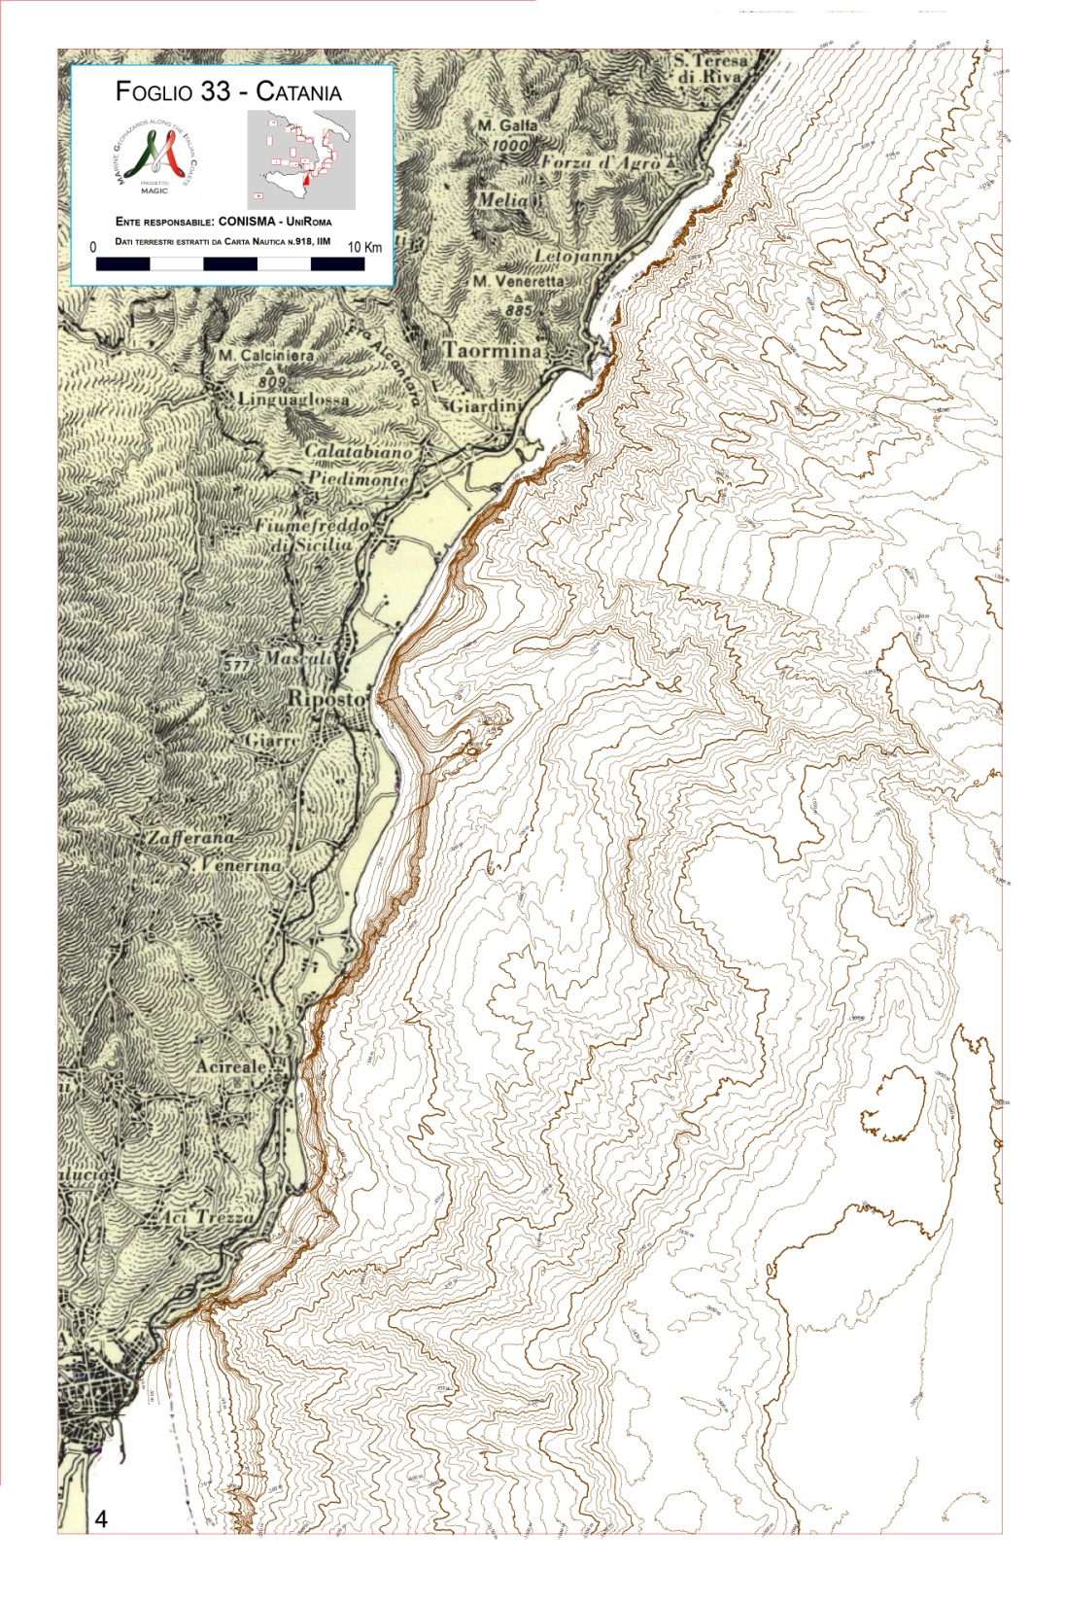
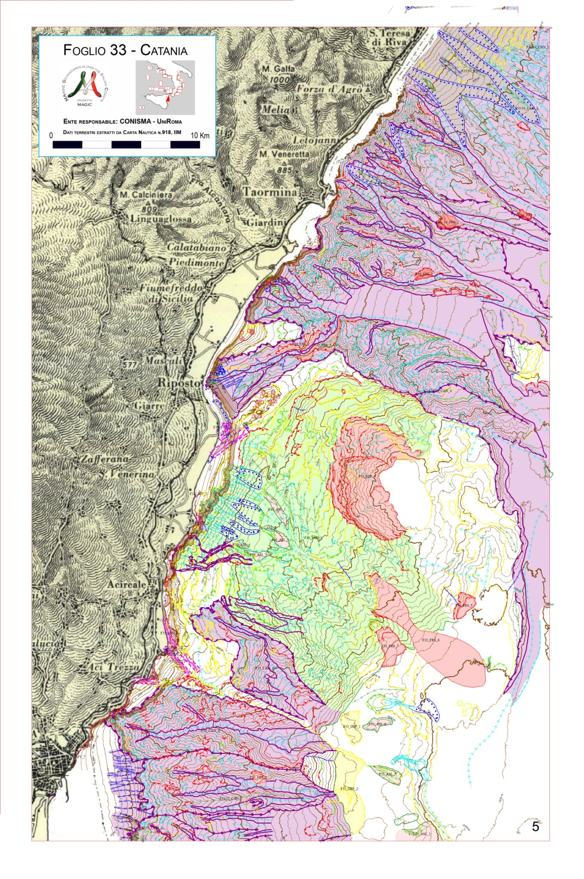

Slide 31
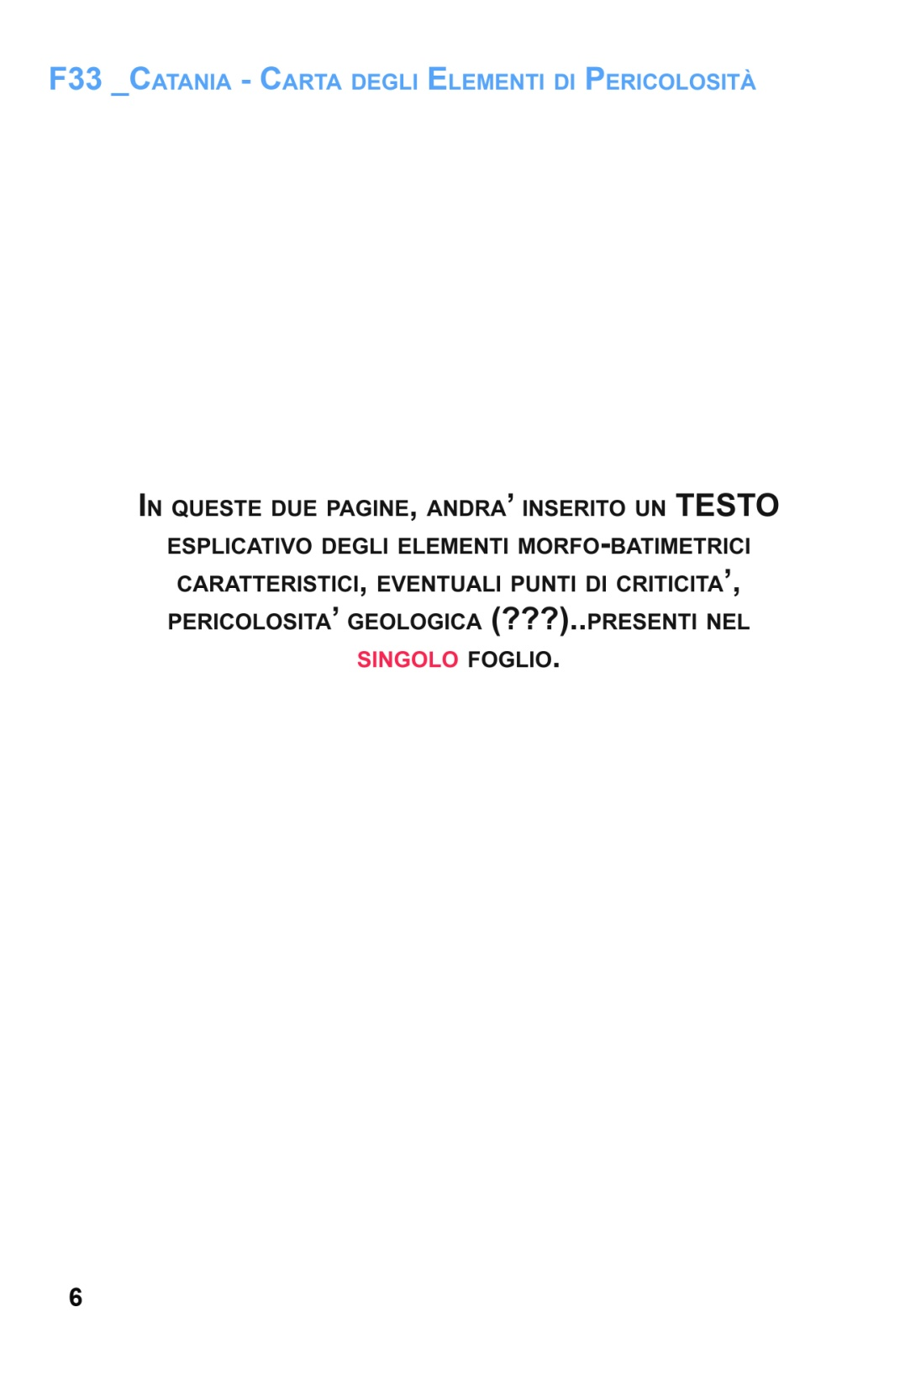
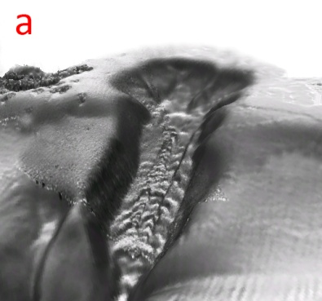
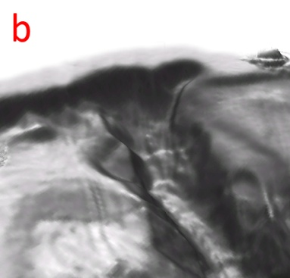
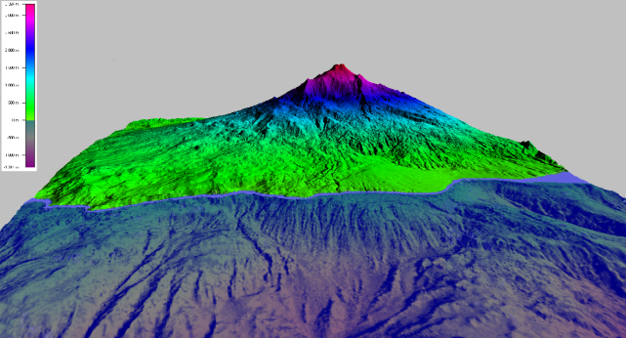
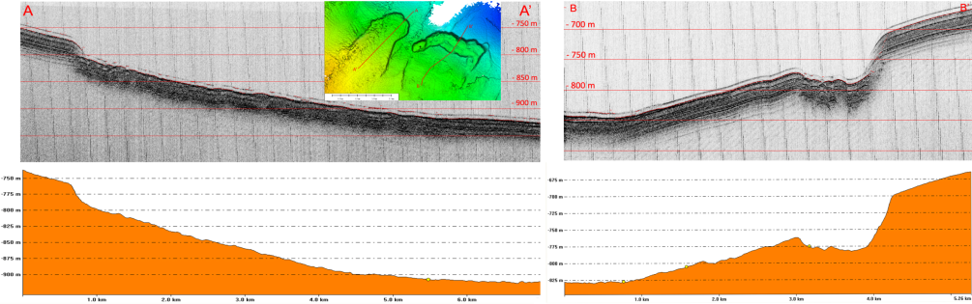
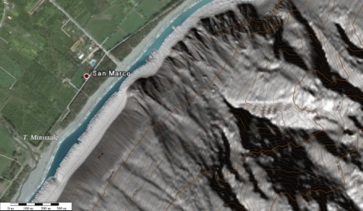
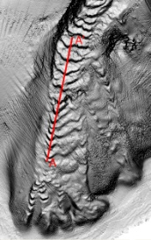
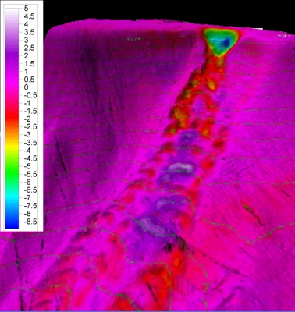
FOGLIO 33_CATANIA
Descrizione del foglio
plutoPippoo, pippol, pluto, plutoPippoo, pippol, pluto, plutoPippoo, pippol, pluto, plutoPippoo, pippol, pluto, plutoPippoo, pippol, pluto, plutoPippoo, pippol, pluto, plutoPippoo, pippol, pluto,,
plutoPippoo, pippol, pluto, plutoPippoo, pippol, pluto, plutoPippoo, pippol, pluto, plutoPippoo, pippol, pluto, plutoPippoo, pippol, pluto, plutoPippoo, pippol, pluto, plutoPippoo, pippol, pluto,,
Fig. 4 PC1_F15 - Superfici 3D della testata meridionale (a, per la localizzazione rettangolo rosso in Fig.1 PC1_F15) e settentrionale (b, per la localizzazione rettangolo verde in Fig.1 PC1_F15) del canyon di Gioia (EV 3X).
plutoPippoo, pippol, pluto, plutoPippoo, pippol, pluto, plutoPippoo, pippol, pluto,
pippol, pluto, plutoPippoo, pippol, pluto,
pippol, pluto, plutoPippoo, pippol, pluto,
pippol, pluto, plutoPippoo, pippol, pluto,
plutoPippoo, pippol, pluto, plutoPippoo, pippol, pluto, plutoPippoo, pippol, pluto,
pippol, pluto, plutoPippoo, pippol, pluto,
pippol, pluto, plutoPippoo, pippol, pluto,
pippol, pluto, plutoPippoo, pippol, pluto,
Fig. 1 a) Etna on-shore ed off-shore. b) Schema Geologico della regione dell’Etna che mostra faglie e sismicità della regione. (Brumetti et al., 2007).
plutoPippoo, pippol, pluto, plutoPippoo, pippol, pluto, plutoPippoo, pippol, pluto,
pippol, pluto, plutoPippoo, pippol, pluto,
pippol, pluto, plutoPippoo, pippol, pluto,
pippol, pluto, plutoPippoo, pippol, pluto,
plutoPippoo, pippol, pluto, plutoPippoo, pippol, pluto, plutoPippoo, pippol, pluto,
pippol, pluto, plutoPippoo, pippol, pluto,
pippol, pluto, plutoPippoo, pippol, pluto,
pippol, pluto, plutoPippoo, pippol, pluto,
Fig. 2 PC1_F33 – a) Erosione del terrazzo deposizionale sommerso da parte di nicchie di distacco alla testata del canalone di Fiumefreddo di Sicilia. Equidistanza contour 10 m; b) Dettaglio delle frane antistanti S. Marco. Es. Vert. 3X. B) Sezione lungo l’asse del canale di Praialonga
Fig. 5 PC4_F15 - Profili sismici longitudinali alla frana F1 (sinistra) e F2 (destra).
plutoPippoo, pippol, pluto, plutoPippoo, pippol, pluto, plutoPippoo, pippol, pluto,
pippol, pluto, plutoPippoo, pippol, pluto,
pippol, pluto, plutoPippoo, pippol, pluto,
pippol, pluto, plutoPippoo, pippol, pluto,
plutoPippoo, pippol, pluto, plutoPippoo, pippol, pluto, plutoPippoo, pippol, pluto,
pippol, pluto, plutoPippoo, pippol, pluto,
pippol, pluto, plutoPippoo, pippol, pluto,
pippol, pluto, plutoPippoo, pippol, pluto,
Fig. 6 PC2_F15 - Mappa dei residui batimetrici, in pianta e in visione prospettica relativa alla testata del canalone di Marinella di Bagnara. Risulta evidente la nicchia di distacco (dal verde al blu) avvenuta a poche decine di metri dalla linea di costa. Per la localizzazione rettangolo rosso in Fig. 1 PC2_F15
Fig. 3 PC3_F15 - Arretramento del ciglio della testata dei canali erosivi. Il confronto multitemporale tra le foto aeree e rilievi batimorfologici ha rivelato la presenza di fenomeni erosivi diffusi, costituiti da nicchie di distacco di piccole dimensioni del tutto simili per forme e dimensioni a quelle individuate nel canale di Marinella di Bagnara. a) Arretramento del margine meridionale della testata del canale di Praialonga, ubicazione rettangolo blu in Fig. 1 PC3_F15.
6
7

Slide 32



Slide 33










FOGLIO 34_MESSINA
Descrizione del foglio
plutoPippoo, pippol, pluto, plutoPippoo, pippol, pluto, plutoPippoo, pippol, pluto, plutoPippoo, pippol, pluto, plutoPippoo, pippol, pluto, plutoPippoo, pippol, pluto, plutoPippoo, pippol, pluto,,
plutoPippoo, pippol, pluto, plutoPippoo, pippol, pluto, plutoPippoo, pippol, pluto, plutoPippoo, pippol, pluto, plutoPippoo, pippol, pluto, plutoPippoo, pippol, pluto, plutoPippoo, pippol, pluto,, plutoPippoo, pippol, pluto, plutoPippoo, pippol, pluto, plutoPippoo, pippol, pluto, plutoPippoo, pippol, pluto, plutoPippoo, pippol, pluto, plutoPippoo
Fig. 5 PC6_F34 - Deposito a largo di Punta Pellaro (RC). Si tratta probabilmente di un deposito di frana. Equidistanza isobate 25 m.
Fig. 6 PC5_F34 - Gullies lungo la fascia costiera di Reggio Calabria. Il profilo mostra, senza esagerazione verticale, le incisioni presenti lungo la sezione indicata in pianta.
plutoPippoo, pippol, pluto, plutoPippoo, pippol, pluto, plutoPippoo, pippol, pluto,
pippol, pluto, plutoPippoo, pippol, pluto,
pippol, pluto, plutoPippoo, pippol, pluto,
pippol, pluto, plutoPippoo, pippol, pluto,
plutoPippoo, pippol, pluto, plutoPippoo, pippol, pluto, plutoPippoo, pippol, pluto,
pippol, pluto, plutoPippoo, pippol, pluto,
pippol, pluto, plutoPippoo, pippol, pluto,
pippol, pluto, plutoPippoo, pippol, pluto,
Fig. 2 - Ambiente tettonico della Sicilia e della Calabria. (A) fronte del sovrascorrimento della Catena Appenninico-Maghrebide. (B) Sismicità e tettonica della Calabria meridionale e della parte nord-orientale della Sicilia. (Antonioli et al., 2006)
Fig. 1 - Localizzazione dei dati relativi al F34.
plutoPippoo, pippol, pluto, plutoPippoo, pippol, pluto, plutoPippoo, pippol, pluto,
pippol, pluto, plutoPippoo, pippol, pluto,
plutoPippoo, pippol, pluto, plutoPippoo, pippol, pluto, plutoPippoo, pippol, pluto,
pippol, pluto, plutoPippoo, pippol, pluto,
Fig.6 PC5_F15 - Probabile relitto a largo di Marina Grande. Sezione trasversale al relitto che evidenzia l’accumulo di sedimento a monte dello stesso.
Fig. 3.1.1 – Campo di dune circa trasversali alla costa, al largo di Ponte Schiavo (Sicilia); rilievi multibeam multi-temporali (a18 mesi di distanza) indicano una migrazione delle dune verso S-SO (il limite è indicato dalle frecce rosse). Negli inserti sono visibili gli ingrandimenti delle impronte da ostacolo (in basso), dei megaripple sovraimposti alle dune (al centro) e delle nicchie di erosione prodotte da correnti di ritorno (in alto).
plutoPippoo, pippol, pluto, plutoPippoo, pippol, pluto, plutoPippoo, pippol, pluto,
plutoPippoo, pippol, pluto, plutoPippoo, pippol, pluto, plutoPippoo, pippol, pluto,
Fig. 1 PC3_F16 - Rilievo ombreggiato con isobate (spaziatura ogni 5 m) del settore costiero antistante il molo di Pizzillo, ai lati del quale sono presenti processi di instabilità a piccola scala che possono destabilizzare le fondazioni del porto. TDS: terrazzo deposizionale sommerso.
Fig. 8 PC3_F33 - Dettaglio delle faglie antistanti Torre Archirafi. Nel riquadro in alto a sinistra il profilo A-B. Esagerazione Verticale 4X.
Fig. 4 PC1_F34 – a) Frane marino-costiere nella zona esterna del porto di Messina. Equidistanza Isobate 50 m. b) PC1_F34 - Profilo longitudinale A-A’della Frana 1, vedi Fig.1 PC1_F34 per ubicazione.
10
11

Slide 34
MAGIC project: MArine Geohazard along the Italian Coasts
Results (direct)
Results (indirect)
Some 13.000 nautical miles of existing multibeam data recovered and reprocessed (if possible)
Creation of a large base of bathymetric data that will be used for any civil protection operation and will highlight future variation at the seafloor
Increase in our knowledge of events/processes occurring at the seafloor, by extensive data comparison and repetition of survey trough time on key areas
Spread over among the Italian Marine Geology research community competencies on multibeam data acquisition, processing and interpretation
Promote marine geology studies on the Italian Seas especially among young fellows
Create a collaborative approach among the marine geology research community, to answer needs and opportunities at national and international level
More than 60.000 nautical miles of MB data acquired during >500 ship working days
72 Sheets (1:50.000, A0 format) of the “Map of Geohazard Features of the Italian Seas” have been produced (4 interpretative levels)
Nearly 8.000 maps present in scientific/technical literature have been classified, georefernced and made available in the web-GIS “infor.mare” sub-project

Slide 35




Grid 200m
Data release to National Hydrographic Service
Grids are released to IIM with an agreement to have the historical soundings exploited by research institutes
Grid 50m
Grid 100m
-150m
-600m

Slide 36


Link:: WebGIS Infor.Mare
Estimate 80% of the whole scientific literature in marine geology of the Italian Seas
2,749 articles or maps in digital format, classified by year, authors, journal, geographic area
7,796 maps georeferenced and classified by type, scale, and quality
84 months/man for data entry (including georeferencing)

Slide 37
4D bathymetry

Slide 38



Tsunamigenic landslides
30/12/2002
10 Mm³
Hmax=10m
12/7/1977
5.5 Mm³
Hmax=5m

Slide 39



Slide 40





Slide 41


Non-tsunamigenic landslides

Slide 42


50m

Slide 43


Mass wasting events detected by SN-1 station
(offshore East Sicily, November 2002)
P.Favali. pers. comm
26 non-seismic events in 130 days !!
(one every 5 days)

Slide 44


Madonna del Mare
Canyon
Pier
Pier pillars
Chemical plant
Chemical plant

Slide 45

Pipeline for salt loading
Pillars

Slide 46



Slide 47




Volume roughly 1.000.000m³
Slope break retreat 60m
Max.seafloor depeneening 20m
Span of coast affected 380m
No tsunami waves (few people, storm)
Pre-slide slope break

Slide 48



Slide 49
Bruxelles, June 19 2012 THE MARINE OBSERVATION AND DATA EXPERT GROUP
http://www.magicproject.it
Thank you for your attention

Slide 50

1979
Stromboli,
Italy
After Tinti et al. (2003)
At 13:05 30/12/2002
tsunami waves originated by a submarine and then sub aerial slide on Sciara del Fuoco, attacked Stromboli coasts, with a max. run-up of more than 10m.
Sciara del Fuoco

Slide 51


1200 km

Slide 52

Tsumani wave height
10m
1m
10cm
30-60m
3-6m
30-60cm
Shoaling
factor
9,5
9
8,5
8
7,5
7
6,5
To consider earthquakes greater than M>7.5
No such earthquakes
M>7.5
Creta 365
M 8.3
No such distance >1200km
Diminuish the response time (30’)
SiciliaW 1693
M 7.4
Below time of response (2h)
Messina 1908
M 7.
Historical
seismicity
in the
Mediter-
ranean
Below risk
threshold
H_{run-up}<1m
Ward (2002)
1/2h 1h 2h 4h arrival time (v=500km/h)

Slide 53


1979
Nice,
France

Slide 54

1977
Gioia Tauro,
Italia

Slide 55


1783
Scilla,
Italy
5 February | XI | XI | 7.1 | Gioia Plain
6 February | VII-IX | IX-X | 5.8 | Messina Strait
7 February | X-XI | X-XI | 6.8 | Gioia Plain
Marina Grande
Beach
San Gregorio
Cape
Town of Scilla
Campallà Mouintain

Slide 56

Scilla
(M.te Pacì, 1783)
Subaerial Scar
Submarine Scar
Block field

Slide 57



Slide 58




Slide 59


P.TA ALICE
Canyon Madonna di Mare

Slide 60


s.l. lowstand
Shelf erosion
Slope sedimentation
Deposition overrides erosion
s.l. highstand
Shelf sedimentation
Slope starvation
Erosion overrides sedimentation
s.l. lowstand
Shelf erosion
Slope sedimentation
Deposition overrides erosion
Draping of previous scar
s.l. highstand
Shelf sedimentation
Slope starvation
Erosion overrides sedimentation
May or may not reach the previous scar

Slide 61




Lambeck et al.,QSR 2004
STROMBOLI
P.ta Lena

Slide 62

50m

Slide 63


Nice
Antibes
1979
Nice,
France

Slide 65
Cirò Marina

Slide 66


Wave refraction
V=√gxh
200m
100m

Slide 67



Slide 68

Strong geostrophic currents create sand-wave field that feed the canyons
Canyon activity witnessed by bedforms on the thalweg and by instability on the coastal sectors
1 km

Slide 70
Notes:
L’incidenza dei fronti d’onda sul fondo del mare produce essenzialmente onde riflesse e diffratte, che rilevate dai trasduttori ricevitori, consentono di restituire, per ciascun ciclo di energizzazione, un profilo batimetrico trasversale alla rotta di navigazione.
Mediante la giustapposizione dei profili trasversali si ha la ricostruzione di una batimetria di dettaglio lungo una fascia parallela alla rotta percorsa.

Slide 71
Possible further fall-outs of
MaGIC Project
pouring on the scientific community an very large amount of multibeam data in order to generate scientific interest, new ideas and boost a new generation of marine geology reserachers in the universities and research institutions
(as it happened on the ‘80s with CNR -P.F. Oceanografia e Fondi Marini)
Creation of synergies and exchanges of experience among different research groups to strength the marine geologists community
Realisation of a large coordinated project on marine geohazards, unique also at international level

Slide 73


MAGIC - MArine Geohazards along the Italian Coasts
www.magicproject.it
geologic processes
geohazard features
volcanic activity
and earthquakes
fault/fold-related
morphology
rapid sediment
accumulation
migrating
bedforms
steep slopes,
submarine
canyons
slope erosion
fluid escape
and venting
insitu deformation,
mud volcanoes
sediment mass
transport/failure
landslide
headscarps
and deposits

Slide 74
Problems and Solutions in geohazard mapping based on Multibeam morpho-bathymetry
Problems:
recognition and representation of geohazard-related features and geological processes relying mainly on MB morpho-bathymetry
Establish objective criteria for homogeneous interpretation/representation of morphobathymetric features yielding geohazard potential
Solutions:
Separate morphological (objective) and genetic (interpretative) aspects (mapping of morphological features independently of their nature and geohazard potential)
1 - Define all mappable morphological features
2 - Define codes for representing morphological features independently
from their nature and related genetic processes
3 - Hierarchy of interpretative and representative scales and levels for
expressing morphological and genetical aspects of geohazard related
features: Multi-level (4 Levels) Map

Slide 75
1 - Define all mappable morphological features
Seafloor morphology is defined through the definition of basic features referred to as Morphobathymetric Elements (ME)
ME are mapped at scale 1:50.000 (lower limit: 100 m) and constitute the basic level of information relative to geohazard-related features/processes
ME are reconducted to 4 main Types:
1 - Morphological breaks or scarps
2 - Bed forms
3 - Event deposits
4 - Irregular and deformed seafloor

Slide 76

2 - Define codes for representing each morphological features and
(if possible) its nature and related genetic processes
Individual Morphobathymetric Elements (ME) are represented by a graphic symbol (line patterns and ichons) and a colour
ME of the same TYPE (e.g. scarps) are imaged by the same graphic symbol but of different colour depending on genesis and processes
(e.g. tectonics, sediment failure, canyon incision, unknown, etc.)
Some examples…….

Slide 77

Foglio 33 - Catania
Unità Responsabile: Conisma- UniRoma

Slide 78

3 - Hierarchy of interpretative and representative scales and levels
for expressing morphological and genetical aspects of
geohazard-related features: Multi-level (4 Levels) Map
At a regional scale, Physiographic Domains (e.g. continental shelf, seamounts, volcanic apparatus, etc.) represent Level 1 (scale 1:250.000)
The envelope of broad (sub-regional) areas including a characterizing assemblage of ME is termed Morphological Unit (MU) and is mapped as at scale 1:50.000 (using a distinctive transparent color) as Level 2
Morphobathymetric Elements (ME) are the basic geological information mapped at scale 1:50.000 as representative Level 3
Critical Features (i.e. near-coast canyon heads) with high risk potential are evidenced with a red rectangle and described in detail using all available data: Level 4
Descriptive Notes (Level 3 and 4)
Morpho-parametric Catalogue (Level 2)
Infor.Mare bibliographic database
Morphological Units:
Canyon and Channel Area
Significant Landslide
Diffused Erosion
Overlapping area

Slide 79
Concluding Remarks
MAGIC Project (MArine Geohazard along the Italian Coasts)
Map of Geohazard-related features of the Italian seas based on
morpho-bathymetric (Multibeam) data
Evidence of geological features/processes and related “danger”
Predisposing tool for Monitoring and Managing Geohazard
Define marine geohazard and potential risk
Integrating MB data with all other geological information

Slide 80
Link:: WebGIS Infor.Mare
Estimate 80% of the whole scientific literature in marine geology of the Italian Seas
2,749 articles or maps in digital format, classified by year, authors, journal, geographic area
7,796 maps georeferenced and classified by type, scale, and quality
84 months/man for data entry (including georeferencing)

Slide 81
Restituzione cartografica
Grid 200m
Data release to National Hydrographic Service
Grids are released to IIM with an agreement to exploit historical soundings
Grid 50m
Grid 100m
-150m
-600m

Slide 82
Objective
To detect and map all the Italian seafloor geohazard features in the more instable continental margins
slide scar
sign of incipient instability
retrogression of canyon head
migrating bedforms
surface faulting
submarine volcanic vent
fluid escape feature
Ligurian
Sea
Southern
Adriatic
Sea
Around
Sardinia
Central-Southern
Tyrhenian Sea
72 Geohazard Maps
(A0 format, 1:50.000)
covering the seafloor
in the depth inetrval 50-500m
Ionian
Sea
5 years (2007-2011)
Budget 5.25 M€ (+1.82 co-financing)
2/3 costs for shiptime

Slide 83


Slide 85

MaGIC Acquisition Cruises YEAR TWO
 | Institutions | Cruises Name | Vessel | Area | Responsible
CNR | IAMC | MAGIC_ISMAR 09/09 | MariaGrazia | Western Sardinia | R. Tonielli
 | IGAG | MAGIC_IGAG 10/09 | MariaGrazia | Tyrrhenian Sea | A. Bosman
 | ISMAR | MAGIC_ISMAR 08/09 | MariaGrazia | Ion. Tyrrh. Sea | F. Foglini
CONISMA | UniRoma1 | MAGIC_UnRm 07/09 | Universitatis | Ionian Sea | A. Bosman
 | UniMilano | MAGIC_UnMi 07/09 | Universitatis | Ionian Sea | A. Savini
 | UniTrieste | MAGIC_UnTs 07/09 | Universitatis | Ionian Sea | E. Colizza
 | UniPalermo | MAGIC_UnPa 07/09 | Universitatis | Tyrrhenian Sea | A. Sulli
 | UniCagliari | MAGIC_UnCa 08/09 | Universitatis | Southern Sardinia | P. Orrù
 | UniSannio | II Year | Universitatis | Ionian Sea | M. Senatore
OGS | OGS | MAGIC_OGS 04/09 | Explora | Ionian Sea | A. Cova
OGS
CONISMA
ISMAR
IAMC
100km
March’09
none
none
none
July
August
September
October
November
December
OGS
CONISMA
ISMAR
IAMC
IGAG
ISMAR
IAMC

Slide 86
Outputs, Deliveralbles and Results
Acquisition of 60.000 nautic miles of multibeam bathymetry
Recovery of 13.000 nautic miles of existing data
Production of 72 marine geohazards maps 1:50.000
Database to manage information in technical and scientific literature
Creation of base of bathymetric data that will be used for any civil protection operation and will highlight future variation at the seafloor
Increase in our knowledge of events/processes occurring at the seafloor, by extensive data comparison and repetition of survey trough time on key areas
Spread overamong the Italian Marine Geology reserach community competencies on multibeam data acquisition, processing and interpretation
Promote marine geology studies on the Italiamn Seas especially among young fellows

Slide 87


Slide 88

Structure of the MaGIC project
Steering Committee
Relationship
among institutions
Scientific
Committee
Mapping
Standard
Group acquisition and processing
Acquisition
Standard
(
)
(
)
(
)
Unità di Ricerca
(Realizzazione Carta)
Italian Seas Geohazards
Maps
1:50.000i
Unità di Ricerca
(Realizzazione Carta)
Unità di Ricerca
(Realizzazione Carta)
Unità di Ricerca
(Realizzazione Carta)
Unità di Ricerca
(Realizzazione Carta)
Unità di Ricerca
(Realizzazione Carta)
Research Unit
(data acquisition and map production)
Integration with IIM (Navy) data
infor.mare
(database of pre-existing information)

