Slide 1
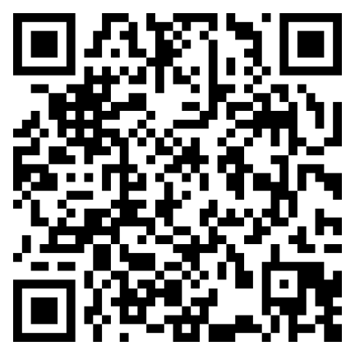
NEW WG5 Survey!
Jotfotm link: https://form.jotform.com/230802637609356
OR click QR code:

Slide 2
For who the survey is?
R&D and industry project coordinators & communicators,
plant owners, and
business & partnership developers,
working in the field of bioremediation and ecosystem services with algae.
Welcome to share with peers!

Slide 3
Action Plan WG5 objectives:
As you might know, the objectives of the Algae4Eco WG are:
1. Develop a knowledge hub on the bioremediation & ecosytem services potential of algae (in particular for nitrogen and phosphorus uptake); the carrying capacities of EU (coastal) waters for seaweed aquaculture and marine permaculture and impacts of algae cultivation on the health of the ocean and humans; and good practices providing algae bioremediation and ecosystem services. 2. Identify regulatory barriers in taking up ecosystem services and provide recommendations to EU and national authorities 3. Promote development of pilot and demonstration facilities and success stories for nutrients and energy recovery in the context of pollution prevention and waste treatment. 4. Facilitate matchmaking between companies and sectors providing and needing algae circular solutions

Slide 4
Why to contribute?
We are in the process of organising and consolidating the knowledge on European actors, projects and studies and we need support to dig deeper on EU state of the art.
By helping us, you can:
promote your projects and work within algae and get profiled as a WG5 good practice
disseminate your project results to a wider audience
highlight gaps in innovation and market access of your projects to drive change
get involved in developing recommendations for R&D agendas and regulatory solutions.
The main findings of this survey will be illustrated in the NEW knowledge library of the EU4Algae Maritime Forum site (currently under migration in 2023).
Findings will be analysed to understand gaps, assess R&D needs, identify good practices (tools, solutions), showcase success stories with the aim to transfer/expand etc.

Slide 5
Hot to fill in?
Fill in the survey:
expect it takes 10-15 minutes to complete.
Provide as many contacts/links as possible, so we follow individually.
Interim findings will be discussed in the next WG meetings, where you will have the opportunity to comment.
Survey is open until 28. April.
Jotfotm link: https://form.jotform.com/230802637609356
OR click QR code:

Slide 6
Now to the content of the survey!!

Slide 7
1. Algae projects
In December during the EU4Algae event in Rome, we presented a list of 750+ algae projects among others.
Since then we have identified 45 European projects relevant to bioremediation and ecosystem servcices.
The short list is:
SeaMark AquaVitae REALM AlgaeService for LIFE EKOGRID ROC-POP-LIFE REMEDIA Life DBL-OA REMEDIA GRACE REWATER P4SB LIFE COASTLAKE NAVEBGO MEWLIFE GreenFly REEgain LIFE ALGAECAN BREWERY LIVE LAGOONS Water2REturn URBIOFIN ALGAMATER SABANA VOLATILE INDALG Live Lagoons (seed) BAQUA SALTGAE WaterPro INCOVER HPGen ReSpirA PHARM AD ECO-LOGIC GREEN FARM NewFert IPHYC-H2020 algaPLUS LIFE+ TL-BIOFER LIFE-REMPHOS SEA-MATTER CENIRELTA ECLIPSE WW-SIP ECOMAWARU.

Slide 8
Algae projects
Add relevant public deliverables from relevant EU projects (if not listed above, add project).
OTHER national, regional, or industry projects - not listed above - and relevant public deliverables
Other comments on projects e.g. questioning data quality.

Slide 9
2. Algae Studies
Please help us identify any public studies or publications on:
assessments, such as LCA or socio-economic, due dilligence
feasibility studies
business models
good practices, such as compensation schemes
other.
Study of any language is welcome here. English is prefered.
Ideally, we need a project/deliverable name and a weblink. If you wish to send documents directly, send content to ea@submariner-network.eu marking "WG5 survey".

