Slide 1
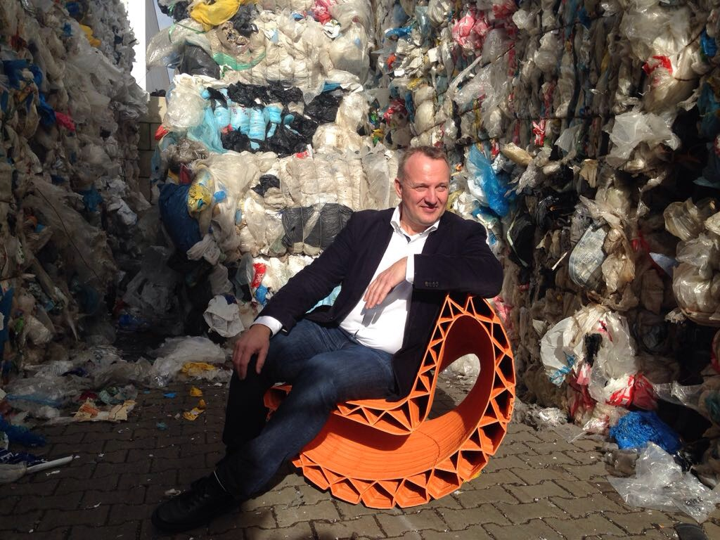

«DOING NOTHING IS NOT AN OPTION»
BERNARD MERKX
Social entrepreneur
Co – founder WasteFreeOceans
Honorary President PlasticsRecyclersEurope
a.o.
EU STAKEHOLDER MEETING FISHING GEAR
BRUSSELS 26 FEBRUARY 2019

Slide 2
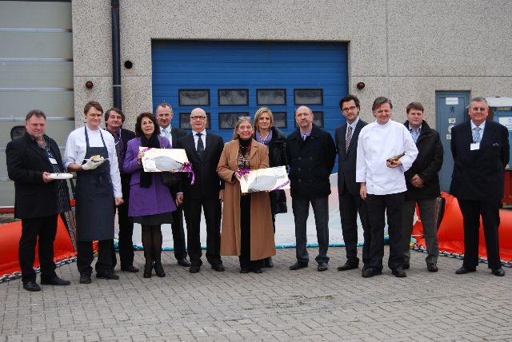
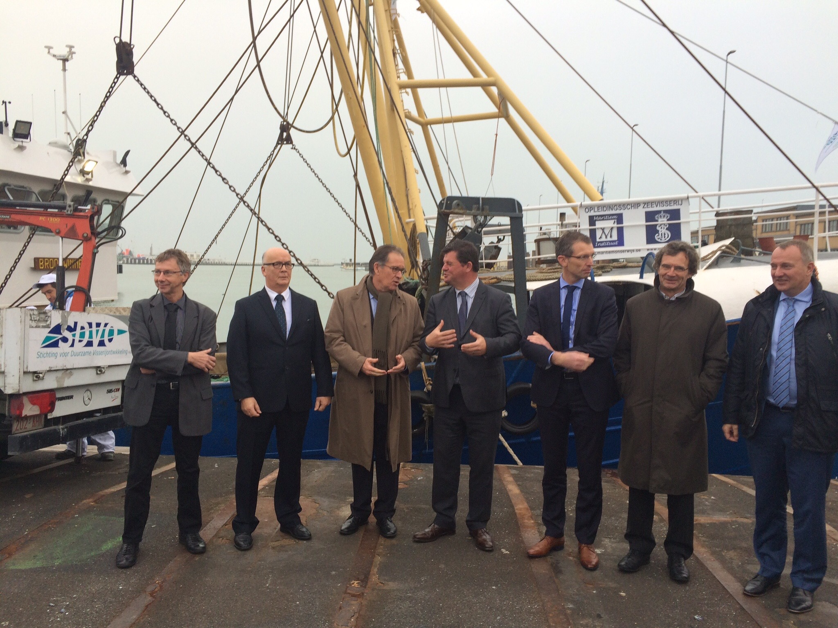
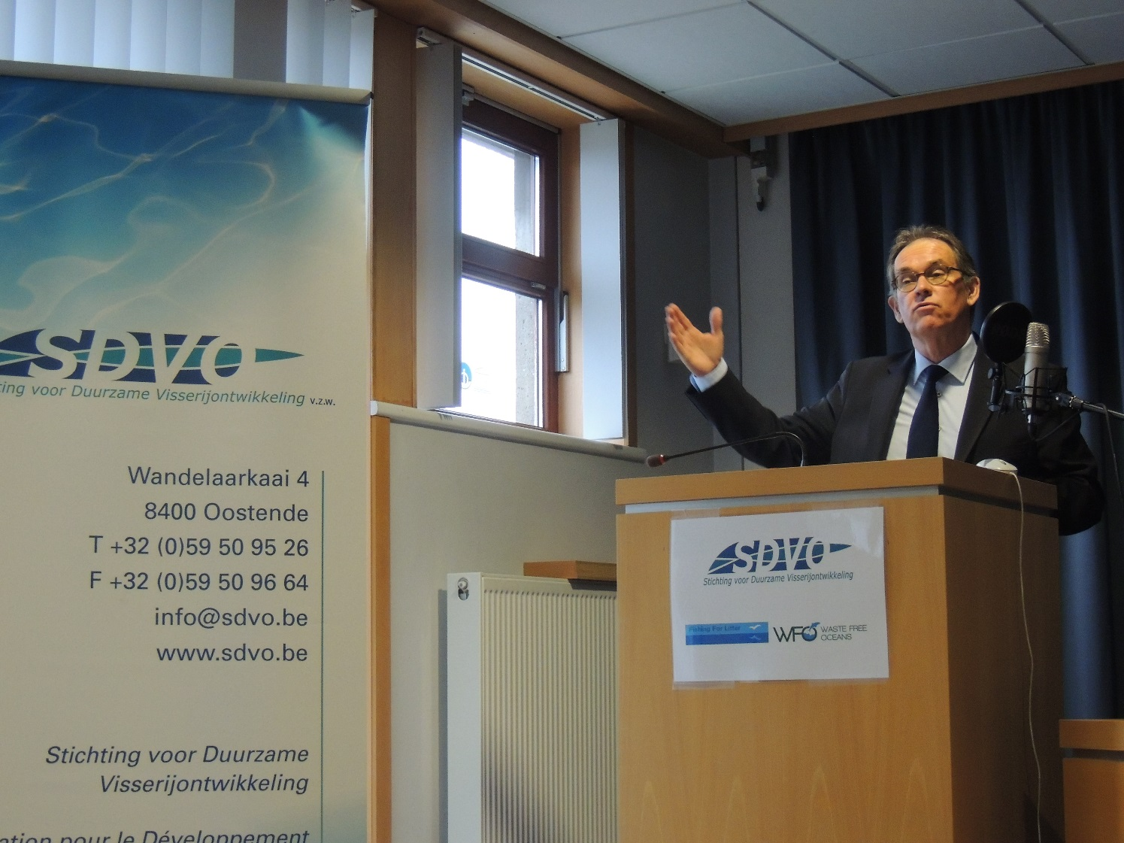





WASTE FREE OCEANS -> HORIZONTAL CO-CREATION SINCE 2011
“Let ‘s combine poverty eradication with improved environmental behaviour
and give local populations a better basis, with cleaner (drinking) water
and less rubbish” - Bernard Merkx WFO co-founder -.
“This WFO foundation activity needs to be promoted all over Europe and
even all over the world. Pollution has already reached levels which are
no longer acceptable for our future generations”.– MEP Alain Cadec,
President EU Parliament Fishery Committee
“Litter is a valuable resource in the wrong place” – Achim Steiner UNEP

Slide 3
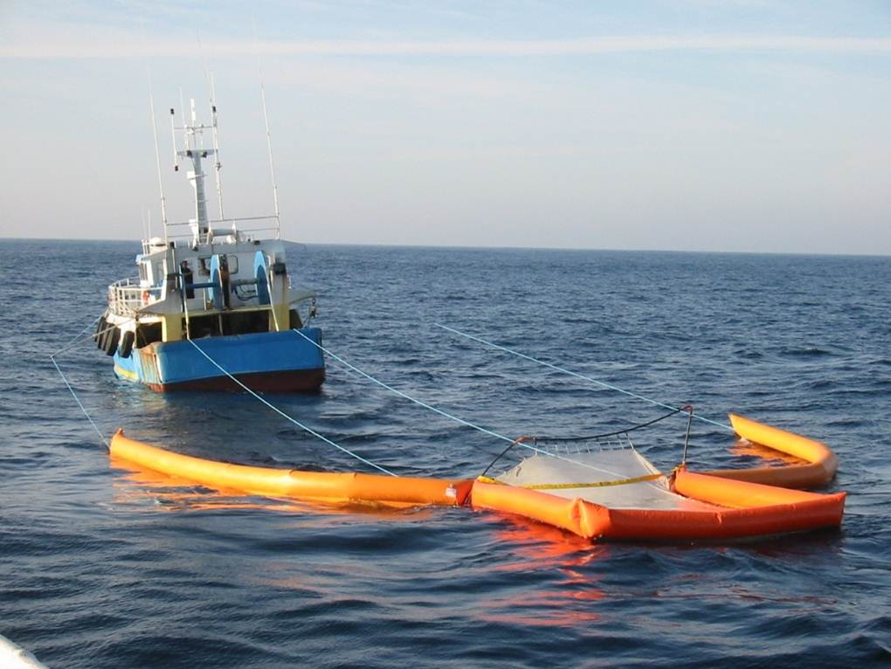
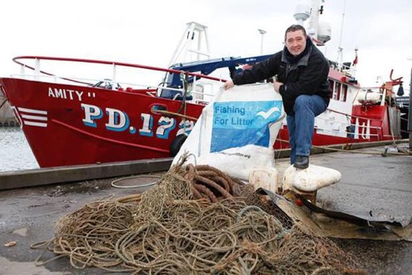
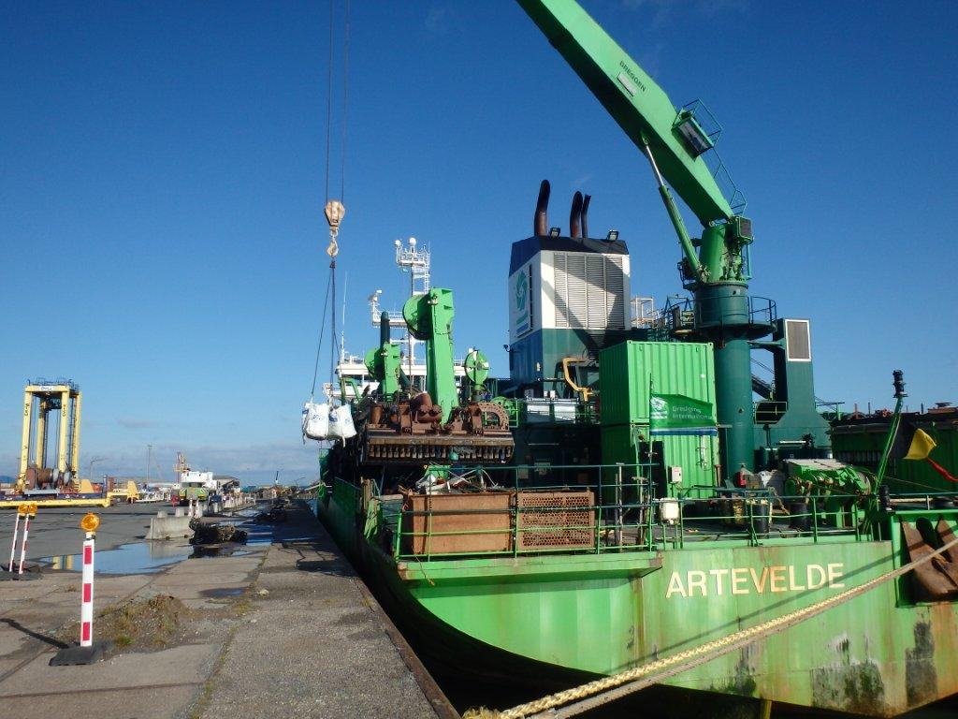
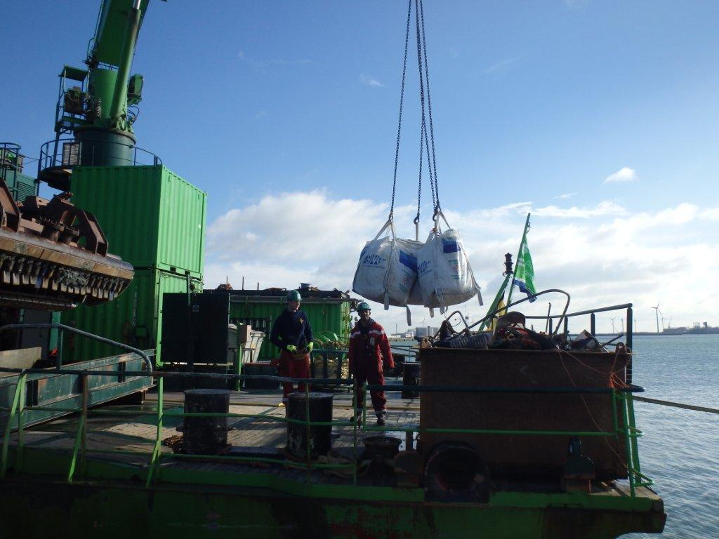
FISHING FOR LITTER WFO STYLE – TACKLING EXISTING MARINE DEBRIS
.

Slide 4
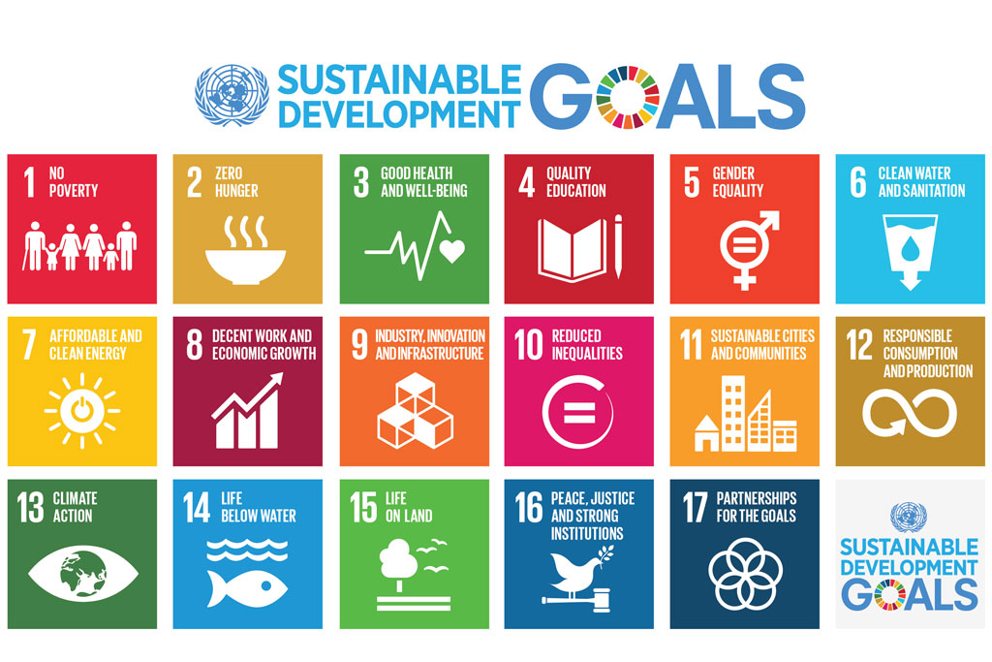
SOLUTIONS ARE TO BE FOUND IN HORIZONTAL CO-CREATION

Slide 5
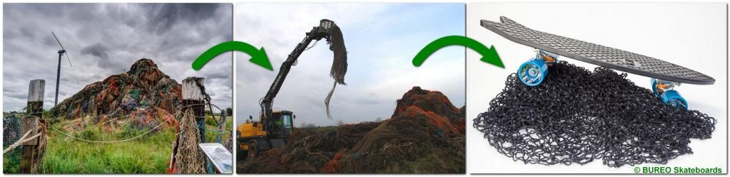
HAPPY SEAL – HORIZONTAL CO- CREATION
.

Slide 6
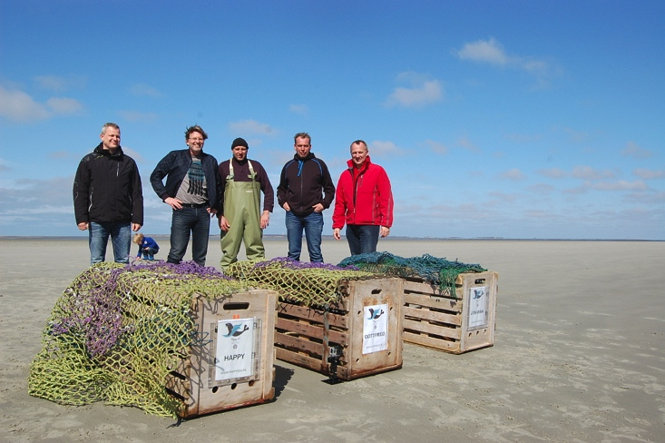
HAPPY the SEAL & FRIENDS BROUGHT BACK TO WILDLIFE WITH FISHERMEN
.

Slide 7
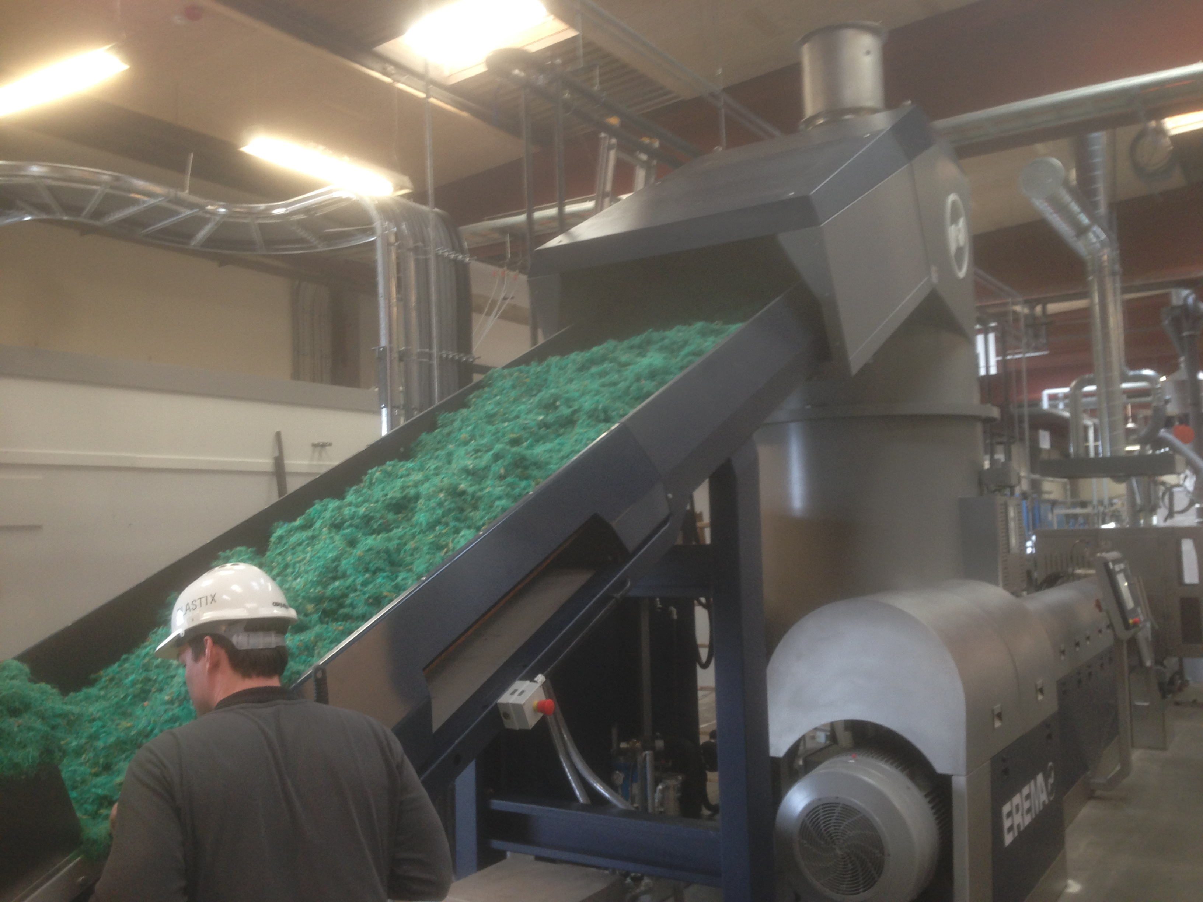
AND MECHANICAL RECYCLING SOLUTIONS BECOME AVAILABLE
.

Slide 8
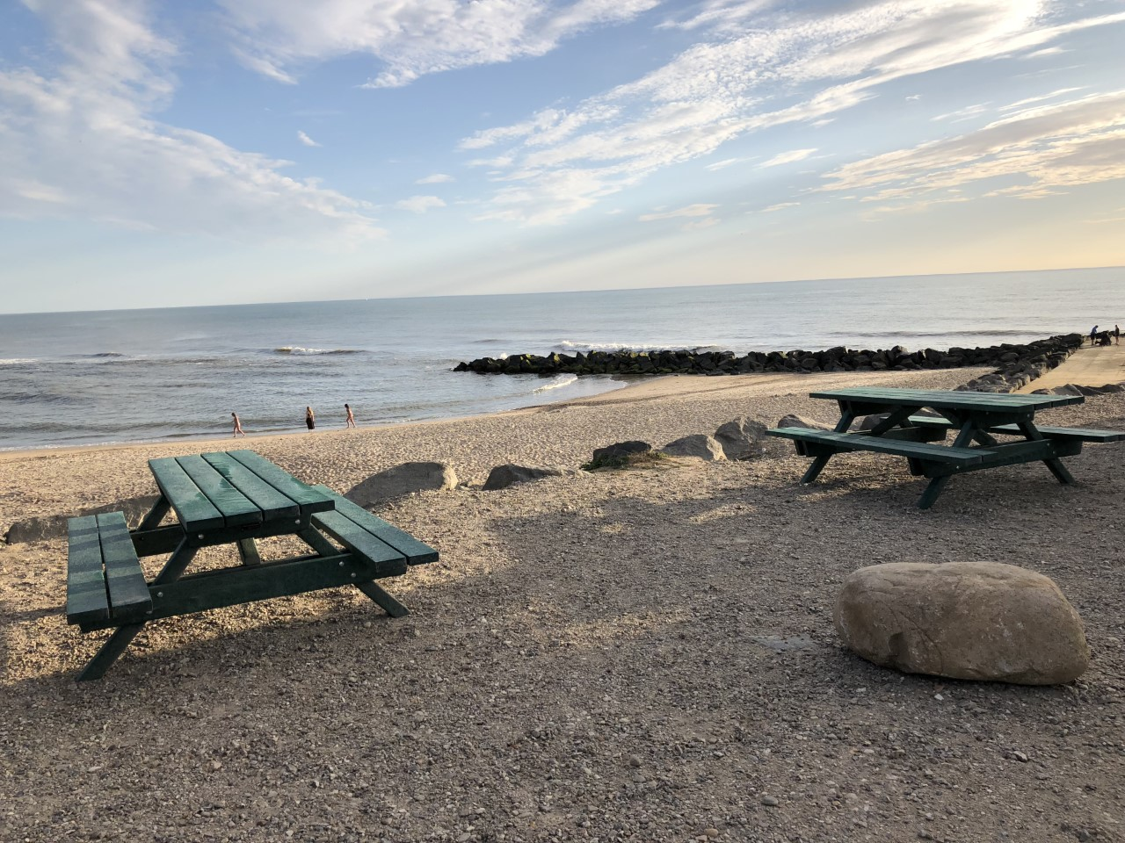

FROM FISHING GEAR TO PIC NIC SET (100% rHDPE)
.

Slide 9
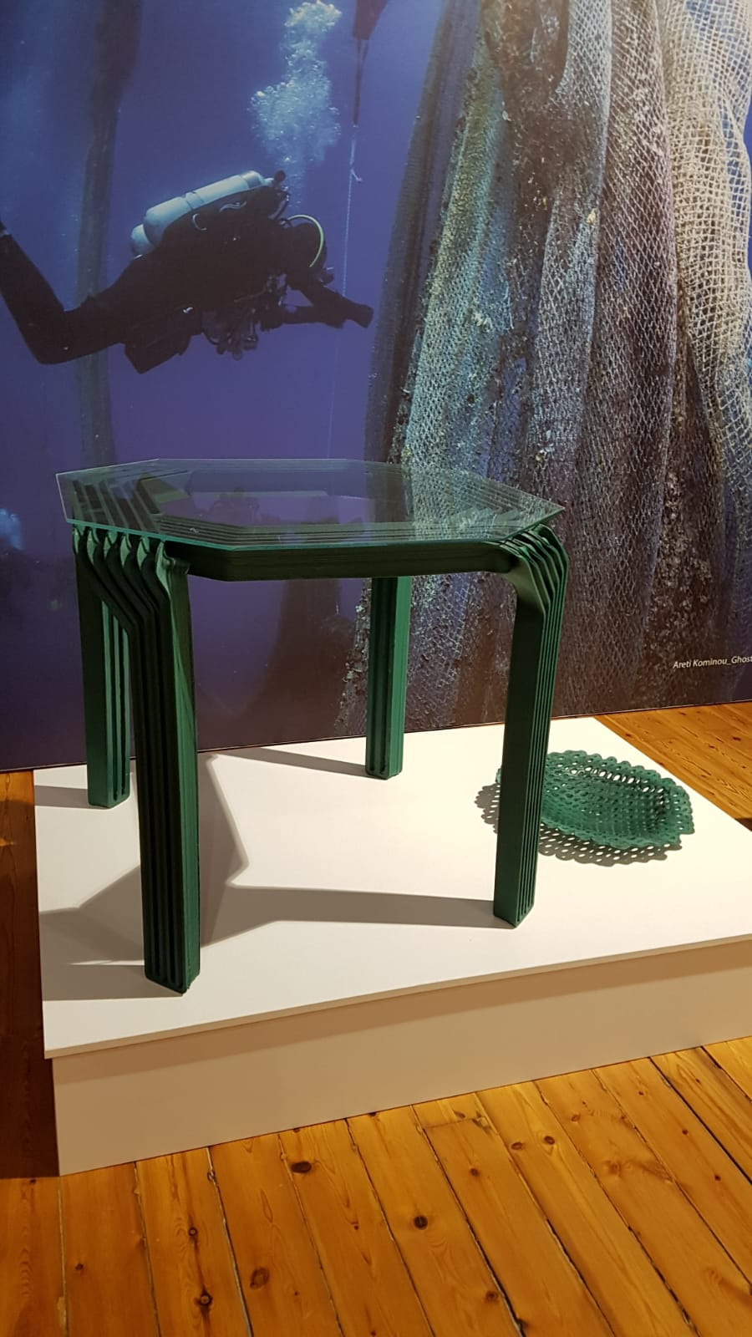
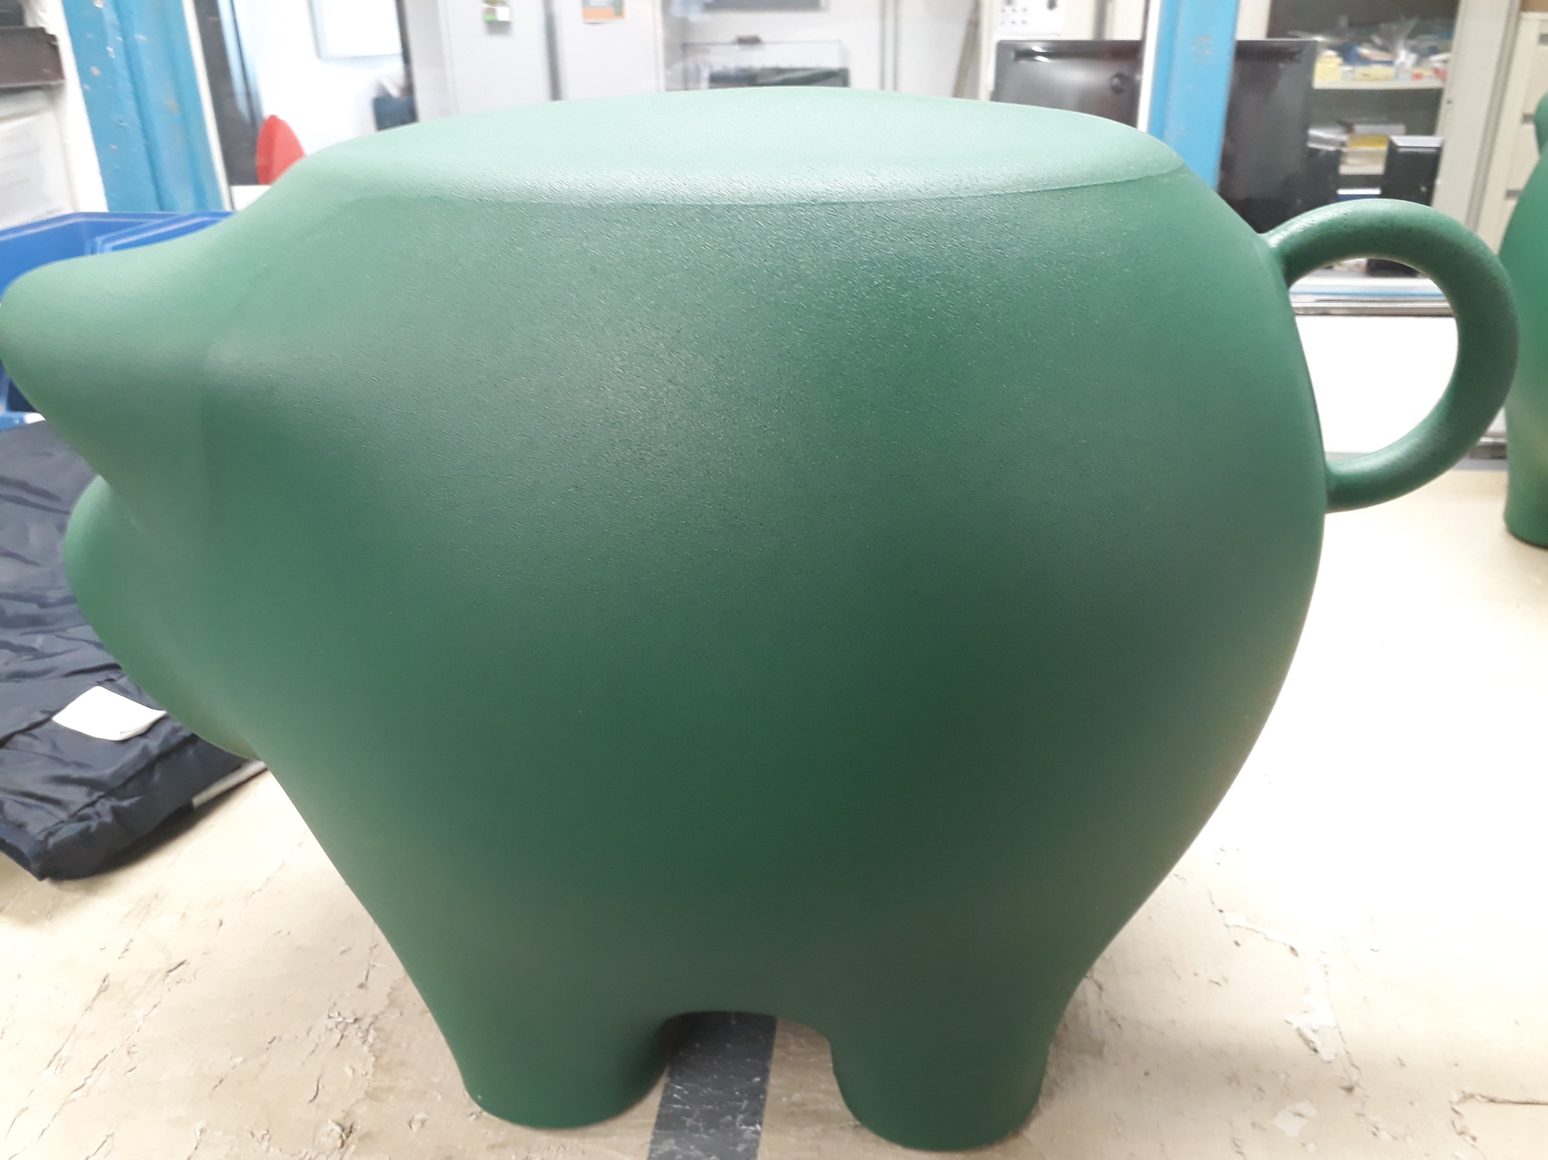
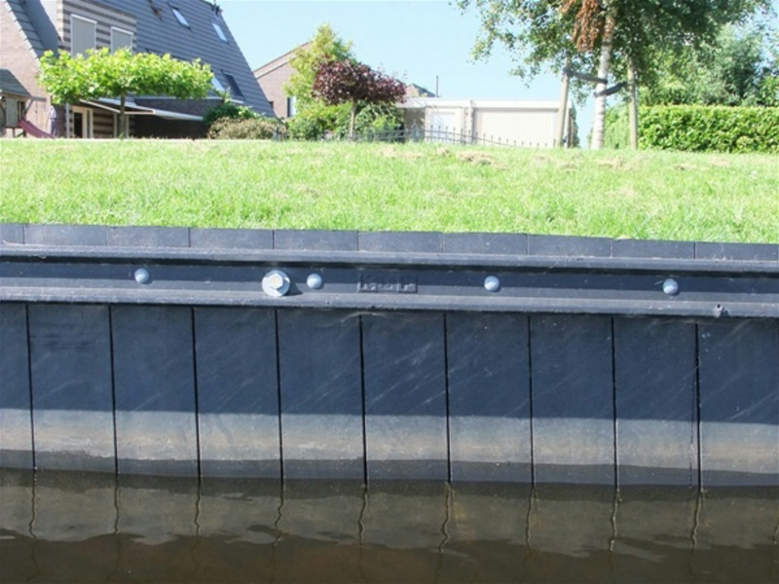
FROM FISHING GEAR TO LONG LIFE APPLICATIONS (100% rHDPE)
.

Slide 10
IT ALL STARTS WITH CLEAR DEFINITIONS
What is RECYCLING ?
(Waste Framework Directive 2008/98/EC definition)
Recycling means any recovery operation by which waste materials are reprocessed into products, materials or substances whether for the original or other purposes.
It includes the reprocessing of organic material but does NOT include energy recovery and the reprocessing into material that are to be used as fuels or for backfilling operations.
Hence: Collection, logistics, sorting and “recovery” is clearly not recycling
Mechanical recycling not only safeguards valuable resources but at the same time also a considerable amount of CO2 emissions compared to virgin plastics

Slide 11
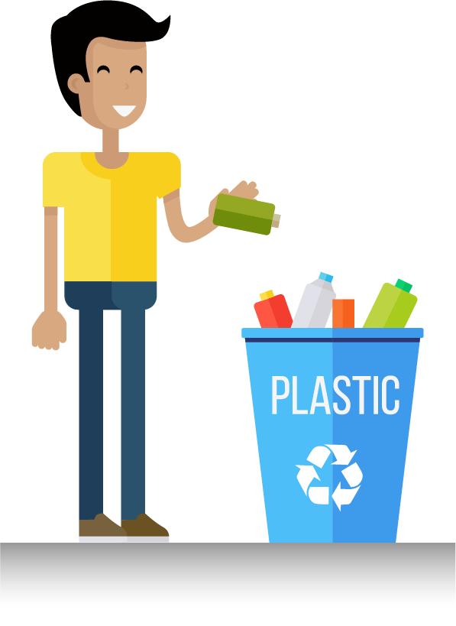
What does recyclability mean?
The product must be made with a plastic that is collected for recycling, has market value and/or is supported by a legislatively mandated program.
The product must be sorted and aggregated into defined streams for recycling processes.
The product can be processed and reclaimed/recycled with commercial recycling processes.
The recycled plastic becomes a raw material that is used in the production of new products.

