Slide 1
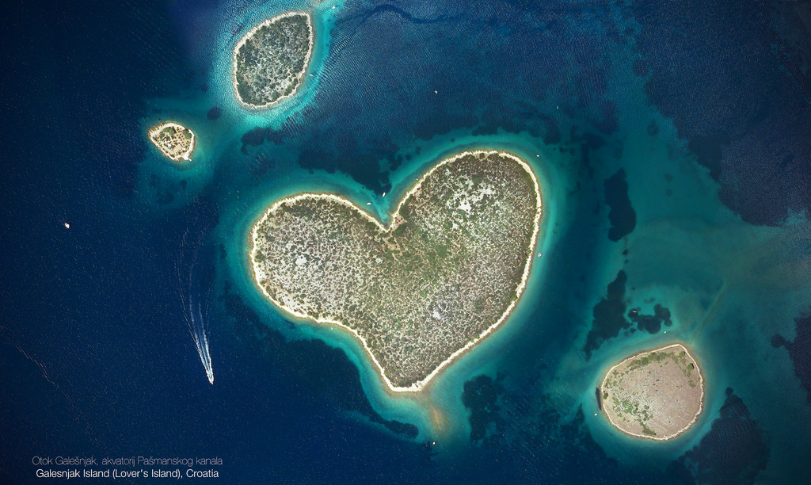
Tomislav Šarić
Department of Ecology, Agronomy and Aquaculture
University of Zadar
Croatia

Slide 2
PROJECT INFO
Total eligible costs: 399.493,00 €
EU contribution: 319.593,00 €
Project duration: 01/01/2017 – 31/12/2018
Coordinator:
P1 - University of Zadar, Department of ecology, agronomy and aquaculture
Partners:
P2 - Cromaris d.d.
P3 - WWF Adria
P4 - Zadar County Rural Development Agency

Slide 3
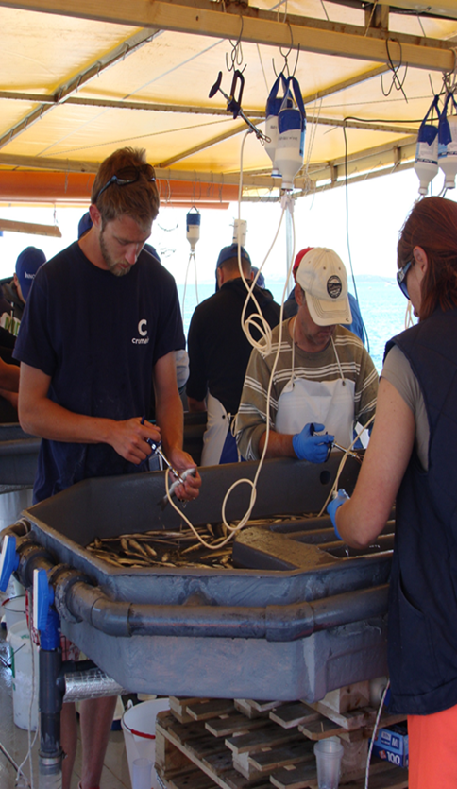
PROJECT OBJECTIVES
Main objective:
To create new skills and competences in blue economy sector and increase the employability of current and future sectors' workers in the County of Zadar and broader
Two specific objectives:
To create conditions for training of a new generation of students and professionals equipped with the appropriate skills to match the needs of the blue industry
To provide people already working in the field with the new skills

Slide 4
GRADUATE STUDY PROGRAMME – 1st objective achieved
„Sustainable Management of Aquatic Ecosystems”
Science area: Biotechnical; Duration - Two years; Number of ECTS: 120 ECTS
Multidisciplinary approach
made with inputs from 4 different sectors (scientific, public, private-blue sector, non-government)
Various fields covered; from local to global topics
Students easily employable

Slide 5
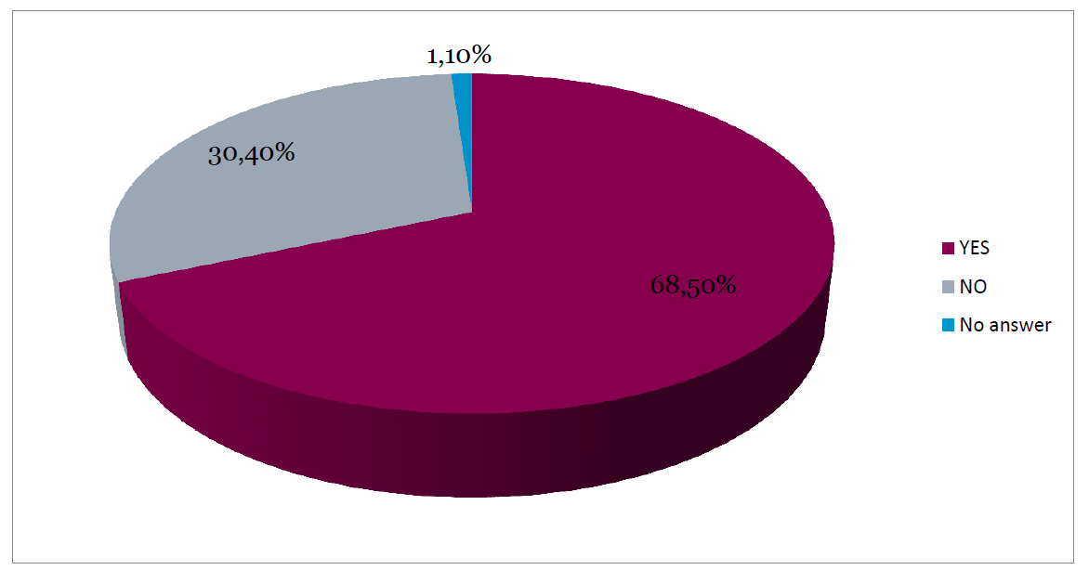
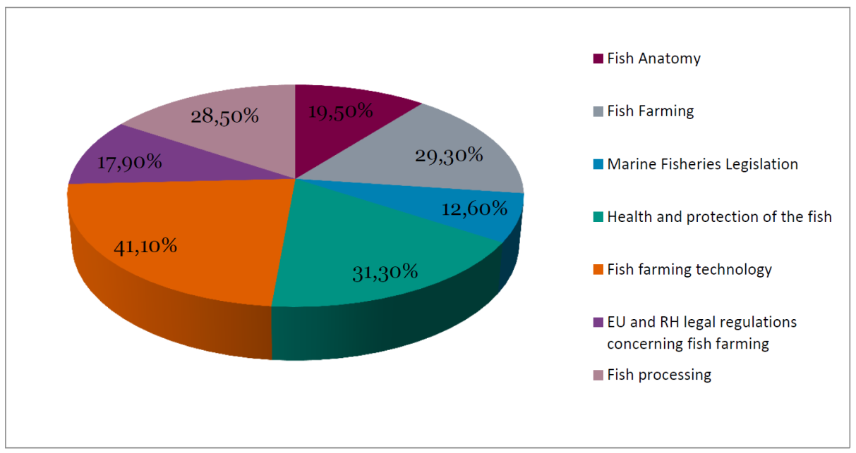
ON-LINE TRAINING COURSE – 2nd objective achieved
New learning material accessible to everybody (Universities, VET providers, companies in the sector, general public) and completely free (on-line)
„Introduction to Sustainable Fisheries Practice ”
Sector analysis and workers’ needs respected during the development of online course
Would you like to improve your knowledge related to the fish farming?
Please, mark in which of the stated areas would you like to gain further knowledge?

Slide 6
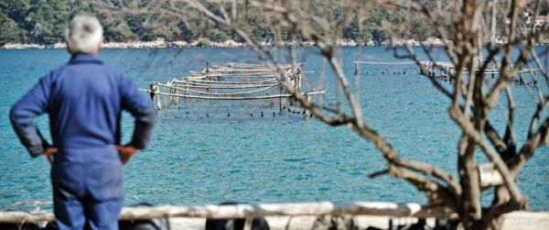
Transferability and replicability
On-line course:
easily transferable and replicable in any other area and/or country in the EU (and wider)
easily adoptable in diverse fisheries and aquaculture sector
Study programme:
transferable thought knowledge within student exchange programs ( for example: ERASMUS+)
development process of graduate study could be used as a good multidisciplinary approach example (joint work of various stakeholders from different sectors –cooperation required!)

Slide 7
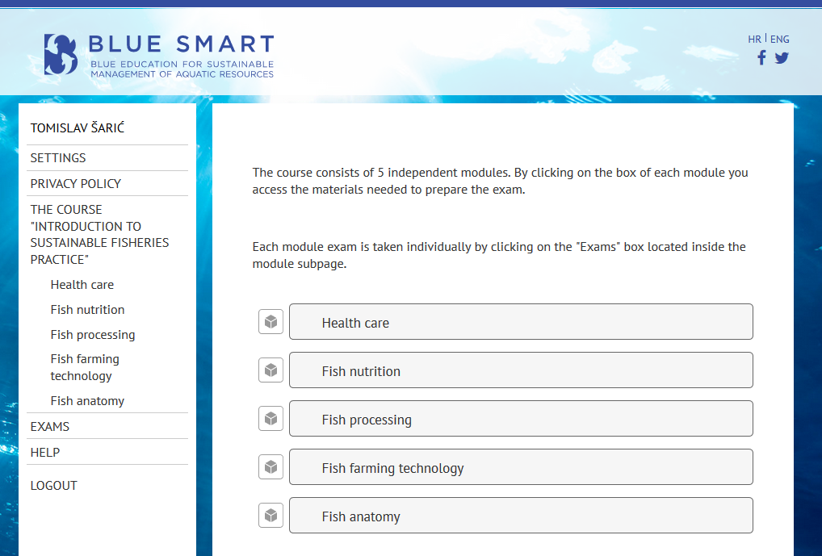
Potential barriers and how to overcome them
On-line course:
Available in English language. However, in fisheries sector through the Mediterranean countries this could be potential barrier. To overcome this problem, modules within on-line course should be translated.
Study programme:
Mainly in Croatian language with few courses taught in English language. Therefore, to have broader audience in future, we plan to propose whole study program in English language.

Slide 8
Thank You For Your Attention
www.bluesmart.hr Facebook Twitter Newsletter

