Slide 1
Standards: INSPIRE view services
Mandatory operations for an INSPIRE View service:
INSPIRE View Service operations ISO 19128:2005(E) WMS operations
Get Service Metadata GetCapabilities
Get Map GetMap
Link View Service Use Discovery Service, “Discover Metadata” operation
The following profiles are recommended for an INSPIRE-compliant View service implementation:
Basic profile: support of GET method for the “Get Service Metadata”, “Get Map” and “Link View Service”;
Standard profile: basic profile and support of the GetFeatureInfo operation through the GET method;
SOAP profile: basic profile plus support of the SOAP/POST method for the three mandatory View service operations;
Advanced SOAP profile: SOAP profile plus support of the GetFeatureInfo operation
though the SOAP/POST method
Notes:
Original plan: Ifremer were going to set up a central SeaDataNet WMS service registry, in which it would be able to register all EMODNET and SeaDataNet services with their service metadata.

Slide 2
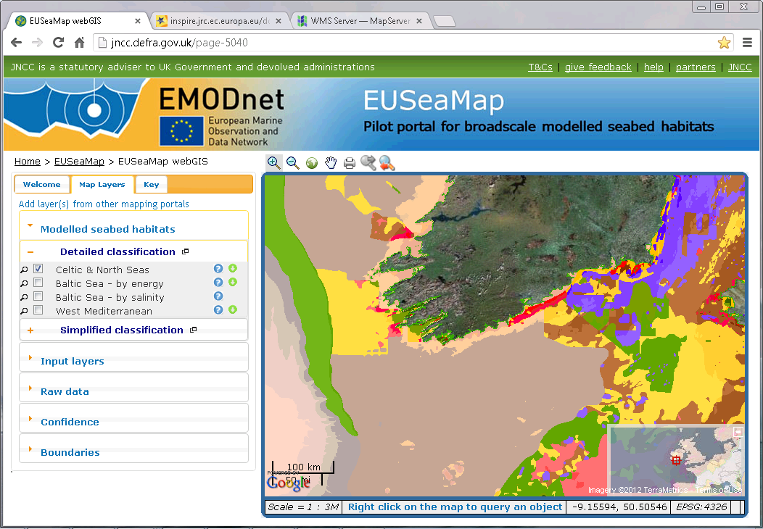
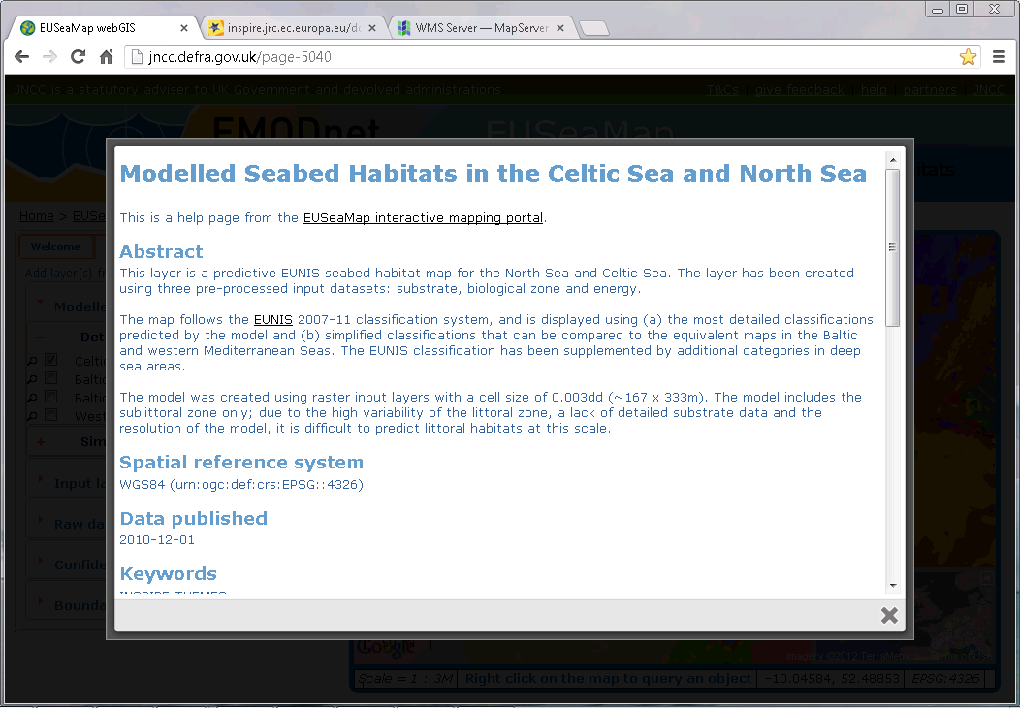

Slide 3
Web Map Services

Slide 4
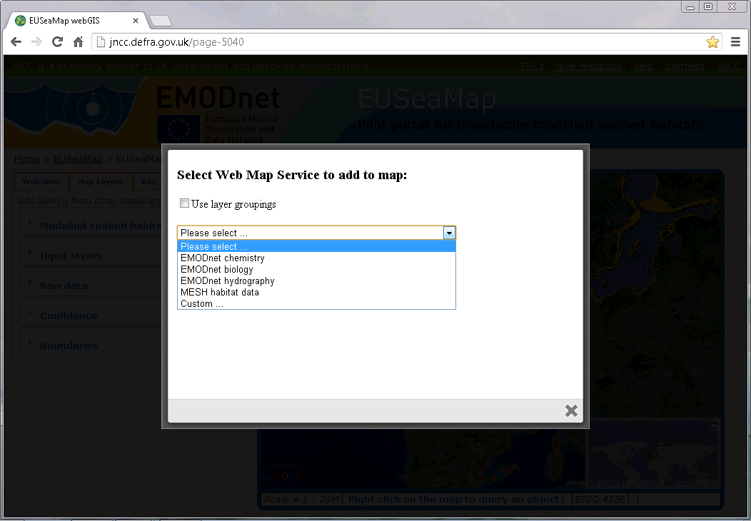
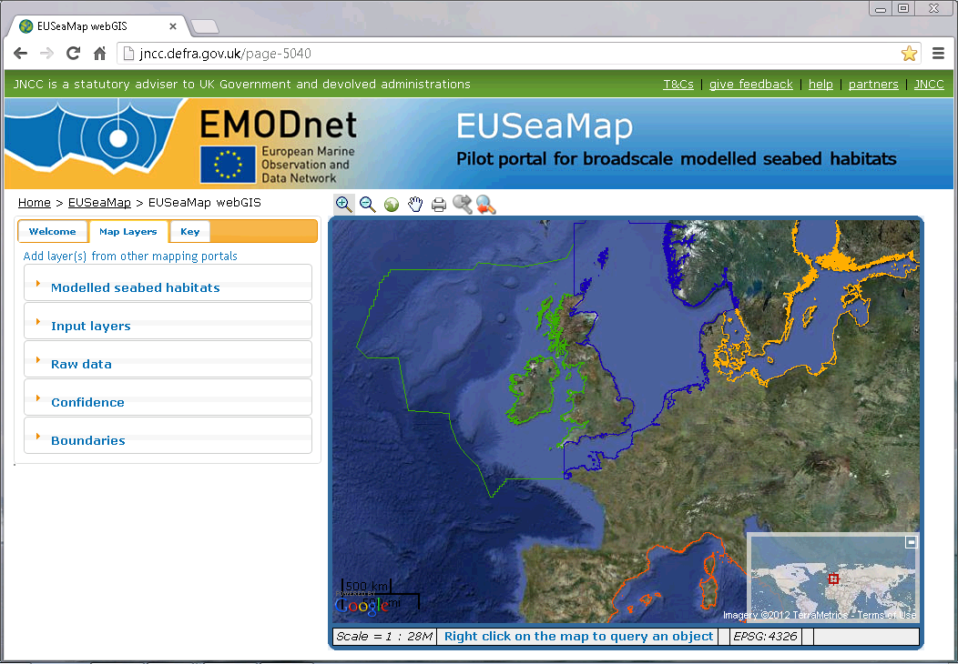
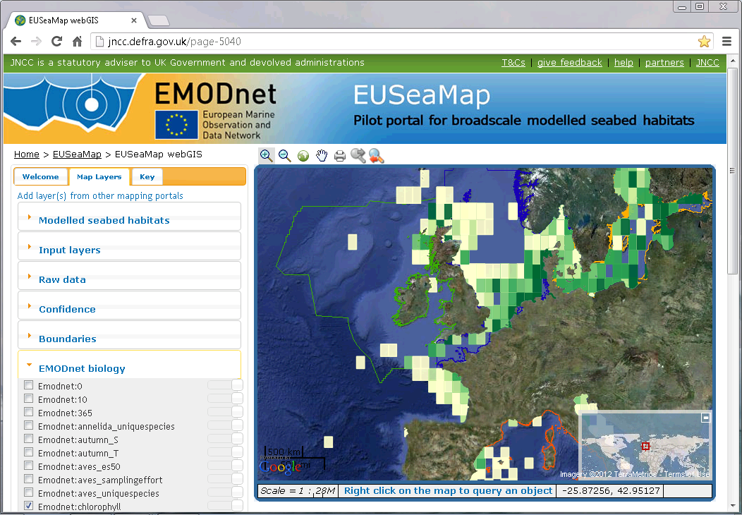

Slide 5
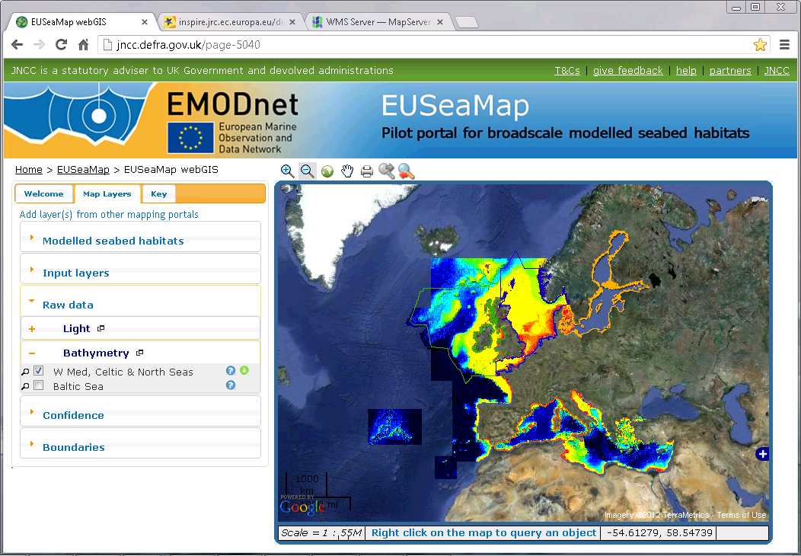

Slide 6
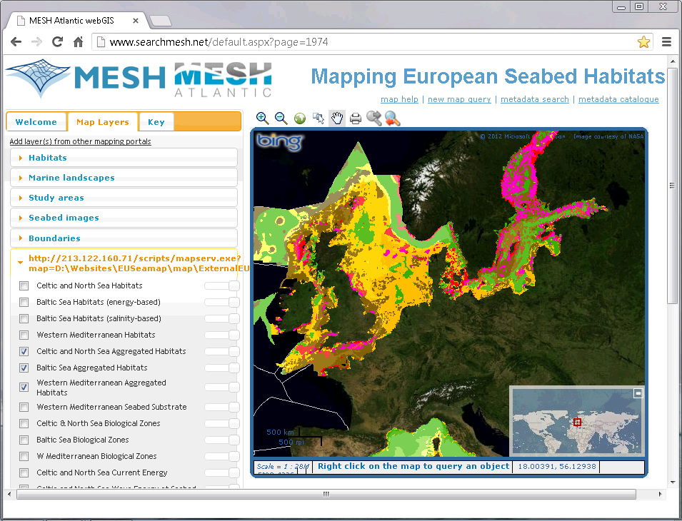

Slide 7
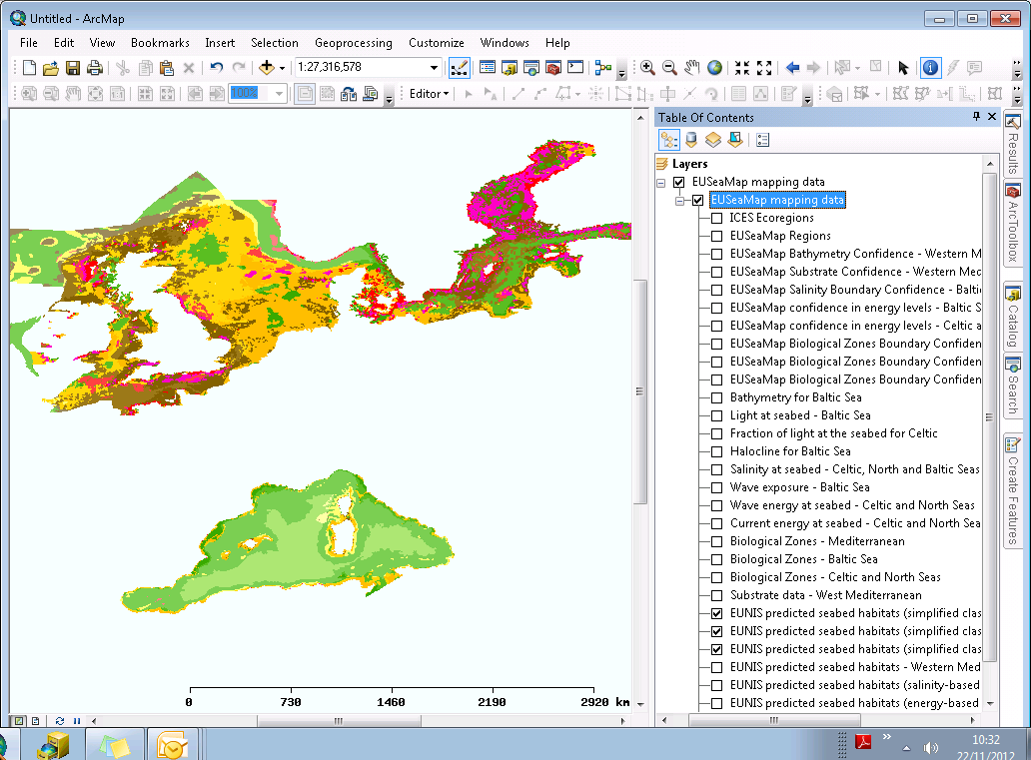
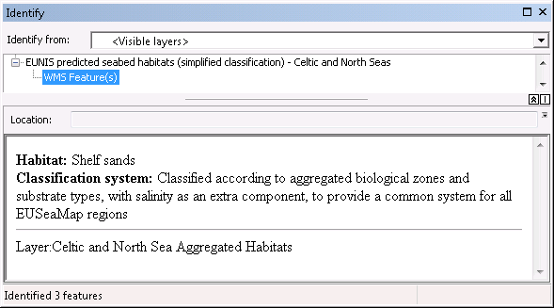
?
Notes:
Web mapping service:
http://213.122.160.71/scripts/mapserv.exe?map=D:\Websites\EUSeamap\map\ExternalEUSeamapWMS.map

