Slide 1
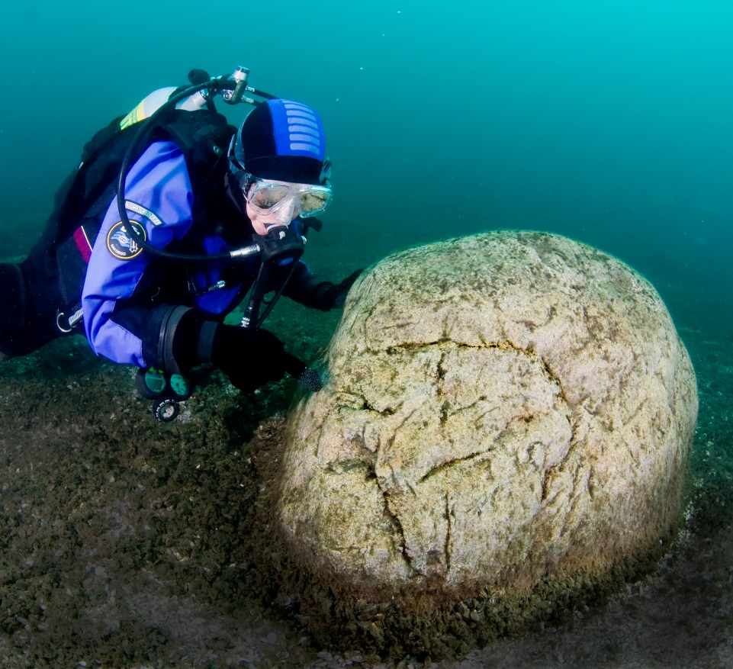
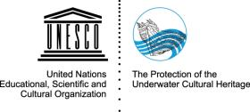
UNESCO and the 2001 Convention on the Protection of the Underwater Cultural Heritage

Slide 2
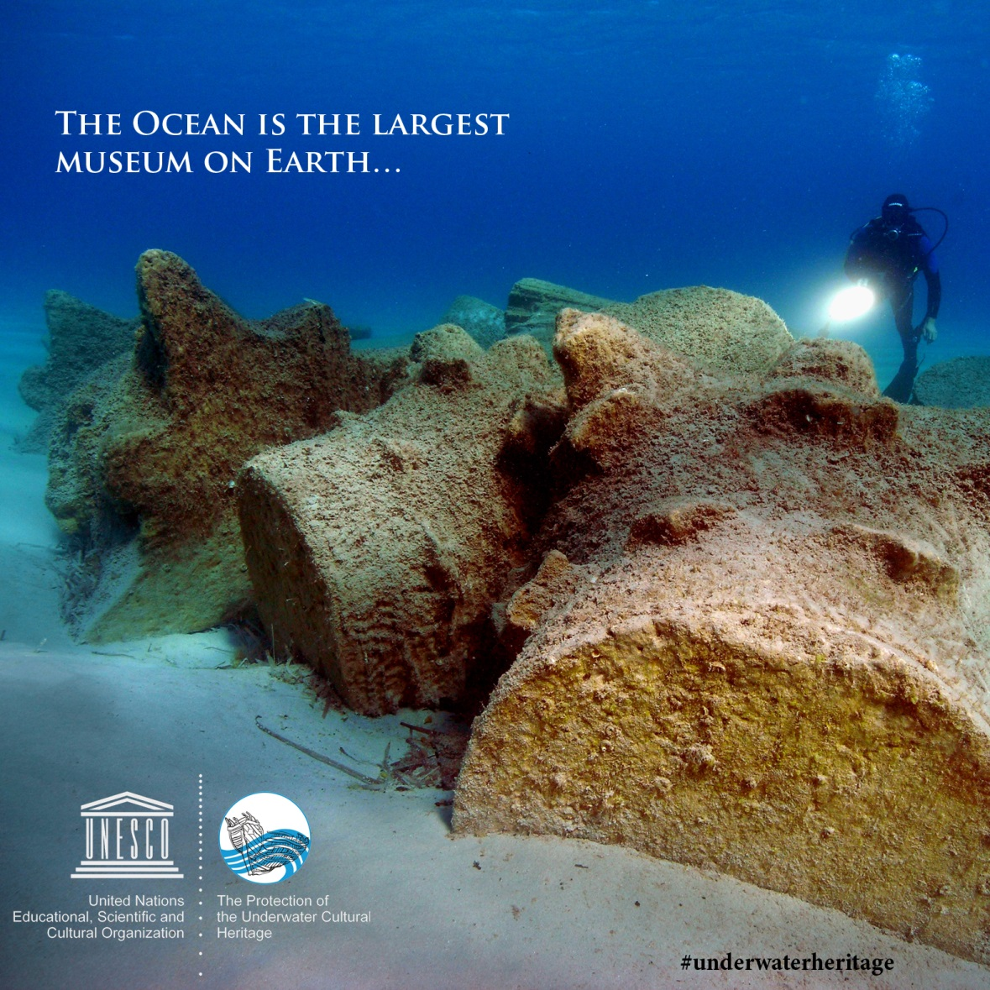
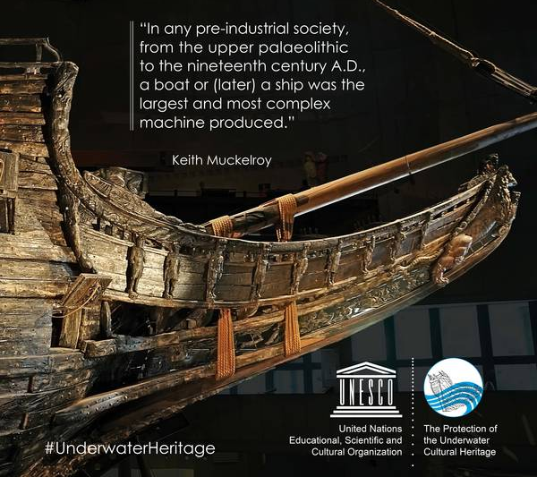
But it is under threat….

Slide 3
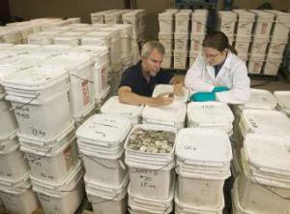
The Challenges
High destruction of UCH
pillaging by treasure-hunters
commercial exploitation
trawling impact and seabed exploitation
metal recovery
Few underwater archaeologists
Too low research and protection investment
Access lackinng…A hidden heritage

Slide 4
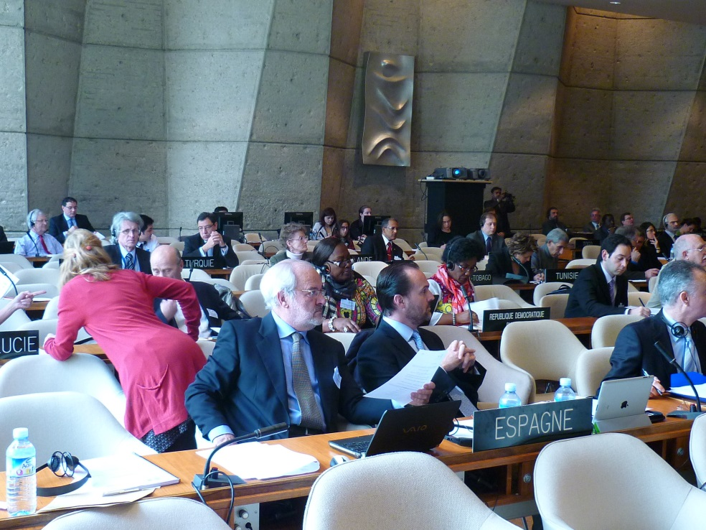
Objective 1 Protection and Research

Slide 5
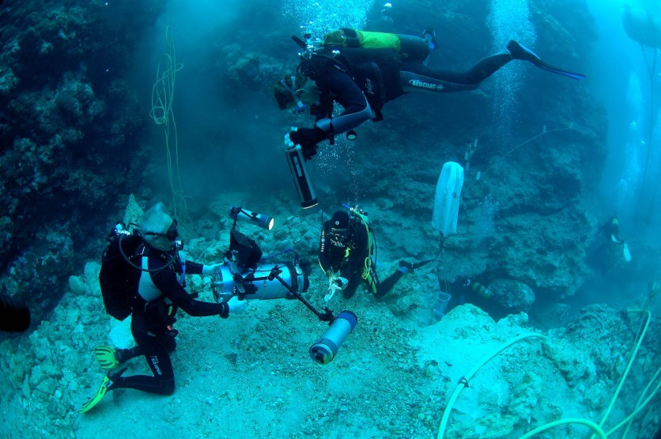
Achieve full legal and practical protection
Help in emergencies
Set standards and foster research
Share data through international networks

Slide 6
→ 1. Legal Protection: The UNESCO 2001 Convention
Ethical principles for the protection of UCH
Comprehensive legal protection against commercial exploitation, pillage and traffic
Legal protection in all waters, from lakes to high seas
Widely recognized rules for the treatment and research of UCH (Annex).
A true expert intervention body.

Slide 7
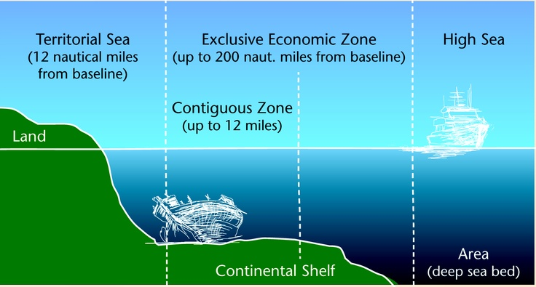
Why do we need a common legal approach?
The situation:
Increasing seabed use; increasing global exchange of artefacts; big difference in technical advances in States; gaps in jurisdiction

Slide 8
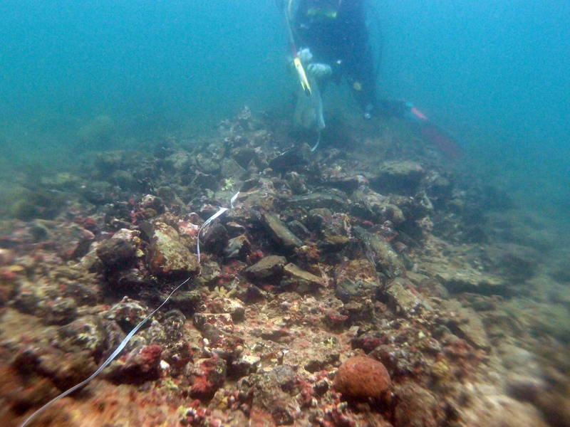
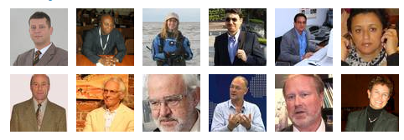
→ 2. Help in Emergencies
Scientific and Technical Advisory Body
12 reputed experts
Practical help to States Parties
High visibility
Responds to lack of competence
Emergency response

Slide 9
→ 3. Building a Network under the Convention
Meeting of States Parties
UNESCO University Network (21 Universities)
15 accredited NGOs
1 regional centre in Zadar, Croatia
Wide expert network
Facilitation of data share through meetings, conferences and education worldwide

Slide 10
Where we stand.
51 ratifications, incl. many EU States
2001 Convention central standard for
underwater archaeology worldwide.
12-expert Advisory Body (STAB)
Wide training provided
Extensive training and communication material
50 UNESCO Field Offices working on UCH issues

Slide 11
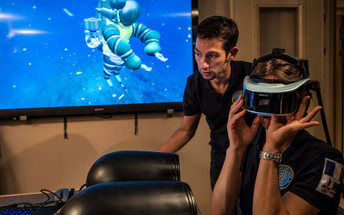
Objective 2 Making Submerged Heritage Accessible

Slide 12
Making the invisible visible.
The difficulty of access is the dividing factor for the respect for UCH in comparison to land heritage.
Make sites accessible, in situ, in museums or virtually is crucial.
Increase the public benefit of UCH.
Provide a common access platform.

Slide 13
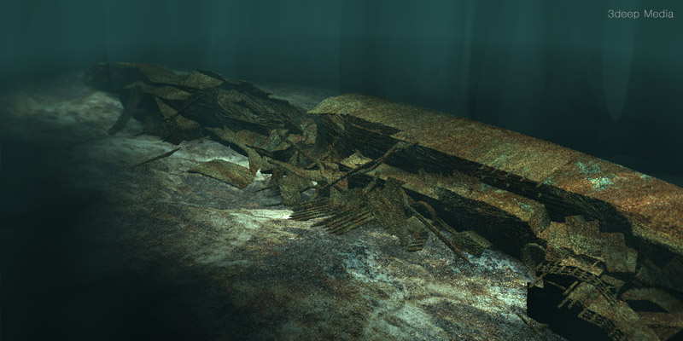
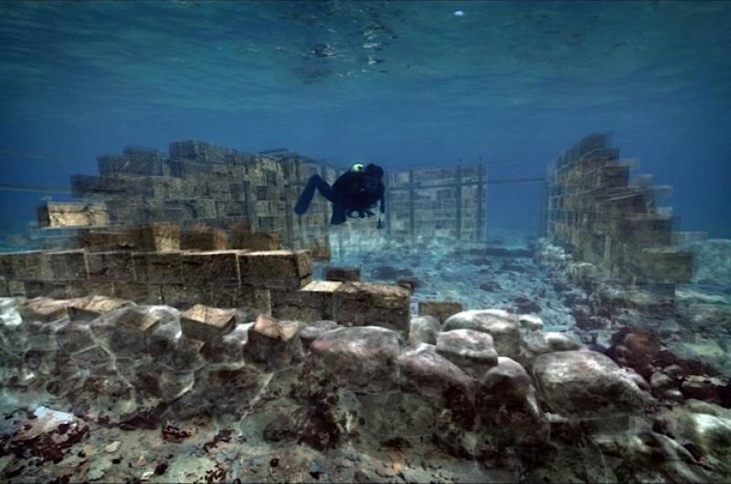

Slide 14
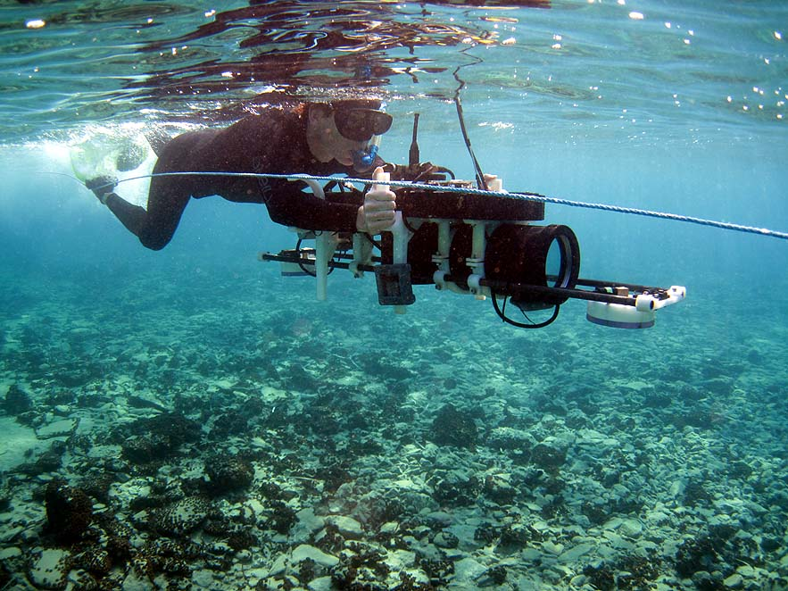
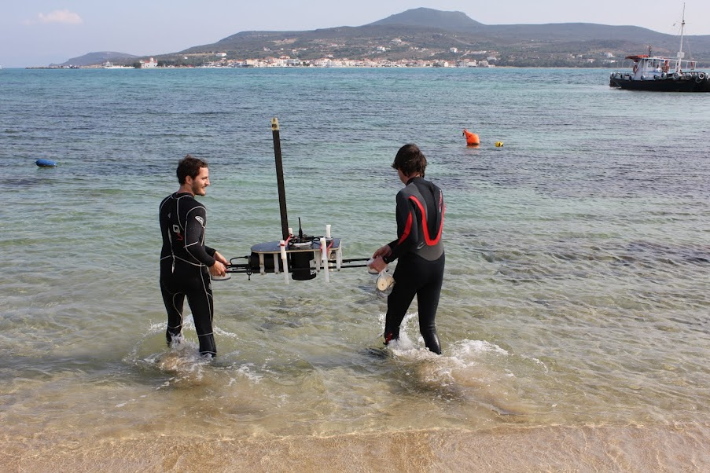
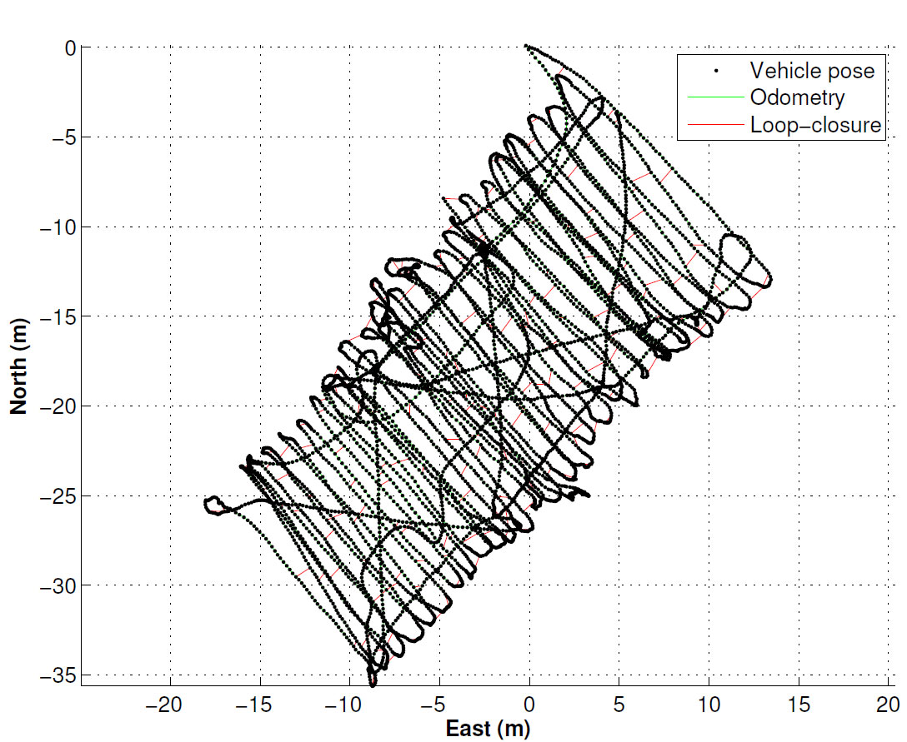
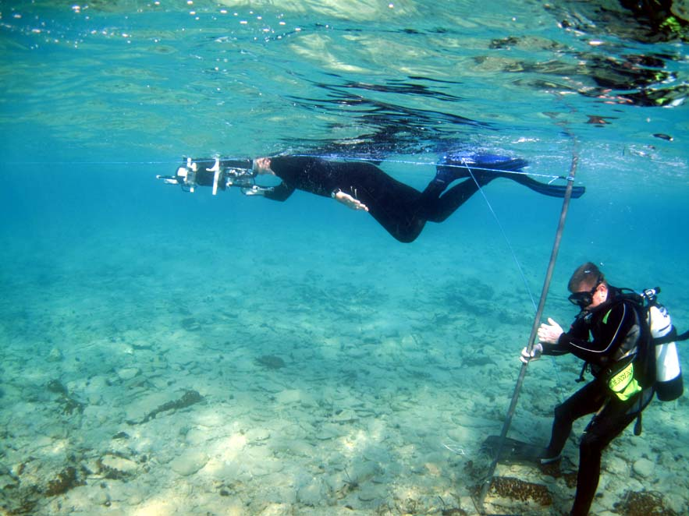

Slide 16
Heritage is more than beauty… Underwater cultural heritage & peace education.

Slide 17
What UNESCO and EU can achieve together

Slide 18
Priorities
Creation of UCH capacities and common advocacy of standards (2001 Convention)
More protection measures, less UCH exploitation
More research and a global academic network
More conscience of submerged heritage
Foster access to UCH
Focusing research and actions on global priorities
Bring UCH issues into high-level discussions on tourism, sustainable development, climate change, research

Slide 19
The advantages of UNESCO
Wide, global expert network
Direct access to 195 governments in culture issues
Close connection to scientific community
50 field offices, 195 Permanent Delegations and National Commissions
Secretariat of 2001 Convention and involvement in field since 40 years
High credibility to set trends in underwater archaeology (scientific standards, foster access, foster virtual reality use, etc.)

Slide 20
What the EU can gain from cooperation with UNESCO
Sustainable projects, integrated in a long-term culture programme
Reliable expert choice and professional lead
Global overview on what is state-of-the-art
Focused interventions on priority issues in the field
Global impact on the cultural heritage domain

Slide 21
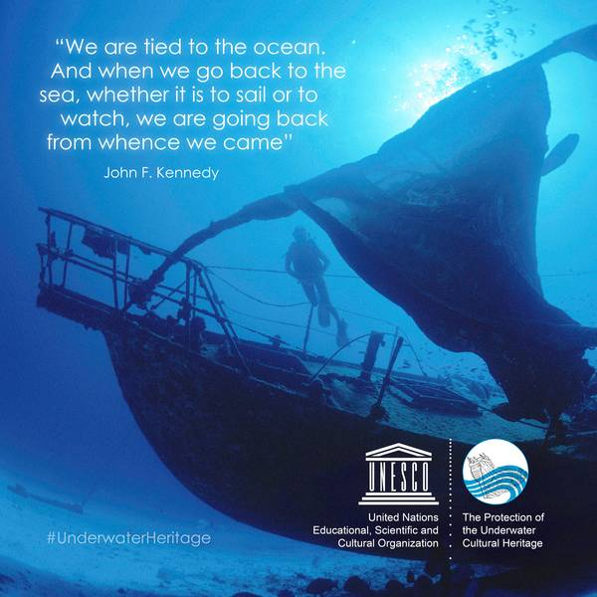
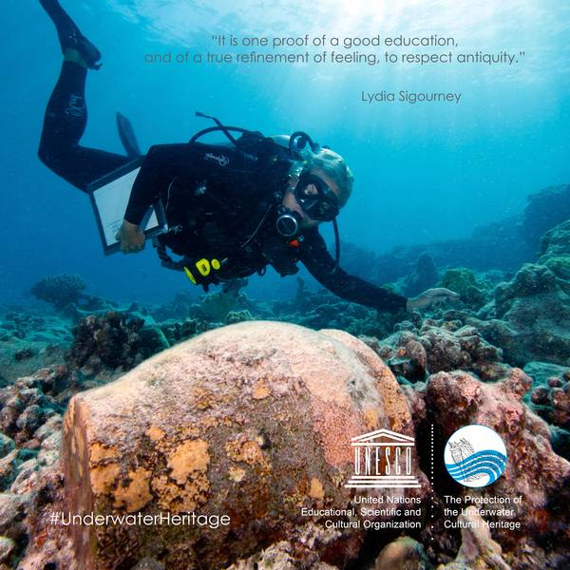
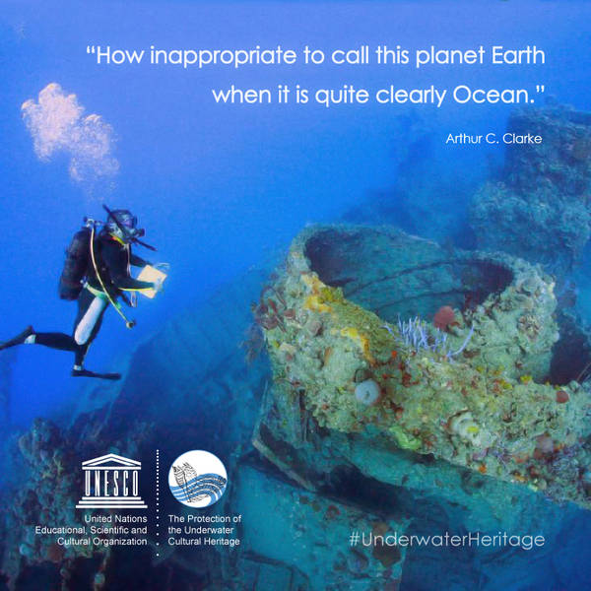
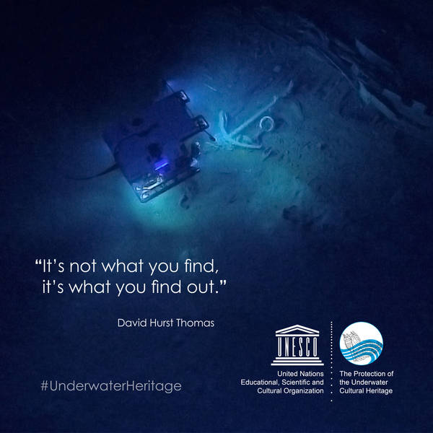

Slide 22
Contact:
Ms Ulrike Guérin, UNESCO
Programme Specialist in charge of
Convention on the Protection of the Underwater Cultural Heritage (2001)
7, place de Fontenoy, 75352 Paris 07 SP France
Tel: + 33 1 45 68 44 06
Email: u.guerin@unesco.org
Skype: underwaterculturalheritage
Web: www.unesco.org/en/underwater-cultural-heritage

