Slide 1
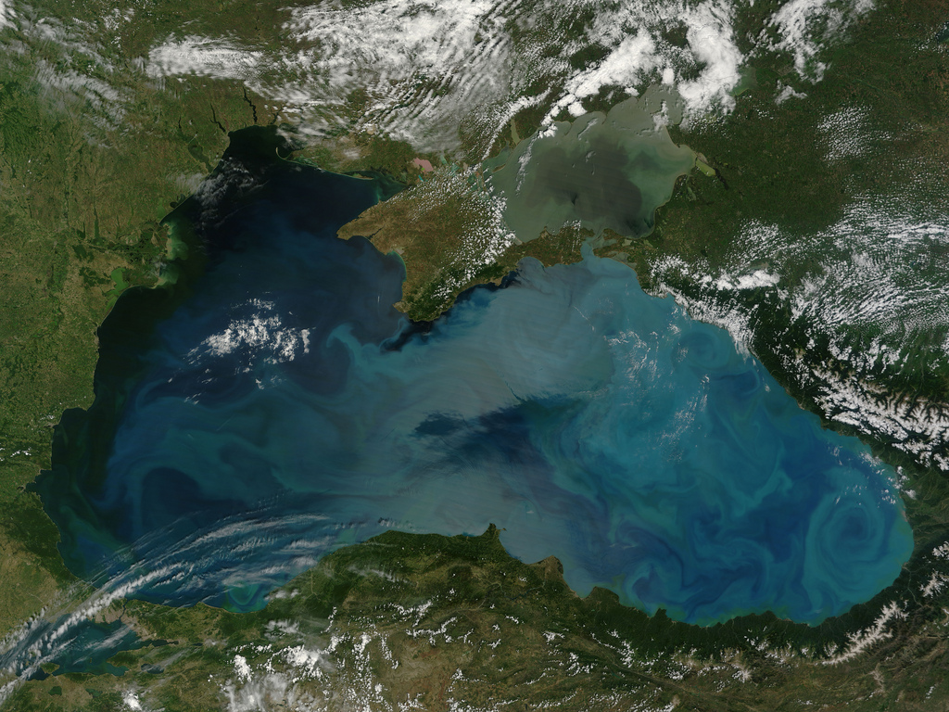
4rd Meeting for Developing a Blue Growth Initiative for Research and Innovation in the Black Sea İstanbul, Turkey
Evaluation of Black Sea Projects
Matrix of Research Gaps & Needs
A Revised Roadmap for a new SRIA for Blue Growth in the Black Sea
Compiled and Collated by
Institute of Marine Sciences, Middle East Technical University, (METU-IMS), TURKEY

Slide 2
Black
Presented during December 2017 workshop
Red
Revised after December 2017 workshop, using
feedback during the talks, Re-circulated on Jan 05 2018
Blue
Feedback sent after Jan 05 2018

Slide 3
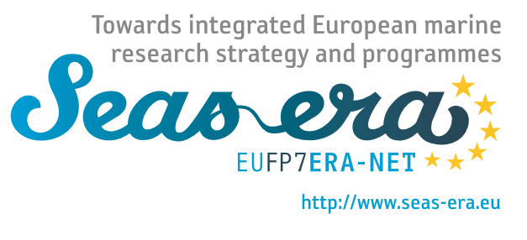
Next steps: The basis for a new Research and
Innovation Strategy in the Black Sea
Notes:
There are others that inspire us
JPI oceans

Slide 4
The basis for a new Research and
Innovation Strategy in the Black Sea
Typical Flow of a SRA document:
Mutually agreed vision and goals
Mutually agreed challenges
Broader strategic context driving the future
Strategic Objectives and Sub-Headings – each section explained in a succinct, well written manner
Annexes

Slide 5
Four Questions that we should be thinking about
today for preparation towards the new SRIA
What are our common vision and goals based on mutually agreed challenges for the Black Sea?
How can the preparation of the new Black Sea
SRIA can be inspired from existing SRIAs?
What will be the specification strategy of the new Black Sea SRIA based on your input?
What are the major strategic objectives and the main pillars as well as transversal themes of the SRIA?

Slide 6
1- What are our common vision and goals based on
mutually agreed challenges for the Black Sea?
Vision for Black Sea – some phrases that must be in there
…Black Sea as a common resource
…Sustainable, productive, healthy ecosystem for blue growth and blue jobs
…Cooperation and integration of knowledge
…

Slide 7
Vision and goals? What would success look like within 5-10 years? An example (proposal): UKRAINE "Center for Problems of Marine Geology, Geoecology and Sedimentary Ore Formation of the National Academy of Sciences”
The Black Sea – a unique natural laboratory and a developed regional geo-ecosystem with a friendly interface to man and society, with unique opportunities for blue growth.
emphasize the importance of the learning and training of new professionals to build and further develop the blue economy in the Black Sea
Notes:
What would we like to achieve
Phrase the vision and the goals

Slide 8
(new slide – A. Stanica) Proposals – Vision for the Black Sea
Reconnecting the Black Sea through a bridge of knowledge.
…using knowledge to develop sustainable blue economy and jobs in a unique and healthy marine environment.
Another option is – “the re-creation of the Common Black Sea Identity through the development of the knowledge-based blue economy in a unique and healthy marine environment”

Slide 9
1- What are our common vision and goals based on
mutually agreed challenges for the Black Sea? –
First exercise
Major Challenges for the Black Sea:
Ecosystem degradation due to anthropogenic impact, pollution, anoxia, climate change and resource extraction
Underdeveloped predictive capability due to increasingly complex array of multi-stressors and their less-known interactions
Lack of integrated, multidisciplinary, blue-growth tailored knowledge
Lack of emergent blue sectors and research-public-private (industry) cooperation (i.e. clusters) inhibiting the growth of blue economy
Georgia: more emphasis on eutrophication as a challenge
Romania: anoxia, deep hydrocarbons, lack of observations targeting oxic-anoxic interface, Gas hydrates, river-sea interactions (impact of river catchments on the marine environment)
Turkey: anoxia and extreme habitats are major challenges but could serve as opportunities for blue biotech
…Challenges offered by A. Stanica (Romania)
Reconnect Black Sea? – see the next slides

Slide 10
(new slide, A. Stanica) The Black Sea – a challenging environment
Challenges of the Black Sea
Uniqueness of the Black Sea environment (water circulation and salinity with all related impacts on the ecosystems, anoxia processes, river-sea interactions)
Almost destroyed in the past by human activities (from agriculture, industry, fisheries, alien species)
Needs to stand huge pressure from the coastal communities, but even higher from the river catchments
A basin-scale effort is needed to “restart the engines” for the knowledge based society around the entire Black Sea.
Has critical potential in energy (especially in classical hydrocarbons but also gas-hydrates, besides wind and wave energy) – not yet well known – and plans for the energy exploitation must be made without destroying the Black Sea ecosystems
Notes:
Breakout sessions to agree on the challenges

Slide 11
Our Vision and Goals of the SRIA
Vision and goals? What would success look like within 5-10 years?
Second exercise
Get inspired by examples of other vision statements:
……the vision will be achieved through creating new knowledge, technologies and services, as well as fostering human capacity and infrastructures capacity building, related to the Black Sea marine and maritime sectors.

Slide 12
Research and Innovation for Blue Jobs and Growth
(Malta 2017)
Blue tourism needs clear waters – algae and litter free.
Blue energy needs to turn oil and gas into offshore wind energy platforms combined with other purposes such as aquaculture.
A blue Mediterranean diet needs sustainable fisheries and hi-tech aquaculture; Blue shipping needs clean quiet engines.
A safe blue Mediterranean Sea needs fit for purpose blue observation – an observation system for climate impact on the food web, forecasting, natural hazards, and underwater volcanic threats to coastal cities and where data are open accessible and turned into services for citizens.

Slide 13
Goals of the SRIA (example of BlueMed)
supporting the implementation of EU Policies and Directives related to marine and maritime issues including better ecosystem assessments and forecasts and deeper understanding of vulnerability, risk and intervention. It also includes, better maritime spatial planning and knowledge-based support to management and decision-making towards the sustainable growth of the maritime economy in response to the societal and environmental challenges;
promoting innovative multi-disciplinary research that will generate the knowledge needed to increase ecosystems resilience; provide new tools to mitigate the impacts from global climate change and the multiple environmental stressors, and to protect and/or restore vulnerable marine ecosystems;
developing new marine based technologies to boost safe and sustainable economic growth of the maritime sectors, the conservation and valorisation of marine cultural heritage;
creating an interoperable, fully integrated observing and forecasting capability. This will be based on open data structures4 and also foster easy access to them;
promoting citizens’ awareness and literacy on the importance of a sustainable prosperous Black Sea for the surrounding countries and for Europe as a whole;
training a new generation of scientists, engineers and entrepreneurs and workers that are able to tackle complex ecological, economic and societal problems from an holistic perspective, while supporting learning, tertiary education, development and transfer of technologies and knowledge for new and qualified “jobs of the sea”
Notes:
Group work on OBJECTIVES

Slide 14
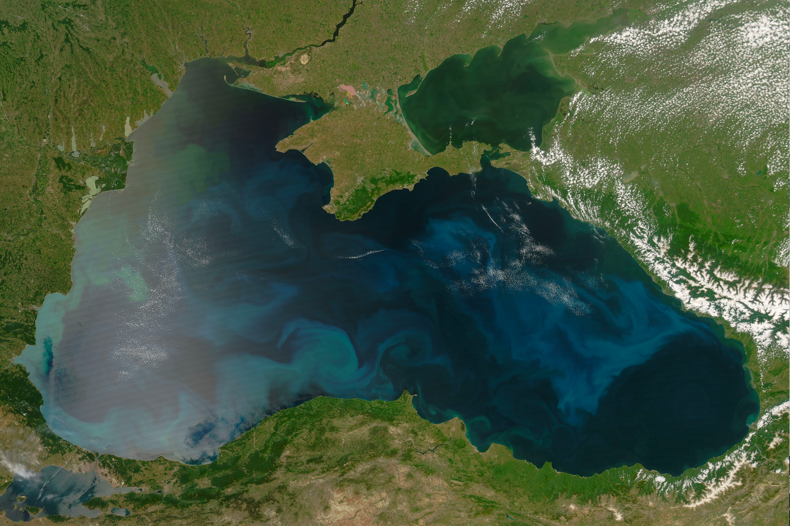
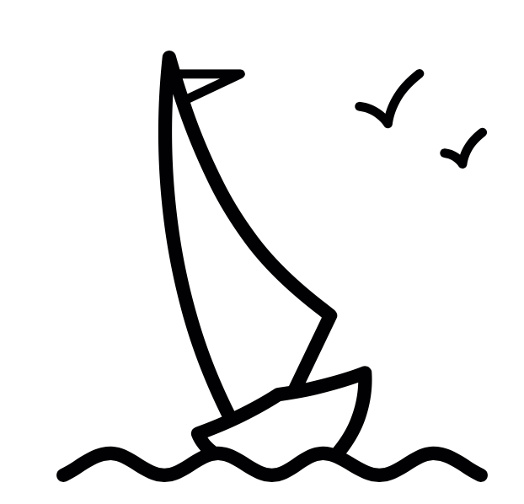
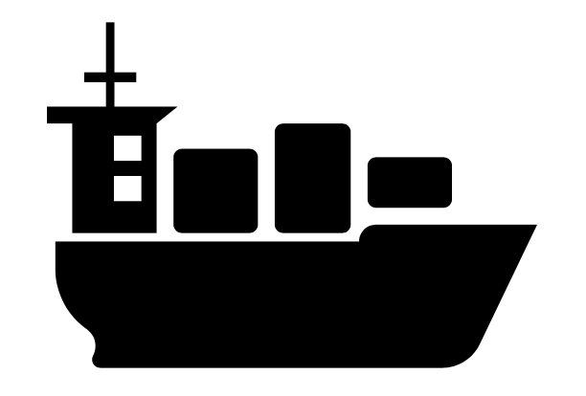
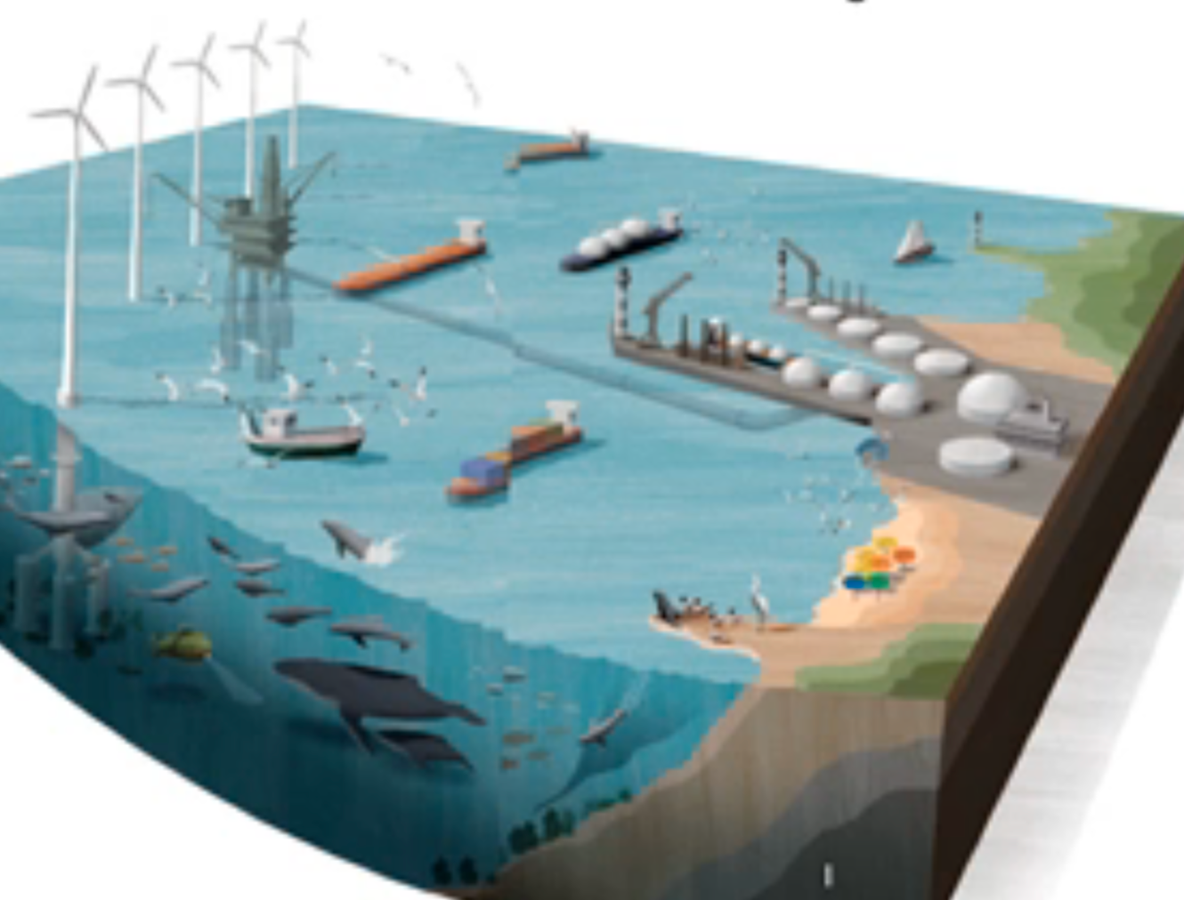
OBJECTIVES Blue Economy in the Black Sea: Growth, Jobs and a Basin that is sustainably managed
Mature, Established Sectors
SYNERGY BETWEEN SECTORS
MANAGEMENT AND
SUSTAINABLE UTILIZATION
MARITIME SPATIAL
PLANNING - MSP
OCEAN FOOD
TOURISM
TRANSPORTATION
Potential Sectors for Growth
BLUE ENERGY
MARINE BIOTECHNOLOGY
SUBMARINE MINERAL AND ENERGY RESOURCES

Slide 15
2- How can the preparation of the new Black Sea
SRIA be inspired from existing SRIAs?
SEAS ERA
Atlantic 2014
Black Sea 2012
Understanding the Baltic Sea
ecosystem structure and functioning
Basic Research and
New Knowledge
Key enabling knowledge
for the Mediterranean
Meeting the multifaceted challenges
in linking the Baltic Sea
with its coast and catchment
Applied Research - Science supporting Society and Economy
Key sectoral enablers
in the Mediterranean
Enhancing sustainable use of coastal and marine goods and services of the Baltic Sea
Improving the capabilities of the society
to respond to challenges directed
to the Baltic Sea region
Critical Supports/
Infrastructure needs
Enabling technology
and capacity creation
for the Mediterranean
Innovative human potential
and infrastructure required
Developing improved and
innovative observation and
data management systems

Slide 16
2- How can the preparation of the new Black Sea
SRIA be inspired from existing SRIAs?
Atlantic 2013
Black Sea Seas Era
Final SRA – (2012)
BlueMed
Basic Research and New Knowledge
Ecosystem Function – Biodiversity- Complexity and Connectivity;
Coping with Uncertainty and Change –the impacts of global climate change.
Basic Research and New Knowledge
Geological structure and dynamics of the Black Sea Basin
Physical climate, hydrological cycle, ventilation and inter‐basin coupling
Climatic variability, ocean acidification
Biodiversity, invasive species
Euthropication, good ecosystem health
Deep sea research
Key enabling knowledge for the Mediterranean
Mediterranean Sea ecosystems: services, resources, vulnerability and resilience to natural and anthropogenic pressures
Mediterranean Sea dynamics: developing services in the field of sustainable adaptation to climate change and plans for mitigation
Hazards and the protection of coastal areas in the Mediterranean
Applied Research - Science supporting Society and Economy:
Protecting the Marine Environment – Implementing the MSFD;
Marine Renewable Energy - Powering Europe;
The Greening of Maritime Transport - Safety, Surveillance and Logistics;
Reclaiming Our Ocean Heritage - Marine/Maritime Leisure and Tourism;
The Marine (Blue) Bioeconomy: Fisheries, Aquaculture, Seafood;
Harvesting the oceans non-living resources: Sustainable mineral, oil and gas extraction from coastal and offshore areas.
Applied Research - Science supporting Society and Economy:
Renewable energy, mineral resources, communication projects
Maritime Transport
Sustainable fisheries and aquaculture
Marine biotechnology
Natural hazards
Socio-economic research
MSP, MPA, ICZM
Key sectoral enablers in the Mediterranean
Innovative businesses based on marine bio-resources in the Mediterranean
Ecosystem-based management of Mediterranean aquaculture and fisheries
Sustainable tourism in the Mediterranean
Maritime clusters in the Mediterranean
Maritime Spatial Planning and Integrated Coastal Zone Management in the Mediterranean
Enabling technology and capacity creation for the Mediterranean Innovative human potential and infrastructure required
A. Smart, greener maritime transport and facilities in the Mediterranean
Observing systems and operational oceanography capacities in the Mediterranean
Multi-purpose offshore platforms in the Mediterranean
DMarine and coastal cultural heritage in the Mediterranean: discovering, protecting and valuing
Critical Supports/Infrastructure needs:
A European Atlantic Ocean Observing and Forecasting Capability (including seabed mapping);
An Atlantic Marine Socio-Economic Assessment Capability and Database;
11. A European Atlantic Marine Science and Technology Foresight Platform.
Critical Supports/Infrastructure needs:
Tools for policy implementation
Observation and forecasting systems
Marine research infrastructure
Human capacity building

Slide 17
2- How can the preparation of the new Black Sea
SRIA be inspired from existing SRIAs?
Atlantic 2013
Black Sea Seas Era
Final SRA – D 8.1.1.
BlueMed
Basic Research and New Knowledge
Ecosystem Function – Biodiversity- Complexity and Connectivity;
Coping with Uncertainty and Change –the impacts of global climate change.
Basic Research and New Knowledge
Geological structure and dynamics of the Black Sea Basin
Physical climate, hydrological cycle, ventilation and inter‐basin coupling
Climatic variability, ocean acidification
Biodiversity, invasive species
Euthropication, good ecosystem health
Deep sea research
Key enabling knowledge for the Mediterranean
Mediterranean Sea ecosystems: services, resources, vulnerability and resilience to natural and anthropogenic pressures
Mediterranean Sea dynamics: developing services in the field of sustainable adaptation to climate change and plans for mitigation
Hazards and the protection of coastal areas in the Mediterranean
Applied Research - Science supporting Society and Economy:
Protecting the Marine Environment – Implementing the MSFD;
Marine Renewable Energy - Powering Europe;
The Greening of Maritime Transport - Safety, Surveillance and Logistics;
Reclaiming Our Ocean Heritage - Marine/Maritime Leisure and Tourism;
The Marine (Blue) Bioeconomy: Fisheries, Aquaculture, Seafood;
Harvesting the oceans non-living resources: Sustainable mineral, oil and gas extraction from coastal and offshore areas.
Applied Research - Science supporting Society and Economy:
Renewable energy, mineral resources, communication projects
Maritime Transport
Sustainable fisheries and aquaculture
Marine biotechnology
Natural hazards
Socio-economic research
MSP, MPA, ICZM
Key sectoral enablers in the Mediterranean
Innovative businesses based on marine bio-resources in the Mediterranean
Ecosystem-based management of Mediterranean aquaculture and fisheries
Sustainable tourism in the Mediterranean
Maritime clusters in the Mediterranean
Maritime Spatial Planning and Integrated Coastal Zone Management in the Mediterranean
Enabling technology and capacity creation for the Mediterranean Innovative human potential and infrastructure required
Smart, greener maritime transport and facilities in the Mediterranean
Observing systems and operational oceanography capacities in the Mediterranean
Multi-purpose offshore platforms in the Mediterranean
Marine and coastal cultural heritage in the Mediterranean: discovering, protecting and valuing
Critical Supports/Infrastructure needs:
A European Atlantic Ocean Observing and Forecasting Capability (including seabed mapping);
An Atlantic Marine Socio-Economic Assessment Capability and Database;
11. A European Atlantic Marine Science and Technology Foresight Platform.
Critical Supports/Infrastructure needs:
Tools for policy implementation
Observation and forecasting systems
Marine research infrastructure
Human capacity building

Slide 18
2- How can the preparation of the new Black Sea
SRIA be inspired from existing SRIAs?
Atlantic 2013
Black Sea Seas Era
Final SRA – D 8.1.1.
BlueMed
Basic Research and New Knowledge
Ecosystem Function – Biodiversity- Complexity and Connectivity;
Coping with Uncertainty and Change –the impacts of global climate change.
Basic Research and New Knowledge
Geological structure and dynamics of the Black Sea Basin
Physical climate, hydrological cycle, ventilation and inter‐basin coupling
Climatic variability, ocean acidification
Biodiversity, invasive species
Euthropication, good ecosystem health
Deep sea research
Key enabling knowledge for the Mediterranean
Mediterranean Sea ecosystems: services, resources, vulnerability and resilience to natural and anthropogenic pressures
Mediterranean Sea dynamics: developing services in the field of sustainable adaptation to climate change and plans for mitigation
Hazards and the protection of coastal areas in the Mediterranean
RED TOPICS: LACKING IN PRESENT BS SRA -
(A Stanica) – I SUPPORT THE INCLUSION OF THE POINTS FROM THE ATLANTIC… HISTORICAL HERITAGE IS A MAJOR POINT, SO ARE OIL AND GAS – AND I THINK GAS-HYDRATES SHOULD STAND SEPARATELY AS THEY ALSO IMPLY STRONG TECHNOLOGICAL DEVELOPMENT FOR THE COASTAL COMMUNITIES
SMART GREENER MARITIME TRANSPORT AND FACILITIES ARE ALSO CRITICAL FOR A BLUE TRANSPORT
A Stanica: Need More on Education capacity building/BLUE work force/Blue talents for the future/outreach/careers
Applied Research - Science supporting Society and Economy:
Protecting the Marine Environment – Implementing the MSFD;
Marine Renewable Energy - Powering Europe;
The Greening of Maritime Transport - Safety, Surveillance and Logistics;
Reclaiming Our Ocean Heritage - Marine/Maritime Leisure and Tourism;
The Marine (Blue) Bioeconomy: Fisheries, Aquaculture, Seafood;
Harvesting the oceans non-living resources: Sustainable mineral, oil and gas extraction from coastal and offshore areas.
Applied Research - Science supporting Society and Economy:
Renewable energy, mineral resources, communication projects
Maritime Transport
Sustainable fisheries and aquaculture
Marine biotechnology
Natural hazards
Socio-economic research
MSP, MPA, ICZM
Key sectoral enablers in the Mediterranean
Innovative businesses based on marine bio-resources in the Mediterranean
Ecosystem-based management of Mediterranean aquaculture and fisheries
Sustainable tourism in the Mediterranean
Maritime clusters in the Mediterranean
Maritime Spatial Planning and Integrated Coastal Zone Management in the Mediterranean
Enabling technology and capacity creation for the Mediterranean Innovative human potential and infrastructure required
Smart, greener maritime transport and facilities in the Mediterranean
Observing systems and operational oceanography capacities in the Mediterranean
Multi-purpose offshore platforms in the Mediterranean
Marine and coastal cultural heritage in the Mediterranean: discovering, protecting and valuing
Critical Supports/Infrastructure needs:
A European Atlantic Ocean Observing and Forecasting Capability (including seabed mapping);
An Atlantic Marine Socio-Economic Assessment Capability and Database;
11. A European Atlantic Marine Science and Technology Foresight Platform.
Critical Supports/Infrastructure needs:
Tools for policy implementation
Observation and forecasting systems
Marine research infrastructure
Human capacity building

Slide 19
2- How can the preparation of the new Black Sea
SRIA be inspired from existing SRIAs?
Major Challenges for the Black Sea:
Need for more knowledge… but integrated and multidisciplinary
Applied science, but also integrated, holistic and towards blue economy. Developing solutions and products that will have to broad applications and impact, decrease costs
Emphasis on technology and observing systems, take account on what exists
France(IFREMER): Consider listing challenges related to economy and ecosystem separately

Slide 20
3- What will be the specification strategy of the
Black Sea R&I SRA (MATRIX A & B)
Specific to ‘fundamental research’ pillar:
To be based on gaps/opportunities analyses
Specific topics to be addressed: fisheries and aquaculture, multistressors, hypoxia, microbe-to-fish ecosystem models as prediction tools, litter and microplastics, vulnerable seafloor ecosystems in the context of deep-sea resource extraction, basin interconnections
Form/foster scientific excellence centers, ‘pockets of excellence’
Notes:
update

Slide 21
3- What will be the specification strategy of the
Black Sea R&I SRA
Specific to ‘applied research for blue economy’ pillar
Need also to emphasize institution/capacity building but not only research capacity. Strong need to build a ‘blue economy sectors’. Engage also more non-marine science academic and research community (economists)
Regional ‘clusters’ where close partnership between private sector, public local governance and research institutions
Notes:
update

Slide 22
3- What will be the specification strategy of the
Black Sea R&I SRA
Major Trends in Research Needs and Opportunities (in no particular order and not exhaustive) Matrix A & B combined
More integrated, frequent and multi-parameter observation
Use of high tech novel tools (genomics, sensors etc.) in established ‘areas’ such as living resources, operational oceanography
Planning – MSP,ICZM and other framework
Catchment-sea interactions
Researcher-industry-stakeholder partnership
Socio-economics
Capacity building, of both blue professionals and public sector
Sustainable utilization of non-living resources, i.e. gas hydrates and renewable energy resources
Coastal communitty resilience against climate change, extreme events
Share of mature and emerging blue growth sectors in the overall Blue Economy – numbers and economic analyses are missing, to the extent that this gap hinders setting up priorities and sub-strategies

Slide 23
Input from Georgia (TSU)
3. What will be the specification strategy of the new Black Sea SRIA?
Specification strategy can be based on ESG approach, in particular: Environmental, Social and Governance, what, actually, adequately response to MSFD and WFD principals.
-Marine bio-resources are affected by a variety of impacts (stressors) in addition to fishing, including landbased pollution, invasive species introduced by transboundary shipping and current human activities.
-Need to establish a regional political mechanism guaranteeing conflict-free use of Black Sea natural resources.
There is an increasing need for adoption of an integrated ecosystem management approach to exploitation of marine natural resources,
-Regarding marine living resources, the information on the state of the populations of marine living resources and in specific mammals are incomplete and require a regionally coordinated effort.
Black Sea riparian countries should co-operate for appropriate protection, conservation and management of areas comprising such habitats.
-Creation of a national/regional network of marine and coastal protected areas for marine living resources can be a priority, also cooperation between neighbouring countries for creating common protected areas.
Notes:
breakout

Slide 24
Input from Georgia (TSU)
Through analysis of data and information related of state of the Black Sea fisheries (state of the main fish stocks) recommendations will be elaborated in correlation with:
* Protection of living resources from Black Sea on the basis of an adequate legal and institutional framework both at national and regional level;
* Sustainable management of the exploitable resources based on the regulations and assessments scientific grounded;
* Dimension of the fishing activities (fishing effort, times, areas);
* Identification of the coastal areas able to be introduced in the regional protected areas network;
* Identification of the priority measures for improvement of the protection in the areas proposed for trans-boundary ecological conservation;
* Identification of the endangered fish species;
* Study on the impact diminishing of the fishing activity on the biocenosis and the improvement of selectivity of the fishing gears;
* Establishment at the regional level of the fishing practices selective – undestructive;
* Initiation of the regional common programmes for periodical evaluation of the trans-frontier fish stocks and of the environmental conditions influencing them;
* Maintaining the health and integrity of marine ecosystems for the benefit of other uses and users including biodiversity, scientific interest, intrinsic value, trophic structure and other economic uses such as tourism and recreation.

Slide 25
4- What will be the main strategic objectives,
main pillars and transversal themes of the Black Sea SRIA?
BlueMed/Atlantic ERA three-pillar strategic approach
But use transversal/horizontal themes: cooperation, training, etc. ‘Reconnecting Black Sea Communities’
Also think about specific strategies for Black Sea. Some aspects (land-sea, emphasis on management) maybe from BONUS.
Notes:
remove

Slide 26
4- Based on the previous discussions
3 main pillars and a 4th one or the 4th should be
transversal of the Black Sea SRIA?
Third exercise
Pillar 1: Fundamental Research addressing Black Sea challenges
…
…
Pillar 2: Developing Products, Solutions and Clusters underpinning Black Sea Blue Growth
…
…
Pillar 3: Critical Support and Innovative Infrastructure Building
…
…
…

Slide 27
4- Based on the previous discussions
3 main pillars and a 4th one or the 4th should be
transversal of the Black Sea SRIA??
To be filled… OUR KEYWORDS DISTRIBUTED
Pillar 1: Fundamental Research addressing Black Sea challenges
Biodiversity
Biological Invasions
Catchment-Sea Interaction
Climate Change & Impacts
Cultural Heritage
Deep Sea Ecosystems
Ecosystem Multiple Stressors
Eutrophication and Deoxygenation
Interconnections of Basins
Marine and Coastal Hazards
Marine Ecosystem Services
Seas and Human Health
Socioeconomic & Policy Research
…
Pillar 2: Developing Products, Solutions and Clusters underpinning Black Sea Blue Growth
Blue Biotechnology
Deep sea mining, Oil and Gas Sustainable Exploitation
Living Marine Resources (fishery, aquaculture, etc.)
Marine Renewable Energy
Maritime Transport
MSP, ICZM
Tourism and Surrounding Economy
Pillar 3: Critical Support and Innovative Infrastructure Building
Operational Oceanography/Observing Systems and Monitoring
Training & Technology Transfer
Other/Multiple areas (specify in column B)
…
…
…
BUT RESEARCH KEYWORDS DO NOT NECESSARILY BE AGENDA SUBHEADINGS… NEED TO CONSTRUCT INCLUSIVE WORDING

Slide 28
Input from Georgia (TSU)
4. If we decide to move forward, what will be the main pillars, transversal themes and major strategic objectives of the SRIA?
Overall objective:
• To formulate recommendations for an ecosystem-based strategy for integrated management of marine natural resources for the Black Sea (including designing of new technologies, tools and services), taking into account the EU Marine Strategy, Birds and Habitats Directives.
The ecosystem approach requires humans to consider the impacts of their activities, including management responses and regulatory regimes, on entire ecosystems rather than individual species or values.
Specific Objectives:
To take steps to facilitate more close cooperation of BSEC and BISEP, basing on coincidences of Blue Economics strategy ( e.g. Blue growth) and MSFD/WFD, aiming to elaborate joint strategy and roadmap.
To collate baseline environmental data and establish unified indicator system employing advanced open-access database and GIS technologies, to monitor the state of Black Sea environment and sustainable use of marine natural resources.
To develop models to assist the mitigation of and adaption to expected environmental changes (e.g. sea level rise, severe weather conditions) and economic development (e.g. transport networks, pipelines) in the Black Sea.

Slide 29
Input from Georgia (TSU)
4. If we decide to move forward, what will be the main pillars, transversal themes and major strategic objectives of the SRIA?
To apply the precautionary approach in management of marine natural resources in order to rebuild and conserve stocks, as well as avoid irreversible or long-term adverse impacts.
To build capacity in research institutions, policy makers and economic actors to adopt and apply the ecosystem approach for sustainable use of marine natural resources using best available cost-effective technologies.
To facilitate the engagement of civil society in developing policies, instruments and practices for sustainable management of marine natural resources, in particular through the provisions of the Aarhus Convention.
Methodologies to prevent the emergence of new threatened species and to halt losses of currently known threatened species and destruction of their habitats by 2020-25 arising from human activities in the BS area. The following will be emphasized:
Measures to increase, where appropriate, protected areas and improve conservation of species, ecosystems and habitats, with particular attention to marine protected area, and manage them in a sustainable and environmentally sound way.
Promotion of the ecosystem approach to all human activities in the project area in particular in exploitation of living marine resources by introducing sustainable practices and eliminating harmful practices.

Slide 30
UKRAINE-"Center for Problems of Marine Geology, Geoecology and Sedimentary Ore Formation of the National Academy of Sciences ”
The Black Sea – a unique natural laboratory and a developed regional geoecosystem with a friendly interface to man and society, with unique opportunities for blue growth.
emphasize the importance of the learning and training of new professionals to build and further develop the blue economy in the Black Sea

Slide 31
Four Questions that we should be thinking about
today for preparation towards the new SRIA
What are our common vision and mutually agreed challenges for the Black Sea?
How can the preparation of the new Black Sea
SRIA be inspired from existing SRIAs?
What will be the specifities of the new Black Sea SRIA?
If we decide to move forward, what will be the main pillars, transversal themes and major strategic objectives of the SRIA?

Slide 32
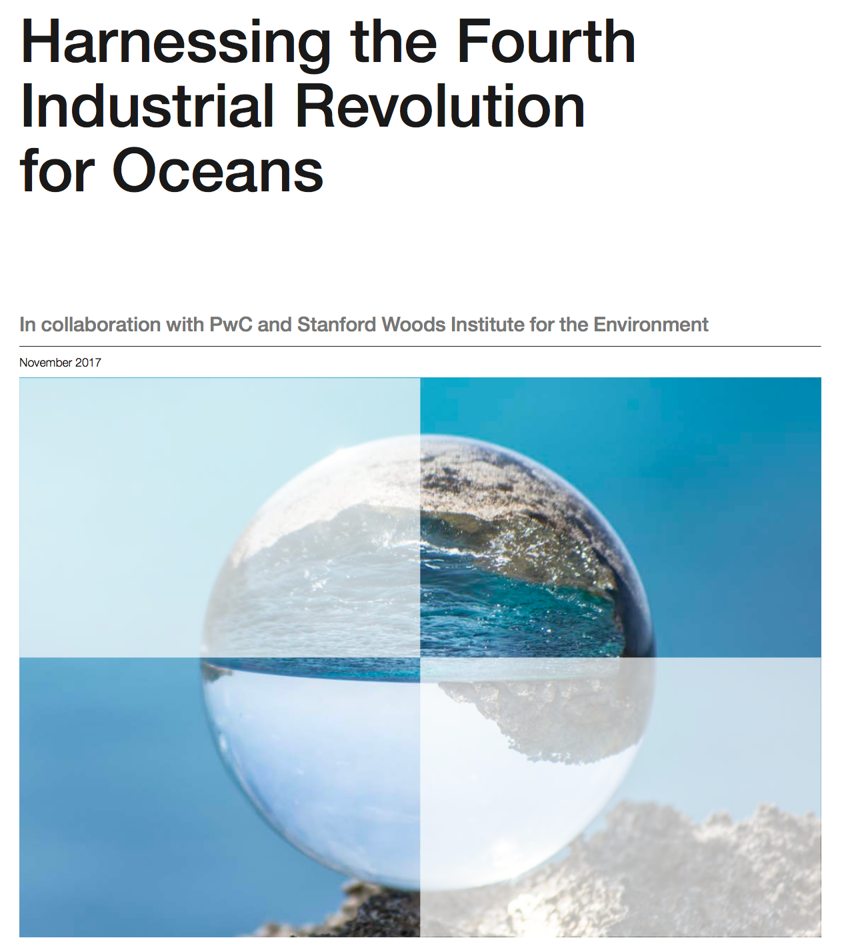
More emphasis on Technology compared to existing strategies
Industry 4.0 and Blue Growth
Five potential game-changers powered by the Fourth Industrial Revolution.
Real-time predictive ocean information
Accountability in markets
Empowered communities
Farming that protect ocean resources
New ocean machines
Robotics
Advanced sensor platforms
Virtual reality
Internet of
things
Advanced materials
Industry 4.0 Technologies towards Blue Growth
3D printing
Blockchain
Artifical Intelligence
Biotechnologies
Drones
Notes:
AMA YAKLAŞAN ENDÜSTRİ 4.0 IN FARKINDAYIZ. YENİ TEKNOLOJİLERİ ÖZÜMSEYEN BUNNLARI KULLANAN KUŞAKLAR DENİZ EKONOMİSİNİN AŞILMASI GEREKEN ZORLUKLARINI AŞACAKLAR. SON DÜNYA EKONOMİK FORUMUNDA DA 5 DENİZ EKONOMİSİ KONUSUNA DESTEK OLACAK BUNLARI DÖNÜŞTÜRECEK 10 ADET ENSİTRSİ 4.0 TEKNOLOJİSİ BELİRLENDİ. BİZ BUNLARI DA MAVİ BÜYÜME VİZYONUNA VE BÖLGENİN ARGE PROGRAMINA ALACAĞIZ.

