Slide 1
A successful case study from Turkey
FFI plans in Georgia
Sophie Benbow
Sophie.benbow@fauna-flora.org
Fleur Scheele
Fleur.scheele@fauna-flora.org

Slide 2
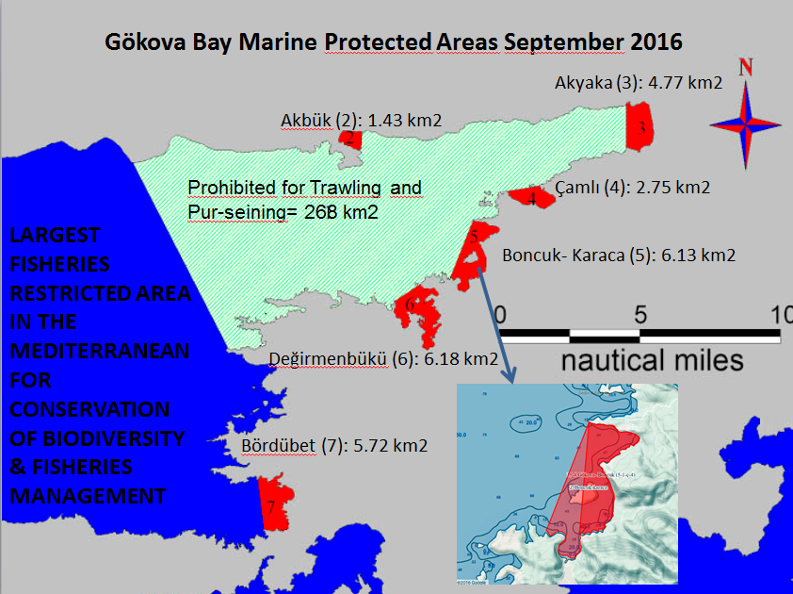
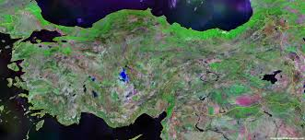
Notes:
Gökova Bay, SEPA in 1988, NFZs in 2009, enforcement began in 2012 and results have been significant, 6 fold increase in in water fish biomass recorded in the NFZs and a 4 fold increase in fisher income recorded through the local fishing cooperative

Slide 3
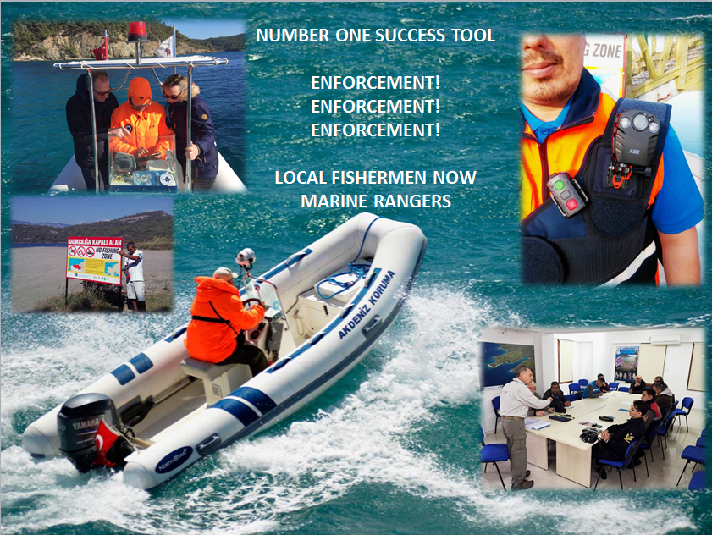
Notes:
Novel partnerships
Community rangers have no legal authority, but they are still increasingly respected by fishers. Enforcement is based on a strong proactive relationships with the coastguard to support patrol activities

Slide 4
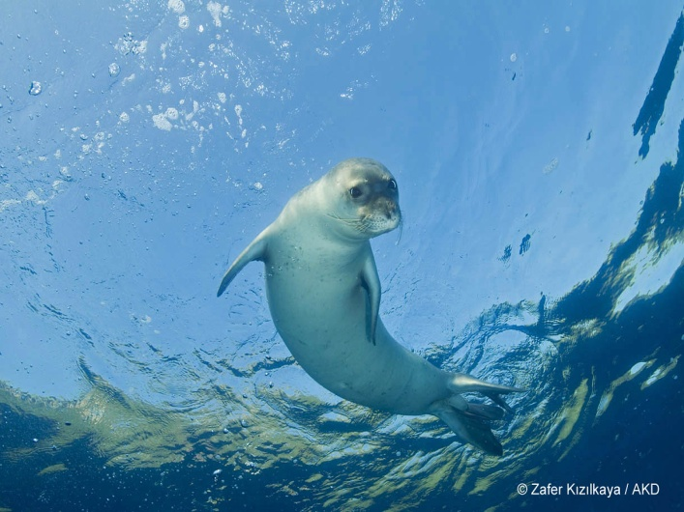
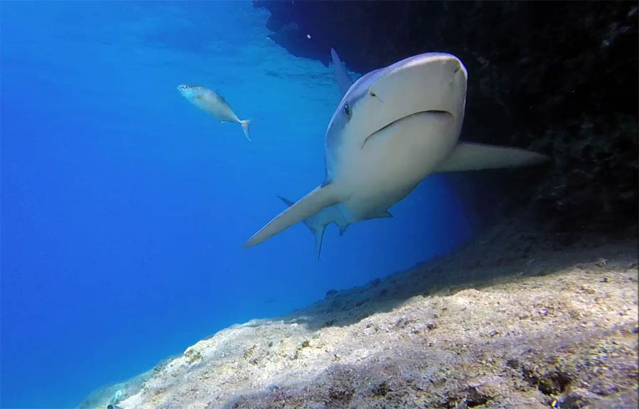
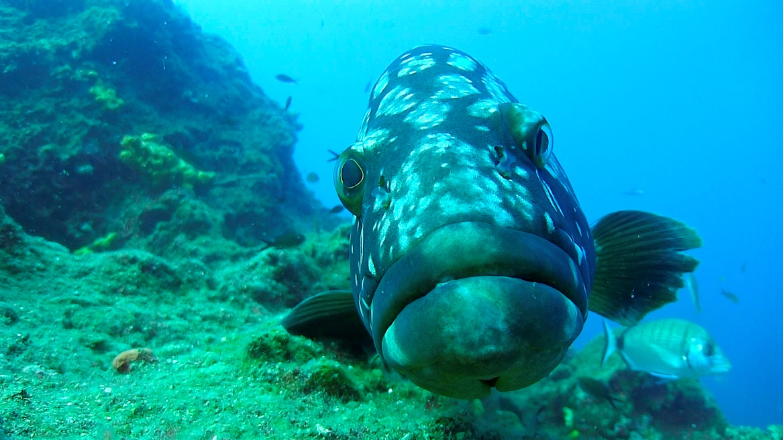
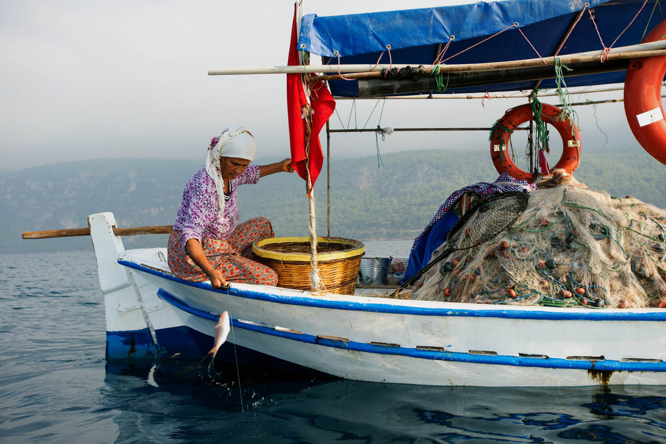
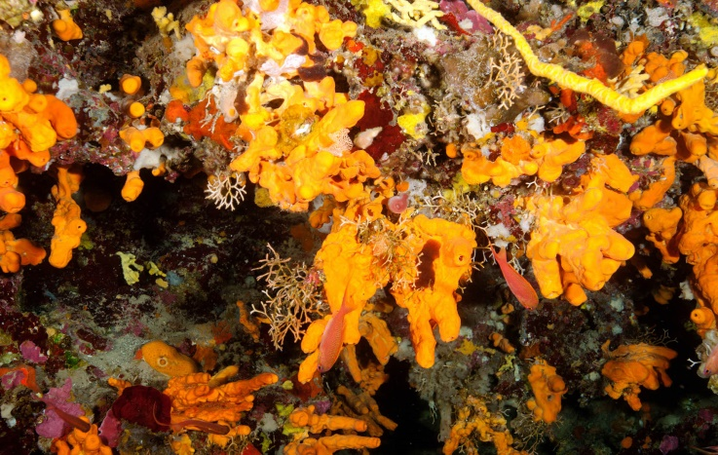
Restoring marine species populations and securing local livelihoods
Notes:
Very simply this ecosystem recovery has occurred by the reduction of human pressures. By giving the environment space to recover we have enabled it to reach a new equilibrium and this includes combating new invasive species entering through the Suez canal
Monk seals, sandbar sharks, grouper populations, and enhanced fishery productivity for traditional small scale fishers

Slide 5
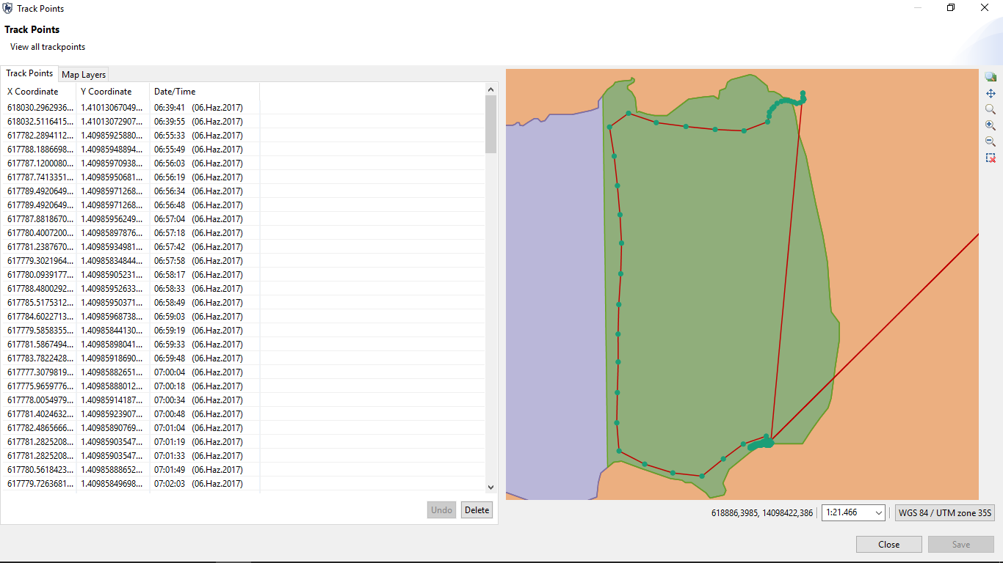
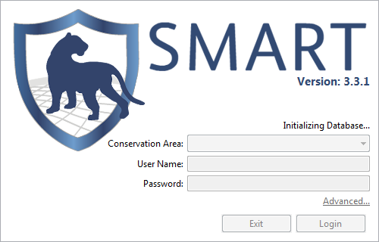
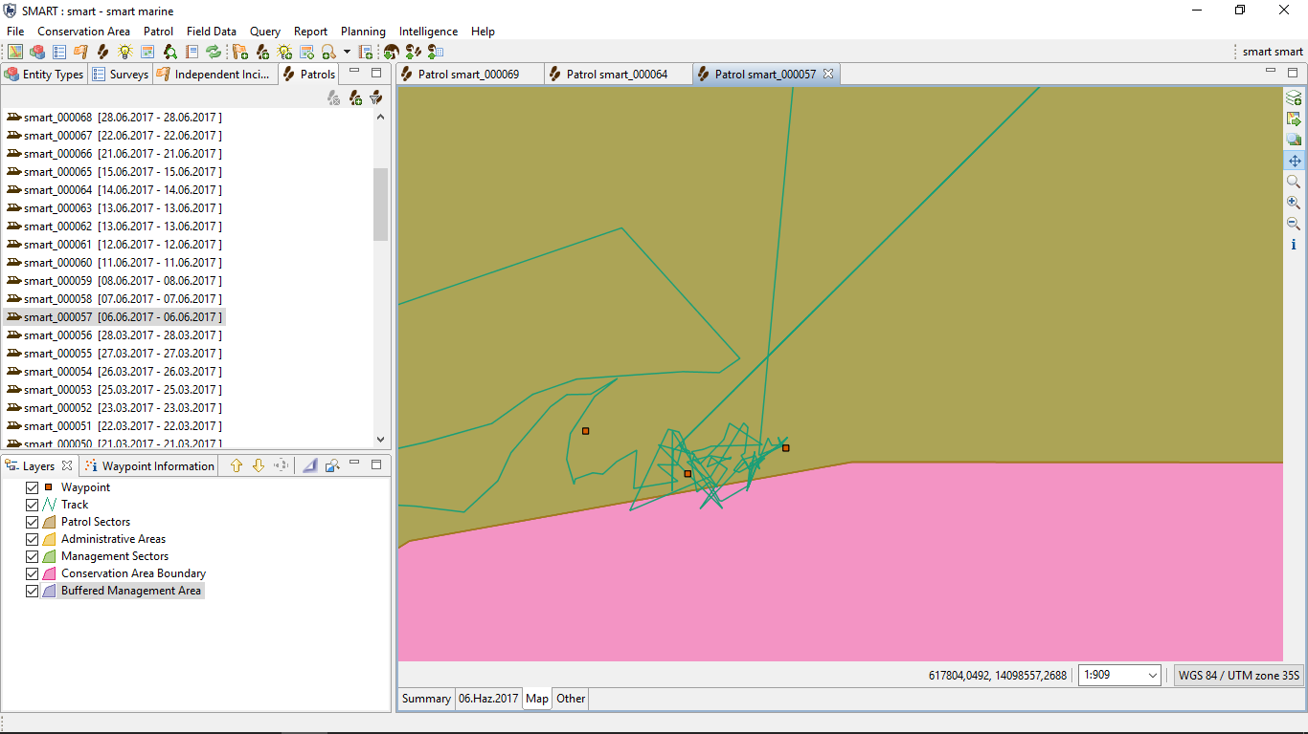
SMART patrolling
Notes:
Innovative new technologies: affordable/free
SMART open source, open access, free technology. Turkey is one of the first sites to have implemented it in the marine environment. Fundamentally it is an android app for a Smartphone. FAGD interested in replication in other areas. Next version of SMART will include a cloud hosted data storage system which will allow PA managers, government, coastguard, NGO partners to view/access/edit data remotely and allow real time data viewing and subsequent response.
Also now adapted as a platform to record fish landings data through the cooperative.

Slide 6
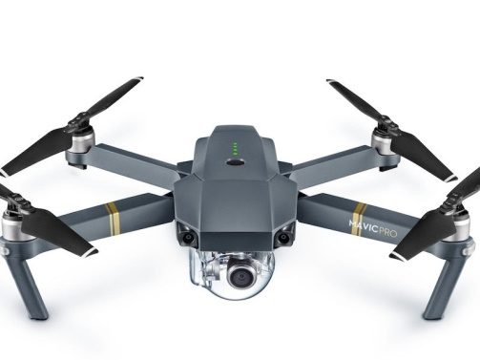
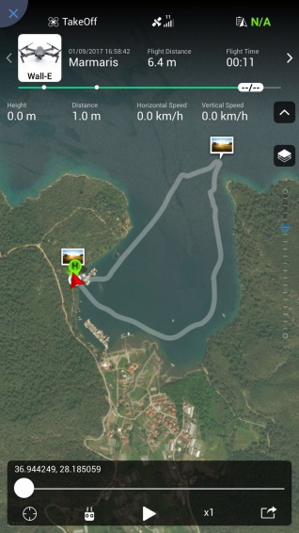
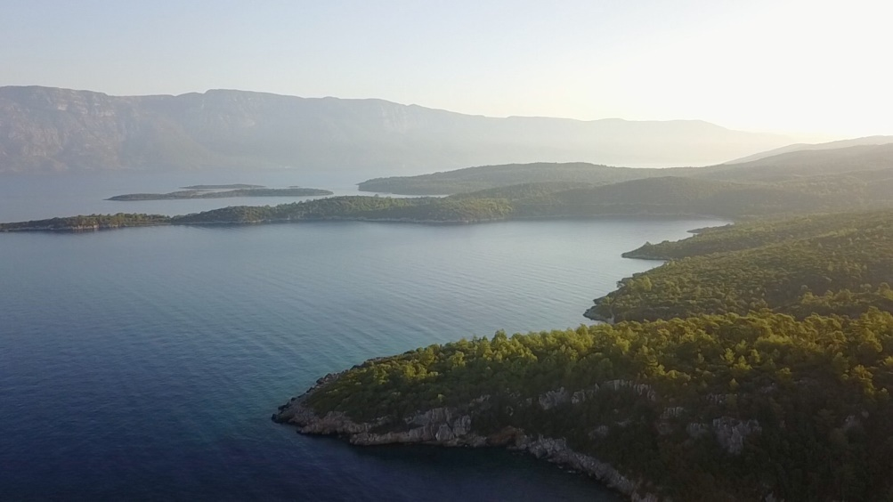
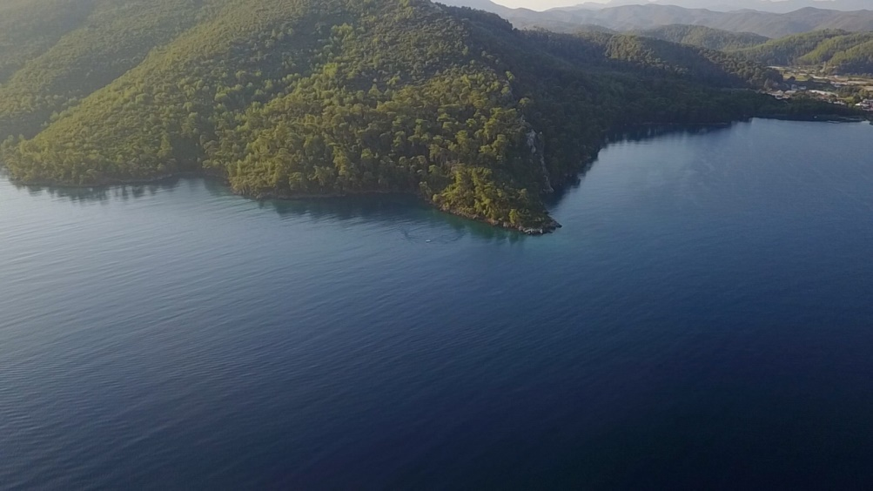
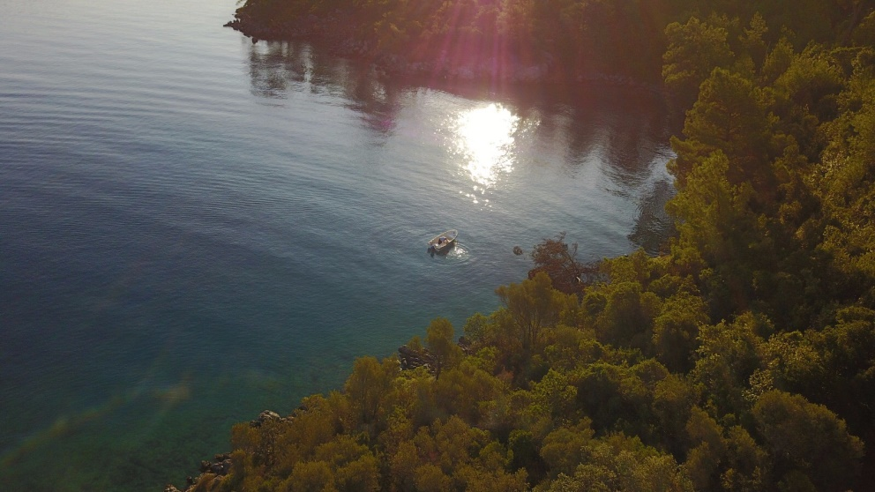
WHAT NEXT? AIR PATROLLING AND INCREASED EFFICIENCY
Take off at 7:41 am
Mavic-Pro
Observing the boat and illegal fishing reported to rangers at 7:54
Spotting suspicious boat at 7:48
Notes:
Innovative new technologies: less affordable but scope for reduced monitoring costs in the long term (biggest expense of existing ranger system is boat fuel)
Ranger boat arrived at 0800, and coastguard informed 5 minutes later
Need to better understand how we can incorporate drone data into SMART

Slide 7
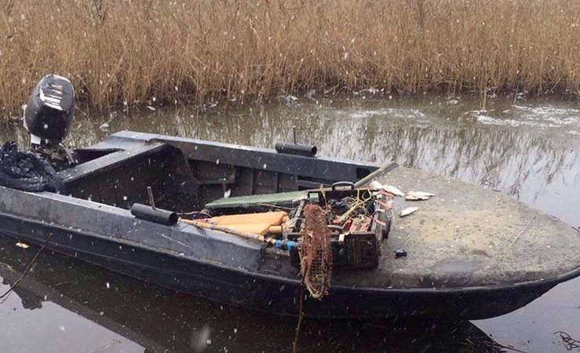
Sturgeon in Georgia
Understand what is there!
Address known threats (poaching and marine by-catch)
Build relationships with fishing communities in Rioni
Support government with enforcement (trade, illegal fishing)
Notes:
New project for FFI with recently secured funding, although we have been scoping opportunities since 2015.
Look to secure protection for critical habitat areas

Slide 8
Final thoughts
New technologies exist which can facilitate monitoring and enforcement of marine areas
Sustainable fisheries management needs to address community needs and include dedicated fisher outreach and participative consultations
We all need to talk more! Conservation of an area such as the Black Sea will only be achievable with true collaboration and partnerships at the regional level
Notes:
The joint declaration currently in preparation is a key step to achieving this critical international cooperation
Particularly linking research institutes and academia with conservation practitioners

Slide 9
Sophie Benbow
Sophie.benbow@fauna-flora.org
Fleur Scheele
Fleur.scheele@fauna-flora.org

