Slide 1
BlueBRIDGE: Blue Cloud and Blue Growth
Donatella Castelli (CNR-ISTI)
donatella.castelli@isti.cnr.it
Pilot Blue Cloud Workshop
23 March 2017
Brussels, Belgium

Slide 2
A new landscape
Services
eInfrastructures
Big Data
VREs

Slide 3
BlueBRIDGE
Objective
To exploit the new technological landscape for facilitating communities of scientists, innovators from SMEs and educators from different domains addressing Blue Growth related challenges in their knowledge production chain, from the initial phases, data collection and aggregation, to the production of indicators for competent authorities and investors.
Keywords
Collaboration, validation, reproducibility, reuse, dynamicity, fast adaptability, low costs of engagement, low cost of service

Slide 4
Addressed areas
Blue Assessment
Assessing the status of fish stocks and facilitating access to global record of stocks and fisheries
Blue Economy
Blue Environment
Blue Skill
Boosting education and knowledge bridging between research and innovation
Analysing socio-economic performance in aquaculture
Monitoring fisheries & habitat degradation
FAO, ICES, FIN, NOAA, GeoMar, IRD Wageningen Univ. , ICCAT, IRD, Ifremer
ICRE8, I2S, CITE, Aleia, Forkys, EllinikaPsaria, …
CLS, FAO, Grid-Arendal, JRC
ICES, IRD, ICCAT, Univ. Of Athens, Univ. of Pisa, World Maritime University, ….

Slide 5
Behind the scene
VRE
VRE
Enables
VRE
Analytics
Engine
Storage
Aggregator
Mediator
Registry
….. Service Commons
Integrates
WPS
External e-Infrastructures, repositories & services

Slide 6
Additional priorities and possible actions at short and medium term in the direction of the Pilot Blue Cloud
Domain specific priorities
Fishery traceability
Spatial planning
Service catalogue
Liaisons with other initiatives (e.g. BIOPAMA, DrUMFISH, PerformFish)
RDA Fisheries Data Interoperability WG
BlueBRIDGE Competitive Call “Data management services for SMEs” http://www.bluebridge-vres.eu/bluebridge-competitive-call-data-management-services-smes
Notes:
Fisheries traceability
We support services that allow partners in the fisheries chain (resource managers, fishermen, trade, and retail) to rely on unique identifiers for stocks and fisheries when 1. searching for data by accessing three existing data repositories, 2. describing the status of the stock or fishery, 3. Comparing data from different sources over time and method, 4. Communicating on a stock or fishery. The unique identifiers are generated in a VRE after the data is harmonized to a global standard.
Spatial planning
We support services that support several activities related to the planning and understanding of aquaculture and marine protected area by 1. Identifying aquaculture structures such as cages and ponds from remote sensing data such as Bing maps and Copernicus Sentinel 1 and 2 imagery, 2. Computing statistics related to these structures, such as size and coverage by type, and 3. Overlay the aquaculture maps with other maps to understand the spatial dynamics and compute the overlap between one or more maps. This last feature is of specific interest to understand the effectiveness of the coverage of managed areas, by answering questions such as “How far is my country from reaching AICHI-11 target to conserve 10 per cent of coastal and marine areas” “what protected species are covered by my protected areas?” “what is the % of protected areas by ecosystem?”
BIOPAMA
The Biodiversity and Protected Areas Management Programme (BIOPAMA) aims to address threats to biodiversity in African, Caribbean and Pacific (ACP) countries, while reducing poverty in communities in and around protected areas. Specifically, the programme will enhance existing institutions and networks by making the best available science and knowledge available for building capacity to improve policies and better decision-making on biodiversity conservation, protected areas management and access and benefit sharing.
PERFORMFISH
Consumer driven Production: Integrating Innovative Approaches for Competitive and Sustainable Performance across the Mediterranean Aquaculture Value Chain
RDA WG
The general objective of the Fisheries Data Interoperability Working Group (FDIWG) is to devise a global data exchange and integration framework to support scientific advice on stock status and exploitation that build on fisheries data. Various fisheries data domains utilized in such scientific processes are concerned, including data collected for monitoring control and surveillance, scientific fisheries Data Collection Frameworks, fisheries scientific observers schemes, and statistical or status & trends reporting frameworks. The proposed framework will facilitate the use of de-facto, and preferably open, standards for the identification, description, mapping and publication of fisheries data supporting scientific processes..

Slide 7
Training opportunities to train a new generation of Blue Cloud experts
Working with different instruments:
Domain specialised courses (e.g. ICES, ICAAT, FAO, ….) making use of the new technological environments for data access, curation, analytics, publication and collaboration
Presenting the range of new opportunities (hands-on & technological background):
University courses, workshops, datathons, webinars
Notes:
University courses bith for marine science and computer /engineering science
ISMAR in particolare sta usando la VRE (DRuMFISH), in maniera collaborativa tra tre ricercatori, per produrre indicazioni di fisheries management per alcune specie di alto interesse commerciale nell'Adriatico. Questo risultato sarà uno degli output del progetto DRuMFISH ed avrà anche un probabile impatto commerciale per l'Adriatico, oltre a risultare nella produzione di un paper. Un ricercatore di ISMAR (Giuseppe Scarcella) ha chiesto di usare una VRE per un corso che terrà all'Università di Bologna tra due settimane.

Slide 8
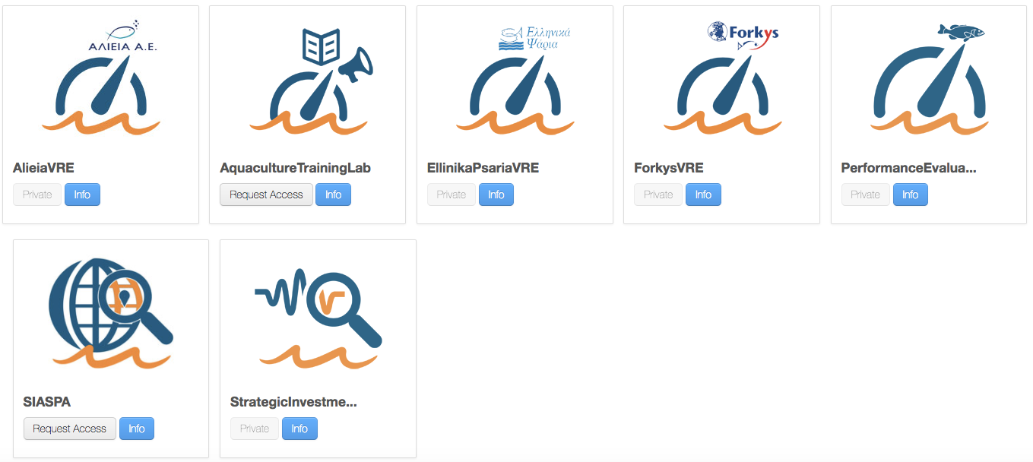
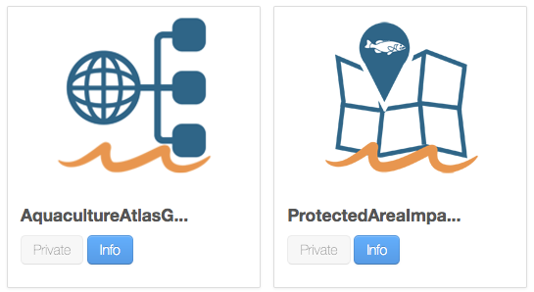
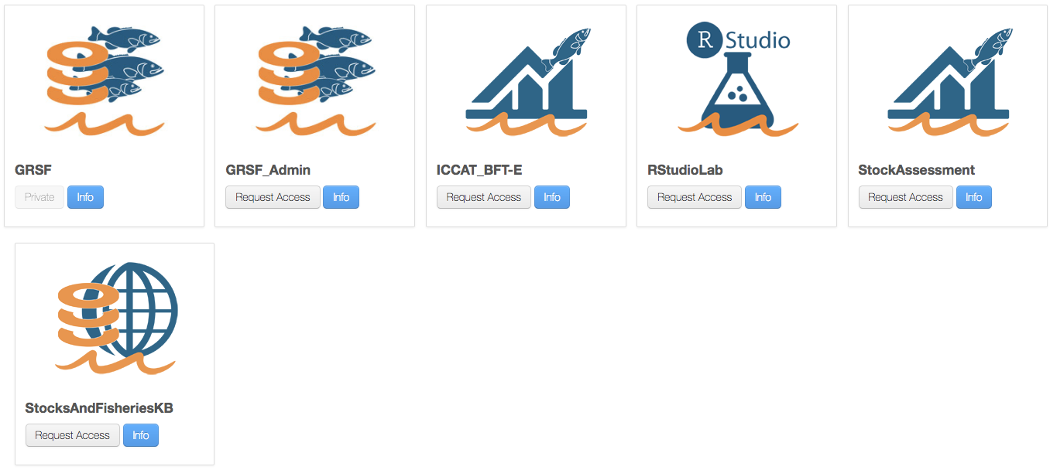
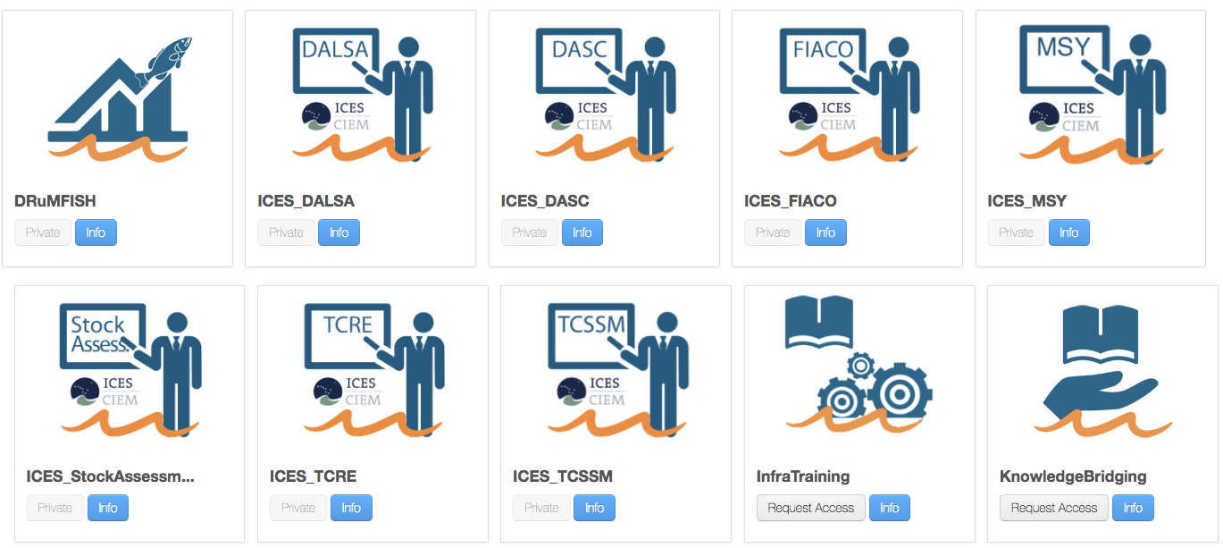
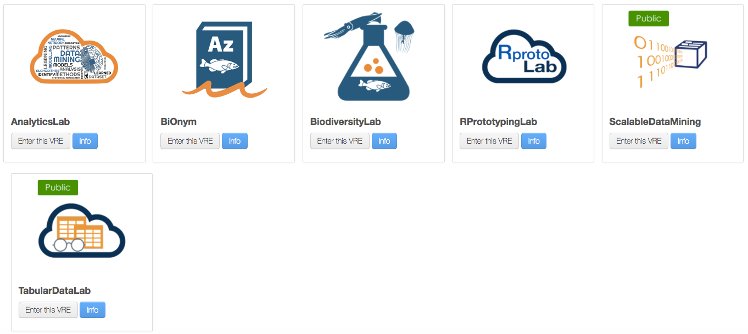
Additional information
BlueBRIDGE
Building Research environments fostering Innovation, Decision making, Governance and Education
for Blue Growth
www.bluebridge-vres.eu
https://bluebridge.d4science.org
www.i-marine.eu
www.d4science.org
http://www.bluebridge-vres.eu/sites/default/files/januaryworkshopreport.pdf

