Slide 1
Coastal Mapping
Final meeting
SHOM
gael.morvan@shom.fr

Slide 2


Genesis - context
  Memorandum of Understanding (MoU) – 23 April 2012
    Framework for interaction between the EC and the IHO
  Creation of the IHO-EU Network WG (June 2013)
    Decided at the 5th IHO IRCC meeting
    Developed and chaired by France
  Development of a Joint European Coastal Mapping Programme (JECMaP) within this WG
  Concurrently, CPMR work on data knowledge for the management of coastal areas
  Service contract signed 29 May 2015 (3 year duration)

Slide 3
Objectives
  Assess the current availability of digital coastal maps in the EU
  Disseminate this information by EMODnet
  Share experience of coastal mapping in the EU
  Develop standards for best practices
  Propose how a future JECMaP could operate

Slide 4
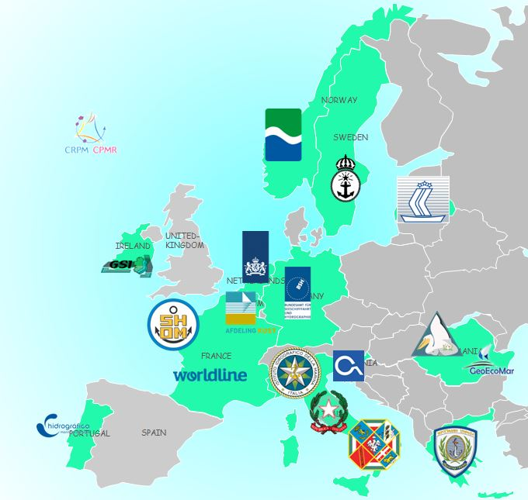
Consortium
Hydrographic offices :
FRANCE – BELGIUM – GERMANY – GREECE – IRELAND – ITALY – LATVIA – NORWAY – PORTUGAL – SLOVENIA – SWEDEN
Regions :
CPMR – Regione Lazio
Public Bodies :
ISPRA – RWS - GeoEcomar – DDNI
IT company :
Worldline

Slide 5
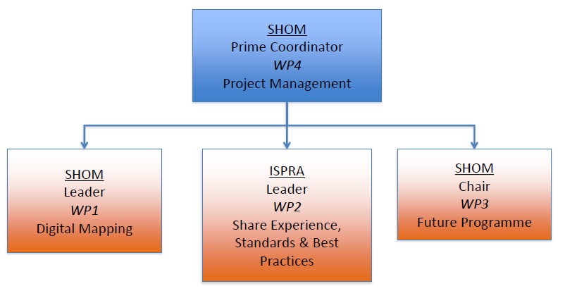
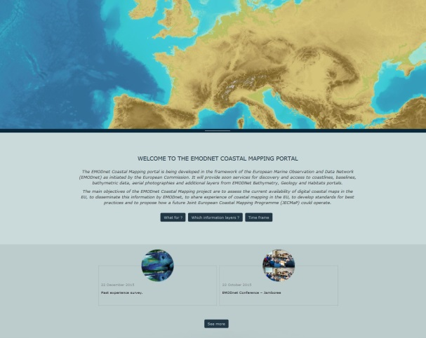
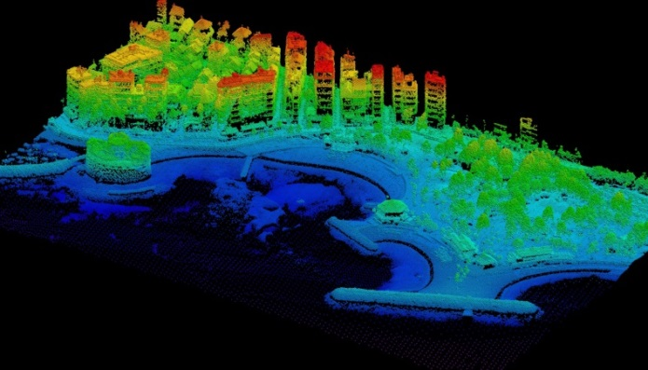
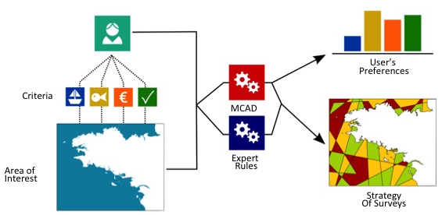
Organisation

Slide 6
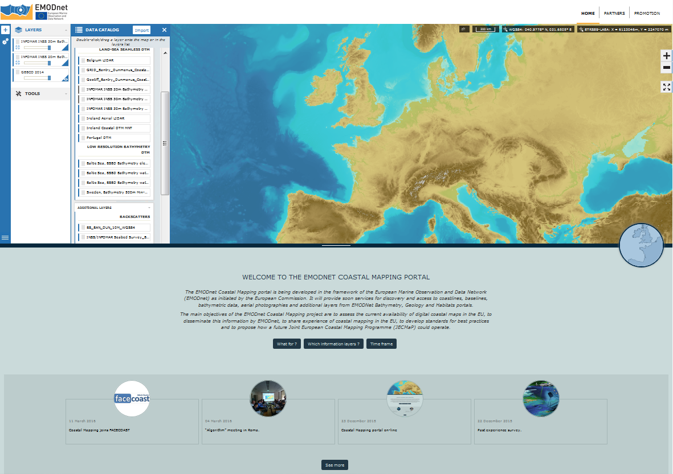
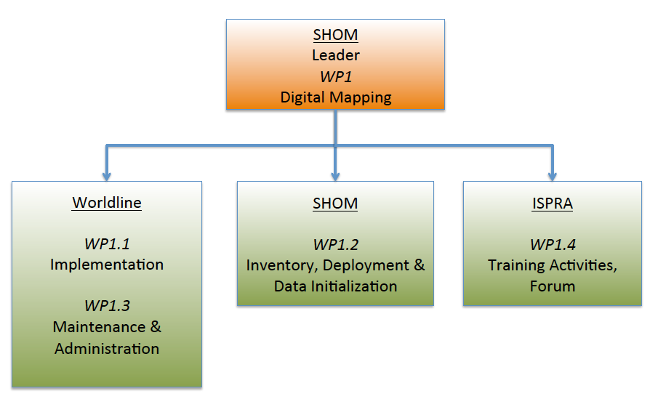
WP1: Digital Mapping

Slide 7
Internet Portal
Portal
  EMODnet look and feel
  Simple and modern design
  Catalog of digital maps
  Tools
    Bathymetric profile
    Data and metadata download
    Coastal Mapping Planner Algorithm
    Data ingestion of GPS points
Data Warehouse
  Data ingestion of Digital Terrain Models and surveys
  Upload of images and data files, and publishing as WMS

Slide 8
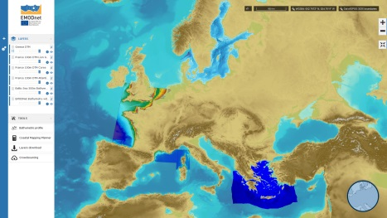
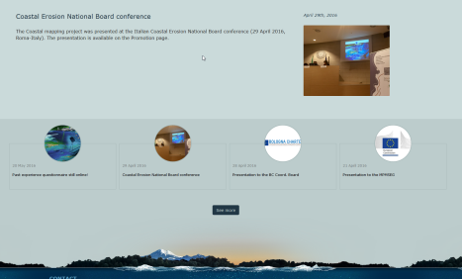
Portal architecture and data origins
Coastal Mapping portal
Partner 1
WMS Service
GIS portal
+
catalog
Partner 2
WMS Service
Data files
Data Warehouse
Data ingestion, transformation and publishing
WMS Service
Partner 3
Editorial portal
Data files

Slide 9
Portal demo
Navigation
Available datasets
Tools

Slide 10
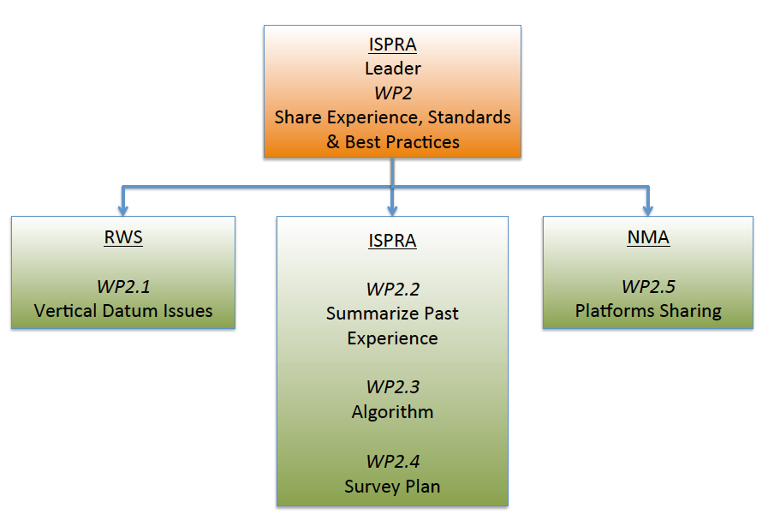
WP2: Share Experience, Standards and Best Practices

Slide 11
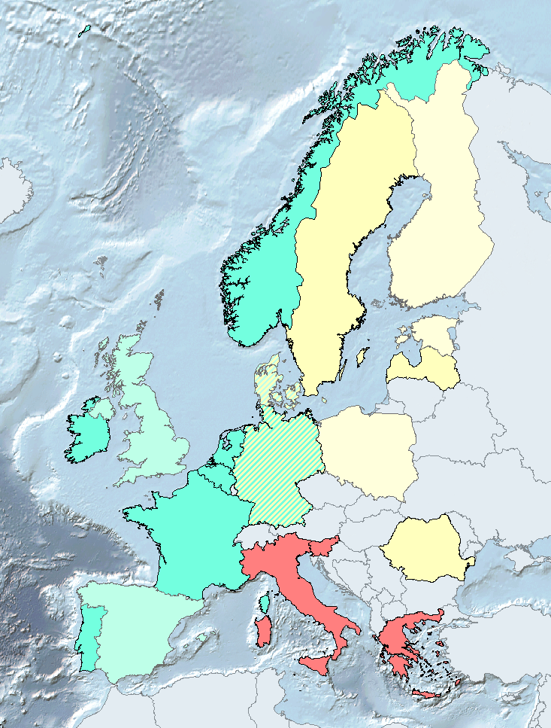
WP2.1: Vertical datum issues
Consistency of vertical datums:
  Questionnaire on VD
  Point out discrepancies within Europe
Towards a standardized datum:
  ETRS89-GRS80 ellipsoid
  European Vertical Reference System
  Harmonized datum on the maritime basin level
LAT (approx)
MSL
Low water

Slide 12
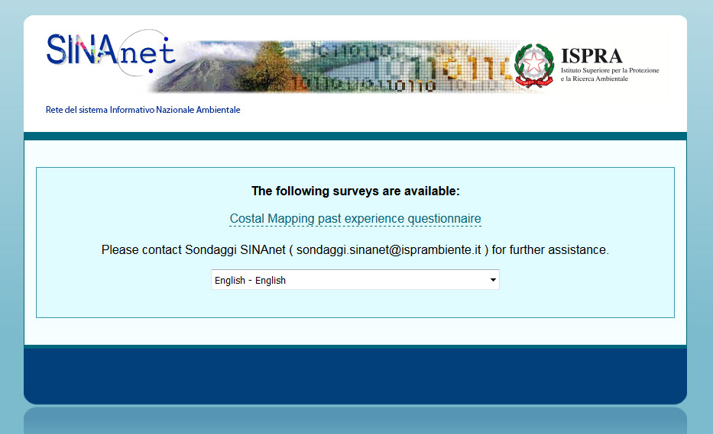
WP2.2: Summarize past experience
Analyze different experiences of coastal data acquisitions gathering information about:
Survey site information
Scope of the survey
Type of instruments
Products obtained
Estimation of the costs

Slide 13
Information gathered
Feedback from 15 partners
645 response to the past experience questionnaire
  487 by excel table
  158 by the on-line form

Slide 14
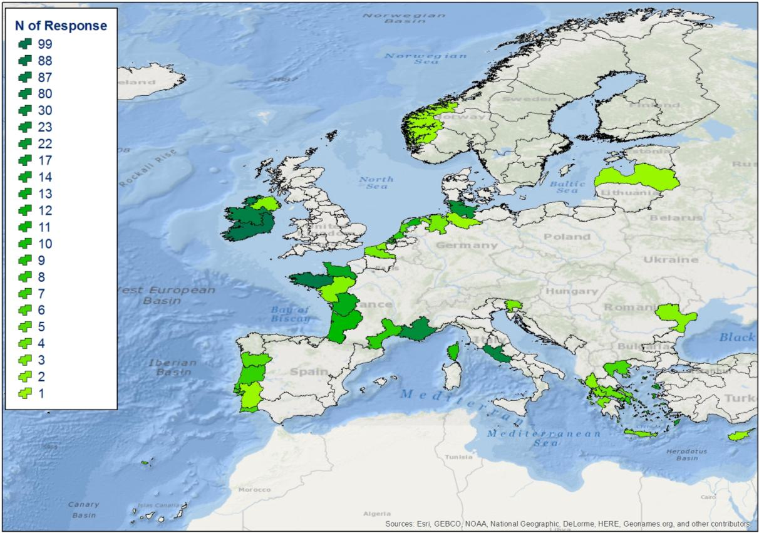
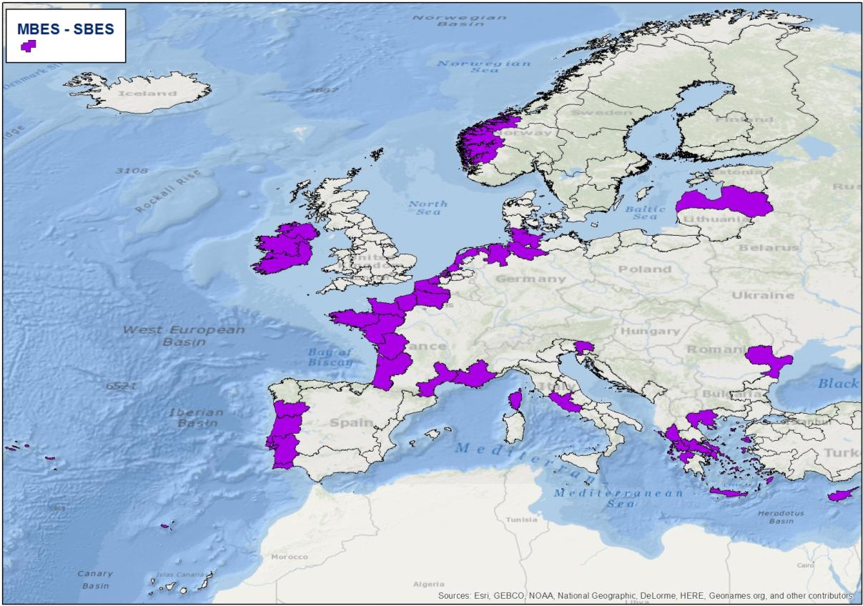
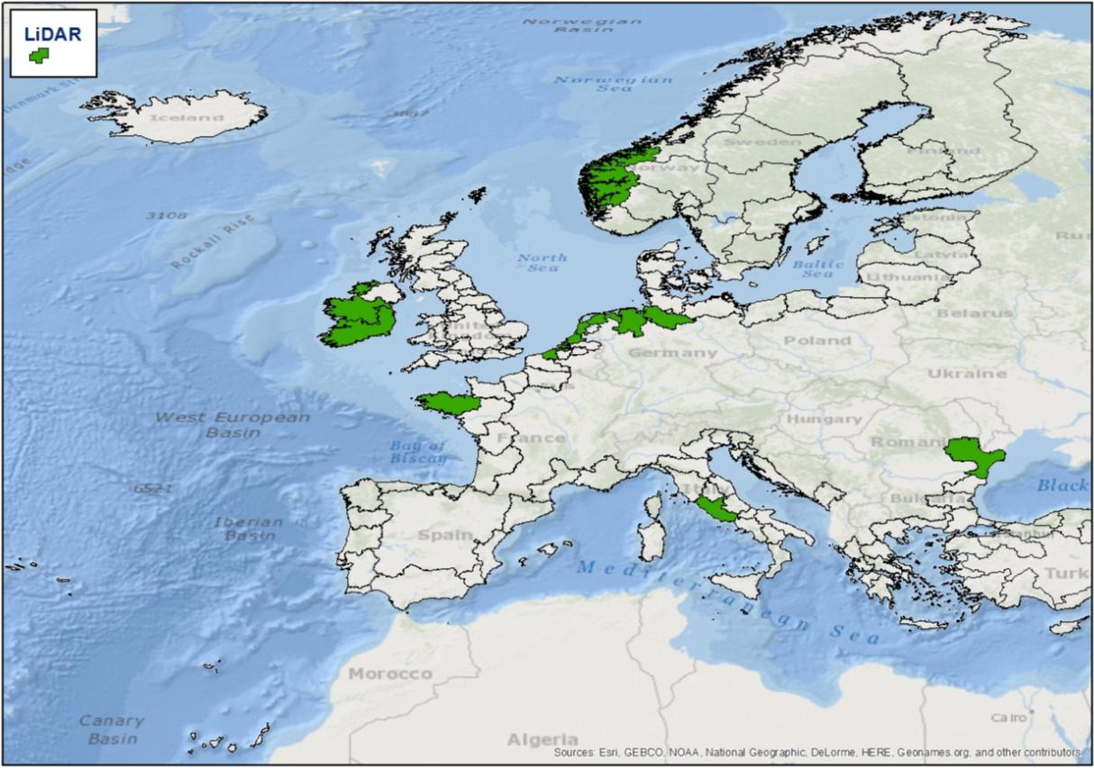
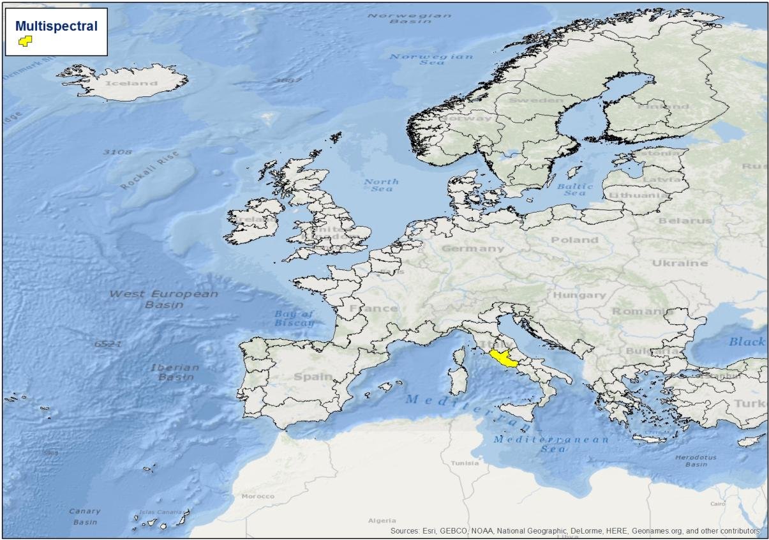
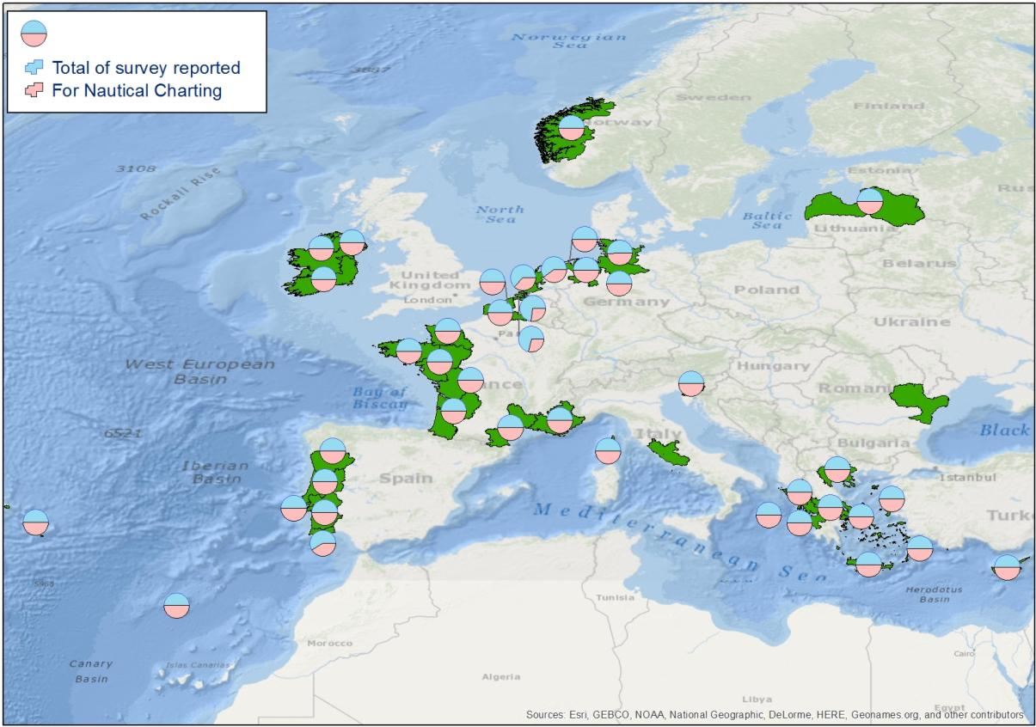
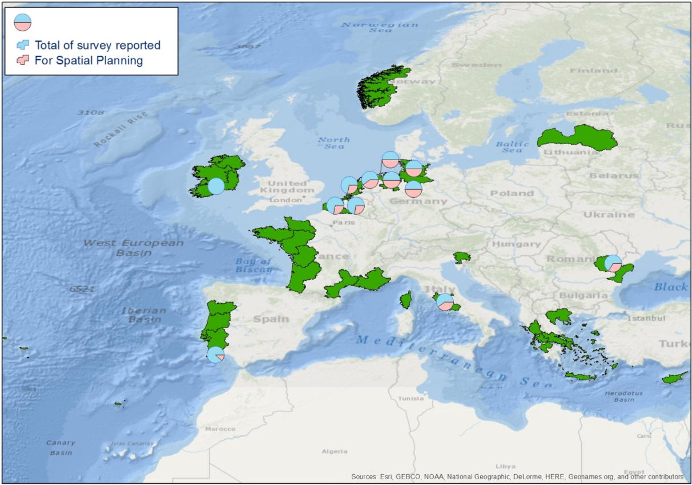
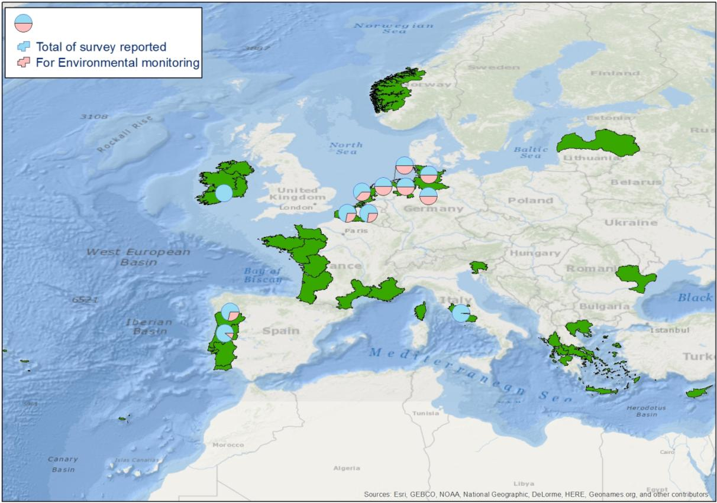
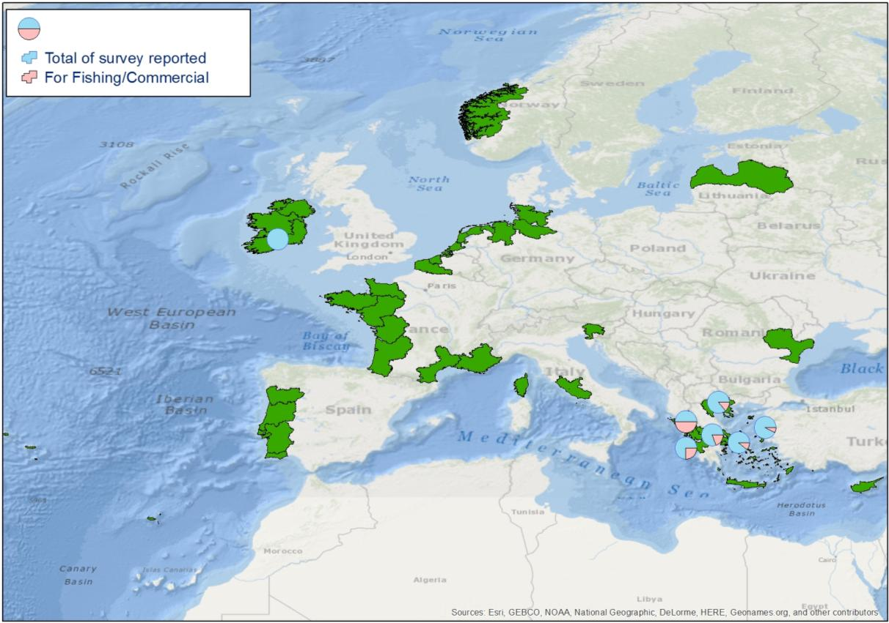

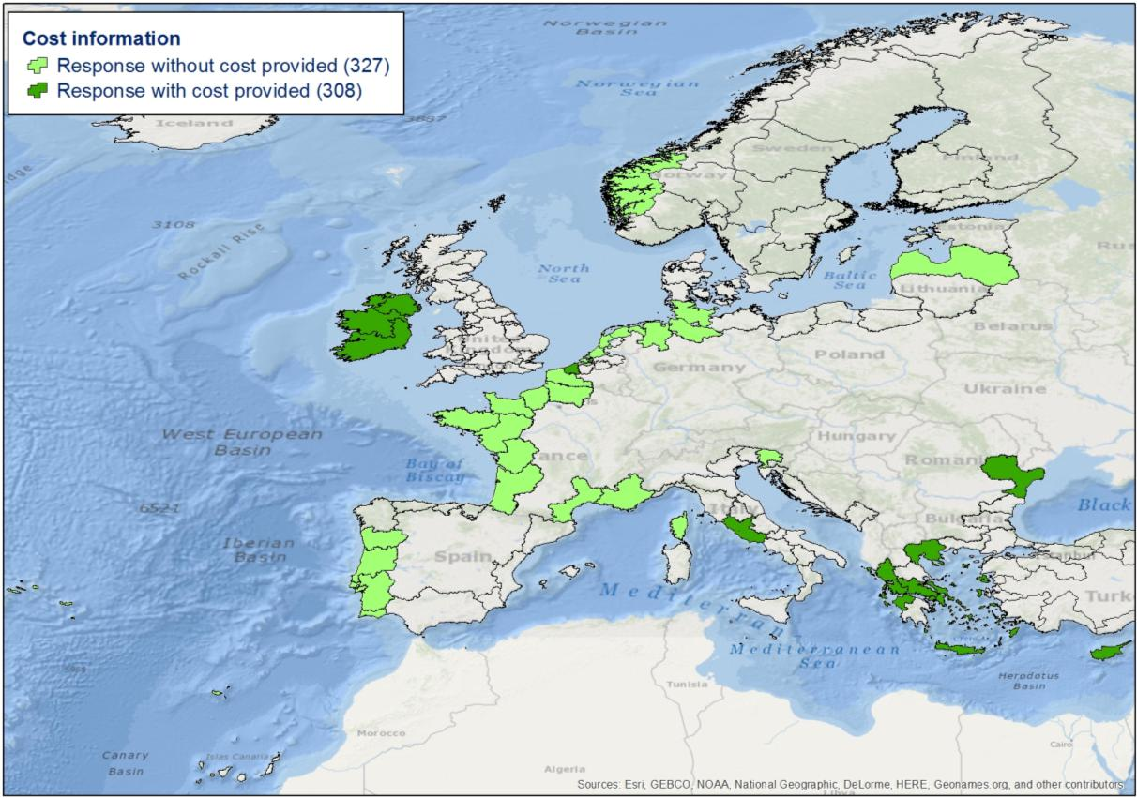
Analysis of the distribution of the answers
Where data were collected
With which instrument
For which purpose
At which cost

Slide 15
Critical element emerged
some areas have not been investigated due to the lack of some European member in the partnership
the partners involved are mainly Hydrographic Offices, and their past experiences are focused on nautical charting which creates a bias in the database of the past experience
The “cost” informations were few and dishomogeneous
 | Survey | N° Cost Provided | Cost Max (€/km2) | Cost Min (€/km2) | Cost Mean (€/km2) | Standard deviation
LIDAR | 85 | 25 | 4022 | 352 | 1961 | 1267.1

Slide 16
WP2.3: Develop and test an algorithm for choosing most appropriate surveying method
The CMP (Coastal Mapping Planner) is designed to help the coastal mapping planning at regional and transnational scale
It will help the EU planners giving indication about optimal survey techniques for different mapping scenarios

Slide 17
CMP characteristics
Different detection technologies can be compared in relation to their ability to obtain the desired products, currently :
  3 technologies (MBES, LIDAR & HYPERSPECTRAL)
  9 selectable products
It has a scalable structure that easily permits to add instruments and products
It takes in account the environmental characteristics of the survey area:
  Elevation
  Secchi disk depth

Slide 18
 | LiDAR | MBES | Air.Hyp.
Low resolution DSM | Suitable | Suitable | Not Suitable
High resolution DSM | Suitable | Suitable | Not Suitable
High resolution DSM for navigational purposes (Special order/Order 1a) | Not Suitable | Suitable | Not Suitable
High resolution DSM for navigational purposes (Order 1b) | Suitable | Suitable | Not Suitable
Shore line | Marginal | Not Suitable | Suitable
Vegetation presence map | Marginal | Marginal | Suitable
Vegetation cover type map | Not Suitable | Not Suitable | Suitable
Floor Cover Type map | Marginal | Suitable | Suitable
Properties of the Emerged Sediment | Not Suitable | Not Suitable | Suitable

Slide 19
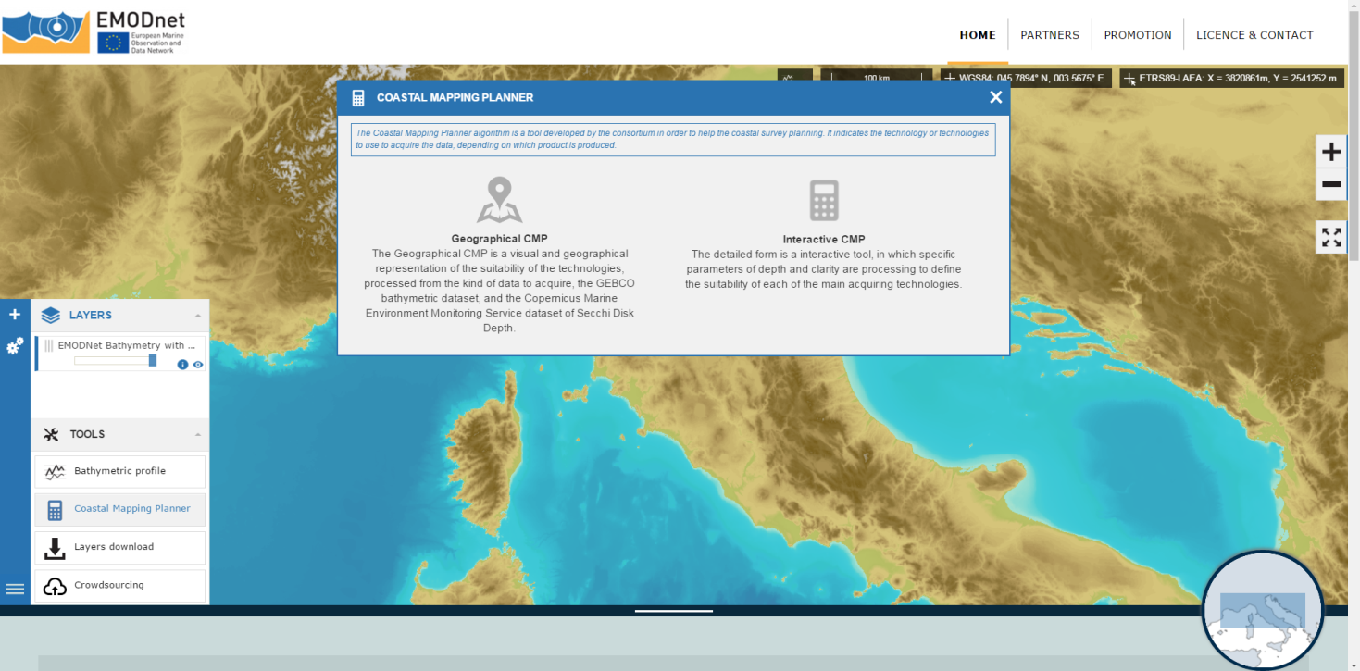
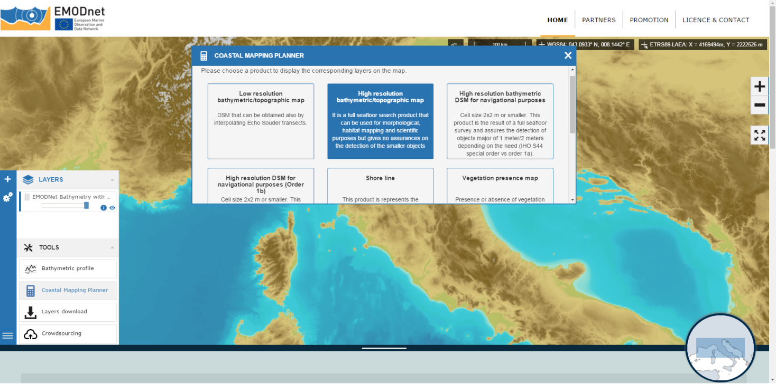
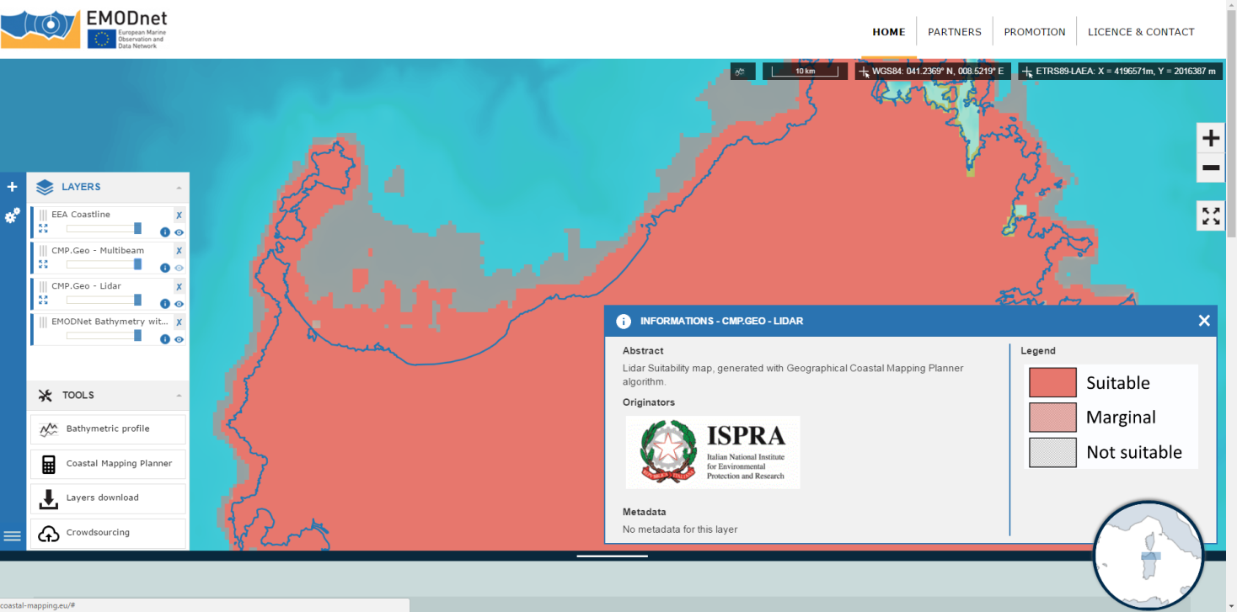
Geographical Coastal Mapping Planner

Slide 20
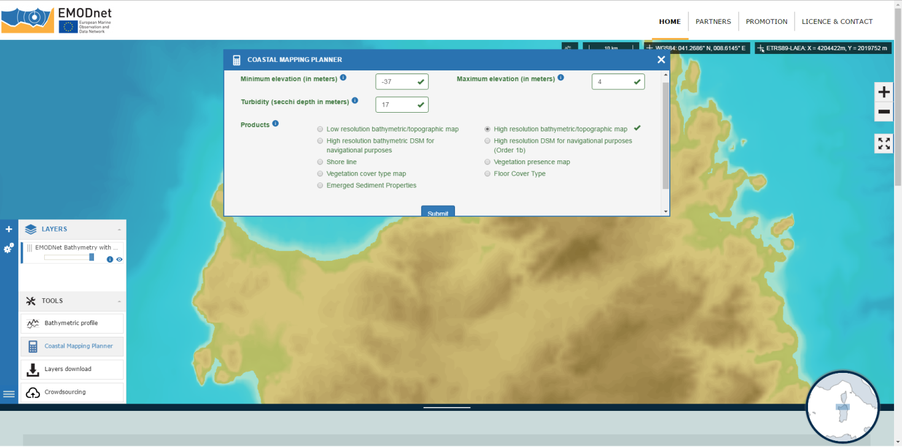
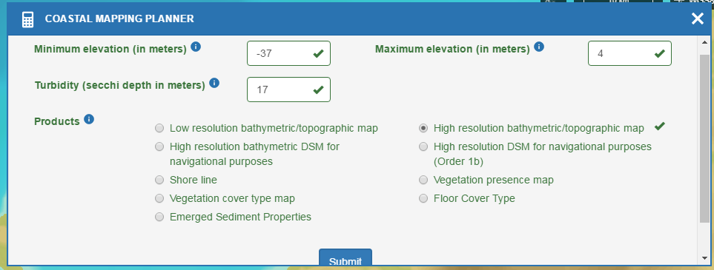
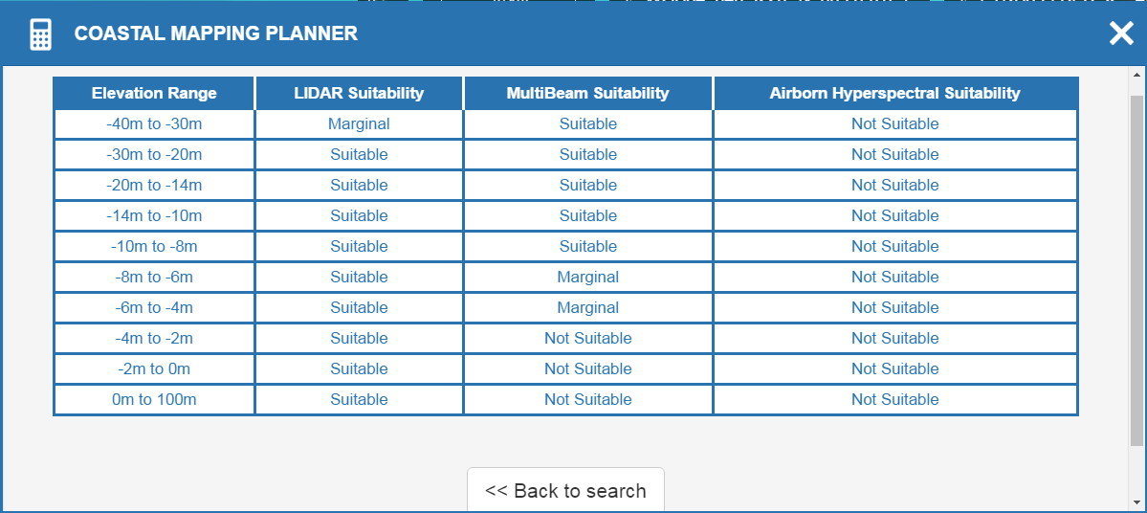
Interactive Coastal Mapping Planner

Slide 21
WP2.4: Build a technical & economical strategy
Define the functions that permit to estimate the cost of a survey for different acquisition technologies and different environmental characteristics
  Analyze the past experiences data
  Discuss the partner knowledge in a working group

Slide 22
Cost Function: Results

Slide 23
Cost Function: Results

Slide 24
Cost Function: Conclusion
Conclusion: the past experiences are not sufficient to build a reliable cost function valid on the whole of Europe
Possible development: other environmental variables, together with surface, should be investigated to model a reliable function to quantify the time cost of the survey

Slide 25
WP 2.5 – Sharing platforms
Research of the main platform categories in order to evaluate the possible technical synergy effects
Review sharing platforms through cooperation, and combining efforts in order to maximize the survey potential

Slide 26
Conclusions
Survey platform of choice is a surface vessel
Varying national restrictions does limit shared efforts
Combined tenders is still desirable
Issues to be resolved
Definition of requirements and standards for the different data types
National restrictions on data aquisition and management needs to be adressed

Slide 27
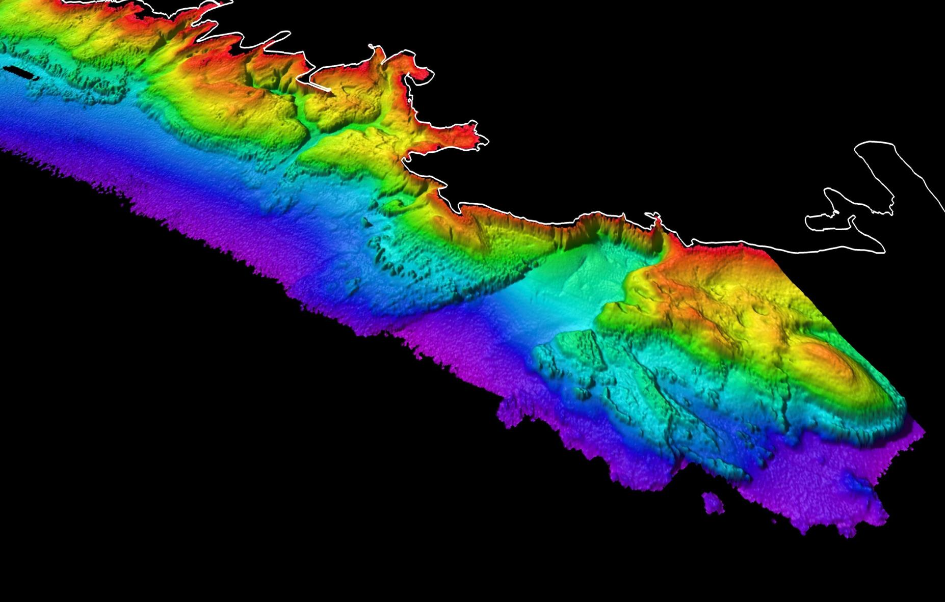
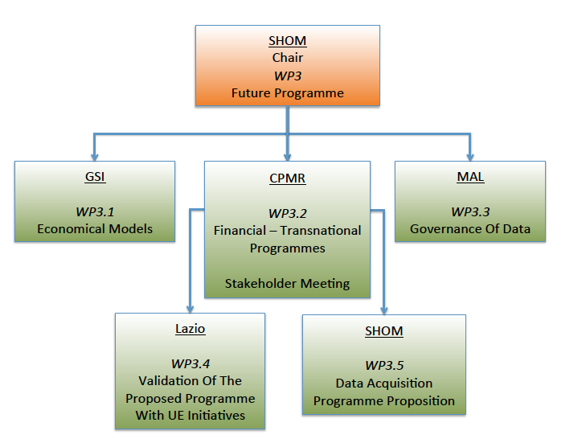
WP3: Organisation

Slide 28
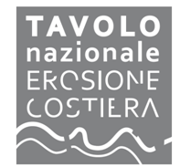

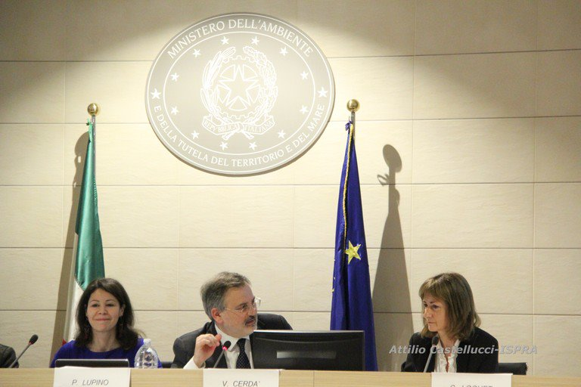
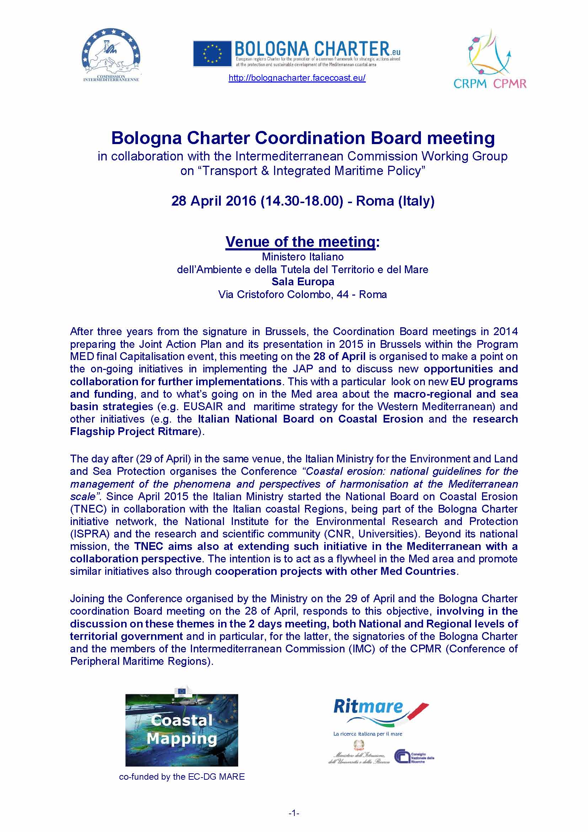
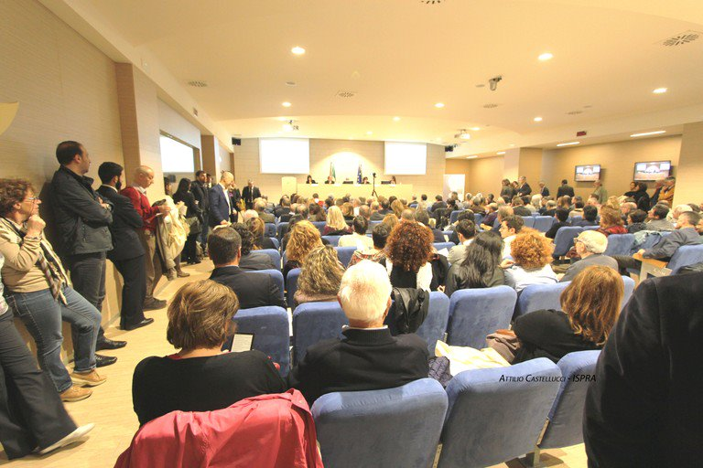
The promotion of the use of Coastal Mapping products
Promotion of Coastal Mapping Portal during Bologna Charter Coordination board in Rome
April 2016

Slide 29
Main feedback on Coastal Mapping tools
.... the evaluation of the quality of the proposed tools was positive for all interviewed….
….. partially interested because of the geographic scale. A more detailed geographic scale for local uses would have been appreciated.
….. in order to be a full DSS, the Algorithm should take account of the survey costs and be able to compare them too.
….. utilization of some other technology (like single beam) in the case of beach profile monitoring for the evaluation of very shallow water morphology
…all regional authorities expressed their interest in collecting and sharing coastal mapping data if they can be used for the production of thematic maps in the context of integrated coastal zone management.

Slide 30
WP3.1/3.3 – Data Governance and Economic Models
  Questionnaire sent to all partners – collated in report.
  19 respondents from 15 countries
  Predominantly Hydrographic Organisations

Slide 31
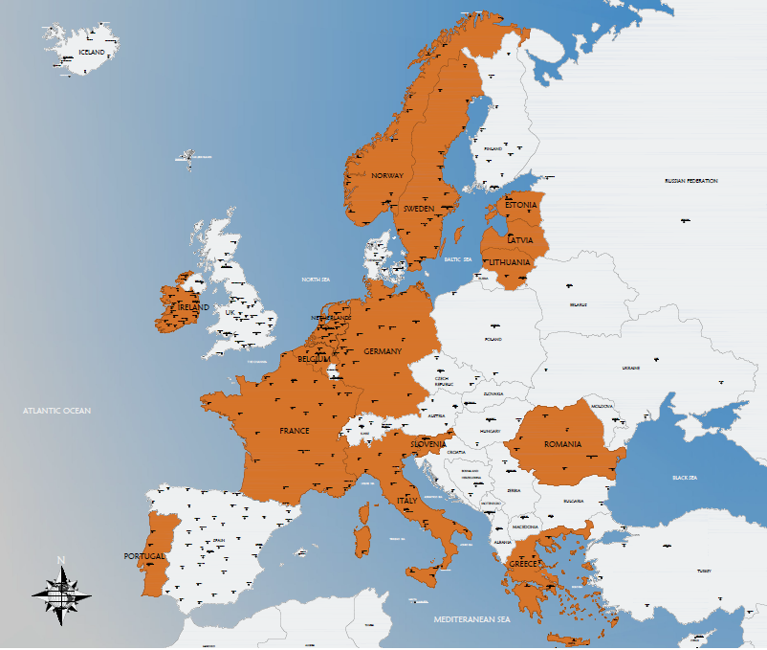
Partners
FRANCE – Naval Hydrographic and Oceanographic Service (SHOM)
BELGIUM – Coastal Division (MDK)
ESTONIA – Estonian Maritime Administration (EMA)
GERMANY – Federal Maritime and Hydrographic Agency (Bundesamt für Seeschifffahrt und Hydrographie) (BSH)
GREECE – Hellenic Navy Hydrographic Service (HNHS)
IRELAND – Geological Survey of Ireland (GSI)
ITALY – Institute for Environmental Protection and Research (ISPRA)
ITALY – Italian Hydrographic Institute (Istituto Idrografico della Marina) (IIM)
ITALY – Latium Region (LAZIO)
LATVIA – Maritime Administration of Latvia (MAL)
LITHUANIA – Lithuanian Maritime Safety Administration (LMSA)
THE NETHERLANDS – Rijkswaterstaat
NORWAY – Norwegian Hydrographic Service (NHS, NMA)
PORTUGAL – Instituto Hidrográfico (IHPT)
ROMANIA – Danube Delta National Institute for Research and Development (DDNI)
ROMANIA – National Institute for Marine Geology and Geo – ecology (GeoEcoMar)
SLOVENIA – Geodetic Institute of Slovenia (GIS)
SWEDEN – Swedish Maritime Administration (SMA)

Slide 32
Results for governance
The first result is an heterogeneity in perception and definition of the coastal area (depth or distance, not the same..), coastal population (municipalities, regions..), coastline, lack of integrated vision?
But an homogeneity in the definition of coastal activities and of the sustainable coastal management, that is a major result.
The responsibility of acquisition of bathymetric data for safety of navigation is a State competence, the organizations in charge are opening their responsibilities to provide bathymetric data to all the stakeholders for coastal management, the Ministries responsibles, generally: Defence, Environment, Transport.
In some countries, the Regions are responsible of the coastal management and do acquisition of data at sea.
Our definition of coastal area and shallow waters to fill the objectives of the call that are our's too; give the more appropriate definition in your country to give useful data to develop sustainable coastal management.

Slide 33
Results for economic models
The obvious trends are that there are one of three categories that each partner falls under.
Freely available data with no restrictions and no cost to the user. (Where publically funded)
Data is available but there is a cost.
Data is restricted under national security limitations with degraded data available either at cost or for free.

Slide 34
Data Policy | Partners | % (x/19) | Cost Benefit Analysis
Free access to all data | GERMANY (BSH) IRELAND (INFOMAR) ITALY (Lazio Region) FRANCE (Litto3D), ESTONIA (MAE) SLOVENIA (GIS) | 32 | No Yes – Pcw No No No No
Open access to all data with some costs | ITALY (IIM) NORWAY (NHS/NMA) | 10 | No Underway
Restricted access to all data | BELGIUM (MDK) LATVIA (MAL) PORTUGAL (IHPT) ROMANIA (DDNI and GeoEcoMar)) LITHUANIA (LMSA) | 26 | No No No No Underway
Restricted access to some data | FRANCE (SHOM) GREECE (HNHS) ITALY (ISPRA) NETHERLANDS (Rijkswaterstaat) SWEDEN (SMA) | 26 | No No No No Benchmarking

Slide 35
Method:
WP3.2: Financial – Transnational Programmes
Collection of the available documents:
  Transnational Operational programmes
  Cross-Border Operational Programmes
Identification of the opportunities for coastal data and mapping. 2 categories:
  Priorities directly related to coastal data and mapping (risk monitoring, erosion, seabed mapping, coastal mapping, ecosystem mapping, etc.)
  Maritime priorities potentially implying a coastal mapping dimension.

Slide 36
Result
Development of 2 maps:
  Map of Transnational Programmes
  Map of Cross-border Programmes
What does the analysis show?
  Several Programmes offer opportunities for coastal mapping;
  Various OPs can cover the same coastal area;
  Different administrative bodies are involved in the same coastal areas depending on the eligibility of the Programme.

Slide 37
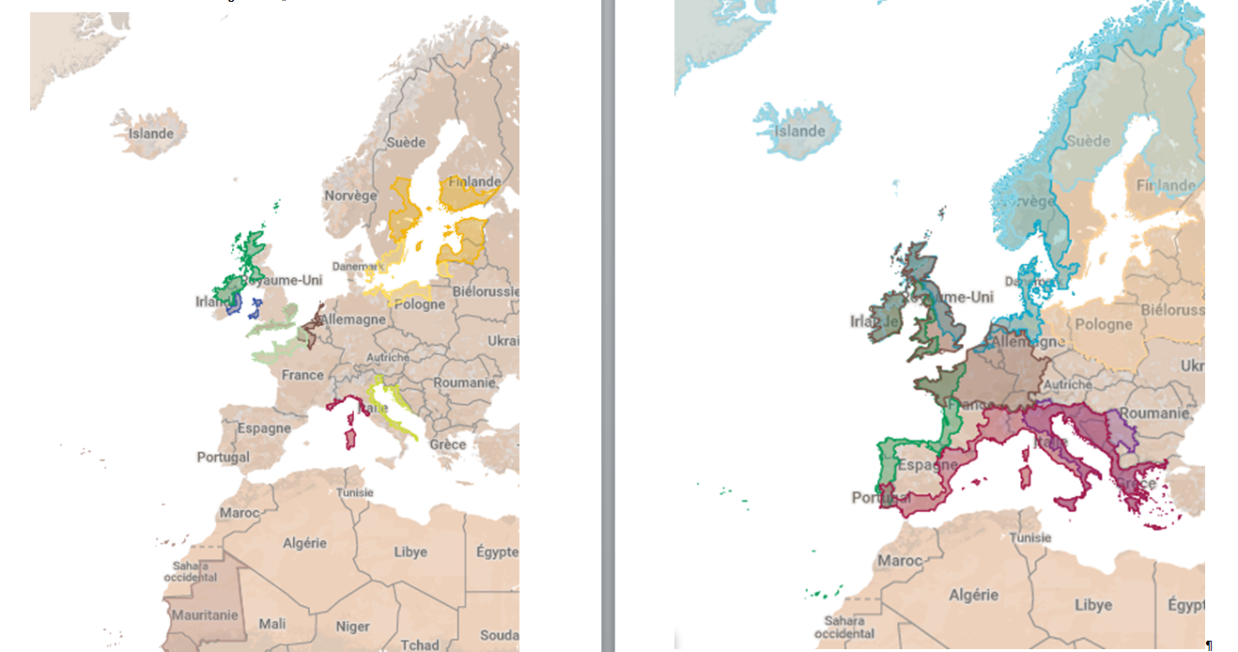
Transnational programmes
Cross-border programmes

Slide 38
WP 3.5 – Data acquisition programme proposition
Coastal mapping:
HR Bathymetry in shallow water
TOWARD A EU STRATEGY
Managing the coastal zone and their risks
Preserving the environment and developping the blue economy

Slide 39
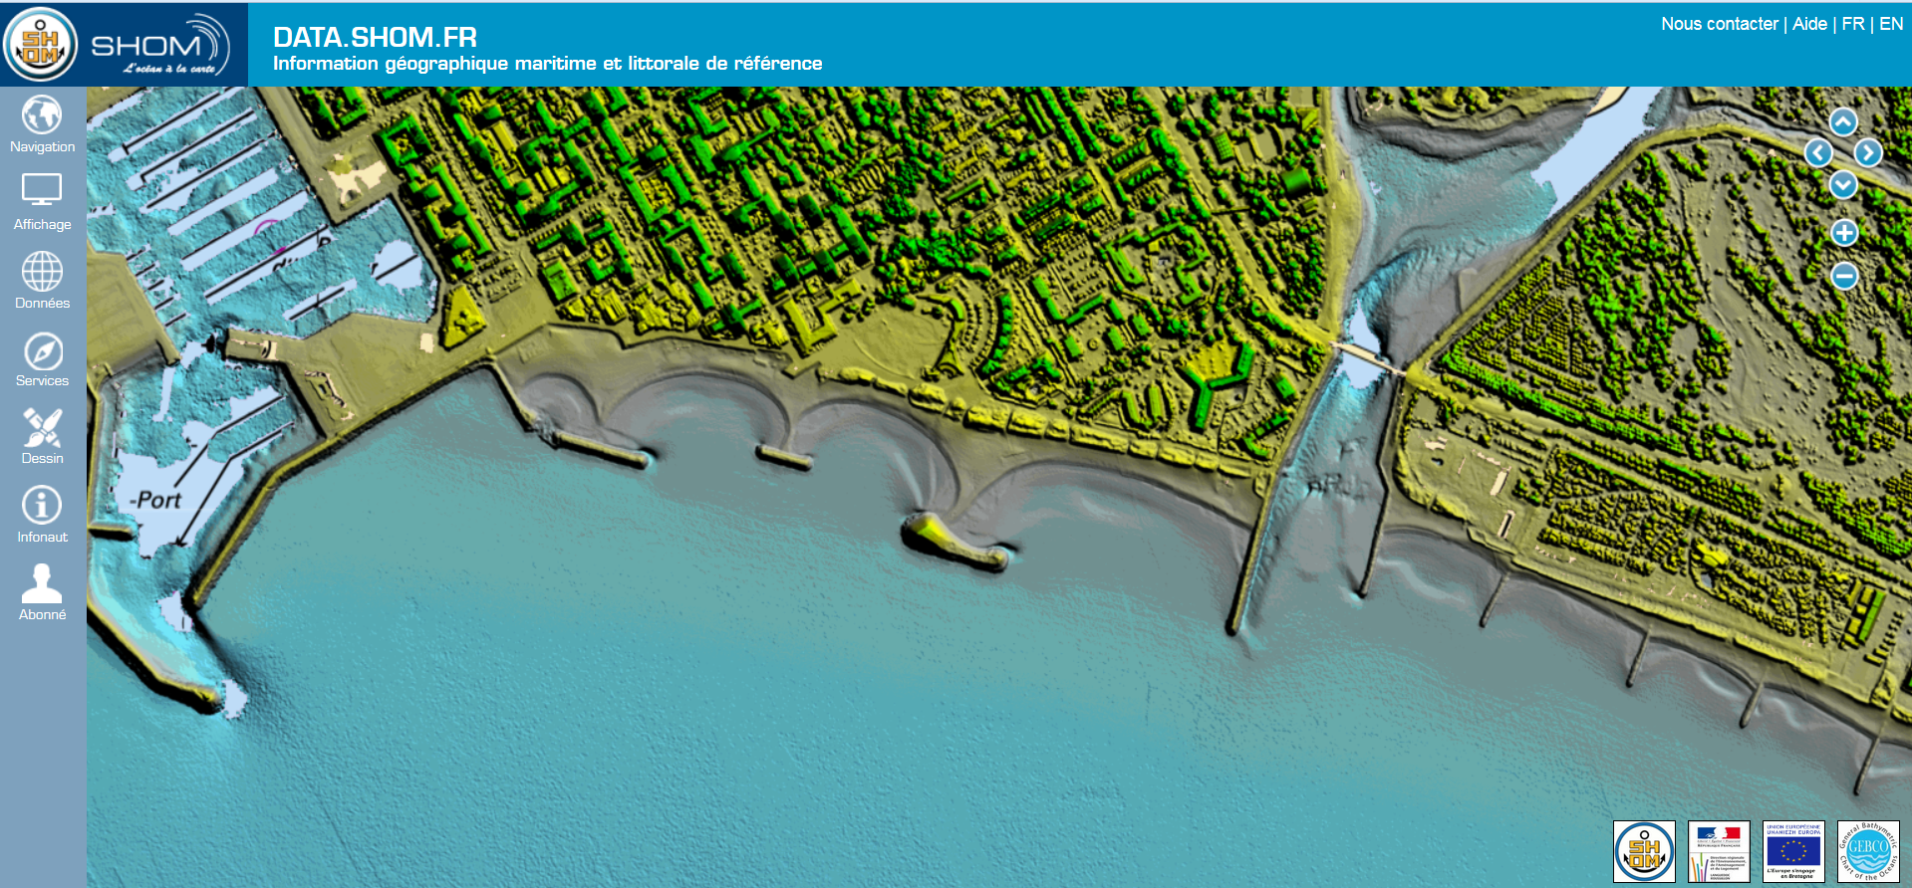
Protection against erosion

Slide 40
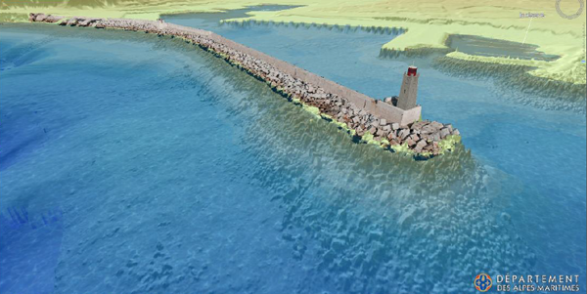
Link between different data scales and methods

Slide 41
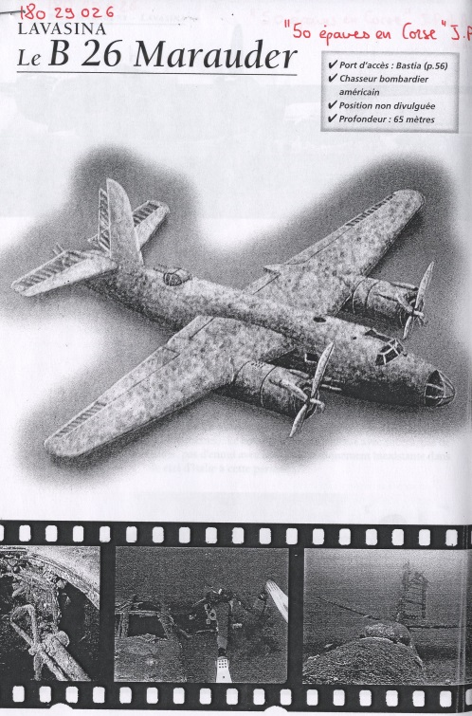
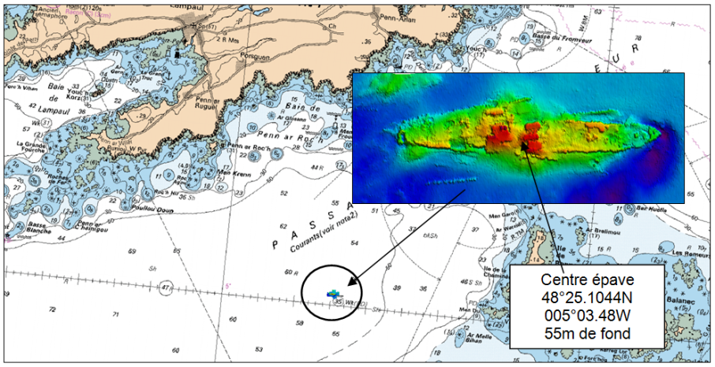
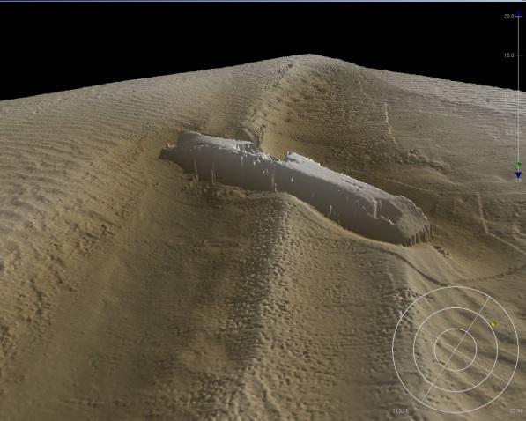
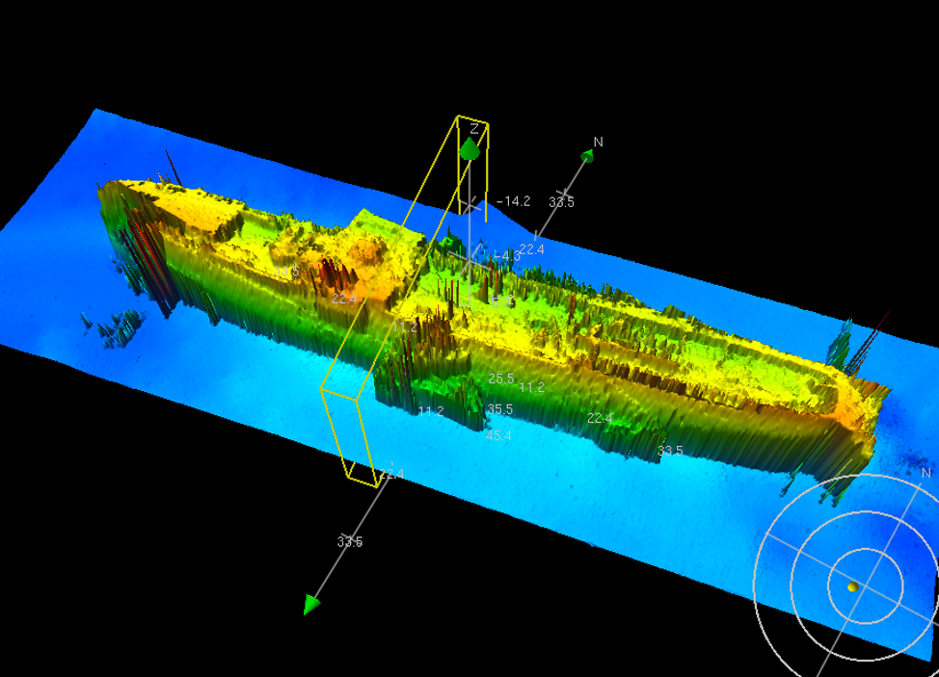
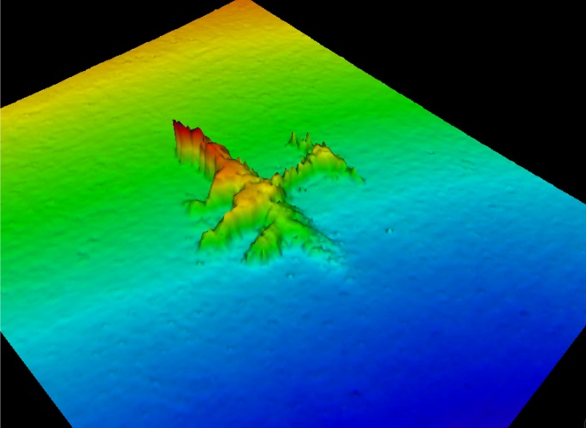
Manage the safety of navigation and the marine archeology

Slide 42
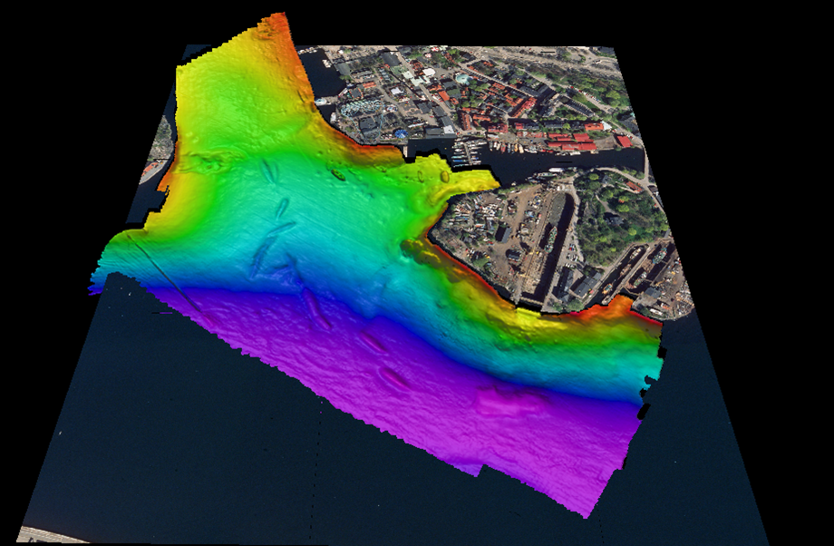
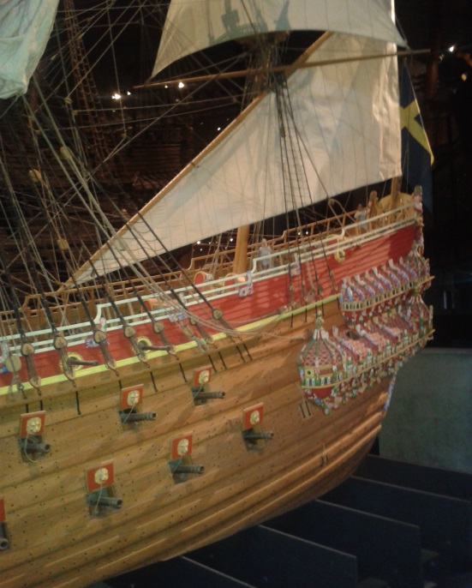
Stockholm coastal management: the Vasa history

Slide 43
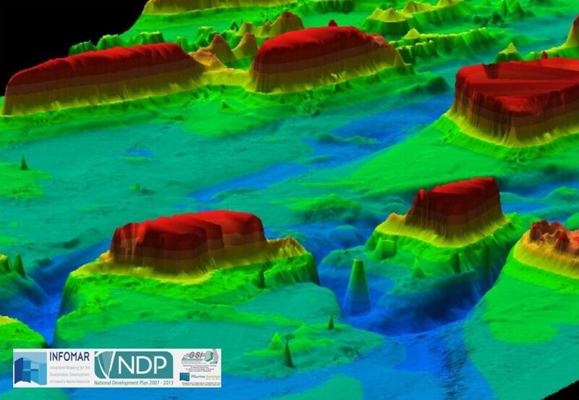
Safety of navigation in Ireland

Slide 44
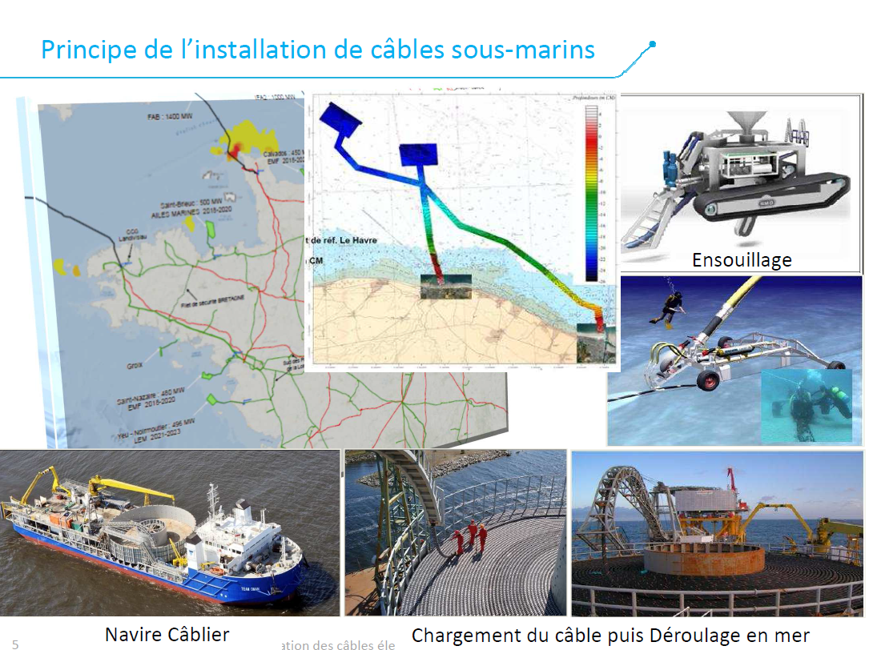
Laying of submarine cables
Trenching & backfilling
Cable ship
Cable loading & unloading at sea

Slide 45
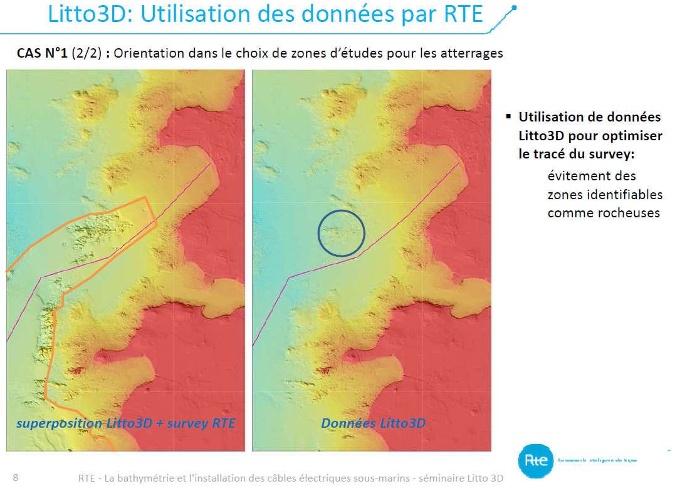
Cables for energy: FR-IRL, FR-UK, FR-SP
Litto3D : use of data by RTE
Use of Litto3D data:
to identify rocky areas
to optimize the survey road.
Litto3D data & RTE survey
Litto3D data

Slide 46
ACQUISITION OF HIGH RESOLUTION COASTAL BATHYMETRIC DATA
TOWARD A EUROPEAN STRATEGY?
The bathymetric data in coastal zones:
A common basis for the coastal
and maritime policies (integrating land-sea interface)
A chance for innovation in blue growth

Slide 47
STUDY OF THE GAPS TO FILL
HR BATHYMETRIC DATA IN COASTAL ZONES
Representability of the partnership; all the EU maritime basins were considered, more than 50% of the maritime EU Countries
Result; more than 175 000 km2 of acquisition to do, only for the panel countries
It is necessary to take into account the specificities of the maritime basins in the future acquisition strategy for coastal data (depth) and not take only one definition for coastal zone, coast line, coastal population.

Slide 48
STUDY OF THE GAPS TO FILL
HR BATHYMETRIC DATA IN COASTAL ZONES
The maximum resolution useful for the evaluation of activities is 0.50m, the actual MBES can deliver 0.20m in good conditions.
Standardized and high resolution data are the conditions of re-usability of data by the national and local authorities and stakeholders for the maritime policies; precision for decisions, activities and juridical situations.
Using standard procedures would allow to give to the data a quality assurance. The IHO rules must be used, no data should be gathered without an assessment about their uncertainty.
We should climb a step with the use of these standards in EU funded projects.

Slide 49
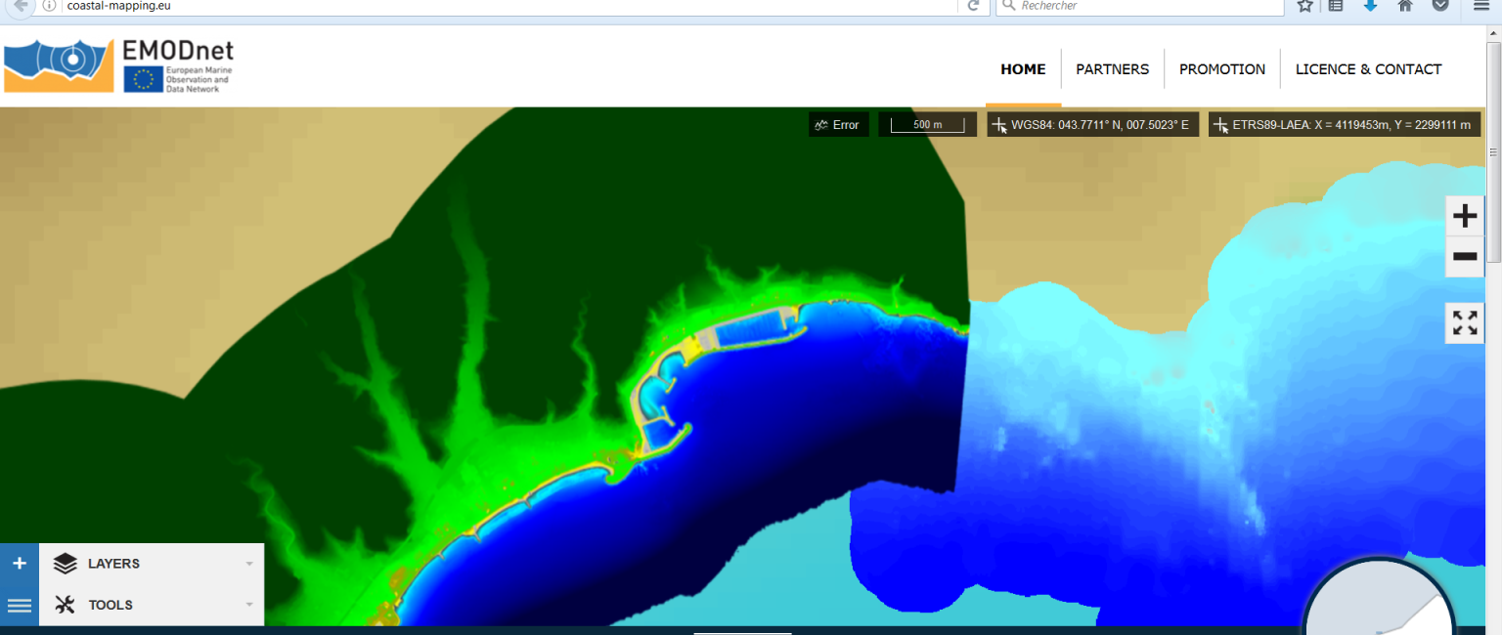
It seems mandatory that experts of bathymetry be involved in the preparation of EU programmes with maritime objectives. This would facilitate the use of standards.
IHO-EU Network can be associated.

Slide 50
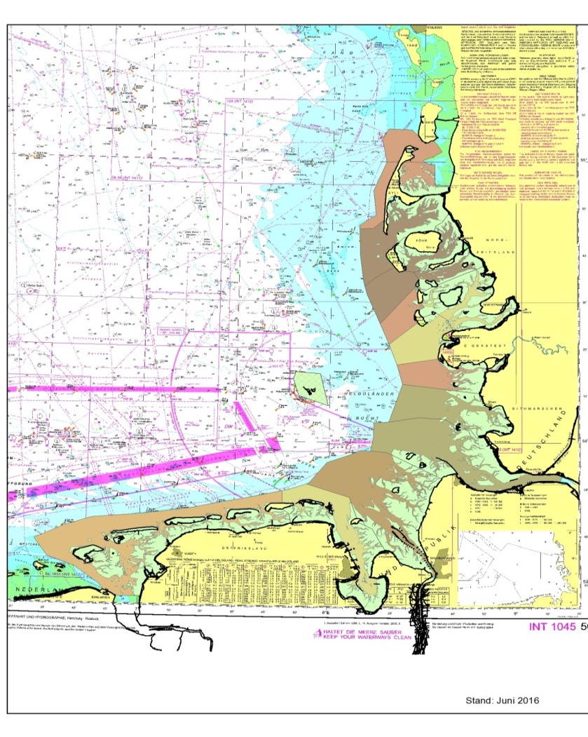
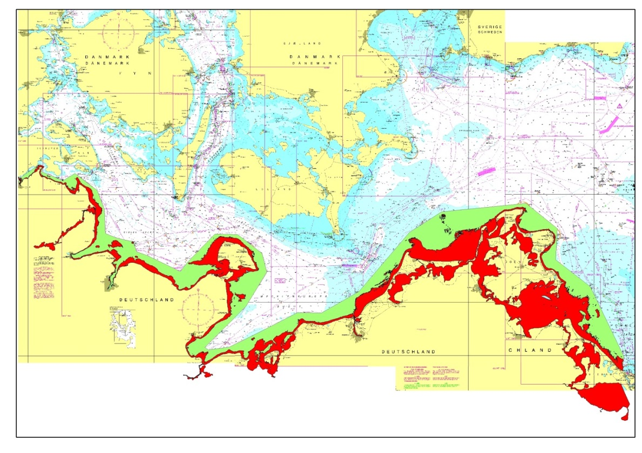
Analysis of the needs and means in Europe for the acquisition of bathymetric data in coastal areas
German coastal zone: North Sea (intertidal zone in light green) & Baltic Sea (Bathymetric Lidar in red)

Slide 51
How to fill the gaps with a
European Strategy ?
Three axes proposed
AXIS 1: Set up coordinated programmes for data acquisition at maritime basin scale;
AXIS 2: Increase the opportunities for bathymetric data acquisition in the framework of the EU operational programmes and funds;
AXIS 3: Promote the production of bathymetric data from multiple sources, usable by different categories of coastal users for maritime policies.

Slide 52
AXIS 1
Cooperation programmes for data acquisition
Organised at the scale of maritime basins, taking into account the scale of IHO geographical commissions
Co-financed by the states, the Regions and EU’s relevant funds (EMFF, ERDF, H2020)
  Proposition to design programmes both at the scale of maritime basins AND by technology/platform with the algorithm teachings and the knowledge developed by the relevant organizations
  Governance of these programmes; by EU public organization, considering bathymetric data as a public service at EU Scale for the global strategy and at basin scale for the acquisition

Slide 53
AXIS 1 - AGENDA
Cooperation programmes for data acquisition
=> Coastal Mapping 2 ?
  Organization of the Governance (strategic and operational):
  => EU public organization around the General Interest Service Status or other? In capacity to operate the acquisitions or the necessary public calls for companies
  2 Scenarii:
  - An existing structure is modified: One year necessary - 2017
  - A new organisation is built: 2017- Mid 2018
  In parallel, design of acquisition programs at the maritime basins level to be approved by the different DGs and the Member States, Regions..,6 months in 2017

Slide 54
AXIS 2
  Increase the possibilities for coastal bathymetric data aquisition in the framework of the Interreg programs, H2020, EMFF, LIFE
  Promoting the legitimacy of coastal bathymetric data production as necessary condition to develop every maritime policies, covered by the 5 first EU funding priorities (of 11 ones),
  Reaffirming that the coastal zone is a high-risk strategic zone for climate change issues and that it requires a lot of knowledge and data to deal with extreme climatic events;
  Explaining that a lot of marine bathymetric data produced in the EU projects suffers a lack of visibility, common standards and mutualisation (EMODNET). Therefore, this data is lost leading to a waste of energy, finances and data
  Promoting the use of international standards for data production funded by EU funds (link with the HOs)
  Promoting the need of pooling these data in the EMODNET database
  Promoting the need for the competent offices of the Member States to validate the data before they are pooled in EMODNET (link with IENWG)
  Developing campaigns in homogeneous areas, sharing platforms and funds from the EU programs, (cf financial CPMR tool)

Slide 55
AXIS 2 AGENDA (1/2)
  Increase the possibilities for coastal bathymetric data aquisition in the framework of the Interreg programs
  Sept-Oct 2016: DONE
  Presentation of the argumentation to the concerned DGs by the coordinator and the CPMR
  Oct 2016: DONE
  Presentation during the Open Days (13th october 11-13h30 Comittee of Regions Brussels)
  Meeting with EU HOs (about international standards, validation of data, common acquisition)
  Dec 2016: TODAY
  Presentation of these results to the DG MARE and other DGs during the last Coastal Mapping meeting ; 8 December
  7 Feb 2017:
  Stakeholders meeting to present the results and prepare the next step with the persons responsible for coastal mapping organisations, parlementarians (Searica), DGs
  1st Semester 2017:
  Presentation to major transnational secretariat of EU programs in order to find a way to:
  Increase recognition for the benefit of producing bathymetric data in the EU programs
  Implement the dissemination and use of international standards (IHO) for bathymetric coastal data production funded by INTERREG and EU funds
  Promote the validation of these data by the competent services in each Member State, before they are pooled in the EMODNET portal
  Create an obligation to pool them in the EMODNET database

Slide 56
AXIS 2 AGENDA (2/2)
  Increase the possibilities for coastal bathymetric data aquisition in the framework of the Interreg programmes
  Coastal Mapping 2 (?) and 2017-2021 period
  *Promoting coastal bathymetric data acquisition in the context of the next mid-term re-orientation (2017-2018) in the EU or regional programs and preparing the next financial period (2021-2027):
  - in order to comply with the EU priorities, highlight the need to do EU funded acquisition of bathymetric data on coastal zone, involving the public organisations responsible in Member States;
  -undertake the necessary modifications inside the operational programs for the current period and prepare the next one with; obligation to use standards, teaching of these standards in the MS, validation of data by HOs, implementation of these data on the EMODNET portal, modification of potential applicants if necessary.
  *Promotion and development of model campaigns in homogeneous areas corresponding to the EU programs, with sharing of platforms, funds, and administrative engineering

Slide 57
AXIS 3
    Community sourcing
        Promoting the production of usable bathymetric data for maritime policies, coming from different sources
        Organising training and dissemination of data acquisition standards, (HOs)
        Organising the validation of these data by the HOs of EU Member States (link with EMODNET “ingestion and safe keeping of marine data)
        Evaluation of the gaps in the EU coastal seabed mapping, in order to address them via community sourcing
        Promoting the link between the EU and the IHO works

Slide 58

EMODnet Data Ingestion project

Slide 59
AXIS 3 AGENDA
    Promote the production of usable bathymetric data for maritime policies,
    Links with axis 2
    Oct 2016 DONE
    Evocation of the different actions undertaken by EU and IHO
    Dec 2016 and Feb 2017
    Proposition of joint actions for organizing training and diffusion of standards, (common with a second phase of Coastal mapping?)
    2017
    A representative of EMODNET in IHO WG for interoperability of the databases and coordination of actions IN PROGRESS
    2017-2018
    Coordination between HOs and EU through IENWG and under the umbrella of CM2, deployment of the learnings
    Organising the validation of these data by the HOs of EU Member States (link with EMODNET “data ingestion”project)
    Evaluation of the gaps in the MS in order to address them via multisourcing
    promoting the link between the EU and IHO works

Slide 60

THE COASTAL MAPPING TEAM
THANKS YOU FOR YOUR ATTENTION AND SUPPORT!

Slide 61




















Slide 62
READY FOR THE NEXT STEP !

