Slide 1
Upcoming publication:
Summary of results on
bioremediation potential with algae
Efthalia Arvaniti

Slide 2
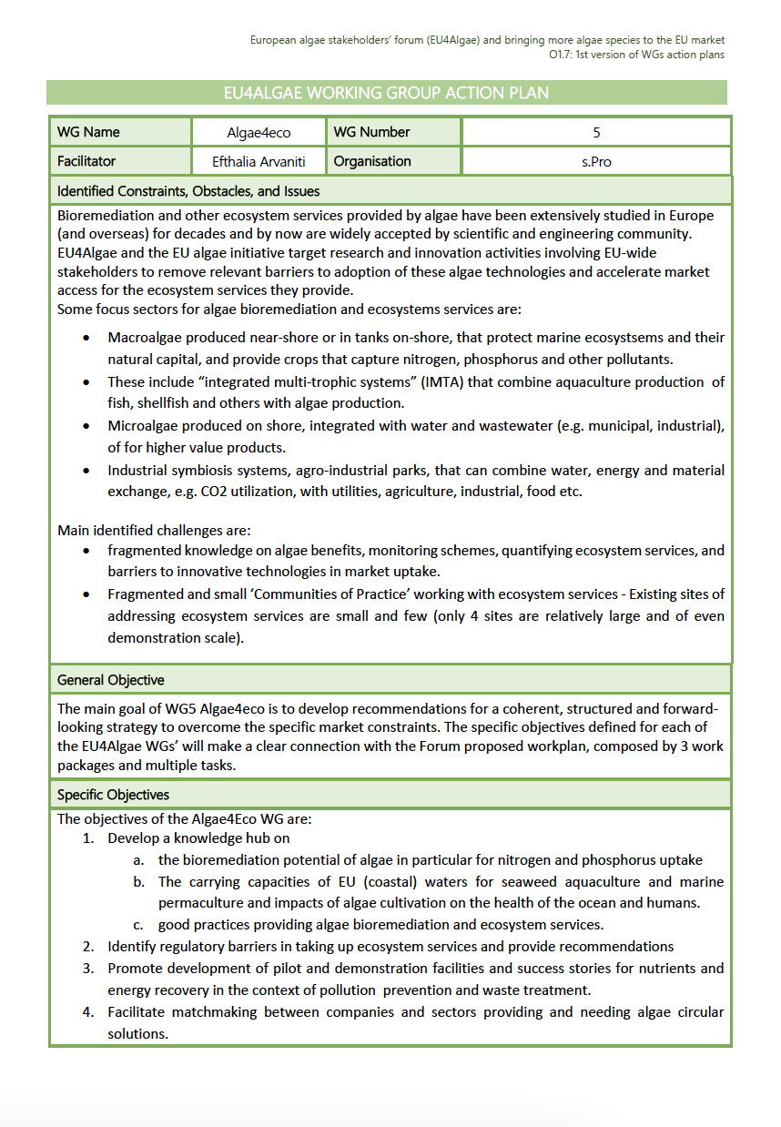
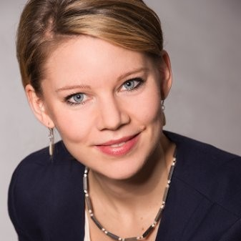
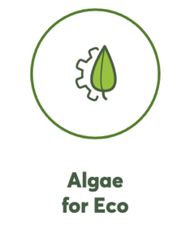
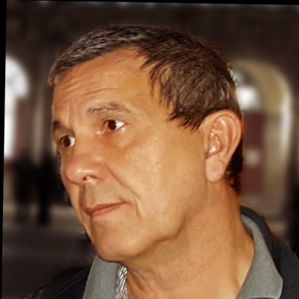
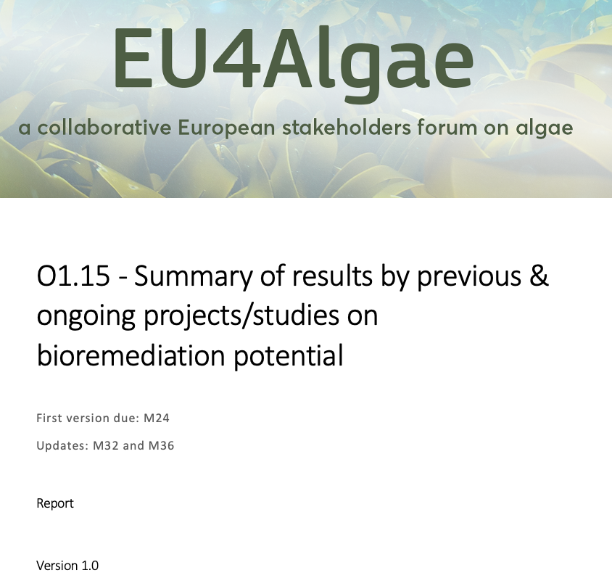
Development of the Output integrated in the EU4Algae WG5 Action Plan
Planned surveys, interviews and workshops in 2023-2024
First survey on “projects, actors and facilities” collected 15 responses
1st workshop on 1. December 2023 – 25 participants joined

Slide 3
Objectives
Assess and synthesise findings on methodologies, tools, maps, scenarios for quantifying ecosystem services and on bioremediation potential of algae,
Summarise finding on carrying capacities of EU waters for seaweed aquaculture and marine permaculture and
Assess impacts of algae cultivation, restoration and harvesting on the health of the ocean and humans.
Compile knowledge gaps and provide recommendations addressing the bioremediation potential of algae.

Slide 4
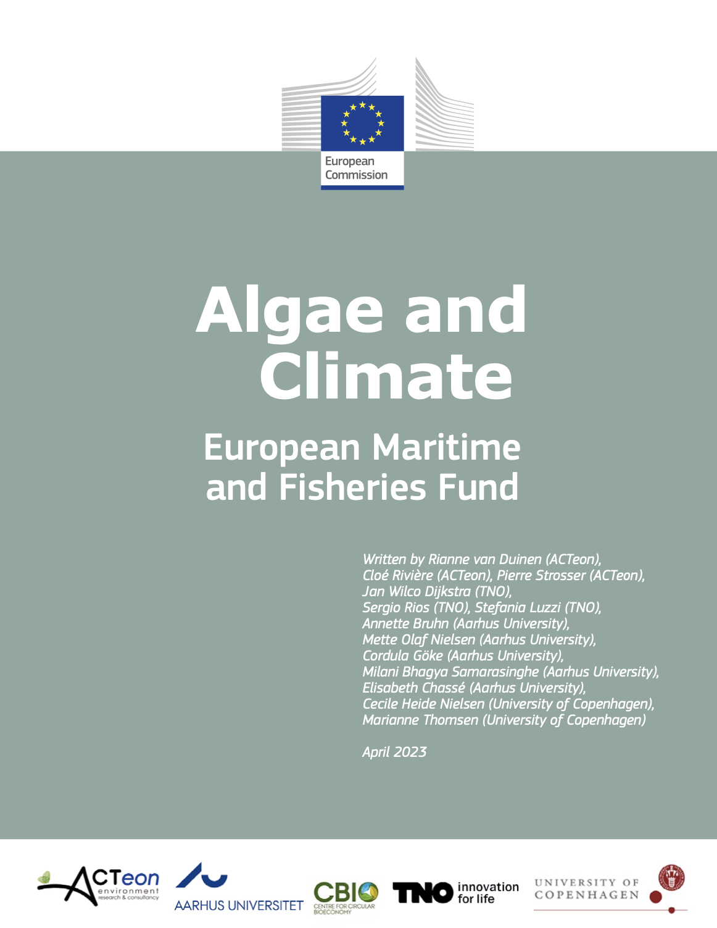
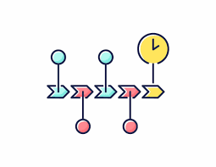
Scope
Build on SotA intelligence: drivers, initiatives, actors, investments, studies
Develop scenarios of most advanced, relevant, and scalable algae solutions within the European context and
Identify techno-economic, regulatory and market barriers
create concrete recommendations for policy, R&D and industry
Prioritise most urgent and impactful actions that need to be taken

Slide 5
Target Groups
Policy makers - EU, national and regional level, working with water, energy, agriculture, climate, waste, environment.
Investors and entrepreneurs, incl. public companies and water utilities
Rarmers, incl. Fish, shellfish and algae
Coastal clusters
Industrial symbiosis schemes with access to water and nutrients
NGOs e.g. Stewardship entities, verification schemes and green labels
Spatial planners at sea on land, incl. Marine Protected Areas
LAGs and coastal communities interested in regeneration farming (permaculture)
Researchers working with environmental benefits of algae

Slide 6
Methodology
Funnel process framework
Content derived from various sources
Contributors are pure gold!
1st level: WG5 members;
2nd level: EU4Algae Advisory board + DG MARE
desk studies,
interviews,
surveys and
workshops with WG5 members
from solution scanning >> deep-dive factsheets

Slide 7
3 solution deep-dives started in 2023
Algae using nutrient-rich side-streams at enclosed industrial systems
Algae as nutrient catch crop in open water systems
Algae for blue carbon capture and (re)use (CCU) in enclosed industrial systems
More will follow?

Slide 8
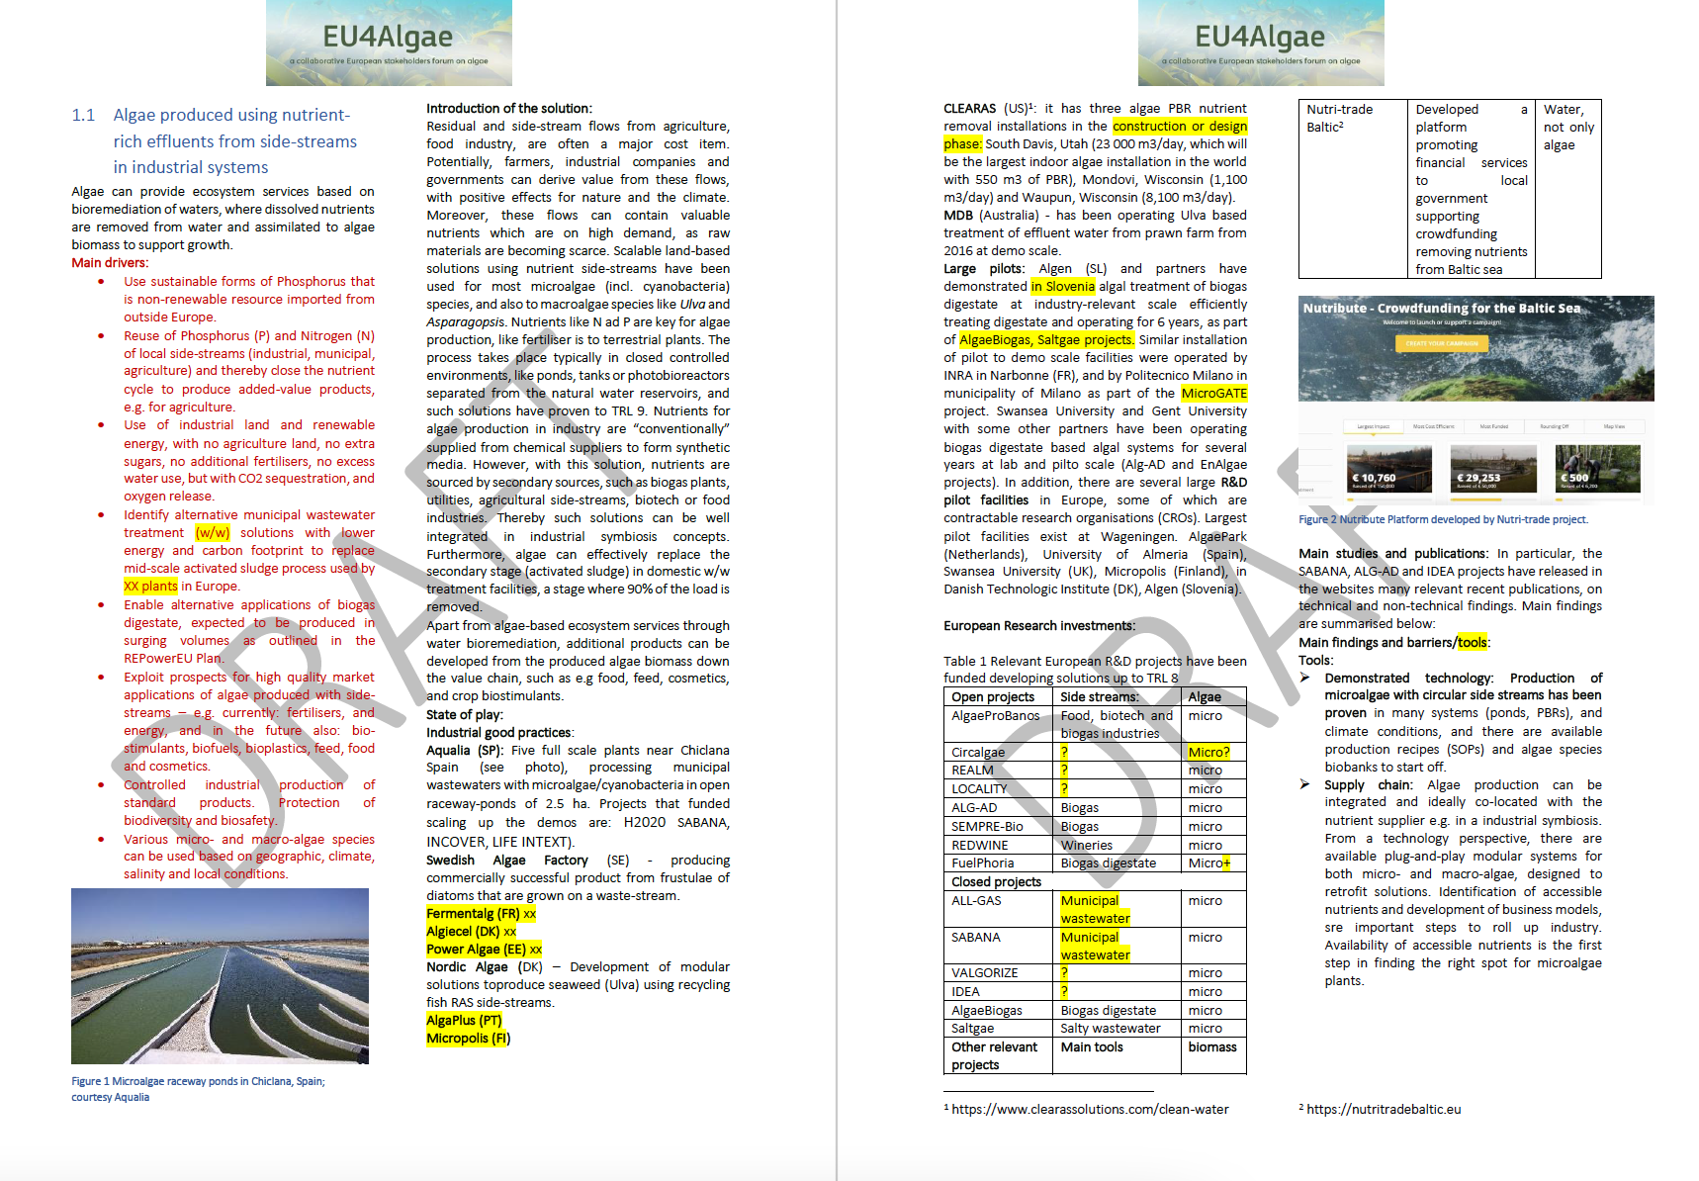
Solution factsheet sections
Main drivers
Introduction to the solution
State of play
Industrial good practices/ large pilots
European Research investments
Main studies and publications
Main findings and barriers/tools
Tools & maps
Techno-economic barriers
Regulatory barriers
Market barriers
Impacts on environment & on human health
Dissemination, exploitation, and legitimacy
SWOT analysis (technology, economic, market, social, environmental KPIs)
Recommendation for Research, Industry and Policy
Priorities, next steps

Slide 9
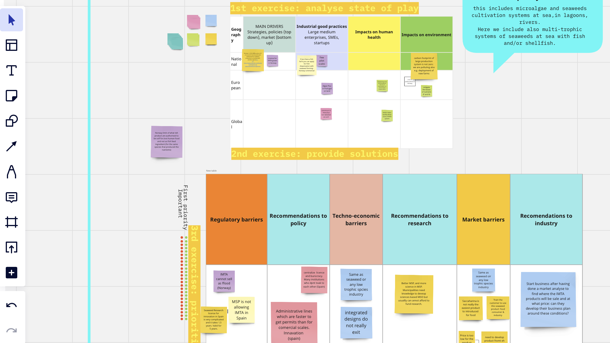
1/12 WG5 workshop
25 participants
Three break-out rooms
Two Factsheets
2-catch crop &
3-CCU
Tools enabling innovation and market access of algae bioremediation services

Slide 10
Implementation plan 2023-2024
15. December: Scoping document for reviewby EU4Algae & DG MARE
January 2024: Assessment & feedback
February - June: Development with WG5+
June: 2nd assessment & feedback
Q3-Q4: Development with WG5+
Q4 2024: Final version submit
Next WG5 workshop in February 2024 – stay tuned with WG5!

Slide 11
Thank you!
Efthalia Arvaniti
Senior Consultant & Project Manager
s.Pro – sustainable projects GmbH
Founding member of the SUBMARINER Network for Blue Growth EEIG

