Slide 1
Antonio
Novellino
Giuseppe
Manzella
Dick
Schaap
Sylvie
Pouliquen
Lesley
Rickards
Patrick
Gorringe

Slide 2
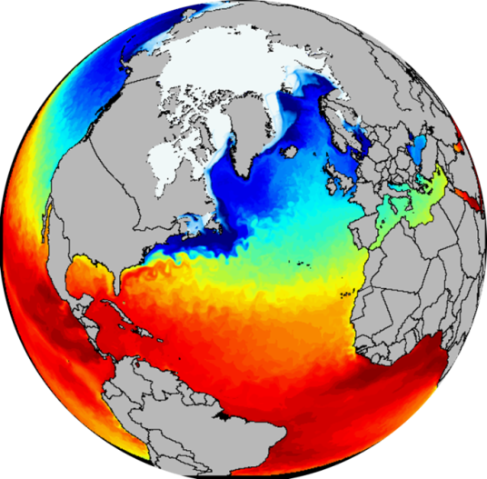
Marine Knowledge 2020
Marine Knowledge 2020 brings together marine data from different sources with the aim of:
helping industry, public authorities and researchers find the data and make more effective use of them to develop new products and services.
improving our understanding of how the seas behave.
Why EU-level action?
National data do not tell us all we need to know about the seas as a global system connected by shifting winds, seasonal currents and migrating species; analysis at European level is essential.
http://ec.europa.eu/maritimeaffairs/policy/marine_knowledge_2020/

Slide 3
ur - EMODnet
The EU practical answer:
Support better discovery of data (INSPIRE Directive), free access to data and few restrictions on use and re-use of data (Environmental Information Directive and Public Sector Information Directive)
Support to the Shared Environmental Information System SEIS (in collaboration with EEA) to modernise and simplify the collection, exchange and use of the data and information required for the design and implementation of environmental policy
(WISE-marine is the marine component of SEIS)
Push the integration of different national and local marine and observation systems into a coherent European system: ur-EMODnet
Development of the European Marine Observation and Data Network - EMODnet by pilot actions and thematic assembly groups - Hydrography, Geology, Biology, Chemistry, Habitats, Physics

Slide 4
EMODnet Physics
Contributes towards the definition of an operational European Marine Observation and Data Network (EMODnet)
Contributes to developing the definition of the Global Monitoring for Environment and Security (GMES) marine core service, WISE-Marine and SEIS
Provides free and open access to marine archived and real-time data from:
Fixed stations, Ferryboxes, (Euro)Argo*, Gliders*, HF Radars*
metadata to these parameters using EMODnet/INSPIRE standards.
Parameters:
Temperature, Sea Level, Salinity, Winds, Waves, Currents, Light Attenuation, Ice Coverage*, Sea level trends*
Geographical coverage:
All European Sea Basins.
Determines how well the data meet the needs of users.
* Follow up call

Slide 5
EU Marine Information Infrastructures
project
project
program
DG
ENTERPRISE & INDUSTRY
GMES
MyOcean
www.myocean.eu
DG
RESEARCH & INNOVATION
FP7
SeaDataNet
www.seadatanet.org
DG
MARITIME AFFAIRS
& FISHERIES
Ur- EMODnet
www.emodnet-physics.eu
EuroGOOS
Operational Oceanography community

Slide 6
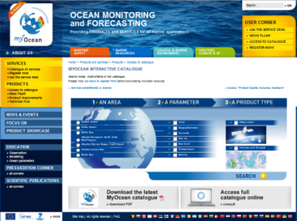
MyOcean
MyOcean is a GMES marine information service
Provides free and open access to real-time and delayed mode « ocean monitoring and forecasting » information
Is based on the combination of satellite, in situ observations and assimilative ocean models
Relays to global oceans and European seas
Provides free and open access to products
Currents, Temperature, Salinity, Sea Level, Sea Ice, Surface winds, Biogeochemistry) – 239 products
two types of in situ products on Global and regional portals:
NRT ones , available within a few hours to a week from acquisition, Quality controlled using homogeneous automatic procedures
Delayed ones , updated yearly , integrating historical T&S data coming from SeaDataNet, ROOS et JCOMM , validated scientifically for reanalisis activities

Slide 7
SeaDataNet
SeaDataNet is a marine information system
connects the National Oceanographic Data Centres - NODC
EDMO: European Directory of Marine Organisations (>2200 entries)
EDMED: European Directory of Marine Environmental Data sets (>3000 entries)
EDMERP: European Directory of Marine Environmental Research Projects (>2500 entries)
CSR: Cruise Summary Reports (>31500 entries)
EDIOS: European Directory of Ocean-observing Systems
provides access to archived multidisciplinary datasets of in situ observations relevant to the monitoring of the ocean state and health
Develops CDI – Common Data Index (ISO 19115)
EU.FP5 2002-05
EU.FP6 2006-11
EU.FP7 2011-15

Slide 8
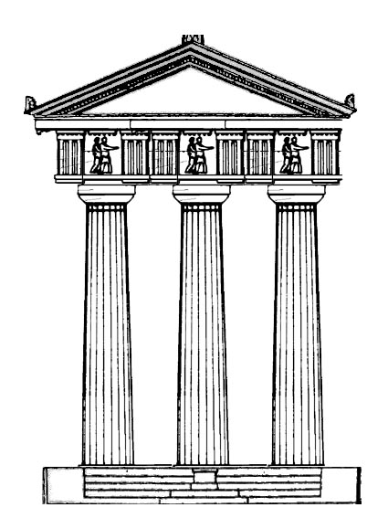
EMODnet Physics
EMODnet Physics is a Marine Observation and Data Information system
Single point of access to Near Real time and Archived data
Build up on existing infrastructures by adding value – not unless complexity
Ensure data access to any user
Brings together acting communities:
EuroGOOS, MyOcean and SeaDataNet
Support and facilitate MoU between MyO SDN
Attract new data holders
Attract better and more data
Facilitate integration with further systems
Connect to new data
EMODnet
Physics
Reinforce
SUSTAIN

Slide 9
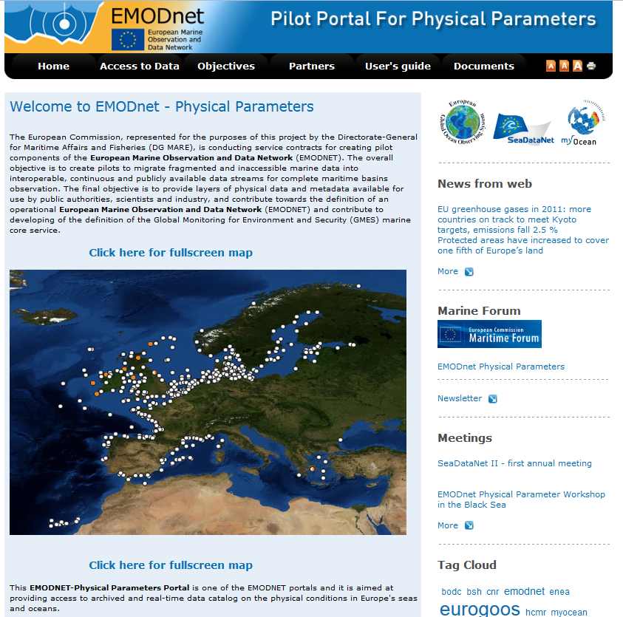
EMODnet Physics
INSPIRE
Services
DISCOVER
VIEW
DOWNLOAD
Data Policy
Open & Free
www.emodnet-physics.eu

Slide 10
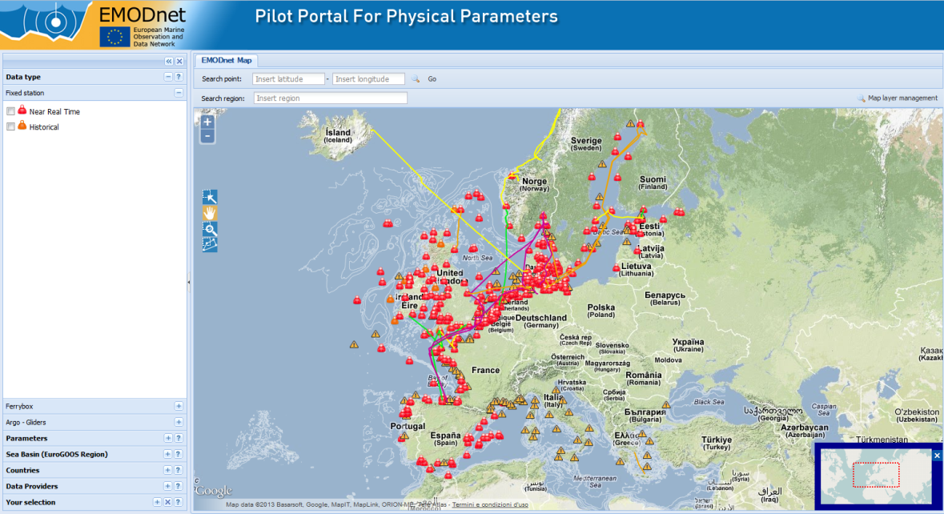
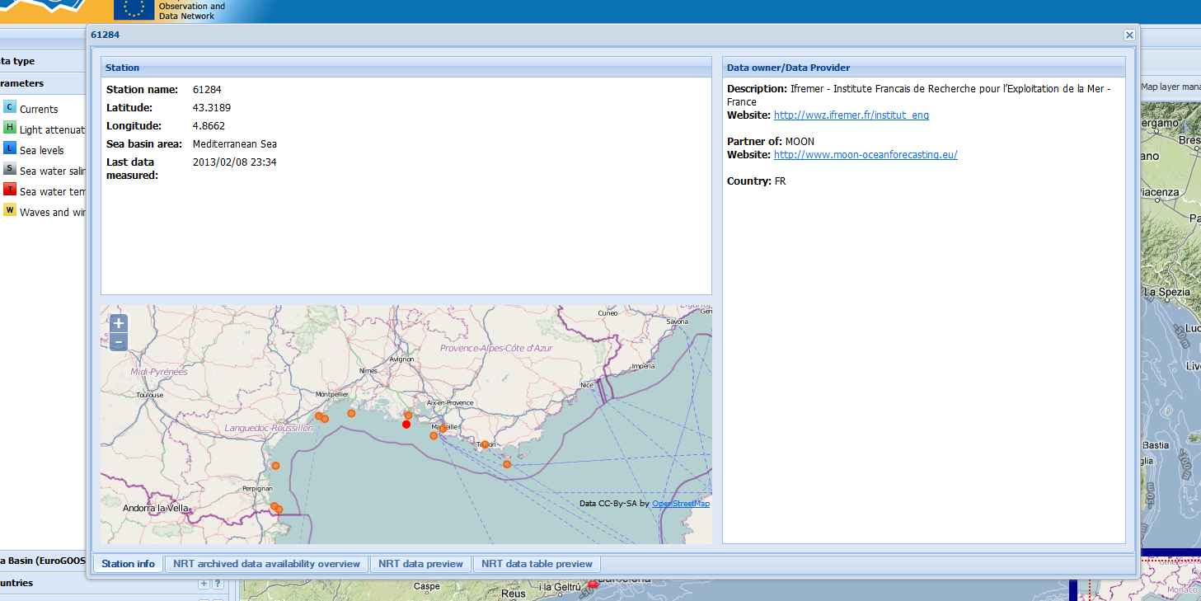
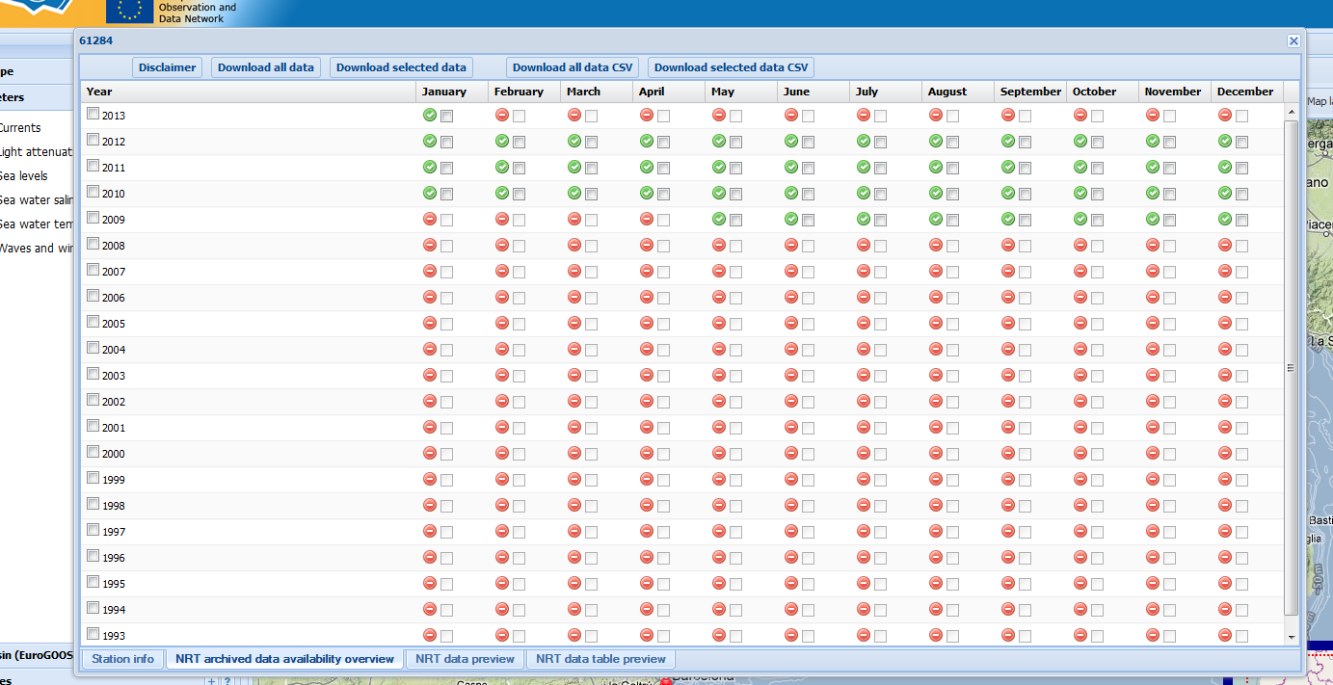
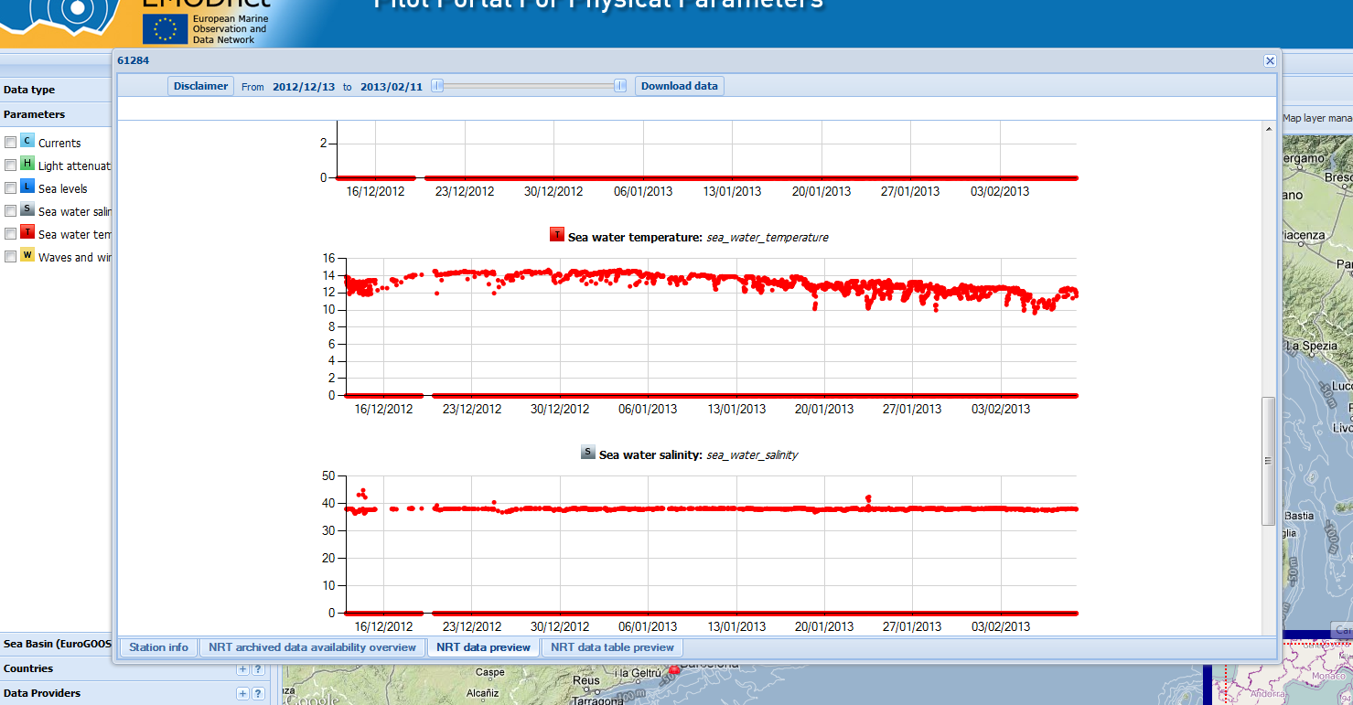
EMODnet Physics – Dicovery, View, Download
Near Real Time data
users
Station 61284

Slide 11
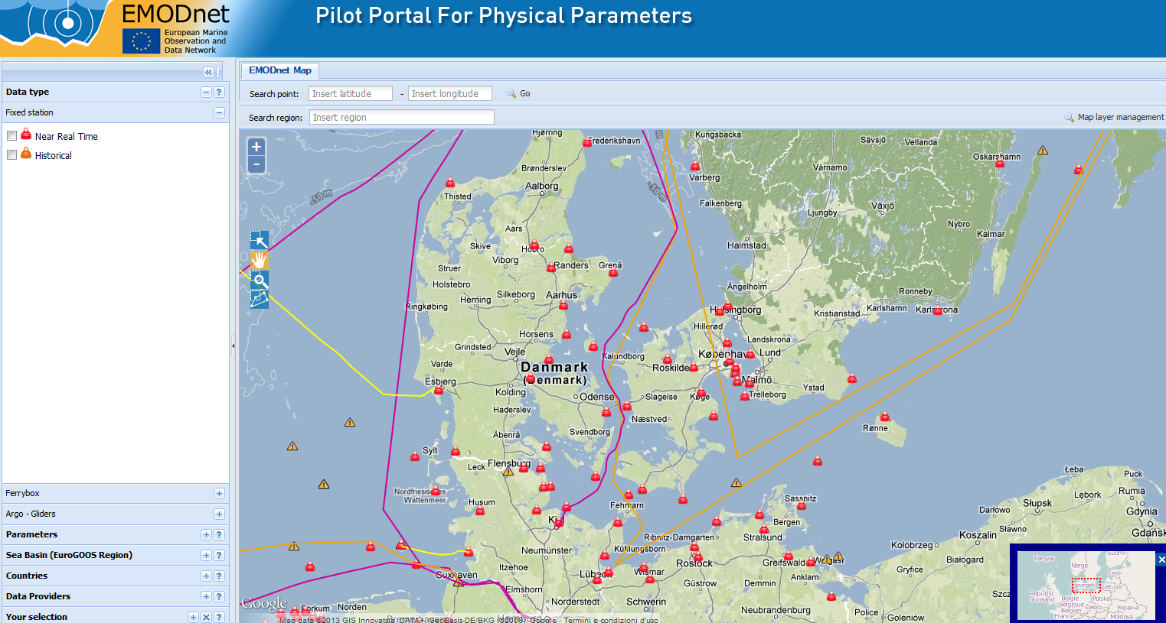
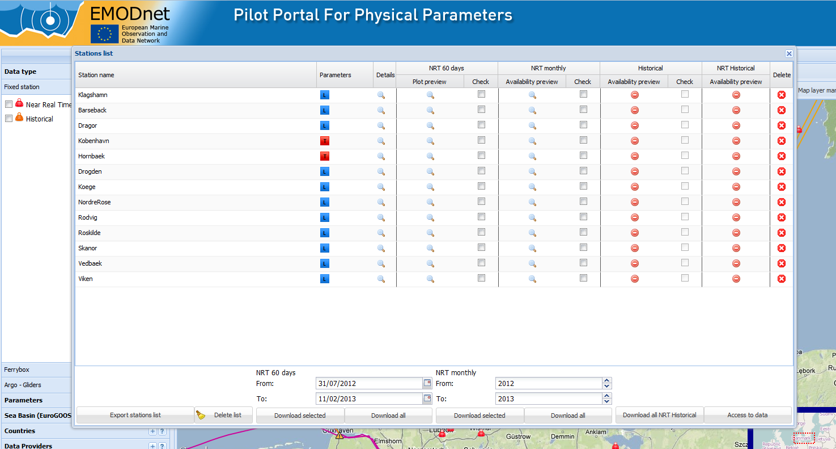
EMODnet Physics – Dicovery, View, Download

Slide 12
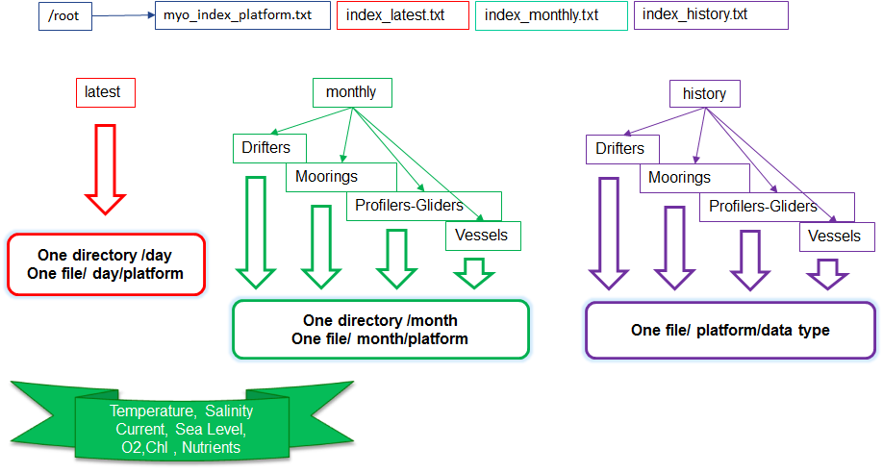
EMODnet Physics - BackOffice Infrastructure
Near Real Time Data Discovery and Access
Federative standardized Infrastructure
users
Folders and info files
Free discovery, access and download of NRT for latest 60 days (any)

Slide 13
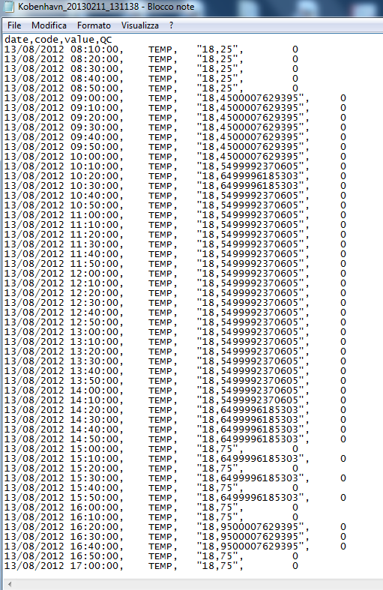
EMODnet Physics – NRT 60 days

Slide 14
EMODnet Physics - BackOffice Infrastructure
Near Real Time Data Discovery and Access
Federative standardized Infrastructure
users
Folders and info files
Free discovery, access and download of NRT (myo users)

Slide 15
EMODnet Physics – NRT monthly

Slide 16
EMODnet Physics – NRT monthly

Slide 17
EMODnet Physics - BackOffice Infrastructure
Near Real Time Data Discovery and Access
Federative standardized Infrastructure
users
Folders and info files
Free discovery, access and download of NRT (myo users)
Arkona
Darsser
Fehmarn
LTKiel
Oderbank

Slide 18
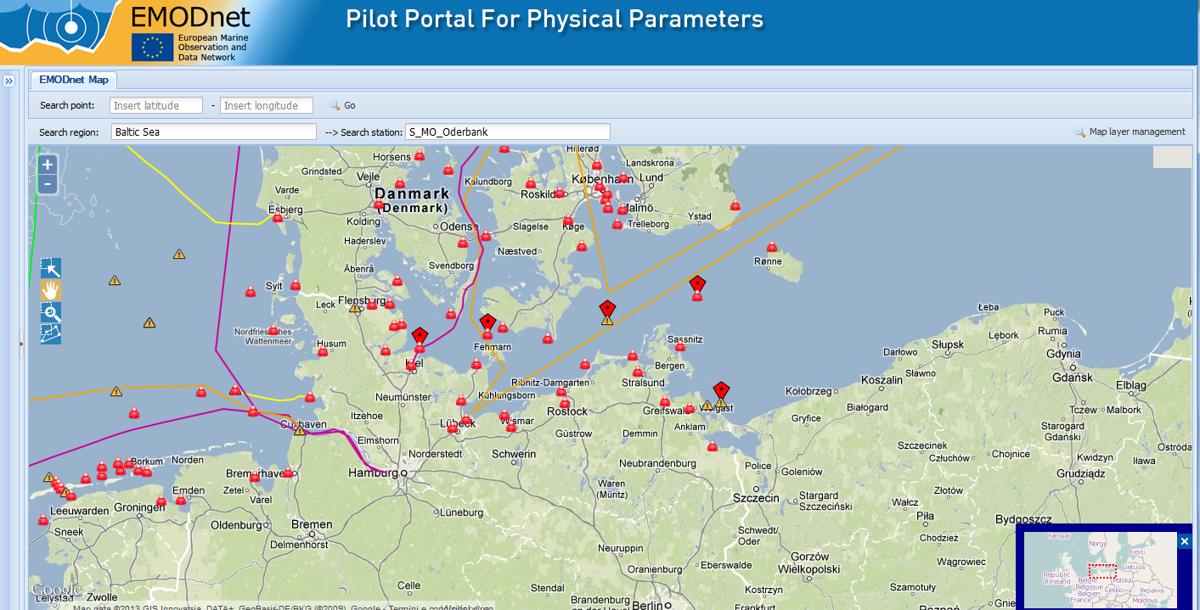
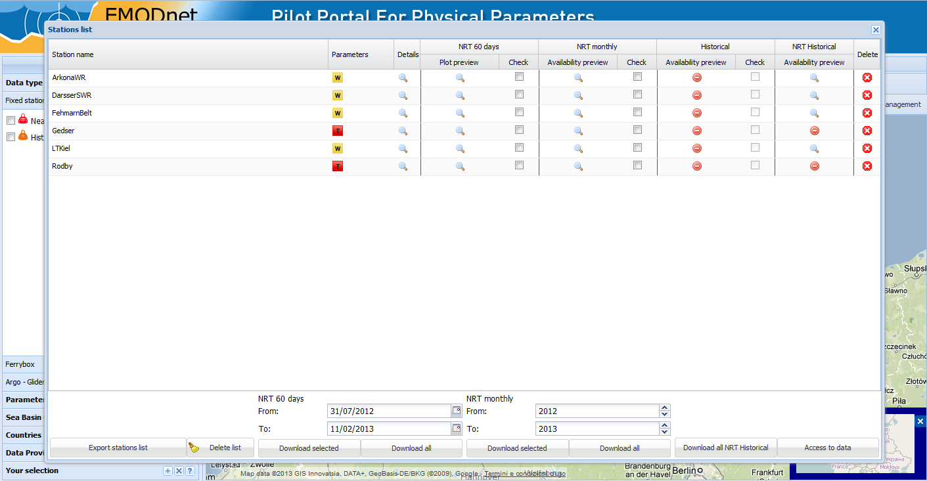
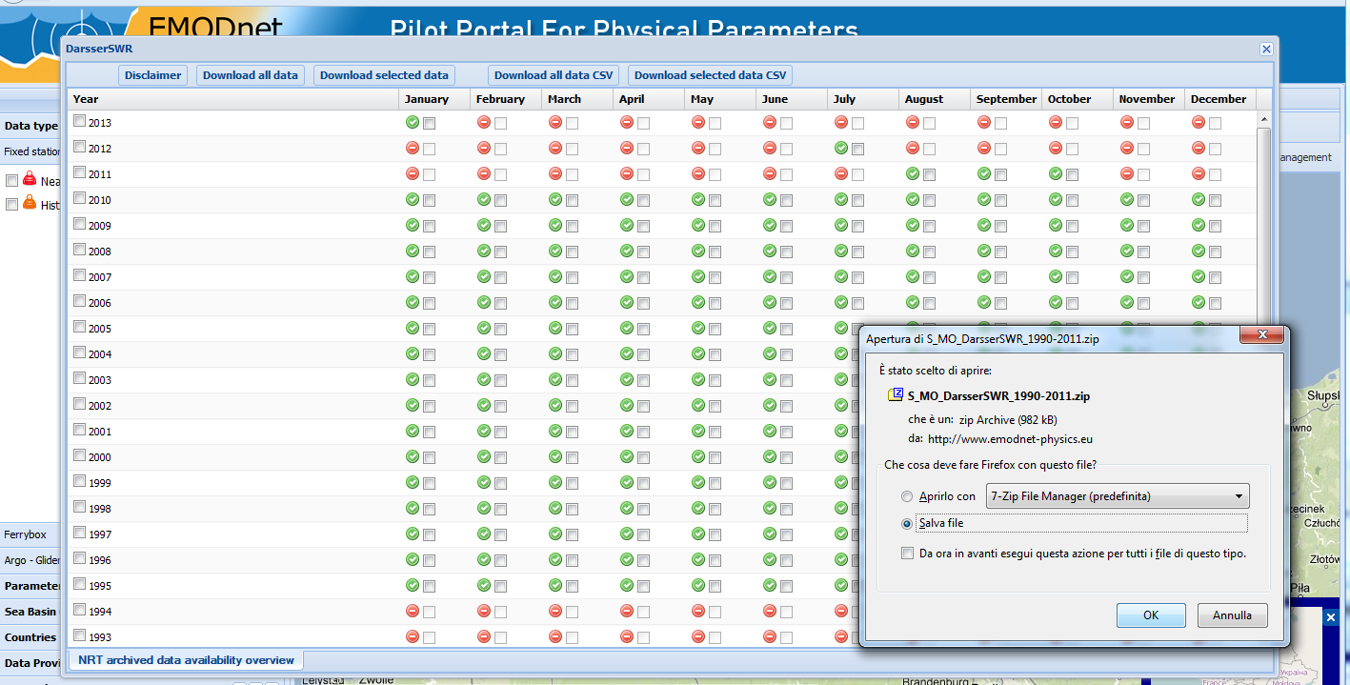
EMODnet Physics – NRT History
Arkona
Darsser
Fehmarn
LTKiel
Oderbank

Slide 19
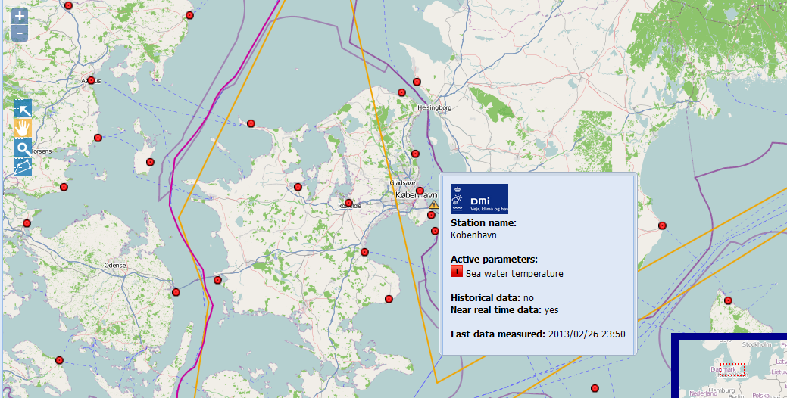
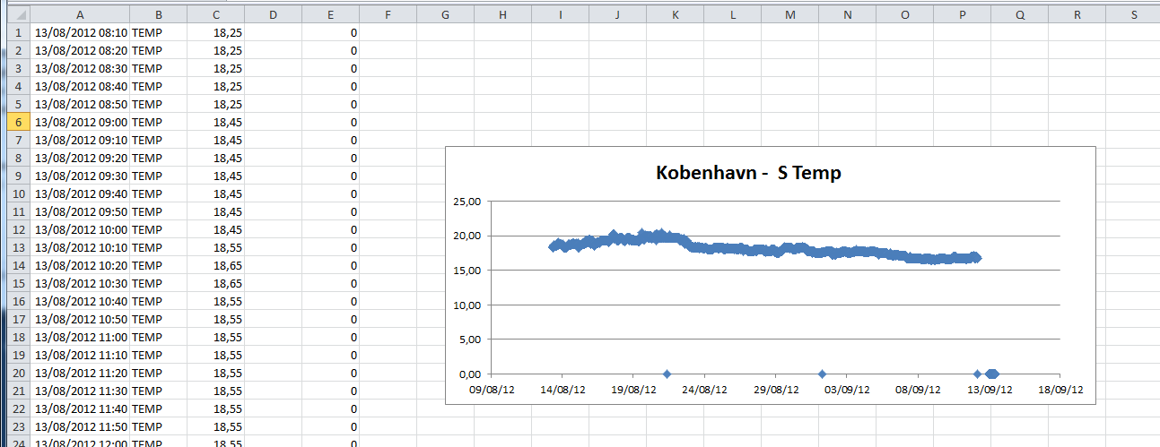
EMODnet Physics - Products
Example of simple products (e.g. trends)

Slide 20
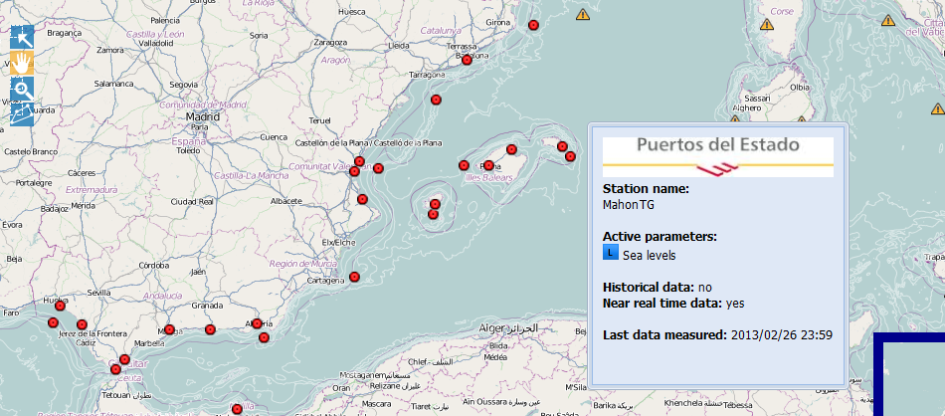
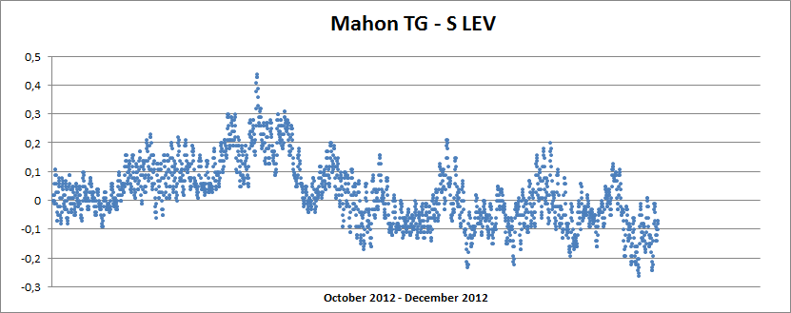
EMODnet Physics - Products
Example of simple products (e.g. trends)

Slide 21
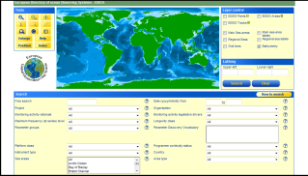
EMODnet Physics - BackOffice Infrastructure
NODCs
Historical Data Discovery and Access
EDIOS
CDI Data Discovery
Users
(SDN users)
CDI Data Access Service
Request Status Manager
Data Owner

Slide 22
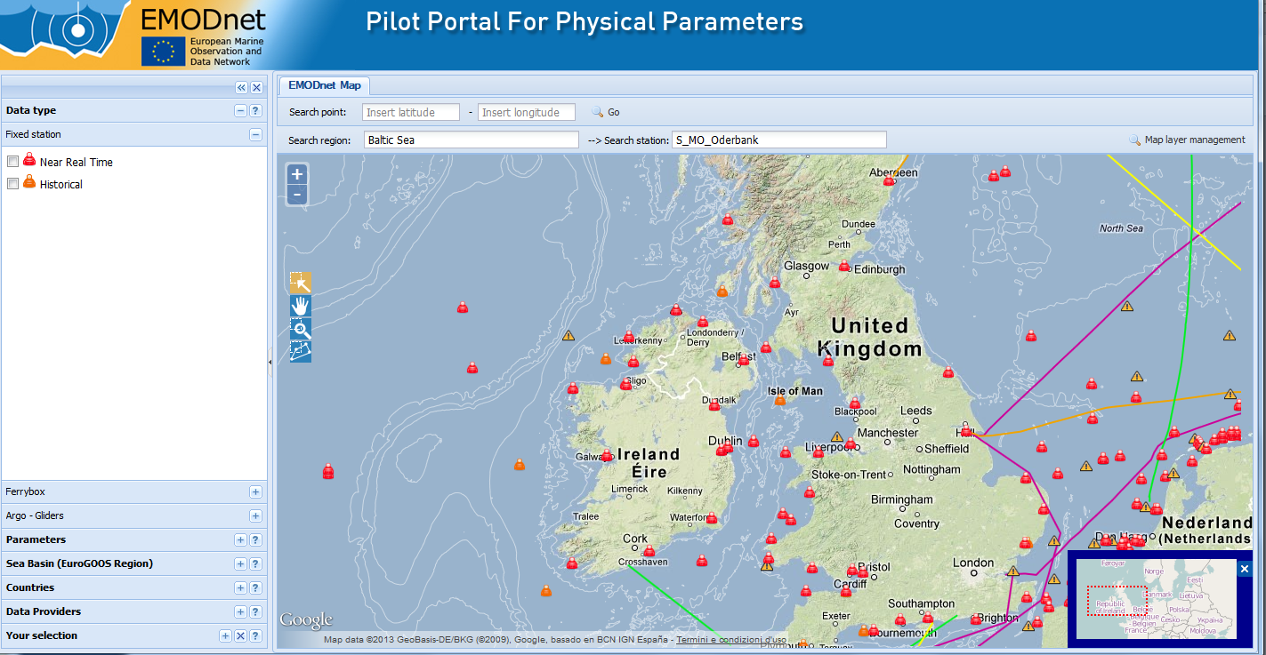
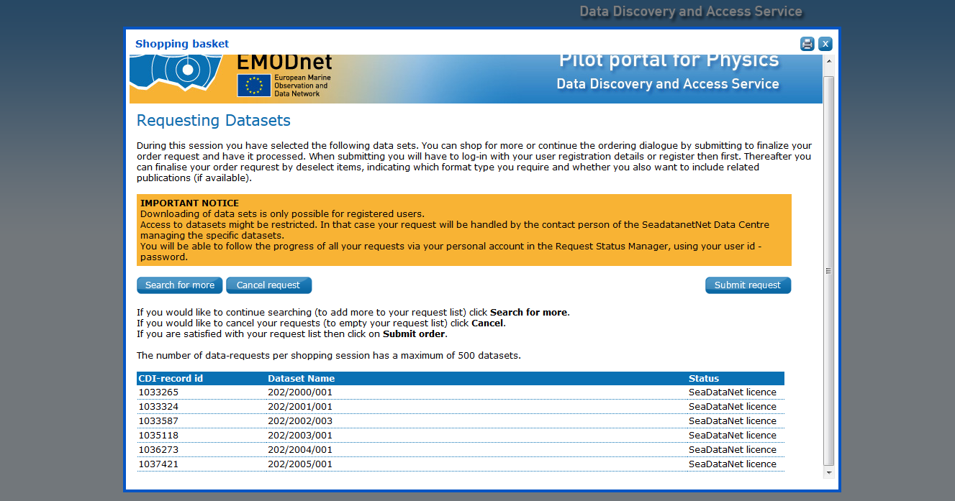
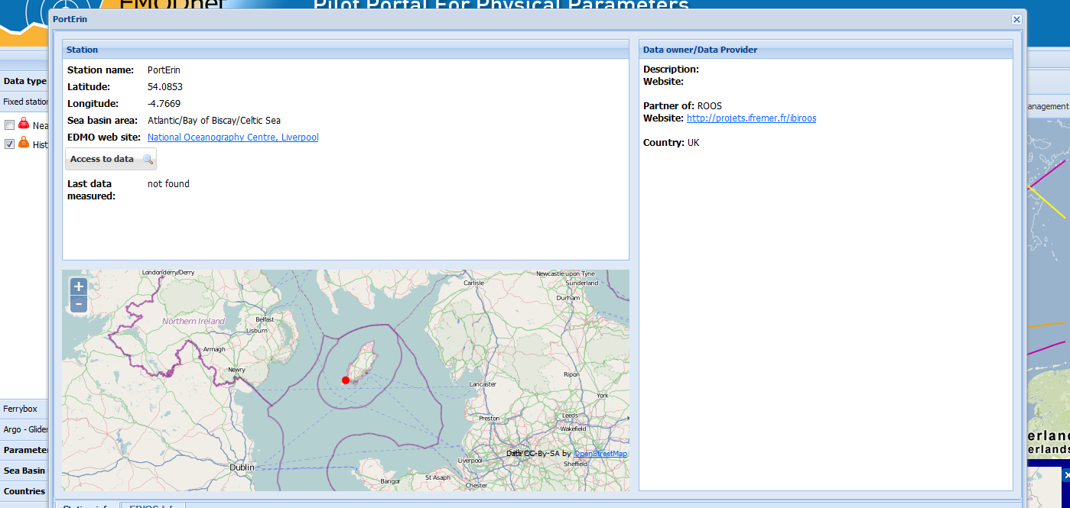
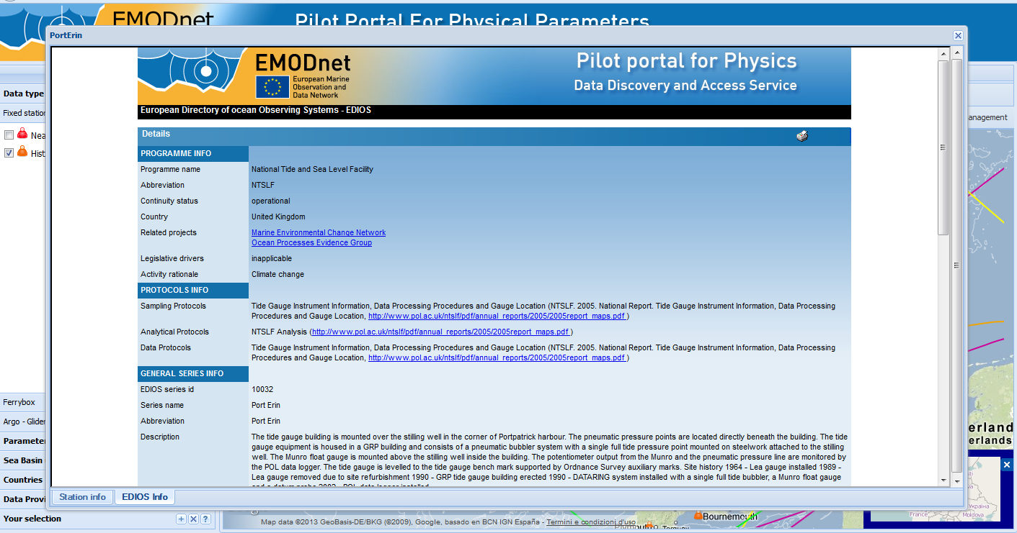
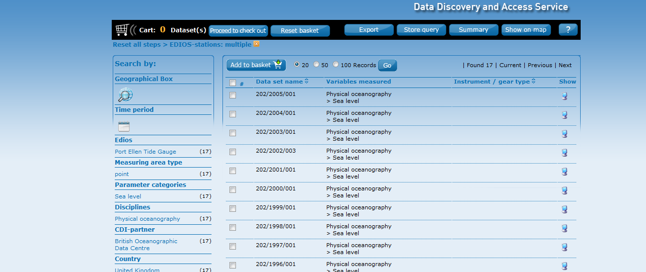
EMODnet Physics – CDI
PortErin

Slide 23
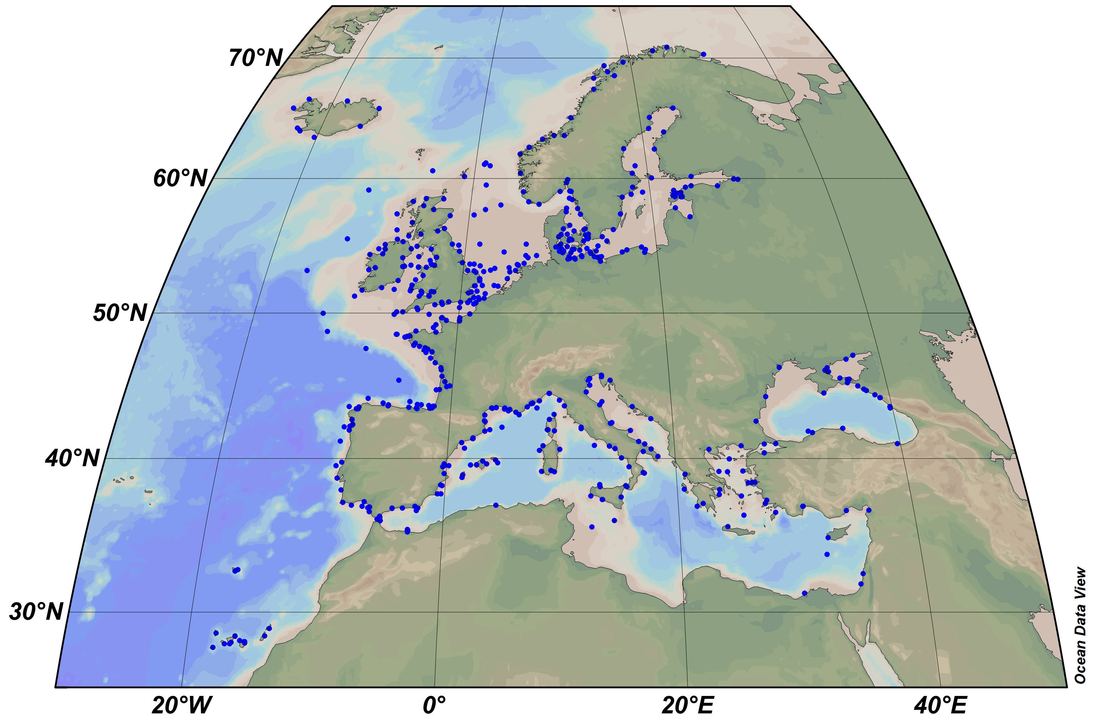
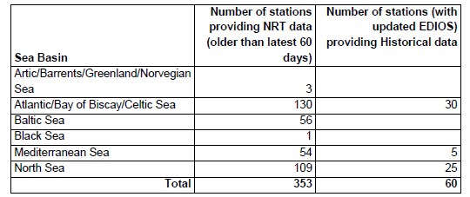
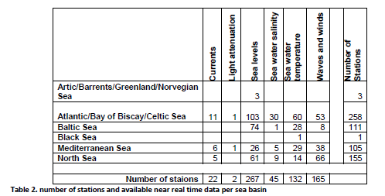
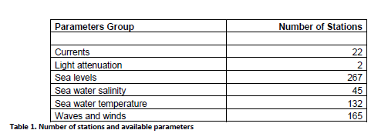
EMODnet Physics - Milestones
December 2010 – formal activity start
December 2011 – about 40 stations
4 workshops (June 2011 – November 2012) to present the program, and involve users and providers.
December 2012 – more than 400 stations

Slide 24
Show case/case history
Success:
Good integration of MyO data and information
RON ISPRA (in EMODnet, not in MyO, applied for EuroGOOS membership, ongoing integration with MyO-SDN infrastructures)
Mediterranean Sea: data owner ready to cooperate and share
Support MoU between MyO and SDN
Open issues
Unique Station ID to better connect RT and Historical Data and EDIOS
EDIOS and better connection between MyO stations and SDN stations
Easier and faster access to data
More data (e.g. integration with some ‘bio-chemical’ data)
Unsuccess
Poland

Slide 25
EMODnet Physics - EDIOS
EDIOS entries from France, Greece, Ireland and UK for EMODNet Physics are more or less complete (although some Greek programmes require some minor revision before loading to the EDIOS database)
Sweden and Germany have provided EDIOS entries for key observing programmes (but need to be encouraged to provide further entries)
Some other countries (Estonia, Italy, Montenegro, Slovenia, Ukraine) have provided some EDIOS entries relevant to EMODNet physics
Key countries (Denmark, Italy, Netherlands, Norway, Spain) need to be encouraged to compile EDIOS entries. Italy, Spain and Norway have completed some entries, but those for Norway and Spain do not cover programmes relevant to EMODNet physics.
Much of the delayed-mode (historical) quality controlled data relevant to EMODNet physics are not available through SeaDataNet yet
Reasons for this may include:
NODCs do not hold the data – (i) they have not been passed on to the data centre within an institute, or (ii) they have been collected by a different organisation that does not normally provide data to the NODC.
Legacy data issues need to be resolved

Slide 26
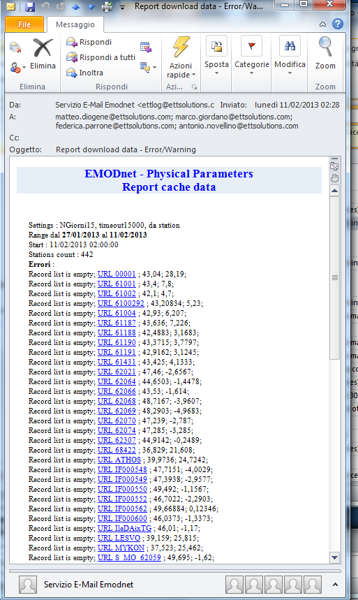
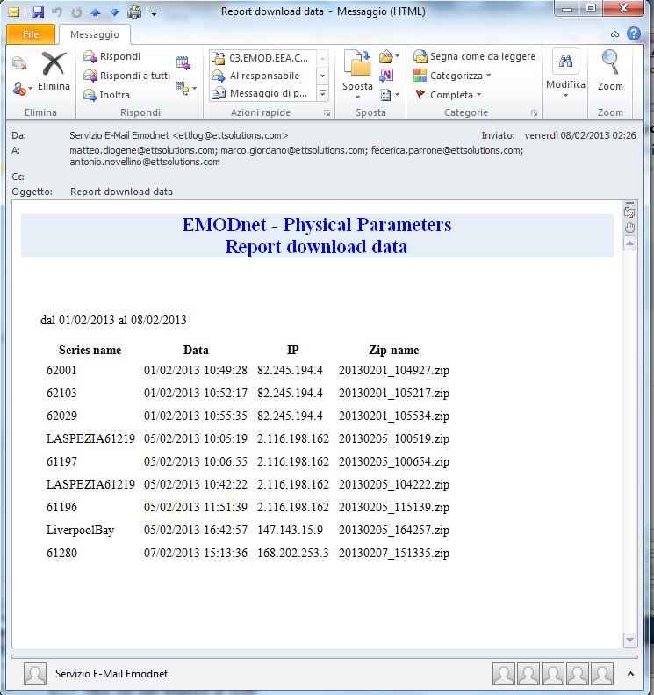
EMODnet Physics – KPIs
KPI and automatc mail services
Daily notification about station status
Weekly notification about downloads
On demand Google analytics

Slide 27
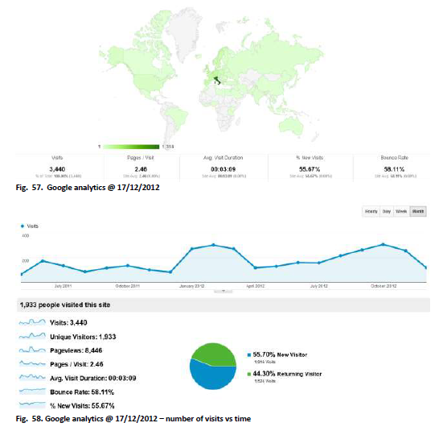
EMODnet Physics – KPIs

Slide 28
EMODnet Physics – follow up call
Better access to additional data not yet in the current system i.e. MyOcean and SeaDataNet, Argo, Gliders, Ice coverage, etc.
Better access to and integration of Ferrybox data
Assisting the work on the completeness of stations – leading to a list of uniform station names that reduces duplication between ROOSs and ongoing projects (EDIOS update)
Upgrate the portal, further developing the existing user interfaces and adding machine-to-machine interfacing functionalities
(Towards an Ocean User directory: working with MYO and SDN)

Slide 29
EMODnet Physics – Conclusions
An impressive effort made by key technical players in MyOcean, Seadatanet, EMODnet and EuroGOOS to reduce unnecessary redundancies and develop common approaches towards users
e.g. MoU signed between Seadatanet and MyOcean to share efforts, and discussion to improve user access to databases See previous comment
A clear and convincing move towards open& free access to data, a strong involvement at the community level in IT tools and methods to offer modern data information services to users
EuroGOOS, MyOcean, SeaDataNet and EMODnet-Physics have developped a strategy of active cooperation, cross-cutting DG ENTR, RTD and MARE initiatives to achieve a wider coverage of data sources and overall interoperability.

Slide 30
EMODnet Physics – Conclusions
results show technical success, common vision, and positive response of users.
It builds a convincing marine community contribution to the overall aim of EMODnet with respect to pan-European marine data management and data access.
It brings to the fore the critical need for sustained marine observation networks.

Slide 31
EMODnet Physics
Thank you

