Slide 1
Working Group 6
Gabriel Acien (EABA) (facien@ual.es)

Slide 2
Working Group 6
Aim
To promote emerging applications of algae related to Materials/Chemicals/Bioactives further than conventional uses by improving the business environment and cooperation across the algae sector
Identification of the most important research, development and innovation needs
Promotion of ongoing activities/projects
Collaborate in market/product development
Validating/ disseminating EU4Algae results
How to do it?
Objectives
Obstacles
Actions
Outcomes

Slide 3
Working Group 6
Workplan
Introducing the WGs to the stakeholders (20th June during the EU4Algae Online Event)
Defining the Actions and outcomes: WGs Meetings and activities (July to October)
Online working group meeting (1st week of October)
Discussions and Action Plan Refinement (October to November)
1st WG Annual Meeting during the EU4Algae Event (Rome 11/12/2022)
2nd Version of Action Plans (December)

Slide 4
Working Group 6
Objectives
Obstacles/Issues
Stakeholders platform to share/collaborate
Boost innovative uses of algae based products
Identify and solve technical/busines problems
To promote social acceptance of algae based products
To promote education/training regarding algae chemicals
High production cost/low production capacity
Lack of standards and flaghship initiatives
Limited knowledge of markets/consumers
Limited knowledge of risks and impacts
Fragmented knowledge of technologies
Actions
Outcomes/Deliverables
Develop EU Algae Industry/connect with chemical industry
To promote demonstration processes
To gather knowledge on carbon, nutrients bioremediation
To improve education/training activities
To promote social acceptance of algae products
Database of algae related companies/technologies
Network of open pilot/demo facilities
Position paper about materials/chemicals/bioactive
Collaboration in education/training courses
Campaigns for social acceptance of algae products

Slide 5
Working Group 6
Defined topics (first round)
Identified Constraints, Obstacles, and Issues
Algae (seaweed and microalgae) biomass production capacity and cost must be improved. Guarantee biomass supply chain, quality and production capacity. Lack of information about real biomass production and main actors. Collaboration between processor/producers and formulators/end-users. To promote platforms for the exchange/development of new processes and case studies Avoid critical terms (biorefinery, waste biomass, contaminated biomass). Need for education and training courses for young people and entrepreneurs
Working Groups Actions
Develop EU Algae Industry/connect with the chemical industry To promote demonstration processes already working and successful. To promote social acceptance of algae products To promote algae-related applications from the industry. To improve education/training activities. To develop biorefinery approaches and to provide recommendations for that. To demonstrate the sustainability of algae-based solutions To promote the end-of-waste regulation to utilize algae biomass for non-food/feed applications. To develop specifications of biomass based on algae standards already defined. To perform a market analysis of biorefinery products. To develop a platform to facilitate the exchange of information between producers and buyers.
Specific Objectives
Collaborate in market/product development Promotion of ongoing activities/projects Identification of the most important research, development and innovation needs Defining expert and training courses
Outcomes
Database of algae-related companies/technologies Network of open pilot/demo facilities Position paper about materials/chemicals/bioactive Collaboration in education/training courses Campaigns for social acceptance of algae products

Slide 6
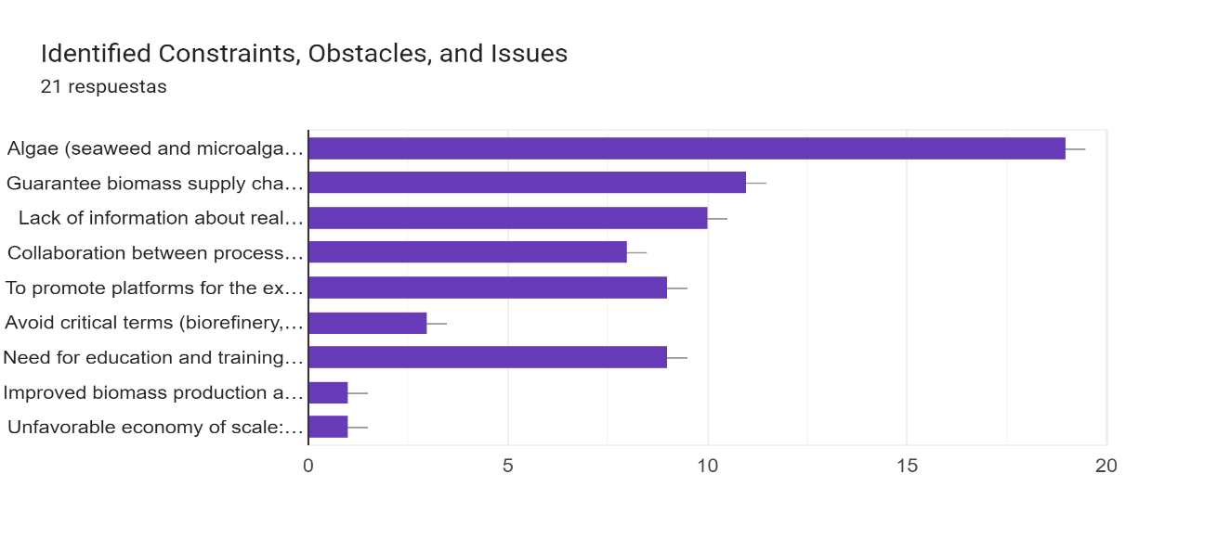
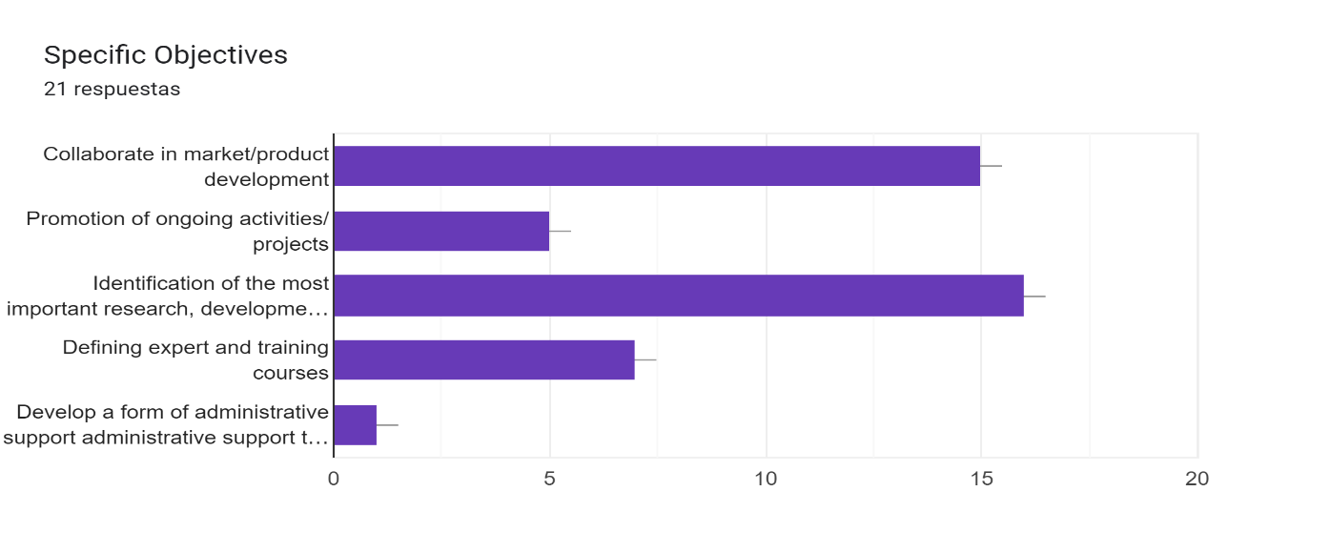
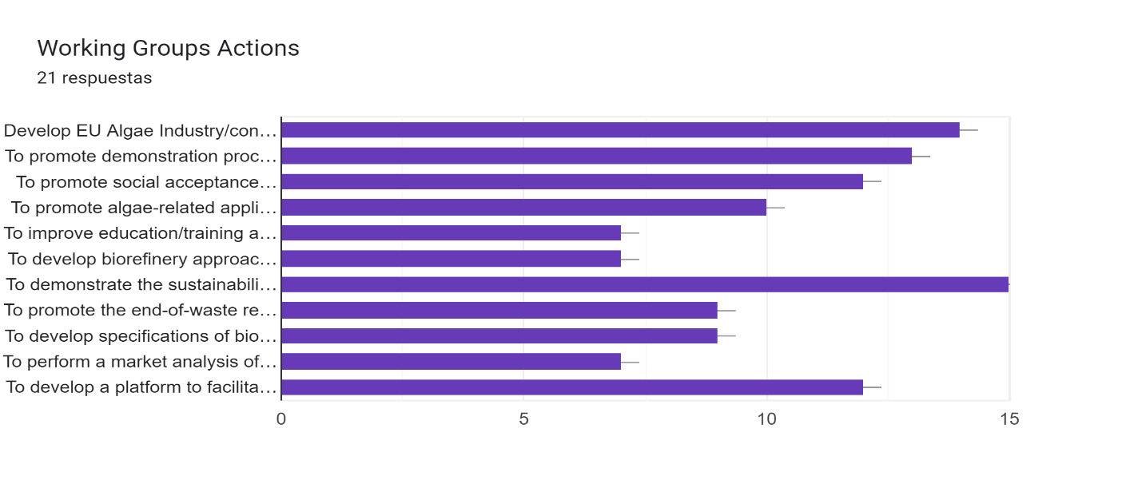
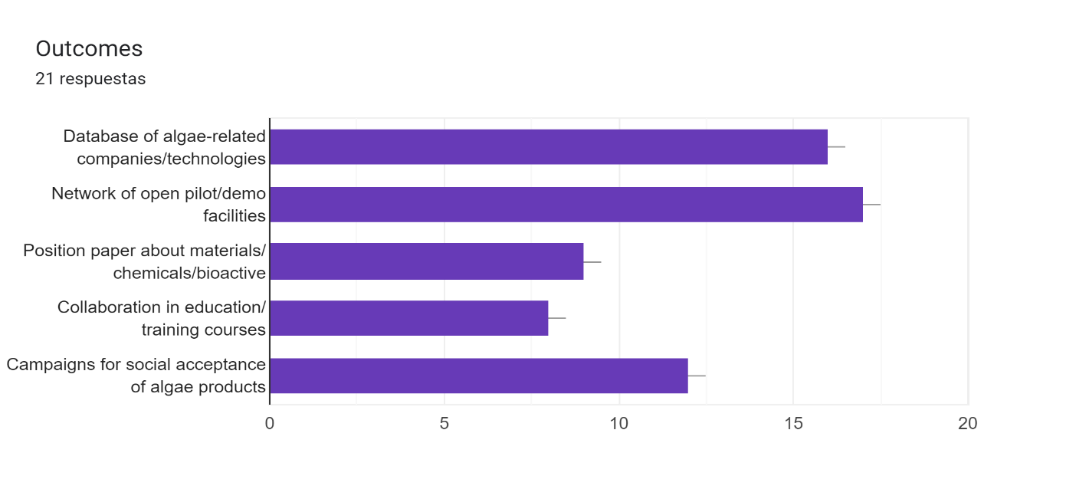
Working Group 6
Survey

Slide 7
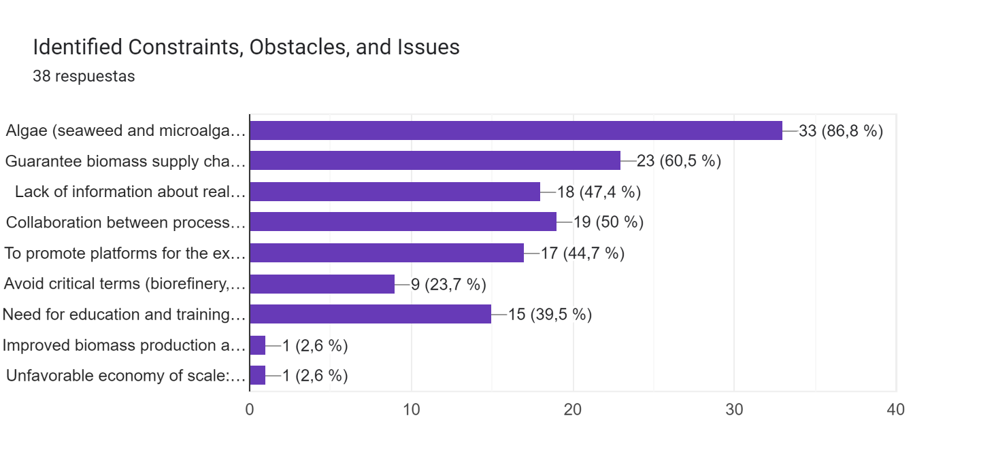
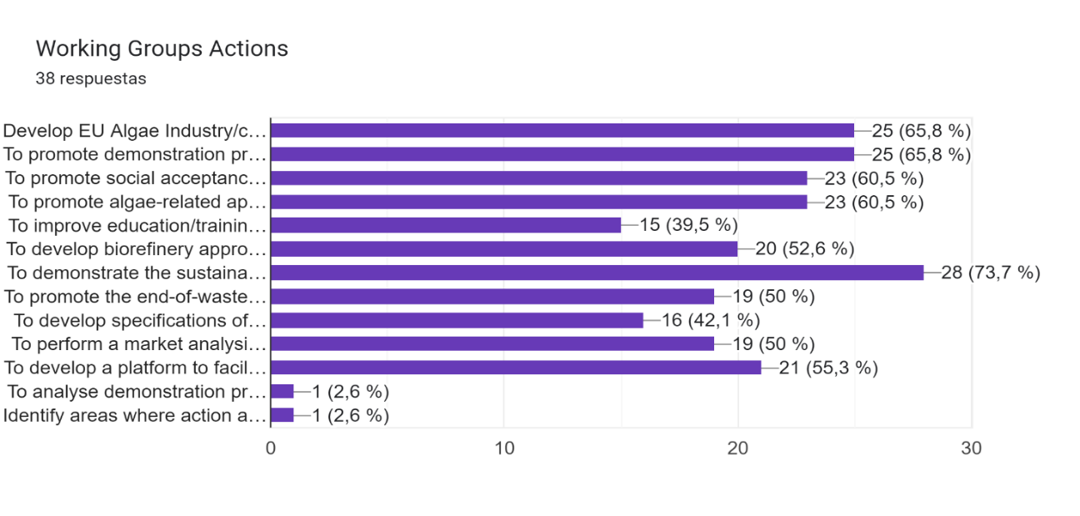
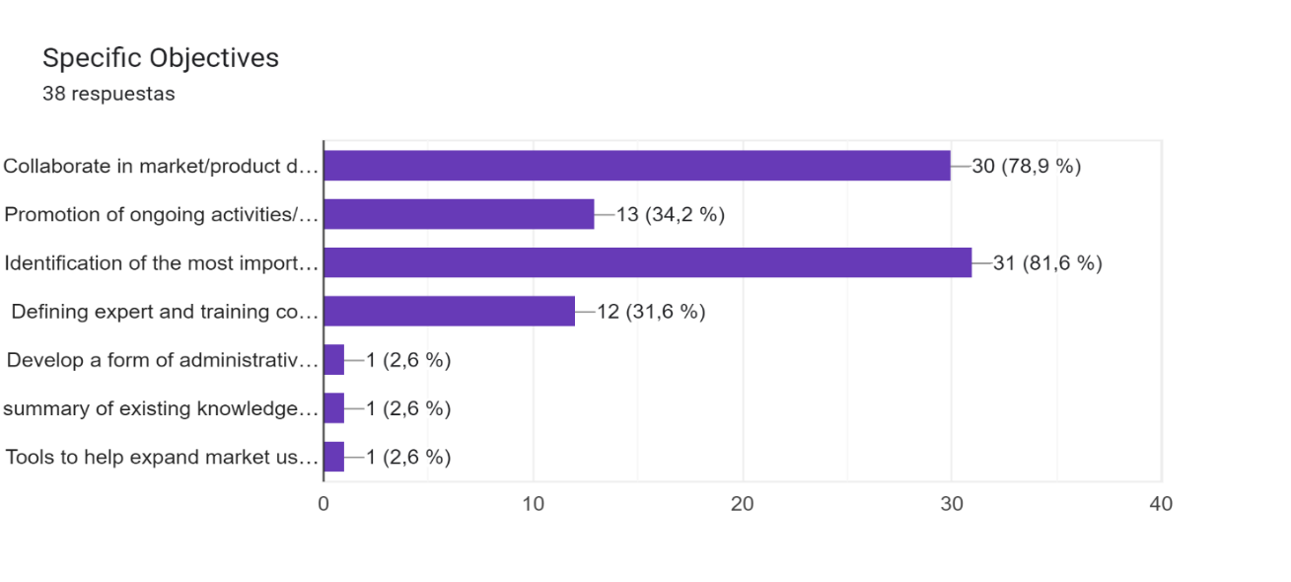
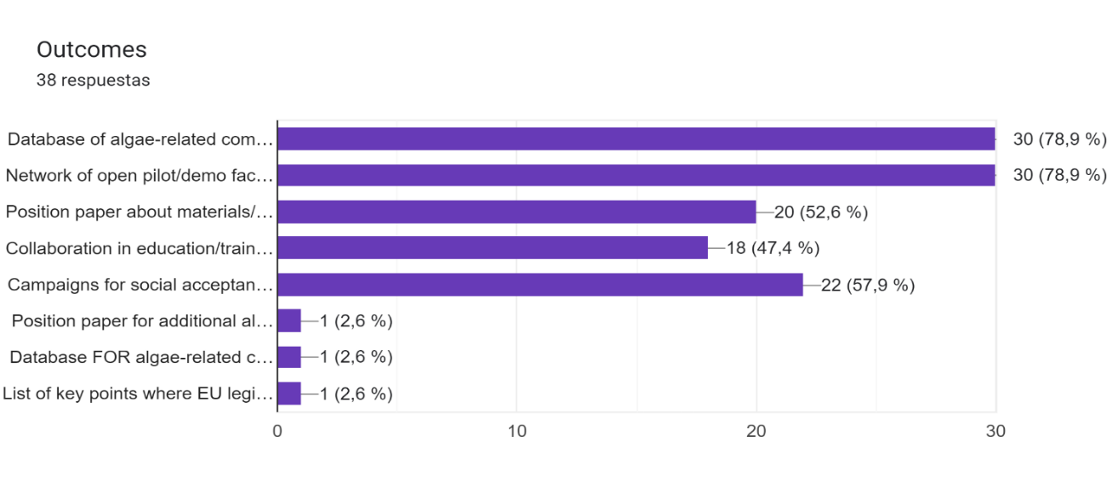
Working Group 6
Survey

Slide 8
Working Group 6
Objectives
Obstacles
Actions
Outcomes
Selected topics
Materials / Chemicals / Bioactives and Algae Biorefining
Specific Objectives
1. Identification of the most important research, development and innovation needs 2. Collaborate in market/product development 3. Promotion of ongoing activities/projects 4. Defining expert and training courses
Identified Constraints, Obstacles, and Issues
1. Algae (seaweed and microalgae) biomass production capacity and cost must be improved. 2. Guarantee biomass supply chain, quality and production capacity. 3. Collaboration between processor/producers and formulators/end-users. 4. Lack of information about real biomass production and main actors. 5. To promote platforms for the exchange/development of new processes and case studies 6. Need for education and training courses for young people and entrepreneurs
Working Groups Actions
1. To demonstrate the sustainability of algae-based solutions 2. Develop EU Algae Industry/connect with the chemical industry 3. To promote demonstration processes already working and successful. 4. To promote social acceptance of algae products 5. To promote algae-related applications from the industry. 6. To develop a platform to facilitate the exchange of information between producers and buyers.
Outcomes
1. Database of algae-related companies/technologies 2. Network of open pilot/demo facilities 3. Campaigns for social acceptance of algae products 4. Position paper about materials/chemicals/bioactive 5. Collaboration in education/training courses
How to connect

Slide 9
Working Group 6
Objectives
Obstacles
Actions
Outcomes
Selected topics
Materials / Chemicals / Bioactives and Algae Biorefining
Identified Constraints, Obstacles, and Issues | 1. Lack of information about industrial biomass processors, needs and main actors
Specific Objectives | Identification of relevant actors and innovation needs (financial, technology, markets)
Working Groups Actions | To identify processing companies, technologies and products, and major challenges
Outcomes | Interviews and surveys to identify algae processing-related companies and major needs.
Identified Constraints, Obstacles, and Issues | 2. Lack of collaboration between relevant actors such as producers, processors, formulators, academia, providers
Specific Objectives | Facilitate the collaboration between relevant actors to accelerate the development of knowledge and industry
Working Groups Actions | To develop a platform to facilitate the exchange of information between producers and buyers, to understand the needs of algae industry and demonstrate the sustainability of algae-based solutions.
Outcomes | Forum /platform, connected to EABA, for the exchange of information/knowledge between major actors. Position paper about algae biorefinery including potential, technology, products, markets, etc.
Identified Constraints, Obstacles, and Issues | 3. Lack of platforms for the development and demonstration of industrial processes
Specific Objectives | Promotion of new and ongoing activities/projects, to facilitate upscaling and demonstration of processes
Working Groups Actions | To promote demonstration processes and industrial applications to materials/chemicals/bioactives
Outcomes | Network of open pilot/demo facilities integrating industry and academia for demonstration of processes and products
Identified Constraints, Obstacles, and Issues | 4. Need for education and training courses for young people and entrepreneurs
Specific Objectives | Defining expert and training courses
Working Groups Actions | To promote dissemination and transference, including social acceptance of algae products.
Outcomes | Development of training courses and transference activities about potential and sustainability of algae products Campaigns for acceptance of algae products to general public and specific target sectors
Bottlenecks:
Connection/overlapping with other WGs
Industrial/Intellectual protection-common problems-CONFIDENTIALITY
Connect with EU Commission, how collect and manage the data- EU Regulation on data protection

Slide 10
Working Group 6
Objectives
Obstacles
Actions
Outcomes
Outcomes
Materials / Chemicals / Bioactives and Algae Biorefining
Identified Constraints, Obstacles, and Issues | Outcomes | Actions | Participants
1. Lack of information about industrial biomass processors, needs and main actors | Interviews and surveys to identify algae processing-related companies and major needs | Define the survey. Collect and process the results. Report summarizing results
2. Lack of collaboration between relevant actors such as producers, processors, formulators, academia, providers | Forum /platform, connected to EABA, for the exchange of information/knowledge between major actors | Revise the database of EABA. Create a form for exchange of information. Integrate interested members on the platform
 | Position paper about algae biorefinery including potential, technology, products, markets, etc. | Publish a position paper integrating academia and industry, but also regulators and policy makers
3. Lack of platforms for the development and demonstration of industrial processes | Network of open pilot/demo facilities integrating industry and academia for demonstration of processes and products | Collect data about available pilot/demo facilities. Create a database of available infrastructure. Integrate the database at part of EABA website
4. Need for education and training courses for young people and entrepreneurs | Development of training courses and transference activities about potential and sustainability of algae products | Training courses for young researchers and entrepreneurs. Transference activities for specific stakeholders
 | Campaigns for acceptance of algae products to general public and specific target sectors | Surveys about social acceptance. Identification of major bottlenecks and challenges

