Slide 1

Marine Strategy Framework Directive:
links to Marine Knowledge 2020 & EMODnet
Integrated Maritime Policy Expert Group
Marine Knowledge 2020 session
11 December 2012, Brussels

Slide 2
Outline
About the MSFD
Reporting requirements
Access to data from assessments and monitoring
Potential for use of EMODnet
Wider Marine Knowledge perspectives

Slide 3
The Marine Strategy Framework Directive (2008)
EU’s legal instrument for the protection of our seas
Overall objective: achieve or maintain Good Environmental Status (GES) of all EU marine waters by 2020.
Adoption of an ecosystem-based and integrated approach to the management of all human activities which have an impact on the marine environment
Overarching Goal:
Achieve GES of EU’s Marine Waters by 2020
Protected
Ecosystems
Clean, healthy, productive seas
Sustainable Uses
of Europe’s marine resources
Common
Approaches
Cooperation at the EU and regional level
Regional approach to implementation, through establishment of Marine Regions and Sub-regions

Slide 4
Implementation Steps
Initial assessment, determine GES, set targets
2012
Implementation of measures
2016
Six-year review
2018 – 2021
Programmes of measures
2015
Monitoring programmes
2014
Main steps of a Marine Strategy:
Initial assessment (IA) of current environmental status of MS waters
Determination of GES
Establishment of environmental targets and associated indicators
Monitoring programme for ongoing assessment and regular updating of targets
Programme of measures to achieve or maintain GES
Review of the different steps every six years

Slide 5

Draft map 25 October 2012
Regional approach and coordination
MSFD regions and subregions
GES is determined at Region or Subregion level (Art. 3.5)
Coherent, coordinated and common approaches (Art. 5.2)
Achieved through Regional Sea Conventions (Art. 6) & CIS

Slide 6
2012 reporting requirements
Article 8 – Initial assessment of MS marine waters
  Characteristics and status of MS marine waters, based on Annex III, Table 1
  Analysis of pressures and impacts, based on Annex III, Table 2
  An economic & social analysis, and cost of degradation
Article 9 - Determination of GES
  Based on GES Descriptors (Annex I) and GES criteria (Decision 2010)
Article 10 – Series of environmental targets and associated indicators

Slide 7
Annex III, Table 1
Characteristics of marine waters
Features | Topics
Physical and chemical features | Topography, bathymetry, temperature, ice cover, salinity, currents, wave action, upwelling, mixing, residence time, turbidity
 | Nutrients, oxygen, pH, pCO₂
Habitat types | Predominant seabed & water column habitats
 | Special habitat types
Biological features | Biological communities of predominant habitats
 | Fish
 | Mammals and reptiles
 | Seabirds
 | Species protected by Directives & Conventions
 | Non-indigenous & genetically-modified species
Other features | Chemicals of concern
 | Other features/characteristics

Slide 8
Annex III, Table 2
Pressures and impacts
Pressure themes | Pressures
Physical loss | Smothering, sealing
Physical damage | Siltation, abrasion, extraction
Other physical disturbance | Noise Litter
Interference with hydrological processes | Thermal regime changes Salinity regime changes
Contamination by hazardous substances | Synthetic compounds Non-synthetic compounds Radio-nuclides
Systematic or intentional release of substances | e.g. CO₂ storage, produced water
Nutrient & organic enrichment | Inputs of N & P-rich substances Inputs of organic matter
Biological disturbance | Microbial pathogens Non-indigenous species Extraction of species (incl. by-catch)

Slide 9
Art. 8.1c - Marine uses and activities
Theme | Use/activity
Energy production | Renewable energy generation (wind, wave & tidal power) Hydrocarbon extraction (oil & gas)
Extraction of living resources | Fisheries incl. recreational fishing (fish & shellfish) Seaweed and other sea-based food harvesting Extraction of genetic resources/bioprospecting/maerl
Extraction of non-living resources | Marine mining (sand, gravel, rock) Dredging Desalination/water abstraction
Food production | Aquaculture (fin-fish & shellfish)
Land-based activities/industries | Industry (discharges, emissions) Agriculture & forestry (run-off, emissions) Urban (municipal waste water discharge)
Man-made structures (incl. construction phase) | Land claim, coastal defence Port operations Placement & operation of offshore structures Submarine cable & pipeline operations
Military | Defence operations Dumping of unwanted munitions
Recreation | Tourism & recreation incl. yachting
Research and survey | Marine research, survey & educational activities
Transport | Shipping
Waste disposal | Solid waste disposal incl. dredge material Storage of gasses

Slide 10
Need for data – synthesised into data products and assessments
Assessments
Data products
Data
Reporting to EC
WISE-Marine
Access for EC/EEA
INSPIRE compliant
Role for EMODnet

Slide 11
Potential role for EMODnet
It handles similar data types
  physical, hydrological, chemical, biological, habitats, human activities
It has/is establishing standards for data
  Enables data aggregation across regions
  INSPIRE compliance
It has/is establishing infrastructure and networks
  Enables/improves data management
It has web portals and tools
  Enables view and access (download) to data

Slide 12

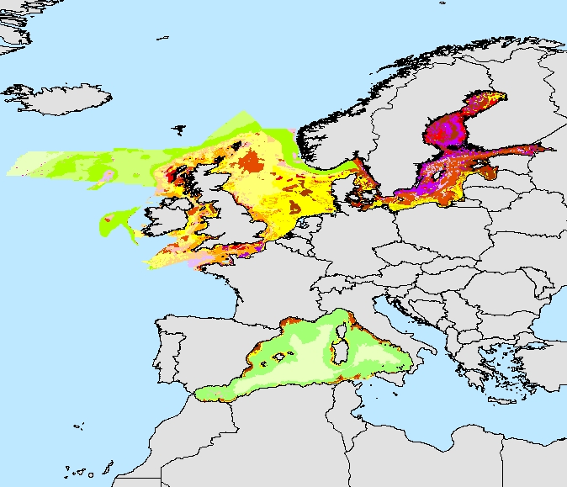
Modeled seabed habitats
MESH Atlantic 2010-2013
EMODnet
2013-2015
Data aggregated as MSFD 'predominant habitats'

Slide 13
Possible scenarios for Member State data flows
Institute A
Data set HELD by EMODnet partner
(institute B)
√
National MSFD Data Set 1
Institute B
Institute C
EMODnet
Institute D
??
National MSFD Data Set 2
Data set NOT held by EMODnet partner
Institute
E

Slide 14
Issues to be addressed
Need to understand the data/products used by MS in their MSFD assessments
  Art. 19.3 'catalogue'
Assess which of these can be accommodated within EMODnet
  As data or data products
Develop and agree data standards
  INSPIRE compliant and labelled as 'MSFD'
Develop data flows from MS to EMODnet
  Particularly where MS 'provider' is not part of EMODnet consortia

Slide 15
Marine Knowledge – future benefits?
MSFD is very data/information/knowledge hungry
Need to unlock 'hidden data'
  From research, public authorities, industry, NGOs
  Clarity on data gaps – priorities for new data
Need to improve data flows
  Infrastructure, data standards, 'free for all' access
Need to interpret data to improve knowledge
  E.g. interactions (state, pressures, activities)
  Bringing data together can stimulate interpretations
Improved knowledge -->wiser management
Efficient data management --> reduced costs

Slide 16

http://ec.europa.eu/environment/marine
Thank you for your attention!

