Slide 1
Norwegian maritime economy
Maritime Forum Norway,
Tord Dale, Managing Direcor

Slide 2
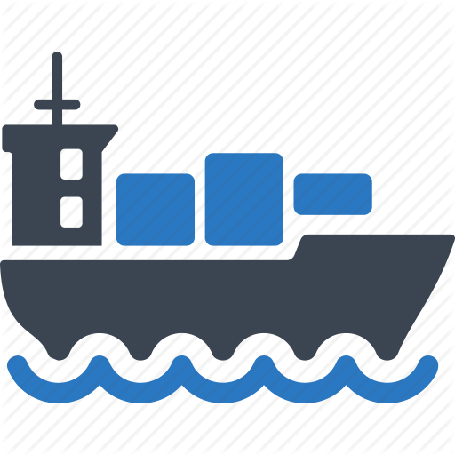

Slide 3
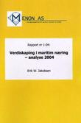
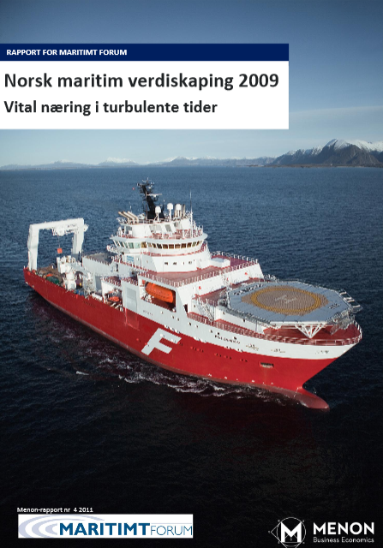
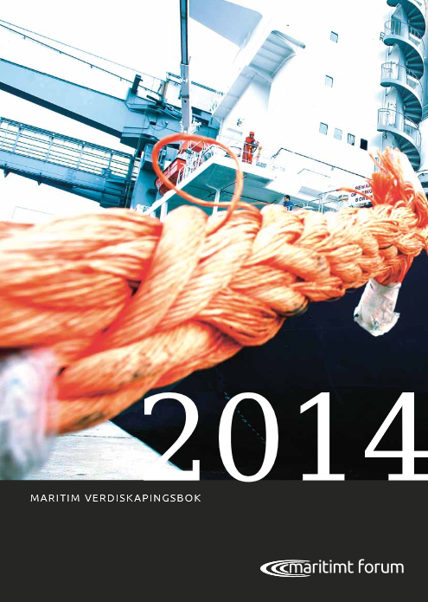
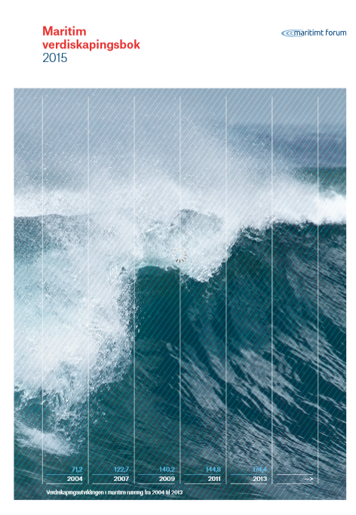
Yearly analysis conducted since 2004 Based on financial statement from more than 10 000 Norwegian maritime enterprises This presentation: 2014 numbers. 2015 numbers ready by 15.01.2017 DEFINITION: Maritime industry - enterprises that own, operate, design, build, produce and deliver equipment or specialized services to all types of ships (floating objects) Sector related to the ocean employed 250 000 persons and a value creation of 850 billion NOK

Slide 4
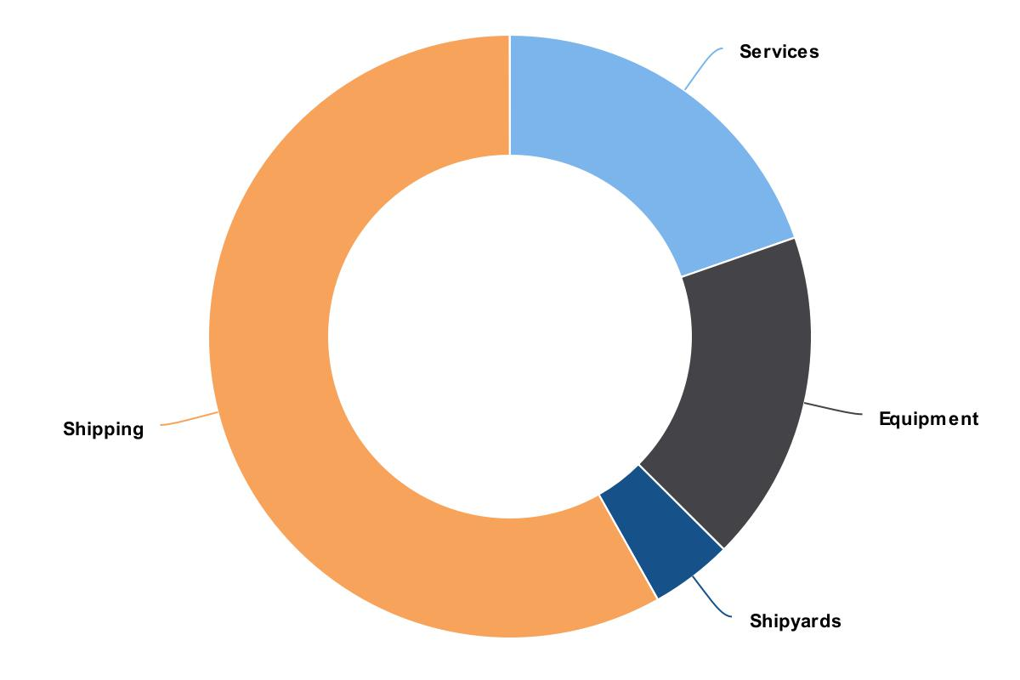
Key findings
110 000 employeed
Value added - 190 billion, 12 % of corporate BNP
About 1/3 of Norwegian export generated from the maritime industry
Historicaly played an important role Norwegian economy

Slide 6
Value added: Turnaround subtracted for expenses for goods and services.
Labour Costs + Operating profit
Important to avoid double counting
Gives a good picture of the contribution to society in terms of wages, taxes to municipalities and state, and profit margins

Slide 7
Employment – 110 000 in maritime industry
10 000
26 000
26 000
45 000

Slide 8
Higher degree of value added Average 2012-2014 1000-NOK

Slide 9
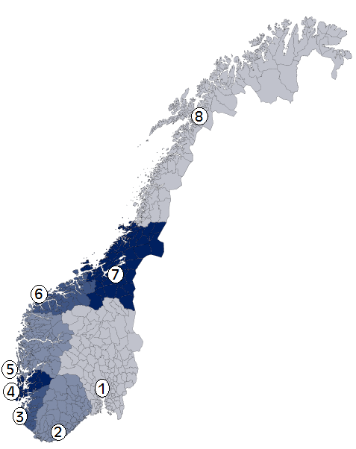
Finding: 8 specialised regional clusters
8
7
6
5
4
1
3
2

Slide 10
Regional specialisation – deep sea and finance
8
7
6
5
4
1
3
2

Slide 11
Regional specialisation – offshore og rigg
8
7
6
5
4
1
3
2

Slide 12
Regional specialisation – equipment
8
7
6
5
4
1
3
2

Slide 13
Regional specialisation – ship yards
8
7
6
5
4
1
3
2

Slide 14
Regional specialisation – technology and artic
8
7
6
5
4
1
3
2

Slide 15
What lies ahead?

Slide 16
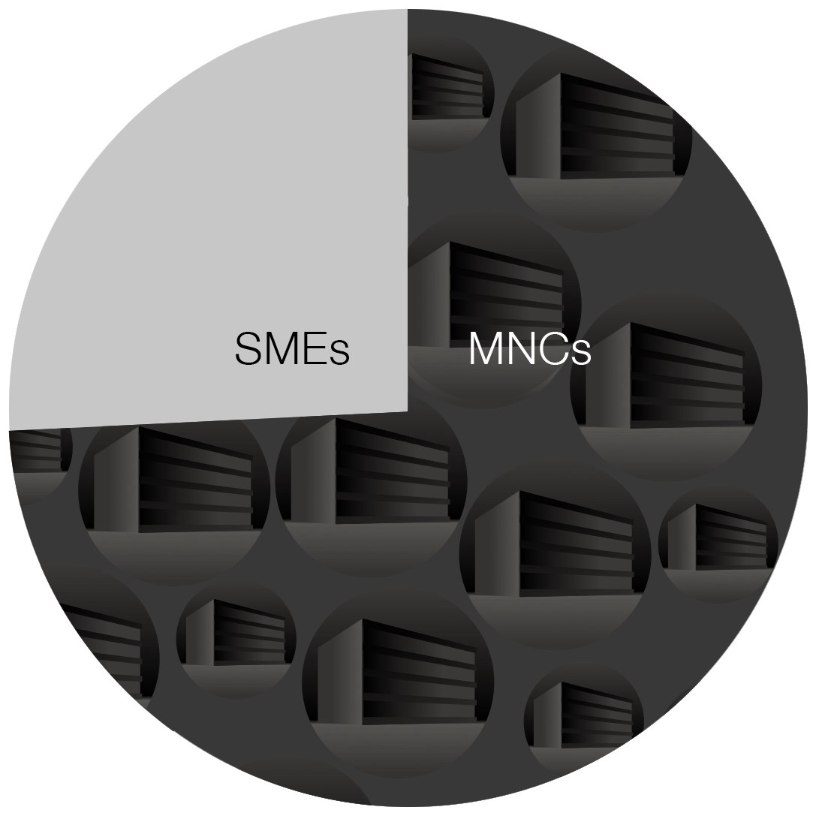
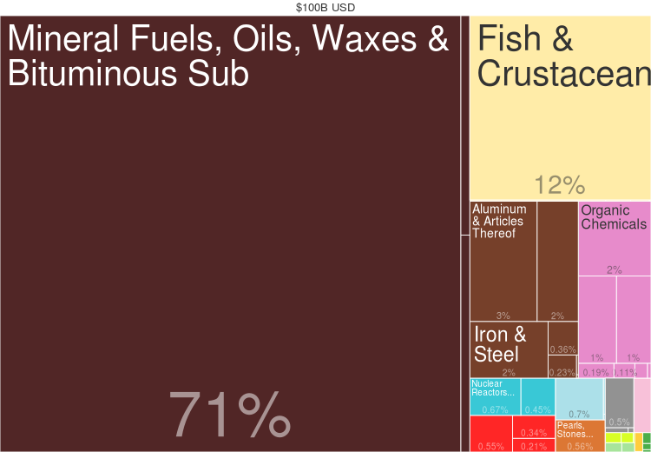
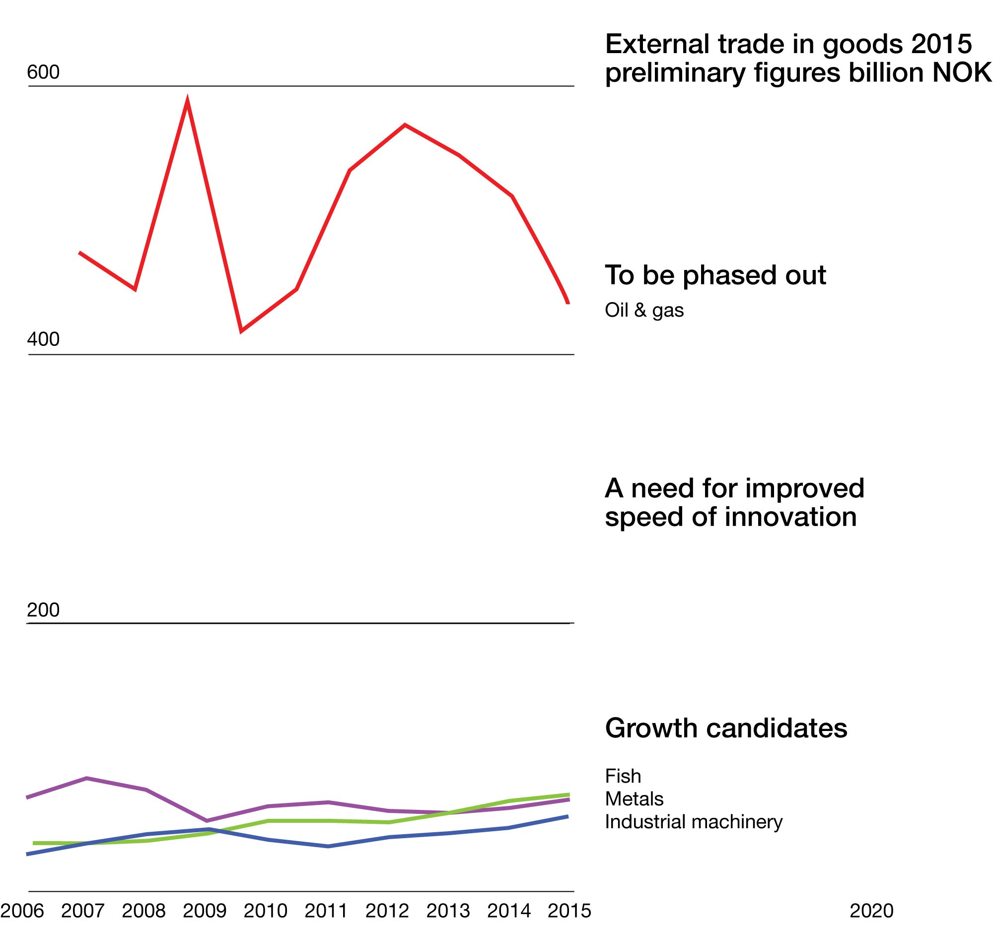
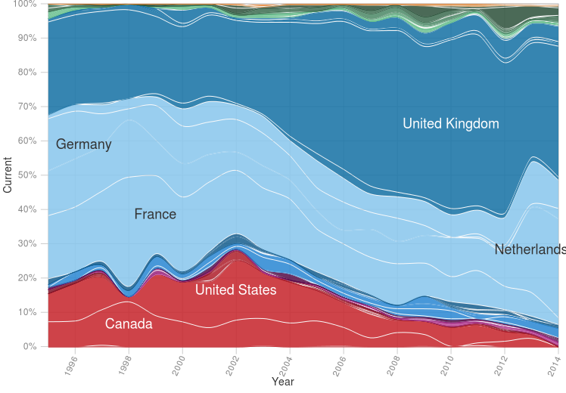
Norwegian exports
Exports by category
External trade in goods 2015
Market access risk
BnNOK
2015, SSB
74% of all exports from Norway go through 1% of the companies
Exports by company type
2014 Data: CfID, Harvard University
Data: Toppindustrisenteret, Arendalsuka
How global are we?
Ocean Industry in need of increased speed of innovation to fill the export gap
Cool start-ups, 0.0? billion NOK
The misplaced focus of our innovation ecosystem
Trade balance by trade partner

Slide 17
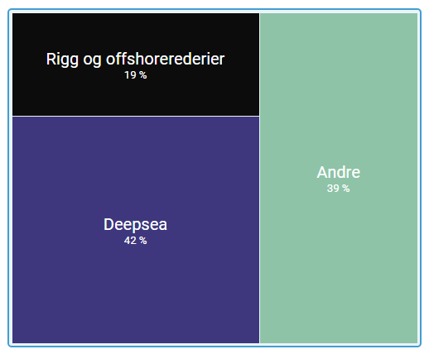
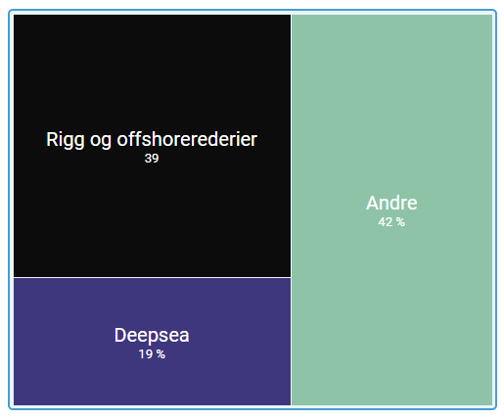
Strong shift towards offshore: Today about 70 % of value creation is offshore related
Part of total value creation 2004
Part of total value creation 2014

Slide 19
digitalization
Sustainability
technology

Slide 20
Questions?
Maritime Forum Norway
tord.dale@maritime-forum.no
+47 40 45 14 14

