Slide 1
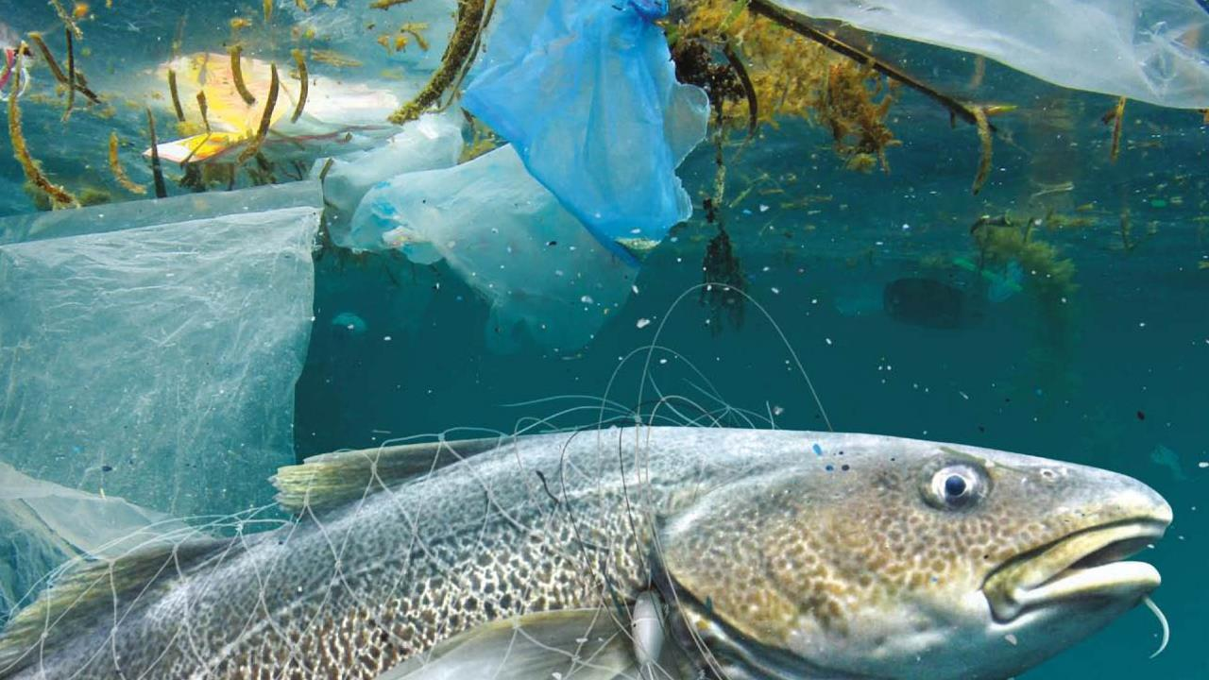
KLAIPĖDA – EUROPEAN YOUTH CAPITAL 2021 LITHUANIAN SEA MUSEUM

Slide 2
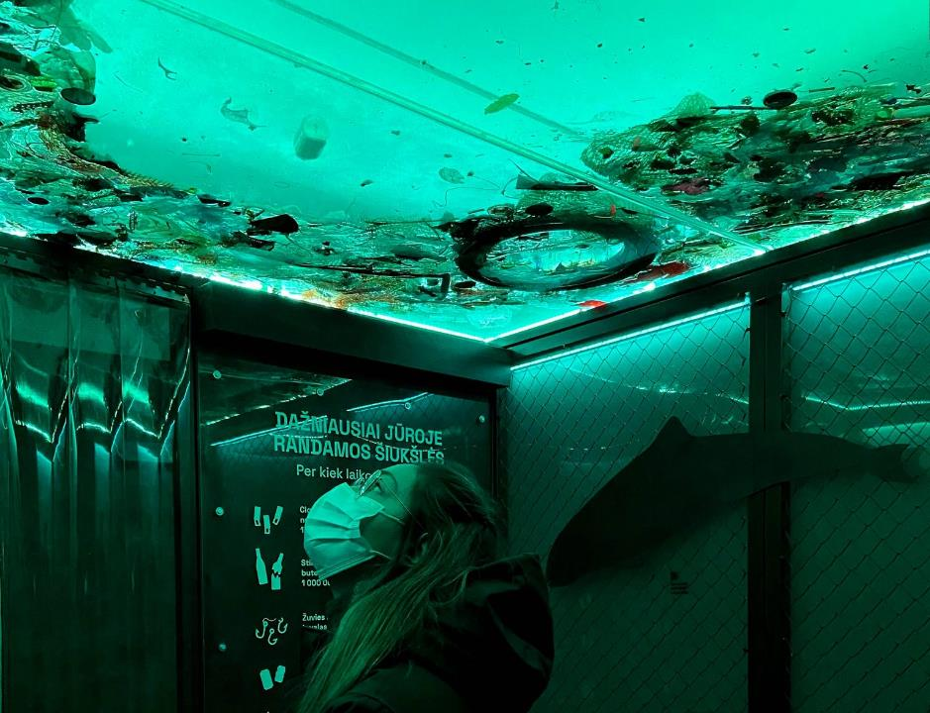
KLAIPĖDA – EUROPEAN YOUTH CAPITAL 2021
Participating in the KLAIPĖDA – EUROPEAN YOUTH CAPITAL 2021 programme, the Lithuanian Sea Museum (LSM) committed itself to become an open and friendly platform for the youth to arrange discussions on marine hot topics, and encourage their creative and critical thinking, self-expression and public spirit.

Slide 3
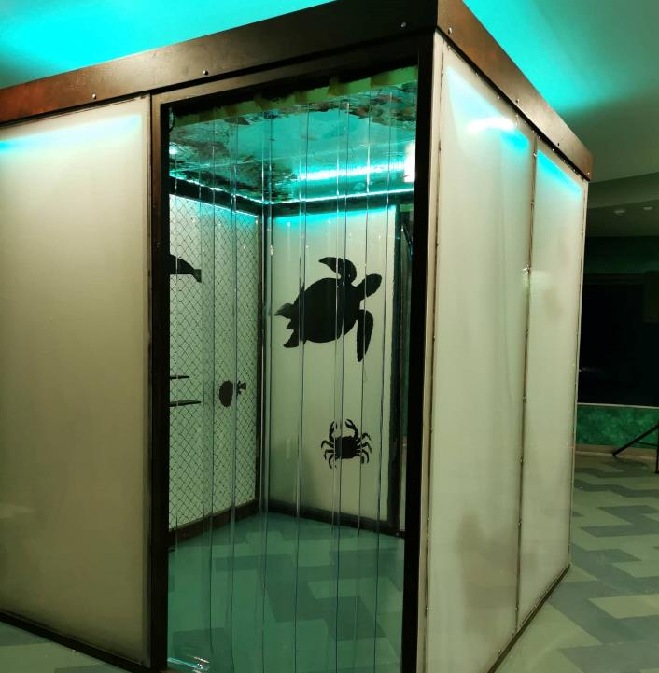
LSM in the KLAIPĖDA EUROPEAN YOUTH CAPITAL 2021 programme
MOBILE ECO POP-UP CUBE
14 m³ of the Baltic Sea in 2050.
DISTOPHIA or REALITY?
https://www.muziejus.lt/lt/muziejus-jaunimui

Slide 4
LSM in the KLAIPĖDA EUROPEAN YOUTH CAPITAL 2021 programme
2020–2021 PROGRAMME
2020 Dec 11 Start of the activities
2021 March 1-23 Live forums with Klaipeda Schools
2021 May 1-30 Take up challenge of 14 m³ of the Baltic Sea
2021 June 8 World Ocean Day

Slide 5
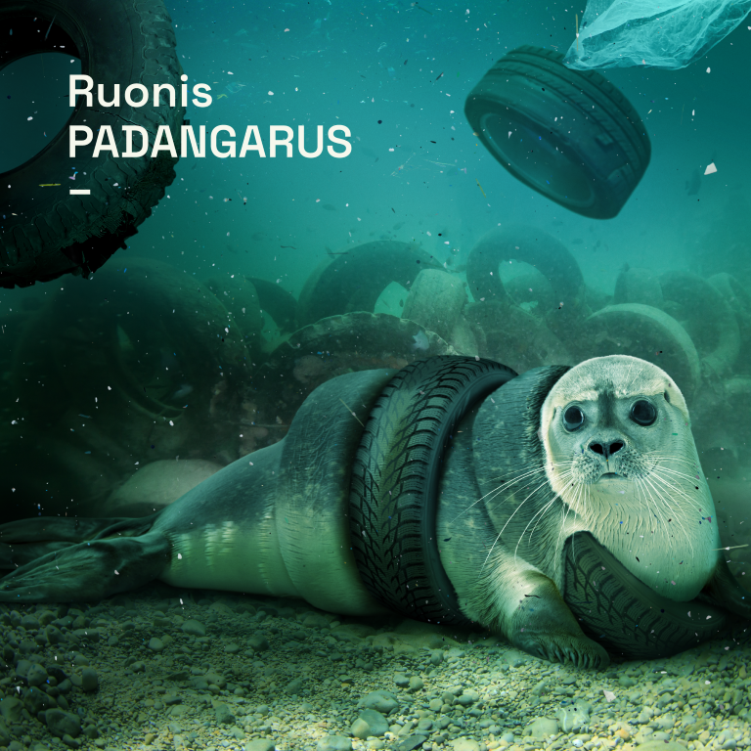
LSM in the KLAIPĖDA EUROPEAN YOUTH CAPITAL 2021 programme
DISTOPHIA or REALITY?
Tire seal

Slide 6
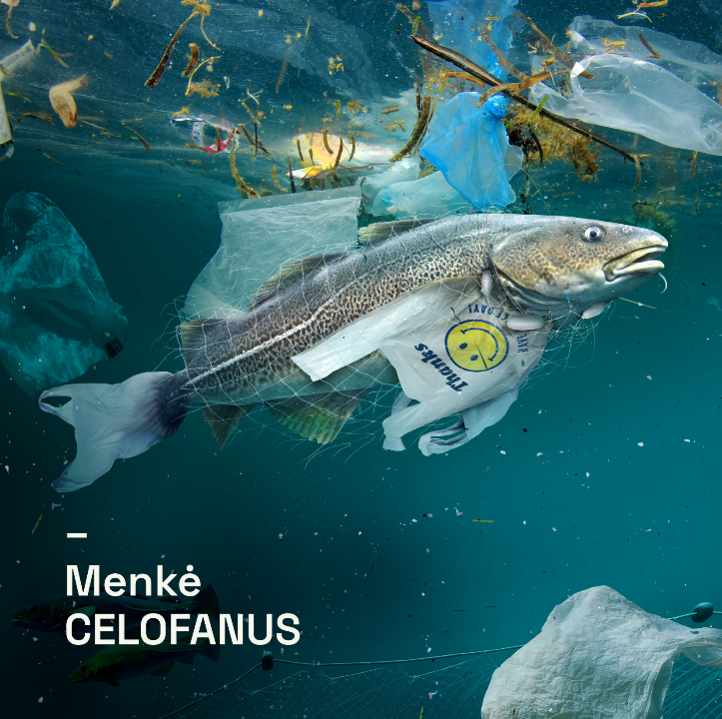
LSM in the KLAIPĖDA EUROPEAN YOUTH CAPITAL 2021 programme
DISTOPHIA or REALITY?
Celofanus cod

Slide 7
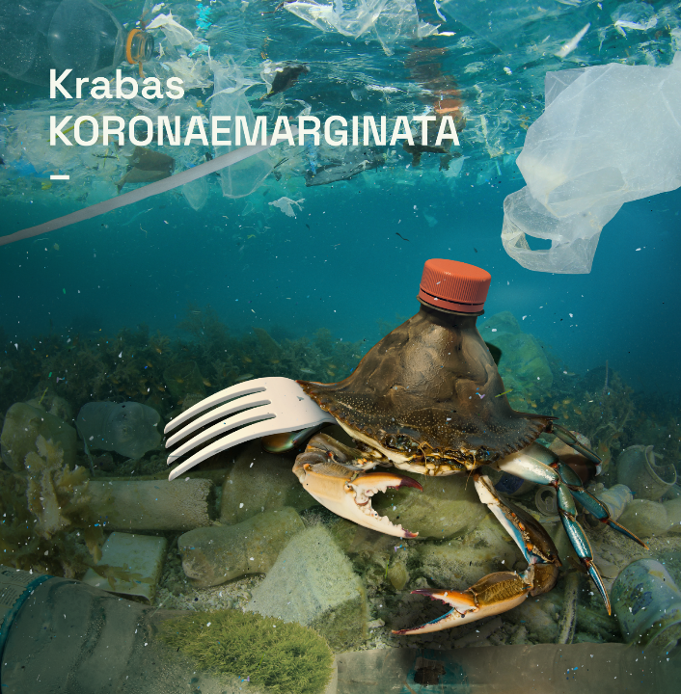
LSM in the KLAIPĖDA EUROPEAN YOUTH CAPITAL 2021 programme
DISTOPHIA or REALITY?
Koronaemarginata crab

Slide 8
LSM in the KLAIPĖDA EUROPEAN YOUTH CAPITAL 2021 programme
DISTOPHIA or REALITY?
Radioactivarous turtle

Slide 9
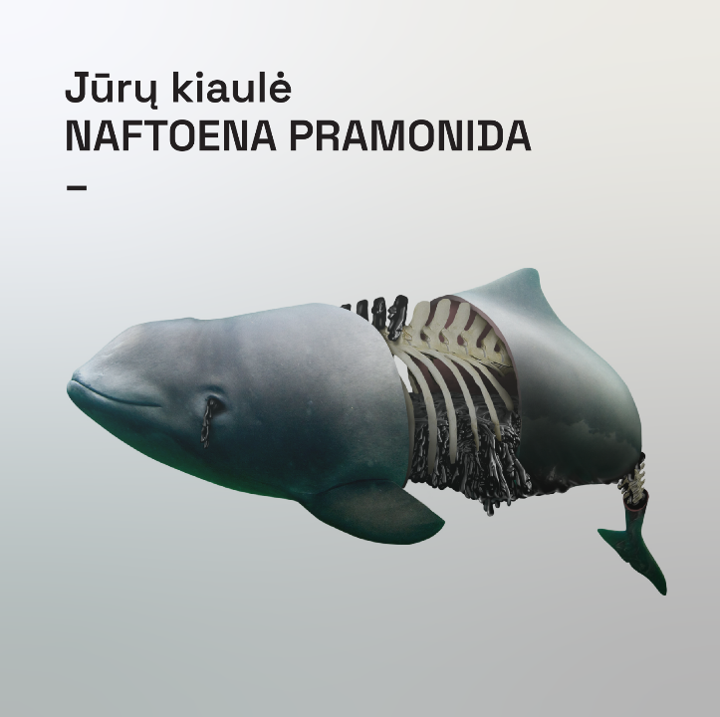
LSM in the KLAIPĖDA EUROPEAN YOUTH CAPITAL 2021 programme
DISTOPHIA or REALITY?
Pramonida harbour purpoise

Slide 10
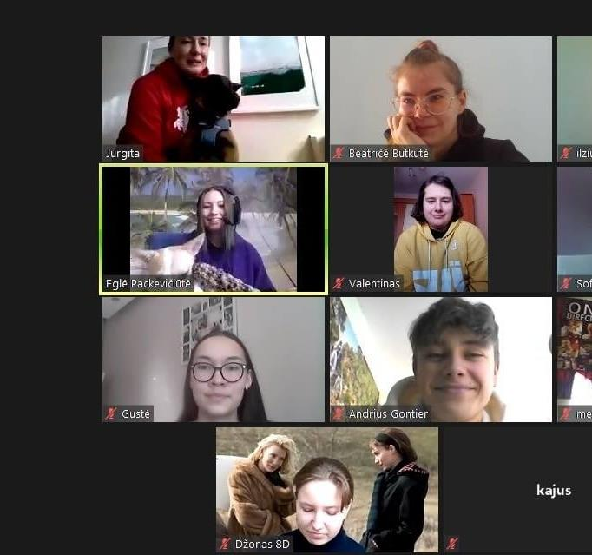
LSM in the KLAIPĖDA EUROPEAN YOUTH CAPITAL 2021 programme
16 Secondary Schools in Klaipeda, Lithuania
Volunteers and young ambassadors of the Ocean
16 hot topics

Slide 11
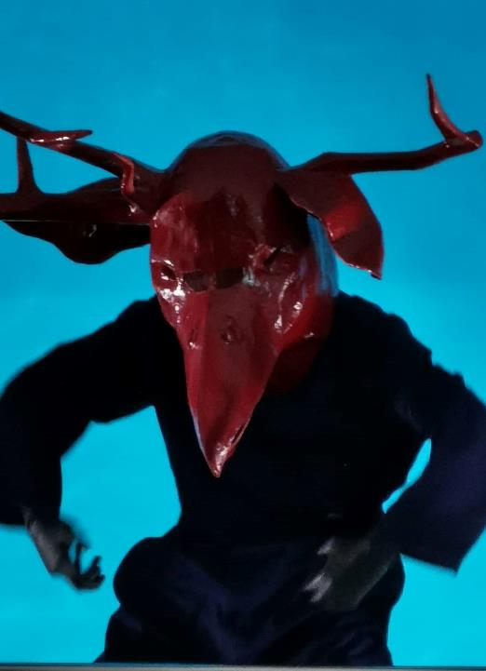
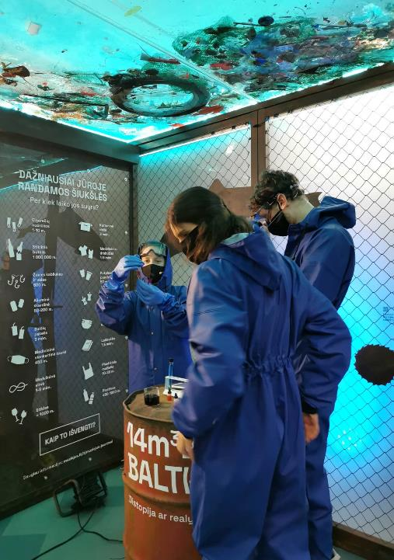
LSM in the KLAIPĖDA EUROPEAN YOUTH CAPITAL 2021 programme
11 December, 2020
Launch of the Programme

Slide 12
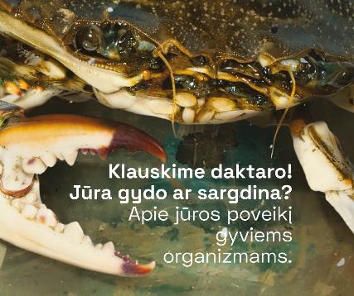
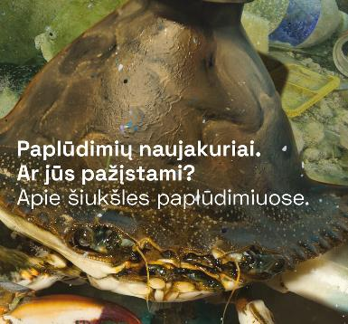
LSM in the KLAIPĖDA EUROPEAN YOUTH CAPITAL 2021 programme
1-23 March, 2021
15:00-15:30 on weekdays
Live on:
facebook.com/muziejus.lt

Slide 13
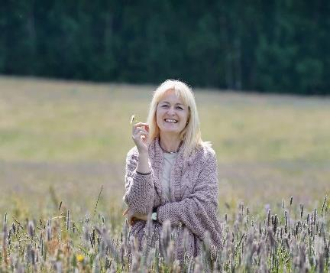
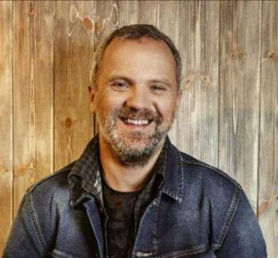
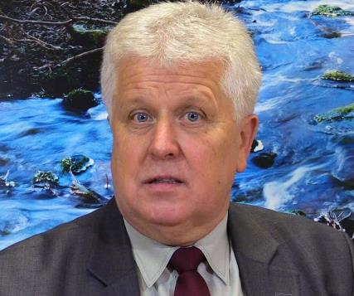
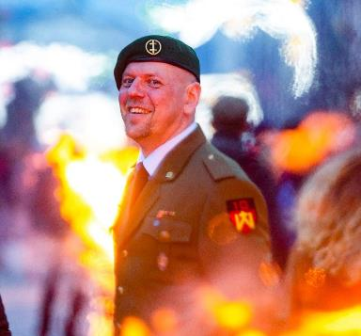
LSM in the KLAIPĖDA EUROPEAN YOUTH CAPITAL 2021 programme
love and devotion to the Sea, cemetery of WW 2 weapons on the bottom of the Baltic Sea, beach rubbish, oil spills, cliisge and rising sea level, overfishing, plastics in the sea, and about a storm in your teacup
Discussions moderated by well-known and popular experts and leaders on various topics:
Does the Ocean need us or do we need it more?
What does it mean to be devoted to the sea?
Starting a change – easy?
Cemetery of WW 2 weapons on the bottom of the Baltic Sea
Beach rubbish
Oil spills
Climate change and rising sea level
Plastics in the sea

Slide 14
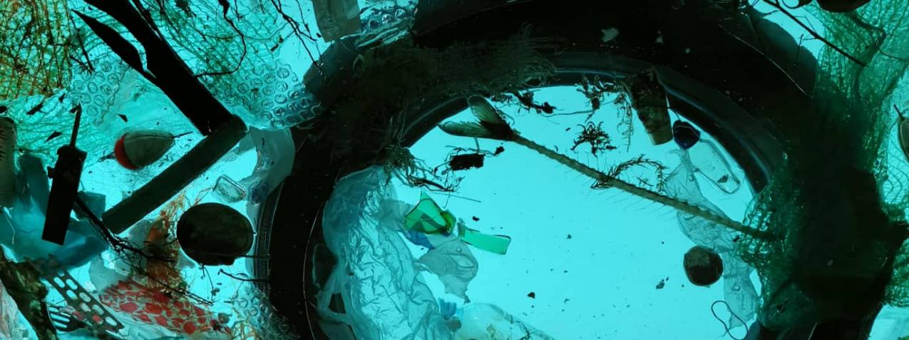
8 JUNE, 2021
ECO CHALLENGE at the Lithuanian Sea Museum
„IMAGINE YOURSELF AS THE OCEAN“

Slide 15
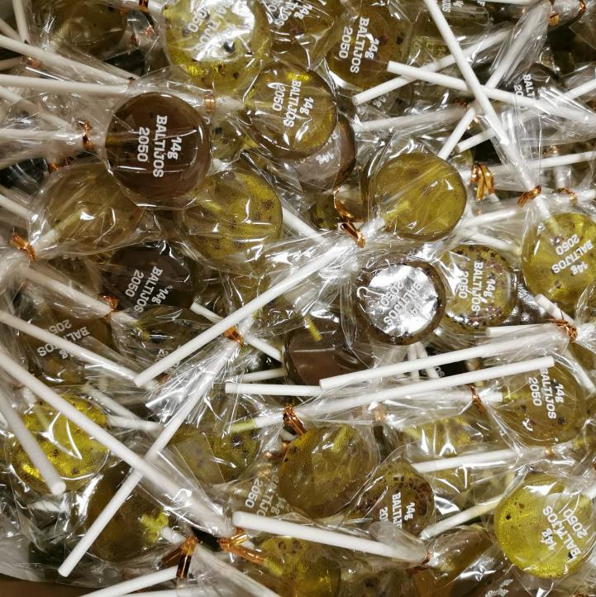
LSM in the KLAIPĖDA EUROPEAN YOUTH CAPITAL 2021 programme
LET‘S KEEP IN TOUCH:
facebook.com/muziejus.lt
ljm@muziejus.lt

