Slide 1
The protection and research of sunken prehistoric landscapes
SPLASHCOS and SINCOS
Friedrich Lüth
friedrich.lueth@dainst.de
UNESCO – EU Parliament meeting
Bruxelles, Belgium
1 October 2015

Slide 2
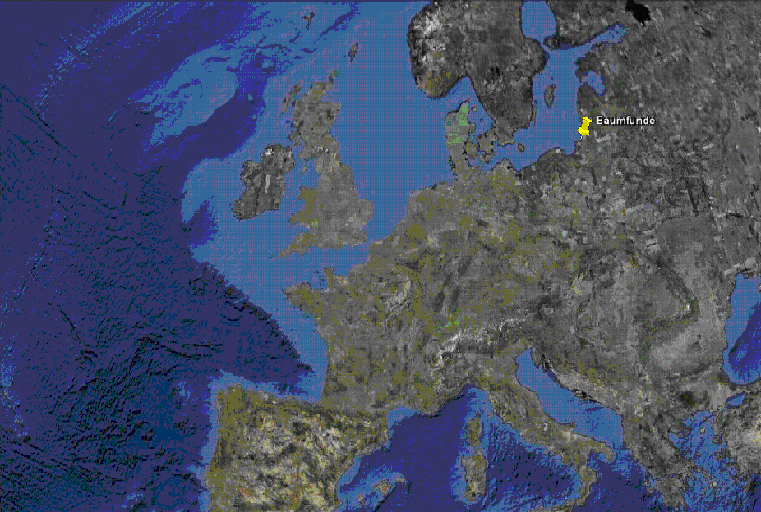
Google-seabed

Slide 3
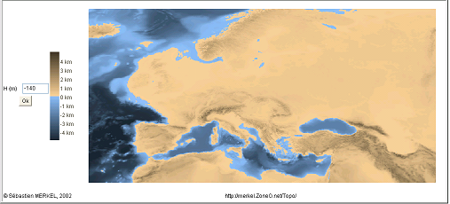
Surface on the continental shelf at -140m sealevel
ca. 19.000 BP
Nach http://merkel.zoneo.net/Topo/Applet/index.php?lang=en

Slide 4
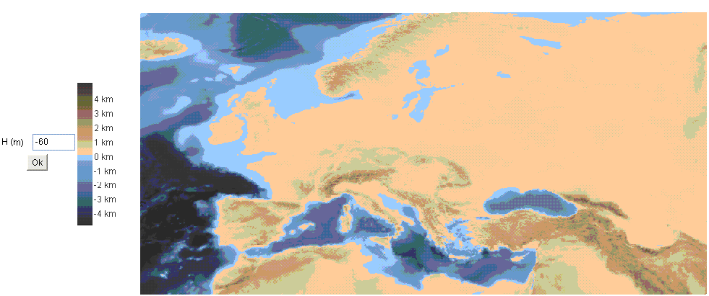
Surface on the continental shelf at -60m sealevel ca. 10.000 BP
Nach http://merkel.zoneo.net/Topo/Applet/index.php?lang=en

Slide 5
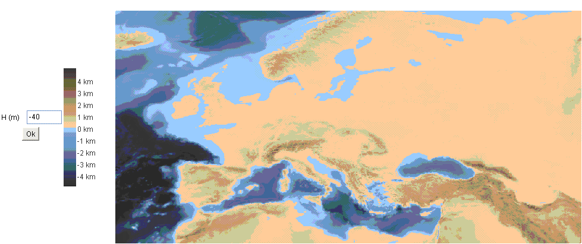
Surface on the continental shelf at -40m sealevel ca. 9.000 BP
Nach http://merkel.zoneo.net/Topo/Applet/index.php?lang=en

Slide 6
Understanding the dynamics of submerging landscapes
Tectonical, climatological, and paleooceanographical concepts are required to understand the processes of rising and sinking coasts and to develop models of future scenarios by the reconstruction of the past.
The Baltic Sea serves as a model ocean that allows to study in an exceptional manner the interrelation between geological and climatic forcing of the evolution of coastlines and the results in changing ecosystem and anthroposphere.

Slide 7
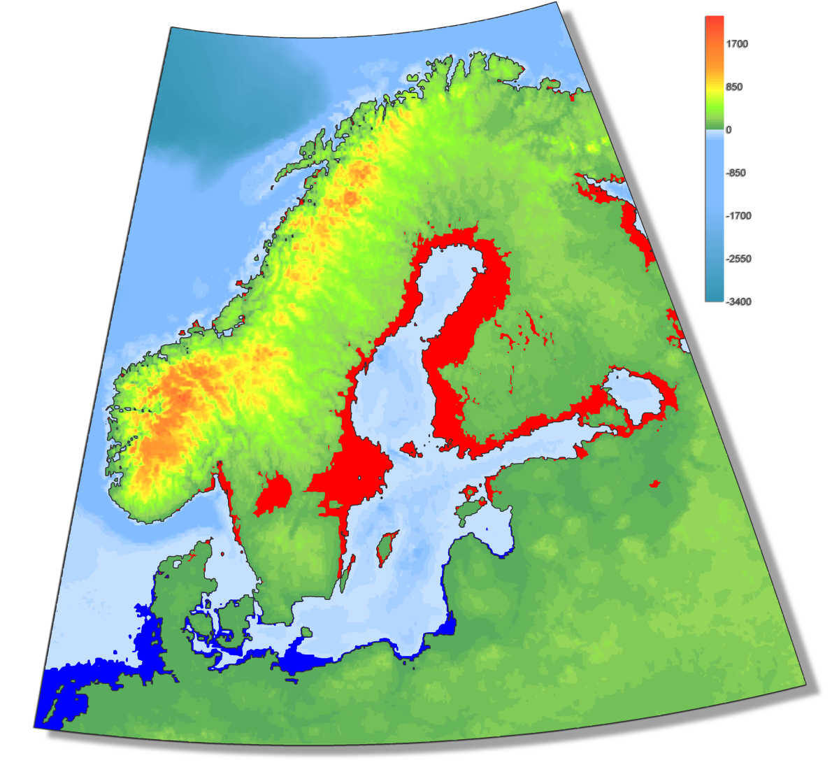
Areas of transgression and regression of the Baltic Sea since 8000 cal. BP
Regression
Transgression
Harff et al. (2007)

Slide 8
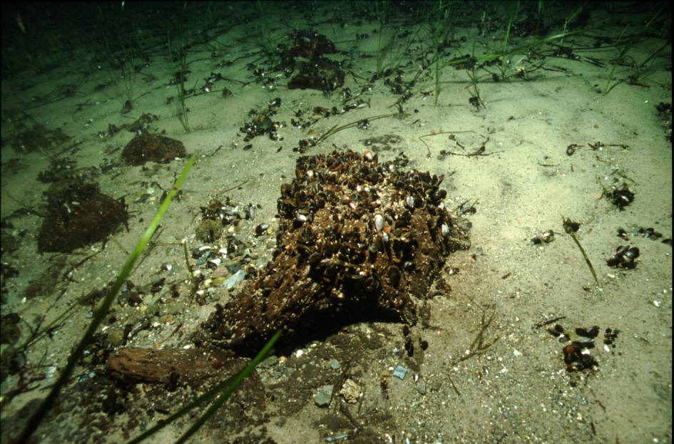
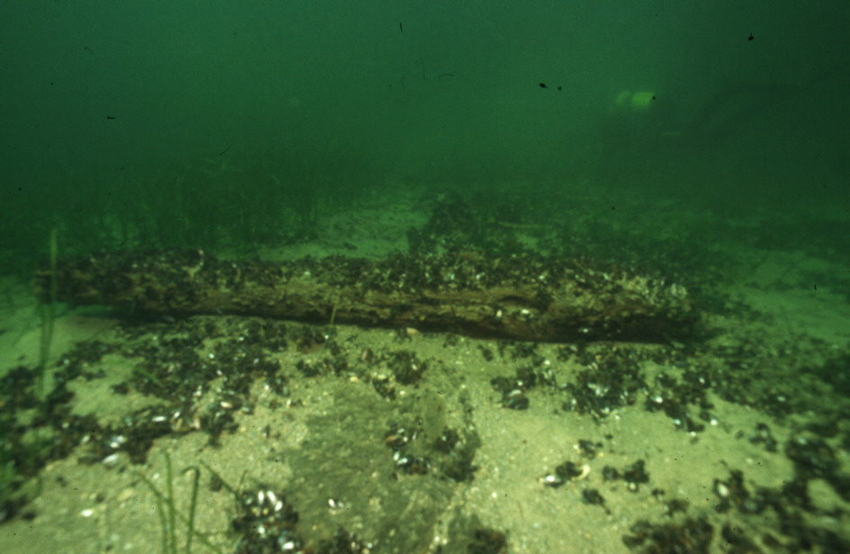
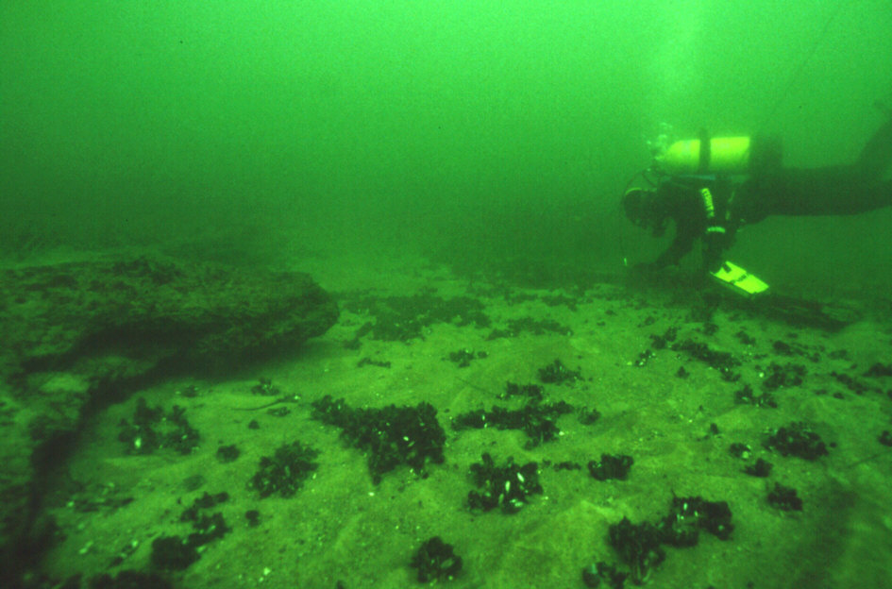
Jäckelberg-Nord
Situation underwater:
Peat-banks
treetrunks

Slide 9
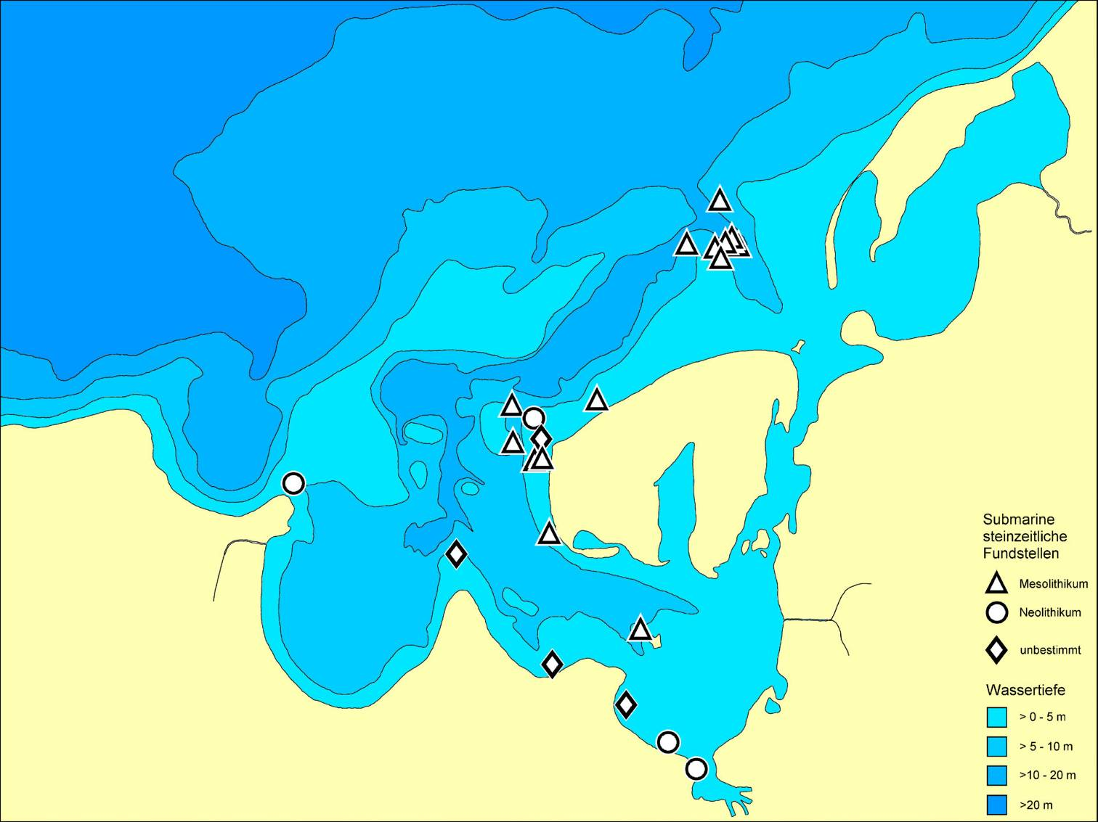

Submarine stoneage Sites from the 7th and 6th Millenium BC at Jäckelgrund und Jäckelberg
DFG Research Unit
Sinking Coasts:
Geosphere, Ecosphere and Anthroposphere
of the Holocene Southern Baltic Sea
Notes:
In der Wismarbucht konzentrierten sich Arbeiten in den beiden letzten Jahren auf den Jäckelberg im Norden der Insel Poel, wo in einer Wassertiefe zwischen 6 und 1m mehrere Fundstellen des 7. und 6 vorchristlichen Jahrtausends entdeckt wurden.

Slide 10
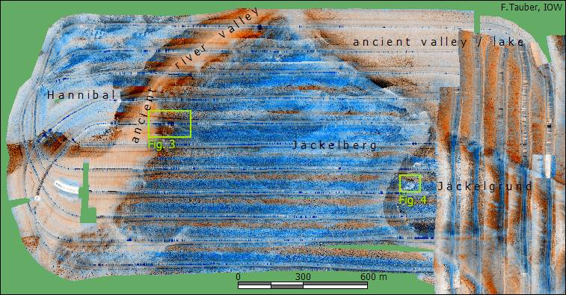
Sidescan sonar mosaic of the northern part of the Jäckelberg, compiled from sidescan sonar raw data of the surveys 2001-10 and 2004-03
Jäckelberg-Huk
Jäckelberg-NNW
Jäckelgrund-Strand
Jäckelgrund-Furt
Jäckelberg-Nord
Jäckelgrund-Orth

Slide 11
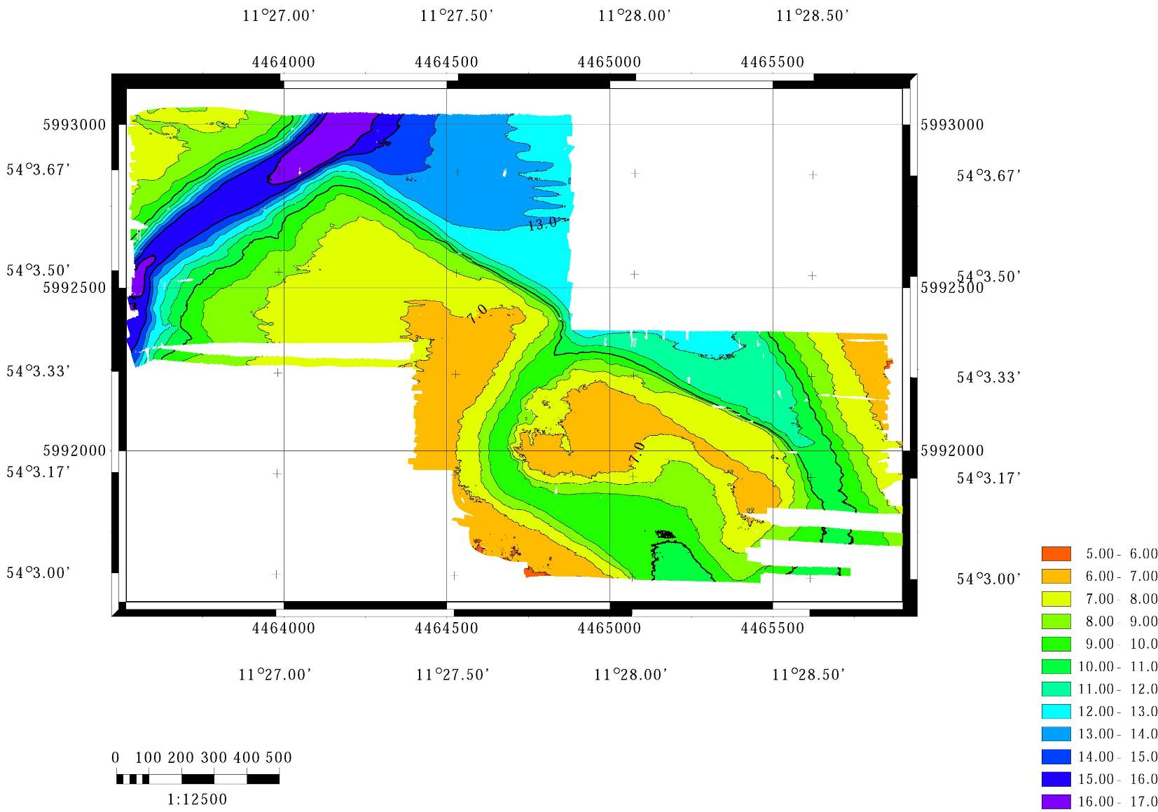

Bathymetry of the North-Eastern Jäckelberg (multibeam-data)
Jäckelberg-NNW
Jäckelberg-Huk
Jäckelgrund-Strand
Jäckelgrund-Furt
Water depth
[m NN]
Jäckelberg-Nord
Jäckelgrund-Orth

Slide 12
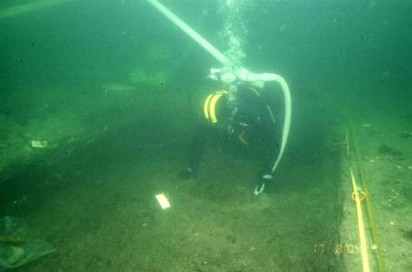
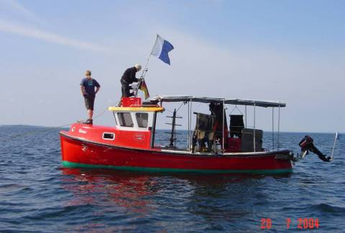
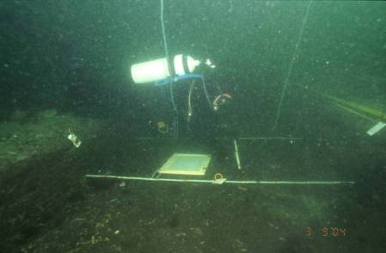
Jäckelberg-Huk
(Poel 45, Ostsee II)
8-10 m below present MSL
6500 – 6000 cal BC
Excavation of Trench 4 and 5,
Summer 2004

Slide 13
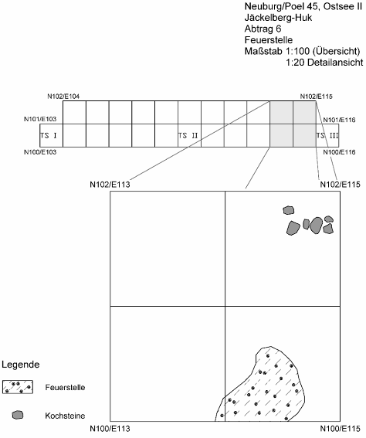
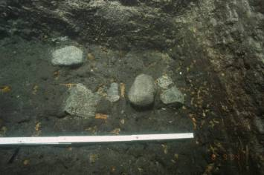
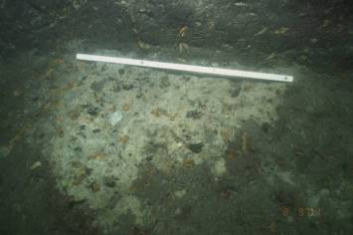
Jäckelberg-Huk (Poel 45, Ostsee II)
Preserved Settlement Features
in 9 m below present Sea level
Cooking
Stones
N101/E114
Open
Fireplace
N100/E114

Slide 14
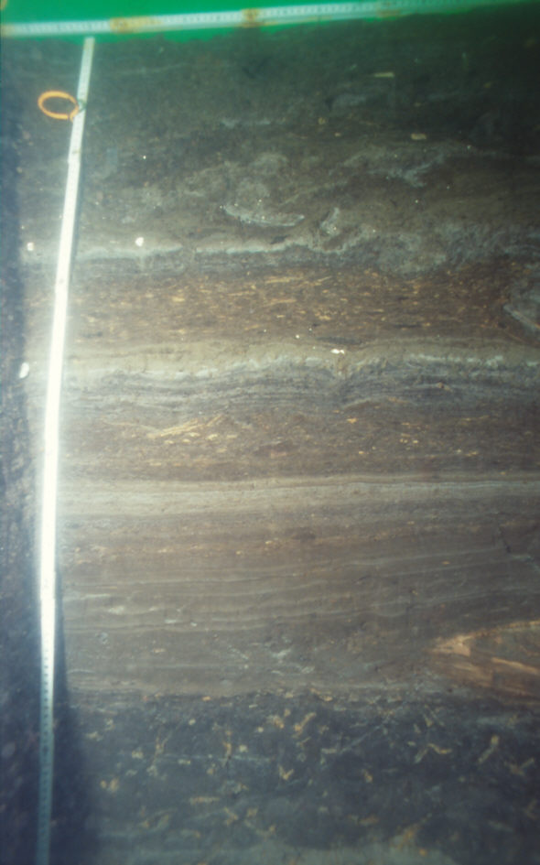
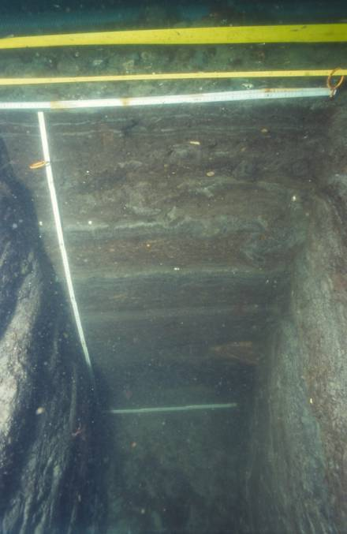
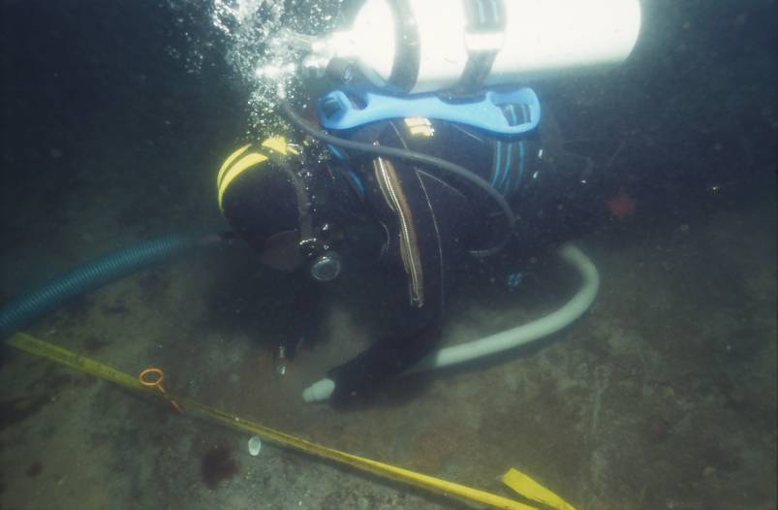
Jäckelberg-Huk (Poel 45, Ostsee II)
Excavation 2005:
Test-trenches 6, 7, 8:
First transgression of marine waters into Wismar Bay shortly
after 6.000 cal BC
- 8,40 m b.s.l.
marine Mud
marine Mud
limnic Gyttja
upper humic horizon
(main culture layer)

Slide 15
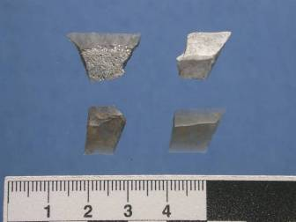
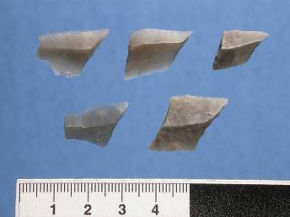
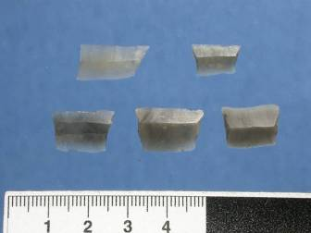
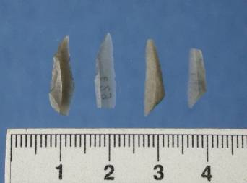
Jäckelberg-Huk (Poel 45, Ostsee II)
Projectil points
Transverse
Arrowheads
Rhombic
Arrowheads
Trapezes
Microlithic
Points,
Triangles

Slide 16
Jäckelberg-Huk
Radiocarbon dates
ALM-Inventory No. | Sample-No. | Age BP | Age calBC | δC13 | Object
2002/1526-0035,1 | KIA-23699 | 7416±43 | 6295±63 | -22,5 | Mammal bone, Red deer
2002/1526-0035,2 | KIA-23700 | 7469±39 | 6322±58 | -20,5 | Mammal bone, Roe deer
2002/1526-0035,3 | KIA-23701 | 7387±42 | 6251±85 | -15,5 | Fish bone, pike
2002/1526-0045,1 | KIA-23940 | 7239±37 | 6103±63 | -20,7 | Mammal bone, undet.
2002/1758-0053,1 | KIA-23941 | 7108±37 | 5964±47 | -18,1 | Fish bone, pike
Jäckelberg-Huk (Poel 45, Ostsee II). Radiocarbon Dates.
Calibration with Calpal 2001 (Jöris/Weninger) and Intcal 98 (calibrated age ± 1 stdv. B.C.).

Slide 17
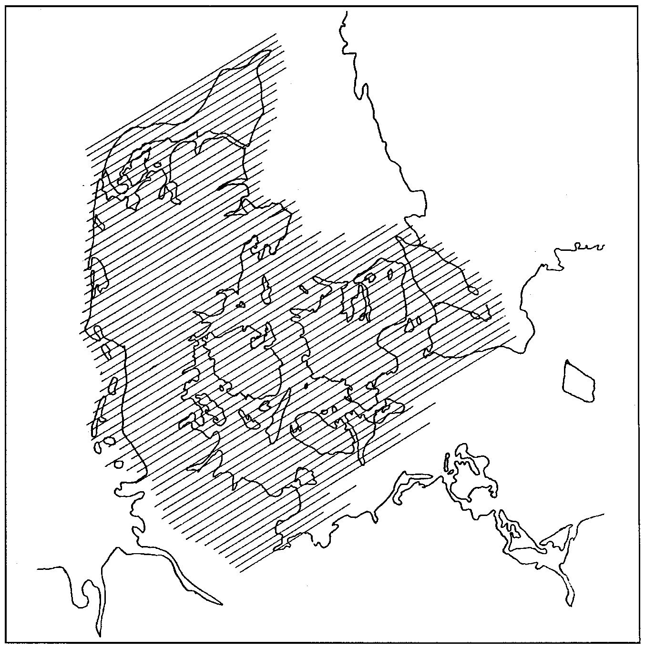
Distribution of the Kongemose Culture in Southern Scandinavia and Northern Germany
after S.A.Sørensen 1996, 136

Slide 18
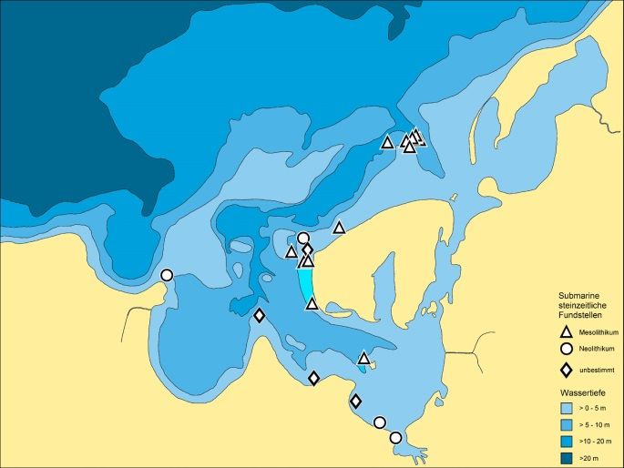
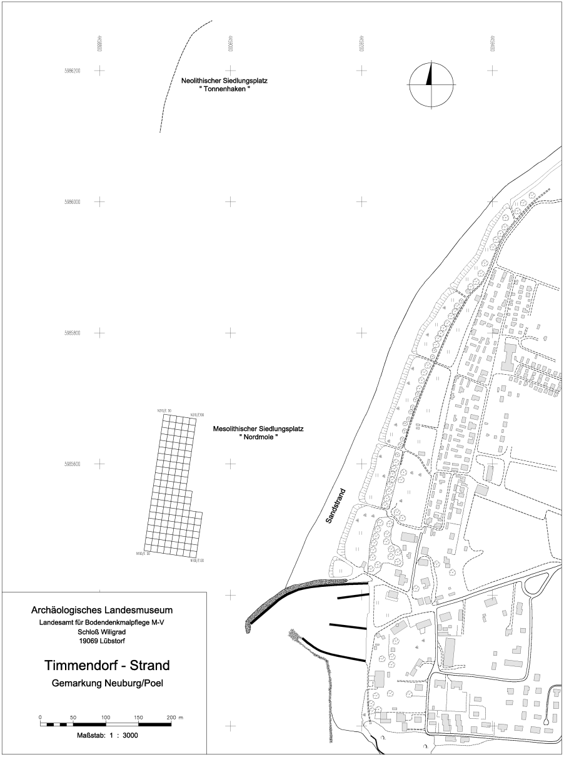
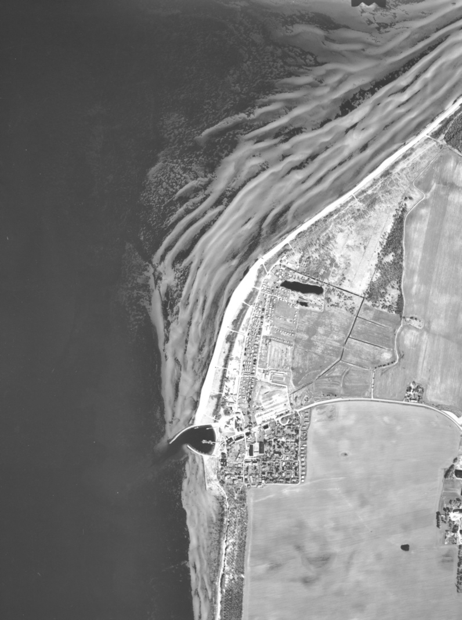
Position of submerged stone-age sites near Timmendorf /Poel

Slide 19
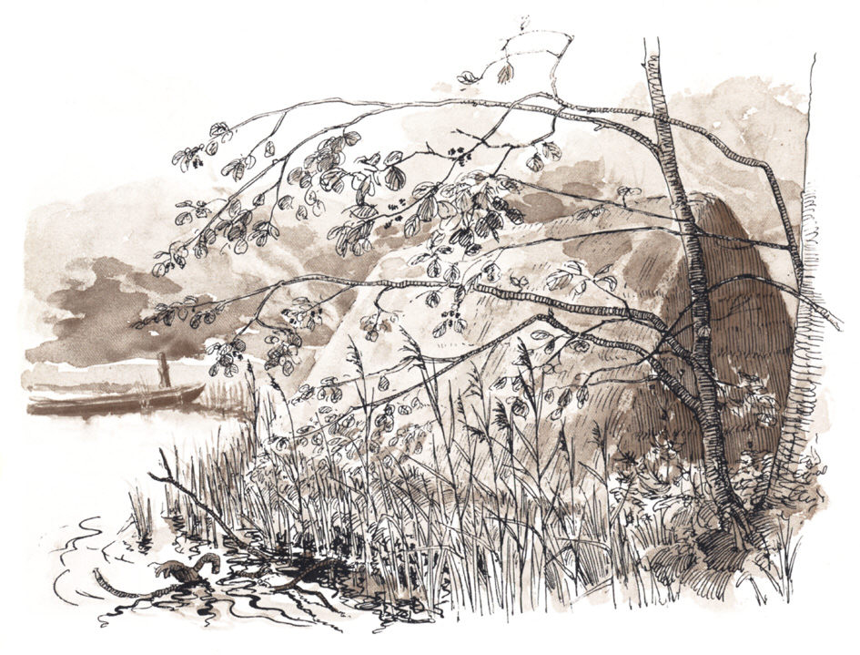
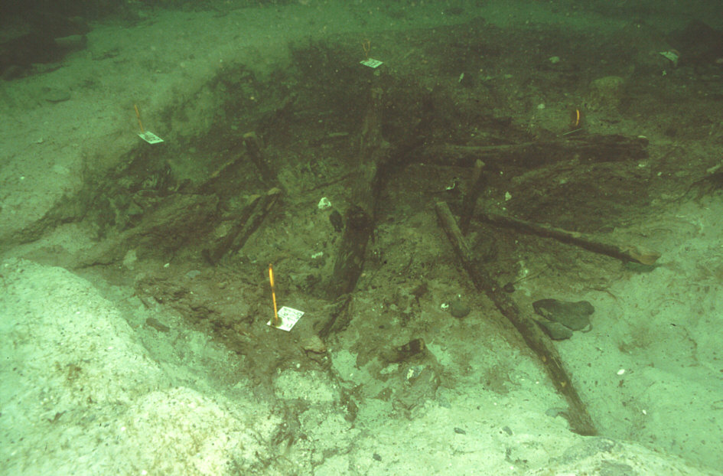
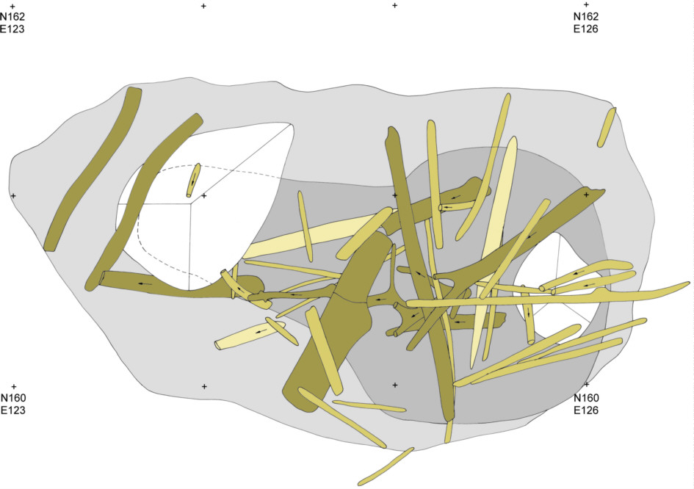
Timmendorf-Nordmole
Pit
Wooden beams from the shelter, collapsed into the pit

Slide 20
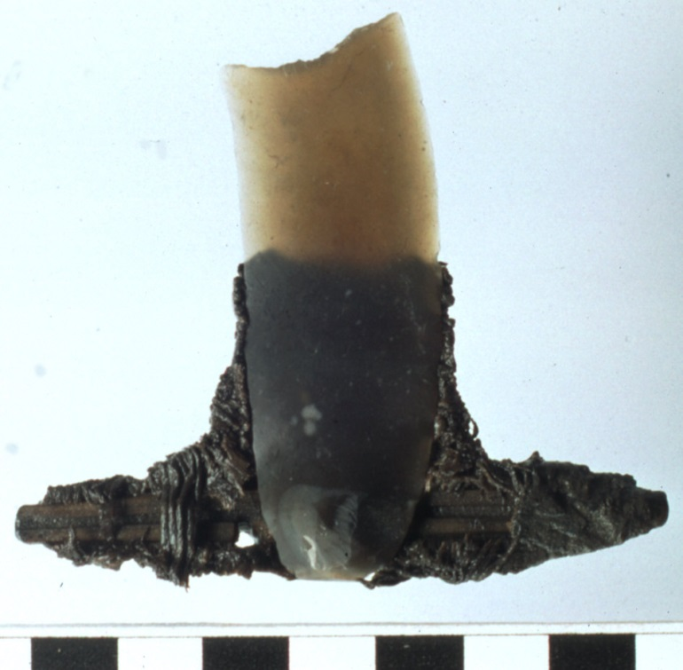
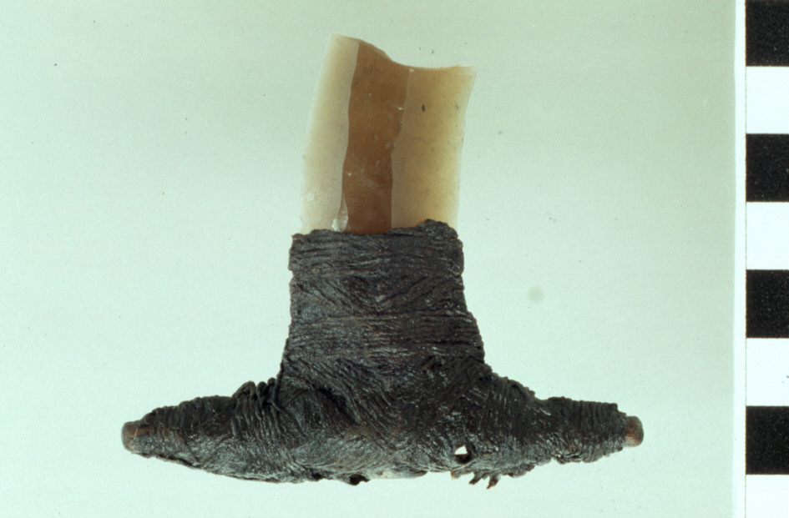
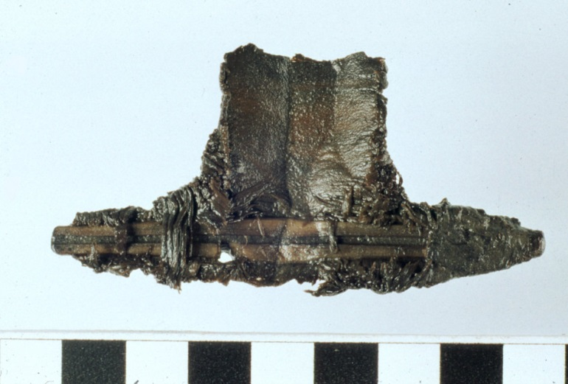
Timmendorf-Nordmole
Pit
Flintknive with preserved handle from haselnut with Limestringing

Slide 21
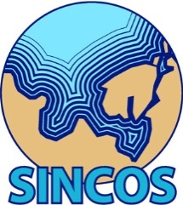
Data on the coastline-development during medieval and modern times

Slide 22
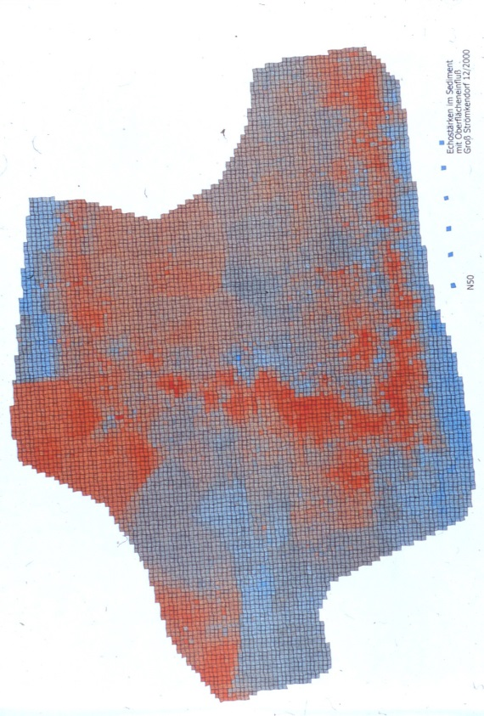
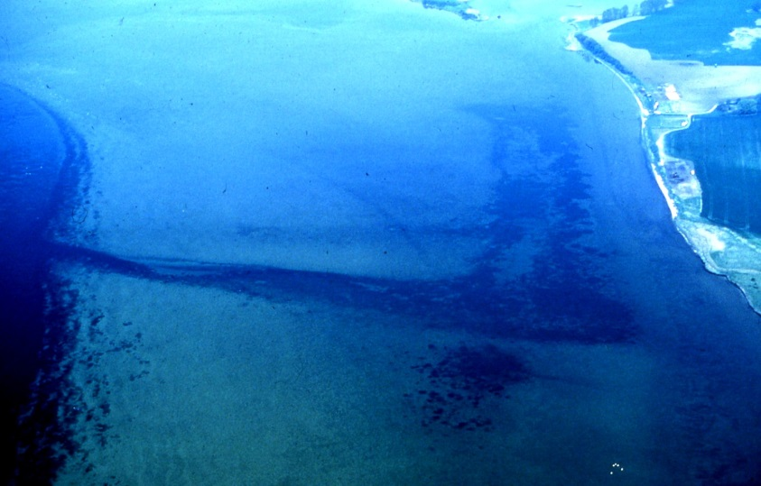
Early medieval (8th c AD) trading site of Groß Strömkendorf/Reric

Slide 23

Older and new AMS ¹⁴C dates from the
Baltic and North Sea in calendar years BP
BALTIC SEA
RESEARCH INSTITUTE
WARNEMÜNDE
BALTIC SEA
RESEARCH INSTITUTE
WARNEMÜNDE
marine material
limnic and terrestrial material

Slide 24
Older and new AMS ¹⁴C dates from the
Mecklenburgian Bight in calendar years BP
BALTIC SEA
RESEARCH INSTITUTE
WARNEMÜNDE
BALTIC SEA
RESEARCH INSTITUTE
WARNEMÜNDE
A
g
e
i
n
c
a
l
e
n
d
a
r
y
e
a
r
s
B
P
16000
14000
12000
10000
8000
6000
4000
2000
0
0
l
e
v
e
l
a
e
s
t
-20
n
e
c
e
r
w
o
l
e
b
m
n
i
h
t
p
e
d
r
-40
e
t
a
W
marine material
limnic and terrestrial material
-60

Slide 25
Older and new AMS ¹⁴C dates from the
Arkona Basin in calendar years BP
BALTIC SEA
RESEARCH INSTITUTE
WARNEMÜNDE
BALTIC SEA
RESEARCH INSTITUTE
WARNEMÜNDE
A
g
e
i
n
c
a
l
e
n
d
a
r
y
e
a
r
s
B
P
16000
14000
12000
10000
8000
6000
4000
2000
0
0
l
e
v
e
l
a
e
s
t
-20
n
e
c
e
r
w
o
l
e
b
m
n
i
h
t
p
e
d
r
-40
e
t
A
r
k
o
n
a
B
a
s
i
n
a
W
marine material
limnic and terrestrial material
-60

Slide 26
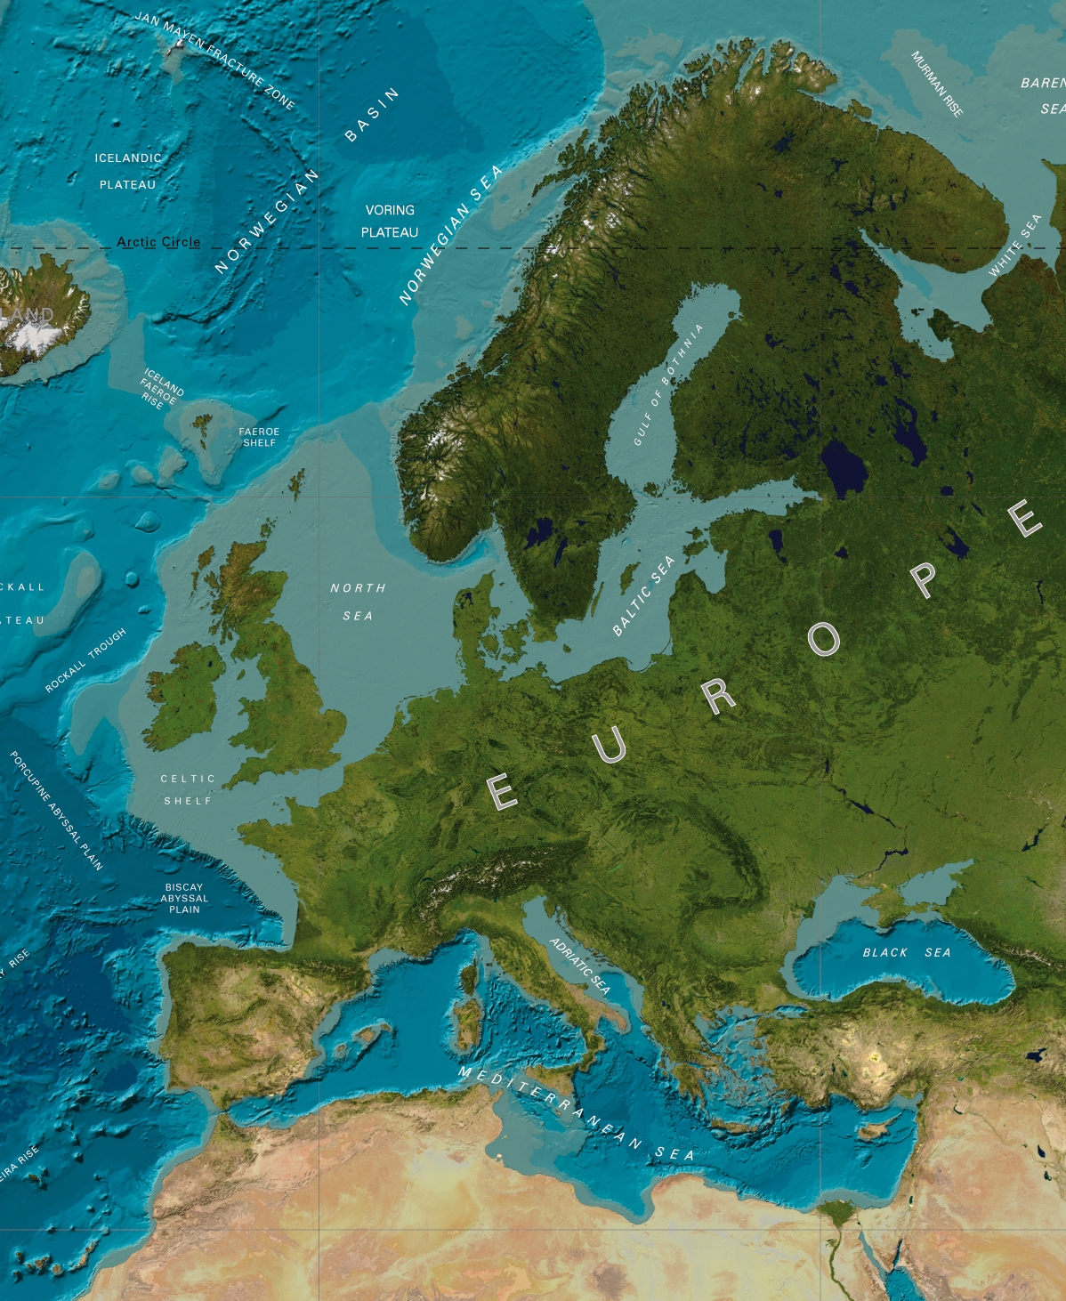
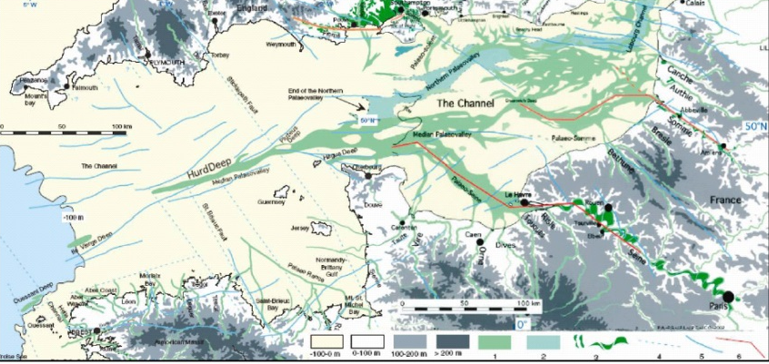
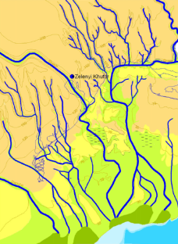
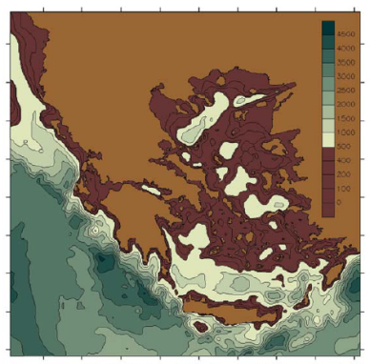
COST Action TD0902
2009 - 2013
„Submerged Prehistoric
Archaeology and Landscapes
of the Continental Shelf”
Grant holder
Geoff Bailey (York University)
42 institutions
29 countries
Stock-taking
State of the art
Splashcos-Viewer (database)
Public outreach
Heritage Management

Slide 27
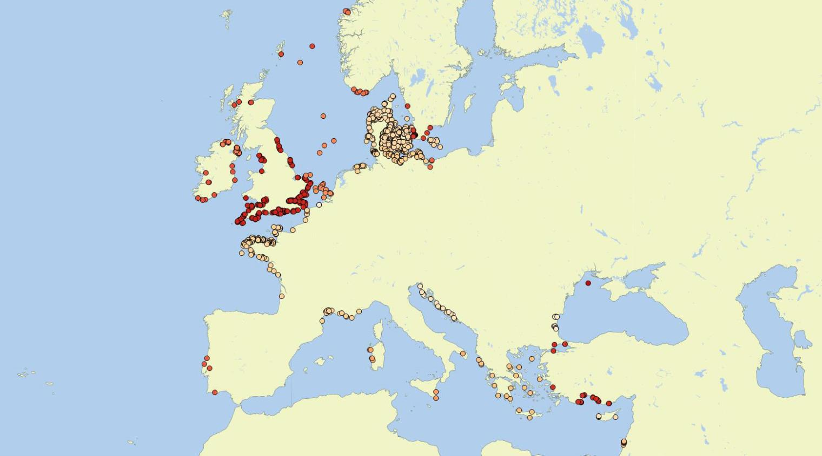
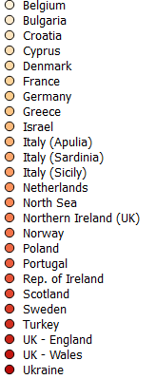
State of the art: 2525 sites from 19 countries
Belgium, Bulgaria, Croatia, Cyprus, Denmark, France, Germany, Greece, Ireland, Israel, Italy, Netherlands,
Norway, Poland, Portugal, Sweden, Turkey, UK, Ukraine, no Splashcos-sites in their waters so far: Estonia, Latvia, Lithuania, Malta, Romania, Spain.

Slide 28
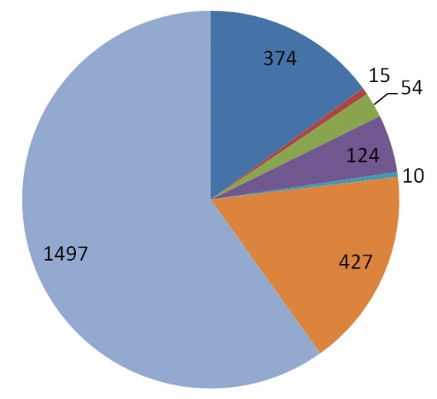
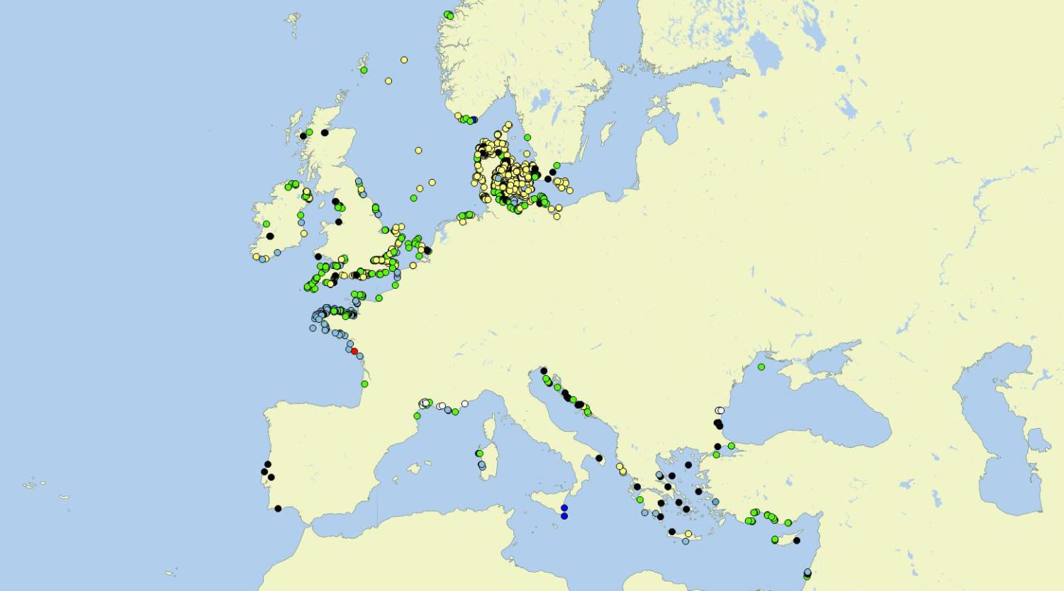

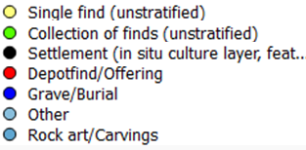
Mapped for „Type of site“

Slide 29
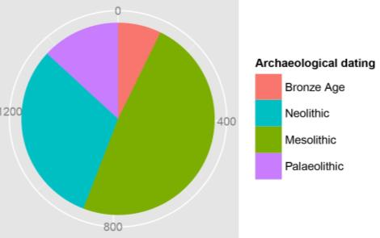
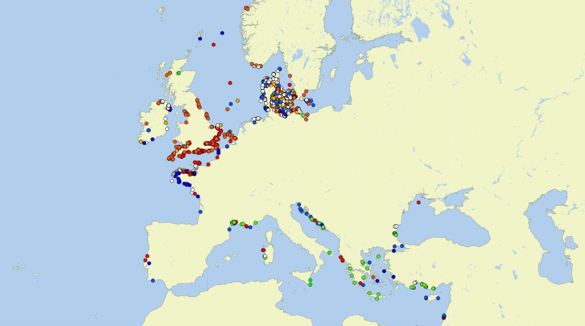

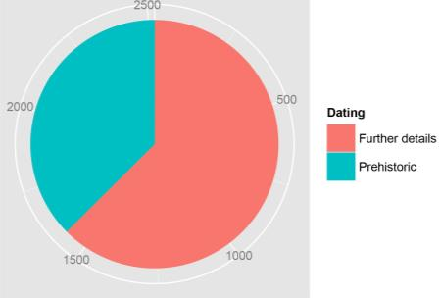
Mapped for „Archaeological Dating“

Slide 30
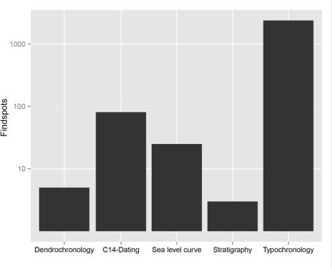


Mapped for „Dating based on “

Slide 31



Mapped for „organic material“

Slide 32




Mapped for „maximum waterdepths “

Slide 33

Thanks a lot to the
Correspondants
Marnix Pieters
Hristina Angelova
Irena Radic Rossi
Anders Fischer
Aivar Kriiska
Cyrille Billard
Nena Galanidou
Kieran Westley
Ehud Galili
Elena Flavia
Valdis Berzin
Algirdas Girininkas
Tim Gambin
Andrea Otte
Hans Peeters
Hakon Glørstad
Prezemyslaw Krajewski
Nuno Bicho
Valentina Voinea
Pablo Arias
Björn Nilsson
Hakan Oniz
Garry Momber
Olena Smyntyna
Thanks to the Splashcos and
working group chairs:
Geoff Bailey
Dimitris Sakellariou
Nic Flemming
Anders Fischer
Jan Harff
Tine Messian
Julie Satchel
Thanks for implementing the Splashcos Viewer into the GeoSeas System to:
Sytze van Heteren & Dick Schaap
Thanks for technical support to
Moritz Mennenga

Slide 34
Understanding the dynamics of submerging landscapes
The Baltic Sea serves as a model ocean that allows to study in an exceptional manner the interrelation between geological and climatic forcing of the evolution of coastlines and the results in changing ecosystem and anthroposphere.
Tectonical, climatological, and paleooceanographical concepts are required to understand the processes of rising and sinking coasts and to develop models of future scenarios by the reconstruction of the past.
For future investigations we have to
extend the investigations temporally to time periods of the late Pleistocene /´Early
Holocene of sudden sea level rise
extend the investigations regionally to transit areas between tectonic uplift and
subsidence,
develop modeling strategies for the interference of neotectonics, eustatic sea level
rise and hydrographic forces on coastal morphogenesis
go into wider international cooperation and transsectoral research……….
access trans-national / European funding scemes

Slide 35

Thank you very much
for your attention

